Slide 1
Detecting and Correcting Bit Errors
COS 463: Wireless Networks
Lecture 8
Kyle Jamieson

Slide 2
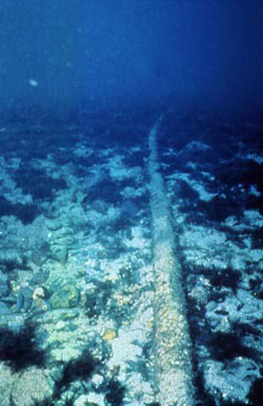



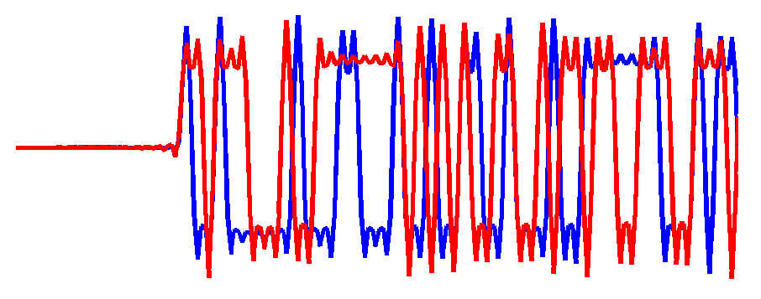
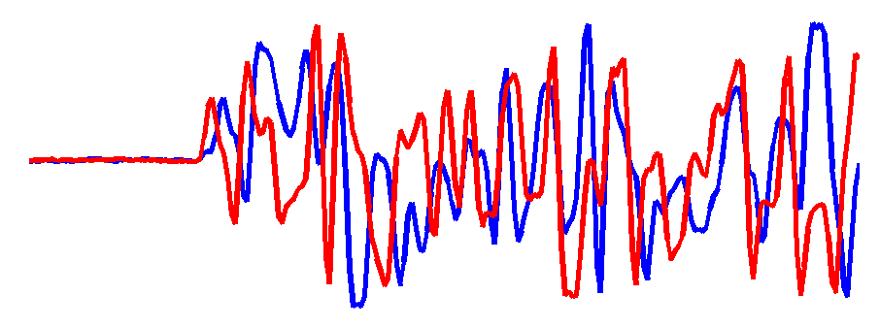

Bit errors on links
Links in a network go through hostile environments
  Both wired, and wireless:
  Consequently, errors will occur on links
  Today: How can we detect and correct these errors?
There is limited capacity available on any link
  Tradeoff between link utilization & amount of error control
Scattering
Diffraction
Reflection

Slide 3
Today
Error control codes
  Encoding and decoding fundamentals
  Measuring a code’s error correcting power
  Measuring a code’s overhead
  Practical error control codes
    Parity check, Hamming block code
Error detection codes
  Cyclic redundancy check (CRC)

Slide 4
Where is error control coding used?
The techniques we’ll discuss today are pervasive throughout the internetworking stack
Based on theory, but broadly applicable in practice, in other areas:
  Hard disk drives
  Optical media (CD, DVD, & c.)
  Satellite, mobile communications
Application
Transport
Network
Link
Physical
In 463, we cover the “tip of the iceberg” in the Internetworking stack

Slide 5
Error control in the Internet stack
Transport layer
  Internet Checksum (IC) over TCP/UDP header, data
IC
TCP payload
TCP header

Slide 6
Error control in the Internet stack
Transport layer
  Internet Checksum (IC) over TCP/UDP header, data
Network layer (L3)
  IC over IP header only
IC
TCP payload
TCP header
IC
IP payload
IP header

Slide 7
Error control in the Internet stack
Transport layer
  Internet Checksum (IC) over TCP/UDP header, data
Network layer (L3)
  IC over IP header only
Link layer (L2)
  Cyclic Redundancy Check (CRC)
IC
TCP payload
TCP header
IC
IP payload
IP header
LL header
LL payload
LL CRC

Slide 8
Error control in the Internet stack
Transport layer
  Internet Checksum (IC) over TCP/UDP header, data
Network layer (L3)
  IC over IP header only
Link layer (L2)
  Cyclic Redundancy Check (CRC)
Physical layer (PHY)
  Error Control Coding (ECC), or
  Forward Error Correction (FEC)
IC
TCP payload
TCP header
IC
IP payload
IP header
LL header
LL payload
LL CRC
PHY payload

Slide 9
Today
Error control codes
  Encoding and decoding fundamentals
  Measuring a code’s error correcting power
  Measuring a code’s overhead
  Practical error control codes
    Parity check, Hamming block code
Error detection codes
  Cyclic redundancy check (CRC)

Slide 10

Error control: Motivation
Network
00
00
01
01
10
10
11
message
11
Sender
Receiver
“Allowed” messages
Every string of bits is an “allowed” message
  Hence any changes to the bits (bit errors) the sender transmits produce “allowed” messages
Therefore without error control, receiver wouldn’t know errors happened!

Slide 11
Error control: Key Ideas
Reduce the set of “allowed” messages
  Not every string of bits is an “allowed” message
  Receipt of a disallowed string of bits means that the message was garbled in transit over the network
We call an allowable message (of n bits) a codeword
  Not all n-bit strings are codewords!
  The remaining n-bit strings are “space” between codewords
Plan: Receiver will use that space to both detect and correct errors in transmitted messages

Slide 12
Encoding and decoding
Problem: Not every string of bits is “allowed”
  But we want to be able to send any message!
  How can we send a “disallowed” message?
Answer: Codes, as a sender-receiver protocol
  The sender must encode its messages ➜ codewords
  The receiver then decodes received bits ➜ messages
The relationship between messages and codewords isn’t always obvious!

Slide 13
A simple error-detecting code
Let’s start simple: suppose messages are one bit long
Take the message bit, and repeat it once
  This is called a two-repetition code
Sender:
0
➜
00
01
10
1
➜
11

Slide 14
Receiving the two-repetition code
Suppose the network causes no bit error
Receiver removes repetition to correctly decode the message bits
Sender:
Network:
Receiver:
0
➜
00
00
➜
0
01
10
1
➜
11
11
➜
1

Slide 15
Detecting one bit error
Suppose the network causes up to one bit error
The receiver can detect the error:
  It received a non-codeword
Can the receiver correct the error?
  No! The other codeword could have been sent as well
Sender:
Network:
Receiver:
0
➜
00
00
➜
0
01
01
Error detected
10
10
Error detected
1
➜
11
11
➜
1

Slide 16
Reception with two bit errors
Can receiver detect presence of two bit errors?
  No: It has no way of telling which codeword was sent!
    Enough bit errors that the sent codeword “jumped over” the space between codewords
Sender:
Network:
Receiver:
0
➜
00
00
➜
0
Space between
codewords:
01
10
1
➜
11
11
➜
1

Slide 17
Hamming distance
Measures the number of bit flips to change one codeword into another
Hamming distance between two messages m₁, m₂: The number of bit flips needed to change m₁ into m₂
Example: Two bit flips needed to change codeword 00 to codeword 11, so they are Hamming distance of two apart:
00
01
11

Slide 18
How many bit errors can we detect?
Suppose the minimum Hamming distance between any pair of codewords is d_{min}
Then, we can detect at most d_{min}− 1 bit errors
  Will land in space between codewords, as we just saw
  Receiver will flag message as “Error detected”
2 bit errors
d_{min} = 3

Slide 19
Decoding error detecting codes
The receiver decodes in a two-step process:
  Map received bits → codeword
    Decoding rule: Consider all codewords
      Choose the one that exactly matches the received bits
      Return “error detected” if none match
  Map codeword → source bits and “error detected”
    Use the reverse map of the sender

Slide 20
A simple error-correcting code
Let’s look at a three-repetition code
If no errors, it works like the two-repetition code:
Sender:
Network:
Receiver:
0
➜
000
000
➜
0
001
001
010
010
100
100
011
011
101
101
110
110
1
➜
111
111
➜
1

Slide 21
Correcting one bit error
Receiver chooses the closest codeword (measured by Hamming distance) to the received bits
  A decision boundary exists halfway between codewords
Sender:
Network:
Receiver:
0
➜
000
000
➜
0
001
001
Fix error
010
010
100
100
Decision boundary
011
011
101
101
Fix error
110
110
1
➜
111
111
➜
1

Slide 22
Decoding error correcting codes
The receiver decodes in a two-step process:
  Map received bits → codeword
    Decoding rule: Consider all codewords
      Choose one with the minimum Hamming distance to the received bits
  Map codeword → source bits
    Use the reverse map of the sender

Slide 23
How many bit errors can we correct?
Suppose there is at least d_{min} Hamming distance between any two codewords
Then, we can correct at most bit flips
  This many bit flips can’t move received bits closer to another codeword, across the decision boundary:
Round down
2 bit errors
d_{min} = 5
Decision boundary

Slide 24
Code rate
Suppose codewords of length n, messages length k (k < n)
The code rate R = k/n is a fraction between 0 and 1
So, we have a tradeoff:
  High-rate codes (R approaching one) correct fewer errors, but add less overhead
  Low-rate codes (R close to zero) correct more errors, but add more overhead

Slide 25
Today
Error control codes
  Encoding and decoding fundamentals
  Measuring a code’s error correcting power
  Measuring a code’s overhead
  Practical error control codes
    Parity check, Hamming block code
Error detection codes
  Cyclic redundancy check (CRC)

Slide 26
Parity bit
Given a message of k data bits D₁, D₂, …, D_{k}, append a parity bit P to make a codeword of length n = k + 1
  P is the exclusive-or of the data bits:
    P = D₁ ⊕ D₂ ⊕ ⋯ ⊕ D_{k}
  Pick the parity bit so that total number of 1’s is even
k data bits
parity bit
011100
1

Slide 27
Checking the parity bit
Receiver: counts number of 1s in received message
  Even: received message is a codeword
  Odd: isn’t a codeword, and error detected
    But receiver doesn’t know where, so can’t correct
What about d_{min}?
  Change one data bit → change parity bit, so d_{min} = 2
    So parity bit detects 1 bit error, corrects 0
Can we detect and correct more errors, in general?

Slide 28
Two-dimensional parity
Break up data into multiple rows
  Start with normal parity within each row (p_{i})
  Do the same down columns (q_{i})
  Add a parity bit r covering row parities
This example has rate 16/25
d_{1,1} | d_{1,2} | d_{1,3} | d_{1,4} | p₁
d_{2,1} | d_{2,2} | d_{2,3} | d_{2,4} | p₂
d_{3,1} | d_{3,2} | d_{3,3} | d_{3,4} | p₃
d_{4,1} | d_{4,2} | d_{4,3} | d_{4,4} | p₄
q₁ | q₂ | q₃ | q₄ | r
p_{j} = d_{j,1} ⨁ d_{j,2} ⨁ d_{j,3} ⨁ d_{j,4}
q_{j} = d_{1,j} ⨁ d_{2,j} ⨁ d_{3,j} ⨁ d_{4,j}
r = p₁ ⨁ p₂ ⨁ p₃ ⨁ p₄

Slide 29
Two-dimensional parity: Properties
Flip 1 data bit, 3 parity bits flip
Flip 2 data bits, ≥ 2 parity bits flip
Flip 3 data bits, ≥ 3 parity bits flip
Therefore, d_{min} = 4, so
  Can detect ≤ 3 bit errors
  Can correct single-bit errors (how?)
2-D parity detects most four-bit errors
d_{1,1} | d_{1,2} | d_{1,3} | d_{1,4} | p₁
d_{2,1} | d_{2,2} | d_{2,3} | d_{2,4} | p₂
d_{3,1} | d_{3,2} | d_{3,3} | d_{3,4} | p₃
d_{4,1} | d_{4,2} | d_{4,3} | d_{4,4} | p₄
q₁ | q₂ | q₃ | q₄ | r

Slide 30
Block codes
Let’s fully generalize the parity bit for even more error detecting/correcting power
Split message into k-bit blocks, and add n−k parity bits to the end of each block:
  This is called an (n, k) block code
k bits
n−k bits
data bits
parity bits
codeword: n bits

Slide 31
A higher rate error correcting code?
D₁D₂D₃D₄
P P P
What if we repeat the parity bit 3×?
  P = D₁ ⊕ D₂ ⊕ D₃ ⊕ D₄; R = 4/7
  Flip one data bit, all parity bits flip. So d_{min} = 4?
    No! Flip another data bit, all parity bits flip back to original values! So d_{min} = 2
  What happened? Parity checks either all failed or all succeeded, giving no additional information

Slide 32
Hamming (7, 4) code
k = 4 bits
n − k = 3 bits
D₁
D₄
P₁
D₁D₂D₃D₄
P₁P₂P₃
P₁ = D₁
P₂ = D₁
P₃ =
⊕ D₂
⊕ D₂
⊕ D₃
⊕ D₃
⊕ D₃
⊕ D₄
⊕ D₄
P₂
P₃
D₂
D₃:all

Slide 33
Hamming (7, 4) code: d_{min}
Change one data bit, either:
  Two P_{i} change, or
  Three P_{i} change
Change two data bits, either:
  Two P_{i} change, or
  One P_{i} changes
D₁
D₄
P₁
P₂
P₃
D₂
D₃:all
d_{min} = 3: Detect 2 bit errors, correct 1 bit error

Slide 34
Hamming (7, 4): Correcting One Bit Error
Infer which corrupt bit from which parity checks fail:
P₁ and P₂ fail ⇒ Error in D₁
P₂ and P₃ fail ⇒ Error in D₂
P₁, P₂, & P₃ fail ⇒ Error in D₃
P₁ and P₃ fail ⇒ Error in D₄
What if just one parity check fails?
D₁
D₄
P₁
P₂
P₃
D₂
D₃:all
Summary: Higher rate (R = 4/7) code correcting one bit error

Slide 35
Today
Error control codes
Error detection codes
  Cyclic redundancy check (CRC)

Slide 36
Cyclic redundancy check (CRC)
Most popular method error detecting code at L2
  Found in Ethernet, Wi-Fi, token ring, many many others
Often implemented in hardware at the link layer
Represent k-bit messages as degree k − 1 polynomials
  Each coefficient in the polynomial is either zero or one, e.g.:
k = 6 bits of message
1 0 1 1 1 0
M(x) = 1x⁵ + 0x⁴ + 1x³ + 1x² + 1x + 0

Slide 37
Modulo-2 Arithmetic
Addition and subtraction are both exclusive-or without carry or borrow
Multiplication example:
Division example:
1
1101
1
0
1
110
101110
110
110
0000
111
11010
110
110100
011
000
101110
110
110

Slide 38
CRC at the sender
M(x) is our message of length k
  e.g.: M(x) = x⁵ + x³ + x² + x (k = 6)
Sender and receiver agree on a generator polynomial G(x) of degree g − 1 (i.e., g bits)
  e.g.: G(x) = x³ + 1 (g = 4)
Calculate padded message T(x) = M(x)∙x^{g−1}
  i.e., right-pad with g − 1 zeroes
  e.g.: T(x) = M(x)∙x³ = x⁸ + x⁶ + x⁵ + x⁴
1 0 1 1 1 0
1 0 0 1
1 0 1 1 1 0
0 0 0

Slide 39
CRC at the sender
Divide padded message T(x) by generator G(x)
  The remainder R(x) is the CRC:
1
0
1
0
1
1
1 0 0 1
1 0 1 1 1 0
0 0 0
1 0 0 1
0 1 0 1
0 0 0 0
1 0 1 0
1 0 0 1
0 1 1 0
0 0 0 0
1 1 0 0
1 0 0 1
1 0 1 0
1 0 0 1
0 1 1
R(x) = x + 1

Slide 40
CRC at the sender
The sender transmits codeword C(x) = T(x) + R(x)
  i.e., the sender transmits the original message with the CRC bits appended to the end
  Continuing our example, C(x) = x⁸ + x⁶ + x⁵ + x⁴ + x + 1
1 0 1 1 1 0
0 1 1

Slide 41
Properties of CRC codewords
Remember: Remainder [ T(x)/G(x) ] = R(x)
What happens when we divide C(x) / G(x)?
C(x) = T(x) + R(x) so remainder is
  Remainder [ T(x)/G(x) ] = R(x), plus
  Remainder [ R(x)/G(x) ] = R(x)
  Recall, addition is exclusive-or operation, so:
    Remainder [ C(x)/G(x) ] = R(x) + R(x) = 0

Slide 42
Detecting errors at the receiver
Divide received message C′(x) by generator G(x)
  If no errors occur, remainder will be zero
1
0
1
0
1
1
1 0 0 1
1 0 1 1 1 0
0 1 1
1 0 0 1
0 1 0 1
0 0 0 0
1 0 1 0
1 0 0 1
0 1 1 0
0 0 0 0
1 1 0 1
1 0 0 1
1 0 0 1
1 0 0 1
0 0 0 → no error detected

Slide 43
Detecting errors at the receiver
Divide received message C′(x) by generator G(x)
  If errors occur, remainder may be non-zero
1
0
1
0
1
1
1 0 0 1
1 0 1 1 1 1
0 1 1
1 0 0 1
0 1 0 1
0 0 0 0
1 0 1 1
1 0 0 1
0 1 0 0
0 0 0 0
1 0 0 1
1 0 0 1
0 0 0 1 → error detected

Slide 44
Detecting errors at the receiver
Divide received message C′(x) by generator G(x)
  If errors occur, remainder may be non-zero
1
0
1
0
1
1
1 0 0 1
1 0 1 1 1 1
0 1 0
1 0 0 1
0 1 0 1
How many errors can the CRC detect?
☟
How do we choose generator G(x)?
0 0 0 0
1 0 1 1
1 0 0 1
0 1 0 0
0 0 0 0
1 0 0 1
1 0 0 1
0 0 0 0 → undetected error!

Slide 45
Detecting errors with the CRC
The error polynomial E(x) = C(x) + C′(x) is the difference between the transmitted and received codeword
  E(x) tells us which bits the channel flipped
We can write the received message C′(x) in terms of C(x) and E(x): C′(x) = C(x) + E(x), so:
  Remainder [C′(x) / G(x) ] = Remainder [ E(x) / G(x) ]
When does an error go undetected?
  When Remainder [ E(x) / G(x) ] = 0

Slide 46
Detecting single-bit errors w/CRC
Suppose a single-bit error in bit-position i: E(x) = x^{i}
  Choose G(x) with ≥ 2 non-zero terms: x^{g−1} and 1
  Remainder [ x^{i} / (x^{g−1} + ⋯ + 1) ] ≠ 0, e.g.:
Therefore a CRC with this choice of G(x) always detects single-bit errors in the received message
1
1 0 0 1
0 0 1 0 0 0
1 0 0 1
1

Slide 47
Error detecting properties of the CRC
The CRC will detect:
  All single-bit errors
    Provided G(x) has two non-zero terms
  All burst errors of length ≤ g − 1
    Provided G(x) begins with x^{g−1} and ends with 1
    Similar argument to previous property
  All double-bit errors
    With conditions on the frame length and choice of G(x)
  Any odd number of errors
    Provided G(x) contains an even number of non-zero coefficients

Slide 48
Error detecting code: CRC
Far less overhead than error correcting codes
  Typically 16 to 32 bits on a 1,500 byte (12 Kbit) frame
Error detecting properties are more complicated
  But in practice, “missed” bit errors are exceedingly rare

Slide 49
Friday Precept:
Work on Lab 2
Tuesday Topic:
Convolutional Codes

