Slide 1
Link Layer I: ALOHA, Time-, Frequency-, and Code Division
COS 463: Wireless Networks
Lecture 4
Kyle Jamieson

Slide 2
Review: The Data Link Layer (L2)
Enables exchange of atomic messages (frames) between end hosts
Determine start and end of bits and frames (framing)
Deliver information reliably
Control errors
Some link layers involve a shared medium
  e.g., Shared-wire Ethernet, satellite uplink, Wi-Fi
  Today: Medium access control to share the medium

Slide 3
Medium access: The Problem
Two questions:
  How should the shared medium be divided?
  Who gets to talk on a shared medium, and when?
A medium access control (MAC) protocol specifies the above

Slide 4
Medium access: Goals
Efficiency
  High throughput (bits/second successfully received through the channel)
    i.e. high utilization (throughput/raw channel rate)
Fairness: All hosts with data to send should get a roughly equal share of the medium over time
Latency: Want to minimize the time a host waits before being granted permission to talk on the shared medium

Slide 5



Physical Limitation: Finite speed of light
From Princeton to...
Geosynchronous Satellite (one way)
100 ms
Yellowstone
Washington,
D.C.
10 ms
1 ms
Mobile
Base station
Trenton
100 μs
1 μs
Wi-Fi AP
10−100 ns
3−30 m
300 m
30 km
300 km
3,000 km
30,000 km

Slide 6
Vastly Different Timescales,
Same Medium Access Protocol!
Satellite Communications
100 ms
Packet Radio
(ALOHA net)
3G/4G Cellular
Data
1 ms
1 μs
Wi-Fi
10−100 ns
3−30 m
300 m
300 km
30,000 km

Slide 7
Today
Sharing by partitioning
  Time division
  Frequency division
  Code division
Contention-based sharing
  ALOHA
  The Ethernet

Slide 8
TDMA: Time Division Multiple Access
Channel time is divided fixed-period, repeating rounds
Each user gets a fixed-length slot (packet time) in each round (unused slots are wasted)
Out-of-band: Mechanism for allocating/de-allocating slots
e.g.: six stations, only 1, 3, and 4 have data to send
6-slot
round
1
3
4
1
3
4
Time

Slide 9
FDMA: Frequency Division Multiple Access
Channel spectrum divided into frequency bands
Each user gets a fixed frequency band (unused frequency slots are wasted)
e.g.: six stations, only 1, 3, and 4 have data to send
time
frequency bands
FDM cable

Slide 10
TDMA and FDMA: Considerations
Advantages
Users are guaranteed to be able to send bits, continuously (FDMA) or periodically (TDMA)
Disadvantages
Unused time slots or frequency bands reduce channel utilization
An out-of-band mechanism is needed to allocate slots or bands (which requires another channel)
Guard bands or guard times reduce channel utilization

Slide 11
Today
Sharing by partitioning
  Time division
  Frequency division
  Code division
Contention-based sharing
  ALOHA
  The Ethernet

Slide 12
CDMA: Code Division Multiple Access
All users transmit over the same frequencies, and at the same time:
Allows multiple users to coexist and transmit simultaneously with no interference, in theory
In practice: also performs well
  Some cellular data networks have used CDMA
Okay!
Cathy
Alice
(CDMA)
Bob

Slide 13
Representing bits as binary levels
Let’s represent bits with two (binary) levels as follows:
  0 bit ←→ +1 level 1 bit ←→ −1 level
Scenario: Alice receives data from Bob and Cathy:
  TDMA e.g.: Bob sends bits 101, Cathy sends 001:
Cathy
Alice
Bob
+1
time
−1
TDMA timeslots:
Bob
Cathy
TDMA timeslots:

Slide 14
CDMA: User codes
Cathy
Alice
Bob
Assign each user a unique binary sequence of bits: code
  Call each code bit a chip (convention)
  Call the code length M
CDMA example:
+1
+1
time
−1
−1
Bob’s code c^{bob}
Cathy’s code c^{cathy}

Slide 15
CDMA: Cathy Sending
Cathy
Alice
Bob
Suppose Cathy alone sends message bits 001:
Cathy’s message
Algorithm (CDMA encoding):
For each message bit m:
Send m × c^{user}
+1
time
−1
L data bits → M × L CDMA chips
Bit rate: Factor of M slower
c^{cathy}:
+1
Cathy’s transmitted
CDMA signal:
−1

Slide 16
CDMA: Assumptions
Cathy
Alice
Bob
Let’s assume we have a way of:
  Synchronizing Cathy’s and Bob’s data bits in time
  Synchronizing Cathy’s and Bob’s CDMA chips in time
  Estimating and correcting the effect of the wireless channel between Cathy and Bob to Alice

Slide 17
What Alice Hears
Cathy
Alice
Bob
+1
Bob’s transmitted
CDMA signal:
−1
Cathy’s transmitted
CDMA signal:
+1
−1
+2
+1
What Alice hears:
−1
Result: Neither Bob nor Cathy’s signal – interference!
−2

Slide 18
Tool: Correlation
+1
Algorithm (correlation):
Multiply two signals pointwise, across time
Sum the result across time
Normalize (divide) by the signal length
Bob’s code c^{bob}
−1
Cathy’s code c^{cathy}
+1
−1
Sum: 0
→ Correlation: 0
2. Sum across time
3. Normalize (÷2)
1. Multiply pointwise:
+1
−1

Slide 19
Tool: Correlation
Algorithm (correlation):
Multiply two signals pointwise, across time
Sum the result across time
Normalize (divide) by the signal length
Cathy’s code c^{cathy}
+1
−1
Cathy’s code c^{cathy}
+1
−1
Sum: 2
→ Correlation: 1
2. Sum across time
3. Normalize (÷2)
1. Multiply pointwise:
+1
−1

Slide 20
Correlating Cathy’s Code and CDMA transmission
Cathy’s transmission
+1
−1
corr
Cathy’s code c^{cathy}
+1
−1
+1
Correlation
−1
Cathy sent: 0 0 1

Slide 21
Listening to Cathy
Cathy
Alice
Bob
Alice hears a mixture
Bob’s transmission
Cathy’s transmission
+2
+1
+1
+1
−1
−1
−1
−2
corr
Cathy’s code c^{cathy}
+1
Zero-correlation with Bob’s code cancels Bob’s transmission from the mixture
−1
+1
Correlation
−1
Cathy sent: 0 0 1

Slide 22
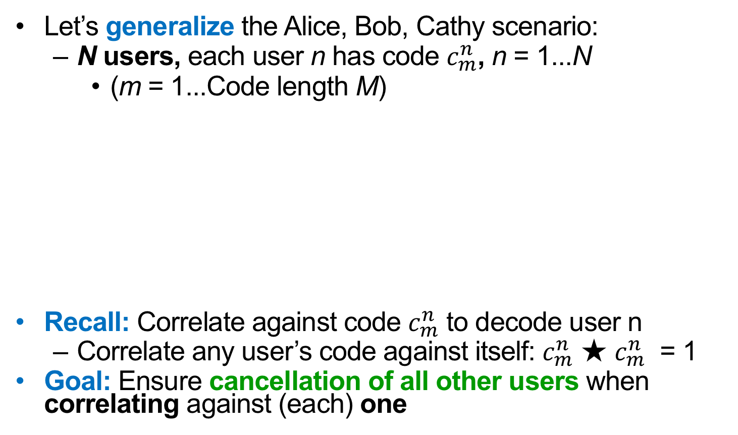
CDMA: How to choose codes?
Let’s generalize the Alice, Bob, Cathy scenario:
  N users, each user n has code $c_{m}^{n}$, n = 1...N
    (m = 1...Code length M)
Recall: Correlate against code $c_{m}^{n}$ to decode user n
  Correlate any user’s code against itself: $c_{m}^{n}$ ★ $c_{m}^{n}$ = 1
Goal: Ensure cancellation of all other users when correlating against (each) one
User 3
...
User N
Zero mutual correlation condition: $c_{m}^{n_{1}}$ ★ $c_{m}^{n_{2}}=0$
User 2
AP
User 1

Slide 23
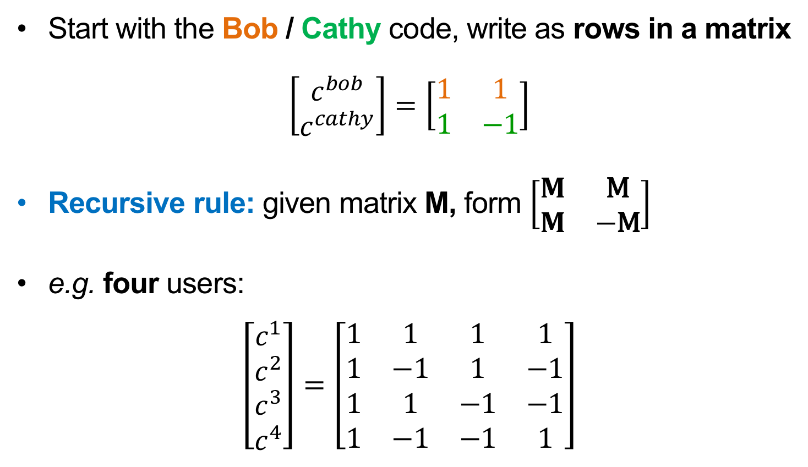
Example of CDMA codes
Start with the Bob / Cathy code, write as rows in a matrix
$$\left[\begin{matrix}c^{bob} \\ c^{cathy}\end{matrix}\right]=\left[\begin{matrix}1 & 1 \\ 1 & −1\end{matrix}\right]$$
Recursive rule: given matrix M, form $\left[\begin{matrix}M & \text{M} \\ M & −\text{M}\end{matrix}\right]$
e.g. four users:
$$\left[\begin{matrix}\begin{matrix}c^{1} \\ c^{2}\end{matrix} \\ \begin{matrix}c^{3} \\ c^{4}\end{matrix}\end{matrix}\right]=\left[\begin{matrix}1 & 1 & 1 & 1 \\ 1 & −1 & 1 & −1 \\ 1 & 1 & −1 & −1 \\ 1 & −1 & −1 & 1\end{matrix}\right]$$

Slide 24
CDMA: Considerations
CDMA advantages:
  Sending over entire channel frequency bandwidth
    Some parts of frequency band interfered? Okay!
FDMA, TDMA, CDMA disadvantages:
  Rigid allocation of channel resources, requires advance coordination (frequency, time, code)
  Partitioning the channel → reduced rate
Can we have the best of both worlds, perhaps?

Slide 25
Today
Sharing by partitioning
  Time division
  Frequency division
  Code division
Contention-based sharing
  Unslotted ALOHA, Slotted ALOHA
  The Ethernet

Slide 26
Contention-based sharing
When a station has a frame to send:
  Transmit at full channel data rate B
  No a priori coordination among nodes
Two or more frames overlapping in time: collision
  Both frames lost, resulting in diminished throughput
A random access MAC protocol specifies:
  How to detect collisions
  How to recover from collisions

Slide 27
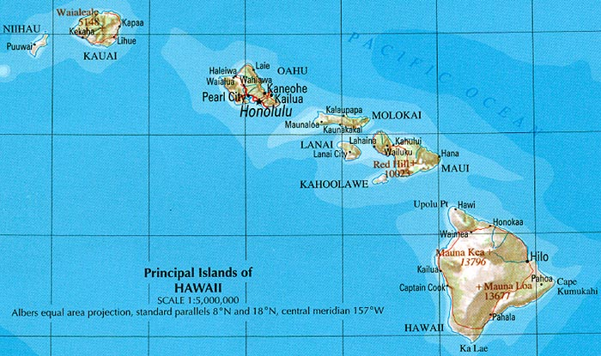
ALOHAnet: Context
Norm Abramson, 1970 at the University of Hawaii
  Seven campuses, on four islands
  Wanted to connect campus terminals and mainframe
  Telephone costs high, so built a packet radio network

Slide 28
Unslotted ALOHA
Simplest possible medium access control: no control at all, anyone can just transmit a packet without delay
Suppose: Probability packet begins in time interval Δt = λ × Δt
  N senders in total, sending frames of time duration 1
λ is the aggregate rate from all N senders
Individual rate λ/N for each sender

Slide 29
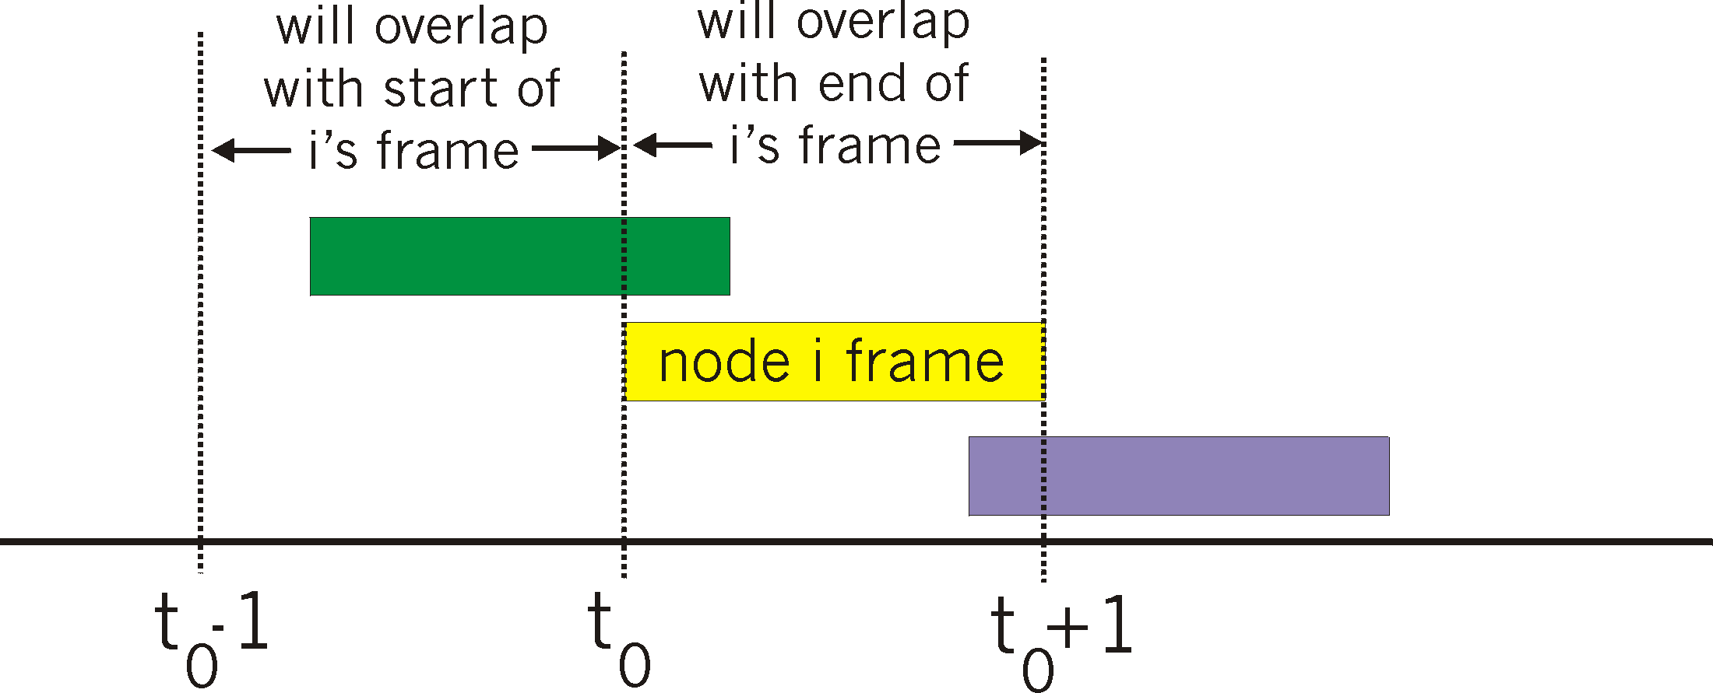
Unslotted ALOHA: Performance
Suppose some node i is transmitting; let’s focus on i ’s frame
Vulnerable period
Others send in [t₀−1, t₀]: overlap i ’s frame start → collision
Others send in [t₀, t₀+1]: overlap i ’s frame end → collision
Otherwise, no collision, node i ’s frame is delivered
Therefore, vulnerable period of length 2 around i ’s frame

Slide 30
Unslotted ALOHA: Performance
Vulnerable period
What’s the chance no one else sends in the vulnerable period (length 2)?

Slide 31
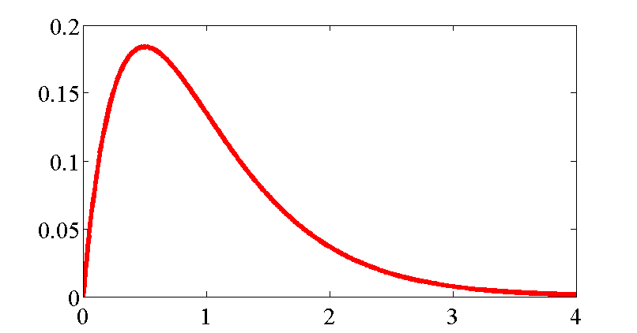
Unslotted ALOHA: Utilization
Utilization
Too many collisions!
1/2e ≈ 18%
Not sending fast enough
λ
Recall λ is the aggregate rate from all senders
  So, utilization = λ × Pr(no other transmission in 2)
= λe^{−2λ}

Slide 32
Slotted ALOHA
Divide time into slots of duration 1, synchronize so that nodes transmit only in a slot
  Each of N nodes transmits with probability p in each slot
  So aggregate transmission rate λ = N × p
As before, if there is exactly one transmission in a slot, can receive; if two or more in a slot, no one can receive (collision)
...
Node N

Slide 33
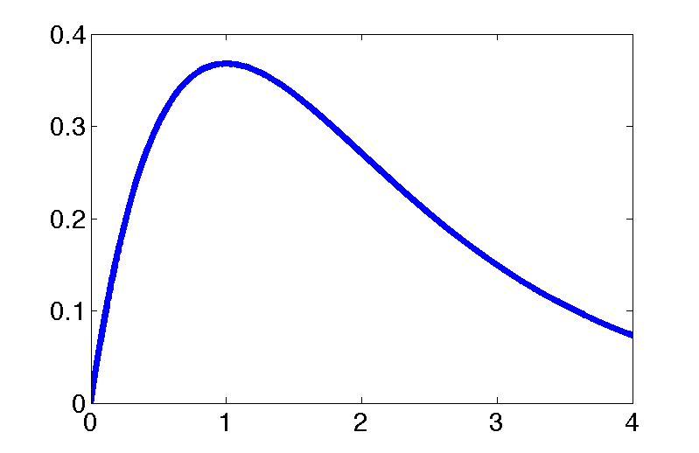
Slotted ALOHA: Utilization
Suppose N nodes, each transmit with probability p in each slot. What is the utilization as a function of aggregate rate λ = N × p?
Pr[A node is successful in a slot] = p(1−p)^{N−1}
Pr[Success in a slot] = Np(1−p)^{N−1}
Utilization
1/e ≈ 37%
λ

Slide 34
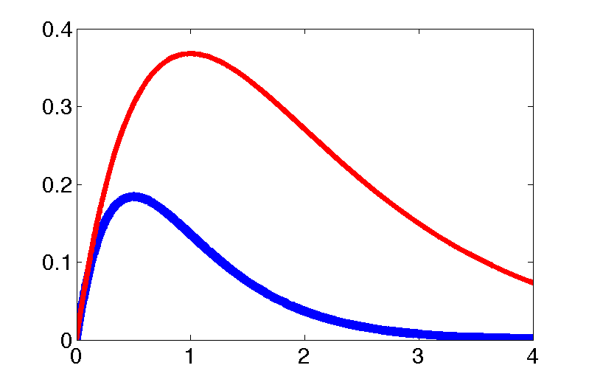
ALOHA throughput: slotted versus unslotted
1/e ≈ 36%
Slotted ALOHA: λe^{−λ}
1/2e ≈ 18%
Unslotted ALOHA: λe^{−2λ}
Just by forcing nodes to transmit on slot boundaries, we double peak medium utilization!

Slide 35
Today
Sharing by partitioning
  Time division
  Frequency division
  Code division
Contention-based sharing
  Unslotted ALOHA, Slotted ALOHA
  The Ethernet

Slide 36
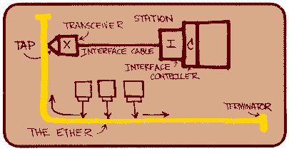
How did the Ethernet get built?
Bob Metcalfe, PhD student at Harvard in early 1970s
  Working on protocols for the ARPAnet
  Intern at Xerox Palo Alto Research Center (PARC), 1973
  Needed a way to network ≈100 Alto workstations in-building
  Adapted ALOHA packet radio
Metcalfe later founds 3Com, acquired by HP in April ’10 for USD $2.7 bn

Slide 37

The Ethernet: Physical design
Coaxial cable, propagation delay τ
  Propagation speed: 3/5 × speed of light
Experimental Ethernet
  Data rate: B = 3 Mbits/s
  Maximum length: 1000 m
Propagation delay: τ

Slide 38
Building the link: Framing bits
Goal: Move bits from one computer to another
  Sender and receiver have independent clocks
  No separate “clock signal” sent on the Ethernet
Problem: Agree on clock tick period
Problem: Agree on clock tick alignment (phase)

Slide 39
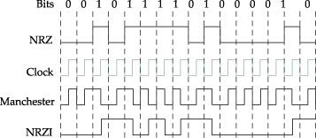
Manchester (phase) encoding
Manchester encoding:
  Exclusive-OR of the NRZ signal and the clock signal
  “0” is a low-to-high transition; “1” is a high-to-low
Transition guaranteed on every bit
Drawback: Halves data rate

Slide 40
Ethernet framing
Preamble
Destination
Source
Data
CRC
8 bits
8 bits
4000 bits
16 bits
Framing
  Beginning of frame determined by presence of carrier
  End of frame determined by absence of carrier
  Preamble: 10101010 produces a square wave that allows receiver to frame bits
CRC (Cyclic Redundancy Check) protects against errors on the Ether
  Does not guard against errors introduced by the tap: rely on higher-layer checksums
Destination address allows filtering at the link layer

Slide 41
Collisions on the Ethernet
A
B
C
Z
Propagation delay: τ seconds
Packet of size N bits: N/B seconds on the wire
From the perspective of a receiver (B):
  Overlapping packets at B means signals sum
  Not time-synchronized: result is bit errors at B
No fate-sharing: C receives OK in this example

Slide 42
Who gets to transmit, and when?
Carrier Sense Multiple Access
with Collision Detection (CSMA/CD)
Begin the transmission procedure at any time
Carrier sensing: defer if you sense that another station is transmitting
Collision detection: while sending, immediately abort your transmission if you detect another station transmitting

Slide 43
Carrier sensing
Mechanism: measure voltage on the wire
Binary encoding: voltage depends on the data
Manchester coding: constant average voltage

Slide 44
Collision detection
A
B
C
Z
Propagation delay: τ seconds
Paper isn’t clear on this point (authors did have a patent in the filing process)
Mechanism: monitor average voltage on cable
  Manchester encoding means your transmission will have a predictable average voltage V₀; others will increase V₀
  Abort transmission immediately if V_{measured} > V₀

Slide 45
When might a collision happen?
Suppose Station A begins transmitting at time 0
Assume that the packet lasts much longer than τ
All stations sense transmission and defer by time τ
  Don’t begin any new transmissions
A
B
C
Z
Propagation delay: τ seconds

Slide 46
How long does a collision take to detect?
A
B
C
Z
Propagation delay: τ seconds
Suppose Station A begins transmitting at time 0
τ seconds after Z starts, A hears Z’s transmission
When does A know whether its packet collided or not?
  At time 2τ

Slide 47
Collision detection and packet size
A
B
C
Z
Propagation delay: τ seconds
Transmit rate B bits/second
If packets take time 2τ, A will still be transmitting when Z’s packet arrives at A, so A will detect collision
  So minimum packet size = 2τB bits
    Experimental Ethernet:
      τ = 5 μs, B = 3 Mbits/s → 2τB = 30 bits

Slide 48
Resolving collisions
Upon abort (carrier detect), station enters the backoff state
Key idea: the colliding stations all wait a random time before carrier sensing and transmitting again
  How to pick the random waiting time? (Should be based on how stations have data to send)
  How to estimate the number of colliding stations?
Goal: Engineer such that nodes will wait different amounts of time, carrier sense, and not collide

Slide 49
Slotted Ethernet backoff
Backoff time is slotted (like slotted ALOHA) and random
  Station’s view of the where the first slot begins is at the end of the busy medium
  Random slot choice in contention window (CW)
Goal: Choose slot time so that different nodes picking different slots CS and defer → don’t collide

Slide 50
Picking the length of a backoff slot
Consider from the perspective of one packet at time t
  Packets before t−τ will cause packet to defer
  Packets after t+τ will not happen (why not?)
Packets beginning within time τ apart will collide
So should we pick a backoff slot length of τ?
OK
Bad
OK
τ
τ
Cause defer
CS fail
(Won’t happen)

Slide 51
The problem of clock skew
No! Slots are timed off the tail-end of the last packet
  Therefore, stations’ clocks differ by at most τ
Suppose we use a backoff slot length of τ
  Different stations picking different slots may collide!
0
1
2
OK
τ
τ
OK
Δ
Station A, slot 1
τ
τ
Station B, slot 0
0
1
2

Slide 52
Picking slot time in presence of clock skew
Want other station’s other slots to all be in “OK” region
  Then, transmissions in different slots won’t collide
  Worst case clock skew: τ
  So, pick a slot time of τ + τ = 2τ
0
1
2
OK
OK
τ
2τ
2τ
0
1
2

Slide 53
Binary Exponential Backoff
Binary exponential backoff (BEB): double CW size on each consecutive collision
Stations wait some number of slots chosen uniformly at random from CW = [0, 2^{m}−1]
  Reset m ← 1 upon a successful transmission
  First retransmit (m = 1): pick from [0, 1]
  Second retransmit (m = 2): pick from [0, 1, 2, 3]
Observe: Stations transmitting new frames don’t take into account recent collisions, might transmit before stations in backoff

Slide 54
Ethernet performance analysis
Divide time into:
  Variable-sized contention intervals,
  Fixed size transmission intervals (duration t_{packet})
t_{packet}
Time →
Efficiency:
Number of slots to acquire the Ether
slot time

Slide 55
Ethernet performance: Acquisition
What’s the probability that one station acquires the medium without a collision?
Suppose there are Q stations waiting to send
Assume stations know Q and send with probability 1/Q (BEB approximates this)
Slotted ALOHA → 37% probability of successful acquisition

Slide 56
Ethernet performance: Waiting time
W = number of slots in a contention window before acquisition of the Ether
Probability of no wait: p_{acquire}
Probability wait one slot: (1 − p_{acquire})p_{acquire}
Probability wait two slots: (1 − p_{acquire})²p_{acquire}
E[slots to wait] = E[W] = (1 − p_{acquire})/p_{acquire}
  = e − 1

Slide 57
Comparing CDMA and ALOHA random access
CDMA wireless
  No interference between transmitting stations
  Adaptation to varying numbers of users possible by changing codes
  Reduced rate of individual transmissions
  Unused codes waste overall capacity
ALOHA random access
  Stations can transmit using the entire medium, at full rate if alone
  Almost-instant adaptation to varying traffic loads
  Concurrent transmissions result in collisions, reduced throughput

Slide 58
Friday Precept
Introduction to Lab 1
Tuesday Topic:
Link Layer II: MACA and MACAW

