Slide 1
End-to-End Transport Over Wireless II:
Snoop and Explicit Loss Notification
COS 463: Wireless Networks
Lecture 3
Kyle Jamieson
[Various parts adapted from S. Das, B. Karp, N. Vaidya]

Slide 2
Today
Transmission Control Protocol (TCP)
  Window-based flow control
  Retransmissions and congestion control
TCP over Wireless
  TCP Snoop
  Explicit Loss Notification

Slide 3
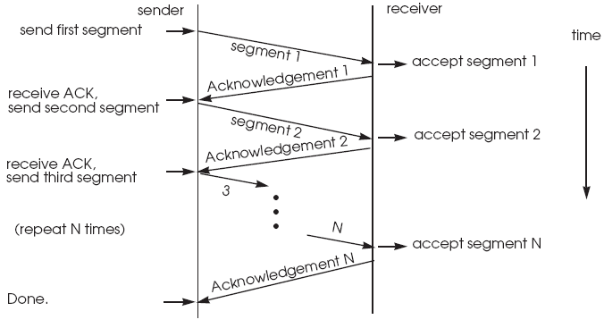
Window-Based Flow Control: Motivation
Suppose sender sends one packet, awaits ACK, repeats…
Result: At most one packet sent, per RTT
e.g., 70 ms RTT, 1500-byte packets → Max t’put: 171 Kbps

Slide 4
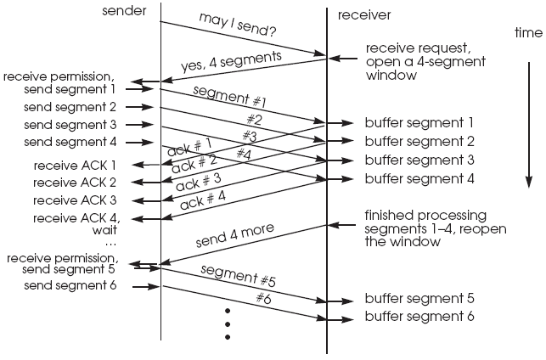
Idea: Pipeline Transmissions
(Fixed Window-Based Flow Control)
But: RTT idle time from grant of new
window to data arrival at receiver
Even better approach, used by TCP: sliding window, extends as each ACK returns, so no idle time!
Dispatch window of segments sequentially, w/o awaiting ACKs
  Retain packets until ACKed, track which are ACKed
  Set retransmit timer for each window
    When expires, resend unACKed segments in window

Slide 5
Choosing Window Size:
The Bandwidth-Delay Product
Network bottleneck: point of slowest rate along path between sender and receiver
What size sender window keeps the pipe full?
Window too small: can’t fill pipe
Window too large: unnecessary network load/queuing/loss

Slide 6
Increasing utilization with pipelining
Data packet size L bits, bottleneck rate R bits/second
sender
receiver
First bit sent, t = 0
Last bit sent, t = L / R
RTT
last bit of 2nd packet, send ACK
ACK arrives, send next
packet, t = RTT + L / R

Slide 7
The bandwidth-delay product
Data packet size L bits, bottleneck rate R bits/second
Keep sending for time RTT = (N-1)L / R
sender
receiver
Number of bits
“in flight”
Delay × Bandwidth
product
RTT
Goal: window size = RTT × bottleneck rate
e.g., to achieve bottleneck rate of 1 Mbps, across a 70 ms RTT, need window size:
W = (10⁶ bps × .07 s) = 70 Kbits = 8.75 Kbytes

Slide 8
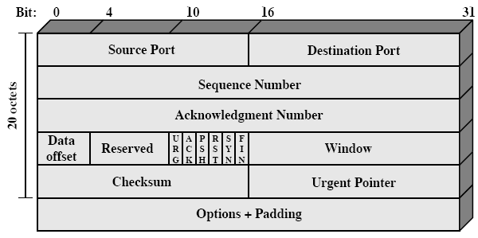
TCP Packet Header
TCP header: 20 bytes long
Checksum covers TCP packet + “pseudo header”
  IP header source and destination addresses, protocol
  Length of TCP segment (TCP header + data)

Slide 9
TCP Header Details
Connections inherently bidirectional; all TCP headers carry both data & ACK sequence numbers
32-bit sequence numbers are in units of bytes
Source and destination port numbers
  Multiplexing of TCP by applications
  UNIX: local ports below 1024 reserved (only root may use)
Window field: advertisement of number of bytes advertiser willing to accept

Slide 10
TCP: Data Transmission
Each byte numbered sequentially (modulo 2³²)
Sender buffers data in case retransmission required
Receiver buffers data for in-order reassembly
Sequence number (seqno) field in TCP header indicates first user payload byte in packet

Slide 11
TCP: Receiver functionality
Receiver indicates offered window size W explicitly to sender in window field in TCP header
  Corresponds to available buffer space at receiver
Receiver sends cumulative ACKs:
  ACK number in TCP header names highest contiguous byte number received thus far, +1
  one ACK per received packet, or:
    Delayed ACK: receiver batches ACKs, sends one for every pair of data packets (200 ms max delay)

Slide 12
TCP: Sender’s Window
Offered window (advertised by receiver)
Usable window at sender:
  Left edge advances as packets sent
  Right edge advances as receive window updates arrive

Slide 13
Today
Transmission Control Protocol (TCP)
  Window-based flow control
  Retransmissions and congestion control
TCP over Wireless
  TCP Snoop
  Explicit Loss Notification

Slide 14
TCP: Retransmit Timeouts
Recall: Sender sets timer for each sent packet
  Expected time for ACK to return: RTT
  when ACK returns, timer canceled
  if timer expires before ACK returns, packet resent
TCP estimates RTT using measurements mi from timed packet/ACK pairs
  RTTi = ((1 − α) x RTTi − 1 + α x mi)
Original TCP retransmit timeout: RTOi = β × RTTi
  original TCP: β = 2

Slide 15
Mean and Variance:
Jacobson’s RTT Estimator
Above link load of 30% at router, β × RTT_{i} will retransmit too early!
  Response to increasing load: waste bandwidth on duplicate packets; result: congestion collapse!
Idea [Jacobson 88]: Estimate mean deviation v_{i}, (EWMA of |m_{i} – RTT_{i}|), a stand-in for variance:
  v_{i} = v_{i-1}×(1-γ) + γ×|m_{i} − RTT_{i}|
  Then use retransmission timeout RTO_{i} = RTT_{i} + 4v_{i}
Mean and Variance RTT estimator used by all modern TCPs

Slide 16
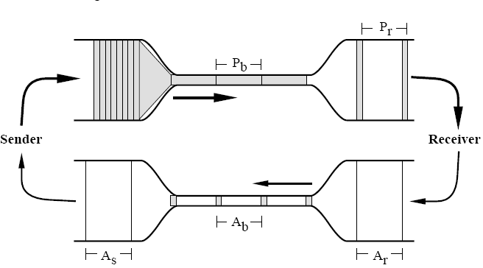
Self-Clocking Transmission
Self-clocking transmission: Conservation of Packets
  each ACK returns, one data packet sent
  spacing of returning ACKs: matches spacing of packets in time at slowest link on path

Slide 17
Goals in Congestion Control
Achieve high utilization on links; don’t waste capacity!
Divide bottleneck link capacity fairly among users
Be stable: converge to steady allocation among users
Avoid congestion collapse

Slide 18
Congestion Collapse
Knee
Throughput (bps)
Congestion collapse!
Offered load (bps)
Cliff behavior observed in [Jacobson 88]

Slide 19
Congestion Requires Slowing Senders
Bigger buffers cannot prevent congestion: senders must slow down
Absence of ACKs implicitly indicates congestion
TCP sender’s window size determines sending rate
Recall: Correct window size is bottleneck link bandwidth-delay product
How can the sender learn this value?
  Search for it, by adapting window size
  Feedback from network: ACKs return (window OK) or do not return (window too big)

Slide 20
Reaching Equilibrium: Slow Start
At connection start, sender sets congestion window size, cwnd, to pktSize (one packet’s worth of bytes), not whole window
Sender sends up to min(cwnd, W)
  Upon return of each ACK, increase cwnd by pktSize bytes until W reached
  “Slow” means exponential window increase!
Takes log₂(W / pktSize) RTTs to reach receiver’s advertised window size W

Slide 21
Avoiding Congestion:
Multiplicative Decrease
Recall sender uses window of size min(cwnd, W), where W is receiver’s advertised window
Upon timeout for sent packet, sender presumes packet lost to congestion, and:
  sets ssthresh = cwnd / 2
  sets cwnd = pktSize
  uses slow start to grow cwnd up to ssthresh
End result: cwnd = cwnd / 2, via slow start

Slide 22
Taking Your Fair Share:
Additive Increase
Drops indicate sending more than fair share of bottleneck
No feedback to indicate using less than fair share
Solution: Speculatively increase window size as ACKs return
  Additive increase: For each returning ACK,
  cwnd = cwnd + (pktSize × pktSize) / cwnd
  Increases cwnd by ≈ pktSize bytes per RTT
Combined algorithm: Additive Increase,
Multiplicative Decrease (AIMD)

Slide 23
Refinement: Fast Retransmit (I)
Sender must wait well over RTT for timer to expire before loss detected
TCP’s minimum retransmit timeout: 1 second
Another indicator of loss:
  Suppose sender sends: 1, 2, 3, 4, 5 (...but 2 is lost)
  Receiver receives: 1, 3, 4, 5
  Receiver sends cumulative ACKs: 2, 2, 2, 2
    Loss causes duplicate ACKs

Slide 24
Fast Retransmit (II)
Upon arrival of three duplicate ACKs, sender:
sets cwnd = cwnd / 2
retransmits “missing” packet
no slow start
Not only loss causes dup ACKs
  Packet reordering, too
A
B
data, seqno = 1
data, seqno = 513
data, seqno = 1025
time
data, seqno = 1537
data, seqno = 2049
ACK = 513
ACK = 513
ACK = 513
ACK = 513
data, seqno = 513

Slide 25
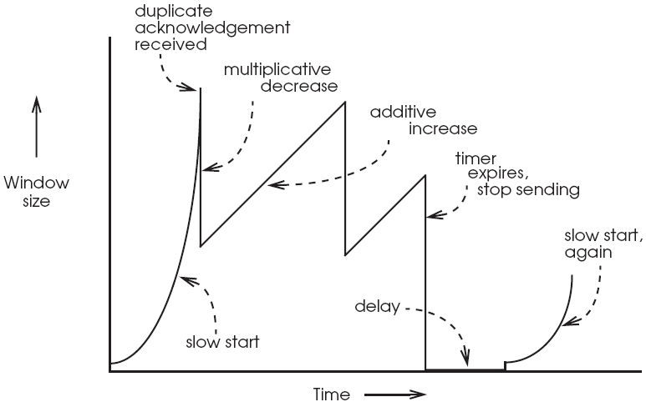
AIMD in Action

Slide 26
Modeling Throughput, Loss, and RTT
How do packet loss rate and RTT affect throughput TCP achieves?
Assume:
Only fast retransmits
No timeouts (so no slow starts in steady-state)

Slide 27
Evolution of Window Over Time
W
W/2
time
Average window size: ¾W
One window of packets is sent per RTT
Bandwidth:
  ¾W packets per RTT
  (¾W x packet size) / RTT bytes per second
  W depends on loss rate…

Slide 28
Window Size Versus Loss
Assume no delayed ACKs, fixed RTT
cwnd grows by one packet per RTT
  So it takes W/2 RTTs to go from window size W/2 to window size W; this period is one cycle
How many packets sent in total, in a cycle?
  ( ¾W / RTT) x (W/2 x RTT) = 3W²/8
One loss per cycle (as window reaches W)
  So, the packet loss rate p = 8/3W²
  W = √(8/3p)

Slide 29
Throughput, Loss, and RTT Model
W = √(8/3p) = (4/3) x √(3/2p)
Recall, bandwidth B = (3W/4 x packet size) / RTT
Consequences:
Increased loss quickly reduces throughput
At same bottleneck, flow with longer RTT achieves less throughput than flow with shorter RTT!
B = packet size / (RTT x √(2p/3))

Slide 30
Today
Transmission Control Protocol (TCP) primer, cont’d
TCP over Wireless
  TCP Snoop
  Explicit Loss Notification

Slide 31
Review: TCP on Wireless Links
TCP interprets any packet loss as a sign of congestion
  TCP sender reduces congestion window
On wireless links, packet loss can also occur due to random channel errors, or interference
  Temporary loss not due to congestion
  Reducing window may be too conservative
  Leads to poor throughput

Slide 32
Review: Two Broad Approaches
Mask wireless losses from TCP sender
  Then TCP sender will not reduce congestion window
  Split Connection Approach
  TCP Snoop
Explicitly notify TCP sender about cause of packet loss

Slide 33
TCP Snoop: Introduction
Removes most significant problem of split connection: breaking end-to-end semantics
  No more split connection
  Single end-to-end connection like regular TCP
TCP Snoop only modifies the AP
Basic Idea (Downlink traffic):
  AP “snoops” on TCP traffic to and from the mobile
    Quickly retransmits packets it thinks may be lost over the wireless link

Slide 34
Snoop Protocol: High-level View
Per TCP-connection state
application
application
application
transport
transport
transport
Retransmit
network
network
network
link
link
link
physical
physical
physical
TCP connection
wireless

Slide 35
TCP Snoop: Downlink traffic case
TCP Segments
40
39
38
37
Content
Server
Wired Internet
34
Wireless Link
36
AP
Mobile
TCP ACKs
AP buffers downlink TCP segments
  Until it receives corresponding ACK from mobile
AP snoops on uplink TCP acknowledgements
  Detects downlink wireless TCP segment loss via duplicate ACKs or time-out

Slide 36
TCP Snoop Goal:
Recover wireless downlink loss
When AP detects a lost TCP segment:
  Locally, quickly retransmit that segment over the wireless link
  Minimize duplicate ACKs flowing back to server
Goal: Content server unaware of wireless loss and retransmission
  No reduction in cwnd

Slide 37
TCP Snoop: Downlink Example
TCP Segments
35
Snoop Cache (at AP):
TCP segments seen (whose ACKs have not yet been seen)
36
37
38
40
39
38
37
Wired Internet
34
Wireless Link
36
TCP ACKs

Slide 38
Downlink traffic operation, at Snoop AP
Downlink TCP segments:

Slide 39
TCP Snoop: Downlink example
35
39
36
37
38
41
40
39
38
34
36

Slide 40
Downlink traffic operation, at Snoop AP
Downlink TCP segments:
Uplink TCP ACKs:

Slide 41
TCP Snoop: Downlink example
35
39
36
37
38
41
40
39
38
34
36

Slide 42
TCP Snoop: Downlink example
37
40
38
39
42
41
40
39
36
36
First
dupack
TCP receiver does not delay duplicate ACKs (dupacks)

Slide 43
TCP Snoop: Downlink example
37
40
38
41
39
43
42
41
40
36
36
36
First
dupack
Second
dupack

Slide 44
Downlink traffic operation, at Snoop AP
Downlink TCP segments:
Uplink TCP ACKs:

Slide 45
TCP Snoop: Downlink example
37
40
38
41
39
42
44
43
37
41
36
36
36
First
dupack
Second
dupack
Third
dupack
Dupack triggers retransmission of packet 37 from AP

Slide 46
Downlink traffic operation, at Snoop AP
Downlink TCP segments:
Uplink TCP ACKs:

Slide 47
TCP Snoop: Downlink example
37
40
43
38
41
39
42
45
44
42
37
36
36
Discard
2nd dupack
36

Slide 48
TCP Snoop: Downlink example
37
40
43
38
41
44
39
42
46
45
43
42
36
41
Discard
3rd dupack
36
36

Slide 49
TCP Snoop: Downlink example
37
40
43
38
41
44
39
42
45
47
46
44
43
41
Discard
4th dupack
36
36
36
TCP sender does not fast retransmit

Slide 50
TCP Snoop: Downlink example
42
45
43
46
44
48
47
45
44
41
43
36
36
36

Slide 51
Uplink traffic case
TCP Segments
40
39
38
37
Wireless Link
34
Wired Internet
36
Mobile
AP
Server
TCP ACKs
Less-common case but becoming more prevalent
Buffer & retransmit TCP segments at AP? Not likely useful
Run Snoop agent on the Mobile? Not likely useful

Slide 52
Negative ACKs: Recovering uplink loss
TCP Segments
40
39
38
37
Wireless Link
34
36
TCP ACKs
AP detects wireless uplink loss via missing sequence numbers
AP immediately sends L2 negative ACK (NACK) to mobile
  Mobile quickly & selectively retransmits data
  Requires modification to AP and mobile’s link layer

Slide 53
Snoop TCP: Advantages
Downlink works without modification to mobile or server
Preserves end-to-end semantics. Crash does not affect correctness, only performance.
After an AP handoff: New AP needn’t Snoop TCP
  Can automatically fall back to regular TCP operation
  No state need be migrated (but if done, can improve performance)
  Note such “state” is called soft state
    Good if available, but correct functionality otherwise

Slide 54
Negative ACKs: Critique
Mobile host still needs to be modified at L2 and L4
  This applies to NACK scheme for uplink traffic, not Snoop for downlink traffic
Violates the layering principle
Almost violates the end-to-end principle

Slide 55
Two Broad Approaches
Mask wireless losses from TCP sender
  Then TCP sender will not reduce congestion window
  Split Connection Approach
  TCP Snoop
Explicitly notify TCP sender about cause of packet loss

Slide 56
Explicit Loss Notification (ELN)
Notify the TCP sender that a wireless link (not congestion) caused a certain packet loss
Upon notification, TCP sender retransmits packet, but doesn’t reduce congestion window
Many design options:
  Who sends notification? How is notification sent? How is notification interpreted at sender?
    We’ll discuss one example approach

Slide 57
ELN for uplink TCP traffic
AP keeps track of gaps in the TCP packet sequence received from the mobile sender
Gap, size 1 at seqno 2
TCP Segments
4
3
2
1
4
3
1
Wireless Link
TCP ACKs
Mobile
Server

Slide 58
ELN for uplink TCP traffic
When AP sees a dupack:
  AP compares dupack seqno with its recorded gaps
    If match: AP sets ELN bit in dupack and forwards it
When mobile receives dupack with ELN bit set:
  Resends packet, but doesn’t reduce congestion window
Gap, size 1 at seqno 2
TCP Segments
4
3
2
1
4
3
1
1
1
1
1
Mobile
Server
Dupack with ELN set

Slide 59
Thursday Topic:
Link Layer I: Time, Frequency,
and Code Division
Friday Precept
Introduction to Lab 1

