Slide 1
Deep Learning for Graphics and Vision
Thomas Funkhouser Princeton University COS 598F, Spring 2017

Slide 2
Goals of the Seminar
Study recent methods in deep learning for graphics and vision
Survey the current state-of-the-art on learning visual representations
Discuss research projects currently being done by students
Brainstorm about future research directions

Slide 3
Seminar Organization
Somewhere between a group meeting and a reading group
Mainly reading, presentation, and discussion
Recent papers and ongoing research
No formal assignments
No exams, no programming assignments
Cannot be taken for undergraduate credit

Slide 4
Coursework
Study and discuss research topics/questions
Make presentation(s) describing the state of the field on a topic/question (30 minute talk, plus discussion afterwards)
Read and discuss research papers
Make a presentation describing at least one research paper in detail (20 minutes or so, plus discussion afterwards)
Present ongoing research projects
Make a presentation about your own research project related to the course (20 minute talk, plus discussion afterwards)

Slide 5
Focus of Study
Using deep networks to learn representations of the real-world from images and leverage them in graphics/vision applications

Slide 6
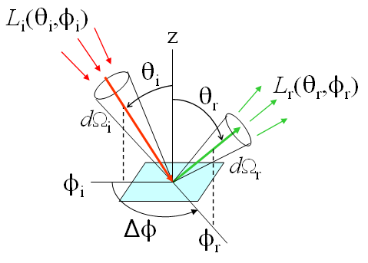
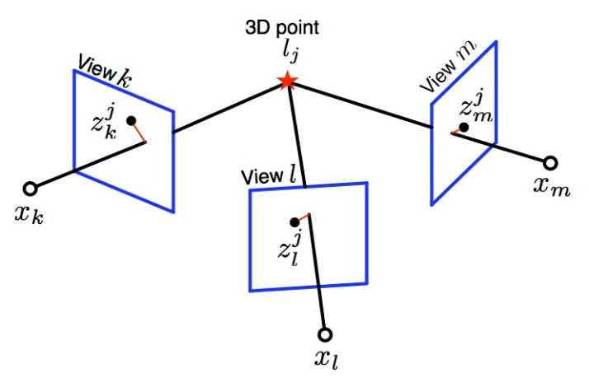
What Will Not be Our Focus …
Background on graphics and vision …
Lighting, materials, cameras, optics, geometry, light transport, etc.
Stereo, flow, tracking, reconstruction, etc.
Hand-tuned features
Background on deep learning …
Network types
CNN, RNN, LSTM, …
Network architectures
Layers, connections, pooling, …
Training strategies
Backpropagation, stochastic gradient descent
Initialization, dropout, batch normalization

Slide 7
Proposed Topics
Recent work on …
Learning without full supervision
Weakly supervised, self-supervised, unsupervised
Learning 3D representations of the world
Voxels, point clouds, surfaces
Learning mappings between domains
Text, RGB, depth, video, 3D shapes, etc.
Synthetic data
Applications at the boundary of graphics and vision
Synthesis, editing, etc.

Slide 8
Proposed Topics
Recent work on …
Learning without full supervision
Weakly supervised, self-supervised, unsupervised
Learning 3D representations of the world
Voxels, point clouds, surfaces
Learning mappings between domains
Text, RGB, depth, video, 3D shapes, etc.
Synthetic data
Applications at the boundary of graphics and vision
Synthesis, editing, etc.

Slide 9
Supervised Learning
Andrey Kurenkov
Will unsupervised and self-supervised learning methods remove the need for human labels?

Slide 10
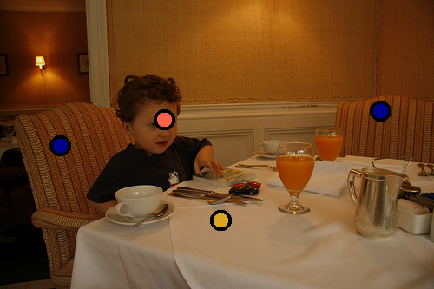
Supervised Learning
What labels?
More categories?
More images per category?
More specific spatial labels?
More data with noisier labels?
“What makes ImageNet good for Transfer Learning?”
Jacob MY Huh, Pulkit Agrawal, Alexei Efros, NIPS Workshop on Large-Scale Computer Vision Systems, 2016
LSUN: Construction of a Large-Scale Image Dataset
using Deep Learning with Humans in the Loop
Fisher Yu Ari Seff Yinda Zhang Shuran Song
Thomas Funkhouser Jianxiong Xiao, arXiv 2016
What's the point: Semantic segmentation with point supervision Amy Bearman, Olga Russakovsky, Vittorio Ferrari and Li Fei-Fei., ECCV 2016.
Will unsupervised and self-supervised learning methods remove the need for human labels?

Slide 11
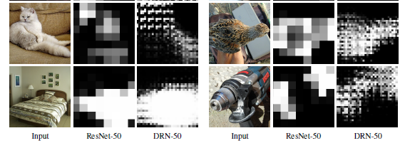
Weakly Supervised Learning
How much can be learned from weak supervision?
Dilated Residual Networks, Fisher Yu et al, 2017.
Will unsupervised and self-supervised learning methods remove the need for human labels?

Slide 12
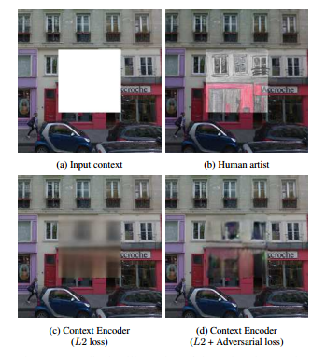
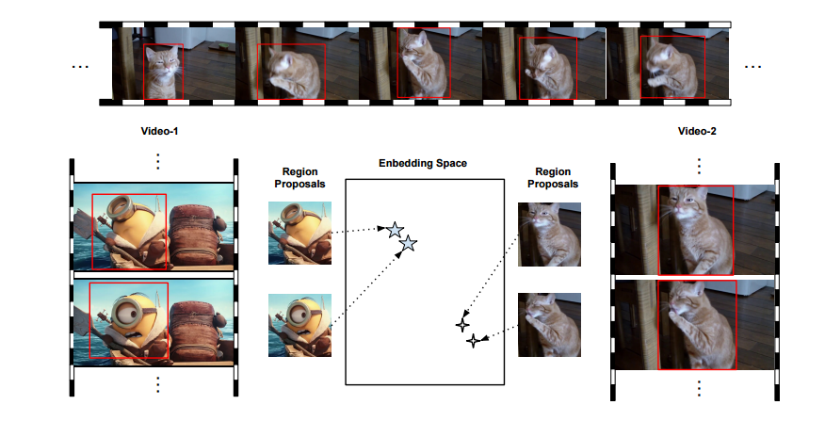
Self-Supervised Learning
“Object-Centric Representation Learning from Unlabeled Videos,” Ruohan Gao, Dinesh Jayaraman, Kristen Grauman, ACCV 2016
Context encoders: Feature learning by inpainting
D Pathak, P Krahenbuhl, J Donahue, T Darrell, AA Efros, CVPR 2016

Slide 13
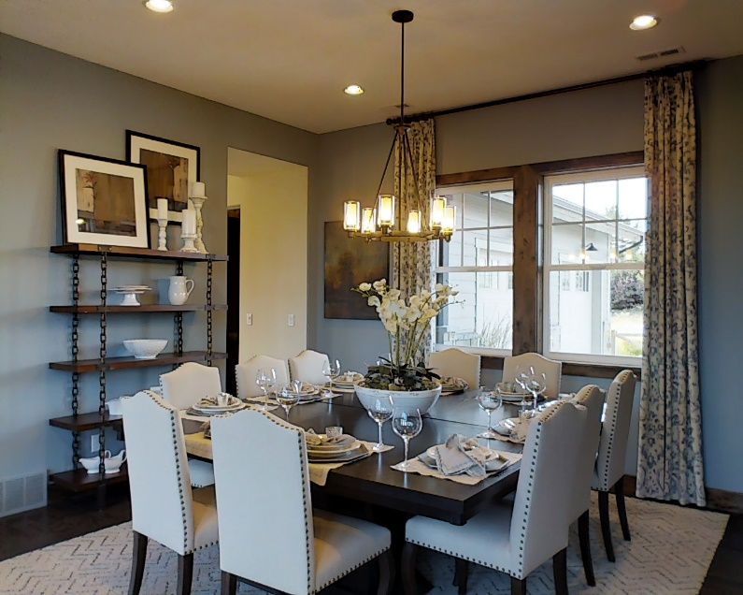
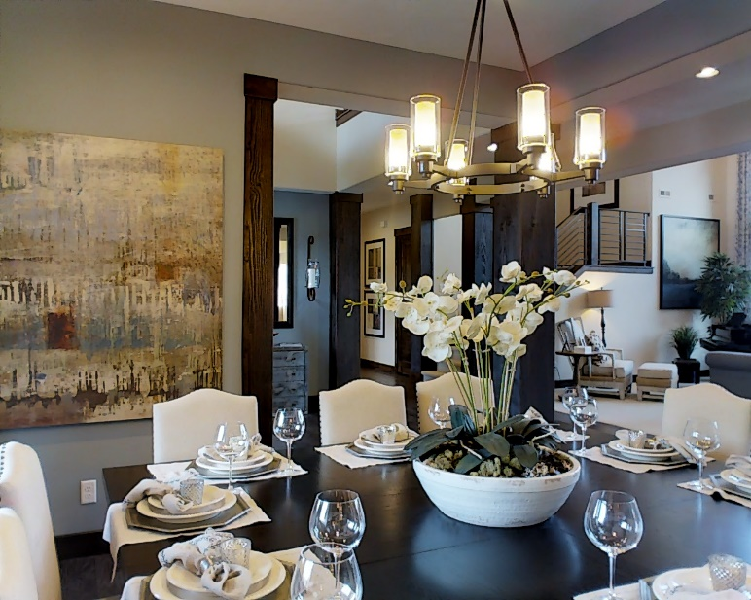
Self-Supervised Learning
What type of data naturally provide self-supervision?
RGB-D images
Multi-view
Synthetic
Video
???

Slide 14
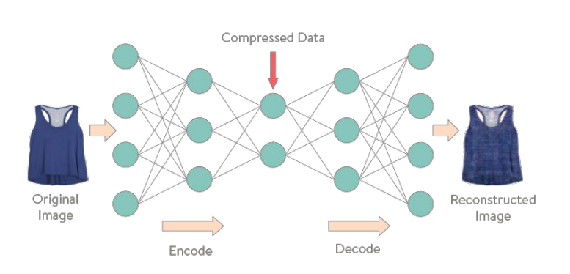
Unsupervised Learning
Variational Autoencoder

Slide 15
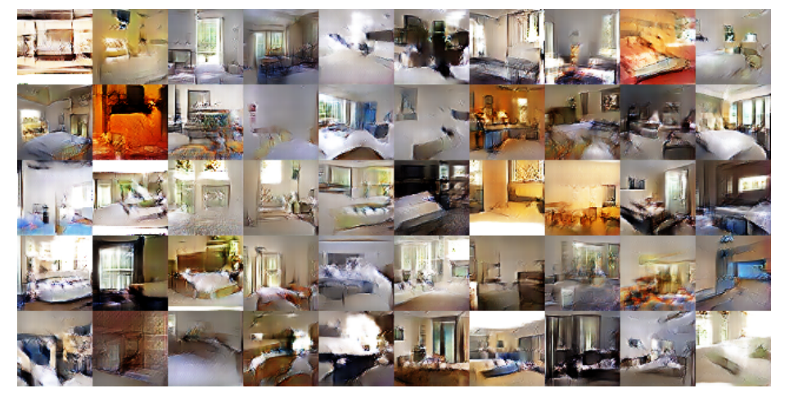
Generative Adversarial Networks
What are the limits of GANs?
Unsupervised Representation Learning with Deep Convolutional Generative Adversarial Networks Alec Radford, Luke Metz, Soumith Chintala, arXiv 2016

Slide 16
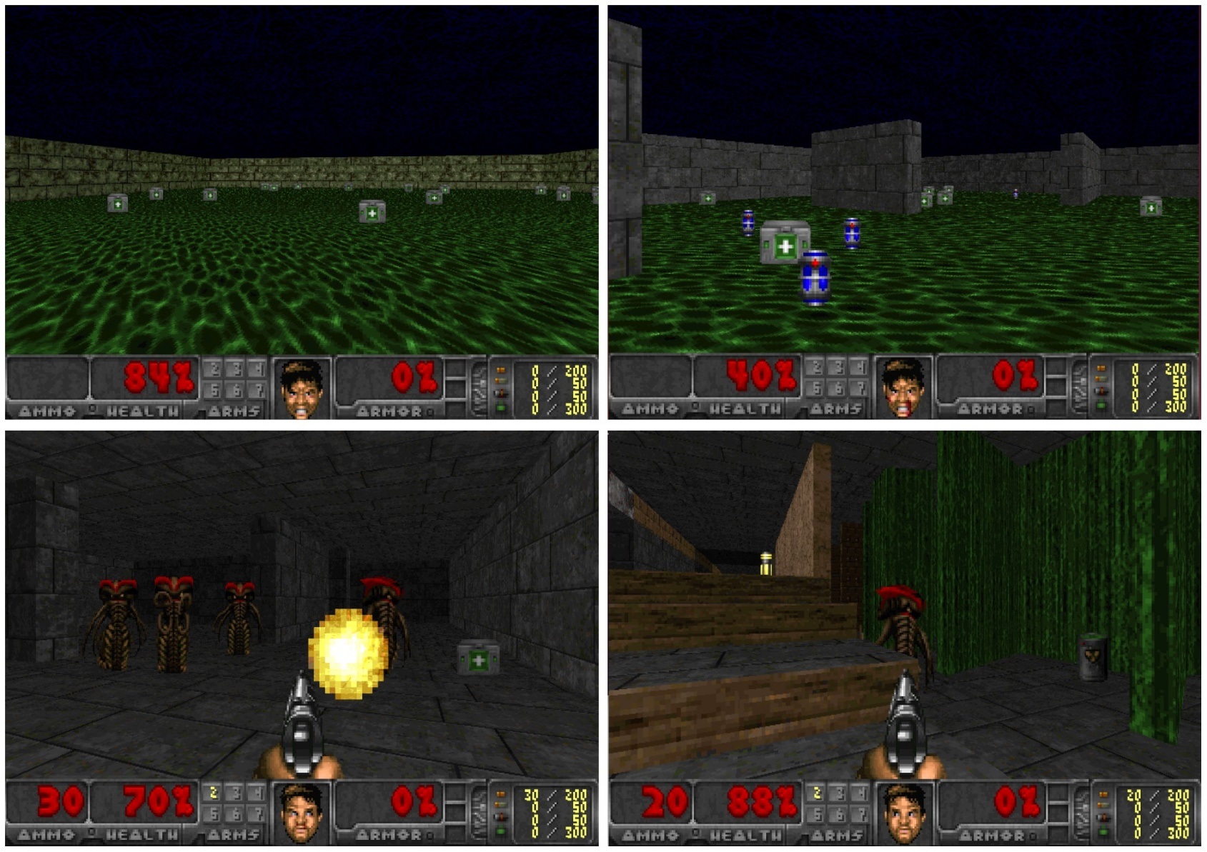
Reinforcement Learning
Learning to Act by Predicting the Future
Alexey Dosovitskiy and Vladlen Koltun, ICLR 2017

Slide 17
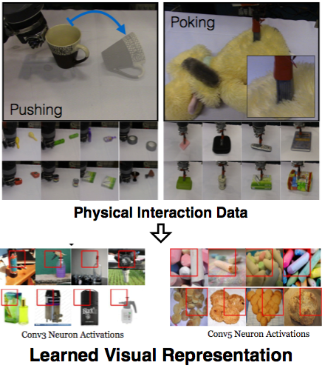
Physical Interaction
Lerrel Pinto, Dhiraj Gandhi, Yuanfeng Han, Yong-Lae Park and Abhinav Gupta. The Curious Robot: Learning Visual Representations via Physical Interactions. ECCV 2016.

Slide 18
Questions to Consider
Is Supervised Learning Necessary?
Is there a combination of unsupervised, self-supervised, and reinforcement learning methods that will subsume the need for supervised human labels?
What real-world constraints are useful for unsupervised learning?
Multiple views, materials, lights, surfaces, occlusion, light transport, physics etc.
Is physical interaction necessary to learn the best representations?

Slide 19
Proposed Topics
Recent work on …
Learning without full supervision
Weakly supervised, self-supervised, unsupervised
Learning 3D representations of the world
Voxels, point clouds, surfaces
Learning mappings between domains
Text, RGB, depth, video, 3D shapes, etc.
Synthetic data
Applications at the boundary of graphics and vision
Synthesis, editing, etc.

Slide 20
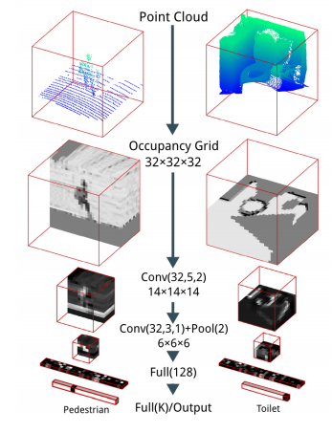
Discriminative Models of 3D Shape
"VoxNet: A 3D Convolutional Neural Network for Real-Time Object Recognition
Daniel Maturana and Sebastian Scherer, IROS 2015

Slide 21
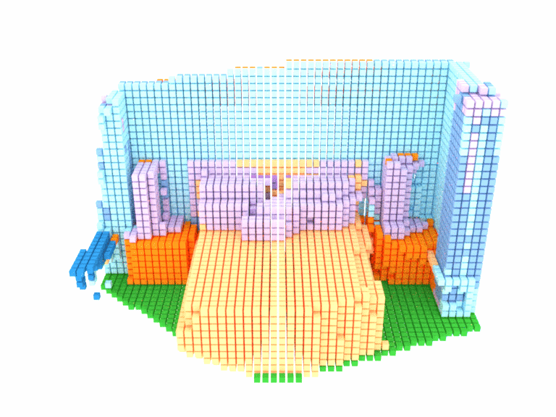
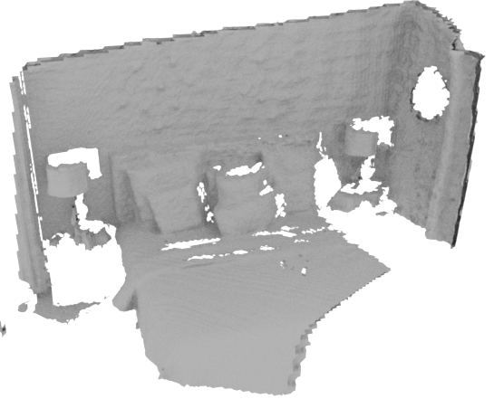
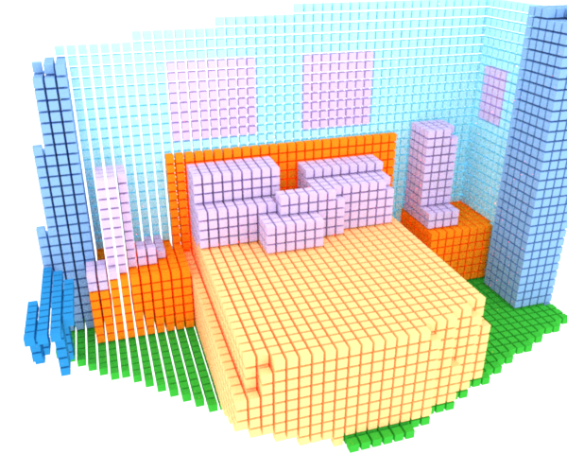
Discriminative Models of 3D Shape
Input
Labeled voxels
Ground truth
"S. Song, F. Yu, A. Zeng, A. Chang, M. Savva, and T. Funkhouser, “Semantic Scene Completion from a Single Depth Image,” arXiv 2016

Slide 22
Generative Models of 3D Shape
"Learning a probabilistic latent space of object shapes via 3d generative-adversarial modeling," Wu, Jiajun, Zhang, Chengkai, Xue, Tianfan, Freeman, Bill, Tenenbaum, Josh, Advances in Neural Information Processing Systems, 2016

Slide 23
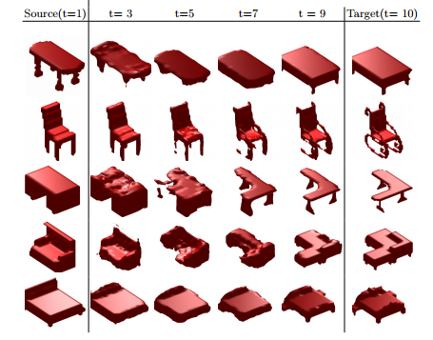
Generative Models of 3D Shape
"Vconv-dae: Deep volumetric shape learning without object labels,“ Sharma, Abhishek, Grau, Oliver, Fritz, Mario, Computer Vision-ECCV 2016 Workshops, 2016

Slide 24
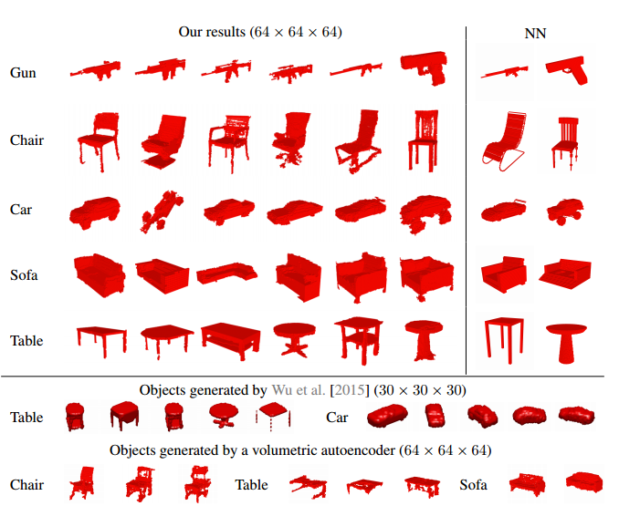
Generative Models of 3D Shape
"Learning a probabilistic latent space of object shapes via 3d generative-adversarial modeling," Wu, Jiajun, Zhang, Chengkai, Xue, Tianfan, Freeman, Bill, Tenenbaum, Josh, NIPS 2016

Slide 25
Questions to Consider
What parameterization is best for 3D shapes?
Voxels, point cloud, surface fans, mapping to sphere, etc.?
How should networks for 3D shapes be different than for natural images?
How do networks, datasets, and training protocols have to be adapted to work effectively for 3D data?

Slide 26
Proposed Topics
Recent work on …
Learning without full supervision
Weakly supervised, self-supervised, unsupervised
Learning 3D representations of the world
Voxels, point clouds, surfaces
Learning mappings between domains
Text, RGB, depth, video, 3D shapes, etc.
Synthetic data
Applications at the boundary of graphics and vision
Synthesis, editing, etc.

Slide 27
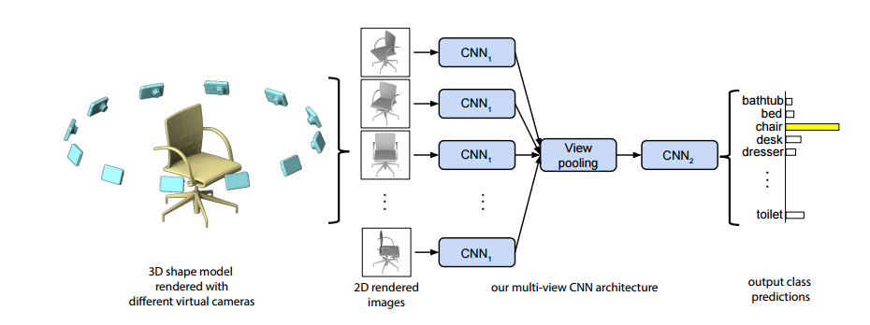
Image to 3D Shape Representation
Multi-view Convolutional Neural Networks for 3D Shape Recognition
Hang Su Subhransu Maji Evangelos Kalogerakis Erik Learned-Miller, ICCV 2015

Slide 28
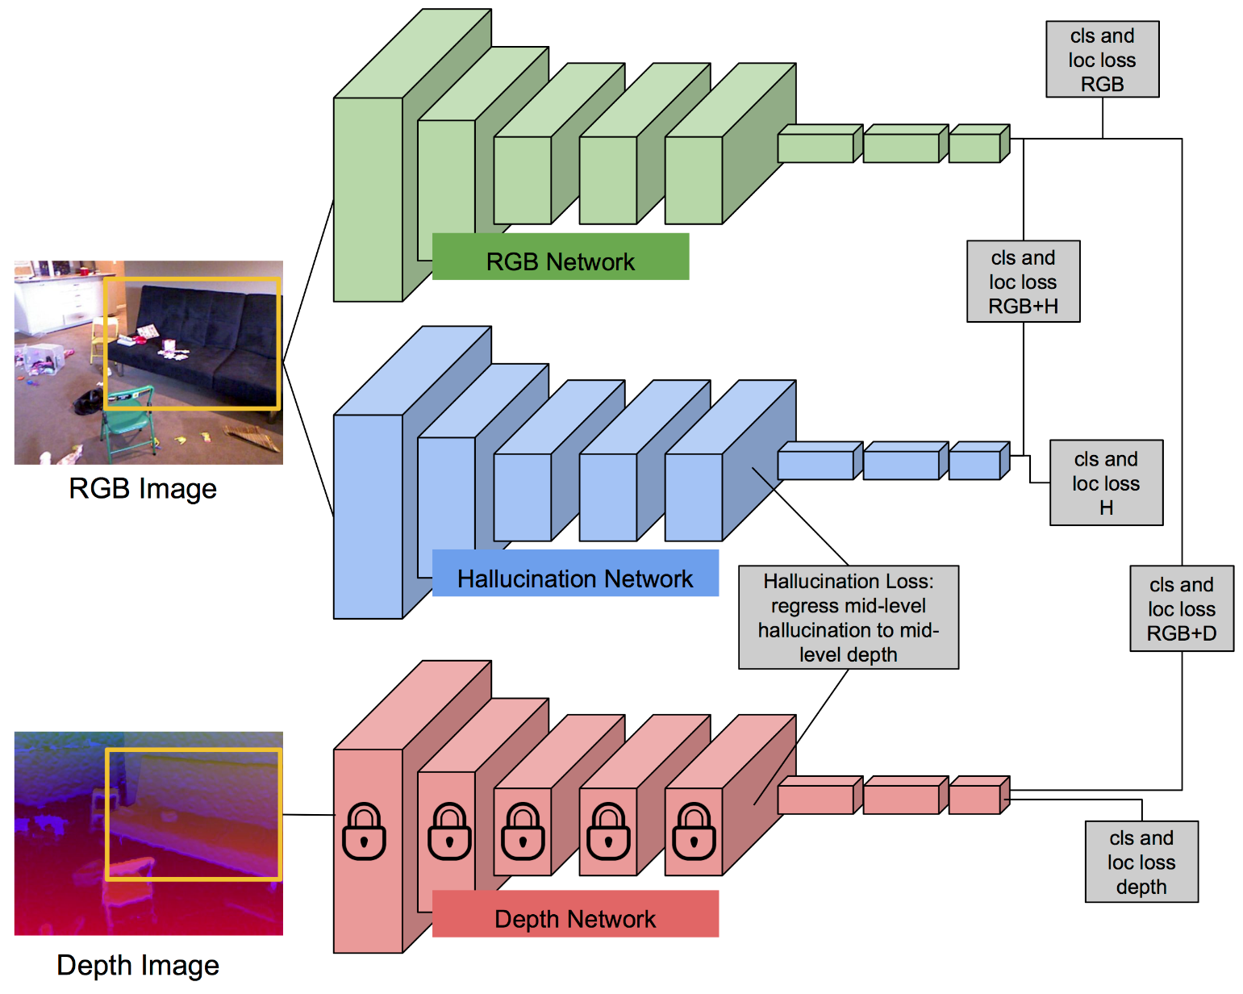
Image and Depth Together
Learning with Side Information through Modality Hallucination, Judy Hoffman, Saurabh Gupta, Trevor Darrell
In Proc. Computer Vision and Pattern Recognition (CVPR), 2016.

Slide 29
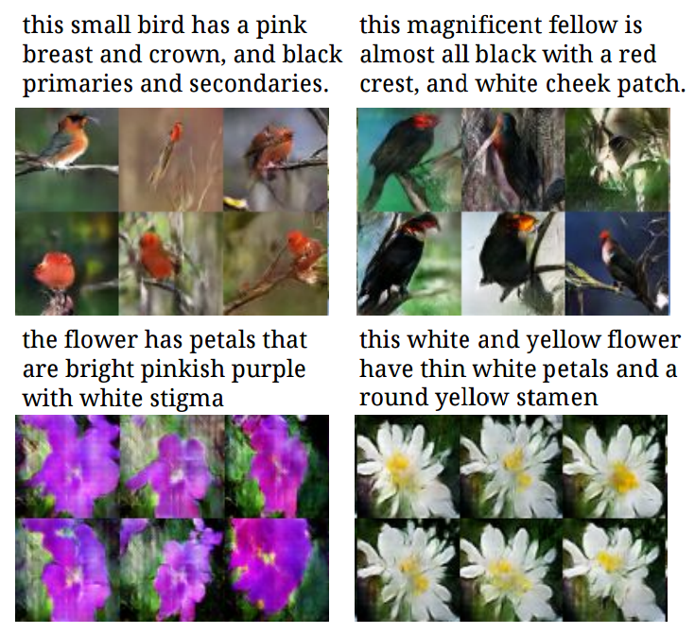
Text to Image
Generative Adversarial Text to Image Synthesis
Scott Reed, Zeynep Akata, Xinchen Yan, Lajanugen Logeswaran, Honglak Lee, Bernt Schiele ICML 2016

Slide 30
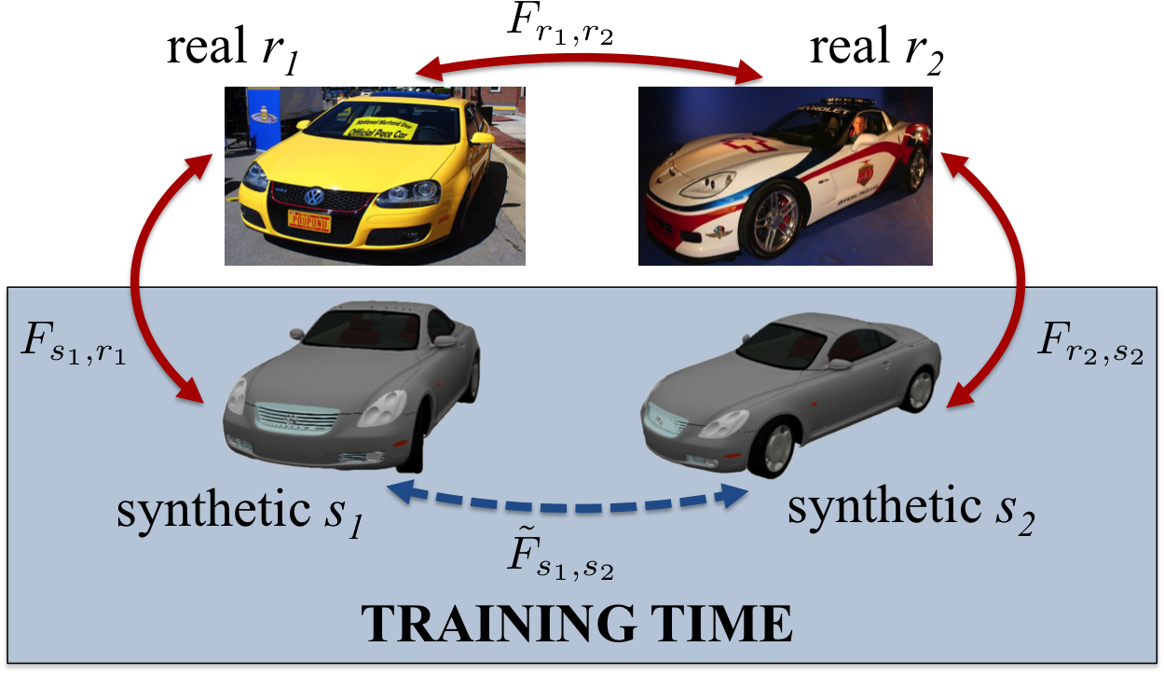
Image to 3D to Image
Learning Dense Correspondence via 3D-guided Cycle Consistency
Tinghui Zhou, Philipp Krähenbühl, Mathieu Aubry, Qixing Huang and Alyosha Efros, CVPR 2016

Slide 31
Questions to Consider
How to transfer representation learned in one domain to another?
How to leverage information from multiple domains into a single representation?

Slide 32
Proposed Topics
Recent work on …
Learning without full supervision
Weakly supervised, self-supervised, unsupervised
Learning 3D representations of the world
Voxels, point clouds, surfaces
Learning mappings between domains
Text, RGB, depth, video, 3D shapes, etc.
Synthetic data
Applications at the boundary of graphics and vision
Synthesis, editing, etc.

Slide 33
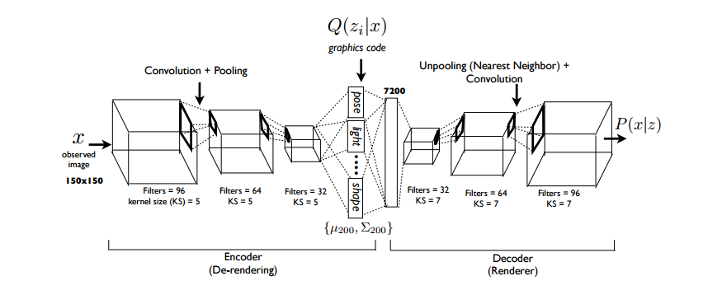
Inverse Graphics
Deep Convolutional Inverse Graphics Network, Tejas D. Kulkarni , Will Whitney, Pushmeet Kohli , Joshua B. Tenenbaum, arXiv:1503.03167v4 [cs.CV] 22 Jun 2015

Slide 34
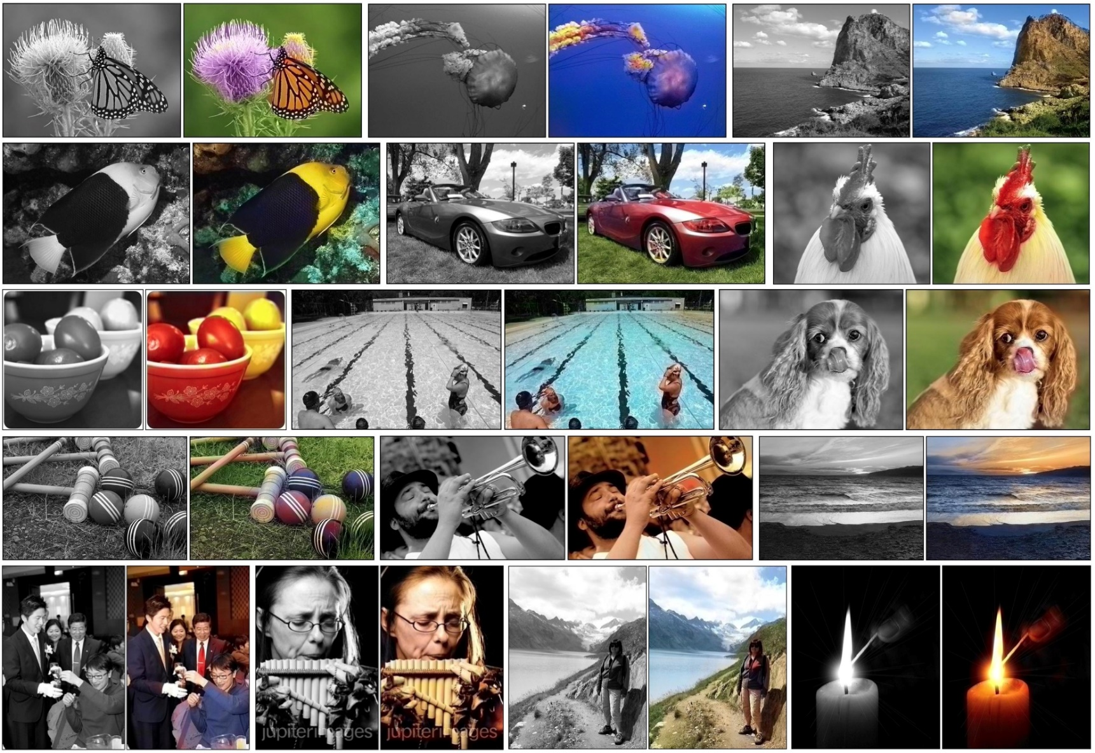
Image Colorization
Colorful Image Colorization
Richard Zhang, Phillip Isola, Alexei A. Efros, ECCV 2016

Slide 35
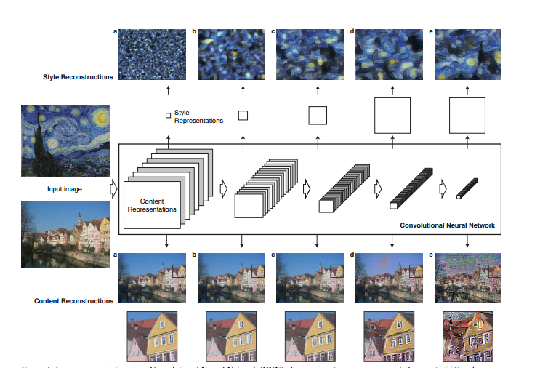
Image Style Transfer
A Neural Algorithm of Artistic Style
Leon A. Gatys, Alexander S. Ecker, Matthias Bethge, CVPR 2016

Slide 36
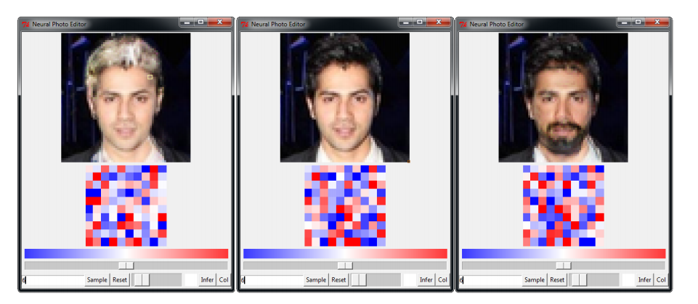
Image Editing
Neural Photo Editing with Introspective Adversarial Networks Andrew Brock, Theodore Lim, J.M. Ritchie, Nick Weston 2016

Slide 37
Questions to Consider
Will GANs completely replace patch-based synthesis?
Combining Markov Random Fields and Convolutional Neural Networks for Image Synthesis, Chuan Li, Michael Wand, CVPR 2016

Slide 38
Questions? Comments?

Slide 39
For the Rest of this Meeting …
Break into small groups
Discuss what are the most interesting and important topics to study in Deep Learning for Graphics and Vision
Report back to the whole group
Integrate suggestions into the class schedule

