Slide 1
Learning Deep Generative Models by Ruslan Salakhutdinov
Frank Jiang
COS 598E: Unsupervised Learning

Slide 2
Motivation
Deep, non-linear models can capture powerful, complex representations of the data.
Non-linear distributed representations (vs mixture models)
However, they are hard to optimize due to non-convex loss functions with many poor local minima.
Small quantity of labelled data compared to large unlabelled dataesets.
Want to learn structure from unlabelled data for use in discriminative tasks.

Slide 3
Solution
In 2006, Hinton et al. introduced a fast, greedy learning algorithm for deep generative models called Deep Belief Networks.
Based on the idea of stacking Restricted Boltzmann Machines.
In 2009, Salakhutdinov and Hinton introduced Deep Boltzmann Machines, which extend DBNs.

Slide 4
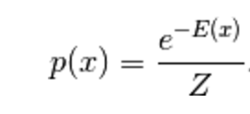
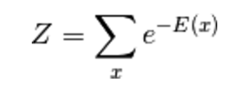
Energy-Based Models
Modelling a probability distribution through an energy function:
The lower the energy, the higher the probability.
Want to optimize the energy manifold to create troughs around actual data, and peaks elsewhere.

Slide 5
Restricted Boltzmann Machines
Markov random field with two-layer architecture: hidden and visible.
Each layer consists of stochastic binary variables.
Edges exist from every hidden node to every visible node, but not within a layer.

Slide 6
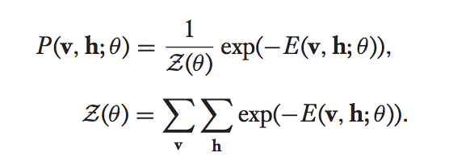
Restricted Boltzmann Machines
RBMs are defined by the following energy function:
The joint distribution over the hidden and visible layers is:

Slide 7
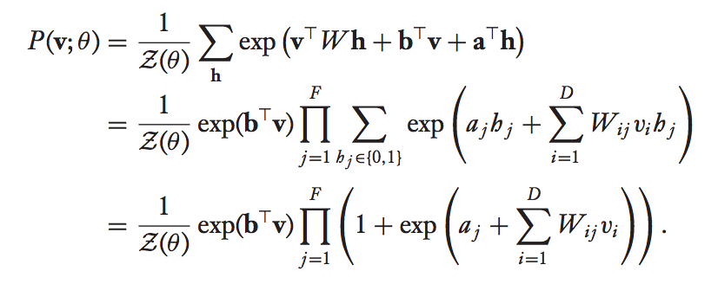
Restricted Boltzmann Machines
The marginal distribution over the visible layer is:
Due to the bipartite structure of the RBM, the hidden variables can be explicitly marginalized out:

Slide 8
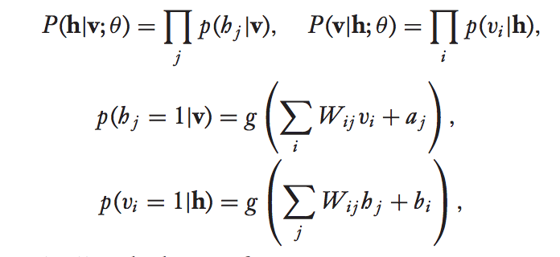
RBM – Conditional Distributions
These equations give us these important and very intuitive conditional distributions:

Slide 9
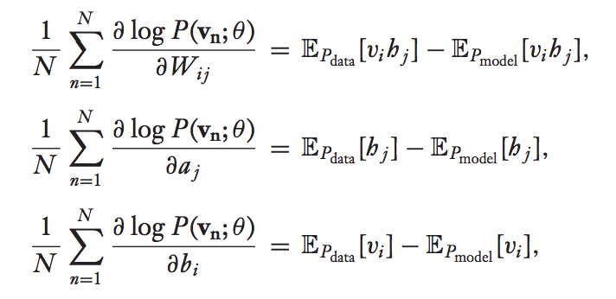
RBM - Learning Procedure
We want to maximize the probability of our data given this probability model, so we perform maximum likelihood estimation on the marginal P(v).
Given a set of observations {v_{n}}^{N}, the derivatives of the log-likelihood with respect to the model parameters are:

Slide 10
RBM – Learning Procedure
Unfortunately, computation of the model expectation requires time exponential in the number of variables.
In 2002, Hinton came up with an algorithm called Contrastive Divergence, which approximates the model expectation with a sample from a Gibbs chain initialized from the data and run for T steps.
In practice, setting T = 1 has yielded good results.
Contrastive Divergence can be implemented using either expectations or sampling.

Slide 11
Inference
Inference uses the same alternating Gibbs sampling to generate samples of either the visible data or hidden variables.
Running the Gibbs sampler for one step with fixed visible variables yields the hidden variables corresponding to that visible data.
Running the Gibbs sampler for one step with fixed hidden variables yields a representation of what that set of hidden variables encodes.
Running the Gibbs sampler for a long time with random initial data yields a random sample from the joint distribution of the RBM.

Slide 12
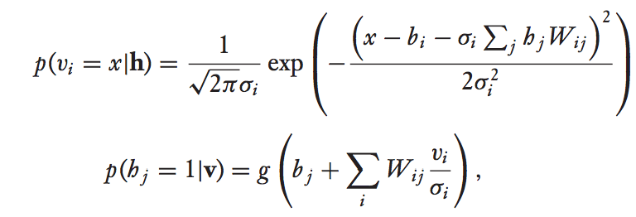
Gaussian-Bernoulli RBMs
Extension of RBMs to model real-valued data.
The conditional distributions are:
Note that the conditional distribution of the visible data given the hidden variables is a Gaussian with mean shifted by a weighted sum of the hidden variables.

Slide 13
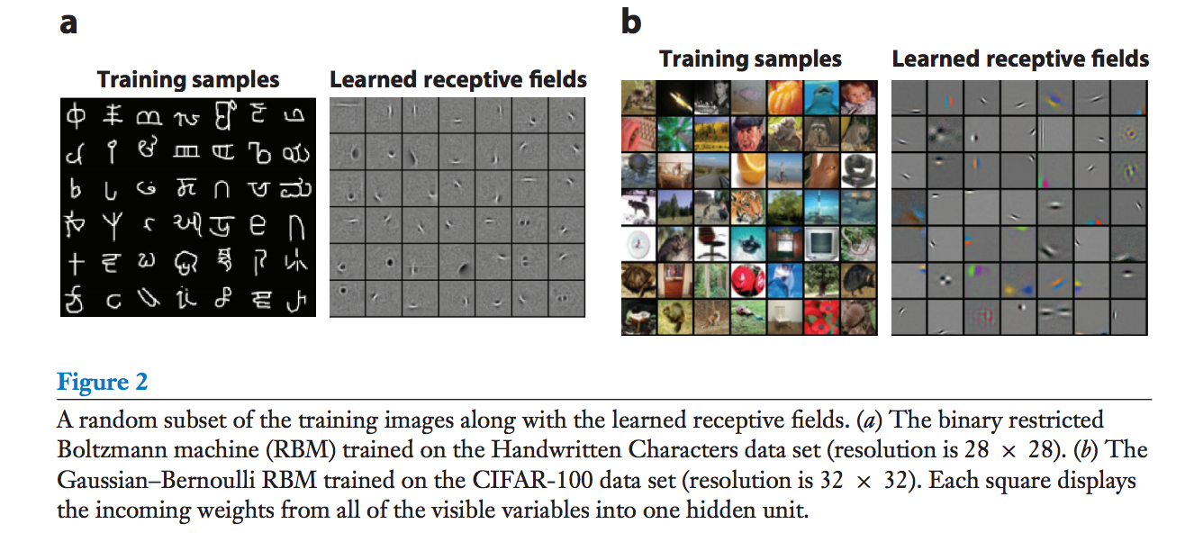
Gaussian-Bernoulli RBMs

Slide 14
Replicated Softmax RBMs

Slide 15
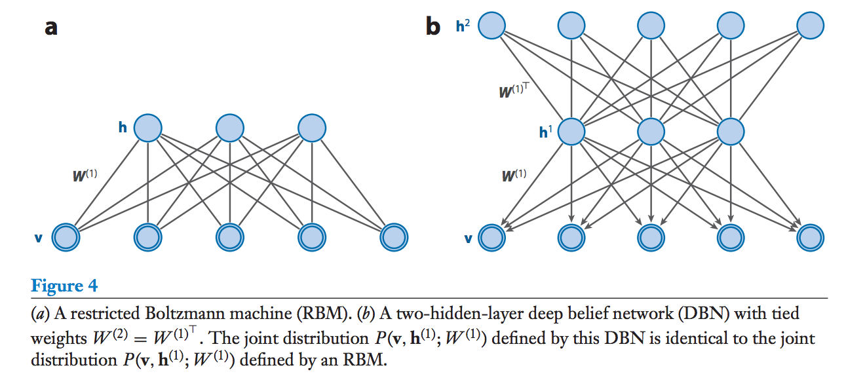
Deep Belief Networks
A DBN is a probabilistic generative model with an RBM in the top two layers and a directed sigmoid belief network in the lower layers.

Slide 16
Deep Belief Networks
The joint distribution over the DBN can be decomposed into the top RBM and the directed sigmoid belief network:
Directed sigmoid belief network:
Top RBM:

Slide 17
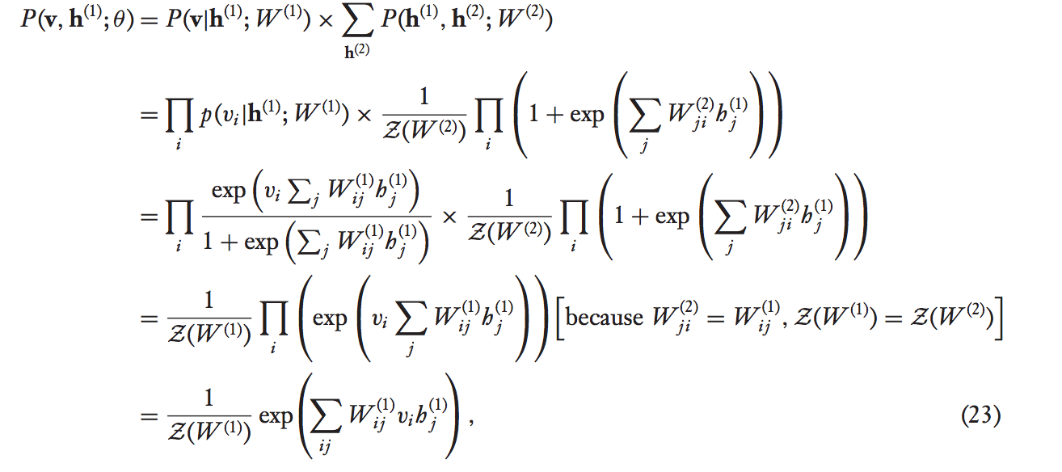
Deep Belief Networks
If we set W⁽²⁾ = W^{(1)T}, then the joint distribution over the visible and first hidden layer of the DBN is actually equal to the joint distribution of the RBM with weights W⁽¹⁾.
Note that the marginal P(h⁽¹⁾) is the same for the RBM and the DBN, as is the conditional P(v | h⁽¹⁾).

Slide 18
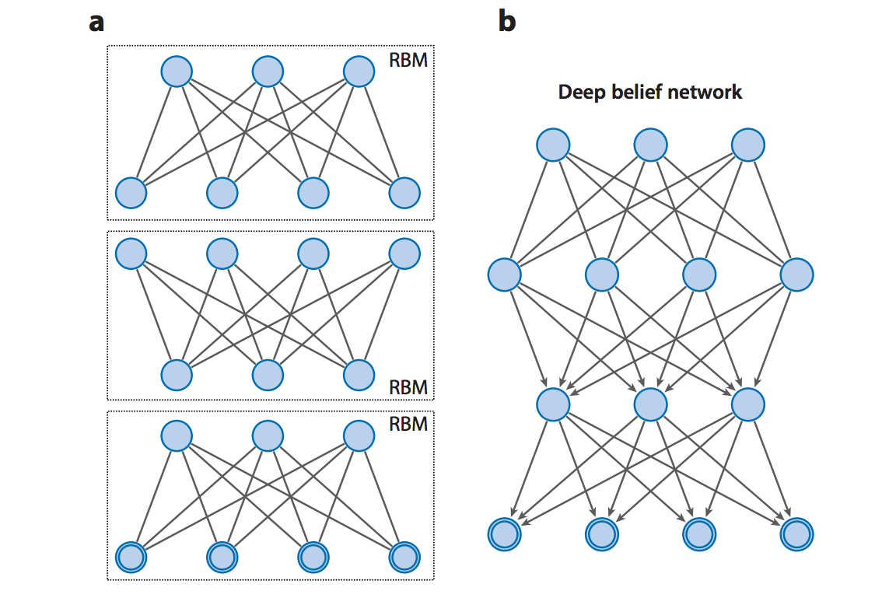
DBNs – Learning Procedure
Greedy layer-by-layer training approach where each pair of layers is trained as an RBM

Slide 19
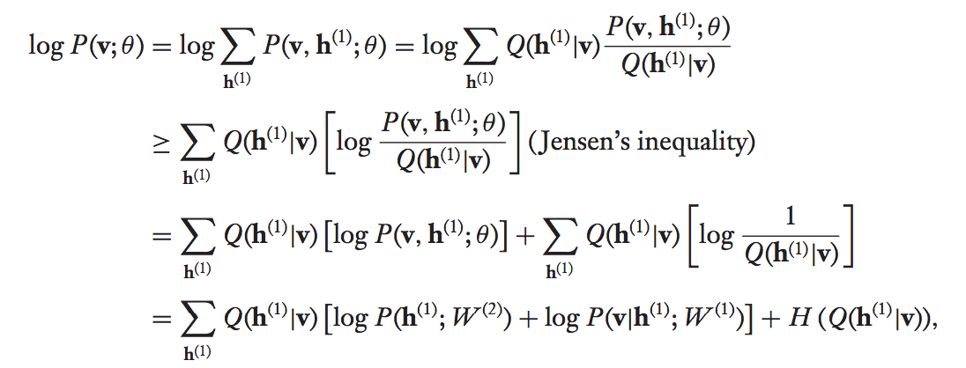
DBNs – Learning Procedure
The variational lower bound of the log-likelihood of the visible data is:
We set the approximating distribution Q to the corresponding conditional from the RBM:
Hence to maximize this bound with fixed W⁽¹⁾, we maximize , which is equivalent to
maximum likelihood training of the second-layer RBM.

Slide 20
DBN – Learning Procedure
The variational bound is initially tight when training the second hidden layer, and so improving it strictly improves the log-likelihood of the data.
However for deeper layers, it is not initially tight and so there is no guarantee, but in practice it does work.

Slide 21
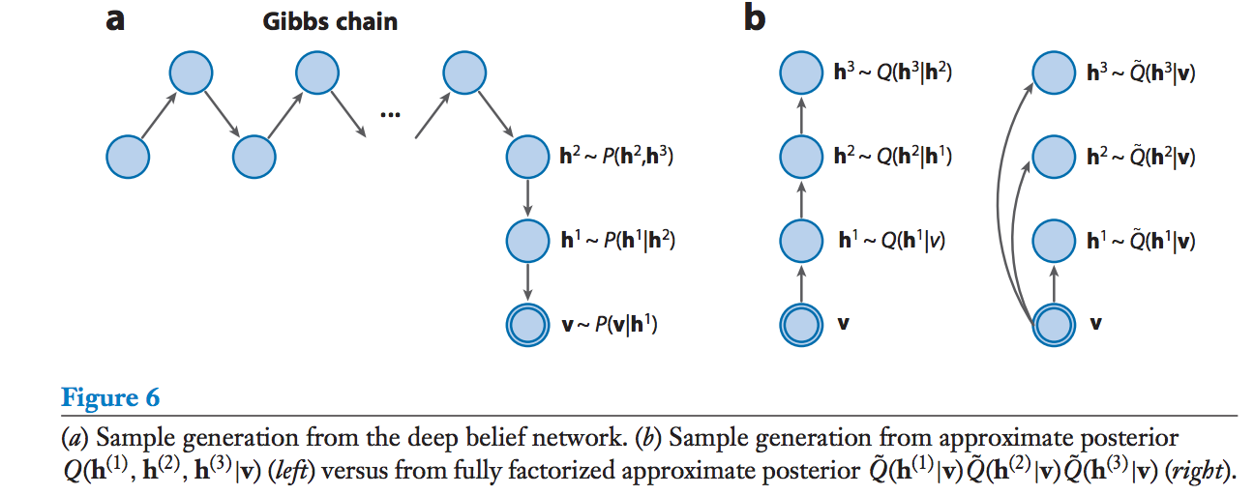
DBN – Inference

Slide 22
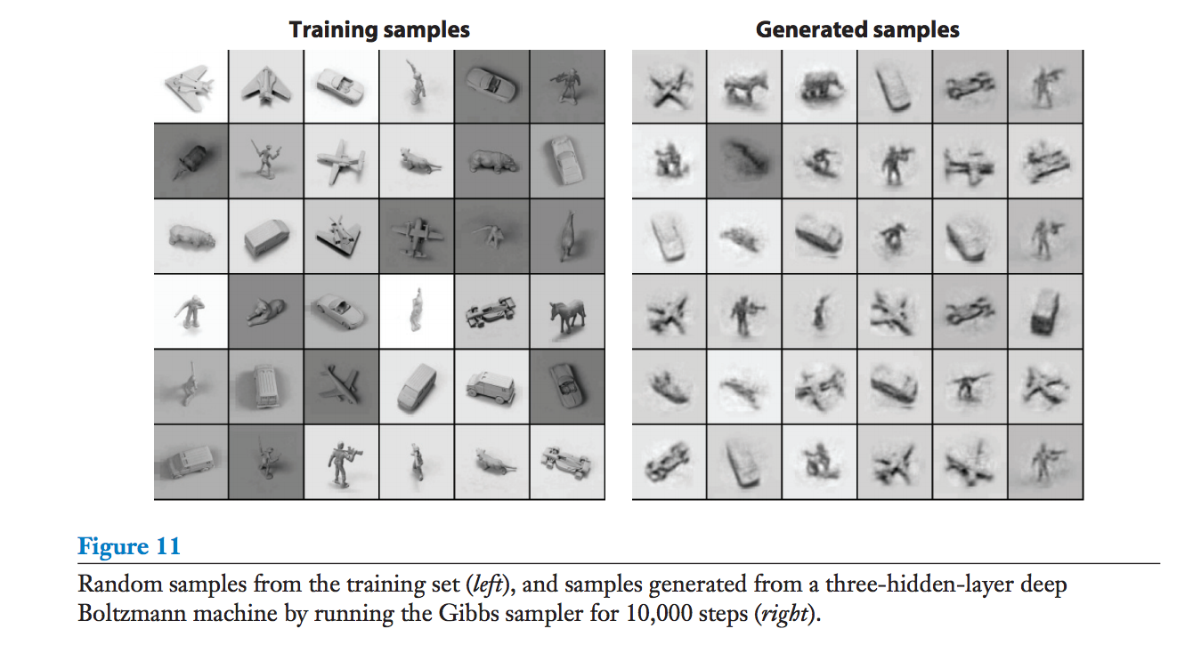
DBN - Inference

Slide 23
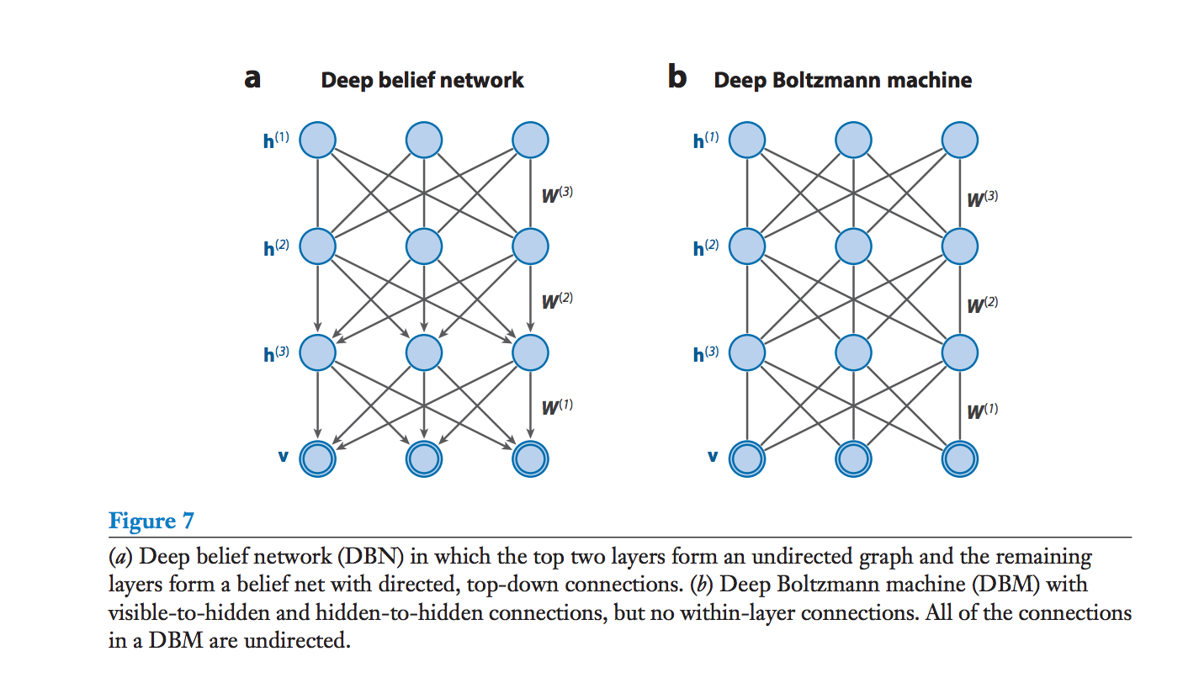
Deep Boltzmann Machines
DBMs are a more general form of DBNs where all of the edges are undirected.

Slide 24
Discriminative DBNs and DBMs
DBNs/DBMs can easily be applied to discriminative tasks after pre-training on unlabelled data.
The stochastic binary variables of the DBN/DBM are converted to deterministic, real-valued variables.
A top layer is added to the network, which transforms the hidden variables into the desired output.
The standard backpropagation algorithm is then used to optimize the weights of this multilayer network.
For DBMs, an approximating distribution Q(h⁽²⁾ | v) is used to create an augmented input for the network, in addition to the actual input.

Slide 25
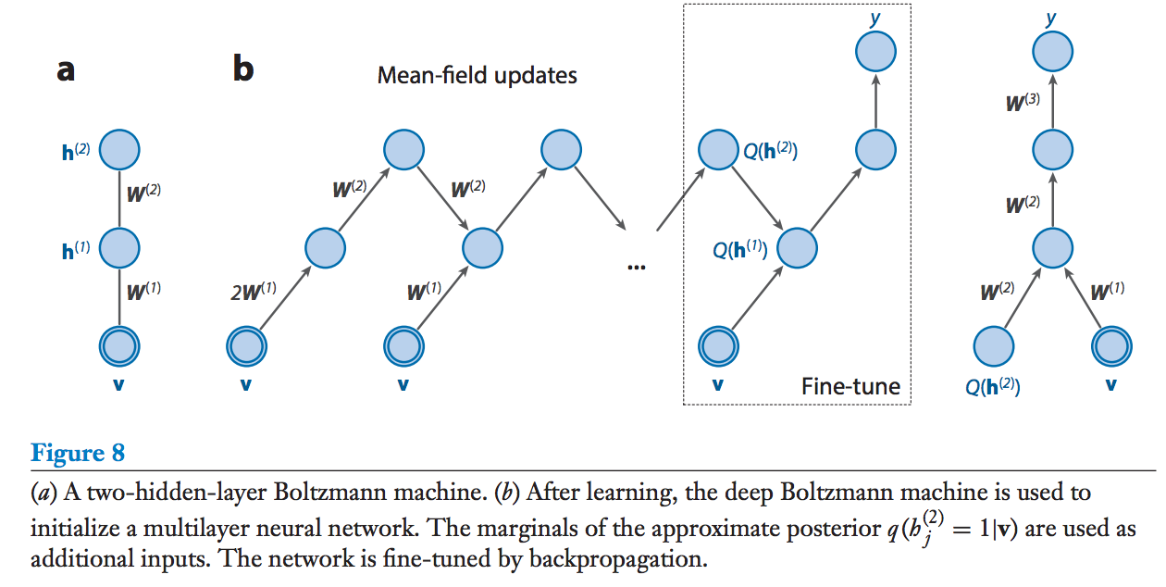
Deep Boltzmann Machines

Slide 26
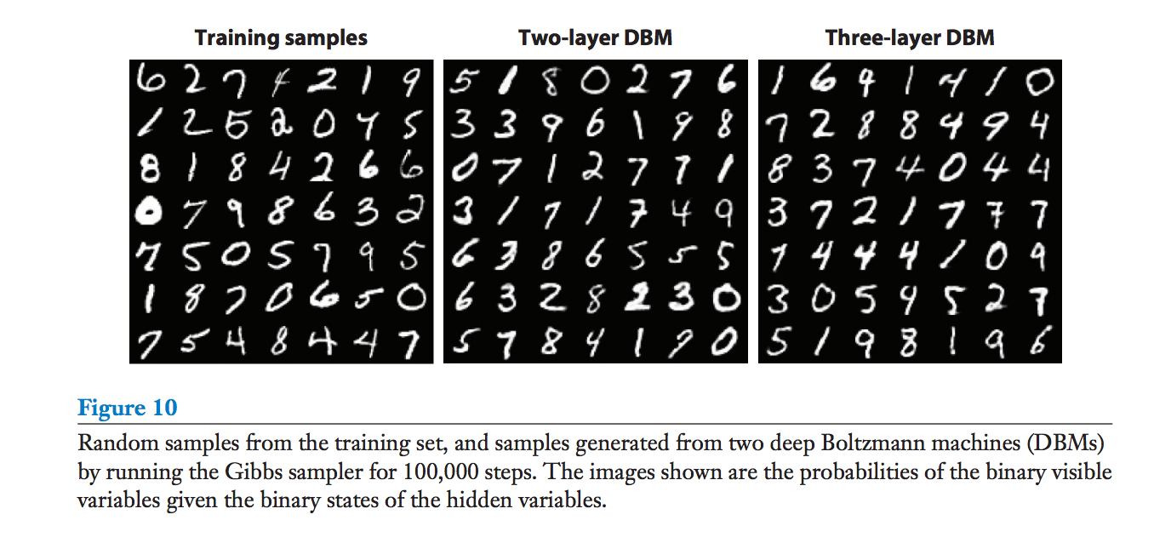
Experimental Results (with DBMs)
MNIST: 0.95% error rate on full MNIST test set with 2-layer RBM, compared to 1.4% by SVMs, 1.2% achieved by DBN.

Slide 27
Experimental Results (with DBMs)
NORB: 10.8% error on full test set, compared to 11.6% by SVM, 22.5% by logistic regression, 18.4% by k-nearest-neighbours.

