Slide 1
Introduction
Principles of System Design
COS 518: Advanced Computer Systems
Lecture 1
Mike Freedman

Slide 2
Goals of this course
Introduction to
  Computer systems principles
  Computer systems research
    Historical and cutting-edge research
    How “systems people” think
Learn how to
  Read and evaluate papers
  Give talks and evaluate talks
  Build and evaluate systems

Slide 3
What is a system?
System
  Inside v. outside: defines interface with environment
  A system achieves specific external behavior
  A system has many components
This class is about the design of computer systems
Much of class will operate at the design level
  Guarantees (semantics) exposed by components
  Relationships of components
  Internals of components that help structure
Notes:
Rather than giving you a direct definition, I’ll tell you three properties

Slide 4
Backrub (Google) 1997

Slide 5
Google 2012

Slide 6
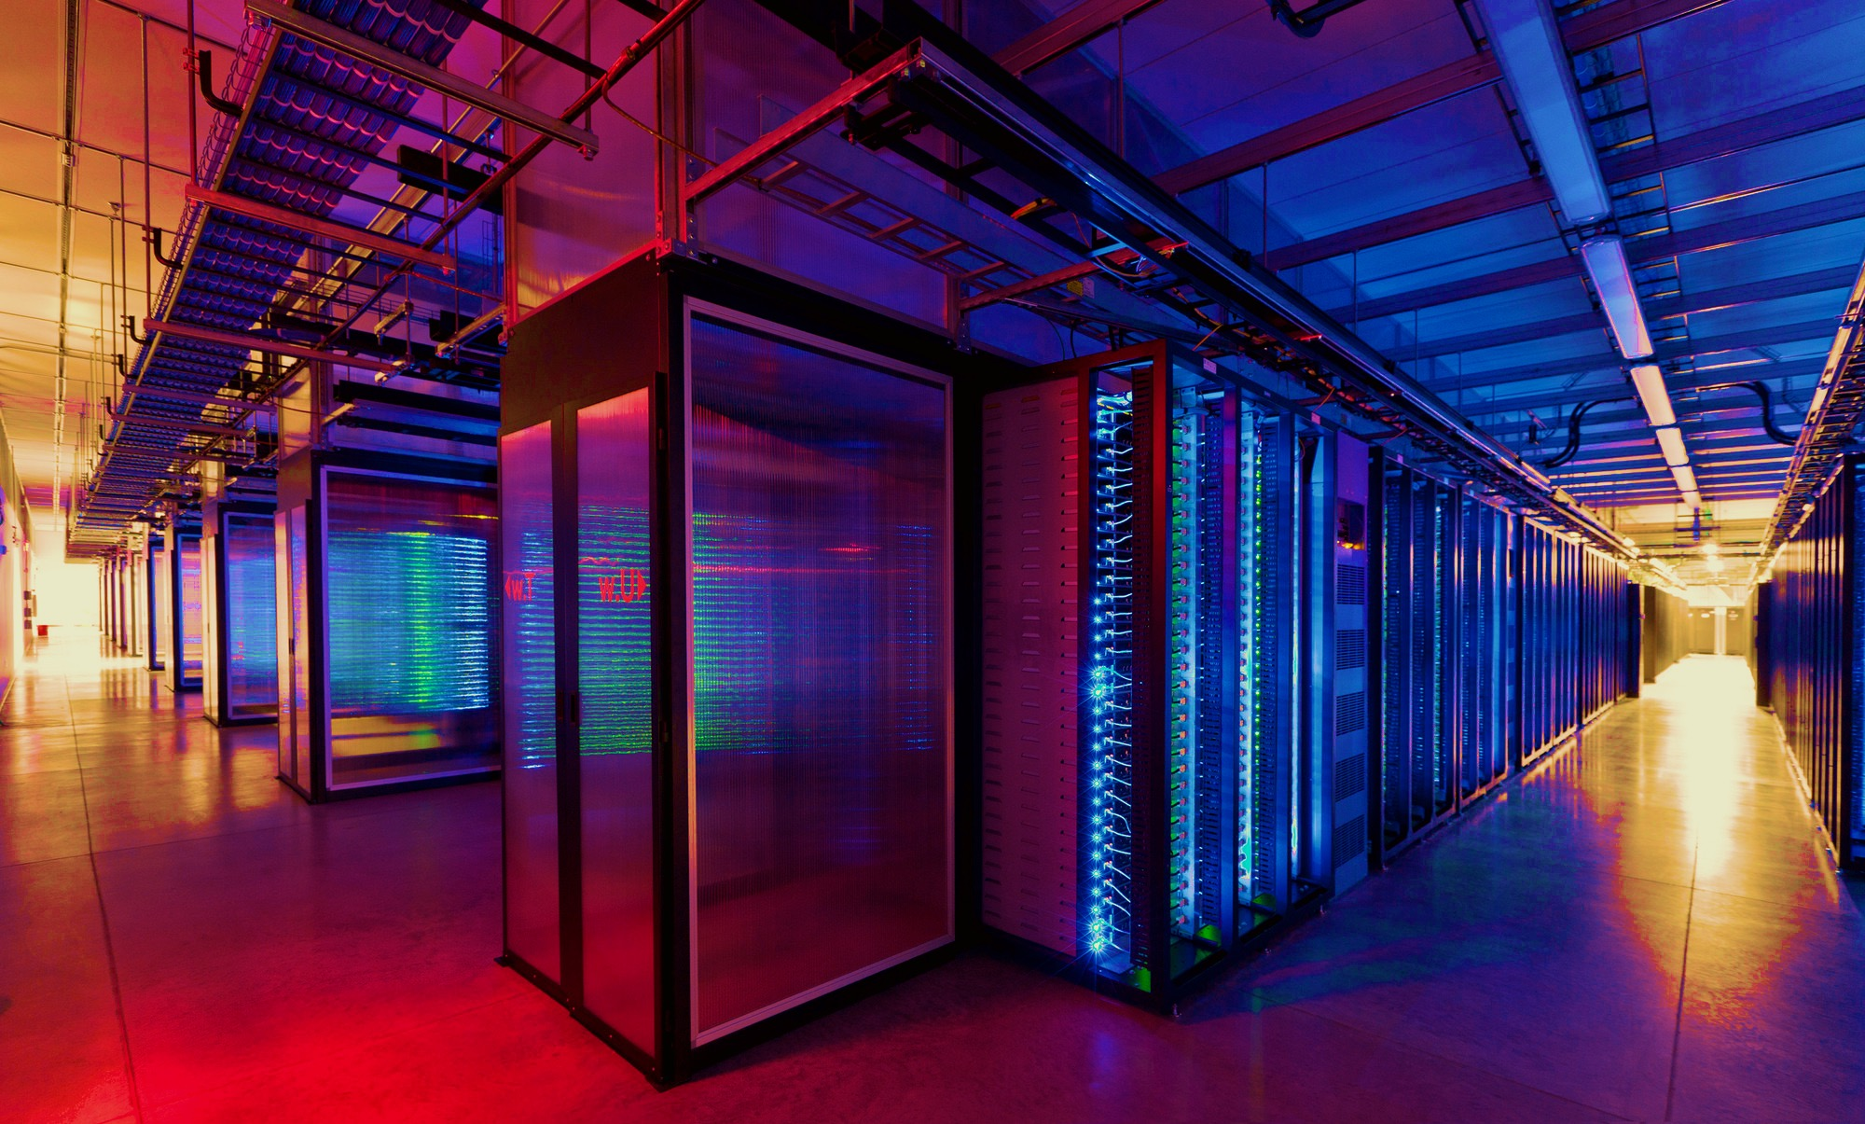
100,000s of physical servers
10s MW energy consumption
Facebook Prineville:
$250M physical infro, $1B IT infra

Slide 7
The central problem: Complexity
Complexity’s hard to define, but symptoms include:
Large number of components
Large number of connections
Irregular structure
No short description
Many people required to design or maintain

Slide 8
Course Organization

Slide 9
Learning the material
Instructors
  Professor Mike Freedman
  TA Daniel Suo
  Office hours immediately after lecture or by appt
Main Q&A forum: www.piazza.com
Optional textbooks
      Principles of Computer System Design. Saltzer & Kaashoek
      Distributed Systems: Principles and Paradigms. Tanenbaum & Van Steen
      Guide to Reliable Distributed Systems. Birman.

Slide 10
Format of Course
Introducing a subject
  Lecture + occasional 1 background paper
  Try to present lecture class before reading
Current research results
  Signup to read 1 of ~3 papers per class
  Before class: Carefully read selected paper
  During class: 1 person presents, others add to discussion
  During class (before presentations): answer a few questions about readings (“quizlet”)

Slide 11
Course Project: Schedule
Groups of 2-3 per project (will finalize tonight)
Project schedule
  Team selection (2/10, Friday)
  Project proposal (2/24)
  Project selection (3/3): Finalize project
  Project presentation (before 5/16, Dean’s Date)
  Final write-up (5/16, Dean’s Date)

Slide 12
Course Project: Options
Choice #1: Reproducibility
  Select paper from class (or paper on related topic)
  Re-implement and carefully re-evaluate results
  See detailed proposal instructions on webpage
Choice #2: Novelty (less common)
  Mus be in area closely related to 418 topics
  We will take a narrow view on what’s permissible
Both approaches need working code, evaluation

Slide 13
Course Project: Process
Proposal selection process
  See website for detailed instructions
  Requires research and evaluation plan
  Submit plan via Piazza, get feedback
  For “novelty” track, important to talk with us early
Final report
  Public blog-like post on design, eval, results
  Likely posted to Medium
  Source code published

Slide 14
Grading
15% paper presentation(s)
15% participation (in-class, Piazza)
20% in-class Q&A quizlets
50% project
  10% proposal
  40% final project
    20% overall, 10% presentation, 10% write-up

Slide 15
Organization of semester
Introduction / Background
Storage Systems
Big Data Systems
Applications

Slide 16
Storage Systems
Consistency
Consensus
Transactions
Key-Value Stores
Column Stores
Flash Disks
Caching

Slide 17
Big Data Systems
Batch
Streaming
Graph
Machine Learning
Geo-distributed
Scheduling

Slide 18
Applications
Publish/Subscribe
Distributed Hash Tables (DHTs)
Content Delivery Networks
Blockchain
Security
Privacy

Slide 19
Principles of System Design

Slide 20
Systems challenges common to many fields
Emergent properties (“surprises”)
  Properties not evident in individual components become clear when combined into a system
  Millennium bridge, London example

Slide 21
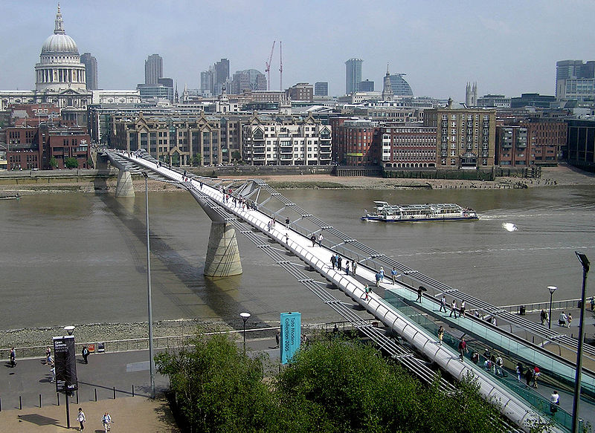
Notes:
Beautiful bridge, supposed to look like a “blade of light”
Opened in 2000 in London
Royal Institute of British Architects – very distinguished and prestigious architectural body had a competition for its design

Slide 22
Millennium bridge
Small lateral movements of the bridge causes synchronized stepping, which leads to swaying
Swaying leads to more forceful synchronized stepping, leading to more swaying
  Positive feedback loop!
Nicknamed Wobbly Bridge after charity walk on Save the Children
Closed for two years soon after opening for modifications to be made (damping)

Slide 23
Systems challenges common to many fields
Emergent properties (“surprises”)
Propagation of effects
  Small/local disruption → large/systemic effects
  Automobile design example (S & K)
Notes:
(SEGUE: Auto design example on next slide)

Slide 24
Propagation of effects: Auto design
Want a better ride so increase tire size
Need larger trunk for larger spare tire space
Need to move the back seat forward to accommodate larger trunk
Need to make front seats thinner to accommodate reduced legroom in the back seats
Worse ride than before
Notes:
The point is that there is no small change!

Slide 25
Systems challenges common to many fields
Emergent properties (“surprises”)
Propagation of effects
Incommensurate scaling
  Design for a smaller model may not scale

Slide 26
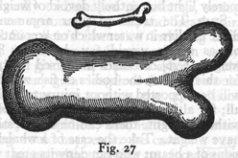
Galileo in 1638
“To illustrate briefly, I have sketched a bone whose natural length has been increased three times and whose thickness has been multiplied until, for a correspondingly large animal, it would perform the same function which the small bone performs for its small animal…
Thus a small dog could probably carry on his back two or three dogs of his own size; but I believe that a horse could not carry even one of his own size.”
—Dialog Concerning Two New Sciences, 2nd Day
Notes:
His overall point: things that work when small often don’t work when scaled up

Slide 27
Incommensurate scaling
Scaling a mouse into an elephant?
  Volume grows in proportion to O(x³) where x is the linear measure
  Bone strength grows in proportion to cross sectional area, O(x²)
  [Haldane, “On being the right size”, 1928]
Real elephant requires different skeletal arrangement than the mouse

Slide 28
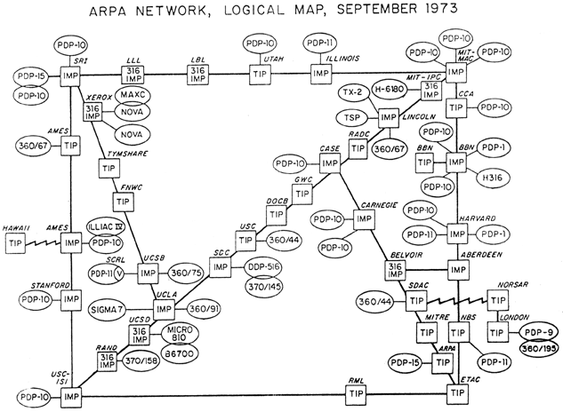
Incommensurate scaling:
Scaling routing in the Internet
Just 39 hosts as the ARPA net back in 1973

Slide 29
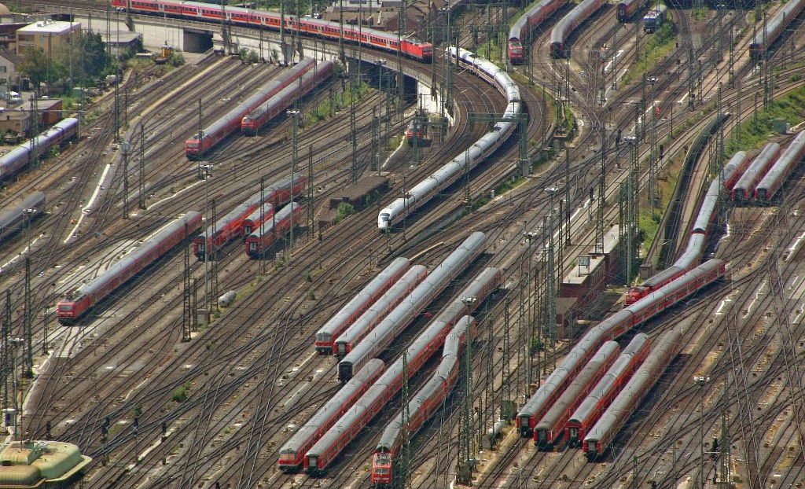
Incommensurate scaling:
Scaling routing in the Internet
Total size of routing tables (for shortest paths): O(n²)
Today’s Internet: Techniques to cope with scale
  Hierarchical routing on network numbers
    32 bit address =16 bit network # and 16 bit host #
  Limit # of hosts/network: Network address translation

Slide 30
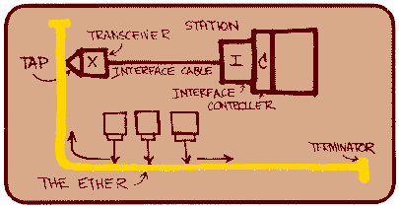
Incommensurate Scaling: Ethernet
All computers share single cable
Goal is reliable delivery
Listen-while-send to avoid collisions
Notes:
Ethernet is the most common LAN today.
For example those data jacks on the wall are Ethernet. My office phone.
Originally designed in early 1970s, has evolved since then.
You’ll study it later in the term, but here’s a preview of one of its subtle properties.
Mention 1km early, don’t mention speed of light until late.
The point: expect surprises!

Slide 31
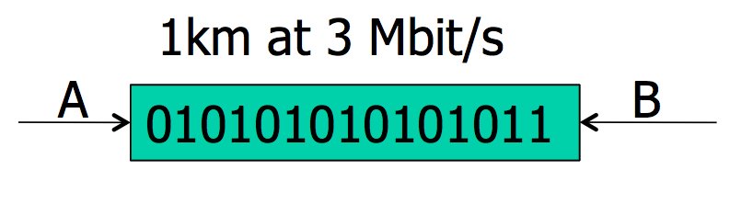
Will listen-while-send detect collisions?
1 km at 60% speed of light is 5 μs
  A can send 15 bits before first bit arrives at B
Thus A must keep sending for 2×5 μs
  To detect collision if B sends when first bit arrives
Thus, min packet size is 2×5 μs×3 Mbit/s = 30 bits

Slide 32
From experimental Ethernet to standard
Experimental Ethernet design: 3 Mbit/s
  Default header is 5 bytes = 40 bits
  No problem with detecting collisions
First Ethernet standard: 10 Mbit/s
  Must send for 2 × 20 μs = 400 bits
    But header is just 112 bits
  Need for a minimum packet size!
Solution: Pad packets to at least 50 bytes

Slide 33
Systems challenges common to many fields
Emergent properties (“surprises”)
Propagation of effects
Incommensurate scaling
Trade-offs
  Many design constraints present as trade-offs
  Improving one aspect of a system diminishes performance elsewhere

Slide 34
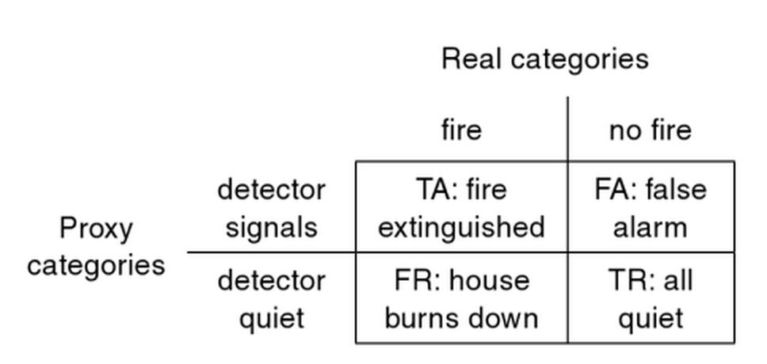
Binary classification trade-off
Have a proxy signal that imperfectly captures real signal of interest
Example: Household smoke detector
Notes:
Can trade-off the two different misclassification rates

Slide 35
Sources of complexity
Cascading and interacting requirements
  Example: Telephone system
    Features: Call Forwarding, reverse billing (900 numbers), Call Number Delivery Blocking, Automatic Call Back, Itemized Billing
  A calls B, B forwards to 900 number, who pays?
A calls B, B is busy
Once B done, B calls A
A’s # appears on B’s bill
CNDB
ACB + IB
A
B
Notes:
first diagram: simple forwarding/forwarding interaction

Slide 36
Interacting Features
Each feature has a spec
An interaction is bad if feature X breaks feature Y
These bad interactions may be fixable…
  But many interactions to consider: huge complexity
  Perhaps more than n² interactions, e.g. triples
  Cost of thinking about / fixing interaction gradually grows to dominate software costs
Complexity is super-linear

Slide 37
Sources of complexity
Cascading and interacting requirements
Maintaining high utilization of a scarce resource
  Ex: Single-track railroad line through long canyon
    Use pullout and signal to allow bidirectional op
    But now need careful scheduling
    Emergent property: Train length < pullout length
Notes:
first diagram: simple forwarding/forwarding interaction

Slide 38
Coping with complexity
Modularity
  Divide system into modules, consider each separately
  Well-defined interfaces give flexibility and isolation
Example: bug count in a large, N-line codebase
  Bug count ∝ N
  Debug time ∝ N × bug count ∝ N²
Now divide the N-line codebase into K modules
  Debug time ∝ (N / K)² × K = N²/K
Notes:
How can we tackle complexity? First tool is modularity

Slide 39
Coping with complexity
Modularity
Abstraction
  Ability of any module to treat others like “black box”
    Just based on interface
    Without regard to internal implementation
  Symptoms
    Fewer interactions between modules
    Less propagation of effects between modules

Slide 40
Coping with complexity
Modularity
Abstraction
  The Robustness Principle: Be tolerant of inputs and strict on outputs

Slide 41
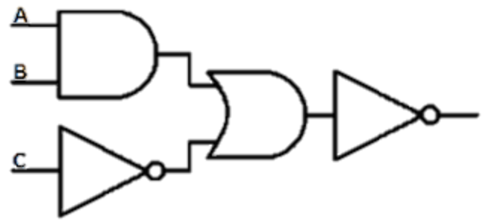
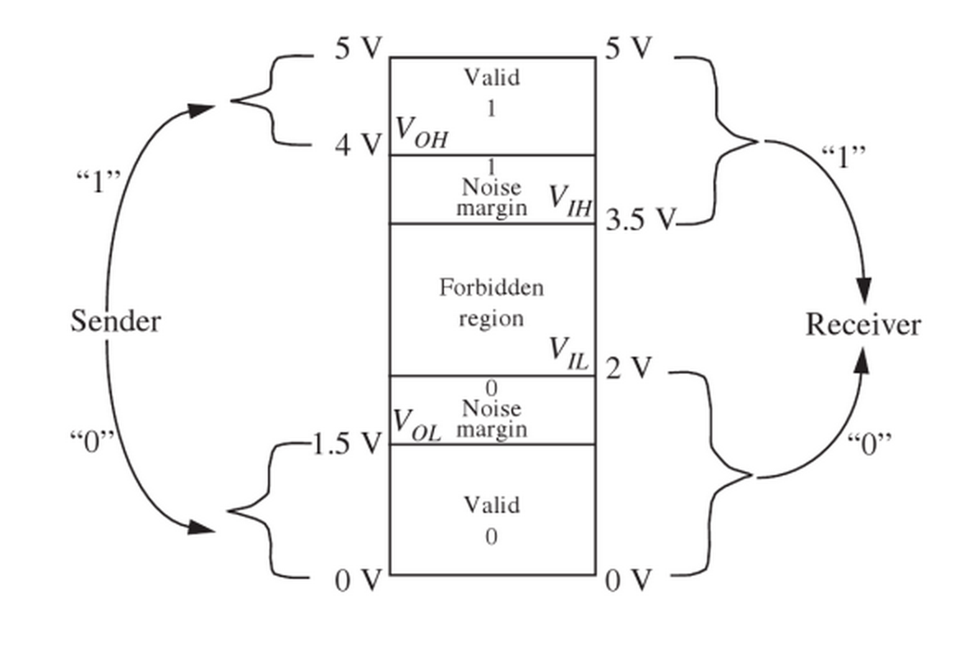
Robustness principle in action:
The digital abstraction
Notes:
Example from digital circuits
Combine logic gates together to form a big combinatorial circuit like you see above
Challenge – noise degrades the signals from each logic gate

Slide 42
Coping with complexity
Modularity
Abstraction
Hierarchy
  Start with small group of modules, assemble
    Assemble those assemblies, etc.
  Reduces connections, constraints, interactions

Slide 43
Coping with complexity
Modularity
Abstraction
Hierarchy
Layering
  A form of modularity
  Gradually build up a system, layer by layer
  Example: Internet protocol stack

Slide 44
Layering on the Internet: The problem
Applications
HTTP
Skype
SSH
FTP
Transmission
media
Coaxial cable
Fiber optic
Wi-Fi
Re-implement every app for every new tx media?
Change apps on any change to tx media (+ vice versa)?
No! But how does the Internet design avoid this?

Slide 45
Layering on the Internet:
Intermediate layers provide a solution
Applications
HTTP
Skype
SSH
FTP
Intermediate layers
Transmission
media
Coaxial cable
Fiber optic
Wi-Fi
Intermediate layers provide abstractions for app, media
New apps or media need only implement against intermediate layers’ interface
Notes:
Intermediate layers in this case is TCP and UDP running over IP, the Internet protocol

Slide 46
Computer systems: The same, but different
Often unconstrained by physical laws
  Computer systems are mostly digital
  Contrast: Analog systems have physical limitations (degrading copies of analog music media)
  Back to the digital static discipline
    Static discipline restores signal levels
    Can scale microprocessors to billions of gates, encounter new, interesting emergent properties
Notes:
…like overheating!

Slide 47
Computer systems: The same, but different
Often unconstrained by physical laws
Unprecedented d(technology)/dt
  Many examples:
    Magnetic disk storage price per gigabyte
    RAM storage price per gigabyte
    Optical fiber transmission speed
  Result: Incommensurate scaling, with system redesign consequences

Slide 48
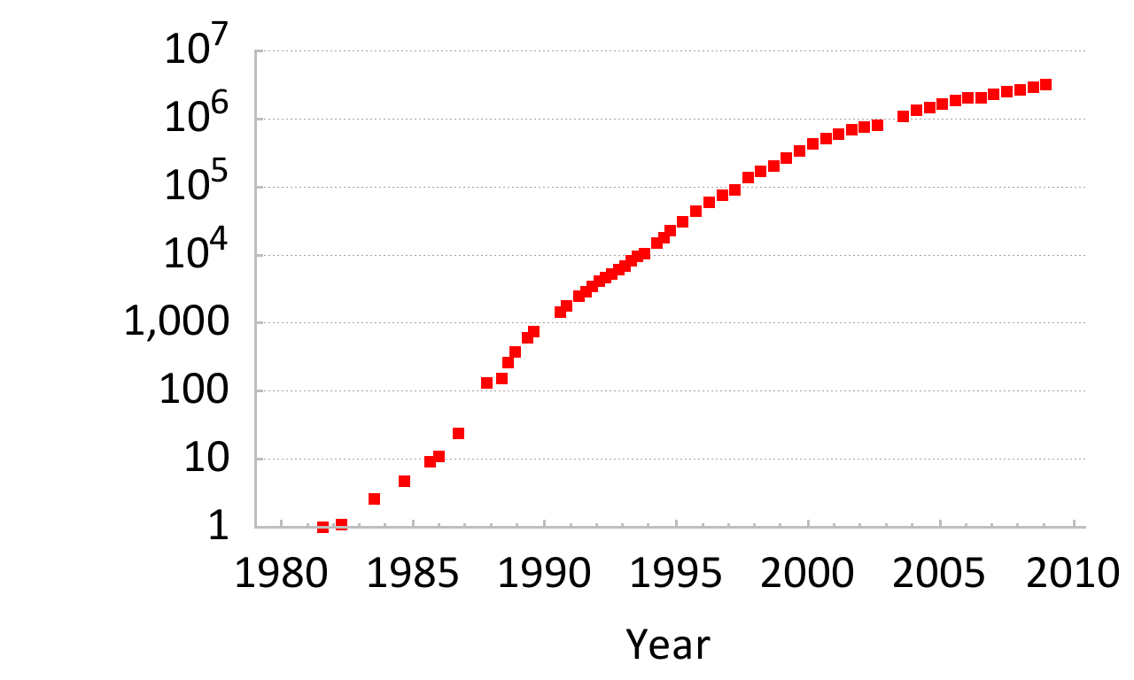
Incommensurate scaling on the Internet
Normalized growth since 1981
Number of Internet hosts
Bits/second/$ (approximate)
Speed of light,
Shannon capacity,
Backhoe rental price
Notes:
Internet scaling is an example of this. Note the log scale on the y – axis!
Network getting bigger, protocols have to cope.
Incommensurate: unequal orders of magnitude
Amount of internet traffic.

Slide 49
Summary and lessons
Expect surprises in system design
There is no small change in a system
10-100× increase? ⇒ perhaps re-design
Complexity is super-linear in system size
Performance cost is super-linear in system size
Reliability cost is super-linear in system size
Technology’s high rate of change induces incommensurate scaling

Slide 50
Paper Readings:
Worse is Better!
Worse is Worse?

Slide 51
Setting: The two approaches
MIT approach
New Jersey approach
Simplicity: Simple in both implementation and especially interface
Correctness: Absolutely correct in all aspects
Completeness: Cover all reasonably expected cases, even to detriment of simplicity
Simplicity: Simple in both interface and especially implementation
Correctness: Correct, but slightly better to be simple
Completeness: Cover as many cases as is practical
  Sacrifice for simplicity
Notes:
To set the scene, Gabriel describes a conversation between two people, one from MIT and one from Bell Labs in NJ
Gabriel holds up early UNIX and C as examples of the New Jersey approach,
common LISP and Scheme as examples of the MIT approach.

Slide 52
Worse is better!
What does the following compute (x is an int): x + 1
  Scheme: Always calculates an integer one larger than x
  Most others incl C: Something like (x + 1) mod 2³²
C: simple implementation, complex interface
  This is the key tradeoff that Gabriel describes
  Probably not what programmer actually wanted
  But, works in the common case
  Most languages follow the New Jersey approach!
Notes:
programming language

Slide 53
Worse is worse!
fgets(char *s, int n, FILE *f) versus gets(char *s)
  fgets limits length of stored string stored to size <= n
  gets stores in s however many chars from stdin are ready to be read
Which is the MIT approach vs. New Jersey approach?
  gets has caused many buffer overflow security exploits
  For security, “the right thing” is the only thing!
Notes:
MIT approach: fgets
NJ approach: gets

Slide 54
Hints for Computer System Design
Butler Lampson
Notes:
Butler Lampson (Turing, MSFT Fellow, Alto, 2PC, …)
SOSP 1993 conference

Slide 55
Systems versus algorithms
Computer systems differ from algorithms
  External interfaces are less precisely designed, more complex, more likely to change
  Much more internal structure, interfaces
  Measure of success much less clear
And, principles of computer system design are much more heuristic, less mathematical
Notes:
SEGUE: So Lampson is offering hints in this paper

Slide 56
Interfaces
Most of hints depend on notion of interface
  Separates clients of an abstraction from the implementation of that abstraction
Interface design is most important part of system!
Interfaces should be:
  Simple
  Complete
  Admit sufficiently small and fast implementation

Slide 57
Keep it simple
In other words, follow the New Jersey approach
Do one thing at a time, and do it well
Don’t generalize: generalizations are usually wrong, lead to unexpected complexity
Interface mustn’t promise more than the implementation knows how to deliver
Notes:
We’ve already seen examples of the perils of generalization (int + 1 example)

Slide 58
Continuity
As a system changes, how do you manage change?
Keep basic interfaces stable
If change interfaces, keep a place to stand
  Compatibility package (a.k.a. shim layer) implementing old interface atop new interface
Notes:
Many OS examples of compatibility packages (for some time OS X 32-bit legacy apps, Win32 API)

Slide 59
Implementation
Plan to throw one away (you will anyhow)
  Brooks’ observation in The Mythical Man-Month
  Revisit old design decisions with benefit of hindsight
Keep secrets of the implementation
  Assumptions about the implementation that clients are not allowed to make (b/c can change)
Instead of generalizing, use a good idea again

Slide 60
Handling all the cases
Handle normal and worst cases separately:
  The normal case must be fast;
  The worst case must make some progress
Notes:
Example: Memory in a virtual memory paging system. Normal operation should be fast, worst case when swapping to disk because real memory is full: keep something in reserve to make progress

Slide 61
Wednesday:
Everybody reads Saltzer E2E

