Slide 1
Topic 15: Static Single Assignment
COS 320
Compiling Techniques
Princeton University
Spring 2016
Lennart Beringer

Slide 2
Def-Use Chains, Use-Def Chains
Many optimizations need to find all use-sites of a definition, and/or all def-sites of a use:
constant propagation needs the site of the unique reaching def
copy propagation, common subexpression elimination,…
Data structures supporting these lookups:
def-use chain: for each definition d of variable r, store the use sites of r that d reaches
use-def chain: for each use site u of variable r, store the def-sites of r that reach u
N definitions, M uses: 2*N*M relationships

Slide 3
Use-Def Chains, Def-Use Chains
Add the def-use relationships…

Slide 4
Use-Def Chains, Def-Use Chains
And these are just the def-use relationships…

Slide 5
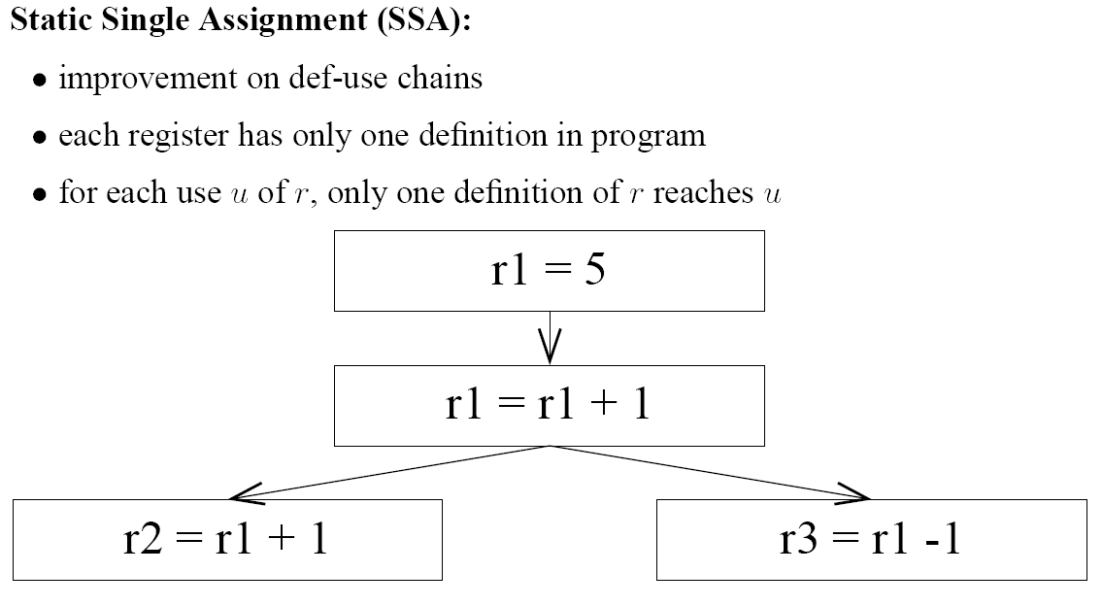
Static Single Assignment
How can this be achieved?

Slide 6
Static Single Assignment
r1’
r1’
r1’
Rename variables consistently between defs and uses.

Slide 7
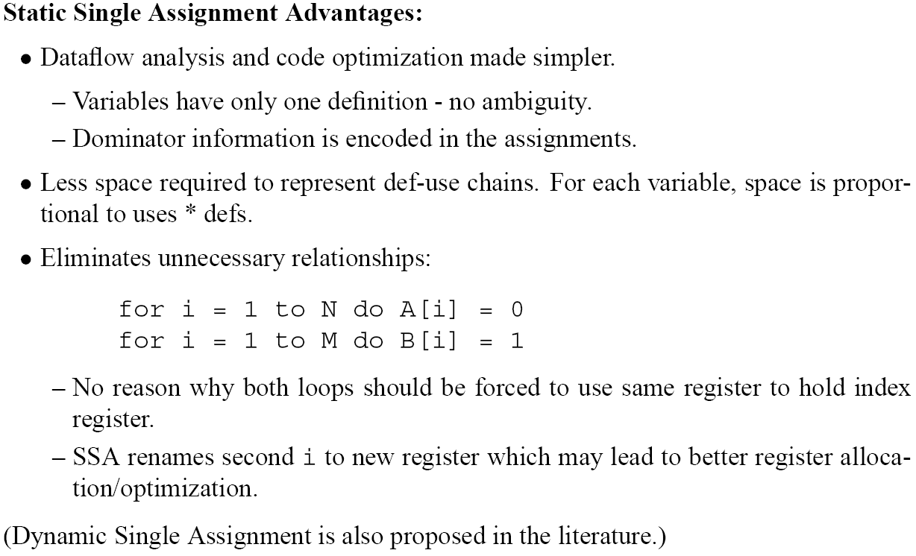
Why SSA?
Distinguishing different defs makes use lists shorter and more precise: less overlap.

Slide 8
Conversion to SSA Code

Slide 9
Conversion to SSA Code
r1 = r3 + r4
r2 = r1 – 1
r1’ = r4 + r2
r2’ = r5 * 4
r1’’ = r1’ + r2’

Slide 10
Conversion to SSA Form

Slide 11
Conversion to SSA Form
r3’
???

Slide 12
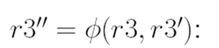
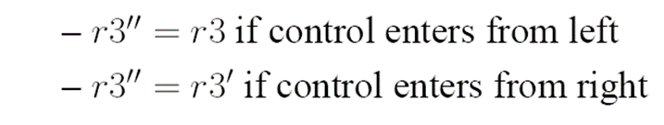
Conversion to SSA Form
r3’
r3’’ = Φ (r3, r3’ )
r3’’

Slide 13


Conversion to SSA Form
for analysis & optimization: no implementation necessary:
Φ just used as notation
left side of Φ-function constitutes a definition; variables in RHS are uses
ordering of argument positions corresponds to (arbitrary) order of incoming control flow arcs, but left implicit (could name positions using the labels of predecessor basic blocks…)
elimination of Φ-functions/translation out-of-SSA:
insert move instructions; often coalesced during register allocation
typically, basic blocks have several Φ-functions – all near the top, with identical ordering of incomings arcs from control flow predecessors

Slide 14
Conversion to SSA Form
Naïve insertion:
add a Φ-function for each register at each node with ≥2 predecessors
r3’
r3’’ = Φ (r3, r3’ )
r2’ = Φ (r2, r2 )
Trivial Φ-functions – should clearly be avoided!
r1’ = Φ (r1, r1)
r3’’
Can we do better?

Slide 15
Conversion to SSA Form
(eg if y=z)
x
y
x
r ← …
r ← …
r ← …
z
y=z
…
r ← …
(use of r could be in successor of z)

Slide 16
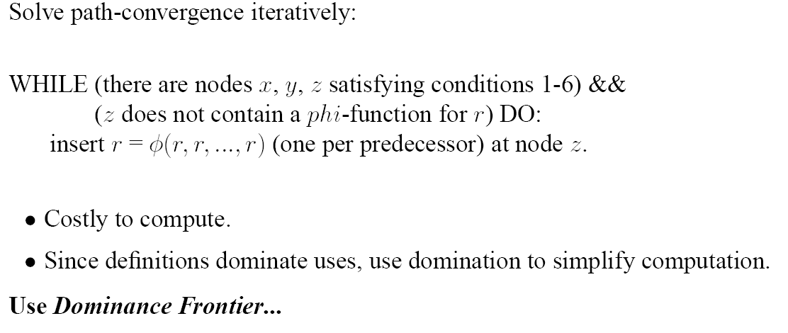
Conversion to SSA Form
(3 nested loops, for x, y, z)

Slide 17
Conversion to SSA Form
(3 nested loops, for x, y, z)
Remember dominance: node x dominates node w if every path from entry to w goes through x.
(In particular, every node dominates itself)

Slide 18
Dominance Frontier
5
DF(5) = ?

Slide 19
Dominance Frontier
x
w
x
w
w
5
5
4
10
11
DF(5) = {4, 5, 10, 11}

Slide 20
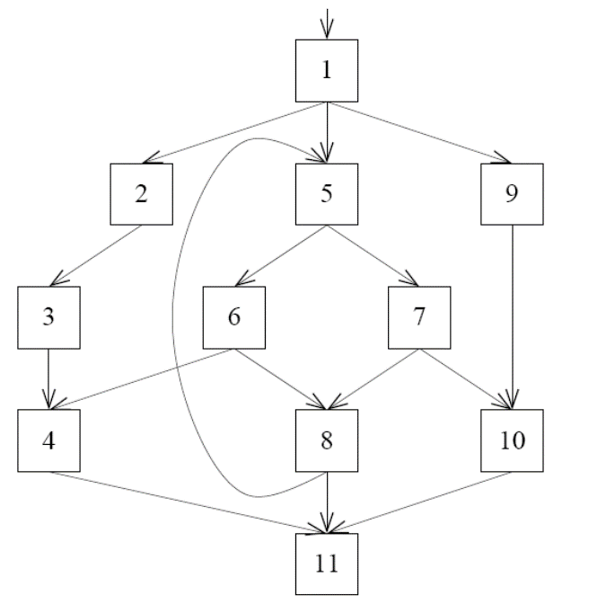
Dominance Frontier
Dominance Frontier Criterion:
Suppose 5 contains a definition of r.
Whenever node x contains a definition of a register r, insert a Φ-function for r in all nodes z є DF(x).
5
Iterated Dominance Frontier Criterion:
Apply dominance frontier condition repeatedly, to account for the fact that Φ-functions constitute definitions themselves.

Slide 21
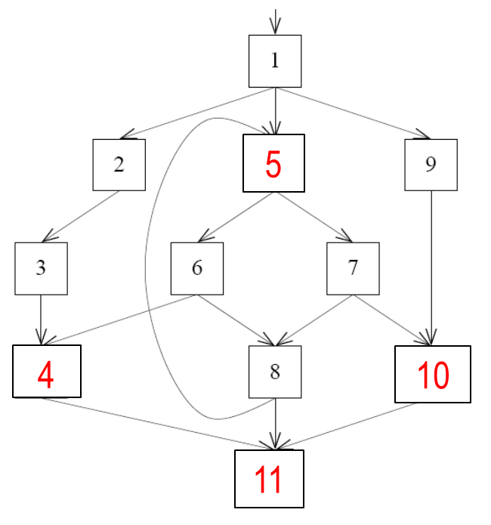
Dominance Frontier
Dominance Frontier Criterion:
Suppose 5 contains a definition of r.
Insert Φ-functions for r in red blocks.
Whenever node x contains a definition of a register r, insert a Φ-function for r in all nodes z є DF(x).
Iterated Dominance Frontier Criterion:
Apply dominance frontier condition repeatedly, to account for the fact that Φ-functions constitute definitions themselves.
But not here.

Slide 22
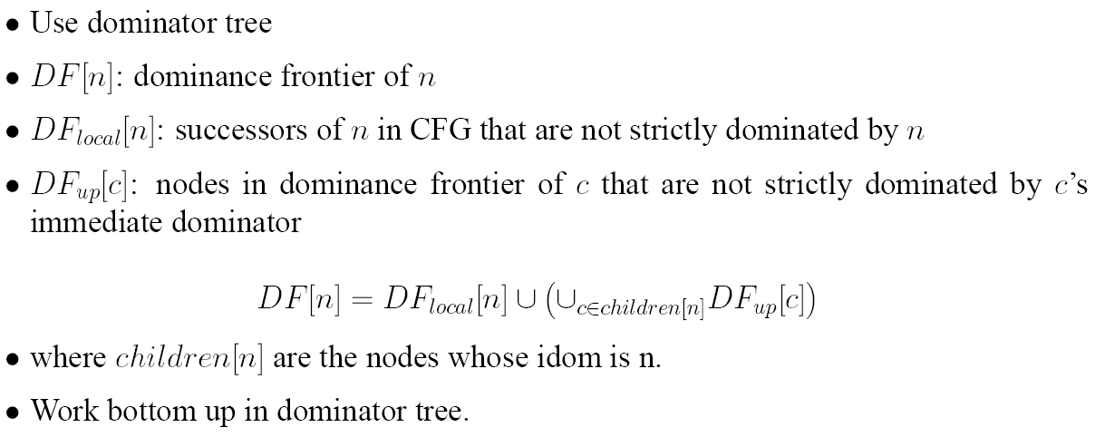
Dominance Frontier Computation
See errata list of MCIML
Leaf p satisfies DF[ p ] = DF_{local}[ p ] since children[p] = {}.
Alternative formulation: DF_{local}[n] = successors s of n with idom[s] <> n.

Slide 23
Dominance Frontier Computation
See errata list of MCIML
Leaf p satisfies DF[ p ] = DF_{local}[ p ] since children[p] = {}.
Alternative formulation: DF_{local}[n] = successors s of n with idom[s] <> n.

Slide 24
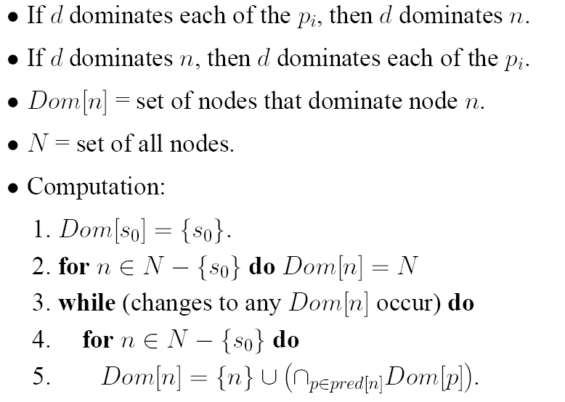
Dominator Analysis (slide 22 from “Control Flow”)
starting point: n dominated by all nodes
nodes that dominate all predecessors of n

Slide 25
SSA Example
set of nodes that dominate n

Slide 26
SSA Example
set of nodes that dominate n
1
1, 2
1, 2, 3
1, 2, 3, 4
1, 2, 3, 4, 5
1, 2, 3, 4, 6
1, 2, 3, 4, 5, 7
1, 2, 3, 4, 5, 7, 8
1, 2, 3, 4, 5, 9
1, 2, 3, 4, 5, 9, 10
1, 2, 3, 4, 5, 11

Slide 27
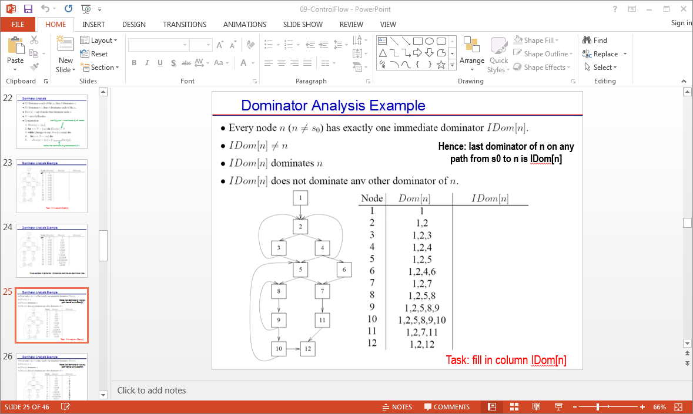
SSA Example
set of nodes that dominate n
1
1, 2
1, 2, 3
1, 2, 3, 4
1, 2, 3, 4, 5
1, 2, 3, 4, 6
1, 2, 3, 4, 5, 7
1, 2, 3, 4, 5, 7, 8
1, 2, 3, 4, 5, 9
1, 2, 3, 4, 5, 9, 10
1, 2, 3, 4, 5, 11

Slide 28
SSA Example
set of nodes that dominate n
1
1, 2
1, 2, 3
1, 2, 3, 4
--
1
2
3
1, 2, 3, 4, 5
1, 2, 3, 4, 6
1, 2, 3, 4, 5, 7
1, 2, 3, 4, 5, 7, 8
4
4
5
7
1, 2, 3, 4, 5, 9
1, 2, 3, 4, 5, 9, 10
1, 2, 3, 4, 5, 11
5
9
5

Slide 29
SSA Example
set of nodes that dominate n
1
2
3
1
1, 2
1, 2, 3
1, 2, 3, 4
--
1
2
3
4
1, 2, 3, 4, 5
1, 2, 3, 4, 6
1, 2, 3, 4, 5, 7
1, 2, 3, 4, 5, 7, 8
4
4
5
7
5
6
11
7
9
1, 2, 3, 4, 5, 9
1, 2, 3, 4, 5, 9, 10
1, 2, 3, 4, 5, 11
5
9
5
8
10
Dominator Tree

Slide 30
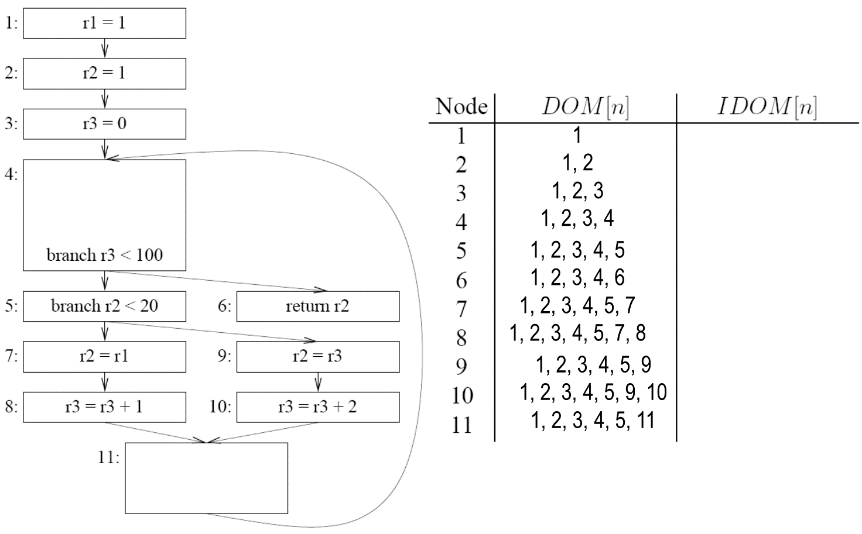
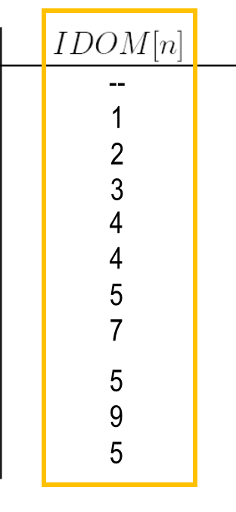
SSA Example
DF_{local}[n] = successors s of n with idom[s] <> n.
DF_{local}[n]

Slide 31
SSA Example
DF_{local}[n] = successors s of n with idom[s] <> n.
DF_{local}[n]
--
--
--
--
--
--
--
11
--
11
4

Slide 32
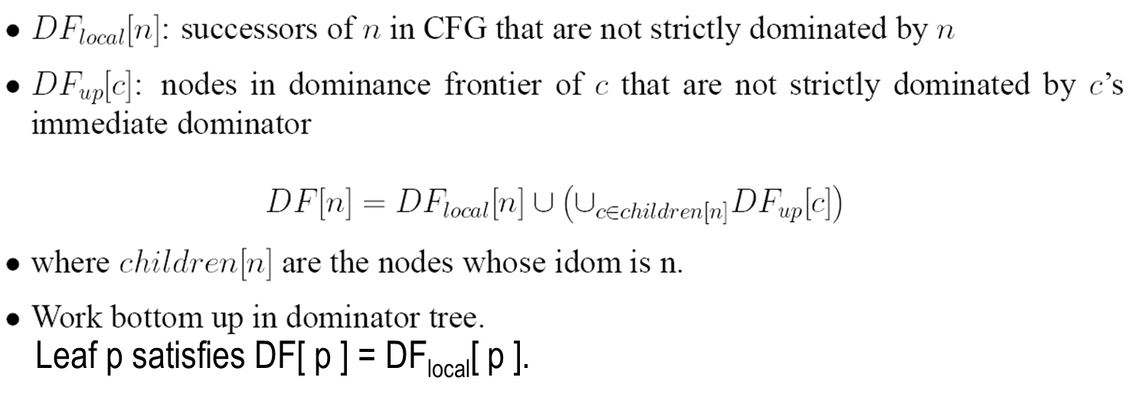
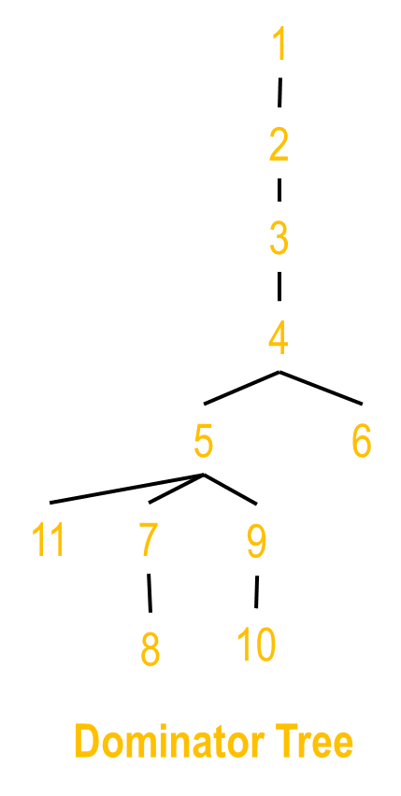
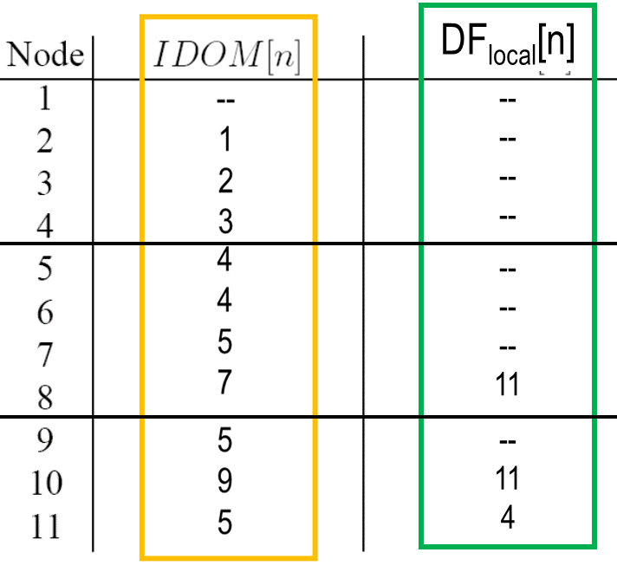
SSA Example
n | U_{c(n)} DF_{up}[c] | DF[n] | DF_{up}[n]
1
2
3
4
5
6 | {}
7
8 | {}
9
10 | {}
11 | {}

Slide 33
SSA Example
n | U_{c(n)} DF_{up}[c] | DF[n] | DF_{up}[n]
1
2
3
4
5
6 | {} | --
7
8 | {} | 11
9
10 | {} | 11
11 | {} | 4

Slide 34
SSA Example
n | U_{c(n)} DF_{up}[c] | DF[n] | DF_{up}[n]
1
2
3
4
5
6 | {} | -- | --
7
8 | {} | 11 | 11
9
10 | {} | 11 | 11
11 | {} | 4 | 4

Slide 35
SSA Example
n | U_{c(n)} DF_{up}[c] | DF[n] | DF_{up}[n]
1
2
3
4
5
6 | {} | -- | --
7 | 11
8 | {} | 11 | 11
9 | 11
10 | {} | 11 | 11
11 | {} | 4 | 4

Slide 36
SSA Example
n | U_{c(n)} DF_{up}[c] | DF[n] | DF_{up}[n]
1
2
3
4
5
6 | {} | -- | --
7 | 11 | 11
8 | {} | 11 | 11
9 | 11 | 11
10 | {} | 11 | 11
11 | {} | 4 | 4

Slide 37
SSA Example
n | U_{c(n)} DF_{up}[c] | DF[n] | DF_{up}[n]
1 |  | --
2 | : | -- | :
3 | : | -- | :
4 |  | --
5 |  | 4
6 | {} | -- | --
7 | 11 | 11 | …
8 | {} | 11 | 11
9 | 11 | 11 | …
10 | {} | 11 | 11
11 | {} | 4 | 4

Slide 38
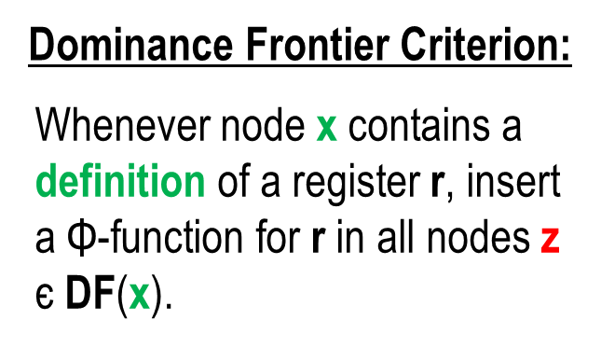
SSA Example
n | DF[n]
1 | {}
2 | {}
3 | {}
4 | {}
5 | 4
6 | {}
7 | 11
8 | 11
9 | 11
10 | 11
11 | 4

Slide 39
SSA Example
n | DF[n]
1 | {}
2 | {}
3 | {}
4 | {}
5 | 4
6 | {}
7 | 11
8 | 11
9 | 11
10 | 11
11 | 4
r2 = Φ(r2, r2)
(second round)
r3 = Φ(r3, r3)
r2 = Φ(r2, r2)
(first round)
r3 = Φ(r3, r3)

Slide 40
SSA Example

Slide 41
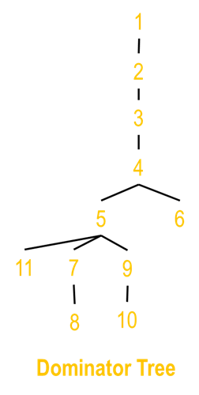
SSA Example
r2' = Φ(r2, r2’’’’)
r3’ = Φ(r3, r3’’’’)
r3’
< 100
r2’
< 20
r2’
r2’’
r2’’’
r3’
r3’’
r3’
+ 1
r3’’’
r3’
+ 2
r2’’’’ = Φ(r2’’, r2’’’)
r3’’’’ = Φ(r3’’, r3’’’)

Slide 42
Alternative construction methods for SSA
Lengauer-Tarjan: efficient computation of dominance tree
near linear time
uses depth-first spanning tree
see MCIML, Section 19.2
John Aycock, Nigel Horspool: Simple Generation of Static Single Assignment Form.9nd Conference on Compiler Construction (CC 2000), pages 110—124, LNCS 1781, Springer 2000
Starts from “crude” placement of Φ-functions: in every block, for every variable
then iteratively eliminates unnecessary Φ-functions
For reducible CFG
M. Braun, et al.: Simple and Efficient Construction of Static Single Assignment Form.22nd Conference on Compiler Construction (CC 2013), pages 102—122, LNCS 7791, Springer 2013
avoids computation of dominance or iterated DF
works directly on AST (avoids CFG)

Slide 43
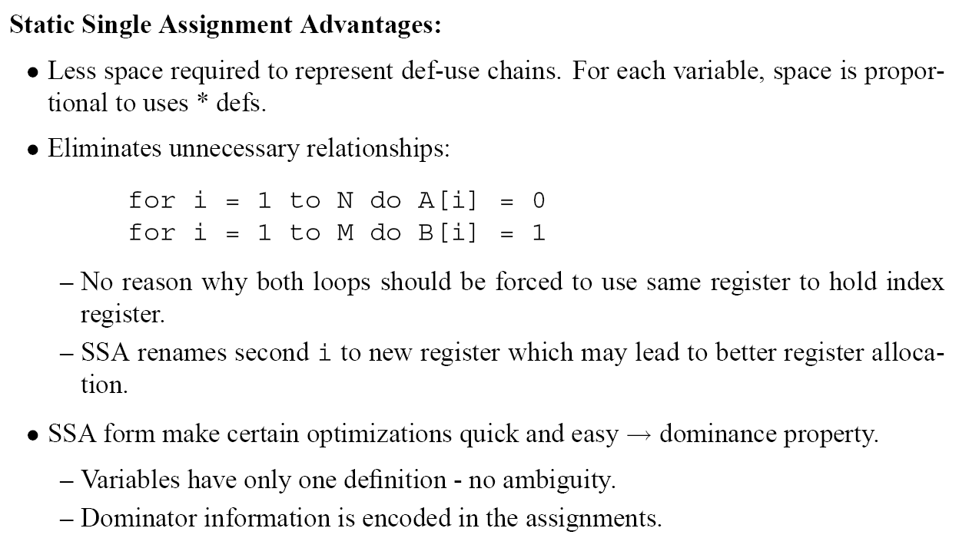
Static Single Assignment

Slide 44
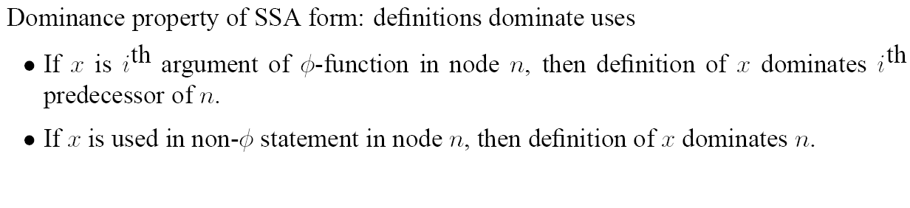
SSA Dominance Property

Slide 45
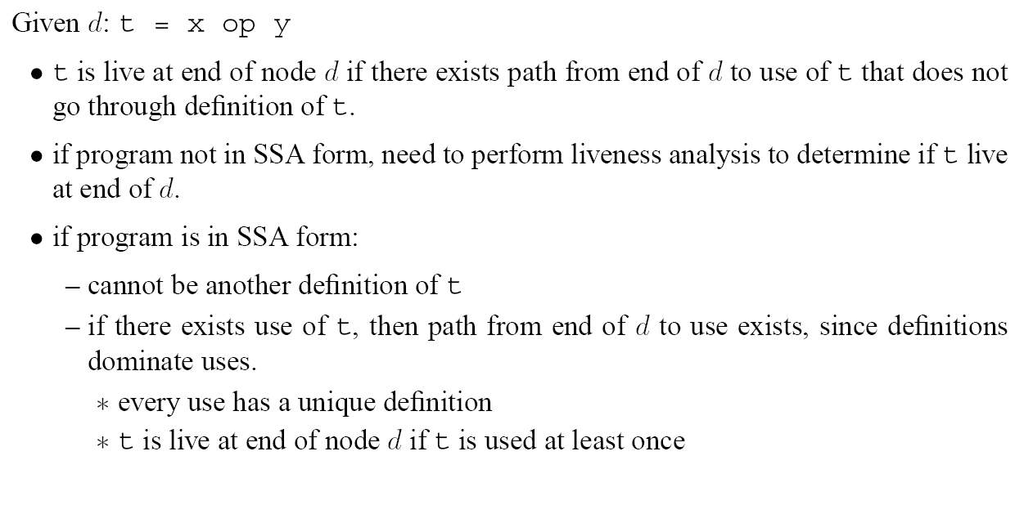
SSA Dead Code Elimination

Slide 46
SSA Dead Code Elimination

Slide 47
SSA Dead Code Elimination
a ← 0
a1 ← 0
a1 ← 0
b ← a + 1
c ← c + b
a ← b * 2
if a < N
a3 ← Φ(a1, a2)
b1 ← Φ(b0, b2)
c2 ← Φ(c0, c1)
b2 ← a3 + 1
c1 ← c2 + b2
a2 ← b2 * 2
if a2 < N
a3 ← Φ(a1, a2)
b1 ← Φ(b0, b2)
c2 ← Φ(c0, c1)
b2 ← a3 + 1
c1 ← c2 + b2
a2 ← b2 * 2
if a2 < N
SSA
DC elim
return c
return c1
return c1
Typo in MCIML…

Slide 48
SSA Simple Constant Propagation

Slide 49
SSA Simple Constant Propagation
eliminate branches whose outcome is constant
Similarly: copy propagation, constant folding, constant condition, elimination of unreachable code

Slide 50
SSA Simple Constant Propagation
i1 ← 1
j1 ← 1
k1 ← 0
j2 ← Φ(j4, j1)
k2 ← Φ(k4, k1)
if k2 < 100
if j2 < 20
return j2
j3 ← i1
k3 ←k2+1
j5 ← k2
k5 ←k2+2
j4 ← Φ(j3, j5)
k4 ← Φ(k3, k5)

Slide 51
SSA Simple Constant Propagation
i1 ← 1
j1 ← 1
k1 ← 0
i1 ← 1
j1 ← 1
k1 ← 0
j2 ← Φ(j4, j1)
k2 ← Φ(k4, k1)
if k2 < 100
j2 ← Φ(j4, )
k2 ← Φ(k4, )
if k2 < 100
1
0
if j2 < 20
return j2
SCP
if j2 < 20
return j2
j3 ← i1
k3 ←k2+1
j5 ← k2
k5 ←k2+2
1
j5 ← k2
k5 ←k2+2
j3 ← i1
k3 ←k2+1
j4 ← Φ(j3, j5)
k4 ← Φ(k3, k5)
j4 ← Φ(j3, j5)
k4 ← Φ(k3, k5)

Slide 52
SSA Conditional Constant Propagation
Φ
Φ
Φ
Φ

Slide 53
SSA Conditional Constant Propagation

Slide 54
SSA Conditional Constant Propagation
┬
. . . -1 . . 2 . . 4 . . .
┴

Slide 55
SSA Conditional Constant Propagation
┬
. . . -1 . . 2 . . 4 . . .
┴

Slide 56
SSA Conditional Constant Propagation

Slide 57
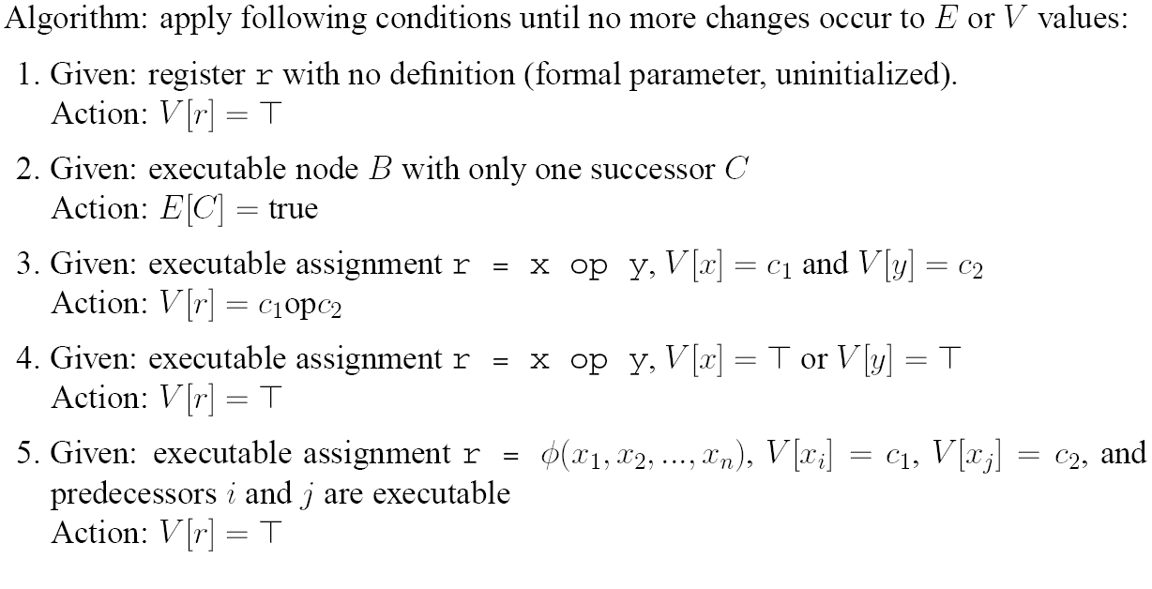
SSA Conditional Constant Propagation
In particular, use this rule for r = c.
6.
Given: executable assignment r = M […] or r = f (…):
Action: V[ r ] =
┬

Slide 58
SSA Conditional Constant Propagation
7.
┬
Given: executable assignment r = Φ (x₁, …, x_{n}) where V [ x_{i} ] =
for some i such that the i^{th} predecessor is executable:
Action: V[ r ] =
┬
8.
Given: executable assignment r = Φ (x₁, …, x_{n}) where
-- V [ x_{i} ] = c_{i} for some i where the i^{th} predecessor is executable, and
-- for each j≠i, either the j^{th} predecessor is not executable or V[ x_{j} ] є { , c_{i} }:
Action: V[ r ] = c_{i}
┴
┬
┬
9.
Given: executable branch br x bop y, L1 (else L2) where V [ x ] = or V [ y ] =
Action: E[ L1 ] = true and E[ L2 ] = true
10.
Given: executable branch br x bop y, L1 (else L2) where V [ x ] = c₁ and V [ y ] = c₂
Action: E[ L1 ] = true or E[ L2 ] = true depending on c₁ bop c₂
Iterate until no update possible.

Slide 59
SSA Conditional Constant Propagation

Slide 60
SSA Conditional Constant Propagation: example
Φ
Φ
Φ
Φ

Slide 61
SSA Conditional Constant Propagation: example
Φ
Φ
Φ
Φ

Slide 62
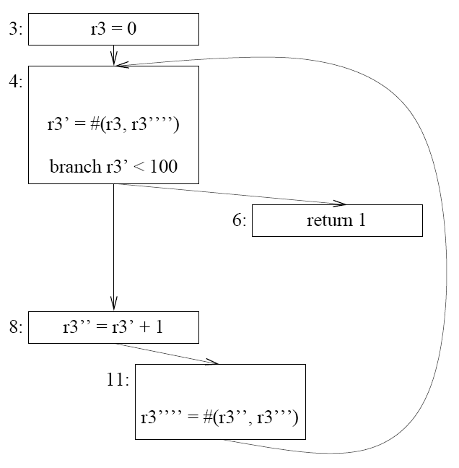
SSA Conditional Constant Propagation: example
Φ
Φ
Next: eliminate Φ-functions: easy in this case - map all versions of r3 to r3

Slide 63
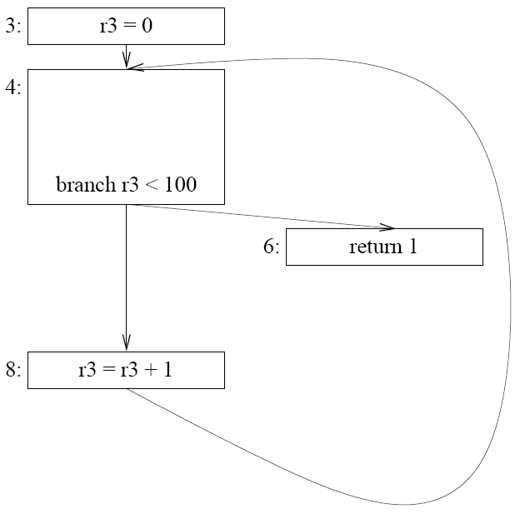
SSA Conditional Constant Propagation: example

Slide 64
Translating out of SSA: elimination of Φ-functions
Intuitive interpretation of Φ-functions suggests insertion of move instructions at the end of immediate control flow predecessors
x₁ ← …
:
x₂ ← …
:
x_{n} ← …
:
:
:
:
z ← Φ(x₁, x₂, …, x_{n})
u ← z * 2
. . .

Slide 65
Translating out of SSA: elimination of Φ-functions
Intuitive interpretation of Φ-functions suggests insertion of move instructions at the end of immediate control flow predecessors
x₁ ← …
:
x₂ ← …
:
x_{n} ← …
:
x₁ ← …
:
x₂ ← …
:
x_{n} ← …
:
:
:
:
:
z ← x₁
:
z ← x₂
:
z ← x_{n}
z ← Φ(x₁, x₂, …, x_{n})
u ← z * 2
. . .
z ← Φ(x₁, x₂, …, x_{n})
u ← z * 2
. . .
Then rely on register allocator to coalesce / eliminate moves when possible.

Slide 66
Translating out of SSA -- issue I
x₂ ← …
y₁ ← …
:
x₁ ← …
:
y₂ ← …
:
z ← Φ(x₁, x₂)
u ← z * 2
. . .
v ← Φ(y₁, y₂)
k ← v * 3
. . .

Slide 67
Translating out of SSA -- issue I
x₂ ← …
y₁ ← …
:
x₁ ← …
:
y₂ ← …
:
x₂ ← …
y₁ ← …
:
z ← x₂
v ← y₁
x₁ ← …
:
z ← x₁
y₂ ← …
:
v ← y₂
z ← Φ(x₁, x₂)
u ← z * 2
. . .
v ← Φ(y₁, y₂)
k ← v * 3
. . .
z ← Φ(x₁, x₂)
u ← z * 2
. . .
v ← Φ(y₁, y₂)
k ← v * 3
. . .
Move instructions pile up in blocks with multiple successors – they’re not dead.

Slide 68
Translating out of SSA -- issue I
x₂ ← …
y₁ ← …
:
x₁ ← …
:
y₂ ← …
:
x₂ ← …
y₁ ← …
:
x₁ ← …
:
z ← x₁
y₂ ← …
:
v ← y₂
z ← Φ(x₁, x₂)
u ← z * 2
. . .
v ← Φ(y₁, y₂)
k ← v * 3
. . .
z ← x₂
v ← y₁
z ← Φ(x₁, x₂)
u ← z * 2
. . .
v ← Φ(y₁, y₂)
k ← v * 3
. . .
Solution: place move instructions “in the CFG edge”, in a new basic block,
whenever predecessor block has several successors.

Slide 69
Translating out of SSA -- issue I
x₂ ← …
y₁ ← …
:
x₁ ← …
:
y₂ ← …
:
x₂ ← …
y₁ ← …
:
x₁ ← …
:
z ← x₁
y₂ ← …
:
v ← y₂
z ← Φ(x₁, x₂)
u ← z * 2
. . .
v ← Φ(y₁, y₂)
k ← v * 3
. . .
z ← x₂
v ← y₁
z ← Φ(x₁, x₂)
u ← z * 2
. . .
v ← Φ(y₁, y₂)
k ← v * 3
. . .
“Edge-split SSA form”: each CFG edge is either its source block’s only out-edge or its sink block’s only in-edge.
Easy to achieve during SSA construction: add empty blocks.

Slide 70
More motivation for edge splitting: “lost copy” problem
x₁ ← 1
x ← 1
x₂ ← Φ(x₁, x₃)
y ← x₂
x₃ ← x₂ + 1
if p
y ← x
x ← x + 1
if p
return y
return y
SSA constr.
Copy prop y
SSA elim

Slide 71
More motivation for edge splitting: “lost copy” problem
x₁ ← 1
x₁ ← 1
x ← 1
x₂ ← Φ(x₁, x₃)
y ← x₂
x₃ ← x₂ + 1
if p
x₂ ← Φ(x₁, x₃)
y ← x₂
x₃ ← x₂ + 1
if p
y ← x
x ← x + 1
if p
return y
return y
return x₂
SSA constr.
Copy prop y
SSA elim

Slide 72
More motivation for edge splitting: “lost copy” problem
x₁ ← 1
x₁ ← 1
x₁ ← 1
x₂ ← x₁
x ← 1
x₂ ← Φ(x₁, x₃)
y ← x₂
x₃ ← x₂ + 1
if p
x₂ ← Φ(x₁, x₃)
y ← x₂
x₃ ← x₂ + 1
if p
y ← x
x ← x + 1
if p
x₃ ← x₂ + 1
x₂ ← x₃
if p
return y
return y
return x₂
return x₂
SSA constr.
Copy prop y
SSA elim

Slide 73
More motivation for edge splitting: “lost copy” problem
x₁ ← 1
x₁ ← 1
x₁ ← 1
x₂ ← x₁
x ← 1
x₂ ← Φ(x₁, x₃)
y ← x₂
x₃ ← x₂ + 1
if p
x₂ ← Φ(x₁, x₃)
y ← x₂
x₃ ← x₂ + 1
if p
y ← x
x ← x + 1
if p
x₃ ← x₂ + 1
x₂ ← x₃
if p
return y
return y
return x₂
return x₂
SSA constr.
Copy prop y
SSA elim
Incorrect result: copy propagation + Φ-elimination incompatible.

Slide 74
More motivation for edge splitting: “lost copy” problem
x₁ ← 1
x₁ ← 1
x₁ ← 1
x₂ ← x₁
x ← 1
x₂ ← Φ(x₁, x₃)
y ← x₂
x₃ ← x₂ + 1
if p
x₂ ← Φ(x₁, x₃)
y ← x₂
x₃ ← x₂ + 1
if p
y ← x
x ← x + 1
if p
x₃ ← x₂ + 1
if p
x₂ ← x₃
return y
return y
return x₂
return x₂
SSA constr.
Copy prop y
SSA elim
+ edge split
Edge split makes copy propagation + Φ-elimination compatible.

Slide 75
More motivation for edge splitting: “lost copy” problem
Root cause: copy propagation (and other transformations) potentially alter liveness ranges, so that the ranges of different SSA-versions x_{i} of a source-program variable x are not any longer distinct.
x₁ ← 1
x₁ ← 1
x₂ ← Φ(x₁, x₃)
y ← x₂
x₃ ← x₂ + 1
if p
x₂ ← Φ(x₁, x₃)
x₃ ← x₂ + 1
if p
return y
return x₂
Copy prop y
After SSA construction, different “versions” x_{i} of a source-program variable x are “first-class citizens”, unrelated to each other or to x.

Slide 76
Translating out of SSA -- issue II: “swap problem”
a₁ ← …
b₁ ← …
a ← …
b ← …
a₂ ← Φ(a₁, a₃)
b₂ ← Φ(b₁, b₃)
x ← a₂
a₃ ← b₂
b₃ ← x
if p
x ← a
a ← b
b ← x
if p
return a-b
return a₃-b₃
SSA constr.
Copy folding
SSA elim
+ edge split

Slide 77
Translating out of SSA -- issue II: “swap problem”
a₁ ← …
b₁ ← …
a₁ ← …
b₁ ← …
a ← …
b ← …
a₂ ← Φ(a₁, a₃)
b₂ ← Φ(b₁, b₃)
x ← a₂
a₃ ← b₂
b₃ ← x
if p
a₂ ← Φ(a₁, b₂)
b₂ ← Φ(b₁, a₂)
if p
x ← a
a ← b
b ← x
if p
return a-b
return a₃-b₃
return b₂-a₂
SSA constr.
Copy folding
SSA elim
+ edge split

Slide 78
Translating out of SSA -- issue II: “swap problem”
a₁ ← …
b₁ ← …
a₁ ← …
b₁ ← …
a₁ ← …
b₁ ← …
a₂ ← a₁
b₂ ← b₁
a ← …
b ← …
a₂ ← Φ(a₁, a₃)
b₂ ← Φ(b₁, b₃)
x ← a₂
a₃ ← b₂
b₃ ← x
if p
a₂ ← Φ(a₁, b₂)
b₂ ← Φ(b₁, a₂)
if p
x ← a
a ← b
b ← x
if p
if p
a₂ ← b₂
b₂ ← a₂
return a-b
return a₃-b₃
return b₂-a₂
return b₂-a₂
SSA constr.
Copy folding
SSA elim
+ edge split

Slide 79
Translating out of SSA -- issue II: “swap problem”
a₁ ← …
b₁ ← …
a₁ ← …
b₁ ← …
a₁ ← …
b₁ ← …
a₂ ← a₁
b₂ ← b₁
a ← …
b ← …
a₂ ← Φ(a₁, a₃)
b₂ ← Φ(b₁, b₃)
x ← a₂
a₃ ← b₂
b₃ ← x
if p
a₂ ← Φ(a₁, b₂)
b₂ ← Φ(b₁, a₂)
if p
x ← a
a ← b
b ← x
if p
if p
a₂ ← b₂
b₂ ← a₂
return a-b
return a₃-b₃
return b₂-a₂
return b₂-a₂
SSA constr.
Copy folding
SSA elim
+ edge split
Incorrect result: copy folding + Φ-elimination incompatible.
p true: correct result
p false: a and b are identified in first loop iteration, so b₂=a₂ holds upon loop exit, so return value is 0.

Slide 80
Translating out of SSA -- issue II: “swap problem”
Root cause: the moves should “execute in parallel”, ie first read their RHS, then assign to the LHS variables in parallel!
a₁ ← …
b₁ ← …
a₂ ← Φ(a₁, b₂)
b₂ ← Φ(b₁, a₂)
if p
return b₂-a₂
Φ-functions in a basic block should be considered a single Φ-block, of concurrent assignment, so that the relative order of Φ-functions is irrelevant:
( ) ← Φ
a₂ (a₁, b₂)
b₂ (b₁, a₂)

Slide 81
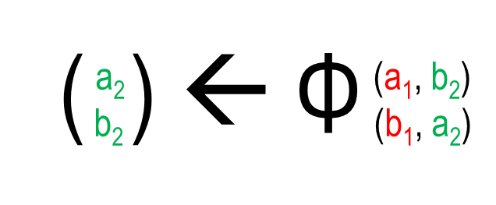
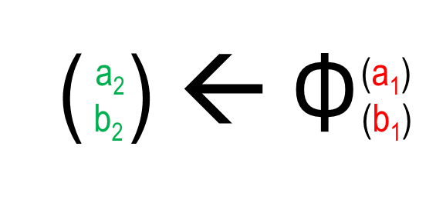
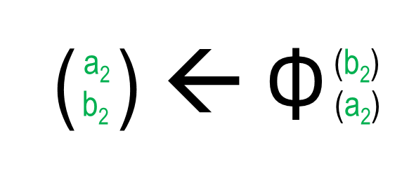
Translating out of SSA -- issue II: “swap problem”
The Φ-functions in a basic block should be considered concurrent – as a single Φ-block:
( ) ← Φ
a₂ (a₁, b₂)
b₂ (b₁, a₂)
And replacement of Φ by moves should respect this interpretation.
Conceptual intermediate step: unary Φ-blocks at the end of the CFG predecessors / in the incoming CFG edges.
a₁ ← …
b₁ ← …
a₂ ← Φ(a₁, b₂)
b₂ ← Φ( b₁, a₂)
if p
a₁ ← …
b₁ ← …
return b₂-a₂
if p
return b₂-a₂

Slide 82
Translating out of SSA -- issue II: “swap problem”
Then, concurrent elimination of unary Φ-blocks.
a₁ ← …
b₁ ← …
a₂ ← a₁
b₂ ← b₁
a₁ ← …
b₁ ← …
no problem here
if p
return b₂-a₂

Slide 83
Translating out of SSA -- issue II: “swap problem”
Then, concurrent elimination of unary Φ-blocks.
a₁ ← …
b₁ ← …
a₂ ← a₁
b₂ ← b₁
a₁ ← …
b₁ ← …
no problem here
but here, have cyclic dependency
if p
return b₂-a₂
horizontal : left-to-right

Slide 84
Translating out of SSA -- issue II: “swap problem”
Then, concurrent elimination of unary Φ-blocks.
a₁ ← …
b₁ ← …
a₂ ← a₁
b₂ ← b₁
a₁ ← …
b₁ ← …
no problem here
but here, have cyclic dependency
if p
return b₂-a₂
k ← a₂
a₂ ← b₂
b₂ ← k
Breaking dependence cycle into sequence of move instructions requires an additional variable.

Slide 85
Translating out of SSA -- issue II: “swap problem”
Resulting code has correct behavior, for p=true and p=false.
a₁ ← …
b₁ ← …
a₂ ← a₁
b₂ ← b₁
as usual, register alloc can clean this up
if p
k ← a₂
a₂ ← b₂
b₂ ← k
return b₂-a₂

Slide 86
Translating out of SSA -- issue II: “swap problem”
In general, the variables in a (unary) Φ-block can form multiple (non-overlapping) cycles, of different length.
( ) ← Φ
a
b
c
d
e
f
(b)
(a)
(d)
(f)
(a)
(c)
New (implicit) sanity condition of SSA:
LHS variables should be distinct!
Variables may occur repeatedly in RHS – but only participate in one cycle.
The cycles can be broken in succession, so the single additional variable/register k can be reused!
The moves not involved in a cycle (like e ← a) are emitted first.

Slide 87
Translating out of SSA -- discussion
Some care is needed to avoid lost copies and the swap problem, but basic principle – manifest the intuitive meaning of Φ-functions by locally inserting copy instructions “in the incoming edges” – works fine.
Alternative: globally identify groups of variables that can be unified
first guess - the original variables: works fine, until aggressive optimizations yield overlapping liveness ranges etc.
Φ-congruence classes (Sreedhar et al., Translating out of static single assignment form. 6th Static Analysis Symposium, LNCS 1694, Springer, 1999)
Insertion of moves, effect on liveness ranges, etc suggest exploration of interaction between SSA and register allocation

Slide 88
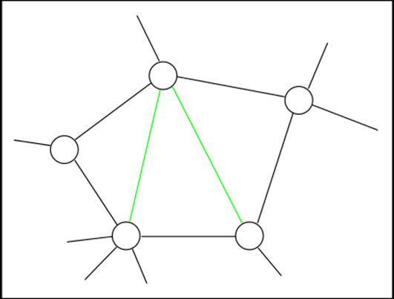
SSA and register allocation
S. Hack et al., Register allocation for programs in SSA form. 15th Conference on Compiler Construction (CC’06), LNCS 3923, Springer, 2006
Interference graphs of SSA programs are chordal graphs.
Any cycle of > 3 vertices has a chord, i.e. an edge that is not part of the cycle but connects two of its vertices.
Key properties of chordal graphs:
their chromatic number is equal to the size of the largest clique
they can be optimally colored in quadratic time (w.r.t. number of nodes)

Slide 89
SSA and register allocation
S. Hack et al., Register allocation for programs in SSA form. 15th Conference on Compiler Construction (CC’06), LNCS 3923, Springer, 2006
Also: the largest clique in the interference graph of an SSA program P is locally manifest in P: there is at least one instruction i_{P} where all members of the clique are live.
Can hence traverse program and obtain required number of colors – and know which variables to spill/coalesce in case we don’t have this many registers.
Resulting approach to register allocation:
Spill
Color
Coalesce
SSA- destruction
No need for iteration!
Don’t merge nodes in G, but share reg for variables in a Φ-node.
In ordinary programs, iteration was needed since spilling/coalescing was not guaranteed to reduce the number of colors needed. For SSA, this is guaranteed, if we spill/coalesce variables live at i_{P}.

Slide 90
SSA and register allocation: Hack et al.’s result
Remember: interference graph of an SSA program P
interference graph: G=(V, E) where
nodes V: program variables
edges E: (v, w) є E if there is a program point at which v and w are both live
SSA: each use of a variable v is dominated by the (unique) definition D_{v} of v
Lemma 1: if v and w interfere, either D_{v} dominates D_{w}, or D_{w} dominates D_{v}.
entry
Idea: Let i be the instruction at which v and w both live.
Thus, there are paths i U_{v} and i U_{w}
to some uses of v and w. As U_{v} is dominated by D_{v}, there is a path D_{v} i. Similarly, there is a path
from D_{w} to i. Hence, entry D_{v} i U_{w} must contain D_{w,} and entry D_{w} i U_{v} must contain D_{v, .} From this obtain claim…
D_{v}
D_{w}
i
U_{v}
U_{w}

Slide 91
SSA and register allocation: Hack et al.’s result
Lemma 1: if v and w interfere, either D_{v} dominates D_{w}, or D_{w} dominates D_{v}.
Lemma 2: if v and w interfere and D_{v} dominates D_{w}, then v is live at D_{v}.

Slide 92
SSA and register allocation: Hack et al.’s result
Lemma 1: if v and w interfere, either D_{v} dominates D_{w}, or D_{w} dominates D_{v}.
Lemma 2: if v and w interfere and D_{v} dominates D_{w}, then v is live at D_{v}.
Theorem 1: Let C = {c₁, … c_{n}} be a clique in G, ie (c_{i},c_{j}) є E forall i≠j. Then, there is a label in P where c₁, …, c_{n} are all live.
Proof :
by Lemma 1, the nodes c₁, … c_{n} are totally ordered by the dominance relationship: c_{σ(1)}, …, c_{σ(n)} for some permutation σ of {1, ..n}
as dominance is transitive, all c_{σ(i)} dominate c_{σ(n)}
by Lemma 2, all c_{σ(i)} are hence all live at c_{σ(n)}.

Slide 93
SSA and register allocation: Hack et al.’s result
we color nodes by stack-based simplify-select (cf Kempe).
suppose we can simplify nodes in a perfect elimination order: when a node is removed, its remaining neighbors form a clique
then, when we reinsert the node, we again have a clique
the size of the latter clique is bound by ω(G), the size of G’ largest clique

Slide 94
SSA and register allocation: Hack et al.’s result
we color nodes by stack-based simplify-select (cf Kempe).
suppose we can simplify nodes in a perfect elimination order: when a node is removed, its remaining neighbors form a clique
then, when we reinsert the node, we again have a clique
the size of the latter clique is bound by ω(G), the size of G’ largest clique
Theorem 2: G admits simplification by a PEO.
(admitting simplification by PEO is equivalent to being chordal)

Slide 95
SSA and register allocation: Hack et al.’s result
we color nodes by stack-based simplify-select (cf Kempe).
suppose we can simplify nodes in a perfect elimination order: when a node is removed, its remaining neighbors form a clique
then, when we reinsert the node, we again have a clique
the size of the latter clique is bound by ω(G), the size of G’ largest clique
Theorem 2: G admits simplification by a PEO.
(admitting simplification by PEO is equivalent to being chordal)
Theorem 3: Chordal graphs are perfect:
max colors needed = size of the largest clique
Thus, we can color G (using a PEO) using ω(G) many colors, and P contains
an instruction where ω(G) variables are live (and no instruction with more).
Thus: can traverse P, search for largest local live-set, and obtain #registers.

Slide 96
SSA and functional programming
SSA:
each variable has a unique site of definition; different uses of the same source-program variable name are disambiguated
the def-site dominates all uses
in straight-line code, each variable is assigned to only once

Slide 97
SSA and functional programming
SSA:
each variable has a unique site of definition; different uses of the same source-program variable name are disambiguated
the def-site dominates all uses
in straight-line code, each variable is assigned to only once
Functional code:
each name has a unique site of binding: let x = e₁ in e₂; different uses of the same name are kept apart by the language definition, or can be explicitly disambiguated by α-renaming
the binding-site determines a scope that contains all uses
in straight-line code, the value to which a name is bound is never changes

Slide 98
SSA and functional programming
SSA:
each variable has a unique site of definition; different uses of the same source-program variable name are disambiguated
the def-site dominates all uses
in straight-line code, each variable is assigned to only once
Functional code:
each name has a unique site of binding: let x = e₁ in e₂; different uses of the same name are kept apart by the language definition, or can be explicitly disambiguated by α-renaming
the binding-site determines a scope that contains all uses
in straight-line code, the value to which a name is bound never changes – and in a recursive function, we’re in different stack frames (but see details on stack frames in later lecture).
Andrew W. Appel: SSA is Functional Programming. ACM SIGPLAN Notices, April 1998 .

Slide 99
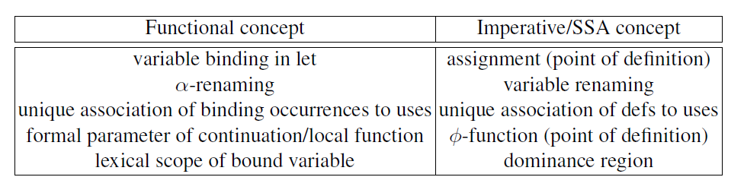
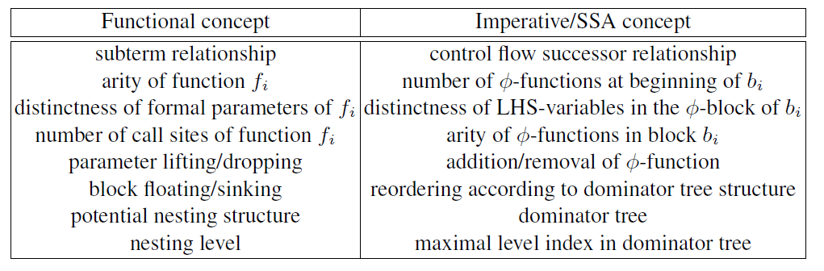
SSA and functional programming - correspondences
construction of SSA can be recast as transformation of a corresponding functional program; destruction, too
latent structural properties of SSA often explicit in FP view
correctness arguments for SSA analyses & transformations transfer to/from functional view

Slide 100
SSA construction in functional style
1:
v ← 1
z ← 8
y ← 4
2:
x ← 5 + y
y ← x * z
x ← x – 1
if x = 0
Step 1
convert into functional form
f
t
3:
w ← y +v
return w
one function per basic block
all functions mutually (tail-)recursive
entry point: top-level initial function call
function bodies: let-bindings for basic instructions (ANF)
liveness analysis yields formal parameter and argument lists

Slide 101
SSA construction in functional style
1:
v ← 1
z ← 8
y ← 4
let fun f₁() = let val v = 1
val z = 8
val y = 4
in f₂(v, z, y) end
and f₂(v ,z, y) = let val x = 5 + y
val y = x * z
val x = x – 1
in if x=0 then f₃(y, v)
else f₂(v, z, y) end
and f₃(y, v) = let val w = y + v
in w end
in f₁() end;
2:
x ← 5 + y
y ← x * z
x ← x – 1
if x = 0
Step 1
convert into functional form
f
t
3:
w ← y +v
return w
one function per basic block
all functions mutually (tail-)recursive
entry point: top-level initial function call
function bodies: let-bindings for basic instructions (ANF)
liveness analysis yields formal parameter and argument lists

Slide 102
SSA construction in functional style
1:
v ← 1
z ← 8
y ← 4
let fun f₁() = let val v = 1
val z = 8
val y = 4
in f₂(v, z, y) end
and f₂(v ,z, y) = let val x = 5 + y
val y = x * z
val x = x – 1
in if x=0 then f₃(y, v)
else f₂(v, z, y) end
and f₃(y, v) = let val w = y + v
in w end
in f₁() end;
all functions closed
variables not globally unique, but uses have unique defs (scope)
2:
x ← 5 + y
y ← x * z
x ← x – 1
if x = 0
Step 1
convert into functional form
f
t
3:
w ← y +v
return w
one function per basic block
all functions mutually (tail-)recursive
entry point: top-level initial function call
function bodies: let-bindings for basic instructions (ANF)
liveness analysis yields formal parameter and argument lists

Slide 103
SSA construction in functional style
let fun f₁() = let val v = 1
val z = 8
val y = 4
in f₂(v, z, y) end
and f₂(v, z, y) = let val x = 5 + y
val y = x * z
val x = x – 1
in if x=0 then f₃(y, v)
else f₂(v, z, y) end
and f₃(y, v) = let val w = y + v
in w end
in f₁() end;
optional
make names
unique
as functions are closed, can rename each function definition individually

Slide 104
SSA construction in functional style
let fun f₁() = let val v = 1
val z = 8
val y = 4
in f₂(v, z, y) end
and f₂(v, z, y) = let val x = 5 + y
val y = x * z
val x = x – 1
in if x=0 then f₃(y, v)
else f₂(v, z, y) end
and f₃(y, v) = let val w = y + v
in w end
in f₁() end;
let fun f₁() = let val v₁ = 1
val z₁ = 8
val y₁ = 4
in f₂(v₁, z₁, y₁) end
and f₂(v₂ ,z₂, y₂) = let val x₁ = 5 + y₂
val y₃ = x₁ * z₂
val x₂ = x₁ – 1
in if x₂=0 then f₃(y₃, v₂)
else f₂(v₂, z₂, y₃) end
and f₃(y₄, v₃) = let val w₁ = y₄ + v₃
in w₁ end
in f₁() end;
optional
make names
unique
as functions are closed, can rename each function definition individually

Slide 105
SSA construction in functional style
1:
v₁ ← 1
z₁ ← 8
y₁ ← 4
let fun f₁() = let val v₁ = 1
val z₁ = 8
val y₁ = 4
in f₂(v₁, z₁, y₁) end
and f₂(v₂ ,z₂, y₂) = let val x₁ = 5 + y₂
val y₃ = x₁ * z₂
val x₂ = x₁ – 1
in if x₂=0 then f₃(y₃, v₂)
else f₂(v₂, z₂, y₃) end
and f₃(y₄, v₃) = let val w₁ = y₄ + v₃
in w₁ end
in f₁() end;
2:
v₂ ← Φ (v₁, v₂)
z₂ ← Φ (z₁, z₂)
y₂ ← Φ (y₁, y₃)
x₁ ← 5 + y₂
y₃ ← x₁ * z₂
x₂ ← x₁ – 1
if x₂ = 0
interpret back in
imperative form
f
t
each formal parameter of a function definition is the LHS of
a Φ-function. Arguments are the function arguments at calls
arity of functions, distinctness of LHS variables etc all ok
resulting code “pruned SSA”
which functional prog avoids the unnecessary Φ-functions?
3:
y₄ ← Φ (y₃)
v₃ ← Φ (v₂)
w₁ ← y₄ + v₃
return w₁
“unnecessary”: all call sites provide identical arguments

Slide 106
Removing unnecessary arguments: λ-dropping
transformation of functional programs to eliminate formal parameters
can be performed before or after names are made unique - former option more instructive
(inverse operation: λ-lifting)
2 phases: block sinking and parameter dropping
remove parameters
modify nesting structure of function definitions

Slide 107
Removing unnecessary arguments: block sinking
Observation: if
all calls to g are in body of f (or g), and
g is closed (all free variables of body are parameters)
then the definition of g can be moved inside the definition of f
let fun …
and f(…) = let … in g(…) end
and g(…) = let …in
if … then g(…) else h (…) end
and h (…) = …(*no call to g*)
in … end;
Placing g near the end of f’s body is advantageous for next step…
let fun …
and f(…) = let … in
let fun g(…) = let …in
if … then g(…) else h (…) end
in g(…) end
and h (…) = …(*no call to g*)
in … end;
Note: g is allowed to
make recursive calls
make calls to “host function” f
make calls to other functions, like h

Slide 108
Block sinking: example
let fun f₁() = let val v = 1
val z = 8
val y = 4
in f₂(v, z, y) end
and f₂(v, z, y) = let val x = 5 + y
val y = x * z
val x = x – 1
in if x=0 then f₃(y, v)
else f₂(v, z, y) end
and f₃(y, v) = let val w = y + v
in w end
in f₁() end;
let fun f₁() = let val v = 1
val z = 8
val y = 4
in let fun f₂(v, z, y) =
let val x = 5 + y
val y = x * z
val x = x – 1
in if x=0
then let fun f₃(y, v) =
let val w = y + v
in w end
in f₃(y, v) end
else f₂(v, z, y) end
in f₂(v, z, y) end
in f₁() end;
move f₃ into f₂
move f₂ into f₁
(in fact, insert f₃ “in the edge” ie only in the then-branch – cf edge split form)

Slide 109
Block sinking: example
let fun f₁() = let val v = 1
val z = 8
val y = 4
in f₂(v, z, y) end
and f₂(v, z, y) = let val x = 5 + y
val y = x * z
val x = x – 1
in if x=0 then f₃(y, v)
else f₂(v, z, y) end
and f₃(y, v) = let val w = y + v
in w end
in f₁() end;
let fun f₁() = let val v = 1
val z = 8
val y = 4
in let fun f₂(v, z, y) =
let val x = 5 + y
val y = x * z
val x = x – 1
in if x=0
then let fun f₃(y, v) =
let val w = y + v
in w end
in f₃(y, v) end
else f₂(v, z, y) end
in f₂(v, z, y) end
in f₁() end;
move f₃ into f₂
move f₂ into f₁
Block sinking makes dominance structure explicit: f₂ = idom(f₃), and f₁ = idom(f₂)

Slide 110
Parameter dropping I
let fun f₁() = let val v = 1
val z = 8
val y = 4
in let fun f₂(v, z, y) =
let val x = 5 + y
val y = x * z
val x = x – 1
in if x=0
then let fun f₃(y, v) =
let val w = y + v
in w end
in f₃(y, v) end
else f₂(v, z, y) end
in f₂(v, z, y) end
in f₁() end;
Parameters y and v of f₃:
tightest scope for y (ie the def of)
surrounding the call to f₃ is also the
tightest scope surrounding the function definition f₃.
Can hence remove parameter y – and similarly parameter v.
let fun f₁() = ... in if x=0
then let fun f₃() =
let val w = y + v
in w end
in f₃() end
else …

Slide 111
Parameter dropping II
let fun f₁() = let val v = 1
val z = 8
val y = 4
in let fun f₂(v, z, y) =
let val x = 5 + y
val y = x * z
val x = x – 1
in if x=0
then let fun f₃() = …
in f₃() end
else f₂(v, z, y) end
in f₂(v, z, y) end
in f₁() end;
Similarly, the external call to f₂ from within the body of f₁ would allow to remove all three parameters from f₂.

Slide 112
Parameter dropping III
let fun f₁() = let val v = 1
val z = 8
val y = 4
in let fun f₂(v, z, y) =
let val x = 5 + y
val y = x * z
val x = x – 1
in if x=0
then let fun f₃() = …
in f₃() end
else f₂(v, z, y) end
in f₂(v, z, y) end
in f₁() end;
Similarly, the external call to f₂ from within the body of f₁ would allow to remove all three parameters from f₂.
Recursive call of f₂:
admits the removal of parameters v and z, since the defs associated with the uses at the call site are the defs in the formal parameter list
does not admit the removal of parameters y, since the def associated with the use of y at the call site is not the def in the formal parameter list

Slide 113
Parameter dropping IV
1:
v₁ ← 1
z₁ ← 8
y₁ ← 4
let fun f₁() = let val v = 1
val z = 8
val y = 4
in let fun f₂(y) =
let val x = 5 + y
val y = x * z
val x = x – 1
in if x=0
then let fun f₃() =
let val w = y + v
in w end
in f₃() end
else f₂(y) end
in f₂(y) end
in f₁() end;
2:
y₂ ← Φ (y₁, y₃)
x₁ ← 5 + y₂
y₃ ← x₁ * z₁
x₂ ← x₁ – 1
if x₂ = 0
make names distinct
read as SSA program
f
t
3:
w₁ ← y₃ + v₁
return w₁
Superfluous Φ-functions avoided.

Slide 114
SSA and functional programming - summary
SSA discipline shares many properties with tail-recursive, first-order fragment of functional languages
transfer of analysis/optimization algorithms
suitable intermediate format for compiling functional and imperative languages
function calls not in tail position: calls to imperative functions/methods/procedures
alternative functional representation of control flow: continuations

