Slide 1
Topic 14: Scheduling
COS 320
Compiling Techniques
Princeton University
Spring 2016
Lennart Beringer

Slide 2
The Back End
Well, let’s see…

Slide 3
Motivating example
Starting point

Slide 4
Motivating example
Starting point
Multiplication takes 2 cycles

Slide 5
Motivating example
Instructions take multiple cycles:
fill empty slots with independent instructions!

Slide 6
Motivating example
Instructions take multiple cycles:
fill empty slots with independent instructions!
what exactly do we mean by “independent”?

Slide 7
Motivating example
When our processor can execute 2 instructions per cycle

Slide 8
Motivating example
When our processor can execute 2 instructions per cycle:
issue pairs of independent instructions whenever possible

Slide 9
Motivating example
When our processor can execute 2 instructions per cycle:
issue pairs of independent instructions whenever possible
same notion of “independent”?
empty slot reappears – tough luck…

Slide 10
Instruction Level Parallelism
The concurrently executed instructions stem from a single program.
Processors can execute several instructions per cycle (Ithanium: up to 6)
ILP/VLIW: dependencies identified by compiler → instruction bundles
Super-Scalar: dependencies identified by processor (instruction windows)
Advantages / Disadvantages?

Slide 11
Instruction Level Parallelism
The concurrently executed instructions stem from a single program.
Processors can execute several instructions per cycle (Ithanium: up to 6)
ILP/VLIW: dependencies identified by compiler → instruction bundles
Super-Scalar: dependencies identified by processor (instruction windows)
Advantages / Disadvantages?
Possible synthesis:
have compiler take care of register-carried dependencies
let processor take care of memory-carried dependencies: exploit dynamic resolution of memory aliasing
use register renaming, register bypassing, out-of-order execution, speculation (branch prediction) to keep all execution units busy

Slide 12
Scheduling constraints
Data dependencies
  ordering between instructions that arises from the flow of data
Control dependencies
  ordering between instructions that arises from flow of control
Resource constraints
  processors have limited number of functional units
  not all functional units can execute all instructions (Floating point unit versus Integer-ALU, …)
  only limited number of instructions can be issued in one cycle
  only a limited number of register read/writes can be done concurrently

Slide 13
Data Dependences
Read After Write
d
r1 ← . . .
“True” dependence: arises from actual flow of values
u
. . ← . . r1 . .

Slide 14
Data Dependences
Read After Write
Write After Read
d
u
r1 ← . . .
. . ← . . r1 . .
“True” dependence: arises from actual flow of values
u
d
. . ← . . r1 . .
r1 ← . . .

Slide 15
Data Dependences
Read After Write
Write After Read
Write After Write
d
u
d₁
r1 ← . . .
. . ← . . r1 . .
r1 ← . . .
“True” dependence: arises from actual flow of values
u
d
d₂
. . ← . . r1 . .
r1 ← . . .
r1 ← . . .

Slide 16
Data Dependences
Read After Write
Write After Read
Write After Write
d
u
d₁
r1 ← . . .
. . ← . . r1 . .
r1 ← . . .
“True” dependence: arises from actual flow of values
u
d
d₂
. . ← . . r1 . .
r1 ← . . .
r1 ← . . .
“False”/”name” dependences: arise from reuse of location; can often be avoided by (dynamic) renaming

Slide 17
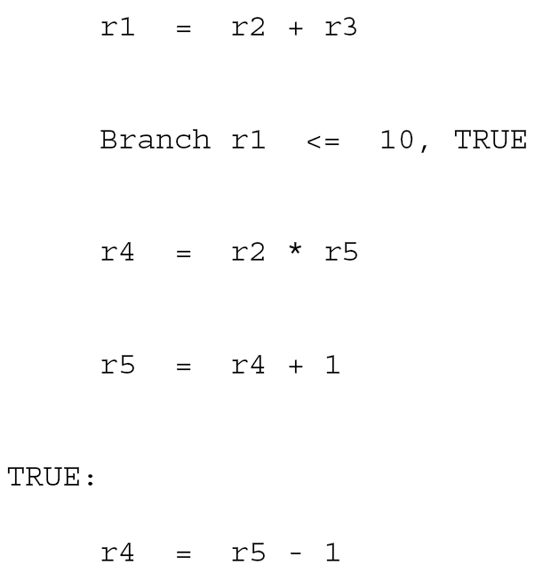
Eliminating false dependencies
WAW and WAR dependencies can often eliminated by register renaming…
… at the cost of adding registers...

Slide 18
Eliminating false dependencies
WAW and WAR dependencies can often eliminated by register renaming…
r6
r6
… at the cost of adding registers...

Slide 19
Eliminating false dependences
WAR dependencies can often be replaced by RAW dependencies
r6
r6
... at the price of using yet another register, and a (move) instruction ….

Slide 20
Eliminating false dependences
WAR dependencies can often be replaced by RAW dependencies
r8 = r5
r6
r6
r8
r6
r6
... at the price of using yet another register, and a (move) instruction ….

Slide 21
Eliminating false dependences
WAR dependencies can often be replaced by RAW dependencies
r8 = r5
r6
r6
r8
r6
r6
In fact, the WAR dependence on r5 already is respected/implied by the RAW dependence on r6 here!
... at the price of using yet another register, and a (move) instruction ….

Slide 22
Control Dependence
Node y is control dependent on x if
x is a branch, with successors u, v
y post-dominates u in the CFG: each path from u to EXIT includes y
y does not post-dominate v in the CFG: there is a path from v to EXIT that avoids y
X
U
V
Schedule must respect control dependences:
don’t move instructions past their control dependence ancestors!
Y
EXIT

Slide 23
Dependences
eg load, depending on cache-hit/miss
Program dependence graph: overlay of data dependence graph with control dependencies (two kinds of edges)

Slide 24
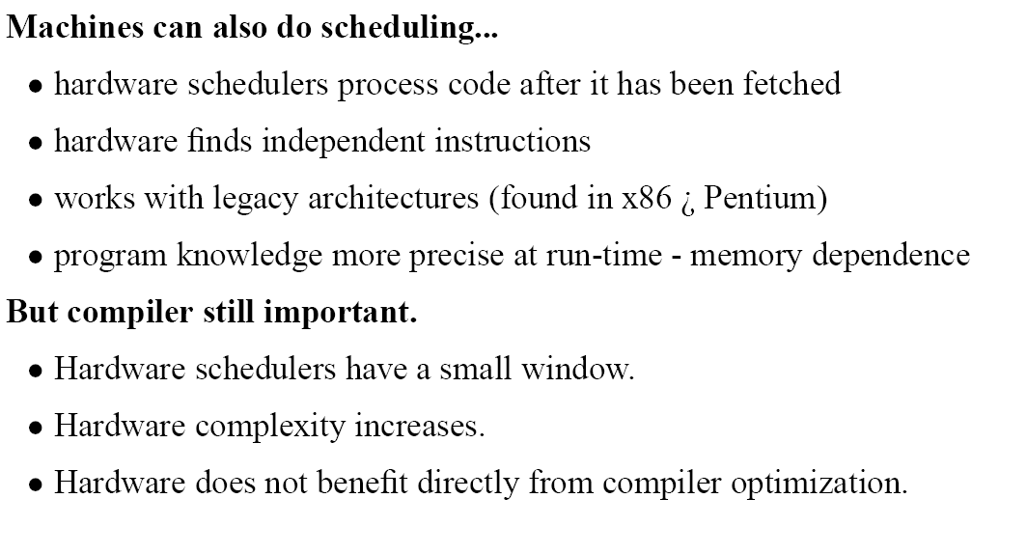
Hardware Scheduling
/
- control flow resolved

Slide 25
RISC-style processor pipeline
translate opcode into signals for later stages
read operands from registers
perform memory loads/stores
FETCH
DECODE
EXECUTE
MEM
WRITE
retrieve instruction from memory
increment PC
carry out specified ALU operation
write-back of result to register
Modern processors:
many more stages (up to 20-30)
different stages take different number of cycles per instruction
some (components of) stages duplicated, eg super-scalar
Common characteristics: resource constraints
each stage can only hold a fixed number of instruction per cycle
but: instructions can be in-flight concurrently (pipeline – more later)
register bank can only serve small number of reads/writes per cycle

Slide 26
Goal of scheduling
Construct a sorted version of the dependence graph that
produces the same result as the sequential program: respect dependencies, latencies
obeys the resource constrains
minimizes execution time (other metrics possible)

Slide 27
Goal of scheduling
Construct a sorted version of the dependence graph that
produces the same result as the sequential program: respect dependencies, latencies
obeys the resource constrains
minimizes execution time (other metrics possible)
Solution formulated as a table that indicates the issue cycle of each instruction:
Cycle | Resoure 1 | Resource 2 | … | Resource n
1 | 1 |  |  | 2
2 |  | 3 |  | 4
3
:
Even simplified version of the scheduling problem are typically NP-hard
→ heuristics

Slide 28
A classification of scheduling heuristics
Schedule within a basic block (local)
instructions cannot move past basic block boundaries
schedule covers only one basic block
Example technique: (priority) list scheduling
x = . . .
y = . . .
M[z] = . . .

Slide 29
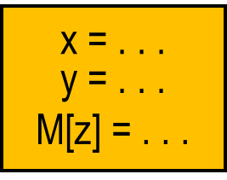
A classification of scheduling heuristics
Schedule within a basic block (local)
instructions cannot move past basic block boundaries
schedule covers only one basic block
Example technique: (priority) list scheduling
x = . . .
y = . . .
M[z] = . . .
Scheduling across basic blocks (global)
instructions move past basic block boundaries
schedule typically covers a (frequently executed ) trace
Example technique: trace scheduling

Slide 30
A classification of scheduling heuristics
Schedule within a basic block (local)
instructions cannot move past basic block boundaries
schedule covers only one basic block
Example technique: (priority) list scheduling
x = . . .
y = . . .
M[z] = . . .
Scheduling across basic blocks (global)
instructions move past basic block boundaries
schedule typically covers a (frequently executed ) trace
Example technique: trace scheduling
Loop scheduling
instructions cannot move past basic block boundaries
each schedule covers body of a loop
exploits/reflects pipeline structure of modern processors
Example technique: SW pipelining, modulo scheduling

Slide 31
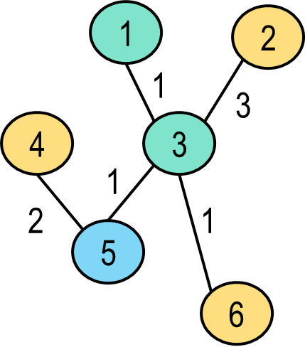
Local scheduling: list scheduling
Advantage: can disregard control dependencies
Input:
data dependence graph of straight-line code,
annotated with (conservative) latencies
instruction forms annotated with suitable type of Functional Units
#available Functional Units of each type
Integer-ALU | FP | MEM
2 | 1 | 1

Slide 32
Local scheduling: list scheduling
Advantage: can disregard control dependencies
Input:
data dependence graph of straight-line code,
annotated with (conservative) latencies
instruction forms annotated with suitable type of Functional Units
#available Functional Units of each type
Output: cycle-accurate assignment of instructions to functional units
Cycle | ALU1 | ALU2 | FP | MEM
1
2
3
4
5
6
Integer-ALU | FP | MEM
2 | 1 | 1
Can be refined for pipelined architectures, where latency != reservation period for FU

Slide 33
Local scheduling: list scheduling
Advantage: can disregard control dependencies
Input:
data dependence graph of straight-line code,
annotated with (conservative) latencies
instruction forms annotated with suitable type of Functional Units
#available Functional Units of each type
Output: cycle-accurate assignment of instructions to functional units
Cycle | ALU1 | ALU2 | FP | MEM
1 | 1 |  |  | 2
2
3
4 |  | 3 |  | 4
5
6 |  |  | 5 | 6
Integer-ALU | FP | MEM
2 | 1 | 1
Can be refined for pipelined architectures, where latency != reservation period for FU

Slide 34
List scheduling: algorithm (sketch)
Insert nodes that have no predecessors into queue
Start with cycle count c=1

Slide 35
List scheduling: algorithm (sketch)
Insert nodes that have no predecessors into queue
Start with cycle count c=1
While queue not empty:
  select an instruction i from the queue such that all predecessors were scheduled “sufficiently long ago” (latency information)
priority: e.g. length of path to EXIT, maybe weighted by latency of RAW (+WAW/WAR?) deps

Slide 36
List scheduling: algorithm (sketch)
Insert nodes that have no predecessors into queue
Start with cycle count c=1
While queue not empty:
  select an instruction i from the queue such that all predecessors were scheduled “sufficiently long ago” (latency information)
  if a functional unit u for i is available:
    insert i in (c, u), and remove it from the queue
    insert any successor of i into queue for which all predecessors have now been scheduled
priority: e.g. length of path to EXIT, maybe weighted by latency of RAW (+WAW/WAR?) deps

Slide 37
List scheduling: algorithm (sketch)
Insert nodes that have no predecessors into queue
Start with cycle count c=1
While queue not empty:
  select an instruction i from the queue such that all predecessors were scheduled “sufficiently long ago” (latency information)
  if a functional unit u for i is available:
    insert i in (c, u), and remove it from the queue
    insert any successor of i into queue for which all predecessors have now been scheduled
  if no functional unit is available for i, select another instruction
priority: e.g. length of path to EXIT, maybe weighted by latency of RAW (+WAW/WAR?) deps

Slide 38
List scheduling: algorithm (sketch)
Insert nodes that have no predecessors into queue
Start with cycle count c=1
While queue not empty:
  select an instruction i from the queue such that all predecessors were scheduled “sufficiently long ago” (latency information)
  if a functional unit u for i is available:
    insert i in (c, u), and remove it from the queue
    insert any successor of i into queue for which all predecessors have now been scheduled
  if no functional unit is available for i, select another instruction
  if no instruction from the queue was scheduled, increment c
priority: e.g. length of path to EXIT, maybe weighted by latency of RAW (+WAW/WAR?) deps

Slide 39
List scheduling: algorithm
Insert nodes that have no predecessors into queue
Start with cycle count c=1
While queue not empty:
  select an instruction i from the queue such that all predecessors were scheduled “sufficiently long ago” (latency information)
  if a functional unit u for i is available:
    insert i in (c, u), and remove it from the queue
    insert any successor of i into queue for which all predecessors have now been scheduled
  if no functional unit is available for i, select another instruction
  if no instruction from the queue was scheduled, increment c
priority: e.g. length of path to EXIT, maybe weighted by latency of RAW (+WAW/WAR?) deps
Variation:
start at nodes without successors and cycle count LAST
work upwards, entering finish times of instructions in table
availability of FU’s still governed by start times

Slide 40
Trace scheduling
Observation: individual basic blocks often don’t have much ILP
speed-up limited
many slots in list schedule remain empty: poor resource utilization
problem is accentuated by deep pipelines, where many instructions could be concurrently in-flight
Q: How can we extend scheduling to many basic blocks?

Slide 41
Trace scheduling
Observation: individual basic blocks often don’t have much ILP
speed-up limited
many slots in list schedule remain empty: poor resource utilization
problem is accentuated by deep pipelines, where many instructions could be concurrently in-flight
Q: How can we extend scheduling to many basic blocks?
A: By considering sets of basic blocks that are often executed together
select instructions along frequently executed traces
schedule trace members using list scheduling
adjust off-trace code to deal with executions that only traverse parts of the trace
e.g. by profiling, counting the traversals of each CFG edge
acyclic path through CFG
Details:
Joseph A. Fisher: Trace Scheduling: A Technique for Global Microcode Compaction.
IEEE Trans. Computers 30(7): 478-490 (1981)

Slide 42
Trace scheduling
branch point (cjump)
B1
1. construct data dependence graph of instructions on trace, but consider liveIn’s of A to be read by b.
b
off-trace predecessor
A
B2
C
off-trace successor
j
B3
join point
B4
A trace t, and its neighbors.

Slide 43
Trace scheduling
branch point (cjump)
B1
1. construct data dependence graph of instructions on trace, but consider liveIn’s of A to be read by b.
2. (list-)schedule instructions in t
b
off-trace predecessor
A
B2
C
off-trace successor
j
B3
B
join point
b
C
A
B4
j
A trace t, and its neighbors.

Slide 44
Trace scheduling
branch point (cjump)
B1
1. construct data dependence graph of instructions on trace, but consider liveIn’s of A to be read by b.
2. (list-)schedule instructions in t
b
off-trace predecessor
A
B2
C
off-trace successor
j
prevents those instructions in B2, B3, B4 that define variables that are used in A from being moved up past b, by creating a WAR dependence.
B3
B
join point
b
C
A
B4
j
A trace t, and its neighbors.

Slide 45
Trace scheduling
branch point (cjump)
B1
1. construct data dependence graph of instructions on trace, but consider liveIn’s of A liveIn of b.
2. (list-)schedule instructions in t
3. adjust code outside of t
b
off-trace predecessor
A
B2
C
off-trace successor
j
B3
B
B
join point
C
b
b
C
S
A
J
B4
A
j
j
A trace t, and its neighbors.

Slide 46
Trace scheduling: compensation code S
In step 2, some instructions in B1 end up above s in B, others below.
B1
s
A
B2
B
s
j
B3
A
j
B4

Slide 47
Trace scheduling: compensation code S
In step 2, some instructions in B1 end up above s in B, others below.
Copy the latter ones into the edge s → A, into a new block S so that they’re executed when control flow follows B1 → s → A, but not when A is entered through a different edge.
B1
s
A
B2
B
B
s
s
j
B3
S
A
A
j
j
B4

Slide 48
Trace scheduling: adjust code jumping to j
In step 2, some instructions in B2 end up above j in B, others below.
B1
b
B2
C
B
C
b
j
B3
j
B4

Slide 49
Trace scheduling: adjust code jumping to j
In step 2, some instructions in B2 end up above j in B, others below.
Adjust the jump in C to point to the first instruction (bundle) following the last instruction in B that stems from B2 – call the new jump target j’. Thus yellow instructions remain non-executed if control enters B from C: all instructions from B2 are above j’.
B1
b
B2
C
B
C
B
C
b
b
j
B3
j
j
j’
B4
Note: if there’s no yellow instruction, we’re in fact adjusting j upwards: j’ follows the last purple instruction.

Slide 50
Trace scheduling: adjusting code jumping into B
Next, some instructions from B3/B4 end up above j’ in B, others below.
B1
b
B2
C
B
C
b
j
B3
j’
B4

Slide 51
Trace scheduling: adjust code jumping to j
Next, some instructions from B3/B4 end up above j’ in B, others below. Copy the former ones into the edge C → j’, into a new block J, ensuring that instructions following j’ receive correct data when flow enters B via C.
B1
b
B2
C
B
C
B
C
b
b
j
J
B3
j’
j’
B4

Slide 52
Trace scheduling: cleaning up S and J
Next, some instructions from B3/B4 end up above j’ in B, others below. Copy the former ones into the edge C → j’, into a new block J, ensuring that instructions following j’ receive correct data when flow enters B via C.
B1
b
B2
C
B
C
B
C
b
b
j
J
B3
j’
j’
B4
Final cleanup: some instructions in S and J may be dead – eliminate them. Then, S and J can be (list-)scheduled or be part of the next trace.

Slide 53
Pipelining
Purely sequential execution:
FETCH
DECODE
EXECUTE
MEM
WRITE
FETCH
DECODE
EXECUTE
MEM
. . .
Pipelining - can partially overlap instructions:
FETCH
DECODE
EXECUTE
MEM
WRITE
FETCH
DECODE
EXECUTE
MEM
WRITE
FETCH
DECODE
EXECUTE
MEM
WRITE
:
One instruction issued (and retired) each cycle – speedup ≈ pipeline depth

Slide 54
Pipelining
Purely sequential execution:
FETCH
DECODE
EXECUTE
MEM
WRITE
FETCH
DECODE
EXECUTE
MEM
. . .
Pipelining - can partially overlap instructions:
FETCH
DECODE
EXECUTE
MEM
WRITE
FETCH
DECODE
EXECUTE
MEM
WRITE
FETCH
DECODE
EXECUTE
MEM
WRITE
:
One instruction issued (and retired) each cycle – speedup ≈ pipeline depth
… assuming that
each instruction spends one cycle in each stage
all instruction forms visit same (sequence of) FU’s
there are no (data) dependencies

Slide 55
Pipelining for realistic processors
Different instructions visit different sets/sequences of functional units, and occasionally multiple types of functional units in the same cycle:
Example: floating point instructions on MIPS R4000 (ADD, MUL, CONV)
FETCH
READ
UNPACK
SHIFT
ROUND
ROUND
WRITE
ADD
ADD
SHIFT
FETCH
READ
UNPACK
MULTA
MULTA
MULTA
MULTB
MULTB
ROUND
WRITE
ADD
FETCH
READ
UNPACK
ADD
ROUND
SHIFT
SHIFT
ADD
ROUND
WRITE

Slide 56
Pipelining for realistic processors
Different instructions visit different sets/sequences of functional units, and occasionally multiple types of functional units in the same cycle:
Example: floating point instructions on MIPS R4000 (ADD, MUL, CONV)
FETCH
READ
UNPACK
SHIFT
ROUND
ROUND
WRITE
ADD
ADD
SHIFT
FETCH
READ
UNPACK
MULTA
MULTA
MULTA
MULTB
MULTB
ROUND
WRITE
ADD
FETCH
READ
UNPACK
ADD
ROUND
SHIFT
SHIFT
ADD
ROUND
WRITE
Contention for FU’s means some pipelinings must be avoided:
FETCH
READ
UNPACK
MULTA
MULTA
MULTA
MULTB
MULTB
ROUND
WRITE
ADD
. . .
FETCH
READ
UNPACK
SHIFT
ROUND
ROUND
WRITE
ADD
ADD
SHIFT

Slide 57
Pipelining constraints: data dependencies
RAW dependency:
FETCH
READ
UNPACK
SHIFT
ROUND
ROUND
WRITE
ADD
ADD
SHIFT
FETCH
READ
UNPACK
. . .

Slide 58
Pipelining constraints: data dependencies
RAW dependency:
FETCH
READ
UNPACK
SHIFT
ROUND
ROUND
WRITE
ADD
ADD
SHIFT
FETCH
READ
UNPACK
. . .
Register bypassing / operand forwarding: extra HW to communicate data directly between FU’s
FETCH
READ
UNPACK
SHIFT
ROUND
ROUND
WRITE
ADD
ADD
SHIFT
FETCH
READ
UNPACK
ADD
ROUND
Result of one stage is available at another stage in the next cycle.

Slide 59
Loop scheduling without resource bounds
illustrates use of loop unrolling and introduces terminology for full SW pipelining
but not useful in practice
for i ← 1 to N
a ← j ◊ V [ i – 1]
b ← a ◊ f
c ← e ◊ j
d ← f ◊ c
e ← b ◊ d
f ← U [ i ]
g: V [ i ] ← b
h: W [ i ] ← d
j ← X [ i ]
scalar replacement
make “iteration index” explicit
◊ some binary op(s)

Slide 60
Loop scheduling without resource bounds
illustrates use of loop unrolling and introduces terminology for full SW pipelining
but not useful in practice
for i ← 1 to N
for i ← 1 to N
a ← j ◊ V [ i – 1]
b ← a ◊ f
c ← e ◊ j
d ← f ◊ c
e ← b ◊ d
f ← U [ i ]
g: V [ i ] ← b
h: W [ i ] ← d
j ← X [ i ]
a _{i} ← j _{i - 1} ◊ b _{i - 1}
b _{i} ← a _{i} ◊ f _{i - 1}
c _{i} ← e _{i - 1} ◊ j _{i - 1}
d _{i} ← f _{i - 1} ◊ c _{i}
e _{i} ← b _{i} ◊ d _{i}
f _{i} ← U [ i ]
g: V [ i ] ← b _{i}
h: W [ i ] ← d _{i}
j _{i} ← X [ i ]
scalar replacement
make “iteration index” explicit
Scalar replacement: poor-man’s alternative to alias analysis (again) but often helpful
◊ some binary op(s)

Slide 61
Loop scheduling without resource bounds
Data dependence graph of body
for i ← 1 to N
a _{i} ← j _{i - 1} ◊ b _{i - 1}
b _{i} ← a _{i} ◊ f _{i - 1}
c _{i} ← e _{i - 1} ◊ j _{i - 1}
d _{i} ← f _{i - 1} ◊ c _{i}
e _{i} ← b _{i} ◊ d _{i}
f _{i} ← U [ i ]
g: V [ i ] ← b _{i}
h: W [ i ] ← d _{i}
j _{i} ← X [ i ]
a
c
j
d
b
f
h
g
e
same-iteration dependence
cross-iteration dependence

Slide 62
Loop scheduling without resource bounds
Data dependence graph of unrolled body – acyclic!
a
c
1
j
1
1
a
c
d
1
f
b
1
j
1
h
1
d
g
e
1
1
b
f
h
a
c
2
2
g
e
j
2
d
2
b
2
f
h
2
2
same-iteration dependence
g
e
2
2
cross-iteration dependence
. . . . . . . .

Slide 63
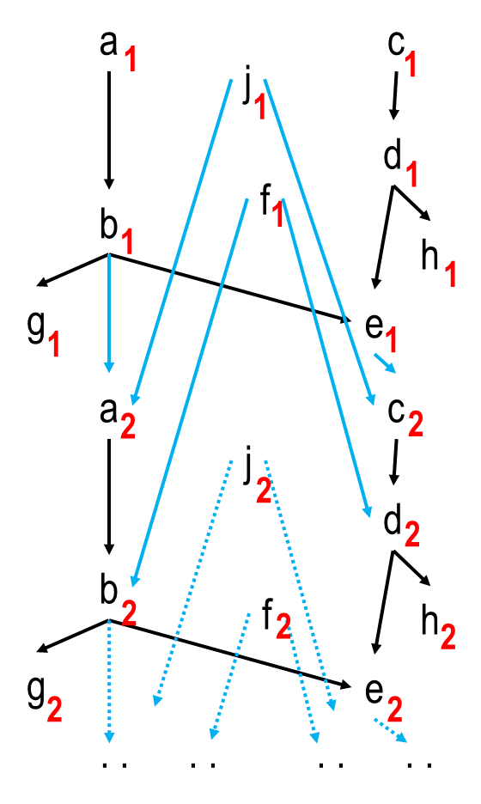
Loop scheduling without resource bounds
Arrange in tableau
 | 1 | 2 | 3 | 4 | 5 | 6
1 | a c f j | f j | f j | f j | f j | f j
2
3
4
5
6
7
8
9
10
11
12
13
14
15
rows: cycles
columns: iterations
unlimited resources

Slide 64
Loop scheduling without resource bounds
Arrange in tableau
 | 1 | 2 | 3 | 4 | 5 | 6
1 | a c f j | f j | f j | f j | f j | f j
2 | b d
3
4
5
6
7
8
9
10
11
12
13
14
15

Slide 65
Loop scheduling without resource bounds
Arrange in tableau
 | 1 | 2 | 3 | 4 | 5 | 6
1 | a c f j | f j | f j | f j | f j | f j
2 | b d
3 | e g h | a
4
5
6
7
8
9
10
11
12
13
14
15

Slide 66
Loop scheduling without resource bounds
Arrange in tableau
 | 1 | 2 | 3 | 4 | 5 | 6
1 | a c f j | f j | f j | f j | f j | f j
2 | b d
3 | e g h | a
4 |  | b c
5
6
7
8
9
10
11
12
13
14
15

Slide 67
Loop scheduling without resource bounds
… some more iterations.
 | 1 | 2 | 3 | 4 | 5 | 6
1 | a c f j | f j | f j | f j | f j | f j
2 | b d
3 | e g h | a
4 |  | b c
5 |  | d g | a
6 |  | e h | b
7 |  |  | c g | a
8 |  |  | d | b
9 |  |  | e h | g | a
10 |  |  |  | c | b
11 |  |  |  | d | g | a
12 |  |  |  | e h |  | b
13 |  |  |  |  | c | g
14 |  |  |  |  | d
15 |  |  |  |  | e h

Slide 68
Loop scheduling without resource bounds
Identify groups of instructions; note gaps
 | 1 | 2 | 3 | 4 | 5 | 6
1 | a c f j | f j | f j | f j | f j | f j
2 | b d |  |  | :
3 | e g h | a |  | XX
4 |  | b c |  | :
5 |  | d g | a
6 |  | e h | b
7 |  |  | c g | a
8 |  |  | d | b
9 |  |  | e h | g | a
10 |  |  |  | c | b
11 |  |  |  | d | g | a
12 |  |  |  | e h | XX | b
13 |  |  |  |  | c | g
14 |  |  |  |  | d | XX
15 |  |  |  |  | e h | XX
slope 0
slope 2
slope 3

Slide 69
Loop scheduling without resource bounds
Close gaps by delaying fast instruction groups
 | 1 | 2 | 3 | 4 | 5 | 6
1 | a c f j
2 | b d | f j
3 | e g h | a
4 |  | b c | f j
5 |  | d g | a
6 |  | e h | b | f j
7 |  |  | c g | a
8 |  |  | d | b
9 |  |  | e h | g | f j
10 |  |  |  | c | a
11 |  |  |  | d | b
12 |  |  |  | e h | g | f j
13 |  |  |  |  | c | a
14 |  |  |  |  | d | b
15 |  |  |  |  | e h | g
slope 3

Slide 70
Loop scheduling without resource bounds
Identify “steady state” – of slope 3
 | 1 | 2 | 3 | 4 | 5 | 6
1 | a c f j
2 | b d | f j
3 | e g h | a
4 |  | b c | f j
5 |  | d g | a
6 |  | e h | b | f j
7 |  |  | c g | a
8 |  |  | d | b
9 |  |  | e h | g | f j
10 |  |  |  | c | a
11 |  |  |  | d | b
12 |  |  |  | e h | g | f j
13 |  |  |  |  | c | a
14 |  |  |  |  | d | b
15 |  |  |  |  | e h | g
prologue
epilogue

Slide 71
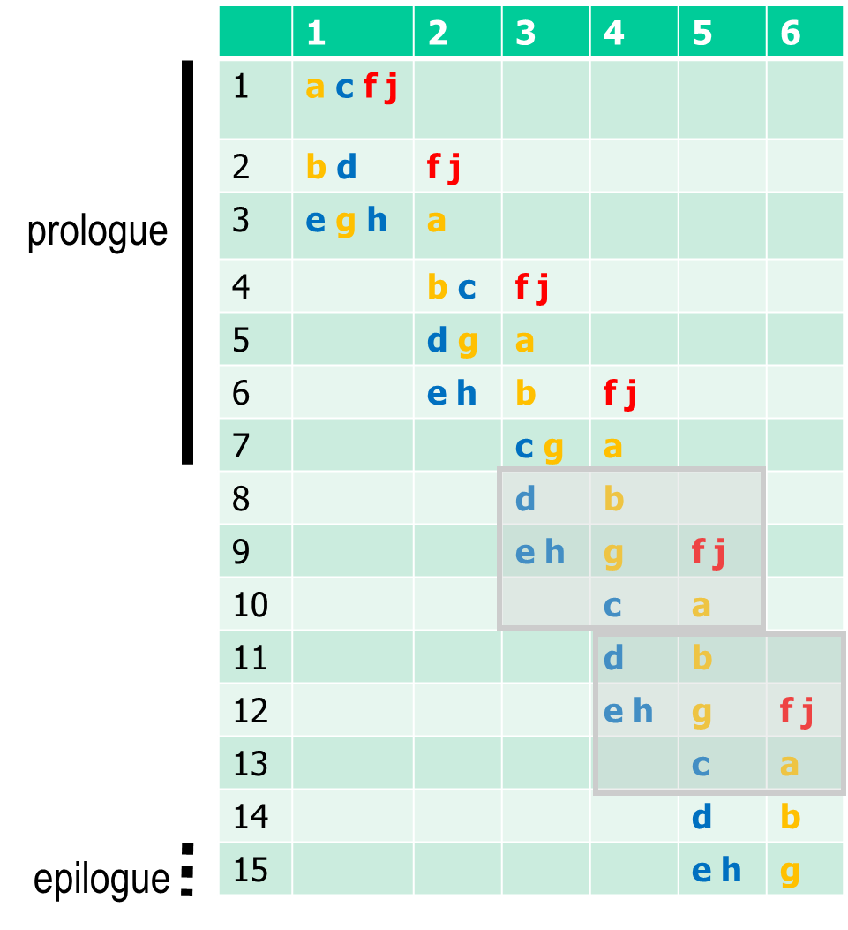
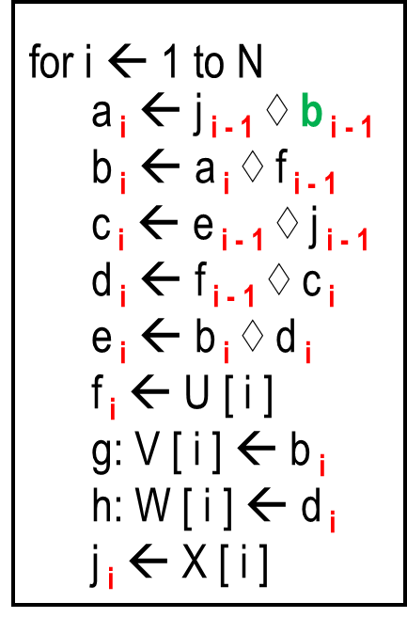
Loop scheduling without resource bounds
Expand instructions
No cycle has > 5 instructions
Instructions in a row execute in parallel; reads in RHS happen before writes in LHS
1. Prologue – also set up i
a₁ ← j₀ ◊ b₀ | c₁ ← e₀ ◊ j₀ | f₁ ← U[1] | j₁ ← X[1]
b₁ ← a₁ ◊ f₀ | d₁ ← f₀ ◊ c₁ | f₂ ← U[2] | j₂ ← X[2]
e₁ ← b₁ ◊ d₁ | V[1] ← b₁ | W[1] ← d₁ | a₂ ← j₁ ◊ b₁
b₂ ← a₂ ◊ f₁ | c₂ ← e₁ ◊ j₁ | f₃ ← U[3] | j₃ ← X[3]
d₂ ← f₁ ◊ c₂ | V[2] ← b₂ | a₃ ← j₂ ◊ b₂
e₂ ← b₂ ◊ d₂ | W[2] ← d₂ | b₃ ← a₃ ◊ f₂ | f₄ ← U[4] | j₄ ← X[4]
c₃ ← e₂ ◊ j₂ | V[3] ← b₃ | a₄ ← j₃ ◊ b₃ |  | i ← 3

Slide 72
Loop scheduling without resource bounds
Expand instructions
no cycle has > 5 instructions
Instructions in a row execute in parallel; reads in RHS happen before writes in LHS
2. Loop body – also increment counter and insert (modified) exit condition
incorrect index a_{i} in MCIML book
L:
d_{i} ← f_{i-1} ◊ c_{i} | b_{i+1} ← a_{i+1} ◊ f_{i}
e_{i} ← b_{i} ◊ d_{i} | W[i] ← d_{i} | V[i+1] ← b_{i+1} | f_{i+2} ← U[i+2] | j_{i+2} ← X[i+2]
c_{i+1} ← e_{i} ◊ j_{i} | a_{i+2} ← j_{i+1} ◊ b_{i+1} | i ← i + 1 | if i < N-2 goto L
As expected, the loop body has one copy of each instruction a-j, plus induction variable update + test

Slide 73
Loop scheduling without resource bounds
Expand instructions
no cycle has > 5 instructions
Instructions in a row execute in parallel; reads in RHS happen before writes in LHS
3. Loop epilogue – finish all N iterations
d_{N-1} ← f_{N-1} ◊ c_{N-2} | b_{N} ← a_{N} ◊ f_{N-1}
e_{N-1} ← b_{N-1} ◊ d_{N-1} | W[N-1] ← d_{N-1} | V[N] ← b_{N}
c_{N} ← e_{N-1} ◊ j_{N-1}
d_{N} ← f_{N} ◊ c_{N-1}
e_{N} ← b_{N} ◊ d_{N} | W[N] ← d_{N}

Slide 74
Loop scheduling without resource bounds
a₁ ← j₀ ◊ b₀ | c₁ ← e₀ ◊ j₀ | f₁ ← U[1] | j₁ ← X[1]
b₁ ← a₁ ◊ f₀ | d₁ ← f₀ ◊ c₁ | f₂ ← U[2] | j₂ ← X[2]
e₁ ← b₁ ◊ d₁ | V[1] ← b₁ | W[1] ← d₁ | a₂ ← j₁ ◊ b₁
b₂ ← a₂ ◊ f₁ | c₂ ← e₁ ◊ j₁ | f₃ ← U[3] | j₃ ← X[3]
d₂ ← f₁ ◊ c₂ | V[2] ← b₂ | a₃ ← j₂ ◊ b₂
e₂ ← b₂ ◊ d₂ | W[2] ← d₂ | b₃ ← a₃ ◊ f₂ | f₄ ← U[4] | j₄ ← X[4]
c₃ ← e₂ ◊ j₂ | V[3] ← b₃ | a₄ ← j₃ ◊ b₃ |  | i ← 3
d_{i} ← f_{i-1} ◊ c_{i} | b_{i+1} ← a_{i+1} ◊ f_{i}
e_{i} ← b_{i} ◊ d_{i} | W[i] ← d_{i} | V[i+1] ← b_{i+1} | f_{i+2} ← U[i+2] | j_{i+2} ← X[i+2]
c_{i+1} ← e_{i} ◊ j_{i} | a_{i+2} ← j_{i+1} ◊ b_{i+1} | i ← i + 1 | if i < N-2 goto L
d_{N-1} ← f_{N-1} ◊ c_{N-2} | b_{N} ← a_{N} ◊ f_{N-1}
e_{N-1} ← b_{N-1} ◊ d_{N-1} | W[N-1] ← d_{N-1} | V[N] ← b_{N}
c_{N} ← e_{N-1} ◊ j_{N-1}
d_{N} ← f_{N} ◊ c_{N-1}
e_{N} ← b_{N} ◊ d_{N} | W[N] ← d_{N}

Slide 75
Loop scheduling without resource bounds
Final step: eliminate indices i from variables – want “constant” variables/registers in body!
d_{i} ← f_{i-1} ◊ c_{i} | b_{i+1} ← a_{i+1} ◊ f_{i}
e_{i} ← b_{i} ◊ d_{i} | W[i] ← d_{i} | V[i+1] ← b_{i+1} | f_{i+2} ← U[i+2] | j_{i+2} ← X[i+2]
c_{i+1} ← e_{i} ◊ j_{i} | a_{i+2} ← j_{i+1} ◊ b_{i+1} | i ← i + 1 | if i < N-2 goto L
need 3 copies of j since up to 3 copies are live: j_{i+2} → j, j_{i+1} → j’, j_{i} → j’’

Slide 76
Loop scheduling without resource bounds
Final step: eliminate indices i from variables – want “constant” variables/registers in body!
d_{i} ← f_{i-1} ◊ c_{i} | b_{i+1} ← a_{i+1} ◊ f_{i}
e_{i} ← b_{i} ◊ d_{i} | W[i] ← d_{i} | V[i+1] ← b_{i+1} | f_{i+2} ← U[i+2] | j_{i+2} ← X[i+2]
c_{i+1} ← e_{i} ◊ j_{i} | a_{i+2} ← j_{i+1} ◊ b_{i+1} | i ← i + 1 | if i < N-2 goto L
need 3 copies of j since up to 3 copies are live: j_{i+2} → j, j_{i+1} → j’, j_{i} → j’’
d_{i} ← f_{i-1} ◊ c_{i} | b_{i+1} ← a_{i+1} ◊ f_{i}
e_{i} ← b_{i} ◊ d_{i} | W[i] ← d_{i} | V[i+1] ← b_{i+1} | f_{i+2} ← U[i+2] | j ← X[i+2]
c_{i+1} ← e_{i} ◊ j’’ | a_{i+2} ← j’ ◊ b_{i+1} | i ← i + 1 | if i < N-2 goto L

Slide 77
Loop scheduling without resource bounds
Final step: eliminate indices i from variables – want “constant” variables/registers in body!
d_{i} ← f_{i-1} ◊ c_{i} | b_{i+1} ← a_{i+1} ◊ f_{i}
e_{i} ← b_{i} ◊ d_{i} | W[i] ← d_{i} | V[i+1] ← b_{i+1} | f_{i+2} ← U[i+2] | j_{i+2} ← X[i+2]
c_{i+1} ← e_{i} ◊ j_{i} | a_{i+2} ← j_{i+1} ◊ b_{i+1} | i ← i + 1 | if i < N-2 goto L
need 3 copies of j since up to 3 copies are live: j_{i+2} → j, j_{i+1} → j’, j_{i} → j’’
d_{i} ← f_{i-1} ◊ c_{i} | b_{i+1} ← a_{i+1} ◊ f_{i} | j’’ ← j’ | j’ ← j
e_{i} ← b_{i} ◊ d_{i} | W[i] ← d_{i} | V[i+1] ← b_{i+1} | f_{i+2} ← U[i+2] | j ← X[i+2]
c_{i+1} ← e_{i} ◊ j’’ | a_{i+2} ← j’ ◊ b_{i+1} | i ← i + 1 | if i < N-2 goto L
the copies live across an iteration need to be updated in each iteration.
also, need to initialize the live-in copies of the loop at the end of prologue (j, j’)
also, can replace the indexed live-in copies of the epilogue with primed versions
all this for all variables a, ..j (see book – modulo typo regarding a, a’)

Slide 78
Loop scheduling without resource bounds
Summary of main steps
calculate data dependence graph of unrolled loop
schedule each instruction from each loop as early as possible
plot the tableau of iterations versus cycles
identify groups of instructions, and their slopes
coalesce the slopes by slowing down fast instruction groups
identify steady state, and loop prologue and epilogue
reroll the loop, removing the iteration-indexed variable names

Slide 79

Loop scheduling with resource bounds
data dependences of loop, with latency annotations
resource requirements of all instruction forms:
ADD
MUL
#available Functional Units of each type, and descriptions of FU types:
  # of instructions that can be issued in one cycle,
  restrictions which instruction forms can be issued simultaneously etc
Input:

Slide 80
Loop scheduling with resource bounds
data dependences of loop, with latency annotations
resource requirements of all instruction forms:
ADD
MUL
#available Functional Units of each type, and descriptions of FU types:
  # of instructions that can be issued in one cycle,
  restrictions which instruction forms can be issued simultaneously etc
Input:
Modulo scheduling:
find schedule that satisfies resource and (data) dependency requirements; then do register allocation
try to schedule loop body using Δ cycles, for Δ = Δ_{min}, Δ_{min} + 1, Δ_{min} + 2 . . .
body surrounded by prologue and epilogue as before

Slide 81
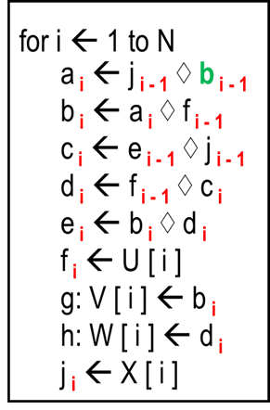
Modulo scheduling: where’s the mod?
Observation: if resource constraints prevent an instruction from being scheduled at time t, they also prevent t from being scheduled at times t + Δ, t + 2Δ, . . . or indeed any t’ with t = t’ mod Δ.
Example:
Δ=3, machine can only execute 1 load instruction at a time, loop body from previous example
0
1 | f_{i} ← U [ i ] | j_{i} ← X [ i ]
2

Slide 82
Modulo scheduling: where’s the mod?
Observation: if resource constraints prevent an instruction from being scheduled at time t, they also prevent t from being scheduled at times t + Δ, t + 2Δ, . . . or indeed any t’ with t = t’ mod Δ.
Example:
Δ=3, machine can only execute 1 load instruction at a time, loop body from previous example
0
1 | f_{i} ← U [ i ] | j_{i} ← X [ i ]
2
0 | f_{i} ← U [ i ]
1 |  | j_{i} ← X [ i ]
2
0
1 |  | j_{i} ← X [ i ]
2 | f_{i} ← U [ i ]

Slide 83
Modulo scheduling: where’s the mod?
Observation: if resource constraints prevent an instruction from being scheduled at time t, they also prevent t from being scheduled at times t + Δ, t + 2Δ, . . . or indeed any t’ with t = t’ mod Δ.
Example:
Δ=3, machine can only execute 1 load instruction at a time, loop body from previous example
0
1 | f_{i} ← U [ i ] | j_{i} ← X [ i ]
2
0 | f_{i} ← U [ i ]
1 |  | j_{i} ← X [ i ]
2
0=3 | f_{i-1} ← U [ i ]
1 |  | j_{i} ← X [ i ]
2
0
1 |  | j_{i} ← X [ i ]
2 | f_{i} ← U [ i ]
0
1 |  | j_{i} ← X [ i ]
2=-1 | f_{i+1} ← U [ i ]

Slide 84
Modulo scheduling: where’s the mod?
Observation: if resource constraints prevent an instruction from being scheduled at time t, they also prevent t from being scheduled at times t + Δ, t + 2Δ, . . . or indeed any t’ with t = t’ mod Δ.
Example:
Δ=3, machine can only execute 1 load instruction at a time, loop body from previous example
0
1 | f_{i} ← U [ i ] | j_{i} ← X [ i ]
2
0
1=4 | f_{i-1} ← U [ i-1 ] | j_{i} ← X [ i ]
2
0 | f_{i} ← U [ i ]
1 |  | j_{i} ← X [ i ]
2
0=3 | f_{i-1} ← U [ i ]
1 |  | j_{i} ← X [ i ]
2
0
1 |  | j_{i} ← X [ i ]
2 | f_{i} ← U [ i ]
0
1 |  | j_{i} ← X [ i ]
2=-1 | f_{i+1} ← U [ i ]

Slide 85
Modulo scheduling
Interaction with register allocation:
delaying an instruction d: z ← x op y
  extends the liveness-range of d’s uses, namely x and y;
  may overlap with other (iteration count-indexed) versions of z, so may need to maintain multiple copies, as in previous example
  shortens liveness range of the def(s) of d, namely, z, to its uses;
  range < 1 illegal; ie need to postpone uses, too
similarly, schedudling an instruction earlier shortens the liveness ranges of its uses and extends the liveness range of its defs
hence, scheduling affects liveness/register allocation

Slide 86
Modulo scheduling: estimating Δ_{min}
Identification of Δ_{min} as the maximum of the following:
resource estimator: for each FU
  calculate requested cycles: add cycle requests of all instructions mapped to that FU
  divide request by number of instances of the FU type
  max over all FU types is lower bound on Δ_{max}
data-dependence estimator: sum of latencies along a simple cycle through the data dependence graph

Slide 87
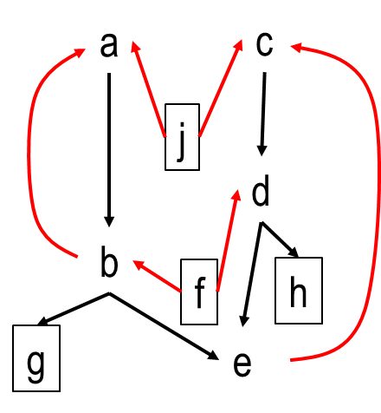
Modulo scheduling: estimating Δ_{min}
Identification of Δ_{min} as the maximum of the following:
resource estimator: for each FU
  calculate requested cycles: add cycle requests of all instructions mapped to that FU
  divide request by number of instances of the FU type
  max over all FU types is lower bound on Δ_{max}
data-dependence estimator: sum of latencies along a simple cycle through the data dependence graph
Example: 1 ALU, 1 MEM; both issue 1 instruction/cycle; instr. latency 1 cycle
Data dependence estimator: 3 (c → d → e → c)
ALU-estimator: 5 instrs, 1 cycle each, 1 ALU ➔ 5
MEM-estimator: 4 instrs, 1 cycle each, 1 MEM ➔ 4
Hence Δ_{min} = 5
(MEM instructions in box)

Slide 88
Modulo scheduling: priority of instructions
Algorithm schedules instructions according to priorities
Possible metrics:
  membership in data dependence cycle of max latency
  execution on FU type that’s most heavily used (resource estimate)
Example: [c, d, e, a, b, f, j, g, h]
(MEM instructions in box)

Slide 89
Modulo scheduling: sketch of algorithm
Main data structures:
 | FU1 | FU2
0 | Instr 1 | Instr 4
1 | Instr 2
2 |  | Instr 3
: | : | :
array SchedTime, assigning to each instruction a cycle time
table ResourceMap, assigning to each FU and cycle time < Δ an instruction
Instr 1 | 8
Instr 2 | 4
Instr 3 | 0
: | :
pick highest-priority instruction that’s not yet scheduled: i
schedule i at earliest cycle that
  respects the data dependencies w.r.t. the already scheduled instructions
  has the right FU for i available
  if i can’t be scheduled for current Δ, place i without respecting resource constraint: evict current inhabitant and/or data-dependence successors of i hat are now scheduled too early. Evictees need to scheduled again.
in principle evictions could go on forever
  define a cut-off (heuristics) at which point Δ is increased

Slide 90
Modulo scheduling: example
 | ALU | MEM
0
1
2
3
4
Δ_{min} = 5
[c, d, e, a, b, f, j, g, h]
a
b
c
d
e
f
g
h
j
highest-priority, unscheduled instruction: c
earliest cycle with free ALU s.t. data-deps
w.r.t. scheduled instructions are respected: 0

Slide 91
Modulo scheduling: example
 | ALU | MEM
0 | c
1
2
3
4
Δ_{min} = 5
[c, d, e, a, b, f, j, g, h]
a
b
c | 0
d
e
f
g
h
j
highest-priority, unscheduled instruction: c
earliest cycle with free ALU s.t. data-deps
w.r.t. scheduled instructions are respected: 0
so schedule c in cycle 0

Slide 92
Modulo scheduling: example
 | ALU | MEM
0 | c
1 | d
2 | e
3 | a
4
Δ_{min} = 5
[c, d, e, a, b, f, j, g, h]
a | 3
b
c | 0
d | 1
e | 2
f
g
h
j
highest-priority, unscheduled instruction: d
earliest cycle with free ALU s.t. data-deps
w.r.t. scheduled instructions are respected: 1
so schedule d in cycle 1
Similarly: e → 2, a → 3. Next instruction: b

Slide 93
Modulo scheduling: example
 | ALU | MEM
0 | c
1 | d
2 | e
3 | a
4
Δ_{min} = 5
[c, d, e, a, b, f, j, g, h]
a | 3
b
c | 0
d | 1
e | 2
f
g
h
j
highest-priority, unscheduled instruction: d
earliest cycle with free ALU s.t. data-deps
w.r.t. scheduled instructions are respected: 1
so schedule d in cycle 1
Similarly: e → 2, a → 3. Next instruction: b
Earliest cycle in which ALU is available: 4. But: b’s successor e is scheduled in (earlier) cycle 2!
Hence: place b in cycle 4, but evict e.

Slide 94
Modulo scheduling: example
 | ALU | MEM
0 | c
1 | d
2 | e
3 | a
4 | b
Δ_{min} = 5
[c, d, e, a, b, f, j, g, h]
a | 3
b | 4
c | 0
d | 1
e | 2
f
g
h
j
highest-priority, unscheduled instruction: d
earliest cycle with free ALU s.t. data-deps
w.r.t. scheduled instructions are respected: 1
so schedule d in cycle 1
Similarly: e → 2, a → 3. Next instruction: b
Earliest cycle in which ALU is available: 4. But: b’s successor e is scheduled in (earlier) cycle 2!
Hence: place b in cycle 4, but evict e.

Slide 95
Modulo scheduling: example
 | ALU | MEM
0 | c
1 | d
2 | e
3 | a
4 | b
Δ_{min} = 5
[c, d, e, a, b, f, j, g, h]
a | 3
b | 4
c | 0
d | 1
e | 2
f
g
h
j
highest-priority, unscheduled instruction: e
ALU-slot for e: 2 (again)
But: data dependence e → c violated –
yes, cross iteration deps count!
So: schedule e in cycle 7 (= 2 mod Δ), but evict c -see next slide…

Slide 96
Modulo scheduling: example
 | ALU | MEM
0 | c
1 | d
2 | e e
3 | a
4 | b
Δ_{min} = 5
[c, d, e, a, b, f, j, g, h]
a | 3
b | 4
c | 0
d | 1
e | 2 7
f
g
h
j
highest-priority, unscheduled instruction: c
ALU-slot for c: 0 (again)
But: data dependence c → d violated
So, schedule c in cycle 5 (= 0 mod Δ), but evict d –
see next slide…

Slide 97
Modulo scheduling: example
 | ALU | MEM
0 | c c
1 | d
2 | e e
3 | a
4 | b
Δ_{min} = 5
[c, d, e, a, b, f, j, g, h]
a | 3
b | 4
c | 0 5
d | 1
e | 2 7
f
g
h
j
highest-priority, unscheduled instruction: d
ALU-slot for d: 1 (again)
Hooray - data dependence d → e respected
So, schedule d in cycle 6 (= 1 mod Δ). No eviction –
see next slide…

Slide 98
Modulo scheduling: example
 | ALU | MEM
0 | c c
1 | d d
2 | e e
3 | a
4 | b
Δ_{min} = 5
[c, d, e, a, b, f, j, g, h]
a | 3
b | 4
c | 0 5
d | 1 6
e | 2 7
f
g
h
j
highest-priority, unscheduled instruction: f
MEM-slot for f: 0; no data-deps, so schedule f:0

Slide 99
Modulo scheduling: example
 | ALU | MEM
0 | c c | f
1 | d d
2 | e e
3 | a
4 | b
Δ_{min} = 5
[c, d, e, a, b, f, j, g, h]
a | 3
b | 4
c | 0 5
d | 1 6
e | 2 7
f | 0
g
h
j
highest-priority, unscheduled instruction: f
MEM-slot for f: 0; no data-deps, so schedule f:0
highest-priority, unscheduled instruction: j
MEM-slot for j: 1; no data-deps, so schedule j:1
highest-priority, unscheduled instruction: g
MEM-slot for g: 2; and earliest cycle c = 2+ k*Δ
where data-dep b→g is respected is 7.
So schedule g:7 – see next slide…

Slide 100
Modulo scheduling: example
 | ALU | MEM
0 | c c | f
1 | d d | j
2 | e e | g
3 | a
4 | b
Δ_{min} = 5
[c, d, e, a, b, f, j, g, h]
a | 3
b | 4
c | 0 5
d | 1 6
e | 2 7
f | 0
g | 7
h
j | 1
highest-priority, unscheduled instruction: h
MEM-slot for h: 3; earliest cycle c = 3 + k*Δ
where data-dep d → h is respected is 8.
So schedule h:8 – final schedule on next slide.

Slide 101
Modulo scheduling: example
 | ALU | MEM
0 | c | f
1 | d | j
2 | e | g
3 | a | h
4 | b
Δ_{min} = 5
[c, d, e, a, b, f, j, g, h]
a | 3
b | 4
c | 5
d | 6
e | 7
f | 0
g | 7
h | 8
j | 1
Instructions c, d, e, g, h are scheduled 1 iteration off.

Slide 102
Modulo scheduling: example
 | ALU | MEM
0 | c c
1 | d
2 | e e
3 | a
4 | b
Δ_{min} = 5
[c, d, e, a, b, f, j, g, h]
a | 3
b | 4
c | 0 5
d | 1
e | 2 7
f
g
h
j
highest-priority, unscheduled instruction: c
ALU-slot for c: 0 (again)
But: data dependence c → d violated
So, schedule c in cycle 5 (= 0 mod Δ), but evict d…

Slide 103
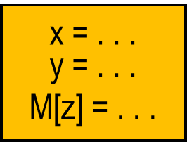
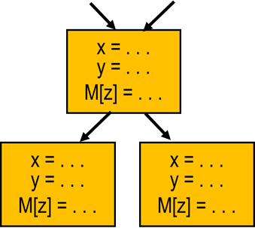
Summary of scheduling
Challenges arise from interaction between
program properties: data dependencies (RAW, WAR, WAW)
and control dependencies
hardware constraints (FU availability, latencies, …)
Optimal solutions typically infeasible → heuristics
Scheduling within a basic block (local): list scheduling
Scheduling across basic blocks (global): trace scheduling
Loop scheduling: SW pipelining, modulo scheduling

