Slide 1
Topic 11: Loops
COS 320
Compiling Techniques
Princeton University
Spring 2016
Lennart Beringer

Slide 2
Loop Preheaders

Slide 3
Loop Preheader Example
goto L
goto L
goto L
goto L
Preheader
L: …….
Loop-invariant code motion
L: …….
if x>5 goto L
if x>5 goto L

Slide 4
Loop Invariant Computation

Slide 5
Loop Invarient Computation

Slide 6
Loop Invariant Code Motion (LICM)

Slide 7
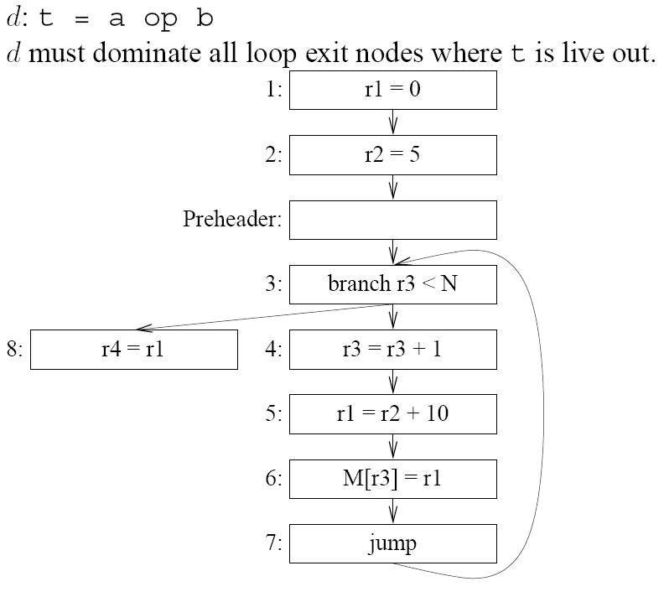
LICM: motivating constraint 1
What could go wrong?

Slide 8
LICM: Constraint 1
Constraint 1
Moving 5: r1 = r2+10 into preheader is illegal: final value of r4 incorrect.

Slide 9
LICM: motivating constraint 2
What could go wrong?
M[r3+4] = r1

Slide 10
LICM: Constraint 2
Constraint 2
Moving 4: r1 = r2+10 into preheader is illegal: second (and later) iteration would use incorrect value of r1 in instruction 5.
6: r1’ = 0
Possible solution: make variable names distinct:
M[r3+4] = r1
7: M[r3] = r1’
Principled approach: SSA

Slide 11
LICM: motivating constraint 3
What could go wrong?
M[r3+4] = r1

Slide 12
LICM: Constraint 3
Constraint 3
Moving 5: r1 = r2+10 into preheader is illegal: initial iteration would read incorrect value from r1
M[r3+4] = r1
(SSA’s variable renaming will get this right, using a trick…)

Slide 13
LICM

Slide 14
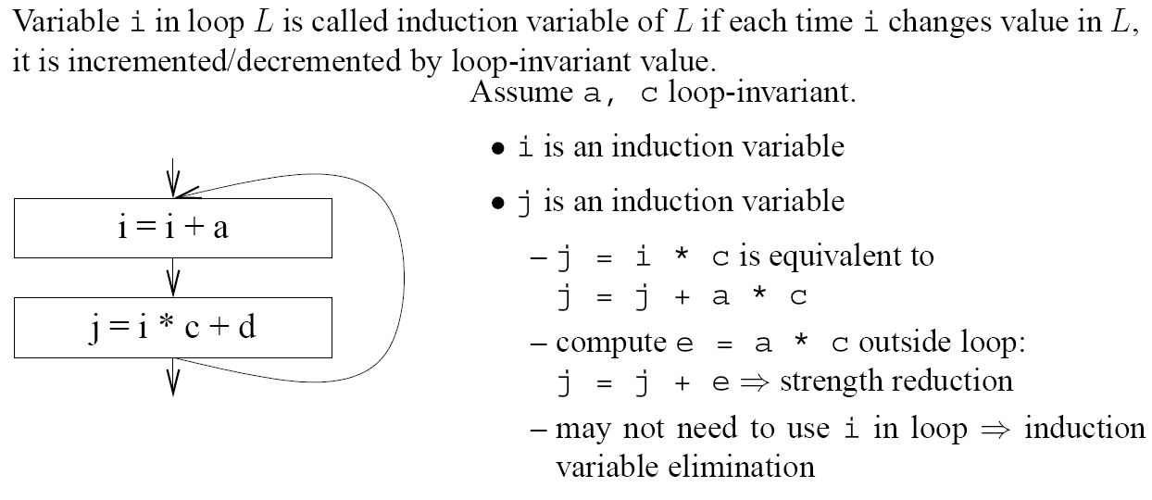
Induction Variables
j0 = i0 * c
i1 = i0 + a
j1 = i1 * c = (i0+a) * c = (i0 * c) + (a * c) = j0 + a * c

Slide 15
Induction Variable Detection

Slide 16
Induction Variable Detection: Algorithm
In general: k = j*c + d → (i, a*c+d, b*c), but there’s usually no instruction form k = j*c + d…

Slide 17
Induction Variable Detection: Algorithm
In general: k = j*c + d → (i, a*c+d, b*c), but there’s usually no instruction form k = j*c + d…

Slide 18
Induction Variable Detection: Algorithm
In general: k = j*c + d → (i, a*c+d, b*c), but there’s usually no instruction form k = j*c + d…

Slide 19
Induction Variable Detection: Algorithm
In general: k = j*c + d → (i, a*c+d, b*c), but there’s usually no instruction form k = j*c + d…

Slide 20
Induction Variable Detection: Example
(* variable s *)
(* variable i *)
basic induction variable(s)?
derived induction variables?

Slide 21
Induction Variable Detection: Example
(* variable s *)
(* variable i *)
r3 : (r2, 0, 4)
r4 : (r2, a, 4)
derived ind.var.
r2 : (r2, 0, 1)
basic ind.var.

Slide 22
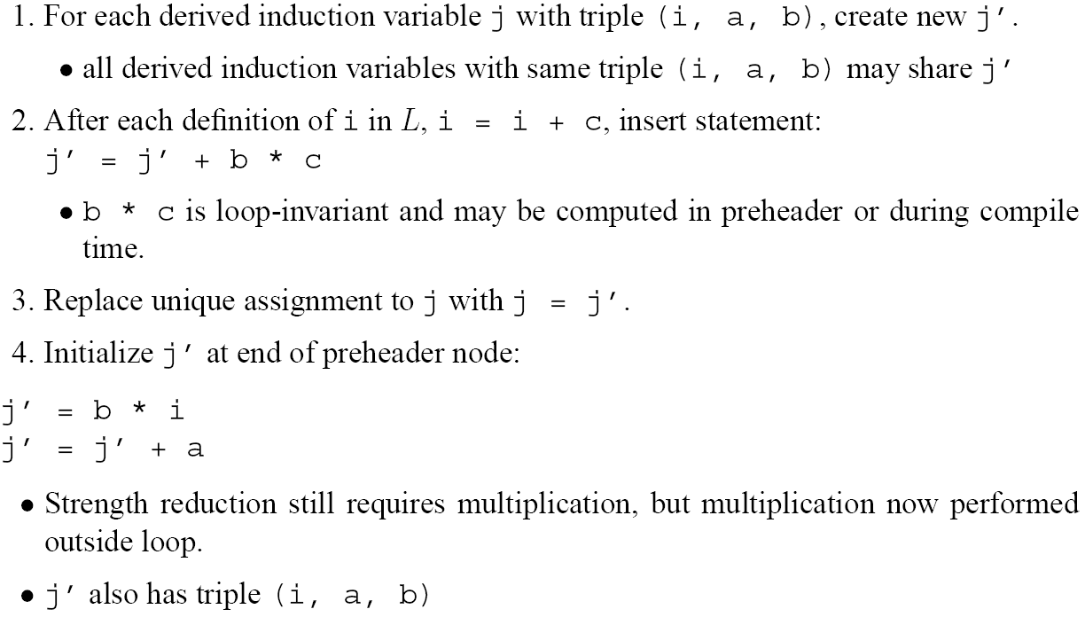
Strength Reduction: replace by cheaper instruction

Slide 23
Strength Reduction Example
r3 : (r2, 0, 4)
r4 : (r2, a, 4)
r2 : (r2, 0, 1)
r33 = r33 + 4*1
r44 = r44 + 4*1

Slide 24
Strength Reduction Example
r3 : (r2, 0, 4)
r3 = r33
r4 : (r2, a, 4)
r4 = r44
r2 : (r2, 0, 1)
r3’ = r33 + 4*1
r4’ = r44 + 4*1

Slide 25
Strength Reduction Example
r33 = 4*r2; r33 = r33 + 0
r44 = 4*r2; r44 = r44 + a
r3 : (r2, 0, 4)
r3 = r33
r4 : (r2, a, 4)
r4 = r44
r2 : (r2, 0, 1)
r3’ = r33 + 4*1
r4’ = r44 + 4*1

Slide 26
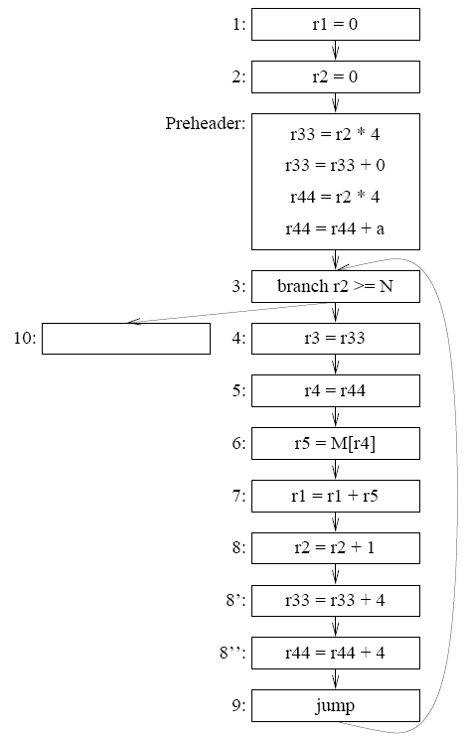
Strength Reduction Example
Strength reduction introduces more opportunities for code optimization . . .

Slide 27
Induction Variable Elimination

Slide 28
Induction Variable Elimination Example
Any dead assignments?
Useless variables?
Copy propagation?

Slide 29
Induction Variable Elimination Example
0
0
0
a
r3 dead
r5 = M[r44]
More?

Slide 30
Induction Variable Elimination Example
0
0
r33 dead
0
a
r3 dead
r5 = M[r44]
r33 useless

Slide 31
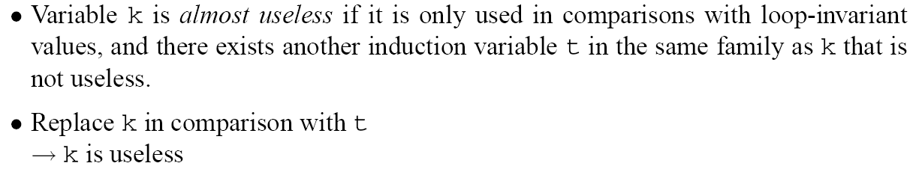
Induction Variable Elimination

Slide 32
Induction Variable Elimination: Example
r2 almost useless
r5 = M[r44]

Slide 33
Induction Variable Elimination: Example
r2 dead
r5 = M[r44]
r2 useless
No more optimizations for now.

Slide 34
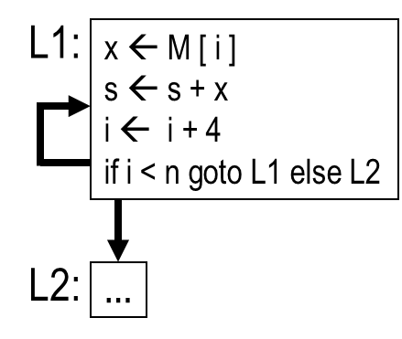
Loop unrolling: Example
Idea: combine several iterations of a loop
# iterations static constant: can unroll fully to straight-line code,
eliminating comparison/jump operation
# iterations fixed (ie loop bound does not change inside the body):
  reduces #iterations/conditional jumps/induction variable increments
  occasionally beneficial for parallelization, scheduling
Running example:

Slide 35
Naïve loop unrolling: simple example
L1:
x ← M [ i ]
s ← s + x
i ← i + 4
if i < n goto L1 else L2
L1:
x ← M [ i ]
s ← s + x
i ← i + 4
if i < n goto L1 else L2
L2:
…
L1’:
x ← M [ i ]
s ← s + x
i ← i + 4
if i < n goto L1’ else L2
L2:
…
Copy loop to make L’ with header h’ and back edges s_{i}’ → h’

Slide 36
Naïve loop unrolling: simple example
L1:
x ← M [ i ]
s ← s + x
i ← i + 4
if i < n goto L1 else L2
L1:
x ← M [ i ]
s ← s + x
i ← i + 4
if i < n goto L1’ else L2
L2:
…
L1’:
x ← M [ i ]
s ← s + x
i ← i + 4
if i < n goto L1’ else L2
L2:
…
Copy loop to make L’ with header h’ and back edges s_{i}’ → h’
Change back edges in L from s_{i} → h to s_{i} → h’

Slide 37
Naïve loop unrolling: simple example
L1:
x ← M [ i ]
s ← s + x
i ← i + 4
if i < n goto L1 else L2
L1:
x ← M [ i ]
s ← s + x
i ← i + 4
if i < n goto L1’ else L2
L2:
…
L1’:
x ← M [ i ]
s ← s + x
i ← i + 4
if i < n goto L1 else L2
L2:
…
Copy loop to make L’ with header h’ and back edges s_{i}’ → h’
Change back edges in L from s_{i} → h to s_{i} → h’
Change back edges in L’ from s_{i}’ → h’ to s_{i}’ → h

Slide 38
Naïve loop unrolling: simple example
L1:
x ← M [ i ]
s ← s + x
i ← i + 4
if i < n goto L1 else L2
L1:
x ← M [ i ]
s ← s + x
i ← i + 4
if i < n goto L1’ else L2
L2:
…
L1’:
x ← M [ i ]
s ← s + x
i ← i + 4
if i < n goto L1 else L2
L2:
…
Copy loop to make L’ with header h’ and back edges s_{i}’ → h’
Change back edges in L from s_{i} → h to s_{i} → h’
Change back edges in L’ from s_{i}’ → h’ to s_{i}’ → h
But: little optimization – still 2 increments and 2 conditional jumps…

Slide 39
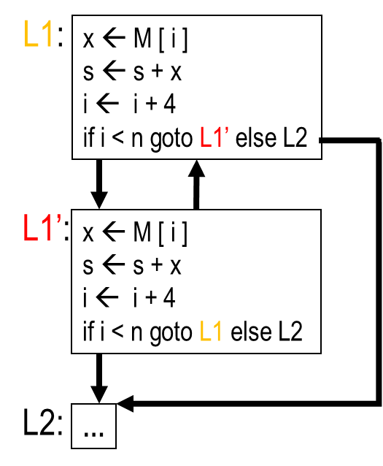
Loop unrolling: “optimistic” merging of bodies
Observe: only one back edge, and both increments to the induction
variable i dominate this back edge. Naïve merging of L1 and L1’:
L1:
x ← M [ i ]
s ← s + x
i ← i + 4
if i < n goto L1’ else L2
L1’:
x ← M [ i ]
s ← s + x
i ← i + 4
if i < n goto L1 else L2
i+4
8
i+4 still needs to be computed…
L2:
…
But: only correct if original loop performed even number of iterations!

Slide 40
Loop unrolling: correcting optimistic merge
L1:
x ← M [ i ]
s ← s + x
i ← i + 4
if i < n goto L1’ else L2
if i + 4 < n goto L1 else L4
L1:
x ← M [ i ]
s ← s + x
x ← M [ i + 4 ]
s ← s + x
i ← i + 8
if i + 4 < n goto L1 else L3
L1’:
x ← M [ i ]
s ← s + x
i ← i + 4
if i < n goto L1 else L2
“do at least 2 more iterations”
i+4
8
“do at most one more iteration”
L2:
…
L3:
if i < n goto L4 else L2
Execute remaining iteration (if necessary) in a new loop epilogue and adjust control flow !
L4:
x ← M [ i ]
s ← s + x
i ← i + 4
“do exactly one more iteration”
L2:
…
Program different from Program 18.11(b) in MCIML, page 424!

Slide 41
Loop unrolling: unroll K iterations
if i + 4 < n goto L1 else L4
if i + 4 (K-1) < n goto L1 else L4
L1:
x ← M [ i ]
s ← s + x
x ← M [ i + 4 ]
s ← s + x
i ← i + 8
if i + 4 < n goto L1 else L3
L1:
x ← M [ i ]
s ← s + x
:
x ← M [ i + 4 (K-1) ]
s ← s + x
i ← i + 4 K
if i + 4 (K-1) < n goto L1 else L3
“do at least 2 more iterations”
“do at least K more iterations”
“do at most one more iteration”
“do at most K-1 more iteration”
L3:
if i < n goto L4 else L2
L3:
if i < n goto L4 else L2
L4:
x ← M [ i ]
s ← s + x
i ← i + 4
L4:
x ← M [ i ]
s ← s + x
i ← i + 4
if i < n goto L4 else L2
“do exactly one more iteration”
“do at least one and at most K-1 more iterations”
degenerate
L2:
…
L2:
…
K=2
epilogue loop
K>2

Slide 42
Loop unrolling: unroll K iterations
if i + 4 (K-1) < n goto L1 else L4
if i + 4 (K-1) < n goto L1 else L4
L1:
x ← M [ i ]
s ← s + x
:
x ← M [ i + 4 (K-1) ]
s ← s + x
i ← i + 4 K
if i + 4 (K-1) < n goto L1 else L3
L1:
x ← M [ i ]
s ← s + x
:
x ← M [ i + 4 (K-1) ]
s ← s + x
i ← i + 4 K
if i + 4 (K-1) < n goto L1 else L3
“do at least K more iterations”
L3:
if i < n goto L4 else L2
L4:
x ← M [ i ]
s ← s + x
i ← i + 4
“do at least one and at most K-1 more iterations”
L4:
x ← M [ i ]
s ← s + x
i ← i + 4
if i < n goto L4 else L2
“do at most K-1 more iteration”
L3:
if i < n goto L4 else L2
L2:
…
K>2
L2:
…
K>2
Swapping order of blocks L3/L4 optimizes code size – at the price of irreducibility!

