Slide 1
Topic 10: Dataflow Analysis
COS 320
Compiling Techniques
Princeton University
Spring 2016
Lennart Beringer

Slide 2
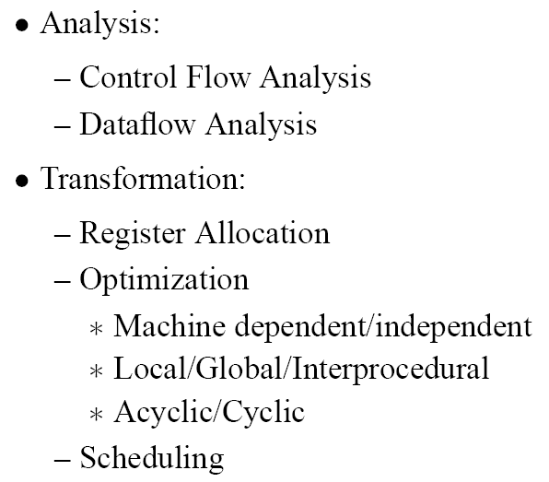
Analysis and Transformation
analysis spans multiple procedures
single-procedure-analysis: intra-procedural

Slide 3
Dataflow Analysis Motivation

Slide 4
Dataflow Analysis Motivation
r2
r3
r4
Assuming only r5 is live-out at instruction 4...

Slide 5
Dataflow Analysis

Slide 6
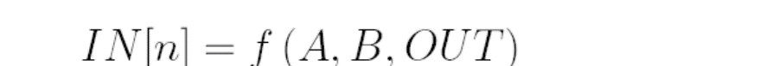
Iterative Dataflow Analysis Framework

Slide 7
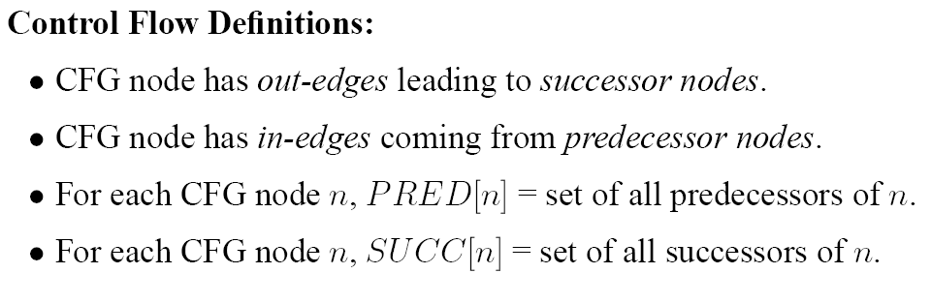
Definitions

Slide 8
Iterative Dataflow Analysis Framework

Slide 9
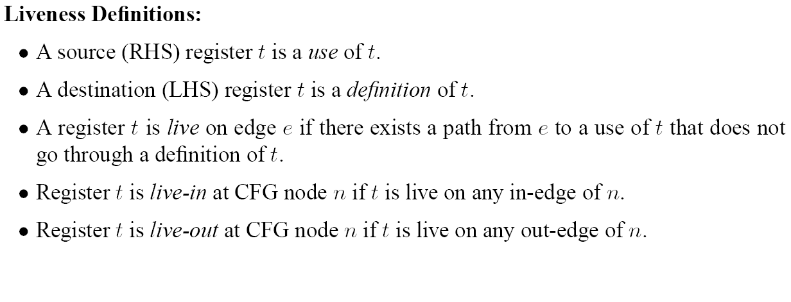
Definitions for Liveness Analysis

Slide 10
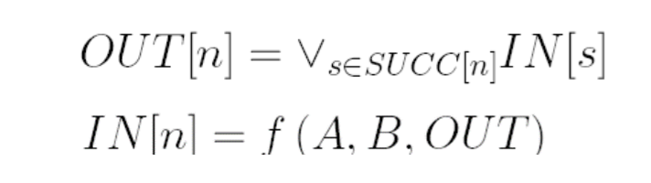
Definitions for Liveness Analysis
Remember generic equations:

Slide 12
--
r1
r1
r2
r2, r3
r3
r2
r1
r1
--
r3
--
--
Smart ordering: visit nodes in reverse order of execution.

Slide 13
--
r1
r1
r2
r2, r3
r3
r2
r1
r3, r1
?
r1
--
r3
r3, r1
r3
--
--
r3
Smart ordering: visit nodes in reverse order of execution.

Slide 14
--
r1
r3, r1
r3
r1
r2
r3, r2
r3, r1
r2, r3
r3
r3, r2
r3, r2
?
r2
r1
r3, r1
r3, r2
r1
--
r3
r3, r1
r3
--
--
r3
Smart ordering: visit nodes in reverse order of execution.

Slide 15
--
r1
r3, r1
r3
r1
r2
r3, r2
r3, r1
:
r2, r3
r3
r3, r2
r3, r2
:
r2
r1
r3, r1
r3, r2
r1
--
r3
r3, r1
r3, r1
r3
--
--
r3
--
r3
Smart ordering: visit nodes in reverse order of execution.

Slide 16
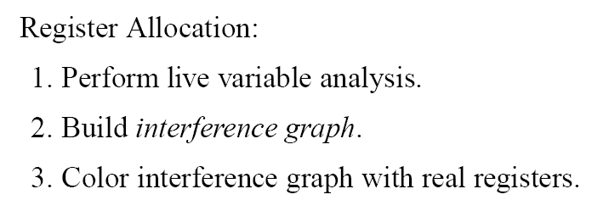
Live Variable Application 1: Register Allocation

Slide 17
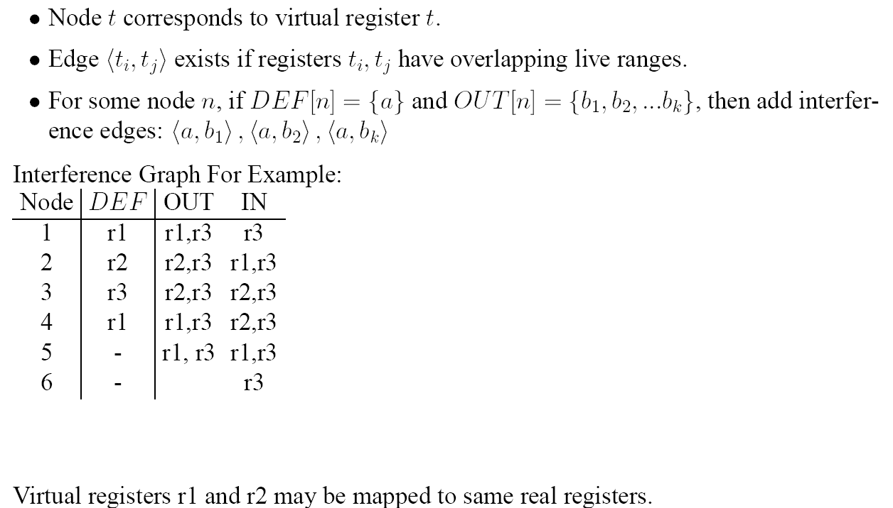
Interference Graph
r1
r3
?
r2

Slide 18
Interference Graph
r1
r3
r2

Slide 19
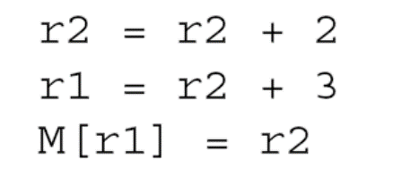
Live Variable Application 2: Dead Code Elimination
of the form
of the form

Slide 20
Live Variable Application 2: Dead Code Elimination
of the form
This may lead to further optimization opportunities, as uses of variables in s disappear. ➔ repeat all / some analysis / optimization passes!
of the form

Slide 21
Reaching Definition Analysis

Slide 22
Reaching Definition Analysis
(details on next slide)

Slide 23
Reaching definitions: definition-ID’s
give each definition point a label (“definition ID”) d:
associate each variable t with a set of labels:
defs(t) = the labels d associated with a def of t
Consider the effects of instruction forms on gen/kill
d: t b op c d: t M[b] d: t f(a_1, …, a_n)
Statement s | Gen[s] | Kill[s]
d: t <- b op c | {d} | defs(t) – {d}
d: t <- M[b] | {d} | defs(t) – {d}
M[a] <- b | {} | {}
if a relop b goto l1 else goto L2 | {} | {}
Goto L | {} | {}
L: | {} | {}
f(a_1, …, a_n) | {} | {}
d: t <- f(a_1, …, a_n) | {d} | defs(t)-{d}

Slide 24
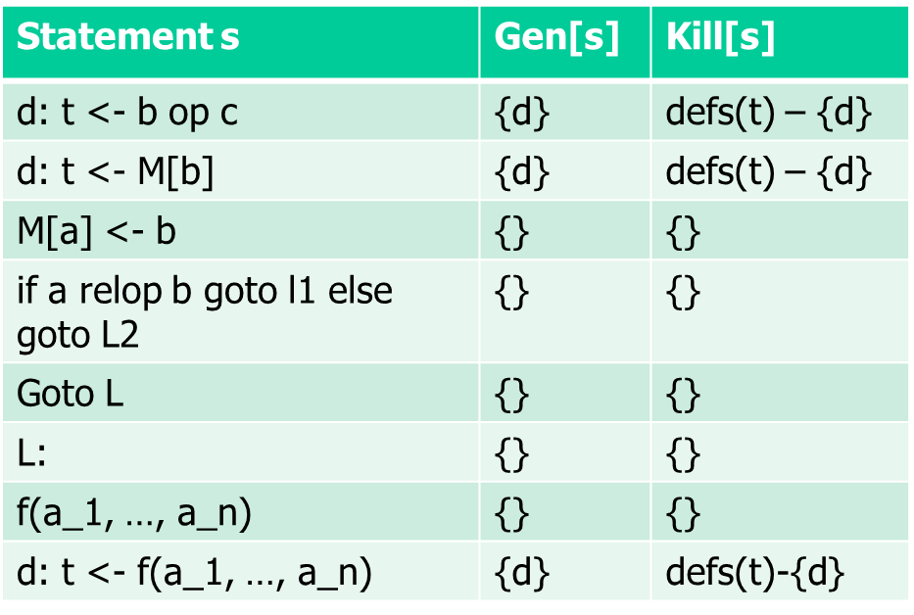
Reaching Defs: Example
1: a <- 5
2: c <- 1
3: L1: if c > a goto L2
6: L2: a <- c-a
4: c <- c+c
7: c <- 0
5: goto L1
defs(a) = ?
defs(c) = ?

Slide 25
Reaching Defs: Example
1: a <- 5
2: c <- 1
3: L1: if c > a goto L2
6: L2: a <- c-a
4: c <- c+c
7: c <- 0
5: goto L1
?
defs(a) = {1, 6}
defs(c) = {2, 4, 7}

Slide 26
Reaching Defs: Example
1: a <- 5
2: c <- 1
3: L1: if c > a goto L2
6: L2: a <- c-a
4: c <- c+c
7: c <- 0
5: goto L1
1
2
4
6
7
?
defs(a) = {1, 6}
defs(c) = {2, 4, 7}

Slide 27
Reaching Defs: Example
1: a <- 5
2: c <- 1
3: L1: if c > a goto L2
6: L2: a <- c-a
4: c <- c+c
7: c <- 0
5: goto L1
1
2
4
6
7
6
4, 7
2, 7
1
2, 4
defs(a)-{1}
defs(c)-{2}
defs(c)-{4}
defs(a)-{6}
defs(c)-{7}
defs(a) = {1, 6}
defs(c) = {2, 4, 7}

Slide 28
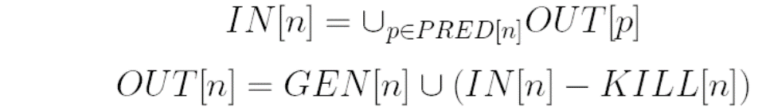
Reaching Defs: Example
1: a <- 5
2: c <- 1
3: L1: if c > a goto L2
6: L2: a <- c-a
4: c <- c+c
7: c <- 0
5: goto L1
1
2
4
6
7
6
4, 7
2, 7
1
2, 4
?
Direction: FORWARD, IN/OUT initially {}

Slide 29
Reaching Defs: Example
1: a <- 5
2: c <- 1
3: L1: if c > a goto L2
6: L2: a <- c-a
4: c <- c+c
7: c <- 0
5: goto L1
1
2
4
6
7
6
4, 7
2, 7
1
2, 4
{ }
{1}
{1}
{1, 2}

Slide 30
Reaching Defs: Example
1: a <- 5
2: c <- 1
3: L1: if c > a goto L2
6: L2: a <- c-a
4: c <- c+c
7: c <- 0
5: goto L1
1
2
4
6
7
6
4, 7
2, 7
1
2, 4
{ }
{1}
{1}
{1, 2}
{1,2}
{1, 2}
{1,2}
{1, 4}

Slide 31
Reaching Defs: Example
1: a <- 5
2: c <- 1
3: L1: if c > a goto L2
6: L2: a <- c-a
4: c <- c+c
7: c <- 0
5: goto L1
1
2
4
6
7
6
4, 7
2, 7
1
2, 4
{ }
{1}
{1}
{1, 2}
{1}
{1, 2}
{1,2}
{1, 4}
{1,4}
{1, 4}
{1,2}
{2,6}
{2,6}
{6,7}

Slide 32
Reaching Defs: Example
1: a <- 5
2: c <- 1
3: L1: if c > a goto L2
6: L2: a <- c-a
4: c <- c+c
7: c <- 0
5: goto L1
1
2
4
6
7
6
4, 7
2, 7
1
2, 4
{ }
{1}
{ }
{1}
{1}
{1, 2}
{1}
{1, 2}
{1,2}
{1, 2}
{1,2,4}
{1, 2,4}
{1,2}
{1, 4}
{1,2,4}
{1, 4}
No change
{1,4}
{1, 4}
{1,4}
{1, 4}
{1,2}
{2,6}
{1,2,4}
{2,4,6}
{2,6}
{6,7}
{2,4,6}
{6,7}

Slide 33
Reaching Definition Application 1: Constant Propagation
c
5
5
10
5
Similarly: copy propagation,
replace eg
r1 = r2; r3 ← r1 + 5
with r3 ← r2 + 5
But often register allocation can
already coalesce r1 and r2.

Slide 34
Reaching Definition Application 2: Constant Folding
15

Slide 35
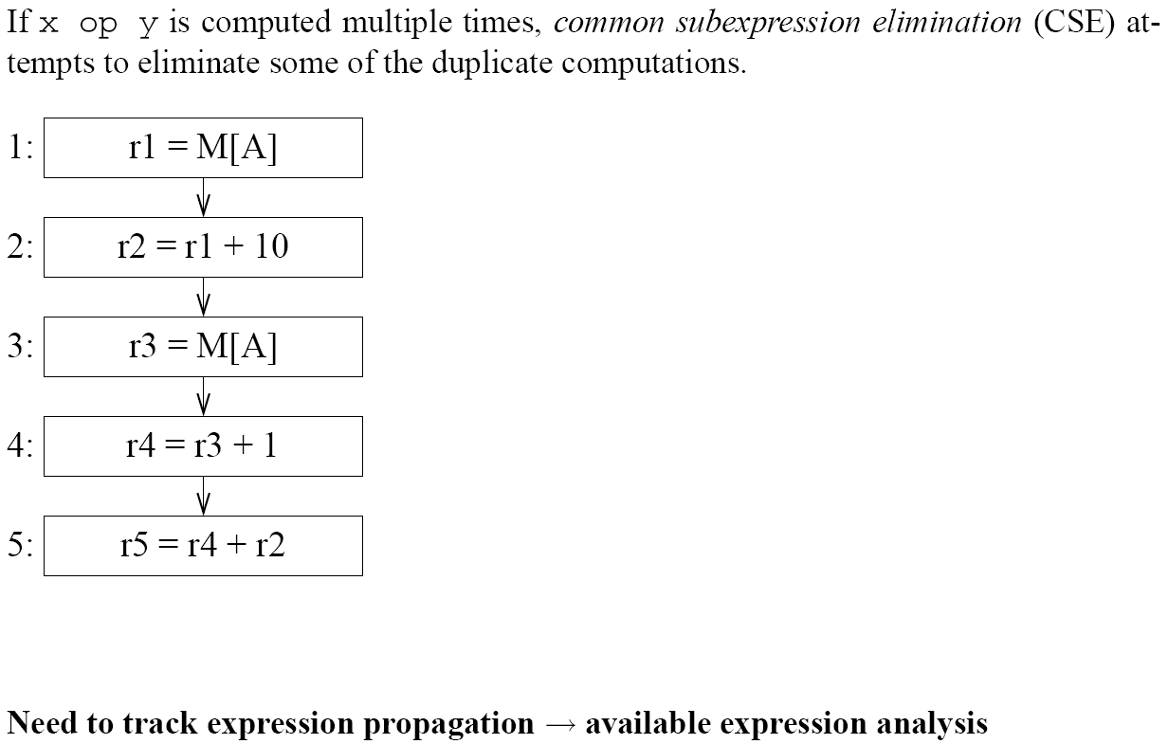
Common Subexpression Elimination
CSE

Slide 36
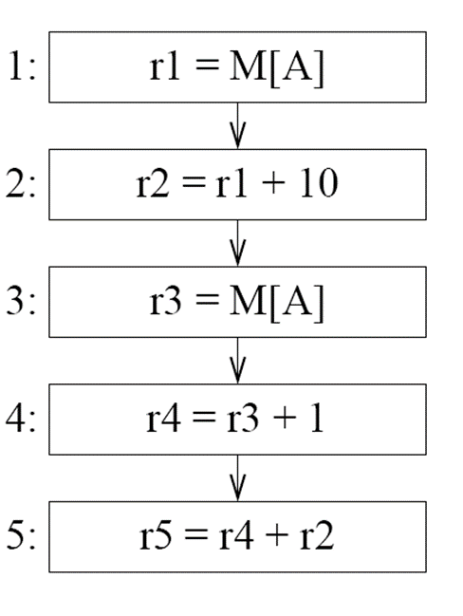
Common Subexpression Elimination
r1
CSE

Slide 37
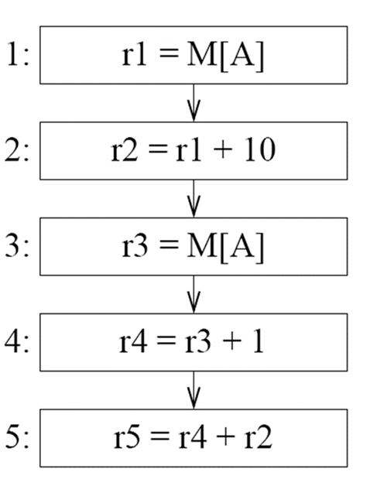
Common Subexpression Elimination
r1
r1
CSE
Copy Prop.

Slide 38
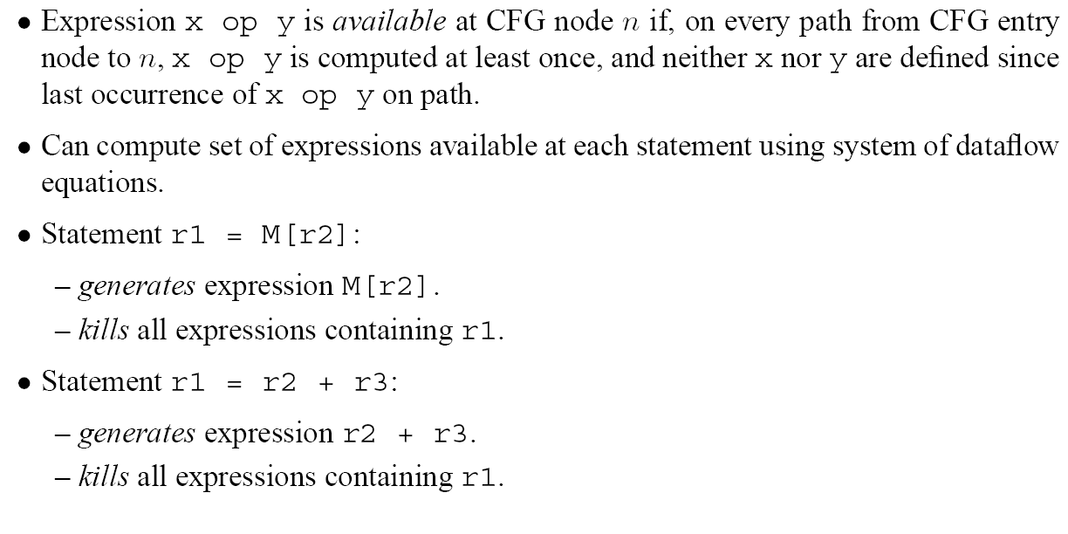

Definitions
entry
e must be computed at least once on any path
e
r1 = x op y
r2 = x op y
x:=66
no defs of registers used by e here!
r3 = x op y
Generally, many expressions are available at any program point
e available here!

Slide 39
Definitions
(ie statements generate/kill availability)
entry
e must be computed at least once on any path
e
r1 = x op y
r2 = x op y
x:=66
no defs of registers used by e here!
r3 = x op y
Generally, many expressions are available at any program point
e available here!

Slide 40
Definitions
(ie statements generate/kill availability)
entry
e must be computed at least once on any path
e
r1 = x op y
r2 = x op y
x:=66
Statement M[r2] = e
- generates no expression (we do
availability in register here)
- kills any M[ .. ] expression, ie loads
no defs of registers used by e here!
r3 = x op y
Generally, many expressions are available at any program point
e available here!

Slide 41
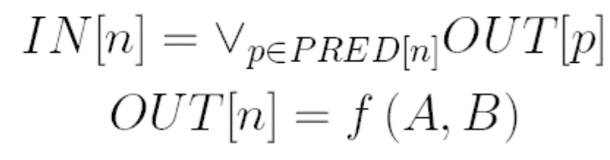
Iterative Dataflow Analysis Framework (forward)
OK?
Statement s | Gen(s) | Kill(s)
t ← b op c | {b op c} | exp(t)
expressions containing t

Slide 42
Iterative Dataflow Analysis Framework (forward)
to deal with t = b or t = c
Statement s | Gen(s) | Kill(s)
t ← b op c | {b op c} – kill(s) | exp(t)
t ← M[b] | {M[b]} – kill(s) | exp(t)
M[a] ← b | {} | “fetches”
if a rop b goto L1 else goto L2 | {} | {}
Goto L | {} | {}
L: | {} | {}
f(a₁,..,a_{n}) | ? | ?
t ← f(a₁, .., a_{n}) | ? | ?
expressions containing t
expressions of the form M[ _ ]

Slide 43
Iterative Dataflow Analysis Framework (forward)
to deal with t = b or t = c
Statement s | Gen(s) | Kill(s)
t ← b op c | {b op c} – kill(s) | exp(t)
t ← M[b] | {M[b]} – kill(s) | exp(t)
M[a] ← b | {} | “fetches”
if a rop b goto L1 else goto L2 | {} | {}
Goto L | {} | {}
L: | {} | {}
f(a₁,..,a_{n}) | {} | “fetches”
t ← f(a₁, .., a_{n}) | {} | exp(t) “fetches”
expressions containing t
expressions of the form M[ _ ]
∩

Slide 44
Available Expression Analysis
only expressions that are out-available at all predecessors of n are in-available at n
fact that sets shrink triggers initialization of all sets to U (set of all expressions), except for IN[entry] = {}

Slide 45
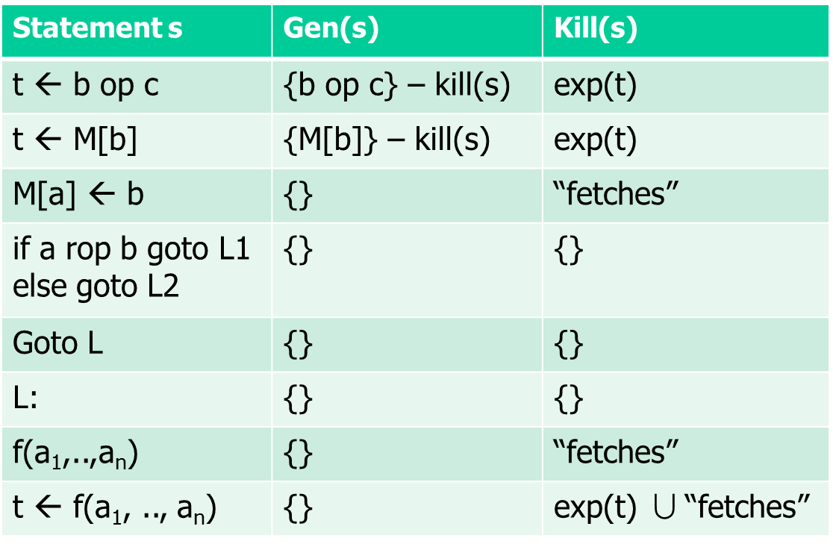
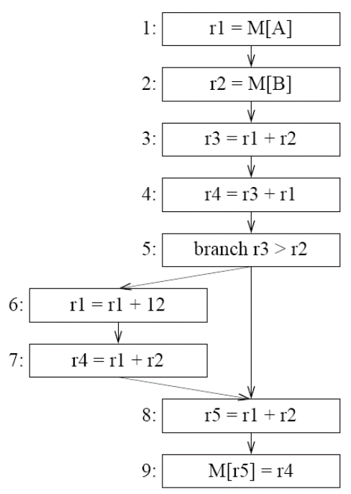
Step 1: fill in Kill[n]
Node n | Gen[n] | Kill[n]
1
2
3
4
5
6
7
8
9
no singleton registers (r4 etc)
no Boolean exprs (r3>r2)
Universe U of expressions:
M[r5], M[A], M[B],
r1+r2, r1+ 12, r3+r1
exp(r5)
“fetches”
exp(r2)
exp(r1)
exp(r3)

Slide 46
Step 2: fill in Gen[n]
Node n | Gen[n] | Kill[n]
1 |  | r1+r2, r1+ 12, r3+r1
2 |  | r1+r2
3 |  | r3+r1
4 |  | -
5 |  | -
6 |  | r1+r2, r1+ 12, r3+r1
7 |  | -
8 |  | M[r5]
9 |  | M[r5], M[A], M[B]
no singleton registers (r4 etc)
no Boolean exprs (r3>r2)
Universe U of expressions:
M[r5], M[A], M[B],
r1+r2, r1+ 12, r3+r1
exp(r5)
“fetches”
exp(r2)
exp(r1)
exp(r3)

Slide 47
Example
Node n | Gen[n] | Kill[n]
1 | M[A] | r1+r2, r1+ 12, r3+r1
2 | M[B] | r1+r2
3 | r1+r2 | r3+r1
4 | r3+r1 | -
5 | - | -
6 | - | r1+r2, r1+ 12, r3+r1
7 | r1+r2 | -
8 | r1+r2 | M[r5]
9 | - | M[r5], M[A], M[B]
no singleton registers (r4 etc)
no Boolean exprs (r3>r2)
Universe U of expressions:
M[r5], M[A], M[B],
r1+r2, r1+ 12, r3+r1
exp(r5)
“fetches”
exp(r2)
exp(r1)
exp(r3)

Slide 48
Example: hash expressions
n | Gen[n] | Kill[n]
1 | M[A] | r1+r2, r1+ 12, r3+r1
2 | M[B] | r1+r2
3 | r1+r2 | r3+r1
4 | r3+r1 | -
5 | - | -
6 | - | r1+r2, r1+ 12, r3+r1
7 | r1+r2 | -
8 | r1+r2 | M[r5]
9 | - | M[r5], M[A], M[B]
n | Gen[n] | Kill[n]
1 | 5 | 1, 2, 3
2 | 6 | 1
3 | 1 | 3
4 | 3 | -
5 | - | -
6 | - | 1, 2, 3
7 | 1 | -
8 | 1 | 4
9 | - | 4, 5, 6
r1+r2 | 1
r1+12 | 2
r3+r1 | 3
M[r5] | 4
M[A] | 5
M[B] | 6

Slide 49
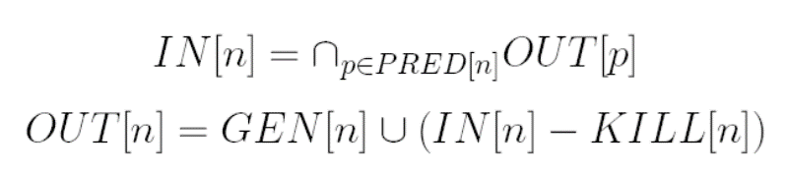
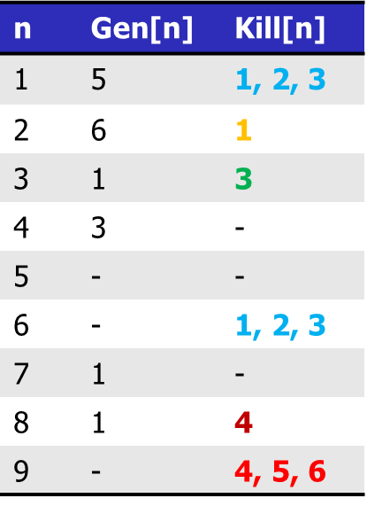
Step 3: DF iteration
FORWARD
In | Out | In[n] | Out[n]
{} | U
U | U
U | U
U | U
U | U
U | U
U | U
U | U
U | U
:
:
:
U = {1, .., 6}

Slide 50
Example
FORWARD
In | Out | In[n] | Out[n]
{} | U | {} | 5
U | U | 5 | 5,6
U | U | 5, 6 | 1, 5, 6
U | U | 1, 5, 6 | 1, 3, 5, 6
U | U | 1, 3, 5, 6 | 1, 3, 5, 6
U | U | 1, 3, 5, 6 | 5, 6
U | U | 5, 6 | 1, 5, 6
U | U | 1, 5, 6 | 1, 5, 6
U | U | 1, 5, 6 | 1
U = {1, .., 6}

Slide 51
Example
M[A]
r1+r2 | 1
r1+12 | 2
r3+r1 | 3
M[r5] | 4
M[A] | 5
M[B] | 6
In[n] | Out[n]
{} | 5
5 | 5, 6
5, 6 | 1, 5, 6
1, 5, 6 | 1, 3, 5, 6
1, 3, 5, 6 | 1, 3, 5, 6
1, 3, 5, 6 | 5, 6
5, 6 | 1, 5, 6
1, 5, 6 | 1, 5, 6
1, 5, 6 | 1
M[A], M[B]
r1+r2, M[A], M[B]
r1+r2, r3+r1, M[A], M[B]
r1+r2, r3+r1, M[A], M[B]
M[A], M[B]
r1+r2, M[A], M[B]
r1+r2, M[A], M[B]
r1+r2, M[A], M[B]
r1+r2

Slide 52
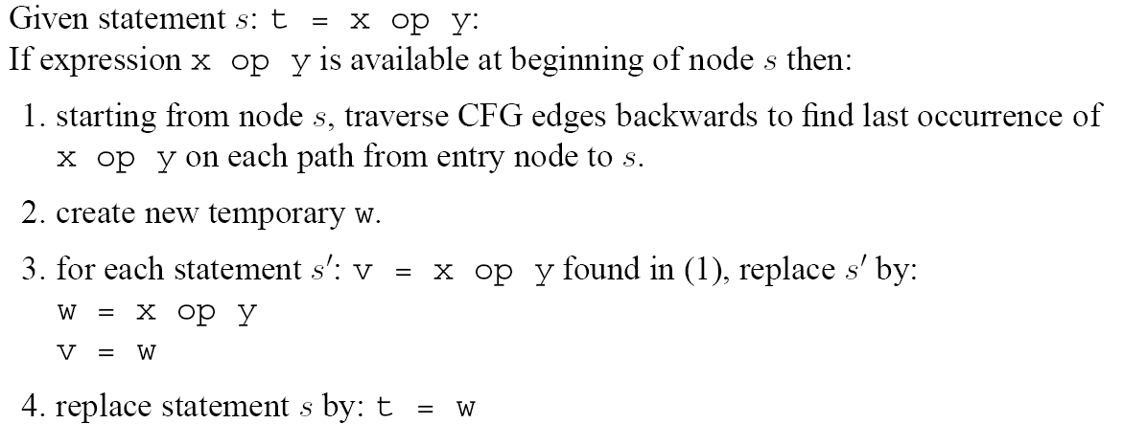
Common Subexpression Elimination (CSE)
Can be seen as further analysis: “reaching expressions”
Note that the same w is used for all occurrences of x op y:
s1: v = x op y
s2: u = x op y
s1’: w = x op y
v = w
s2’: w = x op y
u=w
s: t = x op y
s: t = w

Slide 53
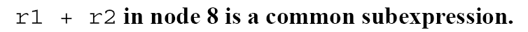
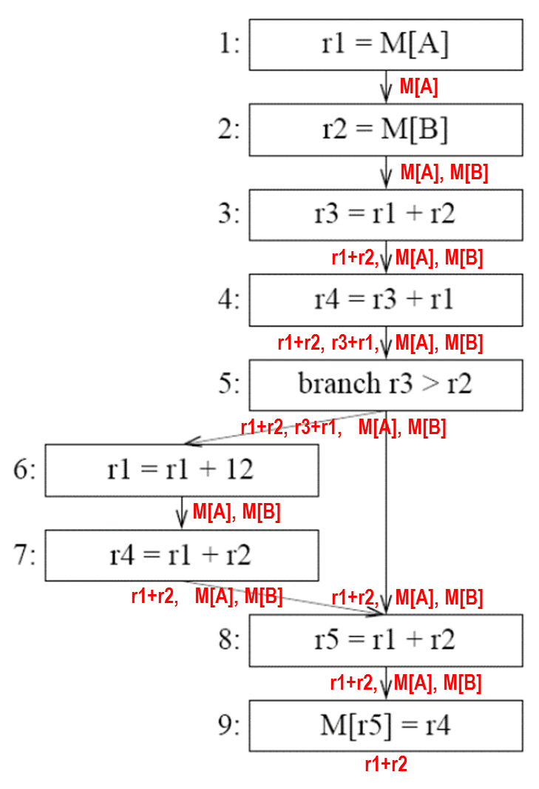
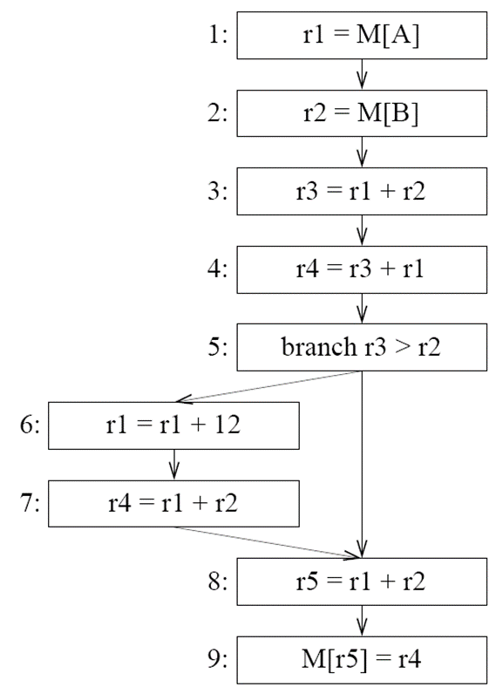
CSE Example
w
; r3 = w
w
; r4 = w
w

Slide 54
Copy Propagation

Slide 55
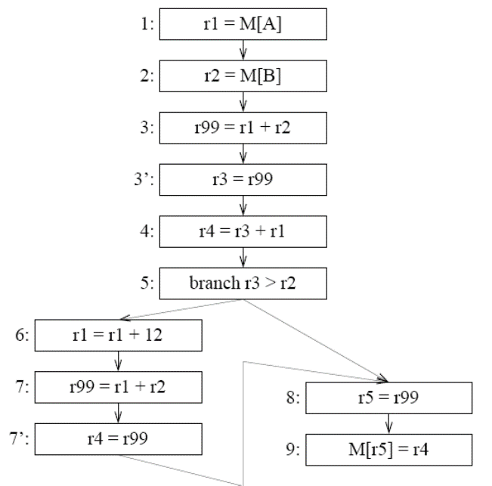
Copy Propagation
r4 = r99 + r1
M[r99] = r4

Slide 56
Sets

Slide 57
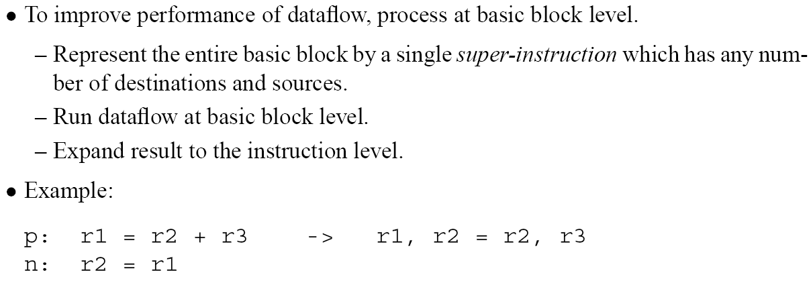
Basic Block Level Analysis
defs
uses

Slide 58
Basic Block Level Analysis

Slide 59
Basic Block Level Analysis
=
=
IN[pn]
OUT[pn]

Slide 60
Reducible Flow Graphs Revisited
irreducible
reducible
Not a backedge – dest does not dominate src

Slide 61
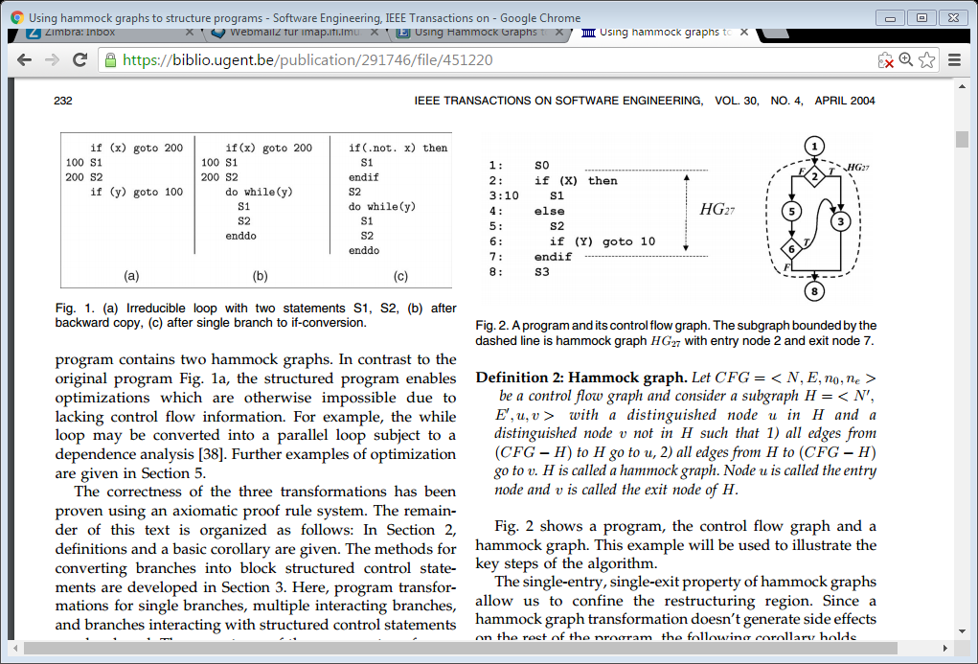
Reducible Flow Graphs – Structured Programs
Subgraph H of CFG, and nodes u є H, v є H such that
all edges into H go to u,
all edges out of H go to v

Slide 62
Reaching Definitions for Structured Programs
Remember:
p
n
l
r

Slide 63
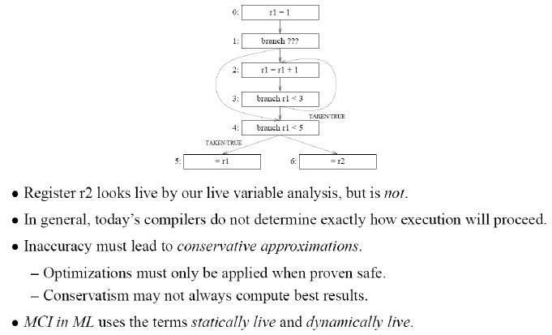
Conservative Approximations

Slide 64
Limitation of Dataflow Analysis
There are more sophisticated program analyses that
can (conservatively) approximate the ranges/sets of “possible values”
fit into a general framework of transfer functions and inference by iterated updates until a fixed point is reached: “abstract interpretation”
are very useful for eliminating dead branches, showing that
array accesses are always within range,…
But eventually, they run into the same theoretical limitations
Other example:

Slide 65
Implementation issues
Representation of data flow info (sets of variables, expressions, labels, …)
  linked lists, maybe ordered by variable name
    suitable for sparse analyses (typically, only few variables are live at a program point … )
  bit-vectors of length N, if set is of size < 2^N
    union, intersection implemented by bit-wise OR/AND
    suitable for dense analyses
Speeding up iterations: worklist algorithms
  instead of traversing all nodes in each iteration, just revisit those nodes for which IN/OUT might change
  FORWARD: after visiting a node, if OUT[n] was modified, ensure that all successors of n are in the queue (insert if necessary)
  BACKWARD: similarly, add predecessors of n if IN[n] has changed
“single-information-at-a-time” versus “exhaustive” information:
  “is the (costly-to-compute) expression e available here” versus “give me all available expressions, at all program points”

Slide 66
Use-def chains, def-use chains
many optimizations exploit def-use relationship
avoid recalculation by introducing a data structure
Use-def chain: for each use of a variable store the set of reaching definitions
Def-use chain: for each definition d of a variable store all its uses
i1
x = …
i3
Var | Use | Defs
x | i2 | i1
x | i4 | i1, i3
x | i5 | i1, i3
y | i6 | i5
x = …
Var | Def | Uses
x | i1 | i2, i4, i5
x | i3 | i4, i5
y | i5 | I6
i2
i4
… = ..x..
… = ..x..
i5
y = ..x..
i6
… = ..y..
Generalization: static single-assignment (SSA) form – see future lecture.

