Slide 1
Topic 5: Types
COS 320
Compiling Techniques
Princeton University
Spring 2016
Lennart Beringer
Notes:
Three major parts: motivation of type systems; formal framework; step-by-step development of a FUN-like type system

Slide 2
Types: potential benefits (I)
For programmers:
help to eliminate common programming mistakes, particularly mistakes that might lead to runtime errors (or prevent program from being compiled)
provide abstractions and modularization discipline: can substitute code with alternative implementation without breaking surrounding program context
Example (ML signatures):
sig
type sorted_list
val sort : int list -> sorted_list
val lookup : sorted_list -> int -> bool
val insert: sorted_list -> int -> sorted_list
end
Internal definition of sorted_list not revealed to clients, so can
replace one implementation by another one!
Similarly for other invariants.

Slide 3
Types: potential benefits (II)
For language designers:
yields structuring mechanism for programs – thus encodes abstraction principles that motivate development of new language
basis for studying (interaction between) language features (references, exceptions, IO, other side effects, h-o-functions)
formal basis for reasoning about program behavior (verification, security analysis, resource usage)

Slide 4
Types: potential benefits (III)
For compiler writers:
filter out programs that backend should never see (and can’t handle)
provide information that’s useful in later phases:
  is that + a floating point add or an integer add?
  does value v fit into a single register? (size of data types)
  how should the stack frame for function f be organized (number and type/size of function arguments and return value)
  support generation of efficient code:
    less code needed for handling errors (and handling casting)
    enables sharing of implementations (source of confusion eliminated by types)
  postY2k: typed intermediate languages
    model intermediate representations as full language, with types that communicate structural code properties and analysis results between compiler phases (example: different types for caller/callee registers)
  “refined” type systems: provide alternative formalism for program analysis and optimization

Slide 5
Type-enforced safety guarantees
Memory Safety – can’t dereference something not a pointer
Control-Flow Safety – can’t jump to something not code
Type Safety – typing predications (“this value will be a string”) come true at run time, so no operator-operand mismatches
Prevents programmer from writing code that “obviously” can’t be right.
All these errors are eliminated during development time, so applications much more robust!
Contrast with C (weakly typed): implicit casting, null pointers, array-out-of-bounds, buffer overruns, security violations

Slide 6
Type systems: limitations
Can’t eliminate all runtime errors
  division by zero (input dependence)
  exception behavior often not modeled/enforced
static type analyses are typically conservative: will reject some safe programs due to fundamental undecidability of perfectly predicting control flow
Types typically involve some programmer annotations - - burden
+ documentation;
+ burden occurs at compile time, not runtime
cryptic error messages
but trade-off against debugging/ tracing effort upon hitting segfault

Slide 7
Types: design & implementation tasks
Practical tasks (for compiler writer): develop algorithms for
  type inference: given an expression e, calculate whether there some type T such that e:T holds. If so, return (the best such) type T, or a representation of all such types.
  May need program annotations.
  type checking: given a fully type-annotated program, check that the typing rules are indeed applied correctly
Theoretical tasks (language designer): study
  uniqueness of typings, existence of best types
  decidability and complexity of above tasks / algorithms
  type soundness: give a precise definition of “good behavior (runtime model, error model) and prove that “well-typed programs can’t go wrong” (Milner)
Common formalism: derivation systems (cf formal logic)
  formal judgments, derivation/typing rules, derivation trees

Slide 8
Defining a Formal Type System
RE → Lexing
CFG → Parsers
Inductive Definitions → Type Systems / logical derivation systems
Components of a type system:
a notion of types
specification of syntactic judgment forms – A judgment is an assertion/claim, may or may not be true.
  implicitly or explicitly underpinned by an interpretation (“validity”)
  Typical judgement forms for type systems in PL: e:T, Γ e:T
inference rules – tell us how to obtain new judgment instances from previously derived ones
  should preserve validity so that only “true” judgments can be derived
т
т

Slide 9
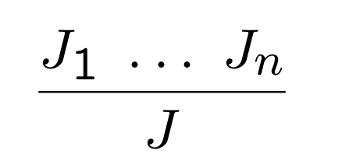
Inference Rules
An inference rule has a set of premises J₁, . . . , J_{n} and one conclusion J, separated by a horizontal line:
Read:
If I can establish the truth of the premises J₁,...,J_{n}, I can conclude: J is true.
To check J, check J₁,...,J_{n}.
An inference rule with no premises is called an Axiom – J always true

Slide 10
But what IS a type?
Competing views:
Types are mostly syntactic entities, with little inherent meaning:
  the types for this language are A, B, C; here are the typing rules
  if you can’t infer a type for e / check that e:T holds, reject e:
  untyped programs are not programs
  intent / design goals of type system (partially) revealed by what you can do with well-typed programs (e.g. compile to efficient code)

Slide 11
But what IS a type?
Competing views:
Types are mostly syntactic entities, with little inherent meaning:
  the types for this language are A, B, C; here are the typing rules
  if you can’t infer a type for e / check that e:T holds, reject e:
  untyped programs are not programs
  intent / design goals of type system (partially) revealed by what you can do with well-typed programs (e.g. compile to efficient code)
Types have “semantic content”, for example by capturing properties an execution may have
  types as an algorithmic approximation to classify behaviors
  if you can’t derive a judgement e:T using the typing rules, but e still “has” the behavior captured by T, that’s fine
  => types describe properties of a priori untyped programs

Slide 12
But what IS a type?
traditional compiler view
Competing views:
Types are mostly syntactic entities, with little inherent meaning:
  the types for this language are A, B, C; here are the typing rules
  if you can’t infer a type for e / check that e:T holds, reject e:
  untyped programs are not programs
  intent / design goals of type system (partially) revealed by what you can do with well-typed programs (e.g. compile to efficient code)
Types have “semantic content”, for example by capturing properties an execution may have
  types as an algorithmic approximation to classify behaviors
  if you can’t derive a judgement e:T using the typing rules, but e still “has” the behavior captured by T, that’s fine
  => types describe properties of a priori untyped programs
Many variations possible, depending on goals!
often more modular

Slide 13
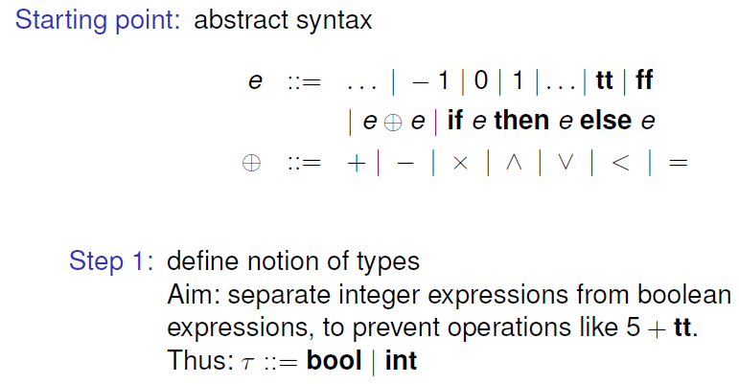
Type system for simple expressions

Slide 14
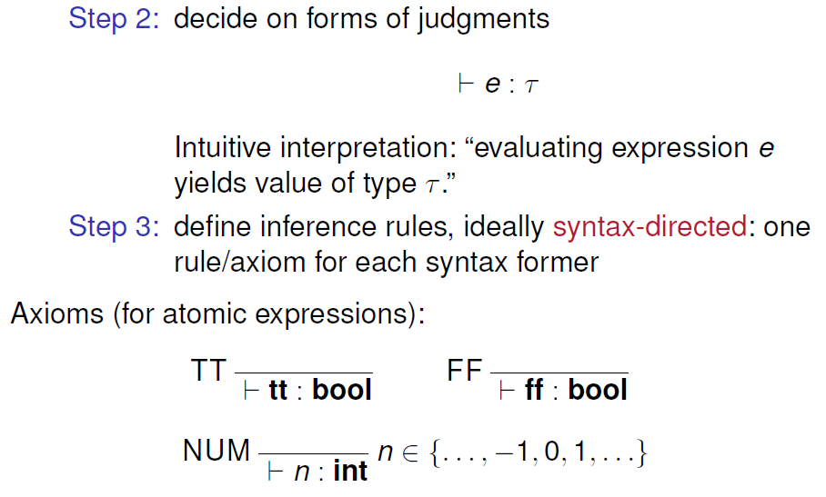
Type system for simple expressions

Slide 15
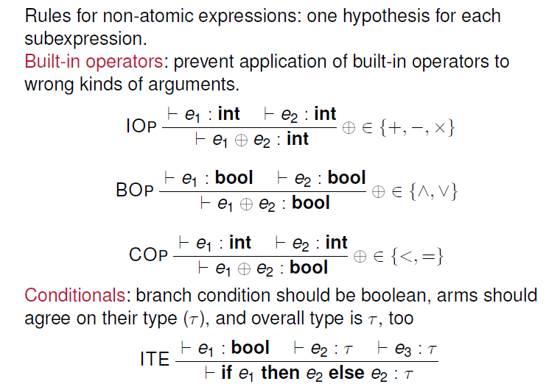
Type system for simple expressions

Slide 16
Type Checking Implementation
fun check (e: Expr, t: Type): bool :=
case t of
Bool => (case e of … )
| Int => (case e of … );
type in the host language (the language the compiler is implemented in)

Slide 17
Type Checking Implementation
fun check (e: Expr, t: Type): bool :=
case t of
Bool => (case e of .. )
| Int => (case e of … )
expressions/types of the object language, ie the language for which we’re writing a compiler

Slide 18
Type Checking Implementation
fun check (e: Expr, t: Type): bool :=
case t of
Bool => (case e of
tt => true
| ff => true
| f e1 e2 => (case f of
AND => check (e1,Bool) andalso check (e2, Bool)
| (*similar case for OR *)
| LESS => check (e1, Int) andalso check(e2, Int)
| (*similar cases for EQ etc*)
| _ => false)
| IF e1 THEN e2 ELSE e3 => check (e1, Bool) andalso
check (e2, Bool) andalso (e3, Bool))
| Int => (case e of … )
Alternative: swap nesting of case distinctions for expressions and types.

Slide 19
Type Inference Implementation
fun infer (e:Expr): Type option =
case e of
tt => Some Bool
| ff => Some Bool
| BINOP f e1 e2 => ???
| …

Slide 20
Type Inference Implementation
fun infer (e:Expr): Type option =
case e of
tt => Some Bool
| ff => Some Bool
| BINOP f e1 e2 => (case f of
AND => if check(e1, Bool) andalso check(e2, Bool)
then Some Bool else None
| …

Slide 21
Type Inference Implementation
fun infer (e:Expr): Type option =
case e of
tt => Some Bool
| ff => Some Bool
| BINOP f e1 e2 => (case f of
AND => if check(e1, Bool) andalso check(e2, Bool)
then Some Bool else None
| …
alternative that does not use check:
case (infer e1, infer e2) of
(Some bool, Some bool) => Some bool
| (_, _) => None

Slide 22
Type Inference Implementation
fun infer (e:Expr): Type option =
case e of
tt => Some Bool
| ff => Some Bool
| BINOP f e1 e2 => (case f of
AND => if check(e1, Bool) andalso check(e2, Bool)
then Some Bool else None
| PLUS => if check (e1, Int) andalso check(e2, Int)
then Some Int else None
| LESS => if check (e1, Int) andalso check (e2, Int)
then Some Bool else None
| … )
| IF e1 THEN e2 ELSE e3 => ???
alternative that does not use check:
case (infer e1, infer e2) of
(Some bool, Some bool) => Some bool
| (_, _) => None

Slide 23
Type Inference Implementation
fun infer (e:Expr): Type option =
case e of
tt => Some Bool
| ff => Some Bool
| BINOP f e1 e2 => (case f of
AND => if check(e1, Bool) andalso check(e2,Bool)
then Some Bool else None
| (*similar cases for other binops*) )
| IF e1 THEN e2 ELSE e3 => if check(e1, Bool)
then case (infer e2, infer e3) of
(Some t1, Some t2) =>
if t1=t2 then Some t1 else None
| (_, _) => None
else None
| (*other expressions*)
equality between types (often defined by induction)
Improvement: replace return type “Type option” by type that allows informative error messages in case where inference fails.

Slide 24
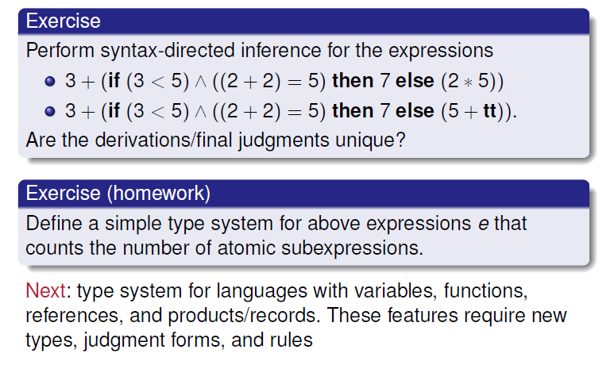
Type system for simple expressions

Slide 25
Type system for simple expressions

Slide 26
Type system for simple expressions

Slide 27
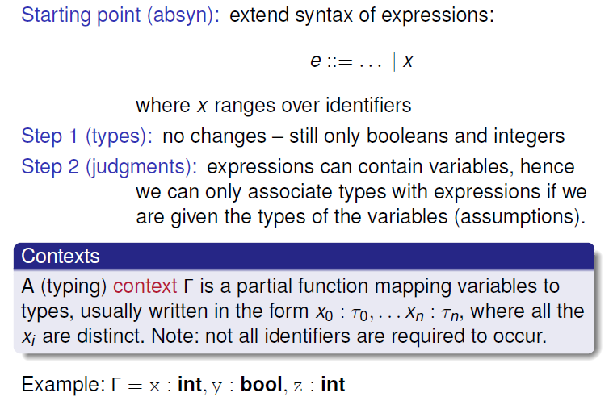
Adding variables (I)
aka symbol table

Slide 28
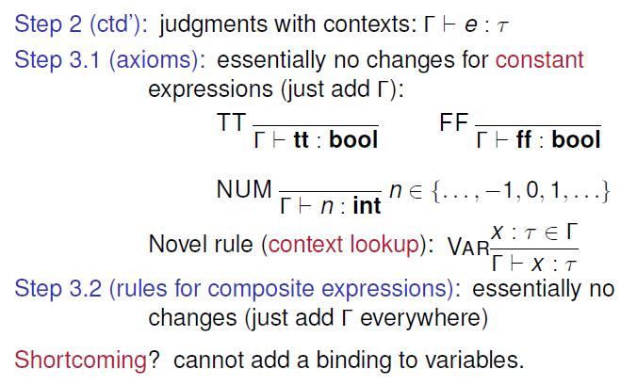
Adding variables (II)
side condition

Slide 29
Adding variables (II)
side condition

Slide 30
Adding variables (II)
side condition

Slide 31
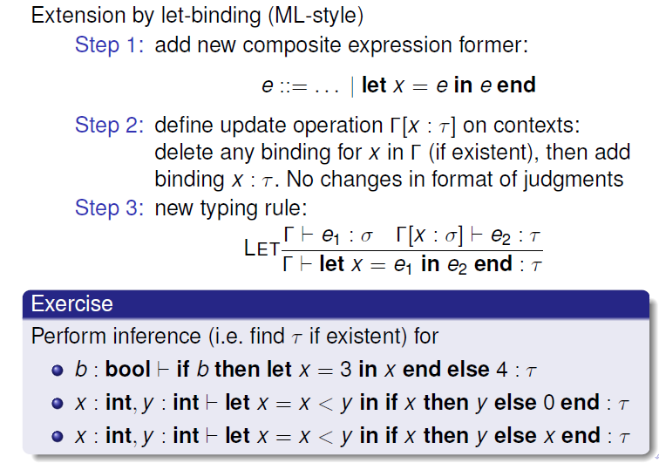
Adding variables (III)

Slide 32
Adding variables (III)

Slide 33
Adding variables (III)

Slide 34
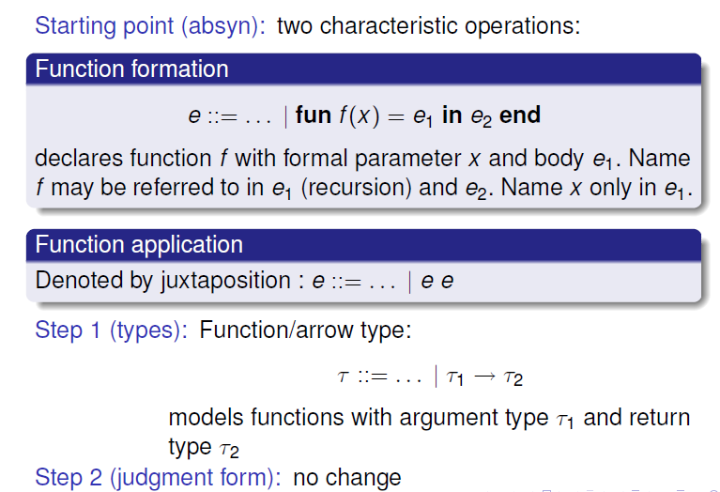
Adding functions (I)

Slide 35
Adding functions (I)

Slide 36
Adding functions (I)

Slide 37
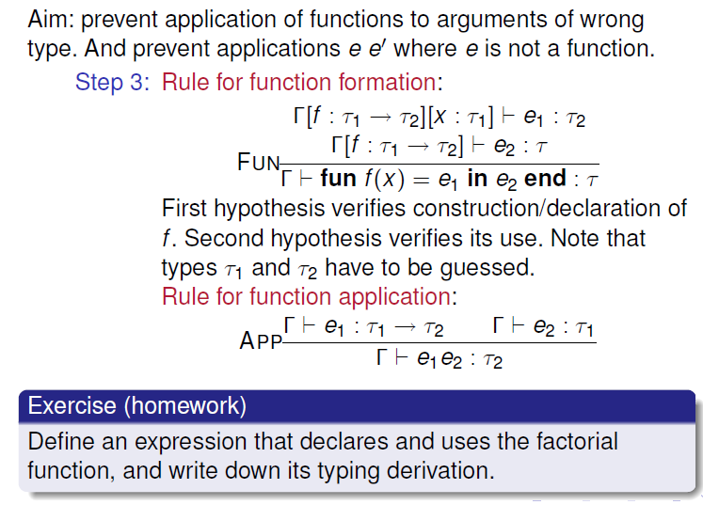
Adding functions (II)

Slide 38
Adding functions (II)
???

Slide 39
Adding functions (II)

Slide 40
Adding functions (II)

Slide 41
Adding functions (II)
???

Slide 42
Adding functions (II)

Slide 43
Adding functions (II)

Slide 44
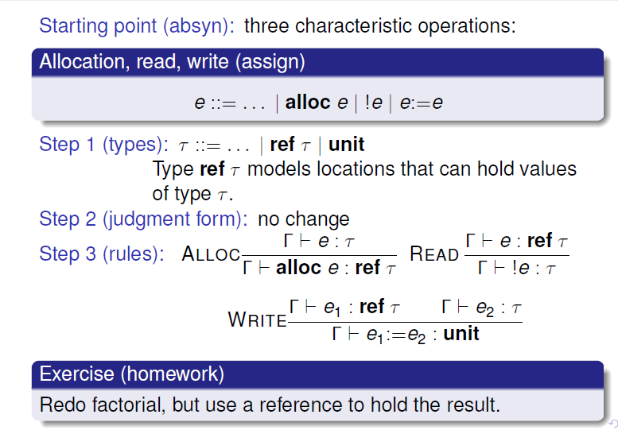
References (cf. ML-primer)

Slide 45
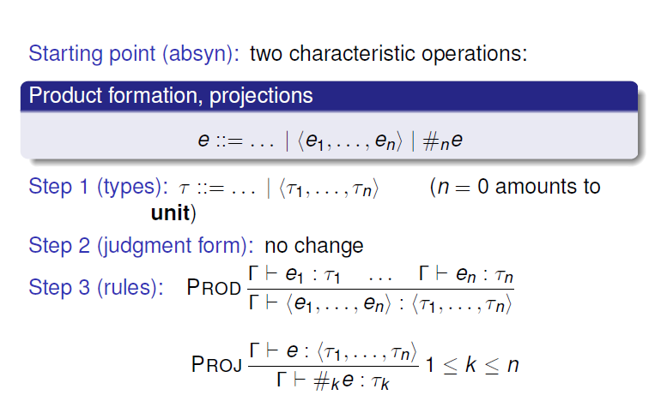
Products/tuples

Slide 46
Products/tuples

Slide 47
Products/tuples

Slide 48
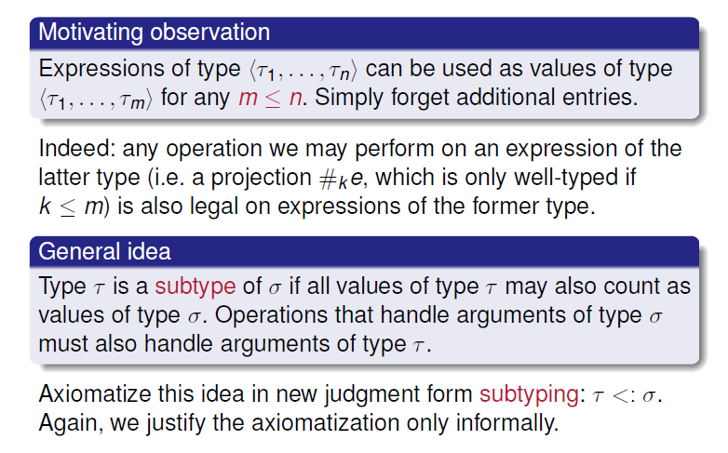
Subtyping (I)

Slide 49
Subtyping (I)

Slide 50
Subtyping (I)

Slide 51
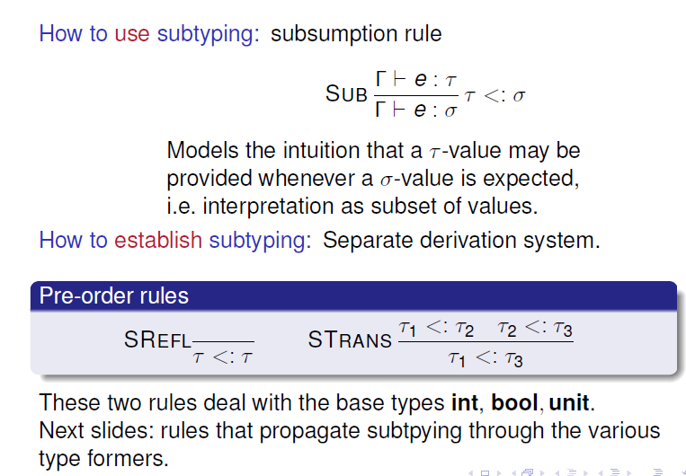
Subtyping (II)

Slide 52
Subtyping (II)

Slide 53
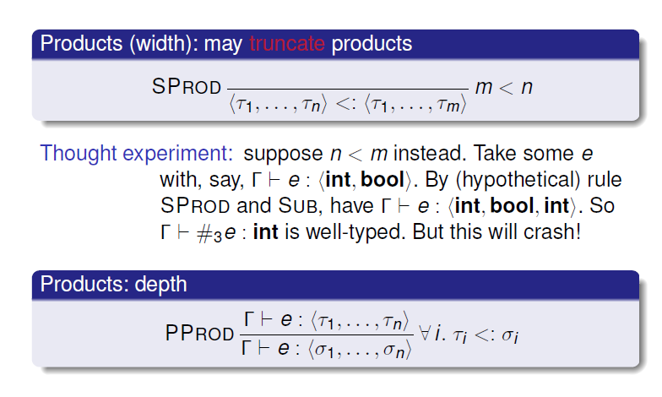
Subtyping (III): propagating through products

Slide 54
Subtyping (III): propagating through products

Slide 55
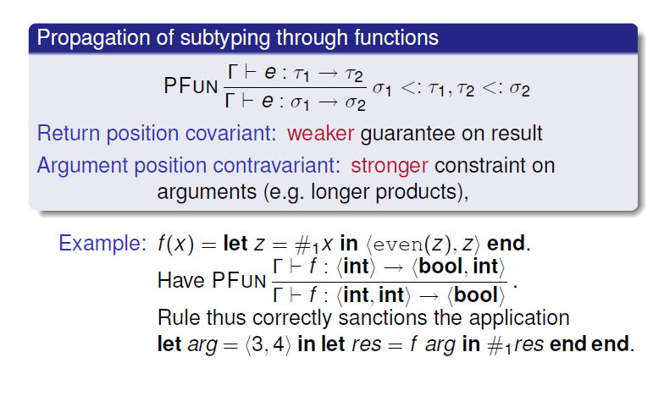
Subtyping (IV): propagating through functions

Slide 56
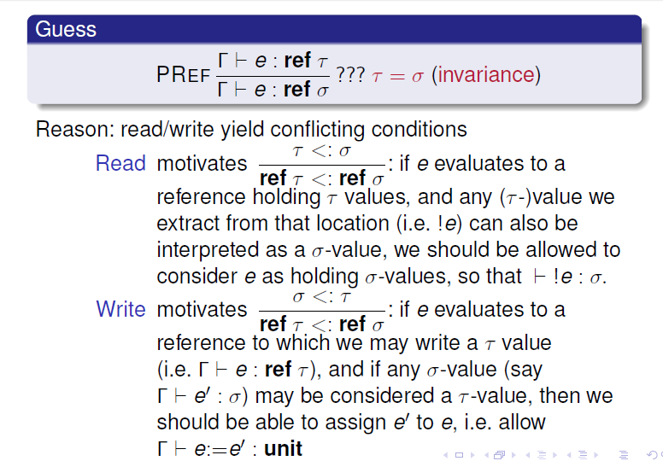
Subtyping (V): propagating through references

Slide 57
Subtyping (V): propagating through references

Slide 58
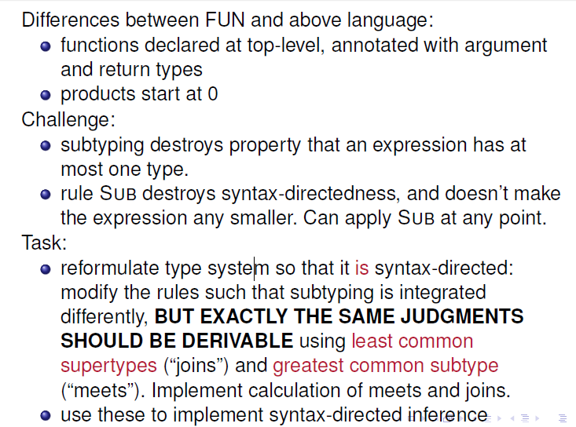
HW4: type analysis
No higher-order functions

Slide 59
Additional aspects
separate name spaces for type definitions vs variables/ functions/procedures ➔ separate environments (cf Tiger)
when syntax-directedness fails, requiring user-supplied type annotations helps inference
Example: functions declarations, in particularly (mutually) recursive ones
not covered:
  overloading (multiple typings for operators)
  example: arithmetic operations over int, float, double
  additional syntactic category (eg statements): new judgements
  Casting/coercion
    explicit (ie visible in program syntax): similar to other operators
    implicit: destroys syntax-directness similar to subtyping
    often symbolizes/triggers change of representation (int -> double) that’s significant for compiler backend
  polymorphism (finite representations for infinitely many typings)
  arrays, class/object systems incl inheritance, signatures/modules/interfaces

Slide 60
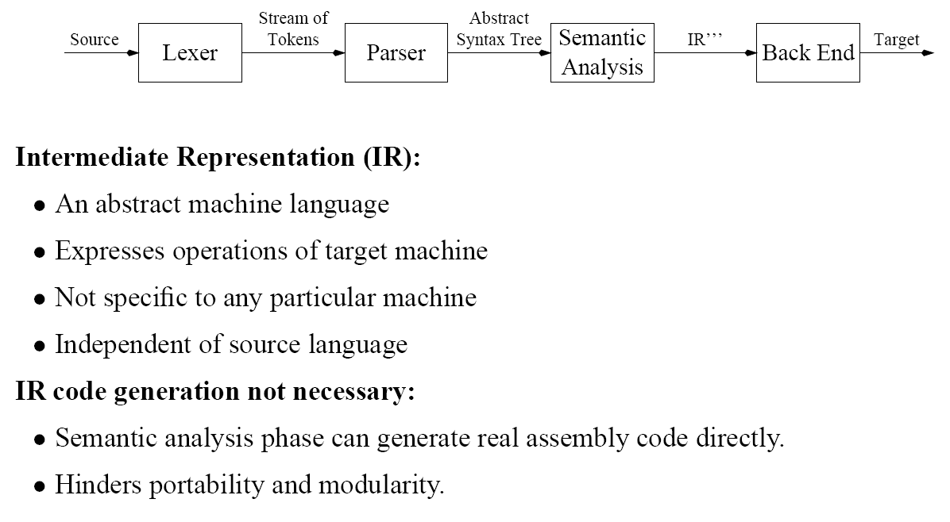
Next steps
IR code generation
But first: need to learn a bit how data will be laid out in memory: activation records / frame stack
Useful homework: read MCIL’s sections on TIGER’s semantic analysis (Chapter 5) and, if possible, TIGER’s activation record layout (Chapters 6)!

Slide 61
Quiz 3: LR(0)
How many states does the LR(0) parse table for the following grammar have? (You may guess or draw the parse table ;-) )
S → B $ P → ε E → B
B → id P P → ( E ) E → B, E
B → id ( E ]
(cf MCIL, page 85, exercise 3.11)

