Slide 1
Topic 4: Abstract Syntax
Symbol Tables
COS 320
Compiling Techniques
Princeton University
Spring 2016
Lennart Beringer

Slide 2
Abstract Syntax

Slide 3
Parse Trees
We have been looking at concrete parse trees, in which
  inner nodes are nonterminals, leaf nodes are terminals
  children are labeled with the symbols in the RHS of the production
stmt → stmt SEMI stmt
stmt → …
stmt
stmt
SEMI
stmt
:
:
Concrete parse trees are inconvenient to use, since they are cluttered with tokens containing no additional information:
  punctuation symbols (SEMI etc) needed to specify structure when writing code, but
  the tree structure already describes the program structure

Slide 4
Parse Tree Example

Slide 5
Abstract parse trees (aka abstract syntac tree – AST)
like concrete parse trees (e.g. inductive datatype, generated as
semantic action by YACC)
each syntactic category (expressions, statements,..) is represented as a separate datatype, with one constructor for each formation
redundant punctuation symbols are left out

Slide 6
Abstract parse trees (aka abstract syntac tree – AST)
like concrete parse trees (e.g. inductive datatype, generated as
semantic action by YACC)
each syntactic category (expressions, statements,..) is represented as a separate datatype, with one constructor for each formation
redundant punctuation symbols are left out
datatype stmt =
CompoundStmt of stmt * stmt
| AssignStmt of string * expr;
datatype expr =
NumExpr of int
| binopExpr of expr * binop * expr;
CompoundStmt
AssignStmt
AssignStmt
“a”
NumExpr(3)
“b”
NumExpr(4)

Slide 7
Abstract parse trees (aka abstract syntac tree – AST)
like concrete parse trees (e.g. inductive datatype, generated as
semantic action by YACC)
each syntactic category (expressions, statements,..) is represented as a separate datatype, with one constructor for each formation
redundant punctuation symbols are left out
datatype stmt =
CompoundStmt of stmt * stmt
| AssignStmt of string * expr;
datatype expr =
NumExpr of int
| binopExpr of expr * binop * expr;
CompoundStmt
AssignStmt
AssignStmt
“a”
NumExpr(3)
“b”
NumExpr(4)
First approximation: nonterminal ⬄ synt. category; CFG rule ⬄ constructor
But: AST is internal interface between components of compiler, so AST design is up to compiler writer, not the language designer; may deviate from organization suggested by grammar/syntax

Slide 8
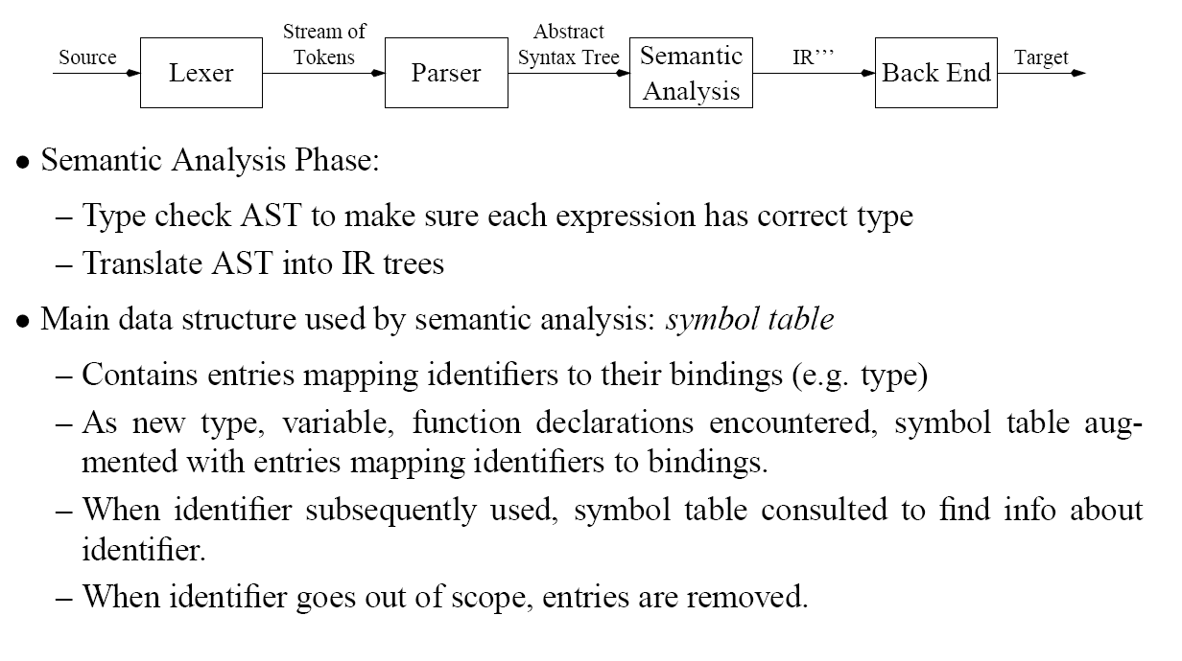
Semantic Analysis: Symbol Tables

Slide 9
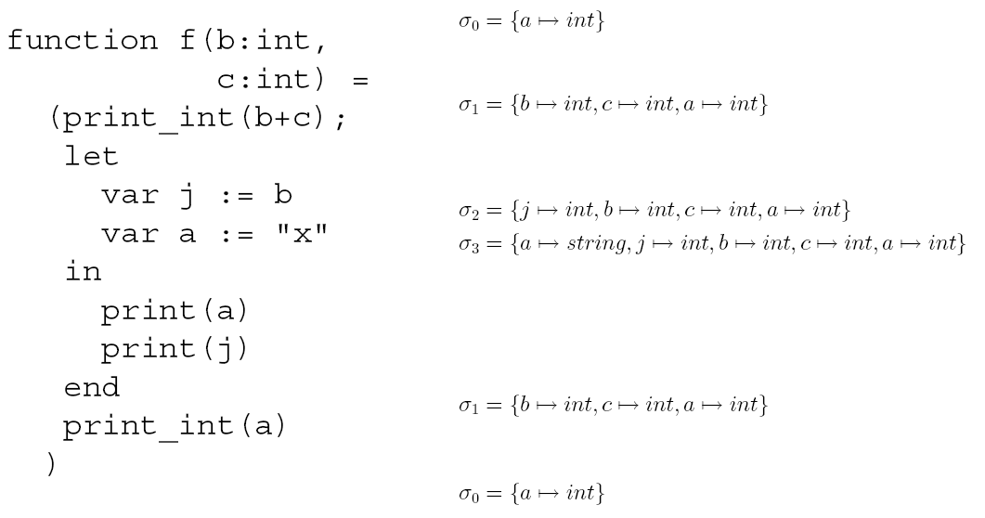
Symbol Table Example
function f (b:int, c:int) = (print_int (b+c);
let var j:= b
var a := “x”
in print (a);
print_int (j)
end;
print_int (a)
)

Slide 10
Symbol Table Implementation

Slide 11
Imperative Symbol Tables

Slide 12
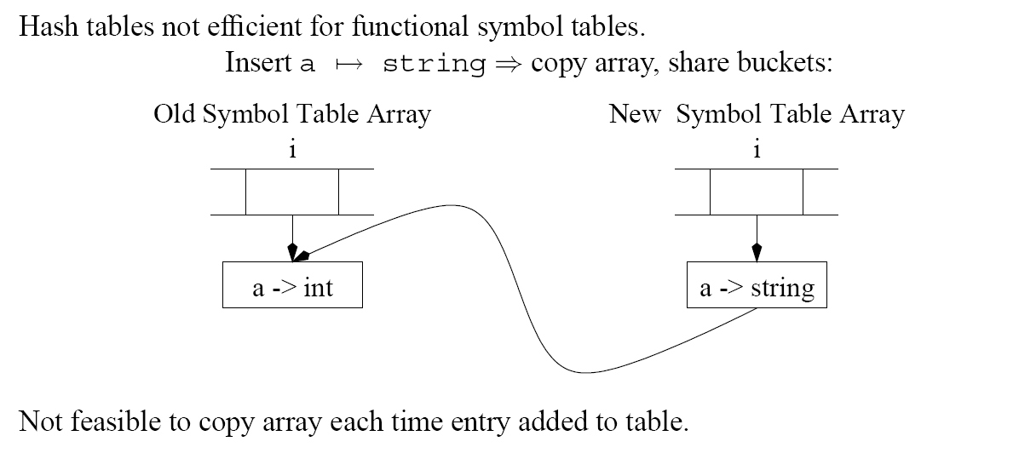
Functional Symbol Tables
Association list (cf HW 1) not efficient (lookup and delete linear)

Slide 13
Functional Symbol Tables

Slide 14
Functional Symbol Table using BST: lookup
Use the “less than” relation to navigate down the tree
f -> int
c -> real
t -> int
d -> string
s -> string

Slide 15
Functional Symbol Table using BST: insertion
f -> int
c -> real
t -> int
d -> string
s -> string
z -> int
Insertion of z-> int:
create node

Slide 16
Functional Symbol Table using BST: insertion
f -> int
f -> int
c -> real
t -> int
t -> int
d -> string
s -> string
z -> int
Insertion of z-> int:
create node
“search” for z in old tree; copy ancestor nodes

Slide 17
Functional Symbol Table using BST: insertion
f -> int
f -> int
c -> real
t -> int
t -> int
d -> string
s -> string
z -> int
Insertion of z-> int:
create node
“search” for z in old tree; copy ancestor nodes
insert links to siblings in original (share subtree)

