Slide 1
Topic 3: Parsing and Yaccing
COS 320
Compiling Techniques
Princeton University
Spring 2016
Lennart Beringer

Slide 2
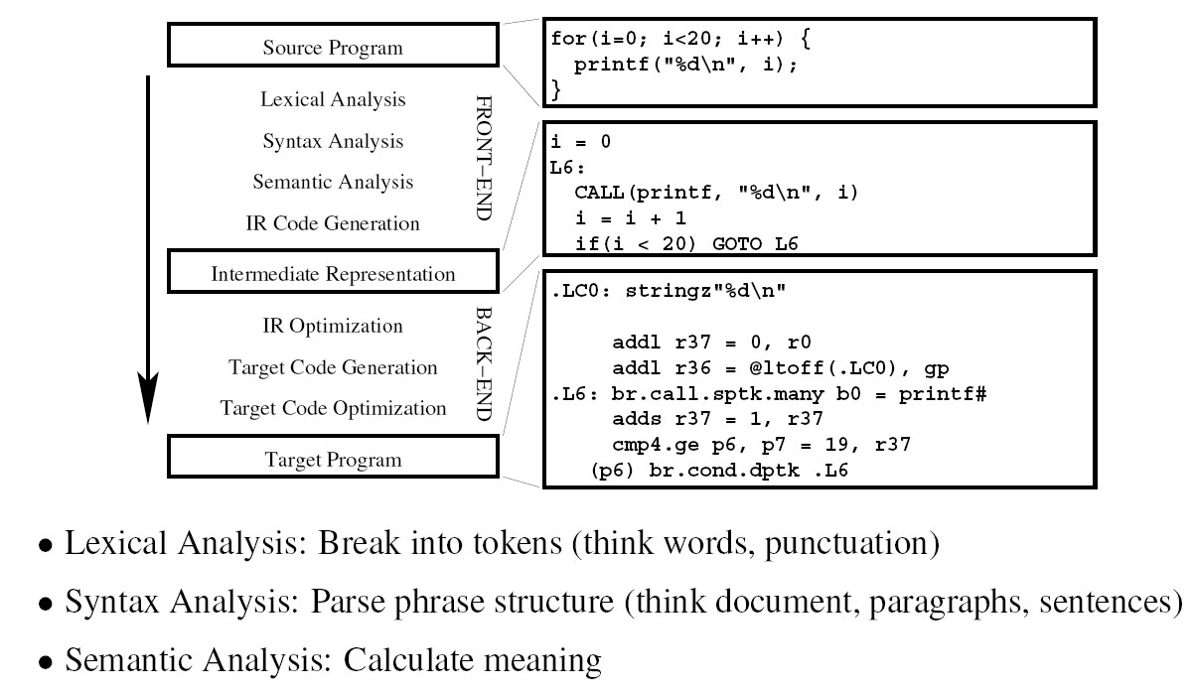
The Compiler

Slide 3
Role of parser
Lexer partitioned document into stream of tokens.
But not all token lists represent programs.
>=
THEN
ID(foo)
IF
NUM(42)
IF
ID(foo)
>=
NUM(42)
THEN
verify that stream of tokens is valid according to the language definition
report violations as (informative) syntax error and recover
build abstract syntax tree (AST) for use in next compiler phase

Slide 4
Syntactical Analysis
each language definition has rules that describe the syntax of well-formed programs.
format of the rules: context-free grammars
why not regular expressions/NFA’s/DFA’s?

Slide 5
Syntactical Analysis
each language definition has rules that describe the syntax of well-formed programs.
format of the rules: context-free grammars
why not regular expressions/NFA’s/DFA’s?
source program constructs have recursive structure:
digits = [0-9]+;
expr = digits | “(“ expr “+” expr “)”

Slide 6
Syntactical Analysis
each language definition has rules that describe the syntax of well-formed programs.
format of the rules: context-free grammars
why not regular expressions/NFA’s/DFA’s?
source program constructs have recursive structure:
digits = [0-9]+;
expr = digits | “(“ expr “+” expr “)”
finite automata can’t recognize recursive constructs, so cannot ensure expressions are well-bracketed: a machine with N states cannot remember parenthesis—nesting depth greater than N
CFG’s are more powerful, but also more costly to implement

Slide 7
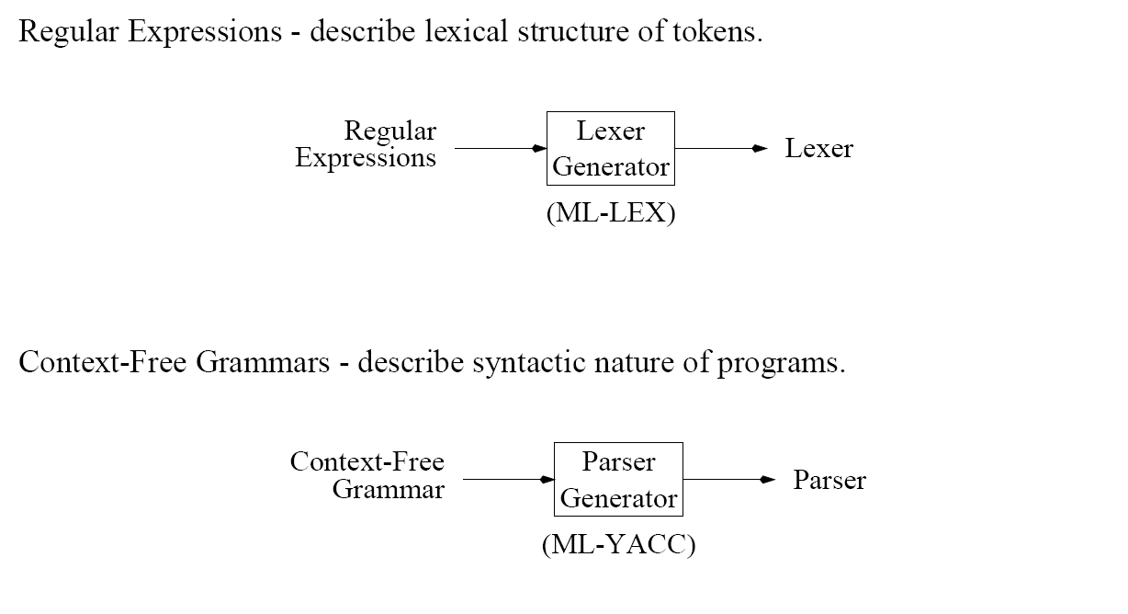
Context-Free Grammar

Slide 8
Context-Free Grammars: definitions
language: set of strings
string: finite sequence of symbols taken from finite alphabet
Regular expressions and CFG’s both describe languages, but over different alphabets
 | Lexical analysis | Syntax analysis
symbols/alphabet | ASCII | token
strings | lists of tokens | lists of phrases
language | set of (legal) token sequences | set of (legal) phrase sequences (“programs”)

Slide 9
Context-free grammars versus regular expressions
CFG’s strictly more expressive than RE’s:
Any language recognizable/generated by a RE can also be recognized/generated by a CFG, but not vice versa.
CFG
RE
matching parentheses
nested comments
Also known as Backus-Naur Form (BNF, Algol 60)

Slide 10
Context-Free Grammars: definition
A CFG consists of
a finite set N = N1 , .., Nk of non-terminal symbols, one of which is singled out as the start symbol
a finite set T = T1, …, Tm of terminal symbols (representing token types)
a finite set of productions LHS RHS where LHS is a single non-terminal, and RHS is a list of terminals and non-terminals
Each production specifies one way in which terminals and non-terminals may be combined to form a legal (sub)string.
Recursion (e.g. well-bracketing) can be modeled by referring to the LHS inside the RHS:
stmt IF exp THEN stmt ELSE stmt
The language recognized by the CFG is the set of terminal-only strings derivable from the start symbol .

Slide 11
CFG’s: derivations
Start with start symbol
While the current string contains a non-terminal N, replace it by the RHS of one of the rules for N.
Non-determinism
Choice of non-terminal N to be replaced in each step
Choice of production/RHS once N has been chosen.
Acceptance of a string is independent of these choices (cf. NFA), so a string may have multiple derivations.
Notable derivation strategies
left-most derivation: in each step, replace the left-most non-terminal
right-most derivation: …
(In both cases, use the chosen symbol’s first rule)

Slide 12
Example (cf HW1)
Nonterminals
Productions
i.e. stmt SEMI stmt
stmt /*statements/*
expr /*expressions*/
expr_list /*expression lists*/
stmt stmt; stmt
stmt ID := expr
stmt print ( expr_list )
i.e. PRINT LPAREN expr_list RPAREN
Terminals : tokens
expr ID
expr NUM
expr expr + expr
expr ( stmt, expr )
SEMI
ID
ASSIGN
LPAREN
RPAREN
NUM
PLUS
PRINT
COMMA
expr_list expr
expr_list expr_list, expr

Slide 13
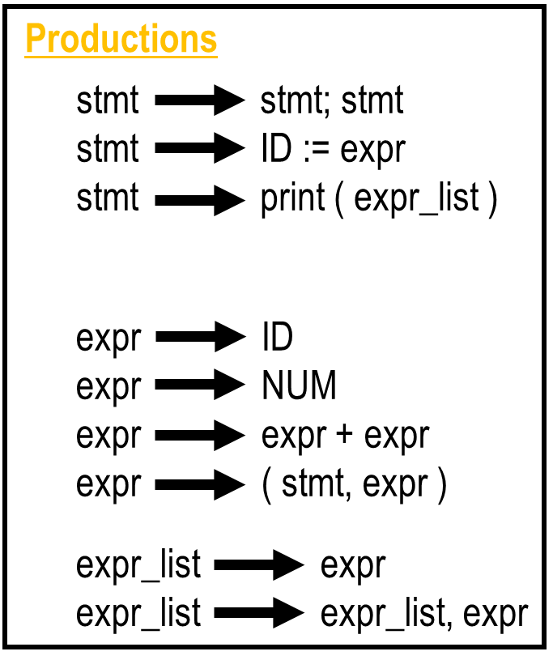
Example: leftmost Derivation for a:=12; print(23)
Show that the following token sequence
ID := NUM; PRINT(NUM) is a legal phrase
ID ASSIGN NUM SEMI PRINT LPAREN NUM RPAREN

Slide 14
Example: leftmost Derivation for a:=12; print(23)
Show that the following token sequence
ID := NUM; PRINT(NUM) is a legal phrase
ID ASSIGN NUM SEMI PRINT LPAREN NUM RPAREN
stmt
stmt SEMI stmt
ID ASSIGN expr SEMI stmt
ID ASSIGN NUM SEMI stmt
ID ASSIGN NUM SEMI PRINT LPAREN expr_list RPAREN
ID ASSIGN NUM SEMI PRINT LPAREN expr RPAREN
ID ASSIGN NUM SEMI PRINT LPAREN NUM RPAREN

Slide 15
Example: rightmost Derivation for a:=12; print(23)
Show that the following token sequence
ID := NUM; PRINT(NUM) is a legal phrase
ID ASSIGN NUM SEMI PRINT LPAREN NUM RPAREN
stmt
stmt SEMI stmt
stmt SEMI PRINT LPAREN expr_list RPAREN
stmt SEMI PRINT LPAREN expr RPAREN
stmt SEMI PRINT LPAREN NUM RPAREN
ID ASSIGN expr SEMI PRINT LPAREN NUM RPAREN
ID ASSIGN NUM SEMI PRINT LPAREN NUM RPAREN

Slide 16
Parse tree: graphical representation of derivation results
Root: start symbol
Inner nodes labeled with non-terminals; #branches according to chosen production
Leaf nodes labeled with terminals
Example (parse tree of previous CFG):
stmt
stmt
SEMI
stmt
ID
ASSIGN
expr
PRINT
LPAREN
expr_list
RPAREN
NUM
expr
NUM
Different derivations may or may not yield different parse trees.

Slide 17
Ambiguous Grammars
A grammar is ambiguous is it can derive a string of tokens with two or more different parse trees
Example?

Slide 18
Ambiguous Grammars
A grammar is ambiguous is it can derive a string of tokens with two or more different parse trees
Example?

Slide 19
Ambiguous Grammars
A grammar is ambiguous is it can derive a string of tokens with two or more different parse trees
Example?

Slide 20
Ambiguous Grammars
A grammar is ambiguous is it can derive a string of tokens with two or more different parse trees
Example?

Slide 21
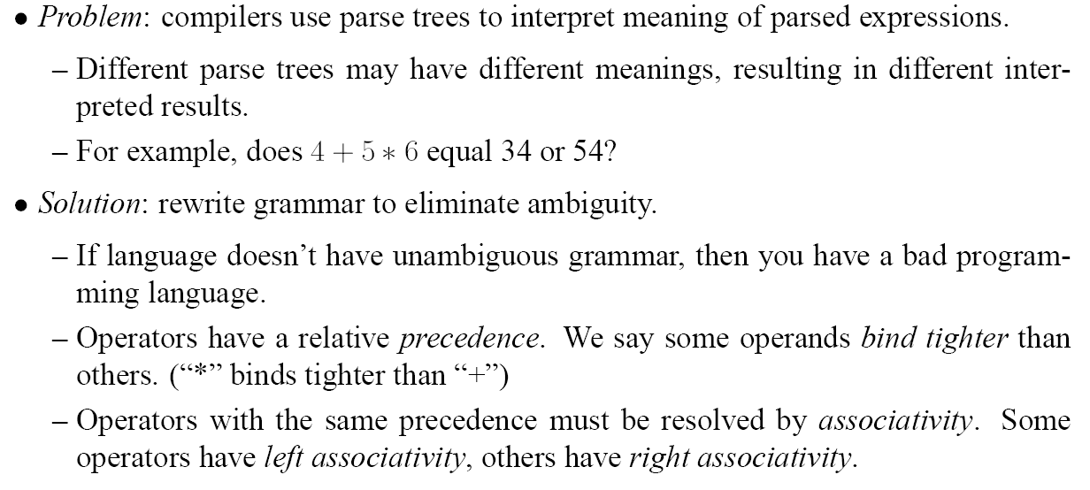
Ambiguous Grammars
plus, minus, times,…
exponentiation,…

Slide 22
Ambiguous Grammars
plus, minus, times,…
exponentiation,…

Slide 23
Ambiguous Grammars
Operators with same precedence should have same associativity
Why?
Example: suppose plus right-assoc, minus left-assoc, equal precedence
a – b – c + d + e
(a – b) – c + (d + e)
Conflict:
((a – b) – c) + (d + e)
vs.
(a – b) – (c + (d + e))
((10 – 4) – 3) + (20 + 15) =
(6 – 3) + 35 = 3 + 35 = 38
(10 - 4) – (3 + (20 + 15)) =
6 – (3 + 35) = 6 – 38 = -32
Next: how to rewrite an ambiguous grammar

Slide 24
Ambiguous Grammars

Slide 25
End-Of-File Marker

Slide 26
Grammars and Lexical Analysis
CFG’s are sufficiently powerful to describe regular expressions.
Example: language (a | b)* abb is described by the following CFG
W aW
X bY
W bW
Y b
W aX
(W start symbol)
So can combine lexical and syntactic analysis (parsing) into one module
+ ok for small languages, with simple/few RE’s and syntactic grammar
- regular expression specification arguably more concise
- separating phases increases compiler modularity

Slide 27
Context-Free Grammars versus REs (I)
Claim: context-free grammars are strictly more powerful that RE’s (and hence NFA’s and DFA’s).
Part 1: any language that can be generated using RE’s can be
generated by a CFG.
Proof: give a translation that transforms an RE R into a CFG G(R)
such that L( R ) = L ( G(R) ).
Part2: define a grammar G such that there is no finite automaton F with L(G)=L( F ).

Slide 28
Context Free Grammars and REs (II)
Part 1: any language that can be generated using RE’s can be
generated by a CFG.
Proof: give a translation that transforms an RE R into a CFG G(R)
such that L( R ) = L ( G(R) ).
Construction of the translation by induction over structure of RE’s:
Introduce one non-terminal (R) for each subterm R of the RE
Rules (base cases):
  Symbol (a): R a
  Epsilon(є): R є
Rules (inductive cases):
  Alternation (M | N ): R M R N
  Concatenation (M N): R M N
  Kleene closure (M *): R M R R ε

Slide 29
Context Free Grammars and REs (II)
Part 1: any language that can be generated using RE’s can be
generated by a CFG.
Proof: give a translation that transforms an RE R into a CFG G(R)
such that L( R ) = L ( G(R) ).
Construction of the translation by induction over structure of RE’s:
Introduce one non-terminal (R) for each subterm R of the RE
Rules (base cases):
  Symbol (a): R a
  Epsilon(є): R є
Rules (inductive cases):
  Alternation (M | N ): R M R N
  Concatenation (M N): R M N
  Kleene closure (M *): R M R R ε

Slide 30
Context Free Grammars and REs (II)
Part 1: any language that can be generated using RE’s can be
generated by a CFG.
Proof: give a translation that transforms an RE R into a CFG G(R)
such that L( R ) = L ( G(R) ).
Construction of the translation by induction over structure of RE’s:
Introduce one non-terminal (R) for each subterm R of the RE
Rules (base cases):
  Symbol (a): R a
  Epsilon(є): R є
Rules (inductive cases):
  Alternation (M | N ): R M R N
  Concatenation (M N): R M N
  Kleene closure (M *): R M R R ε

Slide 31
Context-Free Grammar with no RE/FA
NFA? DFA?
Suggestions?

Slide 32
Context-Free Grammar with no RE/FA
S ( S )
NFA? DFA?
Well-bracketing!
S ε
Proof by contradiction:
assume there’s a NFA/DFA accepting the language
Either one is fine!
FA must have finite number of states, say N
FA must “remember” number of “(“ to generate equally many “)”
At or before seeing the N+1st “(”, FA must revisit a state already traversed, say s
s represents two different counts of “)”, both of which must be accepted
One count will be invalid, ie not match up the number of “(“’s seen.

Slide 33
Grammars versus automata models (for the curious)
Q: is there a class of grammars capturing exactly the power of RE’s?
A: yes, the “regular, right-linear, finite state grammars” for example
at most one non-terminal in each RHS
non-terminals occur only in
right-most position of RHS
Q: is there an automaton model that precisely captures context-free grammars?
A: yes, “push-down automata” (ie automata with a stack)
Q: we use context-free grammars to specify parsing. Are there grammars that are not context-free?
A: yes, context-sensitive grammars, for example (LHS of productions are strings with > 0 nonterminals and >=0 terminals)

Slide 34
Parsing

Slide 35
Outline
Recursive Descent Parsing
Shift-Reduce Parsing
ML-Yacc
Recursive Descent Parser Generation

Slide 36
Recursive Descent Parsing
Reminder: context-free grammars: symbols (terminals, non-terminals),
productions (rules), derivations, …
Many CFG’s can be parsed with an algorithm called recursive descent:
one function for each non-terminal
each production rule yields one clause in the function for the LHS symbol
functions (possibly mutually) recursive
Other names for recursive descent:
predictive parsing: rule selection is based on next symbol(s) seen
top-down parsing (algorithm starts with initial symbol)
LL(1) parsing (Left-to-right parsing, Leftmost derivation, 1 symbol look-ahead)

Slide 37
Recursive descent: example

Slide 38
Recursive descent: another example

Slide 39
The Problem
A S EOF
S id := E
S print ( L )
E id
E num

Slide 40
The Problem
A S EOF
S id := E
S print ( L )
E id
E num
RPAREN is the (only) nonterminal that may follow a string derivable from M (why?...). Seeing RPAREN thus indicates we should use rule M ε.

Slide 41
Limitation of Recursive Descent Parsing
Sometimes, we can modify a grammar so that is amenable to predictive parsing without changing the language recognized, for example by replacing left recursion by right recursion.
Need algorithm that
decides if a grammar is suitable for recursive descent parsing, and
if so, calculates the parsing table, ie a table indicating which production to apply in each situation, given the next terminal in the token stream
Key ingredient: analysis of first and follow.

Slide 42
Formal Techniques for predictive parsing
Let γ range over strings of terminals and nonterminals from our grammar.
FIRST(γ)
(i.e. RHS of grammar rules)
For each γ that is a RHS of one of the rules, must determine the set of all terminals that can begin a string derivable from γ: First(γ)
Examples: First (id := E) = { id } for grammar
on previous slide.

Slide 43
Formal Techniques for predictive parsing
Let γ range over strings of terminals and nonterminals from our grammar.
FIRST(γ)
(i.e. RHS of grammar rules)
For each γ that is a RHS of one of the rules, must determine the set of all terminals that can begin a string derivable from γ: First(γ)
Examples: First (id := E) = { id } for grammar
on previous slide.
First ( T * F ) = { id, num, LPAREN } for
T id
T num
T ( E )
F . . .

Slide 44
Formal Techniques for predictive parsing
Let γ range over strings of terminals and nonterminals from our grammar.
FIRST(γ)
(i.e. RHS of grammar rules)
For each γ that is a RHS of one of the rules, must determine the set of all terminals that can begin a string derivable from γ: First(γ)
Examples: First (id := E) = { id } for grammar
on previous slide.
First ( T * F ) = { id, num, LPAREN } for
T id
T num
T ( E )
F . . .
Predictive parsing impossible whenever there are productions X γ1 and X γ2 such that First (γ1) and First (γ2) overlap: can’t decide which rule to use!

Slide 45
Formal Techniques for predictive parsing
Y …
Y ε
X Y
Z …
S X Y Z
Consider γ = X Y Z where
Then, First (S) should contain First (Z), because Y and X can derive ε.

Slide 46
Formal Techniques for predictive parsing
NULLABLE(N)
Y …
Y ε
X Y
Z …
S X Y Z
Consider γ = X Y Z where
Then, First (S) should contain First (Z), because Y and X can derive ε.
Hence, for calculating First sets we need to determine which nonterminals N can derive the empty string ε: Nullable(N).
Here, Y and (hence) X are nullable.
Extension to strings: γ nullable if all symbols in γ are nullable.

Slide 47
Computation of First

Slide 48
Computation of First

Slide 49
Computation of First

Slide 50
Computation of First
Similarly: first(γ) where γ is a string of terminals and nonterminals.

Slide 51
Formal Techniques for predictive parsing
FOLLOW(N)
For each nonterminal N, we also must determine the set of all terminal symbols t that can immediately follow N in a derivation: Follow(N).
In particular, must know which terminals may follow a nullable nonterminal.

Slide 52
Formal Techniques for predictive parsing
FOLLOW(N)
For each nonterminal N, we also must determine the set of all terminal symbols t that can immediately follow N in a derivation: Follow(N).
In particular, must know which terminals may follow a nullable nonterminal.
Example (S start symbol):
X Y
S P X t
S u
Y …
Y ε
P …
Follow(X) contains t, due to S P X t

Slide 53
Formal Techniques for predictive parsing
FOLLOW(N)
For each nonterminal N, we also must determine the set of all terminal symbols t that can immediately follow N in a derivation: Follow(N).
In particular, must know which terminals may follow a nullable nonterminal.
Example (S start symbol):
X Y
S P X t
S u
Y …
Y ε
P …
Follow(X) contains t, due to S P X t
  hence Follow(P) contains t, since X is nullable
    in case P is also nullable, First (PXt) and hence First(S) contain t

Slide 54
Formal Techniques for predictive parsing
FOLLOW(N)
For each nonterminal N, we also must determine the set of all terminal symbols t that can immediately follow N in a derivation: Follow(N).
In particular, must know which terminals may follow a nullable nonterminal.
Example (S start symbol):
X Y
S P X t
S u
Y …
Y ε
P …
Follow(X) contains t, due to S P X t
  hence Follow(P) contains t, since X is nullable
    in case P is also nullable, First (PXt) and hence First(S) contain t
  hence Follow(Y) contains t, due to X Y

Slide 55
Computation of Follow
Let X and Y be nonterminals, and γ, γ1 strings of terminals and nonterminals.
whenever the grammar contains a production X γY:
follow (X) follow(Y)
UI

Slide 56
Computation of Follow
Let X and Y be nonterminals, and γ, γ1 strings of terminals and nonterminals.
whenever the grammar contains a production X γY:
follow (X) follow(Y)
UI
whenever the grammar contains a production X γ Y δ:
first (δ) follow(Y)
UI
follow (X) follow(Y) whenever δ is nullable
UI

Slide 57
Computation of Follow
Let X and Y be nonterminals, and γ, γ1 strings of terminals and nonterminals.
whenever the grammar contains a production X γY:
follow (X) follow(Y)
UI
whenever the grammar contains a production X γ Y δ:
first (δ) follow(Y)
UI
follow (X) follow(Y) whenever δ is nullable
UI
Iteratively visit grammar productions to compute nullable, first, follow for each nonterminal in grammar.

Slide 58
Computation of Follow
Let X and Y be nonterminals, and γ, γ1 strings of terminals and nonterminals.
whenever the grammar contains a production X γY:
follow (X) follow(Y)
UI
whenever the grammar contains a production X γ Y δ:
first (δ) follow(Y)
UI
follow (X) follow(Y) whenever δ is nullable
UI
Iteratively visit grammar productions to compute nullable, first, follow for each nonterminal in grammar.
want smallest sets!
start the iteration with empty first and follow sets and nullable=No for all nonterminals and only add elements if forced to do so.

Slide 59
Computation of Follow
Let X and Y be nonterminals, and γ, γ1 strings of terminals and nonterminals.
whenever the grammar contains a production X γY:
follow (X) follow(Y)
UI
whenever the grammar contains a production X γ Y δ:
first (δ) follow(Y)
UI
follow (X) follow(Y) whenever δ is nullable
UI
Iteratively visit grammar productions to compute nullable, first, follow for each nonterminal in grammar.
want smallest sets!
start the iteration with empty first and follow sets and nullable=No for all nonterminals and only add elements if forced to do so.
may need to visit some rules repeatedly. Order in which rules are visited affects the number of iterations needed, but not the final result.

Slide 60
Nullable, First, Follow: example
1
3
5
Z d
Z X Y Z
Y ε
Y c
X Y
2
4
6
X a
 | nullable | first | follow
X | No
Y | No
Z | No
Visit rules 1, 3, 4, 6

Slide 61
Nullable, First, Follow: example
1
3
5
Z d
Z X Y Z
Y ε
Y c
X Y
2
4
6
X a
 | nullable | first | follow
X | No
Y | No
Z | No
Visit rules 1, 3, 4, 6
 | nullable | first | follow
X | No | a(6)
Y | Yes (3) | c(4)
Z | No | d(1)
Visit rule 5

Slide 62
Nullable, First, Follow: example
1
3
5
Z d
Z X Y Z
Y ε
Y c
X Y
2
4
6
X a
 | nullable | first | follow
X | No
Y | No
Z | No
Visit rules 1, 3, 4, 6
 | nullable | first | follow
X | No | a(6)
Y | Yes (3) | c(4)
Z | No | d(1)
 | nullable | first | follow
X | Yes(5) | a, c(5)
Y | Yes | c
Z | No | d
Visit rule 5

Slide 63
Nullable, First, Follow: example
1
3
5
Z d
Z X Y Z
Y ε
Y c
X Y
2
4
6
X a
 | nullable | first | follow
X | Yes | a, c
Y | Yes | c
Z | No | d
…..
Visit rule 2

Slide 64
Nullable, First, Follow: example
1
3
5
Z d
Z X Y Z
Y ε
Y c
X Y
2
4
6
X a
 | nullable | first | follow
X | Yes | a, c
Y | Yes | c
Z | No | d
…..
 | nullable | first | follow
X | Yes | a, c | ?
Y | Yes | c | ?
Z | No | d, a(2), c(2) | ?
Visit rule 2

Slide 65
Nullable, First, Follow: example
1
3
5
Z d
Z X Y Z
Y ε
Y c
X Y
2
4
6
X a
 | nullable | first | follow
X | Yes | a, c
Y | Yes | c
Z | No | d
…..
 | nullable | first | follow
X | Yes | a, c | c (2)
Y | Yes | c | ?
Z | No | d, a, c | ?
Visit rule 2

Slide 66
Nullable, First, Follow: example
1
3
5
Z d
Z X Y Z
Y ε
Y c
X Y
2
4
6
X a
 | nullable | first | follow
X | Yes | a, c
Y | Yes | c
Z | No | d
…..
 | nullable | first | follow
X | Yes | a, c | c
Y | Yes | c | a, c, d (2)
Z | No | d, a, c | ?
Visit rule 2

Slide 67
Nullable, First, Follow: example
1
3
5
Z d
Z X Y Z
Y ε
Y c
X Y
2
4
6
X a
 | nullable | first | follow
X | Yes | a, c
Y | Yes | c
Z | No | d
…..
 | nullable | first | follow
X | Yes | a, c | c
Y | Yes | c | a, c, d
Z | No | d, a, c | ?
Visit rule 2
 | nullable | first | follow
X | Yes | a, c | c, a(2), d(2)
Y | Yes | c | a, c, d
Z | No | d, a, c | ?

Slide 68
Nullable, First, Follow: example
1
3
5
Z d
Z X Y Z
Y ε
Y c
X Y
2
4
6
X a
 | nullable | first | follow
X | Yes | a, c | c, a, d
Y | Yes | c | a, c, d
Z | No | d, a, c
…..
next rule?

Slide 69
Nullable, First, Follow: example
1
3
5
Z d
Z X Y Z
Y ε
Y c
X Y
2
4
6
X a
 | nullable | first | follow
X | Yes | a, c | c, a, d
Y | Yes | c | a, c, d
Z | No | d, a, c
…..
Visit rules 1-6
 | nullable | first | follow
X | Yes | a, c | c, a, d
Y | Yes | c | a, c, d
Z | No | d, a, c
(no change)

Slide 70
Parse table extraction
contains “action” for each nonterminal * terminal pair (N,t)
predictive parsing: “action” is “rule to be applied” when seeing token type t during execution of function for nonterminal N
lookup attempt in blank cells indicates syntax error (phrase rejected)
 | a | c | d
X
Y
Z

Slide 71
Parse table extraction
Filling the table:
1. Add rule N γ in row N, column t whenever t occurs in First(γ).
Motivation: seeing t when expecting N selects rule N γ.
 | a | c | d
X
Y
Z

Slide 72
Parse table extraction
 | null. | first | follow
X | Yes | ac | acd
Y | Yes | c | acd
Z | No | acd
1
3
5
Z d
Z X Y Z
Y ε
Y c
X Y
2
4
6
X a
Add rule N γ in row N, column t whenever t occurs in First(γ).
 | a | c | d
X
Y
Z

Slide 73
Parse table extraction
 | null. | first | follow
X | Yes | ac | acd
Y | Yes | c | acd
Z | No | acd
1
3
5
Z d
Z X Y Z
Y ε
Y c
X Y
2
4
6
X a
Add rule N γ in row N, column t whenever t occurs in First(γ).
 | a | c | d
X
Y
Z
X a
Y c
Z X Y Z
Z X Y Z
Z d
Z X Y Z
first (XYZ) = {a,c,d}

Slide 74
Parse table extraction
 | null. | first | follow
X | Yes | ac | acd
Y | Yes | c | acd
Z | No | acd
1
3
5
Z d
Z X Y Z
Y ε
Y c
X Y
2
4
6
X a
Add rule N γ in row N, column t whenever t occurs in First(γ).
 | a | c | d
X
Y
Z
X a
X Y
Y c
Z X Y Z
Z X Y Z
Z d
Z X Y Z
2. If γ is nullable, add rule N γ in row N, column t whenever t in Follow(N).
Motivation: seeing t when expecting N selects rule N γ.

Slide 75
Parse table extraction
 | null. | first | follow
X | Yes | ac | acd
Y | Yes | c | acd
Z | No | acd
1
3
5
Z d
Z X Y Z
Y ε
Y c
X Y
2
4
6
X a
Add rule N γ in row N, column t whenever t occurs in First(γ).
If γ is nullable, add rule N γ in row N, column t whenever t in Follow(N).
 | a | c | d
X
Y
Z
X a
X Y
X Y
X Y
Y c
Y ε
Y ε
Y ε
Z X Y Z
Z X Y Z
Z d
Z X Y Z

Slide 76
Parse table extraction
 | null. | first | follow
X | Yes | ac | acd
Y | Yes | c | acd
Z | No | acd
1
3
5
Z d
Z X Y Z
Y ε
Y c
X Y
2
4
6
X a
Add rule N γ in row N, column t whenever t occurs in First(γ).
If γ is nullable, add rule N γ in row N, column t whenever t in Follow(N).
 | a | c | d
X
Y
Z
X a
X Y
X Y
X Y
Y c
Y ε
Y ε
Y ε
Z X Y Z
Z X Y Z
Z d
Z X Y Z
Observation: some cells contain more than one rule –
which one should be used???

Slide 77
Predictive Parsing Table
 | aa | .. | dd
X
Y
Z
(k=2)

Slide 78
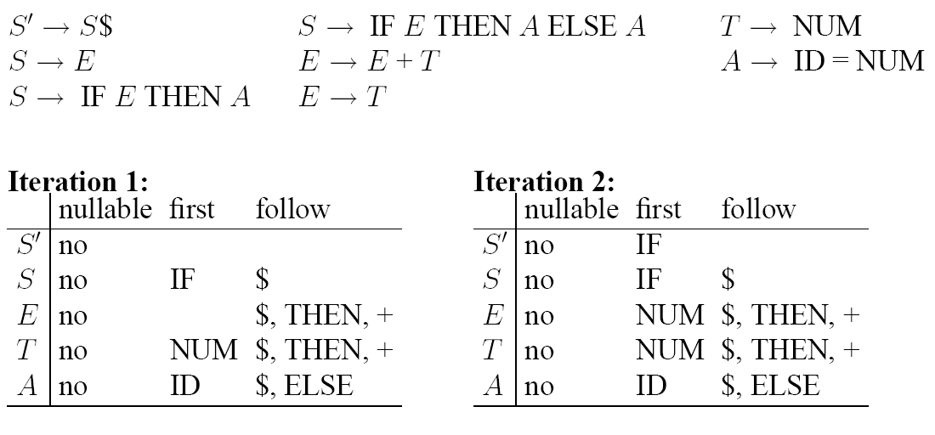
Another Example

Slide 79
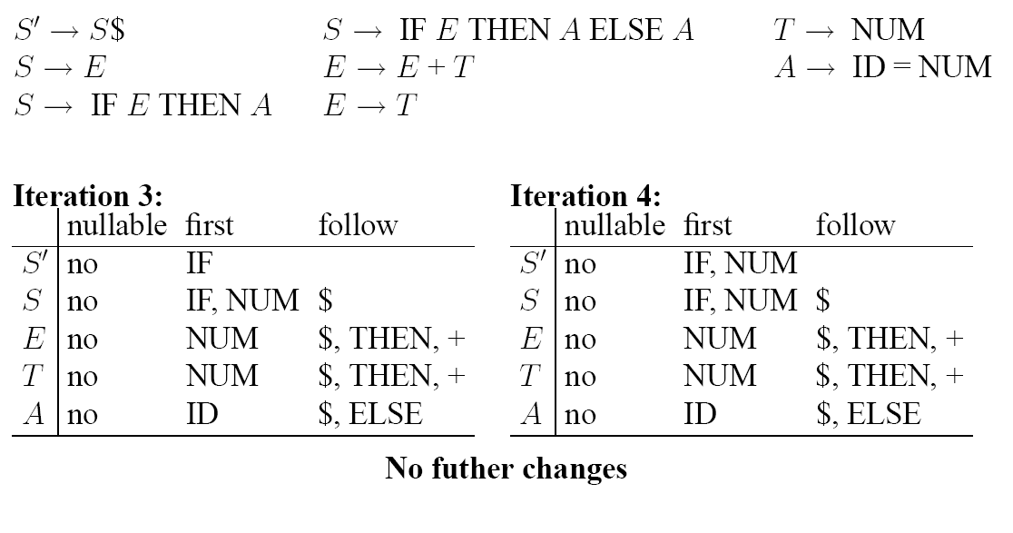
Another Example

Slide 80
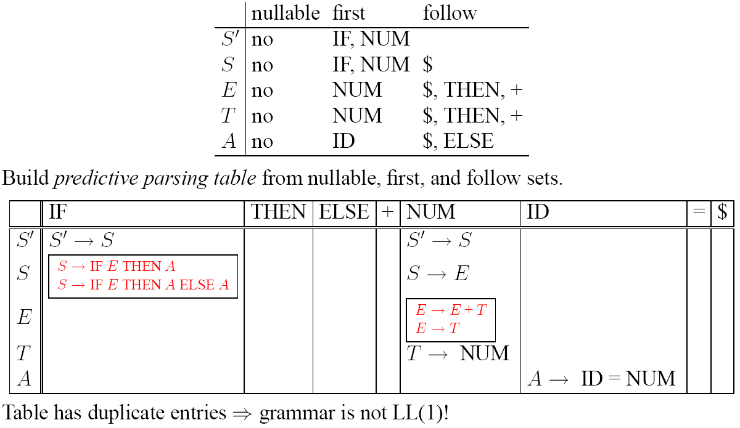
Predictive Parsing Table

Slide 81
Problem 1

Slide 82
Problem 2

Slide 83
Example (try at home)

Slide 84
Example

Slide 85
Limitation of Recursive Descent Parsing
Reminder: predictive parsing selects rule based on the next input token(s)
  LL(1): single next token
  LL(k): next k tokens
Sometimes, there’s no k that does the job.

Slide 86
Shift-Reduce Parsing
Idea: delay decision until all tokens of an RHS have been seen
use a stack to remember (“shift”) symbols
based on stack content and next symbol, select one of two actions:
  shift: push input token onto stack
  reduce: chose a production (X A B C); pop its RHS (C B A); push its LHS (X). So can only reduce if we see a RHS on top of stack.
initial state: empty stack, parsing pointer at beginning of token stream
shifting of end marker $: input stream has been parsed successfully.
exhaustion of input stream with nonempty stack: parse fails

Slide 87
Shift-Reduce Parsing
Idea: delay decision until all tokens of an RHS have been seen
use a stack to remember (“shift”) symbols
based on stack content and next symbol, select one of two actions:
  shift: push input token onto stack
  reduce: chose a production (X A B C); pop its RHS (C B A); push its LHS (X). So can only reduce if we see a RHS on top of stack.
initial state: empty stack, parsing pointer at beginning of token stream
shifting of end marker $: input stream has been parsed successfully.
exhaustion of input stream with nonempty stack: parse fails

Slide 88
Shift-Reduce Parsing
Idea: delay decision until all tokens of an RHS have been seen
use a stack to remember (“shift”) symbols
based on stack content and next symbol, select one of two actions:
  shift: push input token onto stack
  reduce: chose a production (X A B C); pop its RHS (C B A); push its LHS (X). So can only reduce if we see a RHS on top of stack.
initial state: empty stack, parsing pointer at beginning of token stream
shifting of end marker $: input stream has been parsed successfully.
exhaustion of input stream with nonempty stack: parse fails

Slide 89
Shift-Reduce Parsing
Idea: delay decision until all tokens of an RHS have been seen
use a stack to remember (“shift”) symbols
based on stack content and next symbol, select one of two actions:
  shift: push input token onto stack
  reduce: chose a production (X A B C); pop its RHS (C B A); push its LHS (X). So can only reduce if we see a full RHS on top of stack.
initial state: empty stack, parsing pointer at beginning of token stream
shifting of end marker $: input stream has been parsed successfully.
exhaustion of input stream with nonempty stack: parse fails

Slide 90
Shift-Reduce Parsing
Idea: delay decision until all tokens of an RHS have been seen
use a stack to remember (“shift”) symbols
based on stack content and next symbol, select one of two actions:
  shift: push input token onto stack
  reduce: chose a production (X A B C); pop its RHS (C B A); push its LHS (X). So can only reduce if we see a full RHS on top of stack.
initial state: empty stack, parsing pointer at beginning of token stream
shifting of end marker $: input stream has been parsed successfully.
exhaustion of input stream with nonempty stack: parse fails

Slide 91
Shift-Reduce Parsing
Idea: delay decision until all tokens of an RHS have been seen
use a stack to remember (“shift”) symbols
based on stack content and next symbol, select one of two actions:
  shift: push input token onto stack
  reduce: chose a production (X A B C); pop its RHS (C B A); push its LHS (X). So can only reduce if we see a full RHS on top of stack.
initial state: empty stack, parsing pointer at beginning of token stream
shifting of end marker $: input stream has been parsed successfully.
exhaustion of input stream with nonempty stack: parse fails

Slide 92
Shift-Reduce Parsing
Idea: delay decision until all tokens of an RHS have been seen
use a stack to remember (“shift”) symbols
based on stack content and next symbol, select one of two actions:
  shift: push input token onto stack
  reduce: chose a production (X A B C); pop its RHS (C B A); push its LHS (X). So can only reduce if we see a full RHS on top of stack.
initial state: empty stack, parsing pointer at beginning of token stream
shifting of end marker $: input stream has been parsed successfully.
exhaustion of input stream with nonempty stack: parse fails
a.k.a. bottom-up parsing
a.k.a LR(k): left-to-right parse, rightmost derivation, k-token lookahead
shift-reduce parsing can parse more grammars than predictive parsing

Slide 93
Shift-Reduce Parsing

Slide 94
Example

Slide 95
Example
1. A S EOF
2. S ( L )
3. S id = num
4. L L; S
5. L S

Slide 96
Example
1. A S EOF
2. S ( L )
3. S id = num
4. L L; S
5. L S

Slide 97
Example
1. A S EOF
2. S ( L )
3. S id = num
4. L L; S
5. L S

Slide 98
Example
1. A S EOF
2. S ( L )
3. S id = num
4. L L; S
5. L S

Slide 99
Example
1. A S EOF
2. S ( L )
3. S id = num
4. L L; S
5. L S

Slide 100
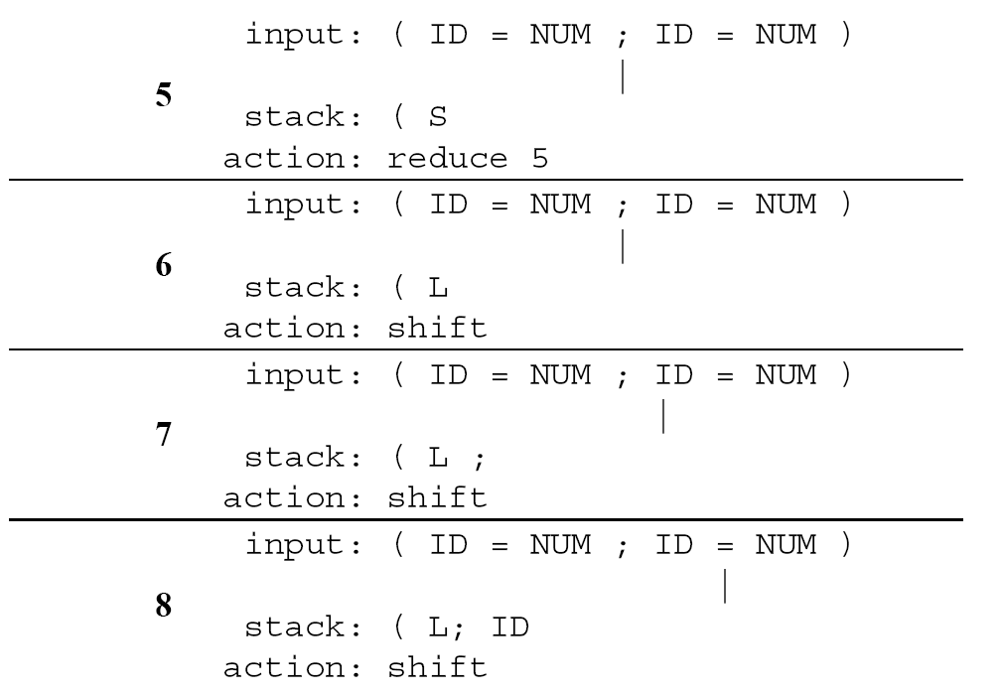
Example
1. A S EOF
2. S ( L )
3. S id = num
4. L L; S
5. L S

Slide 101
Example
1. A S EOF
2. S ( L )
3. S id = num
4. L L; S
5. L S

Slide 102
Example
1. A S EOF
2. S ( L )
3. S id = num
4. L L; S
5. L S

Slide 103
Example
1. A S EOF
2. S ( L )
3. S id = num
4. L L; S
5. L S

Slide 104
Example
1. A S EOF
2. S ( L )
3. S id = num
4. L L; S
5. L S

Slide 105
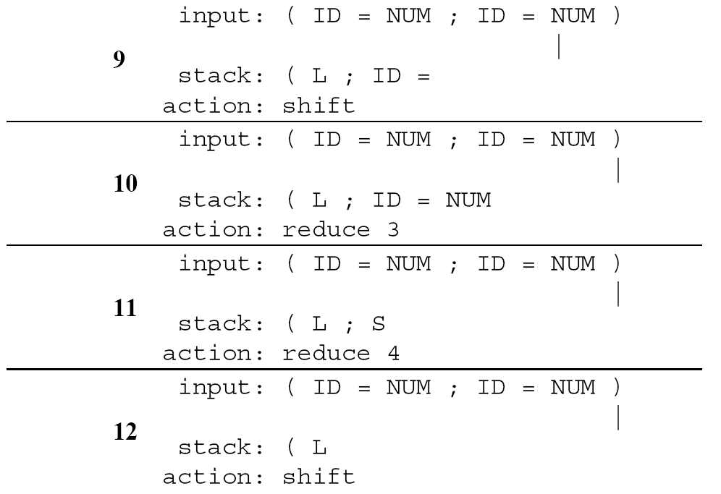
Example
1. A S EOF
2. S ( L )
3. S id = num
4. L L; S
5. L S

Slide 106
Example
1. A S EOF
2. S ( L )
3. S id = num
4. L L; S
5. L S

Slide 107
Example
1. A S EOF
2. S ( L )
3. S id = num
4. L L; S
5. L S

Slide 108
Example
1. A S EOF
2. S ( L )
3. S id = num
4. L L; S
5. L S

Slide 109
Example
1. A S EOF
2. S ( L )
3. S id = num
4. L L; S
5. L S

Slide 110
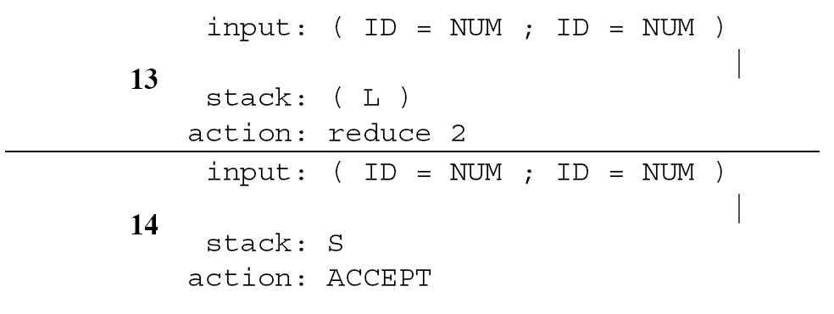
Example
1. A S EOF
2. S ( L )
3. S id = num
4. L L; S
5. L S

Slide 111
Example
1. A S EOF
2. S ( L )
3. S id = num
4. L L; S
5. L S

Slide 112
Example
1. A S EOF
2. S ( L )
3. S id = num
4. L L; S
5. L S
i.e. shift (implicit) EOF

Slide 113
Example
1. A S EOF
2. S ( L )
3. S id = num
4. L L; S
5. L S
i.e. shift (implicit) EOF
Next lecture: how to build the shift-reduce DFA, ie parser table

Slide 114
Example
1. A S EOF
2. S ( L )
3. S id = num
4. L L; S
5. L S
i.e. shift (implicit) EOF
Next lecture: how to build the shift-reduce DFA, ie parser table
Again, duplicate entries in cells denote parse conflicts: shift-reduce, reduce-reduce

Slide 115
The Dangling Else Problem

Slide 116
The Dangling Else Problem
Potential problem?

Slide 117
The Dangling Else Problem

Slide 118
The Dangling Else Problem

Slide 119
The Dangling Else Problem

Slide 120
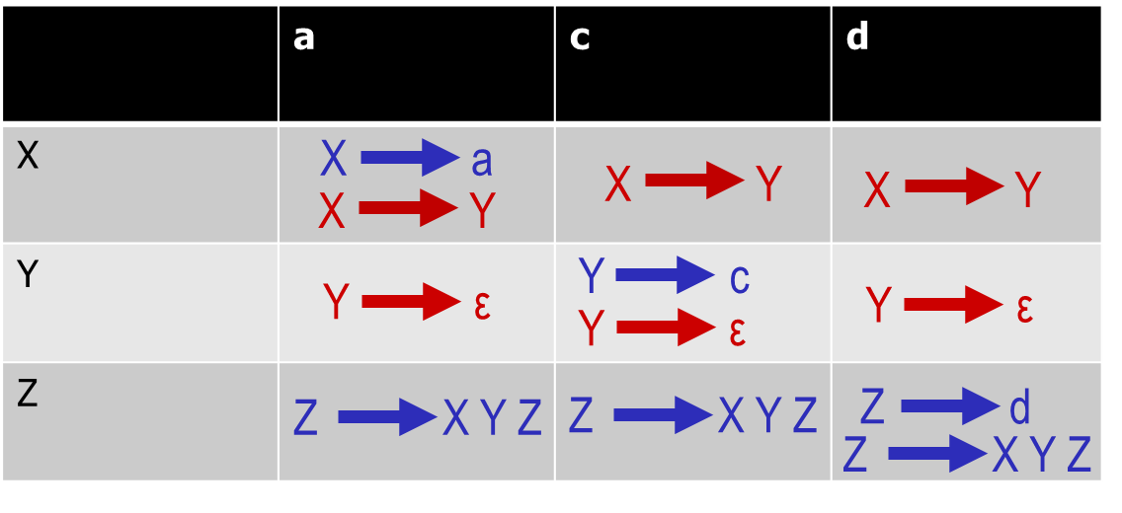
Summary
Construction of recursive-descent parse tables
Shift-reduce parsing overcomes requirement to make decision which rule to apply before entire RHS is seen
“dangling-else” as typical shift-reduce conflict
First
Nullable
Follow
NUM
NUM
=
=
=
shift(NUM)
reduce 3
ID
ID
ID
. . .
. . .
. . .

Slide 121
ML-YACC (Yet Another Compiler-Compiler)

Slide 122
CFG Specification
Specification of a parser has three parts:
User Declarations
%%
ML-YACC-Definitions
%%
Rules
User declarations: definitions of values to be used in rules
ML-YACC Definitions:
definitions of terminals and non-terminals
precedence rules that help resolve shift-reduce conflicts
Rules:
production rules of grammar
semantic actions associated with reductions

Slide 123
ML-YACC Declarations

Slide 124
Attribute Grammar
nonterminal and terminal symbols are associated with “attribute values”
for rule A γ, synthesize attribute for A from attribute for the symbols in γ
  can be used to do simple calculation inside parser:
  requires type-correctness of synthesized attributes w.r.t. ML operators like +, based on association of types to symbols
ML-YACC’s result of successful parse: attribute synthesized for start symbol (unit value if no attribute given)
other use: abstract syntax tree (topic of future lecture)
terminal symbol of grammar
ML’s infix operator int -> int -> int
Semantic action:
synthesize attribute value
exp exp PLUS exp (exp1 + exp2)

Slide 125
Rules

Slide 126
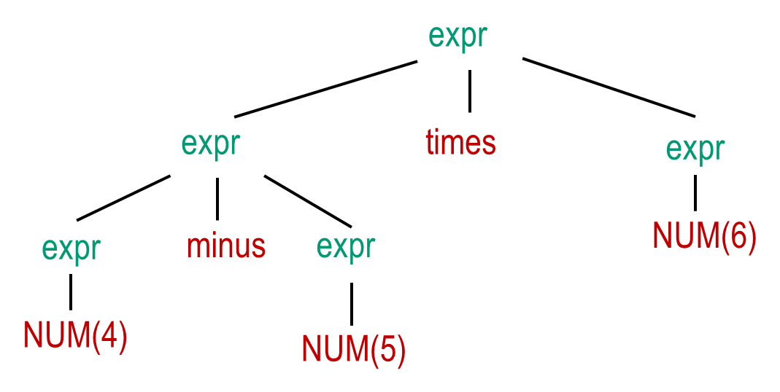
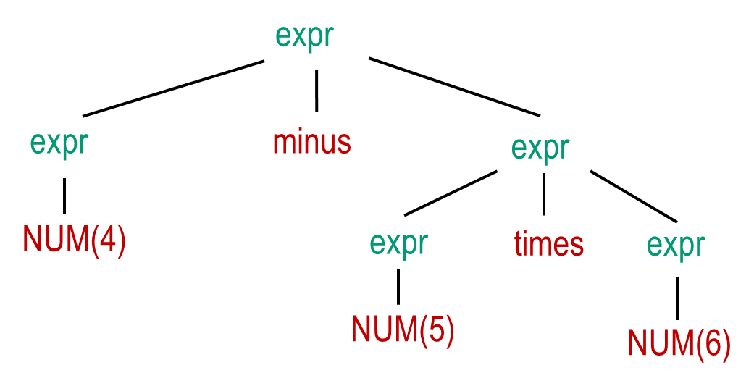
ML-YACC and Ambiguous Grammars
Remember: grammar is ambiguous if there are strings with > 1 parse trees
Example: expr expr – expr
expr expr * expr …
vs.
4 – 5 * 6
4 – 5 * 6
Shift-reduce conflicts:
when parsing 4 – 5 * 6: eventually,
top element of stack is E – E
TIMES is current symbol
can reduce using rule E → E – E,
or can shift TIMES.
shift preferred!

Slide 127
ML-YACC and Ambiguous Grammars
Remember: grammar is ambiguous if there are strings with > 1 parse trees
Example: expr expr – expr
expr expr * expr …
vs.
4 – 5 * 6
4 – 5 * 6
Shift-reduce conflicts:
when parsing 4 – 5 * 6: eventually,
top element of stack is E – E
TIMES is current symbol
can reduce using rule E → E – E,
or can shift TIMES.
shift preferred!
when parsing 4 – 5 – 6: eventually,
top element of stack is E – E
MINUS is current symbol
can reduce using rule E → E – E,
or can shift MINUS.
reduce preferred!
Also: reduce-reduce conflicts if multiple rules can be reduced
ML-YACC warns about conflicts, and applies default choice (see below)

Slide 128
Directives

Slide 129
Directives

Slide 130
Precedence Examples

Slide 131
Default Behavior

Slide 132
Direct Rule Precedence Specification

Slide 133
Syntax vs. Semantics

Slide 134
Constructing LR parsing tables

Slide 135
Shift-Reduce, Bottom Up, LR(1) Parsing

Slide 136
LR(k)

Slide 137
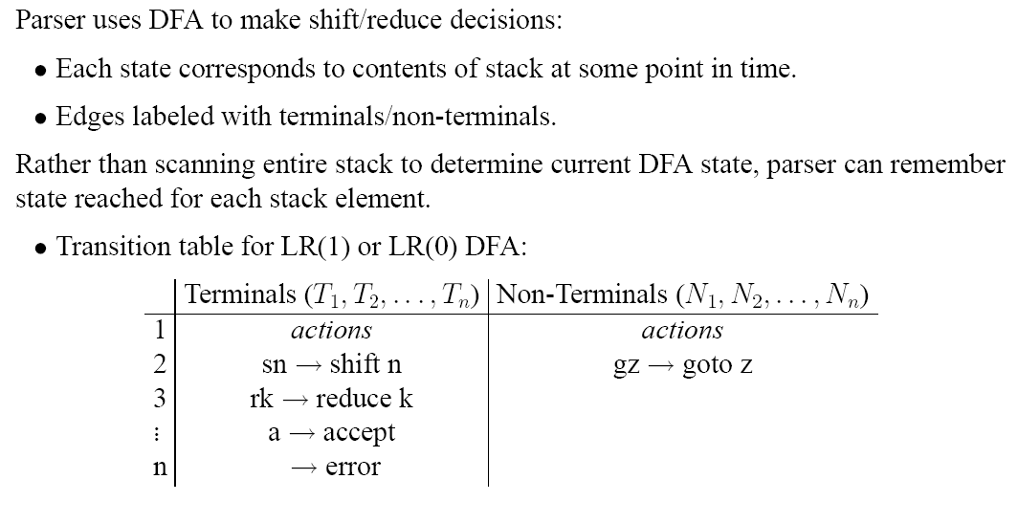
Shift Reduce Parsing DFA

Slide 138
Parsing Algorithm

Slide 139
LR(0) Parsing
Grammar 3.20 (book):
1
represents the initial parser state. Develop other states step by step, by considering all possible transitions:
. . .
move cursor past x
move cursor past (
move cursor past S

Slide 140

LR(0) States
S’ S $
S x
L L , S
S ( L )
L S
1
2
x
S’ . S $
S . ( L )
S . x
S x .
Moving the dot past a terminal t represents “shift t”.

Slide 141
LR(0) States
S’ S $
S x
L L , S
S ( L )
L S
1
2
x
S’ . S $
S . ( L )
S . x
S x .
(
3
S ( . L )
Moving the dot past a terminal t represents “shift t”.

Slide 142
LR(0) States
S’ S $
S x
L L , S
S ( L )
L S
1
2
x
S’ . S $
S . ( L )
S . x
S x .
(
3
S ( . L )
L . S
L . L , S
“shift (“. Don’t forget the closure!

Slide 143
LR(0) States
S’ S $
S x
L L , S
S ( L )
L S
1
2
x
S’ . S $
S . ( L )
S . x
S x .
(
3
S ( . L )
L . S
L . L , S
S . ( L )
S . x
“shift (“. Don’t forget the closure! Yes, CLOSURE!

Slide 144
LR(0) States
S’ S $
S x
L L , S
S ( L )
L S
1
2
x
S’ . S $
S . ( L )
S . x
S x .
(
3
S
S ( . L )
L . S
L . L , S
S . ( L )
S . x
4
S’ S . $
Moving the dot past a nonterminal N represents “goto” after a reduction for a rule with LHS N has been performed.

Slide 145
LR(0) States
S’ S $
S x
L L , S
S ( L )
L S
1
2
x
S’ . S $
S . ( L )
S . x
S x .
x
(
3
S
S ( . L )
L . S
L . L , S
S . ( L )
S . x
4
S’ S . $
S
L
(
In 3 , we have four transitions to consider. Let’s start with the terminals…

Slide 146
LR(0) States
S’ S $
S x
L L , S
S ( L )
L S
1
2
x
S’ . S $
S . ( L )
S . x
S x .
x
(
3
S
S ( . L )
L . S
L . L , S
S . ( L )
S . x
4
S’ S . $
S
L
(
Next, nonterminals S and L.

Slide 147
LR(0) States
S’ S $
S x
L L , S
S ( L )
L S
1
2
x
S’ . S $
S . ( L )
S . x
S x .
x
(
3
S
S ( . L )
L . S
L . L , S
S . ( L )
S . x
4
S’ S . $
5
S ( L . )
L L . , S
S
L
7
L S .
(

Slide 148
LR(0) States
S’ S $
S x
L L , S
S ( L )
L S
1
2
x
S’ . S $
S . ( L )
S . x
S x .
x
(
3
S
S ( . L )
L . S
L . L , S
S . ( L )
S . x
4
,
S’ S . $
5
S ( L . )
L L . , S
)
S
L
7
L S .
(

Slide 149
LR(0) States
S’ S $
S x
L L , S
S ( L )
L S
1
2
8
x
S’ . S $
S . ( L )
S . x
S x .
L L , . S
S . x
S . ( L )
x
(
3
S
S ( . L )
L . S
L . L , S
S . ( L )
S . x
4
,
S’ S . $
5
)
6
S ( L . )
L L . , S
S ( L ) .
S
L
7
L S .
(
Closure! In 8 , we have three transitions to consider. Terminals x and (…

Slide 150
LR(0) States
S’ S $
S x
L L , S
S ( L )
L S
1
2
8
x
x
S’ . S $
S . ( L )
S . x
S x .
L L , . S
S . x
S . ( L )
x
(
3
S
S ( . L )
L . S
L . L , S
S . ( L )
S . x
(
4
,
S’ S . $
5
)
6
S ( L . )
L L . , S
S ( L ) .
S
L
7
L S .
(
and nonterminal S…

Slide 151
LR(0) States
S’ S $
S x
L L , S
S ( L )
L S
1
2
8
x
x
S’ . S $
S . ( L )
S . x
S x .
L L , . S
S . x
S . ( L )
9
S
x
L L , S .
(
3
S
S ( . L )
L . S
L . L , S
S . ( L )
S . x
(
4
,
S’ S . $
5
)
6
S ( L . )
L L . , S
S ( L ) .
S
L
7
L S .
(

Slide 152
LR(0) States
S’ S $
S x
L L , S
S ( L )
L S
1
2
8
x
x
S’ . S $
S . ( L )
S . x
S x .
L L , . S
S . x
S . ( L )
9
S
x
L L , S .
(
3
S
S ( . L )
L . S
L . L , S
S . ( L )
S . x
(
4
,
S’ S . $
5
)
6
S ( L . )
L L . , S
S ( L ) .
S
L
7
L S .
(
Done. How can we extract the parsing table?

Slide 153
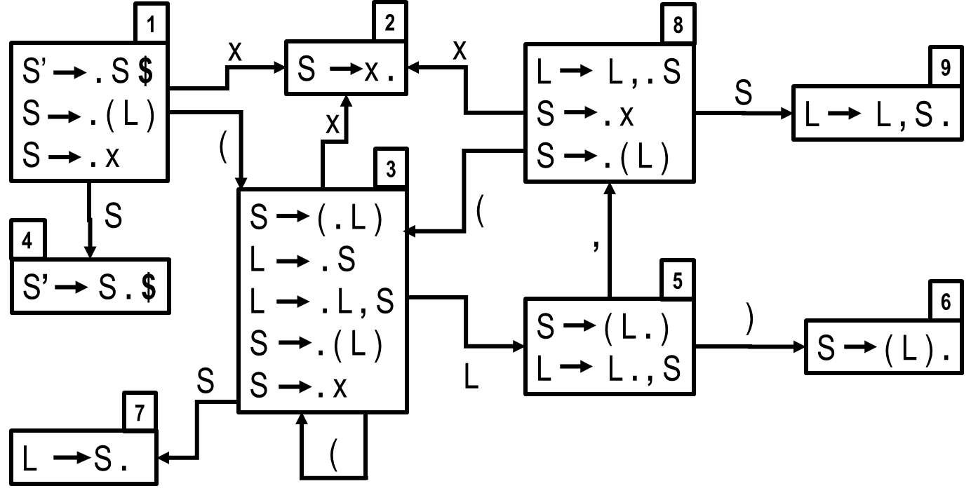
LR(0) parsing table
 | ( | ) | x | , | $ | S | L
1
2
3
4
5
6
7
8
9

Slide 154
LR(0) parsing table
t
For each transition X Y
where t is a terminal, add
“shift-to Y” in cell (X, t).
 | ( | ) | x | , | $ | S | L
1
2
3
4
5
6
7
8
9

Slide 155
LR(0) parsing table
t
For each transition X Y
where t is a terminal, add
“shift-to Y” in cell (X, t).
 | ( | ) | x | , | $ | S | L
1 | s3 |  | s2
2
3 | s3 |  | s2
4
5 |  | s6 |  | s8
6
7
8 |  | s3 | s2
9

Slide 156
LR(0) parsing table
N
For each transition X Y
where N is a nonterminal, add
“goto Y” in cell (X, N).
 | ( | ) | x | , | $ | S | L
1 | s3 |  | s2
2
3 | s3 |  | s2
4
5 |  | s6 |  | s8
6
7
8 |  | s3 | s2
9

Slide 157
LR(0) parsing table
N
For each transition X Y
where N is a nonterminal, add
“goto Y” in cell (X, N).
 | ( | ) | x | , | $ | S | L
1 | s3 |  | s2 |  |  | g4
2
3 | s3 |  | s2 |  |  | g7 | g5
4
5 |  | s6 |  | s8
6
7
8 |  | s3 | s2 |  |  | g9
9

Slide 158
LR(0) parsing table
For each state X containing an
item S’ S . $ put “accept”
in cell (X, $).
 | ( | ) | x | , | $ | S | L
1 | s3 |  | s2 |  |  | g4
2
3 | s3 |  | s2 |  |  | g7 | g5
4
5 |  | s6 |  | s8
6
7
8 |  | s3 | s2 |  |  | g9
9

Slide 159
LR(0) parsing table
For each state X containing an
item S’ S . $ put “accept”
in cell (X, $).
 | ( | ) | x | , | $ | S | L
1 | s3 |  | s2 |  |  | g4
2
3 | s3 |  | s2 |  |  | g7 | g5
4 |  |  |  |  | accept
5 |  | s6 |  | s8
6
7
8 |  | s3 | s2 |  |  | g9
9

Slide 160
LR(0) parsing table
0
2
4
S’ S $
S x
L L , S
1
3
S ( L )
L S
For each state X containing an
item N γ . (dot at end of item for rule n) put “reduce n” in all cells (X, t).
n
 | ( | ) | x | , | $ | S | L
1 | s3 |  | s2 |  |  | g4
2
3 | s3 |  | s2 |  |  | g7 | g5
4 |  |  |  |  | accept
5 |  | s6 |  | s8
6
7
8 |  | s3 | s2 |  |  | g9
9

Slide 161
LR(0) parsing table
0
2
4
S’ S $
S x
L L , S
1
3
S ( L )
L S
For each state X containing an
item N γ . (dot at end of item for rule n) put “reduce n” in all cells (X, t).
n
 | ( | ) | x | , | $ | S | L
1 | s3 |  | s2 |  |  | g4
2 | r2 | r2 | r2 | r2 | r2
3 | s3 |  | s2 |  |  | g7 | g5
4 |  |  |  |  | accept
5 |  | s6 |  | s8
6 | r1 | r1 | r1 | r1 | r1
7 | r3 | r3 | r3 | r3 | r3
8 |  | s3 | s2 |  |  | g9
9 | r4 | r4 | r4 | r4 | r4

Slide 162
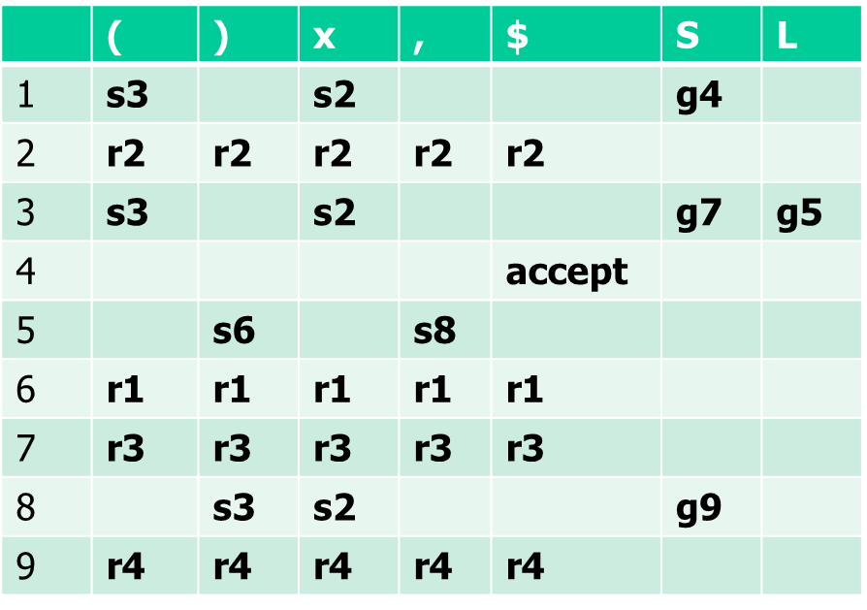
LR(0) parsing table
0
2
4
S’ S $
S x
L L , S
How to use the table: parse (x, x)
1
3
S ( L )
L S
Stack | Input | Action
1 | (x, x) $
No cell with >1 action => LR(0)

Slide 163
LR(0) parsing table
0
2
4
S’ S $
S x
L L , S
How to use the table: parse (x, x)
1
3
S ( L )
L S
Stack | Input | Action
1 | (x, x) $ | Shift 3
1 (3 | x, x) $
No cell with >1 action => LR(0)

Slide 164
LR(0) parsing table
0
2
4
S’ S $
S x
L L , S
How to use the table: parse (x, x)
1
3
S ( L )
L S
Stack | Input | Action
1 | (x, x) $ | Shift 3
1 (3 | x, x) $ | Shift 2
1 (3 x2 | , x) $
No cell with >1 action => LR(0)

Slide 165
LR(0) parsing table
0
2
4
S’ S $
S x
L L , S
How to use the table: parse (x, x)
1
3
S ( L )
L S
Stack | Input | Action
1 | (x, x) $ | Shift 3
1 (3 | x, x) $ | Shift 2
1 (3 x2 | , x) $ | Reduce 2
1 (3 S? | , x) $
No cell with >1 action => LR(0)

Slide 166
LR(0) parsing table
0
2
4
S’ S $
S x
L L , S
How to use the table: parse (x, x)
1
3
S ( L )
L S
Stack | Input | Action
1 | (x, x) $ | Shift 3
1 (3 | x, x) $ | Shift 2
1 (3 x2 | , x) $ | Reduce 2
1 (3 S7 | , x) $
No cell with >1 action => LR(0)

Slide 167
LR(0) parsing table
0
2
4
S’ S $
S x
L L , S
How to use the table: parse (x, x)
1
3
S ( L )
L S
Stack | Input | Action
1 | (x, x) $ | Shift 3
1 (3 | x, x) $ | Shift 2
1 (3 x2 | , x) $ | Reduce 2
1 (3 S7 | , x) $ | Reduce 3
1 (3 L? | , x) $
No cell with >1 action => LR(0)

Slide 168
LR(0) parsing table
0
2
4
S’ S $
S x
L L , S
How to use the table: parse (x, x)
1
3
S ( L )
L S
Stack | Input | Action
1 | (x, x) $ | Shift 3
1 (3 | x, x) $ | Shift 2
1 (3 x2 | , x) $ | Reduce 2
1 (3 S7 | , x) $ | Reduce 3
1 (3 L5 | , x) $
No cell with >1 action => LR(0)

Slide 169
LR(0) parsing table
0
2
4
S’ S $
S x
L L , S
How to use the table: parse (x, x)
1
3
S ( L )
L S
Stack | Input | Action
1 | (x, x) $ | Shift 3
1 (3 | x, x) $ | Shift 2
1 (3 x2 | , x) $ | Reduce 2
1 (3 S7 | , x) $ | Reduce 3
1 (3 L5 | , x) $ | Shift 8
1 (3 L5 ,8 | x) $
No cell with >1 action => LR(0)

Slide 170
LR(0) parsing table
0
2
4
S’ S $
S x
L L , S
How to use the table: parse (x, x)
1
3
S ( L )
L S
Stack | Input | Action
1 | (x, x) $ | Shift 3
1 (3 | x, x) $ | Shift 2
1 (3 x2 | , x) $ | Reduce 2
1 (3 S7 | , x) $ | Reduce 3
1 (3 L5 | , x) $ | Shift 8
1 (3 L5 ,8 | x) $ | Shift 2
1 (3 L5 ,8 x2 | ) $
No cell with >1 action => LR(0)

Slide 171
LR(0) parsing table
0
2
4
S’ S $
S x
L L , S
How to use the table: parse (x, x)
1
3
S ( L )
L S
Stack | Input | Action
1 | (x, x) $ | Shift 3
1 (3 | x, x) $ | Shift 2
1 (3 x2 | , x) $ | Reduce 2
1 (3 S7 | , x) $ | Reduce 3
1 (3 L5 | , x) $ | Shift 8
1 (3 L5 ,8 | x) $ | Shift 2
1 (3 L5 ,8 x2 | ) $ | Reduce 2
1 (3 L5 ,8 S? | ) $
No cell with >1 action => LR(0)

Slide 172
LR(0) parsing table
0
2
4
S’ S $
S x
L L , S
How to use the table: parse (x, x)
1
3
S ( L )
L S
Stack | Input | Action
1 | (x, x) $ | Shift 3
1 (3 | x, x) $ | Shift 2
1 (3 x2 | , x) $ | Reduce 2
1 (3 S7 | , x) $ | Reduce 3
1 (3 L5 | , x) $ | Shift 8
1 (3 L5 ,8 | x) $ | Shift 2
1 (3 L5 ,8 x2 | ) $ | Reduce 2
1 (3 L5 ,8 S9 | ) $
No cell with >1 action => LR(0)

Slide 173
LR(0) parsing table
0
2
4
S’ S $
S x
L L , S
How to use the table: parse (x, x)
1
3
S ( L )
L S
Stack | Input | Action
1 | (x, x) $ | Shift 3
1 (3 | x, x) $ | Shift 2
1 (3 x2 | , x) $ | Reduce 2
1 (3 S7 | , x) $ | Reduce 3
1 (3 L5 | , x) $ | Shift 8
1 (3 L5 ,8 | x) $ | Shift 2
1 (3 L5 ,8 x2 | ) $ | Reduce 2
1 (3 L5 ,8 S9 | ) $ | Reduce 4
1 (3 L? | ) $
No cell with >1 action => LR(0)

Slide 174
LR(0) parsing table
0
2
4
S’ S $
S x
L L , S
How to use the table: parse (x, x)
1
3
S ( L )
L S
Stack | Input | Action
1 | (x, x) $ | Shift 3
1 (3 | x, x) $ | Shift 2
1 (3 x2 | , x) $ | Reduce 2
1 (3 S7 | , x) $ | Reduce 3
1 (3 L5 | , x) $ | Shift 8
1 (3 L5 ,8 | x) $ | Shift 2
1 (3 L5 ,8 x2 | ) $ | Reduce 2
1 (3 L5 ,8 S9 | ) $ | Reduce 4
1 (3 L5 | ) $
No cell with >1 action => LR(0)

Slide 175
LR(0) parsing table
0
2
4
S’ S $
S x
L L , S
How to use the table: parse (x, x)
1
3
S ( L )
L S
Stack | Input | Action
1 | (x, x) $ | Shift 3
1 (3 | x, x) $ | Shift 2
1 (3 x2 | , x) $ | Reduce 2
1 (3 S7 | , x) $ | Reduce 3
1 (3 L5 | , x) $ | Shift 8
1 (3 L5 ,8 | x) $ | Shift 2
1 (3 L5 ,8 x2 | ) $ | Reduce 2
1 (3 L5 ,8 S9 | ) $ | Reduce 4
1 (3 L5 | ) $ | Shift 6
1 (3 L5 )6 | $
No cell with >1 action => LR(0)

Slide 176
LR(0) parsing table
0
2
4
S’ S $
S x
L L , S
How to use the table: parse (x, x)
1
3
S ( L )
L S
Stack | Input | Action
1 | (x, x) $ | Shift 3
1 (3 | x, x) $ | Shift 2
1 (3 x2 | , x) $ | Reduce 2
1 (3 S7 | , x) $ | Reduce 3
1 (3 L5 | , x) $ | Shift 8
1 (3 L5 ,8 | x) $ | Shift 2
1 (3 L5 ,8 x2 | ) $ | Reduce 2
1 (3 L5 ,8 S9 | ) $ | Reduce 4
1 (3 L5 | ) $ | Shift 6
1 (3 L5 )6 | $ | Reduce 1
1 S? | $
No cell with >1 action => LR(0)

Slide 177
LR(0) parsing table
0
2
4
S’ S $
S x
L L , S
How to use the table: parse (x, x)
1
3
S ( L )
L S
Stack | Input | Action
1 | (x, x) $ | Shift 3
1 (3 | x, x) $ | Shift 2
1 (3 x2 | , x) $ | Reduce 2
1 (3 S7 | , x) $ | Reduce 3
1 (3 L5 | , x) $ | Shift 8
1 (3 L5 ,8 | x) $ | Shift 2
1 (3 L5 ,8 x2 | ) $ | Reduce 2
1 (3 L5 ,8 S9 | ) $ | Reduce 4
1 (3 L5 | ) $ | Shift 6
1 (3 L5 )6 | $ | Reduce 1
1 S4 | $
No cell with >1 action => LR(0)

Slide 178
LR(0) parsing table
0
2
4
S’ S $
S x
L L , S
How to use the table: parse (x, x)
1
3
S ( L )
L S
Stack | Input | Action
1 | (x, x) $ | Shift 3
1 (3 | x, x) $ | Shift 2
1 (3 x2 | , x) $ | Reduce 2
1 (3 S7 | , x) $ | Reduce 3
1 (3 L5 | , x) $ | Shift 8
1 (3 L5 ,8 | x) $ | Shift 2
1 (3 L5 ,8 x2 | ) $ | Reduce 2
1 (3 L5 ,8 S9 | ) $ | Reduce 4
1 (3 L5 | ) $ | Shift 6
1 (3 L5 )6 | $ | Reduce 1
1 S4 | $ | Accept
No cell with >1 action => LR(0)

Slide 179
Another Example (3.23 in book)
0
2
S E $
E T
Do on blackboard
1
3
E T + E
T x

Slide 180
Another Example (3.23 in book)
0
2
S E $
E T
1
1
3
2
E T + E
T x
E
S . E $
E . T + E
E . T
T . x
S E . $
3
T
E T . + E
E T .
 | x | + | $ | E | T
1 | s5 |  |  | g2 | g3
2 |  |  | accept
3 | r2 | s4, r2 | r2
4 | s5 |  |  | g6 | g3
5 | r3 | r3 | r3
6 | r1 | r1 | r1
x
+
T
5
x
4
T x .
E T + . E
E . T + E
E . T
T . x
E
6
E T + E .
Duplicate entry – grammar is not LR(0)!

Slide 181
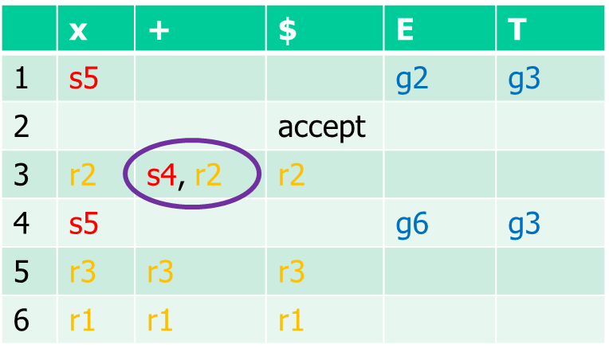
Another Example - SLR
Compare to LR(0) rule for filling parse table:

Slide 182
Another Example – SLR
0
2
S E $
E T
1
3
E T + E
T x
 | nullable | first | follow
S | ? | ? | ?
E | ? | ? | ?
T | ? | ? | ?

Slide 183
Another Example – SLR
0
2
S E $
E T
1
3
E T + E
T x
 | nullable | first | follow
S | No | x
E | No | x | $
T | No | x | + $
 | x | + | $ | E | T
1 | s5 |  |  | g2 | g3
2 |  |  | accept
3 |  | s4 | r2
4 | s5 |  |  | g6 | g3
5 |  | r3 | r3
6 |  |  | r1
No conflicts – grammar is SLR!

Slide 184
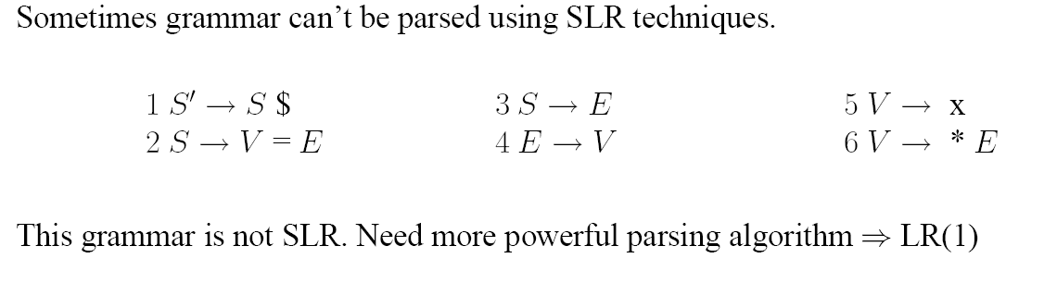
Yet Another Example
Convince yourself
at home!

Slide 185
LR(1) Parsing

Slide 186
LR(1) example
0
2
4
S’ S $
S E
V x
1
3
5
S V = E
E V
V * E
1
S’ . S $ ?
Initial item as in LR(0); lookahead ? arbitrary
since first($z) = { $ } for all z.

Slide 187
LR(1) example
0
2
4
S’ S $
S E
V x
1
3
5
S V = E
E V
V * E
1
S’ . S $ ?
S . V = E $
S . E $
E . V $
V . x $
V . * E $
Closure similar to LR(0), but with lookahead $.

Slide 188
LR(1) example
0
2
4
S’ S $
S E
V x
1
3
5
S V = E
E V
V * E
S
V
1
S’ . S $ ?
S . V = E $
E
S . E $
E . V $
x
V . x $,=
V . * E $,=
*
Repeated closure yields two new items, with new lookaheads.

Slide 189
LR(1) example
0
2
4
S’ S $
S E
V x
1
3
5
S V = E
E V
V * E
2
3
S’ S . $ ?
S V . = E $
E V . $
S
V
5
S E . $
1
S’ . S $ ?
S . V = E $
E
S . E $
E . V $
x
8
V . x $,=
V x . $,=
V . * E $,=
*
6
V * . E $,=
E . V $,=
V . x $,=
V . * E $,=
Transition shared by items from different rules.

Slide 190
LR(1) example
0
2
4
S’ S $
S E
V x
1
3
5
S V = E
E V
V * E
2
3
S’ S . $ ?
S V . = E $
E V . $
S
V
5
S E . $
1
S’ . S $ ?
S . V = E $
E
S . E $
E . V $
x
8
V . x $,=
V x . $,=
V . * E $,=
*
6
V * . E $,=
E . V $,=
V . x $,=
V . * E $,=

Slide 191
LR(1) example
0
2
4
S’ S $
S E
V x
1
3
5
S V = E
E V
V * E
2
3
S’ S . $ ?
S V . = E $
E V . $
S
V
5
S E . $
1
S’ . S $ ?
S . V = E $
E
S . E $
E . V $
x
8
V . x $,=
V x . $,=
V . * E $,=
*
6
V * . E $,=
E . V $,=
V . x $,=
V . * E $,=

Slide 192
LR(1) example
0
2
4
S’ S $
S E
V x
1
3
5
S V = E
E V
V * E
2
3
S’ S . $ ?
S V . = E $
E V . $
S
V
5
S E . $
1
S’ . S $ ?
S . V = E $
E
S . E $
E . V $
x
8
V . x $,=
V x . $,=
V . * E $,=
*
6
V * . E $,=
E . V $,=
Closure yields second item for same rule, but different cursor position.
V . x $,=
V . * E $,=

Slide 193
LR(1) example
0
2
4
S’ S $
S E
V x
1
3
5
S V = E
E V
V * E
2
3
4
S’ S . $ ?
S V . = E $
=
S V = . E $
E V . $
E . V $
V . x $
S
V
5
V . * E $
S E . $
1
S’ . S $ ?
S . V = E $
E
S . E $
E . V $
x
8
V . x $,=
V x . $,=
V . * E $,=
*
x
6
12
V * . E $,=
V
E V . $,=
*
E . V $,=
V . x $,=
E
10
V . * E $,=
V * E . $,=

Slide 194
LR(1) example
0
2
4
S’ S $
S E
V x
1
3
5
S V = E
E V
V * E
2
3
4
S’ S . $ ?
S V . = E $
=
S V = . E $
E V . $
E . V $
V . x $
S
V
5
V . * E $
S E . $
V
1
E
S’ . S $ ?
7
x
9
S . V = E $
E
E V . $
*
S V = E . $
S . E $
E . V $
x
8
V . x $,=
V x . $,=
13
V . * E $,=
V * . E $
11
E . V $
*
x
V x . $
V . x $
6
12
V . * E $
V * . E $,=
V
E V . $,=
*
E . V $,=
V . x $,=
E
10
V . * E $,=
V * E . $,=

Slide 195
LR(1) example
0
2
4
S’ S $
S E
V x
1
3
5
S V = E
E V
V * E
2
3
4
S’ S . $ ?
S V . = E $
=
S V = . E $
E V . $
E . V $
V . x $
S
V
5
V . * E $
S E . $
V
1
E
S’ . S $ ?
7
x
9
S . V = E $
E
E V . $
*
S V = E . $
S . E $
E . V $
x
8
V . x $,=
V x . $,=
V
13
V . * E $,=
V * . E $
11
E . V $
*
*
x
V x . $
x
V . x $
6
12
V . * E $
V * . E $,=
V
E V . $,=
E
*
E . V $,=
14
V . x $,=
E
10
V . * E $,=
V * E . $,=
V * E . $

Slide 196
LR(1) example
0
2
4
S’ S $
S E
V x
1
3
5
S V = E
E V
V * E
2
3
4
S’ S . $ ?
S V . = E $
=
S V = . E $
E V . $
E . V $
V . x $
S
V
5
V . * E $
S E . $
V
1
E
S’ . S $ ?
7
x
9
S . V = E $
E
E V . $
*
S V = E . $
S . E $
E . V $
x
8
V . x $,=
V x . $,=
V
13
V . * E $,=
V * . E $
11
E . V $
*
*
x
V x . $
x
V . x $
6
12
V . * E $
V * . E $,=
V
E V . $,=
E
*
E . V $,=
14
V . x $,=
E
10
V . * E $,=
V * E . $,=
V * E . $

Slide 197
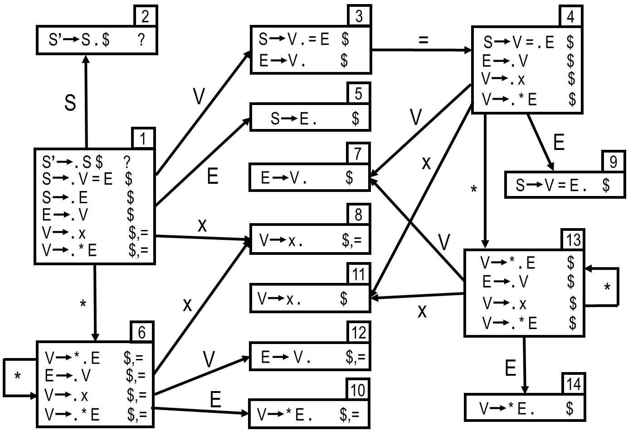
LR(1) parsing table
0
2
4
S’ S $
S E
V x
1
3
5
S V = E
E V
V * E
 | x | * | = | $ | S | E | V
1 | s8 | s6
2
3 |  |  | s4
4 | s11 | s13
5
6 | s8 | s6
7
8
9
10
11
12
13 | s11 | s13
14
shift as before: when dot is
before terminal, ie transition marked by terminal.

Slide 198
LR(1) parsing table
0
2
4
S’ S $
S E
V x
1
3
5
S V = E
E V
V * E
 | x | * | = | $ | S | E | V
1 | s8 | s6 |  |  | g2 | g5 | g3
2
3 |  |  | s4
4 | s11 | s13 |  |  |  | g9 | g7
5
6 | s8 | s6 |  |  |  | g10 | g12
7
8
9
10
11
12
13 | s11 | s13 |  |  |  | g14 | g7
14
goto as before: when dot is
before nonterminal, ie transition marked by nonterminal.

Slide 199
LR(1) parsing table
0
2
4
S’ S $
S E
V x
1
3
5
S V = E
E V
V * E
 | x | * | = | $ | S | E | V
1 | s8 | s6 |  |  | g2 | g5 | g3
2 |  |  |  | acc
3 |  |  | s4
4 | s11 | s13 |  |  |  | g9 | g7
5
6 | s8 | s6 |  |  |  | g10 | g12
7
8
9
10
11
12
13 | s11 | s13 |  |  |  | g14 | g7
14
accept as before: when dot is
before $.

Slide 200
LR(1) parsing table
0
2
4
S’ S $
S E
V x
1
3
5
S V = E
E V
V * E
 | x | * | = | $ | S | E | V
1 | s8 | s6 |  |  | g2 | g5 | g3
2 |  |  |  | acc
3 |  |  | s4 | r3
4 | s11 | s13 |  |  |  | g9 | g7
5
6 | s8 | s6 |  |  |  | g10 | g12
7
8
9
10
11
12
13 | s11 | s13 |  |  |  | g14 | g7
14
reduce n: when dot is at end of
item for rule n with lookahead t in state X, add reduce n in cell (X, t).

Slide 201
LR(1) parsing table
0
2
4
S’ S $
S E
V x
1
3
5
S V = E
E V
V * E
 | x | * | = | $ | S | E | V
1 | s8 | s6 |  |  | g2 | g5 | g3
2 |  |  |  | acc
3 |  |  | s4 | r3
4 | s11 | s13 |  |  |  | g9 | g7
5 |  |  |  | r2
6 | s8 | s6 |  |  |  | g10 | g12
7 |  |  |  | r3
8 |  |  | r4 | r4
9 |  |  |  | r1
10 |  |  | r5 | r5
11 |  |  |  | r4
12 |  |  | r3 | r3
13 | s11 | s13 |  |  |  | g14 | g7
14 |  |  |  | r5
reduce n: when dot is at end of
item for rule n with lookahead t in state X, and add reduce n in cell (X, t).

Slide 202
LR(1) parsing table
0
2
4
S’ S $
S E
V x
1
3
5
S V = E
E V
V * E
 | x | * | = | $ | S | E | V
1 | s8 | s6 |  |  | g2 | g5 | g3
2 |  |  |  | acc
3 |  |  | s4 | r3
4 | s11 | s13 |  |  |  | g9 | g7
5 |  |  |  | r2
6 | s8 | s6 |  |  |  | g10 | g12
7 |  |  |  | r3
8 |  |  | r4 | r4
9 |  |  |  | r1
10 |  |  | r5 | r5
11 |  |  |  | r4
12 |  |  | r3 | r3
13 | s11 | s13 |  |  |  | g14 | g7
14 |  |  |  | r5
No duplicate entries ➔ Grammar is LR(1)!

Slide 203
LALR(1)
 | x | * | = | $ | S | E | V
1 | s8 | s6 |  |  | g2 | g5 | g3
2 |  |  |  | acc
3 |  |  | s4 | r3
4 | s8 | s6 |  |  |  | g9 | g7
5 |  |  |  | r2
6 | s8 | s6 |  |  |  | g10 | g7
7 |  |  | r3 | r3
8 |  |  | r4 | r4
9 |  |  |  | r1
10 |  |  | r5 | r5
s11=s8
s12=s7
s13=s6
s14=s10

Slide 204
Parsing Power

Slide 205
Parsing Error Recovery

Slide 206
Error Recovery

Slide 207
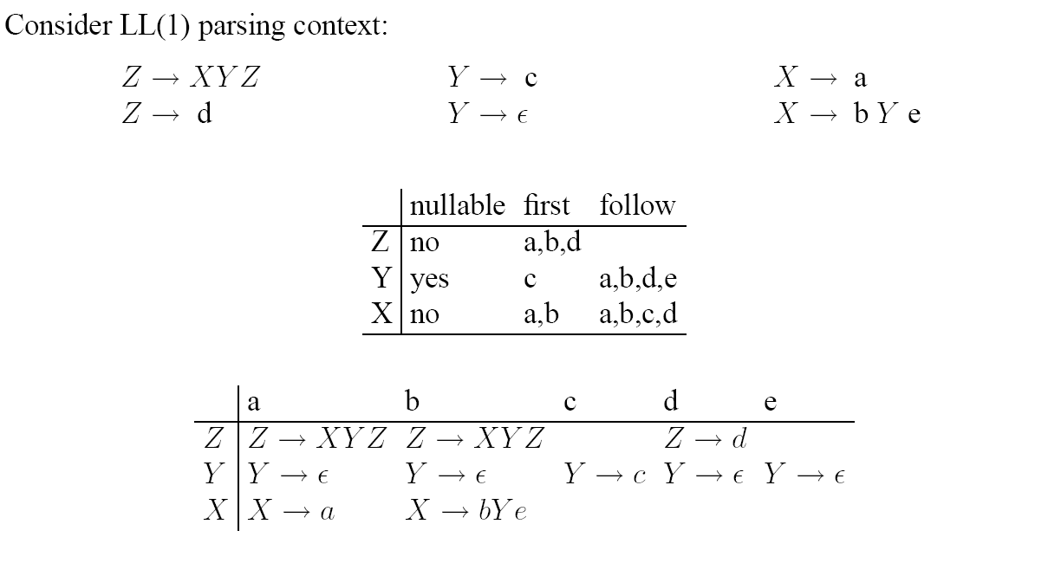
LL Local Error Recovery

Slide 208
LL Local Error Recovery

Slide 209
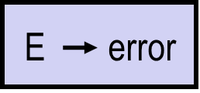
LR Local Error Recovery
Example:
E ID
E ( ES )
ES ES ; E
E E + E
ES E
match a sequence of erroneous input tokens using the error token – a fresh terminal
preferable: have error followed with synchronizing lookahead token, like
RPAREN and SEMI here, by adding rules like this:
(alternative: add but that does not allow us to skip ahead to RPAREN, SEMI)
E (error)
ES error ; E

Slide 210
LR Local Error Recovery
Example:
E ID
E ( ES )
ES ES ; E
E E + E
ES E
match a sequence of erroneous input tokens using the error token – a fresh terminal
preferable: have error followed with synchronizing lookahead token, like
RPAREN and SEMI here, by adding rules like this:
(alternative: add but that does not allow us to skip ahead to RPAREN, SEMI)
build parse table for the extended grammar
E (error)
ES error ; E

Slide 211
LR Local Error Recovery
Example:
E ID
E ( ES )
ES ES ; E
E E + E
ES E
match a sequence of erroneous input tokens using the error token – a fresh terminal
preferable: have error followed with synchronizing lookahead token, like
RPAREN and SEMI here, by adding rules like this:
(alternative: add but that does not allow us to skip ahead to RPAREN, SEMI)
build parse table for the extended grammar
LR parse engine: when trying to read from empty cell,
  pop the stack until a state is reached in which the action for error is shift
  do the shift action
E (error)
ES error ; E

Slide 212
LR Local Error Recovery
Example:
E ID
E ( ES )
ES ES ; E
E E + E
ES E
match a sequence of erroneous input tokens using the error token – a fresh terminal
preferable: have error followed with synchronizing lookahead token, like
RPAREN and SEMI here, by adding rules like this:
(alternative: add but that does not allow us to skip ahead to RPAREN, SEMI)
build parse table for the extended grammar
LR parse engine: when trying to read from empty cell,
  pop the stack until a state is reached in which the action for error is shift
  do the shift action
  discard the input symbols (if necessary) until a state is reached that has a proper shift/goto/reduce/accept action in the current state (in case we have indeed synchronizing lookahead, this will be a shift action for one of the lookaheads)
  resume normal parsing
E (error)
ES error ; E

Slide 213
Global Error Recovery

Slide 214
Burke-Fisher

Slide 215
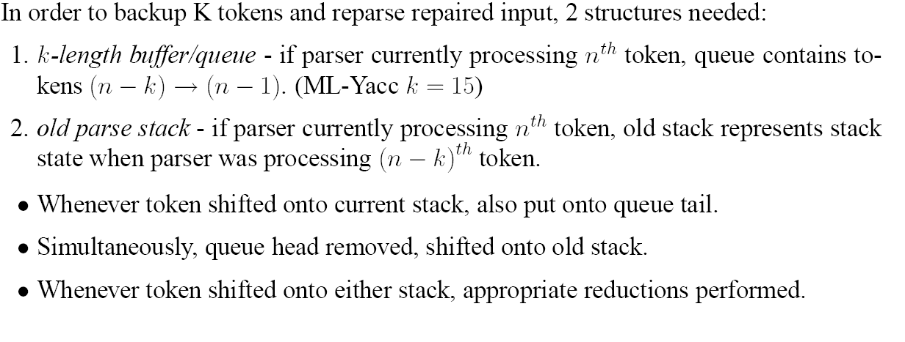
Burke-Fisher

Slide 216
Burke-Fisher Example

Slide 217
Burke-Fisher

Slide 218
Burke-Fisher in ML-YACC

