Slide 1
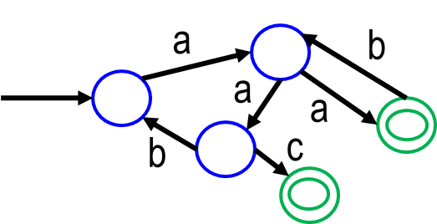
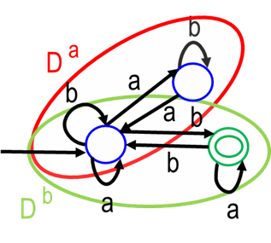
Topic 2: Lexing and Flexing
COS 320
Compiling Techniques
Princeton University
Spring 2016
Lennart Beringer

Slide 2
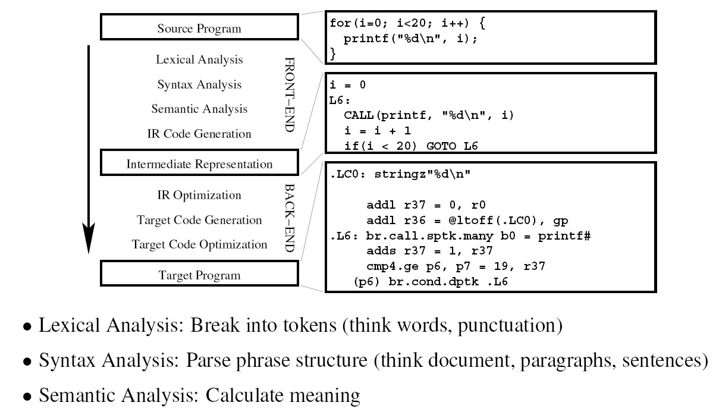
The Compiler

Slide 3
Lexical Analysis
Goal: break stream of ASCII characters (source/input) into sequence of tokens
Token: sequence of characters treated as a unit (cf. word)
Each token has a token type (cf. classification verb - noun - punctuation symbol):
IDENTIFIER
foo, x, quicksort, …
NUM
1, 50, -100
REAL
6.7, 3.9E-33, -4.9
IF
if
SEMI
;
THEN
then
…
LPAREN
(
RPAREN
)
EQ
=
PLUS
+
Many tokens have associated semantic information: NUM(1), NUM(50), IDENTIFIER(foo), IDENTIFIER(x), but typically not SEMI(;), LPAREN(()
Definition of tokens (mostly) part of language definition
White space and comments often discarded. Pros/Cons?

Slide 4
Lexical Analysis
Goal: break stream of ASCII characters (source/input) into sequence of tokens
Token: sequence of characters treated as a unit (cf. word)
Each token has a token type (cf. classification verb - noun - punctuation symbol):
IDENTIFIER
foo, x, quicksort, …
NUM
1, 50, -100
REAL
6.7, 3.9E-33, -4.9
IF
if
SEMI
;
THEN
then
…
LPAREN
(
RPAREN
)
EQ
=
PLUS
+
Many tokens have associated semantic information: NUM(1), NUM(50), IDENTIFIER(foo), IDENTIFIER(x), but typically not SEMI(;), LPAREN(()
Definition of tokens (mostly) part of language definition
White space and comments often discarded. Pros/Cons?

Slide 5
Lexical Analysis
Goal: break stream of ASCII characters (source/input) into sequence of tokens
Token: sequence of characters treated as a unit (cf. word)
Each token has a token type (cf. classification verb - noun - punctuation symbol):
IDENTIFIER
foo, x, quicksort, …
NUM
1, 50, -100
REAL
6.7, 3.9E-33, -4.9
IF
if
SEMI
;
THEN
then
…
LPAREN
(
RPAREN
)
EQ
=
PLUS
+
Many tokens have associated semantic information: NUM(1), NUM(50), IDENTIFIER(foo), IDENTIFIER(x), but typically not SEMI(;), LPAREN(()
Definition of tokens (mostly) part of language definition
White space and comments often discarded. Pros/Cons?

Slide 6
Lexical Analysis
Goal: break stream of ASCII characters (source/input) into sequence of tokens
Token: sequence of characters treated as a unit (cf. word)
Each token has a token type (cf. classification verb - noun - punctuation symbol):
IDENTIFIER
foo, x, quicksort, …
NUM
1, 50, -100
REAL
6.7, 3.9E-33, -4.9
IF
if
SEMI
;
THEN
then
…
LPAREN
(
RPAREN
)
EQ
=
PLUS
+
Many tokens have associated semantic information: NUM(1), NUM(50), IDENTIFIER(foo), IDENTIFIER(x), but typically not SEMI(;), LPAREN(()
Definition of tokens (mostly) part of language definition
White space and comments often discarded. Pros/Cons?

Slide 7
Lexical Analysis
Goal: break stream of ASCII characters (source/input) into sequence of tokens
Token: sequence of characters treated as a unit (cf. word)
Each token has a token type (cf. classification verb - noun - punctuation symbol):
IDENTIFIER
foo, x, quicksort, …
NUM
1, 50, -100
REAL
6.7, 3.9E-33, -4.9
IF
if
SEMI
;
THEN
then
…
LPAREN
(
RPAREN
)
EQ
=
PLUS
+
Many tokens have associated semantic information: NUM(1), NUM(50), IDENTIFIER(foo), IDENTIFIER(x), but typically not SEMI(;), LPAREN(()
Definition of tokens (mostly) part of language definition
White space and comments often discarded. Pros/Cons?

Slide 8
Lexical Analysis Example

Slide 9
Lexical Analysis Example
IDENTIFIER(x)
EQ
LPAREN
IDENTIFIER(y)
PLUS
NUM(4.0)
RPAREN
SEMI

Slide 10
Implementing a Lexical Analyzer (Lexer)
Option 1: write it from scratch:
Source: text file
Lexer for language L
Stream of tokens

Slide 11
Implementing a Lexical Analyzer (Lexer)
Option 1: write it from scratch:
Source: text file
Lexer for language L
Stream of tokens
Option 2: eat your own dog food! (use a lexical analyzer generator):
Source: text file
Token stream
wrt L1
Lexer
for L1
Lexer
for L2
Token stream
wrt L2
Input: lexing rules for L1
Lexer generator
Input: lexing rules for L2

Slide 12
Implementing a Lexical Analyzer (Lexer)
Option 1: write it from scratch
Source: text file
Lexer for language L
Stream of tokens
Option 2: eat your own dog food! (use a lexical analyzer generator)
Source: text file
Token stream
wrt L1
Lexer
for L1
Lexer
for L2
Token stream
wrt L2
Input: lexing rules for L1
Lexer generator
Input: lexing rules for L2
Q: how do we describe the tokens for L1, L2, …?
A: using another language, of course!
Yeah, but how do we describe the tokens of that language???

Slide 13
Theory to the rescue: regular expressions
Some definitions
An alphabet is a (finite) collection of symbols.
Examples: ASCII, {0, 1}, {A, ..Z, a, .. Z}, {0, ..9}
Notes:
RE’s also used by Unix tools (grep, …) some search engines,…

Slide 14
Theory to the rescue: regular expressions
Some definitions
An alphabet is a (finite) collection of symbols.
Examples: ASCII, {0, 1}, {A, ..Z, a, .. Z}, {0, ..9}
A string/word (over alphabet A) is a finite sequence of symbols from A.
Notes:
RE’s also used by Unix tools (grep, …) some search engines,…

Slide 15
Theory to the rescue: regular expressions
Some definitions
An alphabet is a (finite) collection of symbols.
Examples: ASCII, {0, 1}, {A, ..Z, a, .. Z}, {0, ..9}
A string/word (over alphabet A) is a finite sequence of symbols from A.
A language (over A) is a (finite or infinite) set of strings over A.
Notes:
RE’s also used by Unix tools (grep, …) some search engines,…

Slide 16
Theory to the rescue: regular expressions
Some definitions
An alphabet is a (finite) collection of symbols.
Examples: ASCII, {0, 1}, {A, ..Z, a, .. Z}, {0, ..9}
A string/word (over alphabet A) is a finite sequence of symbols from A.
A language (over A) is a (finite or infinite) set of strings over A.
Examples:
  the ML language: set of all strings representing correct ML programs (infinite)
  the language of ML keywords: set of all strings that are ML keywords (finite)
  the language of ML tokens: set of all strings that map to ML tokens (infinite)
Notes:
RE’s also used by Unix tools (grep, …) some search engines,…

Slide 17
Theory to the rescue: regular expressions
Some definitions
An alphabet is a (finite) collection of symbols.
Examples: ASCII, {0, 1}, {A, ..Z, a, .. Z}, {0, ..9}
A string/word (over alphabet A) is a finite sequence of symbols from A.
A language (over A) is a (finite or infinite) set of strings over A.
Examples:
  the ML language: set of all strings representing correct ML programs (infinite)
  the language of ML keywords: set of all strings that are ML keywords (finite)
  the language of ML tokens: set of all strings that map to ML tokens (infinite)
Q: How to describe languages?
A(for lexing): regular expressions!
REs are finite descriptions/representations of (certain) finite or infinite languages, including
  the language of a (programming) language’s tokens (eg the language of ML tokens)
  the language describing the language of a (programming) language’s tokens,
  the language describing …
Notes:
RE’s also used by Unix tools (grep, …) some search engines,…

Slide 18
Constructing regular expressions
Base cases
Inductive cases: given RE’s M and N,

Slide 19
Constructing regular expressions
Base cases
the RE ε (epsilon): the (finite) language containing only the empty string.
for each symbol a from A, the RE a denotes the (finite) language
containing only the string a.
Inductive cases: given RE’s M and N,

Slide 20
Constructing regular expressions
Base cases
the RE ε (epsilon): the (finite) language containing only the empty string.
for each symbol a from A, the RE a denotes the (finite) language
containing only the string a.
Inductive cases: given RE’s M and N,
the RE M | N (alternation, union) describes the language
containing the strings in M or N.
Example: a | b denotes the two-element language {a, b}

Slide 21
Constructing regular expressions
Base cases
the RE ε (epsilon): the (finite) language containing only the empty string.
for each symbol a from A, the RE a denotes the (finite) language
containing only the string a.
Inductive cases: given RE’s M and N,
the RE M | N (alternation, union) describes the language
containing the strings in M or N.
Example: a | b denotes the two-element language {a, b}
The RE MN (concatenation) denotes the strings that can be
written as the concatenation mn where m in from M and n is from N.
Example: (a|b)(a|c) denotes the language {aa, ac, ba, bc}

Slide 22
Constructing regular expressions
Base cases
the RE ε (epsilon): the (finite) language containing only the empty string.
for each symbol a from A, the RE a denotes the (finite) language
containing only the string a.
Inductive cases: given RE’s M and N,
the RE M | N (alternation, union) describes the language
containing the strings in M or N.
Example: a | b denotes the two-element language {a, b}
The RE MN (concatenation) denotes the strings that can be
written as the concatenation mn where m in from M and n is from N.
Example: (a|b)(a|c) denotes the language {aa, ac, ba, bc}
The RE M* (Kleene closure/star) denotes the (infinitely many) strings
obtained by concatenating finitely many elements from M.
Example: (a|b)* denotes the language {ε, a, b, aa, ab, ba, bb, aaa, aab, aba, abb, …}

Slide 23
Regular Expression Examples
For alphabet Σ = {a,b}:
a
Strings with an even number of a’s:
RE =
Strings that with an odd number of b’s:
b
RE =

Slide 24
Regular Expression Examples
For alphabet Σ = {a,b}:
Solutions not unique!
a
b* ( a b* a b* )*
Strings with an even number of a’s:
RE =
Strings that with an odd number of b’s:
b
RE =

Slide 25
Regular Expression Examples
For alphabet Σ = {a,b}:
Solutions not unique!
a
b* ( a b* a b* )*
Strings with an even number of a’s:
RE =
Strings that with an odd number of b’s:
b
a* b a* (b a* b a*)*
RE =

Slide 26
Regular Expression Examples
For alphabet Σ = {a,b}:
a
b* ( a b* a b* )*
Strings with an even number of a’s:
RE =
Strings that with an odd number of b’s:
b
a* b a* (b a* b a*)*
RE =
Strings with an even number of a’s
OR an odd number of b’s:
a,b
RE =
Strings that can be split into a string with
an even number of a’s, followed by a string
with an odd number of b’s:

Slide 27
Regular Expression Examples
For alphabet Σ = {a,b}:
a
b* ( a b* a b* )*
Strings with an even number of a’s:
RE =
Strings that with an odd number of b’s:
b
a* b a* (b a* b a*)*
RE =
Strings with an even number of a’s
OR an odd number of b’s:
a,b
a
b
RE =
RE |
RE
Strings that can be split into a string with
an even number of a’s, followed by a string
with an odd number of b’s:

Slide 28
Regular Expression Examples
For alphabet Σ = {a,b}:
a
b* ( a b* a b* )*
Strings with an even number of a’s:
RE =
Strings that with an odd number of b’s:
b
a* b a* (b a* b a*)*
RE =
Strings with an even number of a’s
OR an odd number of b’s:
a,b
a
b
RE =
RE |
RE
Strings that can be split into a string with
an even number of a’s, followed by a string
with an odd number of b’s:
a
b
RE =
RE
RE
a,b

Slide 29
Regular Expression Examples
For alphabet Σ = {a,b}:
a
b* ( a b* a b* )*
Strings with an even number of a’s:
RE =
Strings with an odd number of b’s:
b
a* b a* (b a* b a*)*
RE =
Strings with an even number of a’s
OR an odd number of b’s:
a,b
a
b
RE =
RE |
RE
Strings that can be split into a string with
an even number of a’s, followed by a string
with an odd number of b’s:
a
b
RE =
RE
RE
a,b
Optional Homework:
Strings with an even number of a’s and an odd number of b’s….

Slide 30
Implementing RE’s: finite automata
Source: text file
Automaton
Automaton
Token stream
wrt L1
Lexer
for L1
Lexer
for L2
Token stream
wrt L2
RE
RE
Input: lexing rules for L1
Lexer generator
Input: lexing rules for L2
Finite automata (aka finite state machines, FSM’s):
a computational model of machines with finite memory
Components of an automaton over alphabet A:
a finite set S of nodes (“states”)
a set of directed edges (“transitions”) s t, each linking two states and labeled with a symbol from A
a designated start state s0 from S, indicated by “arrow from nowhere”
a nonempty set of final (“accepting”) states (indicated by double circle)
a

Slide 31
Finite Automata recognize languages
Definition: the language recognized by an FA is the set of (finite) strings it accepts.
a
b
a
a
Q:
how does the finite automaton D accept a string A?
c
b
A: follow the transitions:
start in the start state s0 and inspect the first symbol, a1
when in state s and inspecting symbol a, traverse one edge labeled a to get to the next state. Look at the next symbol.
After reading in all n symbols: if the current state s is a final one, accept. Otherwise, reject.
whenever there’s no edge whose label matches the next symbol: reject.

Slide 32
Classes of Finite Automata
Deterministic finite automaton (DFA)
all edges leaving a node are uniquely labeled.
Nondeterministic finite automaton (NFA)
two (or more) edges leaving a node may be identically uniquely labeled. Any choice that leads to acceptance is fine.
edges may also be labeled with ε. So can “jump” to the next state without consuming an input symbol.

Slide 33
Classes of Finite Automata
Deterministic finite automaton (DFA)
all edges leaving a node are uniquely labeled.
Nondeterministic finite automaton (NFA)
two (or more) edges leaving a node may be identically uniquely labeled. Any choice that leads to acceptance is fine.
edges may also be labeled with ε. So can “jump” to the next state without consuming an input symbol.
Strategy for obtaining a DFA that recognizes exactly the language described by an RE:
convert RE into an NFA that recognizes the language
transform the NFA into an equivalent DFA
Remember Tuesday’s quiz?

Slide 34
NFA Examples
Over alphabet {a, b}:
Strings with an even number of a’s:
Strings with an odd number of b’s:

Slide 35
NFA Examples
Over alphabet {a, b}:
b
b
a
a
Strings with an even number of a’s:
D :
a
Strings with an odd number of b’s:

Slide 36
NFA Examples (adhoc)
Over alphabet {a, b}:
b
b
a
a
Strings with an even number of a’s:
D :
a
b
b
Strings with an odd number of b’s:
D :
b
a
a
Can we systematically generate NFA’s from RE’s?

Slide 37
RE to NFA Rules

Slide 38
RE to NFA Rules

Slide 39
RE to NFA Rules

Slide 40
RE to NFA Rules

Slide 41
RE to NFA Conversion: examples for | and concat
a
a
D
ε
a
Strings with an even number of a’s
OR an odd number of b’s:
b
a
b
b
RE |
RE
b
ε
b
b
D
a
a
b
a
D
b
a
Strings that can be split into a string with
an even number of a’s, followed by a
string with an odd number of b’s:
a
b
b
b
a
a
b
D
a
RE
RE

Slide 42
RE to NFA Conversion: examples for | and concat
a
a
D
ε
a
Strings with an even number of a’s
OR an odd number of b’s:
b
a
b
b
RE |
RE
b
ε
b
b
D
a
a
b
a
D
b
a
Strings that can be split into a string with
an even number of a’s followed by a
string with an odd number of b’s:
a
b
b
b
a
a
b
D
a
RE
RE

Slide 43
NFA to DFA Conversion
b
a
2
4
1
b
ε
a
c
ε
c
3
5
6
Idea:
combine identically labeled NFA transitions
DFA states represent sets of “equivalent” NFA states

Slide 44
NFA to DFA conversion
Auxiliary definitions:
a
edge(s, a) = { t | s t }
set of NFA states reachable from NFA state s by an a step
closure(S) = S U ( U edge(s, ε))
s є S
set of NFA states reachable from any s є S by an ε step
Main calculation:
DFA-edge(D,a) = closure( U edge(s,a))
s є D
set of NFA states reachable from D by making
one a step and (then) any number of ε steps

Slide 45
NFA to DFA Example
b
a
2
4
1
b
ε
a
c
ε
c
3
5
6
closure(S)
S U ( U edge(s, ε))
s є S

Slide 46
NFA to DFA Example
b
a
2
4
1
b
ε
a
c
ε
c
3
5
6
Step 1: closure sets
1 : {1}
2:{2}
3:{3,5}
4:{4,6}
5:{5}
6:{6}
closure(S)
edge(s, a)
S U ( U edge(s, ε))
a
{ t | s t }
s є S

Slide 47
NFA to DFA Example
b
a
2
4
1
b
ε
a
c
ε
c
3
5
6
Step 1:
closure sets
Step 2: edge sets
 | a | b | c
1 | 2,3 | - | -
2 | - | 4 | -
3 | - | - | -
4 | - | - | -
5 | - | 2 | 4,6
6 | - | - | -
1 | {1}
2 | {2}
3 | {3,5}
4 | {4,6}
5 | {5}
6 | {6}
closure(S)
edge(s, a)
DFA-edge(D,a)
S U ( U edge(s, ε))
a
closure( U edge(s,a))
{ t | s t }
s є S
s є D

Slide 48
NFA to DFA Example
 | a | b | c
1 | 2,3 | - | -
2 | - | 4 | -
3 | - | - | -
4 | - | - | -
5 | - | 2 | 4,6
6 | - | - | -
a
b
2
4
1
a
b
c
ε
3
ε
5
c
6
Step 3: DFA-sets
D | a | b | c
{1} | Cl(2) + Cl(3) = {2,3,5} | {} | {}
{2,3,5} | {} | Cl(2)+Cl(4) = {2,4,6} | Cl(4) + Cl(6) = {4,6}
{2,4,6} | {} | Cl(4) = {4,6} | {}
{4,6} | {} | {} | {}
1 | {1}
2 | {2}
3 | {3,5}
4 | {4,6}
5 | {5}
6 | {6}
closure(S)
edge(s, a)
DFA-edge(D,a)
S U ( U edge(s, ε))
a
closure( U edge(s,a))
{ t | s t }
s є S
s є D

Slide 49
NFA to DFA Example
b
Step 4:
Transition matrix
a
2
4
1
a
b
c
ε
3
ε
5
c
6
A
B
C
D
D | a | b | c
{1} | Cl(2) + Cl(3) = {2,3,5} | {} | {}
{2,3,5} | {} | Cl(2)+Cl(4) = {2,4,6} | Cl(4) +Cl(6) = {4,6}
{2,4,6} | {} | Cl(4) = {4,6} | {}
{4,6} | {} | {} | {}
B
c
a
D
A
b
C
b

Slide 50
NFA to DFA Example
a
b
Step 5:
Initial state: closure of
initial NFA state
2
4
1
a
b
c
ε
3
ε
5
c
6
A
B
C
D
D | a | b | c
{1} | Cl(2) + Cl(3) = {2,3,5} | {} | {}
{2,3,5} | {} | Cl(2)+Cl(4) = {2,4,6} | Cl(4) + Cl(6) = {4,6}
{2,4,6} | {} | Cl(4) = {4,6} | {}
{4,6} | {} | {} | {}
B
c
a
D
A
b
C
b

Slide 51
NFA to DFA Example
b
Step 6:
Final state(s): DFA
states “containing”
a final NFA state
a
2
4
1
a
b
c
ε
3
ε
5
c
6
A
B
C
D
D | a | b | c
{1} | Cl(2) + Cl(3) = {2,3,5} | {} | {}
{2,3,5} | {} | Cl(2)+Cl(4) = {2,4,6} | Cl(4) + Cl(6) = {4,6}
{2,4,6} | {} | Cl(4) = {4,6} | {}
{4,6} | {} | {} | {}
B
c
a
D
A
b
C
b
Algorithm in pseudo-code: Appel, page 27

Slide 52
The Longest Token
Lexer should identify the longest matching token:
ifz8 should be lexed as IDENTIFIER, not as two tokens IF, IDENTIFIER
Hence, the implementation
saves the most recently encountered accepting state of the DFA (and the corresponding stream position) and
updates this info when passing through another accepting state
Uses the order of rules as tie-breaker in case several tokens (of equal length) match

Slide 53
Other Useful Techniques
(see exercise 2.7)
(generalized NFA’s: transitions may be labeled with RE’s)

Slide 54
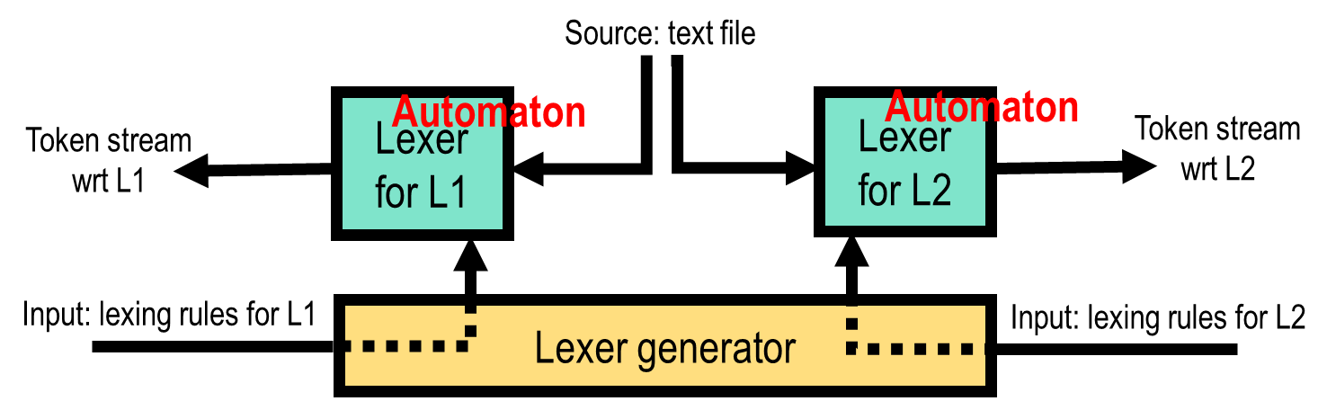

Summary
Motivated use of lexer generators for partitioning input stream into tokens
Three formalisms for describing and implementing lexers:
  Regular expressions
  NFA’s
  DFA’s
  Conversions RE -> NFA -> DFA
Next lecture: practicalities of lexing (ML-LEX)

Slide 55
The Compiler

Slide 56
Practicalities of lexing: ML Lex, Lex, Flex, …

Slide 57
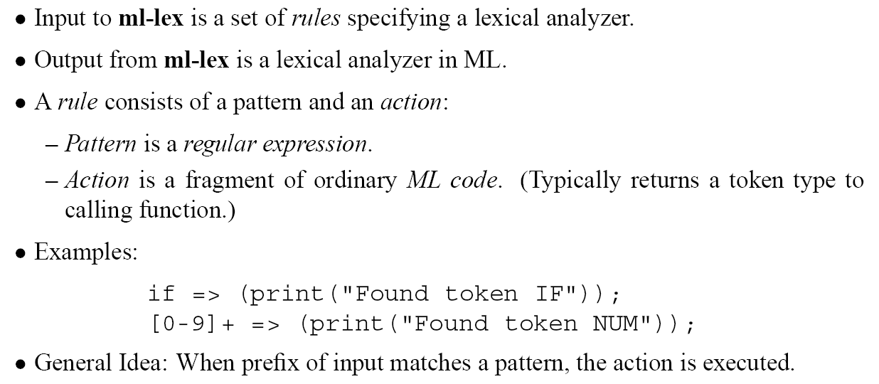
ML Lex: lexer generator for ML
(similar tools for C: lex, flex)

Slide 58
Lexical Specification
Specification of a lexer has three parts:
User Declarations
%%
ML-LEX Definitions
%%
Rules
User declarations:
definitions of values to be used in the action fragments of rules
Two values must be defined in the section:
  type lexresult: type of the value returned by the rule actions
  fun eof(): function to be called by the generated lexer when end of input stream is reached (eg call parser, print “done”)

Slide 59
Lexical Specification
Specification of a lexer has three parts:
User Declarations
%%
ML-LEX Definitions
%%
Rules
ML-LEX Definitions:
definitions of regular expressions abbreviations:
DIGITS=[0..9]+;
LETTER = [a-zA-Z];
definitions of start states to permit multiple lexers to run together:
%s STATE1 STATE2 STATE3;
Example: entering “comment” mode, e.g. for supporting nested comments

Slide 60
Lexical Specification
Specification of a lexer has three parts:
User Declarations
%%
ML-LEX Definitions
%%
Rules
optional, states must
be defined in
ML-LEX section
ML expression (eg construct
a token and return it to
the invoking function)
reg.expr
Rules:
format: <start-state-list> pattern => (action_code);
Intuitive reading: if you’re in state mode, lex strings matching the pattern as described by the action.

Slide 61
Rule Patterns

Slide 62
Rule Actions

Slide 63
Start States

Slide 64
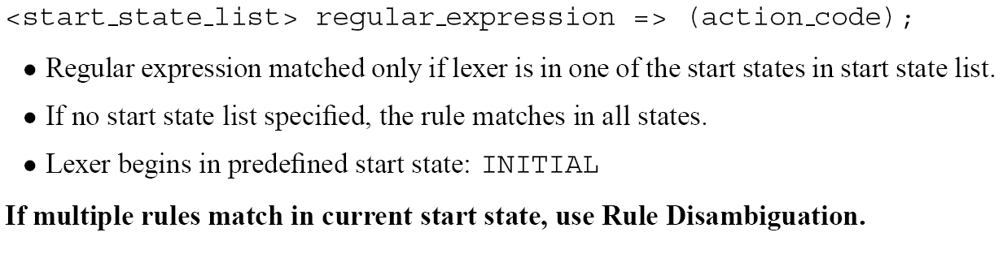
Rule Matching and Start States

Slide 65
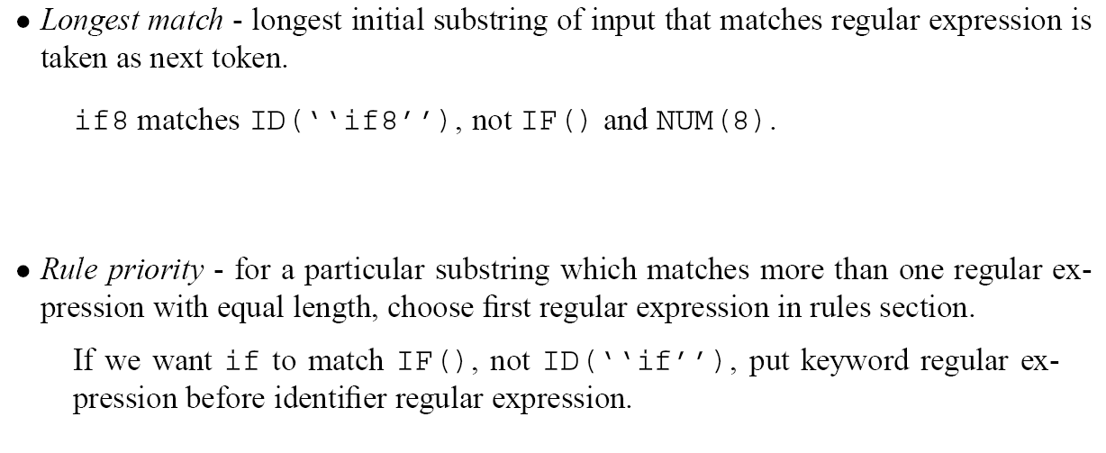
Rule Disambiguation

Slide 66
Example

Slide 67
Example in Action

