Slide 1
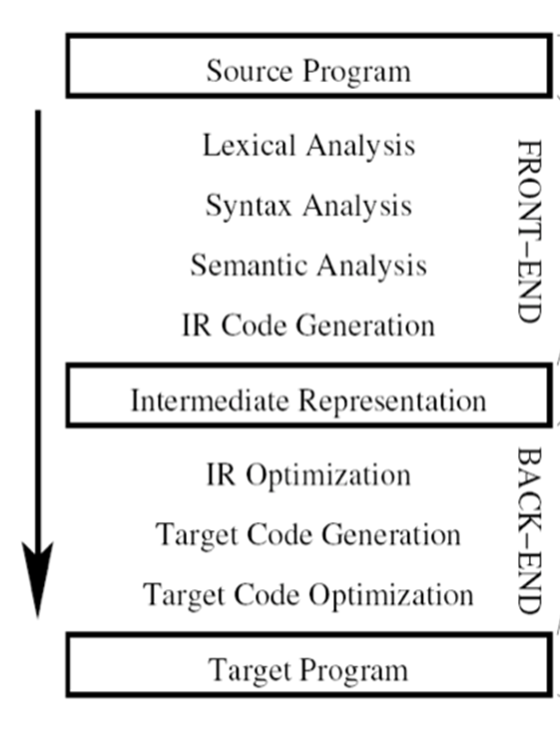
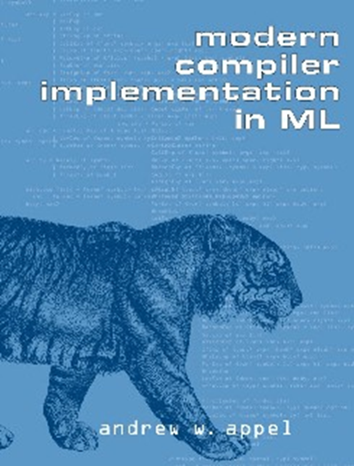
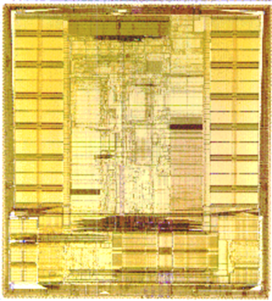
Topic 1: Introduction
COS 320
Compiling Techniques
Princeton University
Spring 2016
Lennart Beringer

Slide 2
(Half) The Cast
Me: Lennart Beringer, Room 217 CS Building
eberinge@cs.princeton.edu, 258-0451
Office Hours: after class and by appointment
TA: Mikkel Kringelbach, Room 004 CS Building
mikkelk@cs.princeton.edu
Office Hours: TBC
(thanks to David August, David Walker, and Andrew Appel)
Notes:
This slide is for the 3-min class administrative matters.
Make sure we update Handout #1 so it is consistent with this slide.

Slide 3
The more important half of the cast
Me: Lennart Beringer, Room 217 CS Building
eberinge@cs.princeton.edu, 258-0451
Office Hours: after class and by appointment
TA: Mikkel Kringelbach, Room 004 CS Building
mikkelk@cs.princeton.edu
Office Hours: TBC
YOU
Notes:
Lots of participation involvement eg when looking at particular algorithms

Slide 4
What is a Compiler?
A compiler is a program that takes a program written in a source language and translates it into a functionally equivalent program in a target language.
Source Languages: C, C++, Java, FORTRAN,Haskell...
Target Languages: x86 Assembly, Arm Assembly, C, JVM bytecode
Compiler can also:
  Report errors in source
  Warn of potential problems in source
  Optimize program, including parallelization eg for multi-core

Slide 5

What is a Compiler?

Slide 6
Interpreters versus compilers
I
C

Slide 7
Interpreters versus compilers
I
C
dynamic processing of commands
often: interaction loop with user
access to stream of input (data)
future commands/input unknown
often: transformation of state / top-level environment
easy to implement/extend
helps rapid exploration of language features
single execution
little optimization potential

Slide 8
Interpreters versus compilers
I
C
dynamic processing of commands
often: interaction loop with user
access to stream of input (data)
future commands/input unknown
often: transformation of state / top-level environment
easy to implement/extend
helps rapid exploration of language features
single execution
little optimization potential
static (i.e. compile-time) processing program module
programmatic interaction with user (read/write/files,…)
little prior knowledge of input
entire program text is known
goal: efficient execution
difficult to implement/extend
implemented for mature languages
huge optimization potential
effort pays off over many runs

Slide 9
Interpreters versus compilers
I
C
dynamic processing of commands
often: interaction loop with user
access to stream of input (data)
future commands/input unknown
often: transformation of state / top-level environment
easy to implement/extend
helps rapid exploration of language features
single execution
little optimization potential
static (i.e. compile-time) processing program module
programmatic interaction with user (read/write/files,…)
little prior knowledge of input
entire program text is known
goal: efficient execution
difficult to implement/extend
implemented for mature languages
huge optimization potential
effort pays off over many runs
Many languages implemented in interpreters and compilers (Java, ML, ..).
Primary view affects language design. Sharing of techniques/components.
Notes:
Next: why are you taking this course? Why do you want to learn about compilers?

Slide 10

Why Learn About Compilers?
Compiler technology everywhere.
C++ → Assembly
Assembly → Machine Code
Microcode → microcode binary
Interpreters: Perl, Python, Java, …
JITs: Android Dalvik VM, Java VM, …
Publishing: Latex → PDF → Print on Paper
Hardware Design: HW Description → Circuit/FPGA
Automation: Water Fountain DL → Water Display
Bellagio, Las Vegas
Notes:
Next: two more reasons

Slide 11
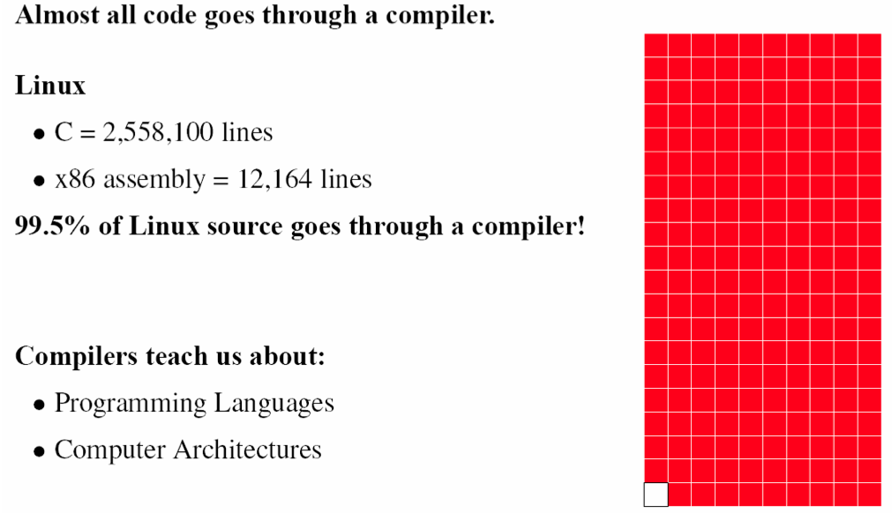
Why Learn About Compilers?

Slide 12
Why learn about compilers?
Applications, Requirements (performance, security, …)
Programming abstractions
Language features
Compiler technology
Processor architecture

Slide 13
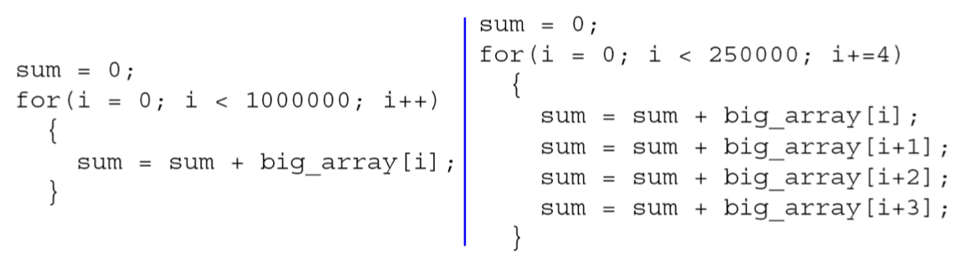
Why Learn About Compilers?
preparatory step for later program optimizations and parallelization
clarifies model of computation: are the above code snippets equivalent?

Slide 14
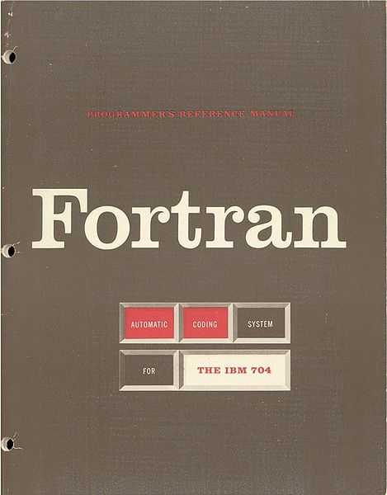
Why Learn About Compilers?
IBM developed the first FORTRAN compiler in 1957
Took 18 person-years of effort
You will be able to do it in less than a week!
Notes:
In fairness, they had to do it in 8K…

Slide 15
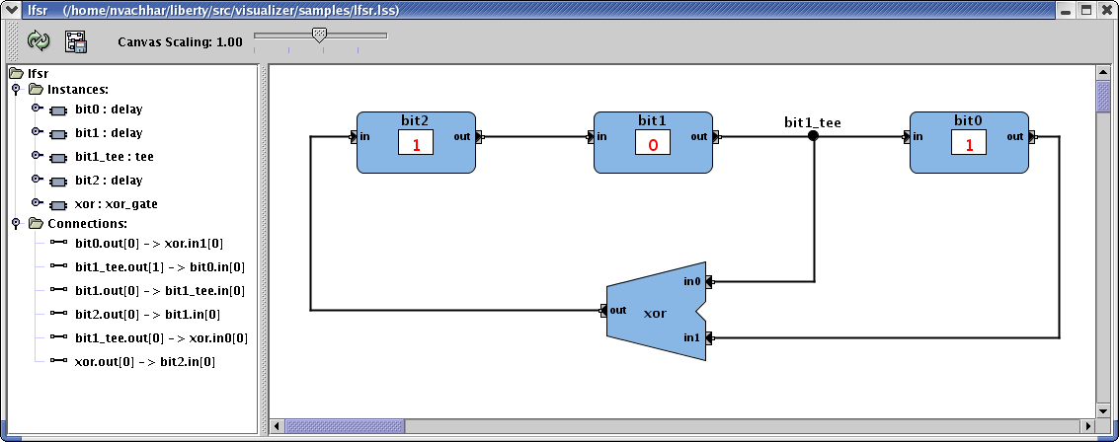

Why Learn About Compilers? Hardware Design
Compilation I
module toplevel(clock,reset);
input clock;
input reset;
reg flop1;
reg flop2;
always @ (posedge reset or posedge clock)
if (reset)
begin
flop1 <= 0;
flop2 <= 1;
end
else
begin
flop1 <= flop2;
flop2 <= flop1;
end
endmodule
Compilation II

Slide 16
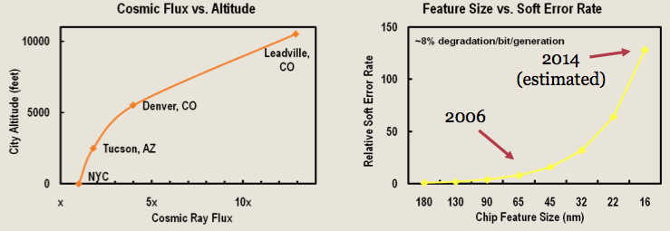

Why Learn About Compilers?
Computer Architecture
Selectively “harden” code regions where correctness is paramount

Slide 17
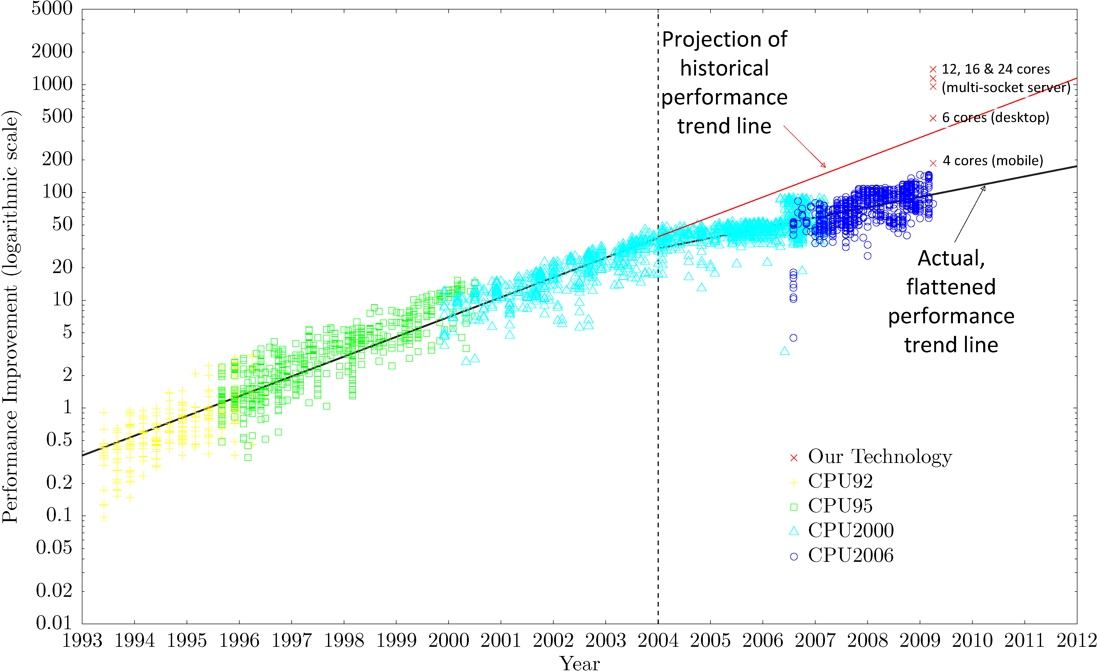
Why Learn About Compilers?
Your chosen field of computer architecture effectively dead?

Slide 18
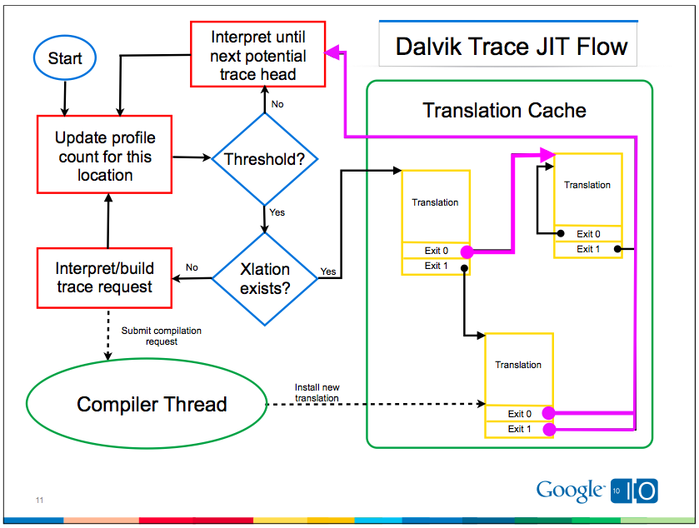

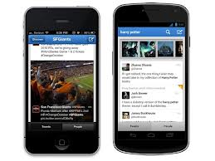
Why Learn About Compilers?
Dynamic (re-)compilation of hot spots
Interaction between compiler and runtime monitoring

Slide 19
Grading
HW assignments | 40%
Exams | 20% + 35%
Participation/Quizzes | 5%

Slide 20
Project
Build an optimizing compiler
Front end
  Lexer
  Parser
  Abstract Syntax Generator
  Type Checker
  Code Generator
Back End Optimization
  MakeGraph
  Liveness
  RegAlloc
  Frame
HW1 through 6 individual projects; HW7-HW9 probably in small groups

Slide 21
Exams
Exams cover concepts presented in the lecture material, homework assignments, and required readings
One double sided 8.5x11 page of notes allowed
Midterm Exam
Thursday before break
In class
Final Exam
The final exam will be cumulative
Time/Place determined by the Registrar

Slide 22
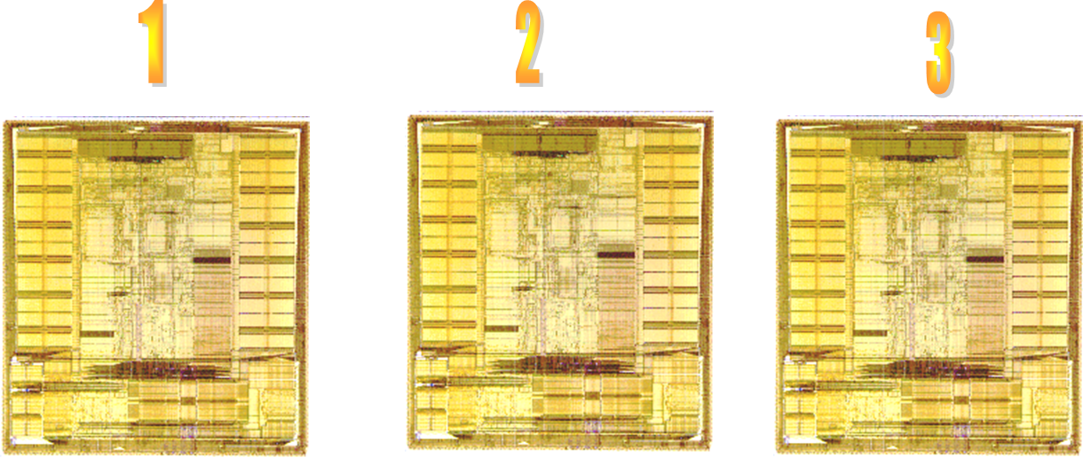
Quizzes
Tuesday classes may have quizzes
Not intended as a scare tactic – liberally graded
Helps us assess progress of class
Helps you to identify items you may want to revise
Just one question (usually)

Slide 23
Participation
Negatives
Class disruptions (snoring, email, reading a book, etc.)
Mistreatment of TA
Positives
Contribute questions and comments to class
Participate in discussions in class and in Piazza
Constructive feedback
Notes:
Make sure we update Handout #1 so it is consistent with this slide.

Slide 24
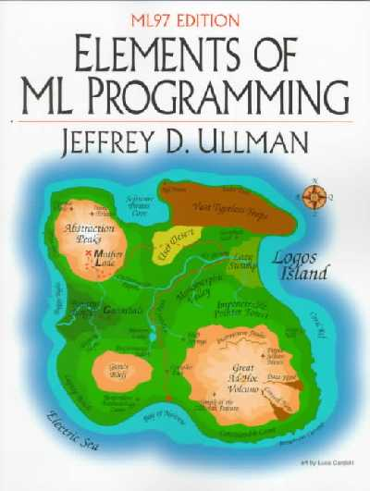

Reading
ML (optional)
  Jeffrey D. Ullman, Elements of ML Programming, 2nd Edition, Prentice Hall.
  Lawrence Paulson, ML for the working programmer
  Bob Harper’s online course book
Required: Andrew W. Appel, Modern Compiler Implementation in ML. Cambridge University Press.
CHECK ERRATA ON BOOK WEB SITES!
Course Web Page – Off of CS page
  Project Assignments (released successively)
  Course Announcements
  Blackboard, Piazza

Slide 25


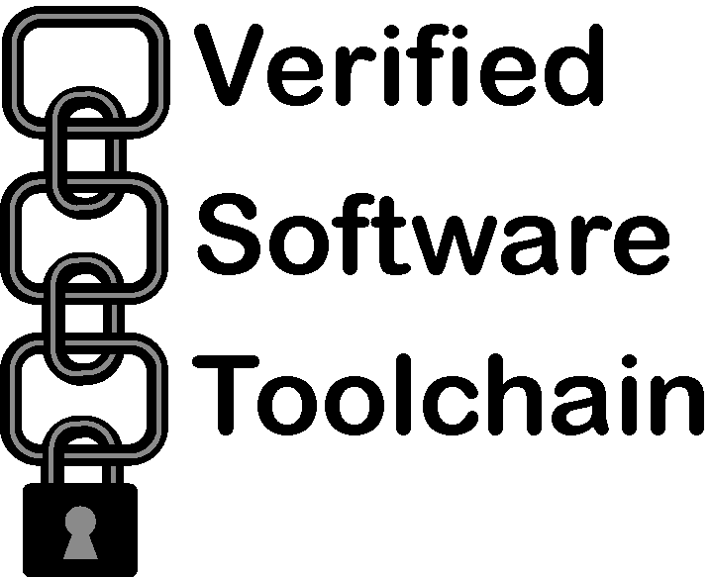




Who Am I?
Research Scholar at Princeton since 2009:
interactive theorem proving (Coq)
program verification, compiler correctness
applications to crypto & security
Postdoc & Researcher (Edinburgh & LMU Munich)
proof-carrying code
resource-bounded computation
Mobile Resource
Guarantees
Mobius
Ph.D. Edinburgh:
Thesis: Reasoning about asynchronous processors

Slide 26
Our Pledge to You
Quick response to questions and issues
Reasonable late policy
  Up to 2 days late for any single assignment without penalty
  Up to 6 days late total across assignments I through VI
  Lateness policy for HW7-9 announced later in semester
  Contact me prior to deadline for special circumstances
Fast turn-around on grading
END OF ADMINISTRATIVE STUFF

Slide 27
It’s Tuesday
1
2
3
Notes:
Make sure we update Handout #1 so it is consistent with this slide.

Slide 28
It’s Tuesday
1
2
3
Notes:
Make sure we update Handout #1 so it is consistent with this slide.

Slide 29
Quiz 0: Background (use index cards)
Front:
Full name and Email Address above the red line
Major/UG or G/Year (immediately below the red line)
Area (G: Research Area/UG: Interests)
Briefly describe ML/Ocaml/Haskell experience.
Briefly describe any C/C++ experience.
Briefly describe any compiler experience.
In which assembly languages are you fluent?
Back:
Why do processors have registers?
What is an instruction cache?
Can one always convert an NFA to a DFA? (yes, no, or wha?)

