Slide 1
Precept 6
Hashing & Partitioning
Peng Sun
Notes:
Move examples to front. Why using hashing? replicated path or content: split the content: split over various replicas. consistency (one packet one way)
Multiple paths, multiple servers. Flow-level consistency.
Show problems first.
why non-hashing techniques don’t work
basic Load balancing (flow consistency)
data partitioning
bloom filter: save efforts. less miss. mostly accurate.

Slide 2
Server Load Balancing
Balance load across servers
Normal techniques:
Round-robin?
Notes:
Why non-hashing doesn’t work

Slide 3
Limitations of Round Robin
Packets of a single connection spread over several servers

Slide 4
Multipath Load Balancing
Balance load over multiple paths
Round-robin?

Slide 5
Limitations of Round Robin
Different RTT on paths
Packet reordering

Slide 6
Data Partitioning
Spread a large amount of data on multiple servers
Random?
Very hard to retrieve

Slide 7
Goals in Distributing Traffic
Deterministic
Flow-level consistency
Easy to retrieve content from servers
Low cost
Very fast to compute/look up
Uniform load distribution

Slide 8
Hashing to the Rescue
Map items in one space into another space in deterministic way
Hash
Function
Keys
Hashes
H. Potter
00
01
R. Weasley
02
03
H. Granger
04
…
T. M. Riddle
14
15
Notes:
similar things are mapped to same location.
Usually map large but sparse space into small space

Slide 9
Basic Hash Function
Modulo
Simple for uniform data
Data uniformly distributed over N. N >> n
Hash fn = <data> mod n
What if non-uniform?
Typically split data into several blocks
e.g., SHA-1 for cryptography

Slide 10
Hashing for Server Load Balancing
Load Balancing
Virtual IP / Dedicated IP Approach
One global-facing virtual IP for all servers
Hash clients’ network info (srcIP/port)
Direct Server Return (DSR)

Slide 11
Load Balancing with DSR
LB
Reverse traffic doesn’t pass LB
Greater scalability
Server
Cluster
Switches
Notes:
server binds to both VIP and DIP
LB replaces Dst MAC address
Server sees client IP. Reply directly

Slide 12
Equal-Cost Multipath Routing
Balancing flows over multiple paths
Path selection via hashing
# of buckets = # of outgoing links
Hash network Info (src/dst IP) to links

Slide 13
Data Partitioning
Hashing approach
Hash data ID to buckets
Data stored on machine for the bucket
Cost: O(# of buckets)
Non-hashing, e.g., “Directory”
Data can be stored anywhere
Maintenance cost: O(# of entries)

Slide 14
But…
Basic hashing is not enough
Map data onto k=10 servers
with (dataID) mod k
What if one server is down?
Change to mod (k-1)?
Need to shuffle the data!
Notes:
So we want to introduce consistent hashing

Slide 15
Consistent Hashing
Servers are also in the Key Space (uniformly)
Red Nodes: Servers’ positions in the key space
Blue Nodes: Data’s position in the key space
Which Red Node to use:
Clockwise closest
0
14
12
Bucket
4
8
Notes:
LB with hashing. no failures
LB with hashing. with failures. Hashing is not enough, we should do consistent hashing.
What the properties we want based on problems.
BF: efficient look-up, quick checking
problem -> requirement -> algorithms to reach requirement

Slide 16
Features of Consistent Hashing
Smoothness: Addition/removal of bucket does not cause movement among existing buckets (only immediate buckets)
Spread and load: Small set of buckets that lie near object
Balanced: No bucket has disproportionate number of objects
Notes:
Finishing consistent hashing, we will talk about bloom filter.
So introduce another category of problems

Slide 17
Another Important Problem
How to quickly answer YES or NO?
Is the website malicious?
Is the data in the cache?

Slide 18
Properties We Desire
Really really quick for YES or NO
Okay for False Positive
Say Yes, but actually No
Never False Negative
Say No, but actually Yes

Slide 19
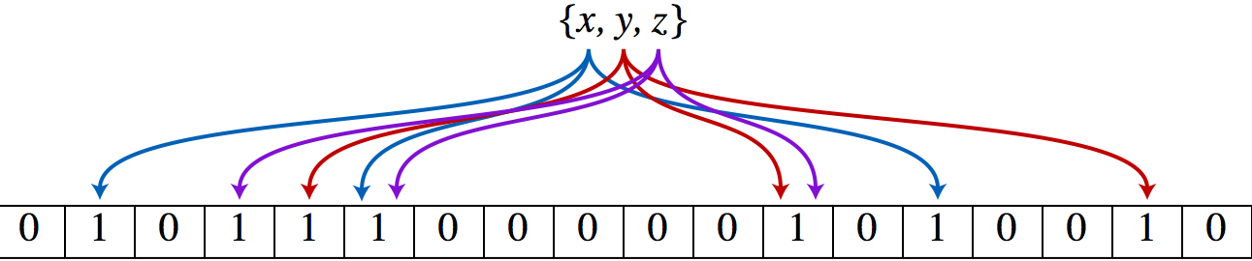
Bloom Filter
Membership Test: In or Not In
k independent hash functions for each data
If all k spots are 1, the item is in.
Notes:
O(1) time inserting
accurate a lot of time, never miss.
Useful for caching. Set up motivation.
Whether I have cache for this webpage (bloom filter
use bloom filter: casandra. Is the key in the cache? (storage)
chrome bloom filter bad url

Slide 20
Bloom Filter
Only use a few bits
Fast and memory-efficient
Never gives a false negative
Possible to have false positives

Slide 21
Demo of Bloom Filter
Start with an m bit array, filled with 0s.
0
0
0
0
0
0
0
0
0
0
0
0
0
0
0
0
To insert, hash each item k times. If H_{i}(x) = a, set Array[a] = 1.
0
1
0
0
1
0
1
0
0
1
1
1
0
1
1
0
To check if y is in set, check array at H_{i}(y). All k values must be 1.
0
1
0
0
1
0
1
0
0
1
1
1
0
1
1
0
Possible to have a false positive: all k values are 1, but y is not in set.
0
1
0
0
1
0
1
0
0
1
1
1
0
1
1
0
Notes:
Never false negative

Slide 22
Application of Bloom Filter
Google Chrome uses BF:
First look whether website is malicious
Storage services (i.e., Apache Cassandra)
Use BF to check cache hit/miss
Lots of other applications…
Notes:
Chrome:
http://blog.alexyakunin.com/2010/03/nice-bloom-filter-application.html
Wiki
http://en.wikipedia.org/wiki/Bloom_filter
Apache Cassandra:
http://en.wikipedia.org/wiki/Apache_Cassandra

Slide 23
Thanks!

Slide 24
Backup

Slide 25
Hashing in P2P File Sharing
Two Layers: Ultrapeer and Leaf
Leaf sends hash table of content to Ultrapeer
Search request floods Ultrapeer network
Ultrapeer checks hash table to find leaf

Slide 26
Applying Basic Strategy
Consider problem of data partition:
Given document X, choose one of k servers to store it
Modulo hashing
Place X on server i = (X mod k)
Problem? Data may not be uniformly distributed
Place X on server i = (hash(X) mod k)
Problem? What happens if a server fails or joins (k → k±1)?

Slide 27
Use of Hashing
Equal-Cost Multipath Routing
Network Load Balancing
P2P File Sharing
Data Partitioning in Storage Services

