Slide 1
Course summary
COS 433: Crptography -Spring 2010
Boaz Barak

Slide 2
This course was hard…
…and it was (partly) my fault.

Slide 3
Goals for this course
Balanced coverage of crypto: “appetizers, main course, and desserts”
Develop “crypto-intuition”..
..through hard work but with not too much “grunt work”

Slide 4
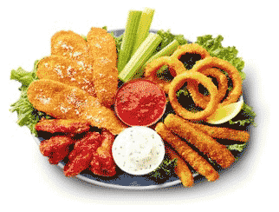
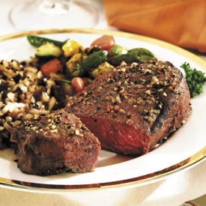
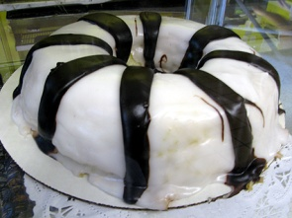
Coverage of crypto
Classical ciphers (ceasar, enigma etc..), one-time pad, limitations of information-theoretic security.
Pseudorandom generators and functions, CPA/CCA private and public key encryption, Message authentication codes and digital signatures, hash functions.
Zero knowledge, multiparty secure computation (e-voting, a-auctions,..), private information retrieval, homomorphic encryption, quantum & crypto.

Slide 5
“Crypto intuition”
“Paradoxical tradeoffs”: have the cake and eat it too:
CPA/CCA security: hide all information about message, with a mathematical proof of security.
Public key encryption: secure communication over an insecure channel.
Digital signatures/MACs: authentication stronger than hand-written signatures.
Secure multiparty computation: “virtual trusted party”, elections with ideal privacy and ideal accuracy.
Homomorphic encryption: cloud computing without trust.
Subtle issues: but often we get the cake in our face..
Subtle attacks against protocols using CPA instead of CCA security.
Precise modeling of adversarial capabilities.
Complex interaction of secure components (e.g. EtA vs AtE)

Slide 6
Classical vs. “Modern”/Rigorous crypto
Build scheme (based on intuition, experience)
Attempt to attack.
Deploy
If attack found then patch/restart
Give security definition (partly uses intuition, experience)
Build scheme
Prove (under assumptions / ROM/ICM heuristics) satisfies definition.
Refine: More efficient,better analysis.
If attack found then either:
Assumption violated.
Model doesn’t capture reality.
Main difference: security definitions
separation of modeling and construction
enable rigorous analysis
comparison of schemes → make progress
art → science
→ refine/restart

Slide 7
What we didn’t do:
More coverage of authentication protocols:
Much of crypto use:
“handshake” protocol using public key crypto to obtain private key k
Use key k to establish communication channel with confidentiality and integrity. (MACs+private key crypto)
Different scenarios:
symmetric case (both sides have public keys)
One-sided (only server has public key)
Password-Authenticated-Key-Exchange - low entropy password - protocols, salt/pepper/slow hash etc..
Tokens / smartcards (e.g. secureID)
Didn’t do enough: definitions (often simulation based), protocols, insecure examples , case studies (SSL,IPSec,GSM,wi-fi)

Slide 8
What we didn’t do:
More examples of widely used or important constructions, standards
Only mentioned El-Gamal encryption.
Standard padding schemes for RSA, analysis of OAEP.
Standard protocols.
Digital signature standard.
Cramer-Shoup encryption and signatures.
Elliptic curve variants of Diffie-Hellman / El-Gamal
More block ciphers, modes of encryption.
Constructions of hash functions.
Concrete multiparty protocols: set intersection, voting.
Moderately hard functions – salts / fighting spam.
Lattice / Error-Correcting-Codes based public key cryptography.

Slide 9
What we didn’t do:
Key sizes, concrete security
Attacks:
Factoring and discrete log subexponential algorithms: Quadratic/Number Field Sieve, Pollard’s rho method.
Attacks on private key crypto.
Reductions:
Concrete analysis: (T,²) security, tighter reductions.
Derive key size from reduction.

Slide 10
What we didn’t do:
Other issues in cryptography:
Identity based encryption: keys: (PUBmaster,PRIV_{master}) e_{name} = DERIVE(PUB_{master},name) d_{name} = DERIVE(PRIV_{master},name)
example: name = “boaz@princeton.edu#2010-04-28”
Crypto using the Weil pairing
Forward security: break in time t cannot violate security in time t’<t
Entropy seeding in pseudorandom generators.
Key leakage and side channel attacks.

Slide 11
Some of what we did:
Rigorous definitions of security of basic crypto primitives: CPA/CCA/CMA. Importance of right definition: CCA vs CPA.
Web of reductions between crypto primitives (e.g., PRFs from PRGs, length reduction for MACs, Goldreich-Levin theorem, signature schemes from one-way functions + collision resistant hash functions)
High-level goals using basic primitives (e.g. authentication)
Basic number theory and RSA/Rabin trapdoor permutations.
Random oracle model
Zero Knowledge and its use for identification protocols.
Multiparty secure computation, and GMW compiler.
Homomorphic encryption.

Slide 12
Final Exam
All material covered in course (lectures+homework), except quantum. Most likely: 4-5 questions totaling 120 points.
Can be downloaded starting Monday May 3, must be completed before min{ time download + 48 hours, Fri May 14 2pm }
Can use your notes, homework, my handouts, textbooks (Katz-Lindell, Boneh-Shoup, Trevisan’s lectures). Nothing more.
Sufficient time to solve, write, review&polish. Not sufficient to review material.
Before you start go over: (1) lecture notes (2) your homework and AI’s comments.
Can prepare summary in advance, also in a group.

Slide 13
Good luck!
My office hours Friday 10:30-12pm
Review precept: Saturday 1:30pm.
Email me/Sushant/Shi
Questions??

