Slide 1
COS 433: Cryptography
Princeton University
Spring 2010
Boaz Barak
      Please stop me if you have questions!
Notes:
1-32
to print, choose File-Page Setup-Landscape, View-Header and Footer, Print-Properties-Long Side and Color,
and deselect Grayscale

Slide 2
Cryptography
History of 2500- 4000 years.
Throughout most of this history:
cryptography = “secret writing”:
“Scramble” (encrypt) text such that it is hopefully unreadable by anyone except the intended receiver that can decrypt it.
Recurring theme: (until 1970’s)
Secret code invented
Typically claimed “unbreakable” by inventor
Used by spies, ambassadors, kings, generals for crucial tasks.
Broken by enemy using cryptanalysis.
“Human ingenuity cannot concoct a cipher
which human ingenuity cannot resolve.”
Edgar Alan Poe, 1841

Slide 3
Crypto History: B.DH
1587: Ciphers from Mary of Scots plotting assassination of queen Elizabeth broken; used as evidence to convict her of treason.
1860’s (civil war): Confederacy used good cipher (Vigenere) in a bad way. Messages routinely broken by team of young union cryptanalysts; in particular leading to a Manhattan manufacturer of plates for printing rebel currency.
1878: New York Tribune decodes telegram proving Democrats’ attempt to buy an electoral vote in presidential election for $10K.
1914: With aid of partial info from sunken German ships, British intelligence broke all German codes.
Cracked telegram of German plan to form alliance with Mexico and conquer back territory from U.S. As a result, U.S. joined WWI.
WWII: Cryptanalysis used by both sides. Polish & British cryptanalysts break supposedly unbreakable Enigma cipher using mix of ingenuity, German negligence, and mechanical computation.
Churchill credits cryptanalysts with winning the war.

Slide 4
Crypto History: A.DH
1976: Diffie and Hellman propose new, more ambitious, notion of “public key cryptography” based on simple to state, hard to solve, computational problem.
“We stand today on the brink of a revolution in cryptography”
1977: Rivest, Shamir and Adleman (RSA) propose another public key crypto candidate.
1977-: Schemes stay unbroken despite attacks with unprecedented manpower and computer cycles.
1980’s-: Web of reductions – even more ambitious notions: CCA secure encryption, CMA secure signatures, zero knowledge, electronic cash, electronic elections and auctions, privacy preserving data mining, …. , fully homomorphic encryption (2009).
Today: Breaking cryptography not considered top cyber security threat.

Slide 5
This Course
What you’ll learn:
Foundations and principles of the science
Basic primitives and components.
Definitions and proofs of security
High-level applications
Critical view of security suggestions and products
What you will not learn:
Buzzwords
The most efficient and practical versions of components.
Designing secure systems*
Will help you avoid designing insecure systems.
“Hacking” – breaking into systems.
Viruses, worms, Windows/Unix bugs, buffer overflow etc..
Everything important about crypto

Slide 6
This Course
Modern (post 1970’s) cryptography:
Provable security – breaking the “invent-break-tweak” cycle
      Perfect security (Shannon) and its limitations
      Computational security
      Pseudorandom generators, one way functions
Beyond encryption – public-key crypto and other wonderful creatures
      Public-key encryption based on factoring and RSA problem
      Digital signatures, hash functions
      Zero-knowledge proofs
      Active security – Chosen-Ciphertext Attack
Advanced topics (won’t have time for all ☹ )
      The SSL Protocol and attacks on it
      Multi-party secure computation
      Quantum cryptography
      Password-based key-exchange, broadcast encryption, obfuscation
      Fully homomorphic encryption (Gentry 2009)

Slide 7
Administrative Info
Instructor: Boaz Barak: boaz@cs
Lectures: Mon,Wed 1:30-2:50pm (start on time!)
Office hrs: By email appointment.
Web page: http://www.cs.princeton.edu/courses/archive/Spring10/cos433/
Or: Search “Boaz Barak” and click “courses”
TAs: Sushant Sachdeva ( sachdeva@cs )
Shi Li ( shili@cs )
Precepts: ---
Office hrs: ---
Important: join mailing list.

Slide 8
Prerequisites
Required:
1. Ability to read and write mathematical proofs and definitions.
2. Familiarity with algorithms – proving correctness and analyzing running time (O notation).
3. Familiarity with basic probability theory (random variables, expectations – see handout).
Helpful but not necessary:
Complexity. NP-Completeness, reductions, P, BPP, P_{/poly}
Probabilistic Algorithms. Primality testing, hashing,
Number theory. Modular arithmetic, prime numbers
See web-site for links and resources.

Slide 9
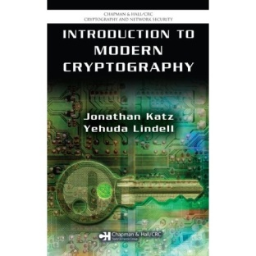
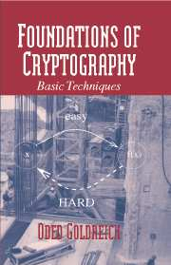
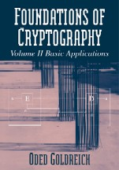
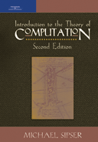
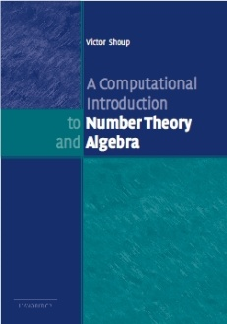
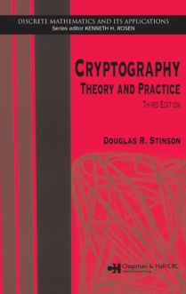
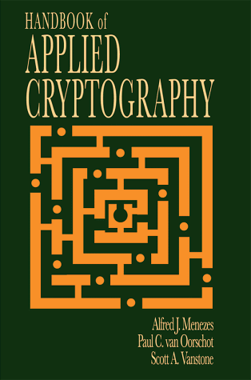
Reading
A graduate course in applied cryptography / Boneh & Shoup
Draft of a textbook, parts will be distributed in class.
Introduction to Modern Cryptography / Katz & Lindell
Undergraduate text, most accessible.
Foundations of Cryptography / Goldreich.
Graduate-level text, will be sometimes used.
Excellent lecture notes on the web
Trevisan, Vadhan, …

Slide 10
Requirements
Exercises: Weekly from Wednesday till Wednesday before class.
Submit by email / mailbox / in class to Sushant.
Flexibility: 4 late days, bonus questions
Take home final.
Final grade:
50% homework, 50% final
Honor code. Collaboration on homework with other students encouraged.
However, write alone and give credit.
Work on final alone and as directed.

Slide 11
This course is hard
Challenging weekly exercises
Emphasis on mathematical proofs
Counterintuitive concepts.
Extensive use of quantifiers/probability
But it’s not my fault :)
Good coverage of crypto (meat, vegetables and desert) takes a year.
Simulation / experimentation can’t be used to show security.
Need to acquire “crypto-intuition”
Quantifiers, proofs by contradiction, reductions, probability are inherent.
Mitigating hardness
Avoid excessive exercises – only questions that teach you something.
Try best to explain intuition behind proofs
Me, Shi & Sushant available for any questions and clarifications.

Slide 12
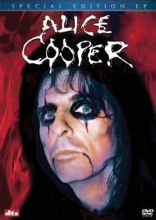
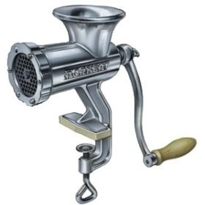
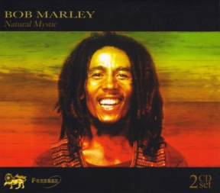
Encryption Schemes
Alice wants to send Bob a secret message.
m:
AMEX 1234567890
m’ = D(c)
AMEX 1234567890
k
k
ASJGKJQEIREWIYU
c = E(m)
They agree in advance on 3 components:
Encryption algorithm: E
Decryption algorithm: D
Secret key: k
To encrypt plaintext m, Alice sends c = E(m,k) to Bob.
To decrypt a cyphertext c, Bob computes m’ = D(c,k).
A scheme is valid if m’=m
Intuitively, a scheme is secure if eavesdropper can not learn m from c.

Slide 13
Example 1: Caesar’s Cipher
Key: k = no. between 0 and 25.
Encryption: encode the i^{th} letter as the (i+k) ^{th} letter.
(working mod 26: z+1=a )
Decryption: decode the j^{th} letter to the (j-k) ^{th} letter.
Plain-text:
S E N D R E I N F O R C E M E N T
Key: 2
Cipher-text:
U G P F T F K P H Q T E G O G P V
Problem: only 26 possibilities for key – can be broken in short time.
Kerchoff’s Principle (1883): System should be secure even if algorithms are known, as long as key is secret.
In other words: “security through obscurity” does not work.

Slide 14
Example 2: Substitution Cipher
Key: k = table mapping each letter to another letter
A
B
C
Z
U
R
B
E
Encryption and decryption: letter by letter according to table.
# of possible keys: 26!
( = 403,291,461,126,605,635,584,000,000 )
However – substitution cipher is still insecure!
Key observation: can recover plaintext using statistics on letter frequencies.
Here e r e h e t t r r ht
ethe eet e r e h h t e e t e
HereUpOnLeGrandAroseWithAGraveAndStatelyAirAndBrought
MeTheBeetleFromAGlassCaseInWhichItWasEnclosedItWasABe
He e e e h e t t ht
ethe eet e e h h t e e t e
Here e ra a e ha a ea tat a ra r ht
ethe eet e r a a e h h t a e e t a a e
LIVITCSWPIYVEWHEVSRIQMXLEYVEOIEWHRXEXIPFEMVEWHKVSTYLX
ZIXLIKIIXPIJVSZEYPERRGERIMWQLMGLMXQERIWGPSRIHMXQEREKI
I – most common letter
I=e L=h X=t
LI – most common pair
V=r E=a Y=g
XLI – most common triple

Slide 15
Example 3- Vigenere
(Belaso, 1553)
“Multi-Caesar Cipher” – A stateful cipher
Key: k = (k₁,k₂,…,k_{m}) list of m numbers between 0 and 25
Encryption:
1st letter encoded as Caesar w/ key=k₁ : i → i + k₁ (mod 26)
n^{th} letter encoded w/ key=k_{(n mod m)} : i → i + k_{(n mod m)} (mod 26)
Decryption: In the natural way
2nd letter encoded as Caesar w/ key=k₂ : i → i + k₂ (mod 26)
…
Important Property: Can no longer break using letter frequencies alone.
m^{th} letter encoded as Caesar w/ key=k_{m} : i → i + k_{m} (mod 26)
‘e’ will be mapped to ‘e’+k₁,‘e’+k₂,…,‘e’+k_{m} according to location.
m+1th letter encoded as Caesar w/ key=k₁ : i → i + k₁ (mod 26)
Considered “unbreakable” for 300 years (broken by Babbage, Kasiski 1850’s)

Slide 16
Example 3- Vigenere
(Belaso, 1553)
“Multi-Caesar Cipher” – A stateful cipher
Key: k = (k₁,k₂,…,k_{m}) list of m numbers between 0 and 25
Encryption:
n^{th} letter encoded w/ key=k_{(n mod m)} : i → I + k_{(n mod m)} (mod 26)
Decryption: In the natural way
Breaking Vigenere:
LIVITC
SWPIYV
EWHEVS
RIQMXL
EYVEOI
EWHRXE
XIPFEM
VEWHKV
Step 1: Guess the length of the key m
Step 2: Group together positions {1, m+1, 2m+1, 3m+1,…}
{2, m+2, 2m+2, 3m+2,…}
…
{m-1, 2m+m-1, 3m+m-1,…}

Slide 17
Example 3- Vigenere
(Belaso, 1553)
“Multi-Caesar Cipher” – A stateful cipher
Key: k = (k₁,k₂,…,k_{m}) list of m numbers between 0 and 25
Encryption:
n^{th} letter encoded w/ key=k_{(n mod m)} : i → i + k_{(n mod m)} (mod 26)
Decryption: In the natural way
Breaking Vigenere:
LIVITC
SWPIYV
EWHEVS
Step 1: Guess the length of the key m
RIQMXL
EYVEOI
Step 2: Group together positions 1, m+1, 2m+1, 3m+1,…
EWHRXE
XIPFEM
{2, m+2, 2m+2, 3m+2,…}
VEWHKV
…
{m-1, 2m+m-1, 3m+m-1,…}
Step 3: Frequency-analyze each group independently.

Slide 18
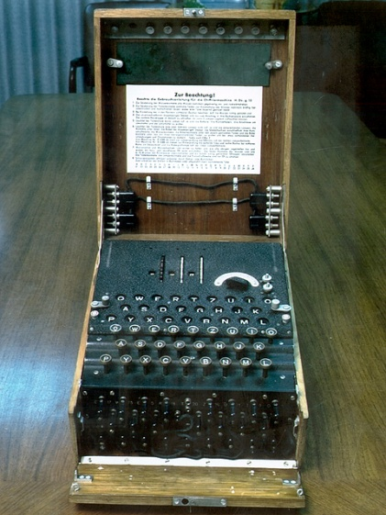
Example 4 - The Enigma
A mechanical stateful cipher.
Used by Germany in WWII for top-secret communication.
Roughly: composition of 3-5 substitution ciphers implemented by wiring.
Wiring on rotors moving in different schedules,
making cipher stateful
Key:
1) Wiring of machine (changed infrequently)
2) Daily key from code books
3) New operator-chosen key for each message
Tools used by Poles & British to break Enigma:
1) Mathematical analysis combined w/ mechanical computers
2) Captured machines and code-books
3) German operators negligence
4) Known plaintext attacks (greetings, weather reports)
5) Chosen plaintext attacks

Slide 19
Post 1970’s Crypto
Two major developments:
1) Provably secure cryptography
Encryptions w/ mathematical proof that are unbreakable*
* Currently use conjectures/axioms,
however defeated all cryptanalysis effort so far.
2) Cryptography beyond “secret writing”
Public-key encryptions
Digital signatures
Zero-knowledge proofs
Anonymous electronic elections
Privacy-preserving data mining
e-cash
…

Slide 20


Review of Encryption Schemes
Alice wants to send Bob a secret message.
c
c = E(m,k)
m’ = D(c,k)
Encryption algorithm: E
Decryption algorithm: D
Secret key: k
To encrypt m, Alice sends c = E(m,k) to Bob.
To decrypt c, Bob computes m’ = D(c,k).
Q: Can Bob send Alice the secret key over the net?
A: Of course not!! Eve could decrypt c!
Q: What if Bob could send Alice a “crippled key”
useful only for encryption but no help for decryption

Slide 21
Public Key Cryptography [DH76,RSA77]
Alice wants to send Bob a secret message.
e
c
choose d,e
c = E(m,e)
m’ = D(c,d)
Encryption algorithm: E
Decryption algorithm: D
Key: Bob chooses two keys:
      Secret key d for decrypting messages.
      Public key e for encrypting messages.
To encrypt m, Alice sends c = E(m,e) to Bob.
Even if Eve knows the key e!
Should be safe to send e “in the clear”!
To decrypt c, Bob computes m’ = D(c,d).
A scheme is valid if m’=m
Intuitively, a scheme is secure if eavesdropper can not learn m from c.

Slide 22
Other Crypto Wonders
Digital Signatures. Electronically sign documents in unforgeable way.
Zero-knowledge proofs. Alice proves to Bob that she earns <$50K without Bob learning her income.
Privacy-preserving data mining. Bob holds DB. Alice gets answer to one query, without Bob knowing what she asked.
Playing poker over the net. Alice, Bob, Carol and David can play poker over the net without trusting each other or any central server.
Distributed systems. Distribute sensitive data to 7 servers
s.t. as long as <3 are broken, no harm to security occurs.
Electronic auctions. Can run auctions s.t. no one (even not seller)
learns anything other than winning party and bid.
Fully homomorphic encryption. Encrypt E(m) in a way that allows anyone to compute E(f(m)) for every function f.

Slide 23
Cryptography & Security
Prev slides: Have provably secure algorithm for every crypto task imaginable.
Q: How come nothing is secure?
A1: Not all of these are used or used correctly:
Strange tendency to use “home-brewed” cryptosystems.
Combining secure primitives in insecure way
Misunderstanding properties of crypto components.
Strict efficiency requirements for crypto/security:
      The cost is visible but benefit invisible.
      Many provably secure algs not efficient enough
Easy to get implementation wrong – many subtleties
Compatibility issues, legacy systems,

Slide 24
For Wednesday
1) Join the course mailing list.
2) Think how would you try to (mathematically) define the notion that a pair of functions (E,D) is a secure encryption scheme.
Then read Katz-Lindell pp 18-24 (see also Goldreich)
3) Go over mathematical background handout

