Slide 1
Course Overview
COS 418/518: Distributed Systems
Lecture 2
Wyatt Lloyd, Mike Freedman

Slide 2
Learning Objectives
Reasoning about concurrency
Reasoning about failure
Reasoning about performance
Building systems that correctly handle concurrency and failure
Knowing specific system designs and design components
Notes:
[Also mention art of abstraction design]

Slide 3
Lectures
M/W 10-1050a
  Slides posted just before class
Core topics, system design components, system designs…
You should be actively thinking during the lectures

Slide 4
Precepts
Th or Fr
  Slides will be posted after all precepts
Helps with assignments and/or reinforces lecture material
Actively work through problems together

Slide 5
Course Staff Intro
Wyatt Lloyd
Mike Freedman
Dwaha Daud (P1)
Fengchen Gong (P2)
Nataliia Khotiaintseva (P3)
Nanqinqin Li (518)
Undergrad LabTAs TBD

Slide 6
Grading
Two exams (50%)
  Midterm 25%
  Final 25%
Assignments (50%)
  Five assignments 10% each
Notes:
[Simple and direct to calculate your grade]

Slide 7
Grade Cutoffs
We do not anticipate a curve up
We will not curve down
A [93, 100]
A- [90, 93)
B+ [87, 90)
B [83, 87)
…
Notes:
A+ is not a particular cutoff, typically top 1-2 students in class

Slide 8
Exams
In person exams
  3 hours: should not have time pressure
  Closed book
Midterm
  Registrar will schedule during week of Mar 3–7
  Likely Mar 6th (but could be the 7th)
  3 hours
Final
  Tu 5/13, 830–1130am (in the morning)
  3 hours

Slide 9
Exams
Test learning objectives mostly using designs covered in lectures
And tests knowledge of specific design patterns and designs
Recipe for success:
  Attend lecture and actively think through problems
  Ask questions during lecture and afterwards in my office hours
  Attend precept and actively work through problems
  Complete programming assignments
  Study lecture materials for specific design patterns and designs
  Run the system designs in your mind / on paper and see what happens
Notes:
[Attend lectures, actively think through problems, ask questions after class in my office hours,

Slide 10
Midterm Review
Monday March 17th, in class + time before and/or after
Go over midterm together
One and only opportunity to argue for points
Notes:
Ask for a raise of hands for who has a class before or after this one

Slide 11
Programming Assignments
Reinforce / demonstrate all learning objectives!
1: “MapReduce” in Go
2: Distributed Snapshots
3: Raft Leader Election
4: Raft Log Consensus
5: Key-Value Storage Service

Slide 12
Programming Assignments
All are individual assignments
We will give you all the tests
  Non-determinism for later tests though
    Each failed test run => lose 50% of points for a test
Daily grading script emails your grade
  We use exactly this grade

Slide 13
Programming Assignments- Late Policy
Late policy
  G = Grade you would have earned if turned in on time
  1 day late => 90%*G
  …
  > 5 days late => 50%*G
3 “free” late days
  We assign them at the end of the semester to maximize your score
  Used in 1 day granularity
  Cannot use for last assignment (Deans date)

Slide 14
Policies: Write Your Own Code
Programming is an individual creative process. At first, discussions with friends is fine. When writing code, however, the program must be your own work.
Do not copy another person’s programs, comments, or any part of submitted assignment. This includes character-by-character transliteration but also derivative works. Cannot use another’s code, etc. even while “citing” them.
Writing code for use by another or using another’s code is academic fraud in context of coursework.
Do not publish your code e.g., on github, during/after course!

Slide 15
Policies: Write Your Own Code
Programming is an individual creative process. At first, discussions with friends is fine. When writing code, however, the program must be your own work.
Do not copy another person’s programs, comments, or any part of submitted assignment. This includes character-by-character transliteration but also derivative works. Cannot use another’s code, etc. even while “citing” them.
Writing code for use by another or using another’s code is academic fraud in context of coursework.
Do not publish your code e.g., on github, during/after course!
Don’t Plagiarize!

Slide 16



Policies: Generative AI is not Allowed
Simple blanket ban on generative AI
  Cannot use it to help write code
  Cannot use it to help debug code
  Cannot use it to discuss your design
  Cannot use it at all!

Slide 17
Warnings
This is a 400-level course,
with expectations to match.

Slide 18
Warning #1:
Assignments are a LOT of work
Assignment 1 is purposely easy to teach Go. Don’t be fooled.
Starting 3-4 days before deadline for later assignment => Disaster.
Distributed systems are hard
  Need to understand problem and protocol, carefully design
  Can take 5x more time to debug than “initially program”
Assignment #4 builds on your Assignment #3 solution, i.e., you can’t do #4 until your own #3 is working! (That’s the real world!)

Slide 19
Programming Assignment Statistics
Self Reported Hours Spent on Assignments: Median [Min-Max]
1-1: 2 [1-6]
1-2: 3 [1-8]
1-3: 4 [1-10]
2: 6 [2-15]
3: 12 [5-29]
4: 30 [10-100+]
5: 14 [3-25]

Slide 20
Warning #2:
Software engineering, not just programming
COS 126, 217, 226 told you how to design & structure your programs. This class doesn’t.
Real software engineering projects don’t either.
You need to learn to do it.
If your system isn’t designed well, can be significantly harder to get right.
Your friend: test-driven development
  We’ll supply tests, extra credit for adding new ones

Slide 21
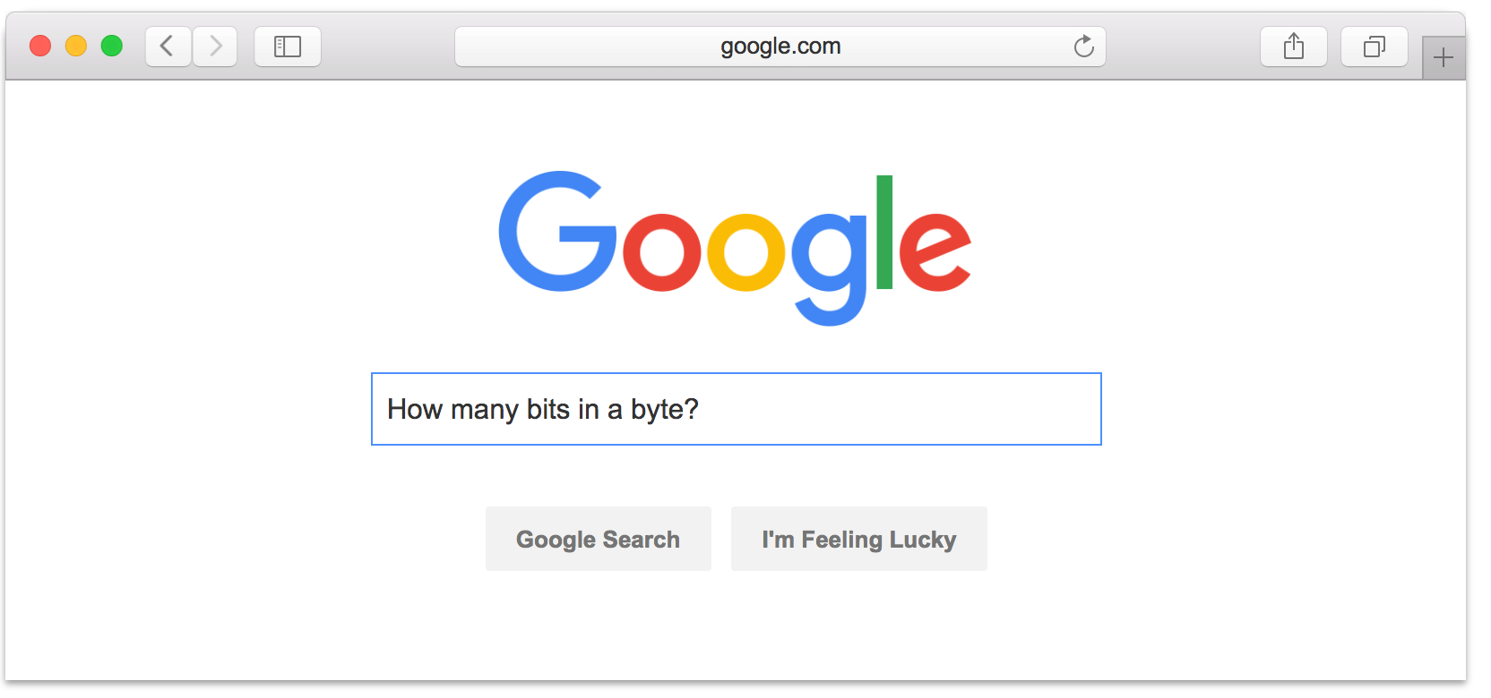
Warning #3:
Don’t expect 24x7 answers
Try to figure out yourself
Ed discussion not designed for debugging
  Utilize right venue: Go to office hours
  Send detailed Q’s / bug reports, not “no idea what’s wrong”
Staff are not on pager duty 24 x 7
  Don’t expect response before next business day
  Questions Friday night @ 11pm should not expect fast responses. Be happy with something on Monday.
Implications
  Students should answer each other
  Start your assignments early!

Slide 22
Programming Assignments
Recipe for disaster
  Start day assignment is due
  Write code first, think later
  Test doesn’t pass => randomly flip some bits
  Assume you know what program is doing

Slide 23
Programming Assignments
Recipe for success
  Start early (weeks early)
  Think through a complete design
  Progressively build out your design (using tests to help)
  Checkpoint progress in git (and to github) frequently
  Debug, debug, debug
    Verify program state is what you expect (print it out!)
    Write your own smaller test cases
    Reconsider your complete design
  Attend office hours

Slide 24
Programming Assignment Office Hours
8+4*N hours of office hours per week!
Schedule posted on Ed discussion
Expectations
  No: “You have a bug on line 17.”
  Yes: Helping you think like they would think about a problem

Slide 25
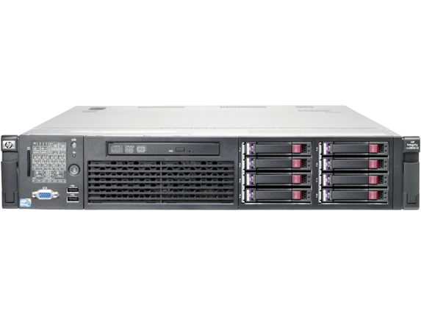
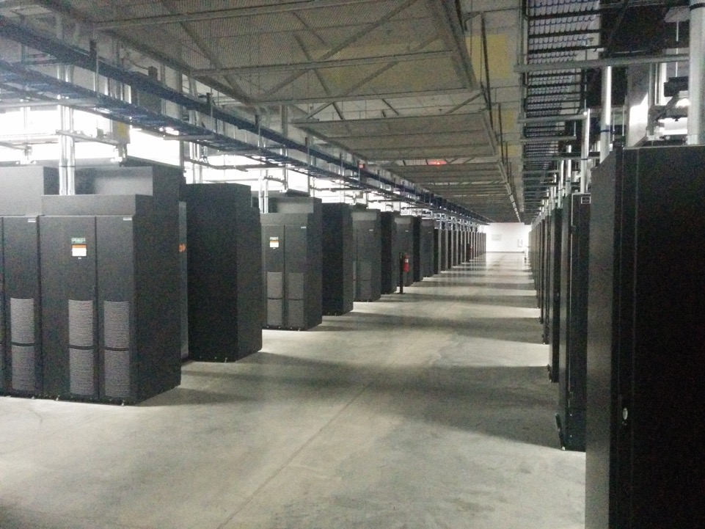
Course Overview Conclusion
Attend lecture, attend precept, think actively!
Start programming assignments early, use the right strategy!
Super cool distributed systems stuff starts Monday!

