Slide 1

Course Overview
Light at the
end of the tunnel
Mike Freedman
COS 461: Computer Networks
http://www.cs.princeton.edu/courses/archive/spr20/cos461/

Slide 2
Key Concepts in Networking

Slide 3
Some Key Concepts
Course was organized around protocols
  But a small set of concepts recur in many protocols
General CS concepts
  Hierarchy, indirection, caching, randomization
Networking-specific concepts
  Soft state, layering, (de)multiplexing
  End-to-end argument

Slide 4

Hierarchy
Scalability of large systems
  Cannot store all information everywhere
  Cannot centrally coordinate everything
Hierarchy to manage scale
  Divide system into smaller pieces
Hierarchy to divide control
  Decentralized management
Examples in the Internet
  IP addresses, routing protocols, DNS, peer-to-peer

Slide 5
Hierarchy: IP Address Blocks
Number related hosts from a common subnet
  1.2.3.0/24 on the left LAN
  5.6.7.0/24 on the right LAN
1.2.3.4
1.2.3.7
1.2.3.156
5.6.7.8
5.6.7.9
5.6.7.212
host
host
...
host
host
host
...
host
LAN 1
LAN 2
router
router
router
WAN
WAN
1.2.3.0/24
5.6.7.0/24
forwarding table

Slide 6
Hierarchy: IP Address Blocks
Separation of control
  Prefix: assigned to an institution
  Addresses: assigned by institution to its nodes
Who assigns prefixes?
  Internet Corporation for Assigned Names & Numbers
  Regional Internet Registries (RIRs)
  Internet Service Providers (ISPs)
  Stub networks
  Regions within an enterprise

Slide 7

Hierarchy: Routing Protocols
AS-level topology
  Nodes are Autonomous Systems (ASes)
  Edges are links and business relationships
  Hides the detail within each AS’s network
4
3
5
2
7
6
1
Client
Web server

Slide 8
Hierarchy: Routing Protocols
Interdomain routing ignores details in an AS
  Routers flood information to learn the topology
  Routers determine “next hop” to other routers…
  By computing shortest paths based on link weights
2
3
1
1
3
2
1
5
4
3

Slide 9
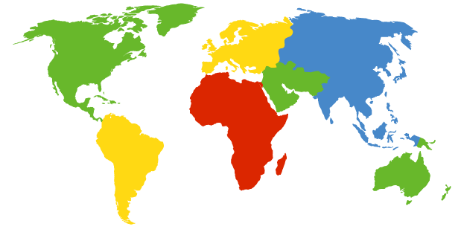
Hierarchy: Domain Name System
13 root servers (see http://www.root-servers.org/)
Labeled A through M
A Verisign, Dulles, VA
C Cogent, Herndon, VA (also Los Angeles)
D U Maryland College Park, MD
G US DoD Vienna, VA
H ARL Aberdeen, MD
J Verisign, ( 11 locations)
K RIPE London (also Amsterdam, Frankfurt)
I Autonomica, Stockholm (plus 3 other locations)
E NASA Mt View, CA
F Internet Software C. Palo Alto, CA (and 17 other locations)
m WIDE Tokyo
B USC-ISI Marina del Rey, CA
L ICANN Los Angeles, CA

Slide 10
Hierarchy: Domain Name System
unnamed root
com
edu
org
ac
uk
zw
arpa
generic domains
country domains
bar
ac
in-
addr
west
east
cam
12
foo
my
usr
34
my.east.bar.edu
usr.cam.ac.uk
56
12.34.56.0/24

Slide 11
Hierarchy: Super Peers in P2P (KaZaA)
Each peer is either group leader or assigned to group leader
  TCP connection between peer and its group leader
  TCP connections between some pairs of group leaders
Group leader tracks the content in all its children

Slide 12
Indirection
Referencing by name
  Rather than the value itself
  E.g., manipulating a variable through a pointer
Benefits of indirection
  Human convenience
  Reducing overhead when things change
Examples of indirection in the Internet
  Names vs. addresses
  Mobile IP

Slide 13
Indirection: Names vs. Addresses
Host name to IP address
  Mnemonic names to location-dependent addresses
  E.g., from www.cnn.com to 64.236.16.20
  Using the Domain Name System (DNS)
From IP address to MAC address
  From hierarchical global address to interface card
  E.g., from 64.236.16.20 to 00-15-C5-49-04-A9
  Using the Address Resolution Protocol (ARP)

Slide 14
Indirection: Load Balancers & Switches
Not fixed binding of IPs or MAC address to physical machine
  NAT allows multiple machines to share single public IP address
  Load balancers: Machines share IP address, LB maps to physical machine by network flow
  VM can migrate across L2 network through gratuitous ARP

Slide 15
Indirection: Mobile IP
foreign agent receives packets, forwards to mobile
home agent intercepts packets, forwards to foreign agent
visited
network
home
network
3
wide area network
2
1
correspondent addresses packets using home address of mobile
4
mobile replies directly to correspondent

Slide 16
Caching
Duplicating data stored elsewhere
  To reduce latency for accessing the data
  To reduce resources consumed
Caching is often quite effective
  Speed difference between cache and primary copy
  Locality of reference, and small set of popular data
Examples from the Internet
  DNS caching, Web caching

Slide 17
Caching: DNS Caching
Root server
3
4
Application
DNS cache
5
Top-level
domain server
DNS query
1
10
Local DNS
server
6
2
DNS resolver
7
DNS response
9
8
Second-level
domain server

Slide 18
Caching: Web Caching
Caching location
  Proxy cache
  Browser cache
Better performance
  Lower RTT
  Existing connection
  Less network load
origin
server
Proxy
server
HTTP request
HTTP request
client
HTTP response
HTTP response
HTTP request
HTTP response
client
origin
server

Slide 19
Randomization
Distributed adaptive algorithms
  Multiple distributed parties
  Adapting independently
Risk of synchronization
  Many parties reacting at the same time
  Leading to bad aggregate behavior
Randomization can desynchronize
  Ethernet back-off, Random Early Detection
Rather than imposing centralized control

Slide 20
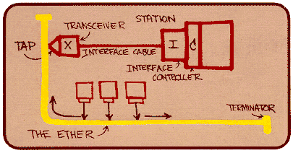
Randomization: Ethernet Back-off
Random access: exponential back-off
  After collision, wait random time before retrying
  After m^{th}, choose K randomly from {0, …, 2^{m}-1}
  Wait for K*512 bit times before trying again

Slide 21
Randomization: Dropping Packets Early
Congestion on a link
  Eventually the queue becomes full
  And new packets must be dropped
Drop-tail queuing leads to bursty loss
  Many packets encounter a full queue
  Many TCP senders reduce their sending rates

Slide 22
Randomization: Dropping Packets Early
Better to give early feedback
  Get a few connections to slow down
  … before it is too late
Random Early Detection (RED)
  Randomly drop packets when queue (near) full
  Drop rate increases as function of queue length
Probability
Average Queue Length

Slide 23
Soft State
State: stored in nodes by network protocols
  Installed by receiver of a set-up message
  Updated when conditions change
Hard state: valid unless told otherwise
  Removed by receiver of tear-down message
  Requires error handling to deal with sender failure
Soft state: invalid if not told to refresh
  Periodically refreshed, removed by timeout
Soft state reduces complexity
  DNS caching, DHCP leases

Slide 24
Soft State: DNS Caching
Cache consistency is a hard problem
  Ensuring the cached copy is not out of date
Strawman: explicit revocation or updates
  Keep track of everyone who has cached information
  If name-to-host mapping changes, update caches
Soft state solution
  DNS responses include a “time to live” (TTL) field
  Cached entry is deleted after TTL expires

Slide 25
Soft State: DHCP Leases
DHCP “offer message” from the server
  Configuration parameters (proposed IP address, mask, gateway router, DNS server, ...)
  Lease time (the time information remains valid)
Why is a lease time necessary?
  Client can release address (DHCP RELEASE)
    E.g., “ipconfig /release” or clean shutdown of computer
  But, the host might not release the address
    E.g., the host crashes or buggy client software
  You don’t want address to be allocated forever

Slide 26
Layering: A Modular Approach
Sub-divide the problem
  Each layer relies on services from layer below
  Each layer exports services to layer above
Interface between layers defines interaction
  Hides implementation details
  Layers can change without disturbing other layers
Application
Application-to-application channels
Host-to-host connectivity
Link hardware

Slide 27
Layering: Standing on Shoulders
host
host
HTTP message
HTTP
HTTP
TCP segment
TCP
TCP
router
router
IP
IP packet
IP packet
IP packet
IP
IP
IP
Ethernet
interface
Ethernet
interface
SONET
interface
SONET
interface
Ethernet
interface
Ethernet
interface
Ethernet frame
SONET frame
Ethernet frame

Slide 28
Layering: Internet Protocol Suite
FTP
HTTP
NV
TFTP
Applications
TCP
UDP
UDP
TCP
Waist
IP
Data Link
NET₁
NET₂
…
NET_{n}
Physical
The Hourglass Model
The waist facilitates interoperability

Slide 29
Layering: Encapsulation of Data
Different devices switch different things
  Physical layer: electrical signals (repeaters and hubs)
  Link layer: frames (bridges and switches)
  Network layer: packets (routers)
Application gateway
Transport gateway
Frame
header
Packet
header
TCP
header
User
data
Router
Bridge, switch
Repeater, hub

Slide 30
Demultiplexing
Separating multiple streams out of one
  Recognizing the separate streams
  Treating the separate streams accordingly
Examples in the Internet
type
port #
Frame
header
Packet
header
TCP
header
User
data
protocol

Slide 31
(De)multiplexing: With a NAT
138.76.29.7
10.0.0.1
outside
NAT
10.0.0.2
inside

Slide 32
Power at the End Host
End-to-End Principle
Whenever possible, communications protocol operations should be defined to occur at the end-points of a communications system.
Programmability
With programmable end hosts, new network services can be added at any time, by anyone.

Slide 33
Why No Math in This Course?
Hypothesis #1: theory not relevant to Internet
  Body of math created for telephone networks
  Many of these models don’t work in data networks
Hypothesis #2: too many kinds of theory
  Queuing: statistical multiplexing works
  Control: TCP congestion control works
  Optimization: TCP maximizes aggregate utility
  Game: reasoning about competing ASes

Slide 34
What Will Happen to the Internet

Slide 35
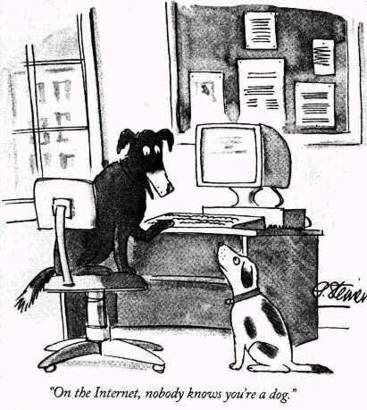
No Strict Notions of Identity
Leads to
  Spam
  Spoofing
  Denial-of-service
  Route hijacking

Slide 36
Protocols Designed Based on Trust
That you don’t spoof your addresses
  MAC spoofing, IP address spoofing, spam, …
That port numbers correspond to applications
  Rather than being arbitrary, meaningless numbers
That you adhere to the protocol
  Ethernet exponential back-off after a collision
  TCP additive increase, multiplicative decrease
That protocol specifications are public
  So others can build interoperable implementations

Slide 37
Nobody in Charge
Traffic traverses many Autonomous Systems
  Who’s fault is it when things go wrong?
  How do you upgrade functionality?
Implicit trust in the end host
  What if some hosts violate congestion control?
Anyone can add any application
  Whether or not it is legal, moral, good, etc.
Spans many countries
  So no one government can be in charge

Slide 38
Challenging New Requirements
Disseminating data
Mobile, multi-homed hosts
Sometimes-connected hosts
Large number of hosts
Real-time applications

Slide 39

The Internet of the Future
Can we fix what ails the Internet
  Security, performance, reliability
  Upgradability, managability
  <Your favorite gripe here>
Without throwing out baby with bathwater
  Ease of adding new hosts
  Ease of adding new services
  Ease of adding new link technologies
An open technical and policy question…

Slide 40
Thank You!

