Slide 1

Programmable Networks
Jennifer Rexford
COS 461: Computer Networks
http://www.cs.princeton.edu/courses/archive/spr20/cos461/

Slide 2

The Internet: A Remarkable Story
Tremendous success
  From research experiment
  to global infrastructure
Brilliance of under-specifying
  Network: best-effort packet delivery
  Hosts: arbitrary applications
Enables innovation in applications
  Web, P2P, VoIP, social networks, smart cars, …
But, change is easy only at the edge… ☹

Slide 3
Inside the ‘Net: A Different Story…
Closed equipment
  Software bundled with hardware
  Vendor-specific interfaces
Over specified
  Slow protocol standardization
Few people can innovate
  Equipment vendors write the code
  Long delays to introduce new features
Impacts performance, security, reliability, cost…

Slide 4



Networks are Hard to Manage
Operating a network is expensive
  More than half the cost of a network
  Yet, operator error causes most outages
Buggy software in the equipment
  Routers with 20+ million lines of code
  Cascading failures, vulnerabilities, etc.
The network is “in the way”
  Especially in data centers and the home

Slide 5
A Helpful Analogy
From Nick McKeown’s talk “Making SDN Work” at the Open Networking Summit, April 2012

Slide 6

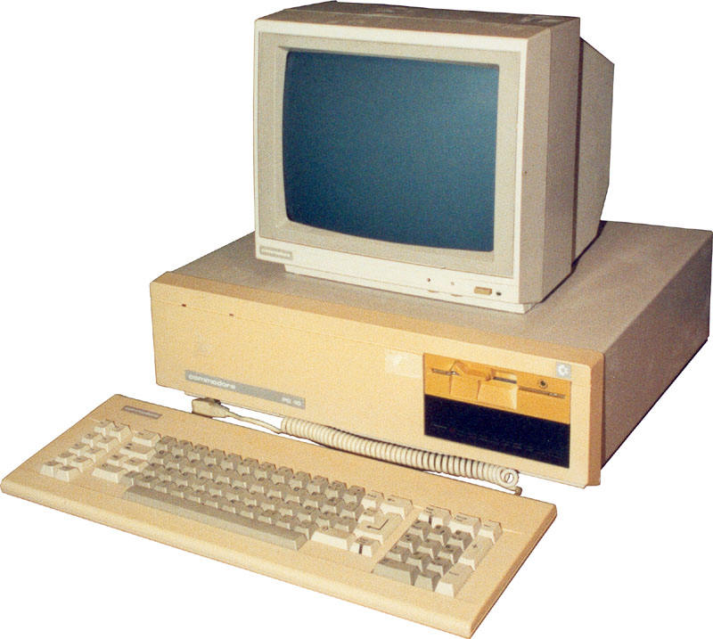
Mainframes
App
App
App
App
App
App
App
App
App
App
App
Specialized
Applications
Open Interface
Windows
(OS)
Linux
Mac
OS
Specialized
Operating
System
or
or
Open Interface
Specialized
Hardware
Microprocessor
Vertically integrated
Closed, proprietary
Slow innovation
Small industry
Horizontal
Open interfaces
Rapid innovation
Huge industry

Slide 7
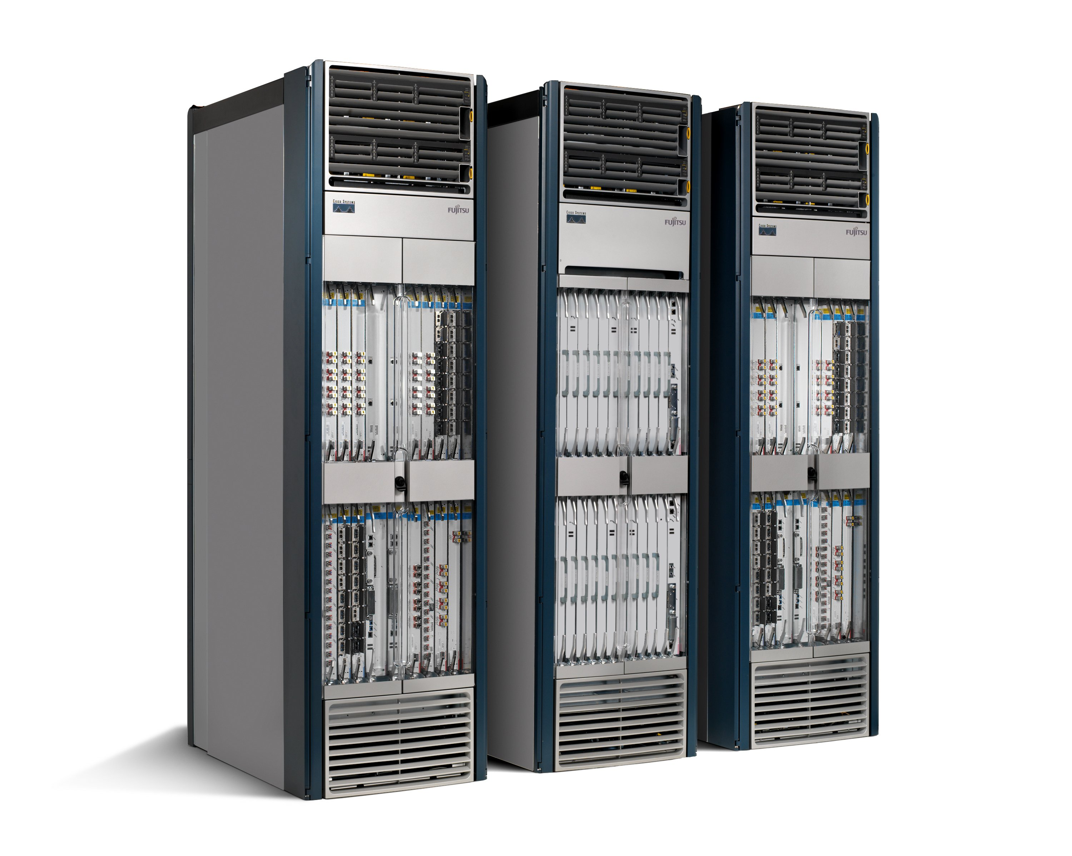
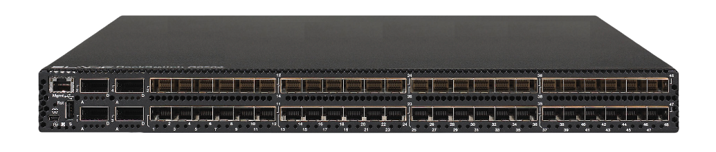
Routers/Switches
App
App
App
App
App
App
App
App
App
App
App
Specialized
Features
Open Interface
Control
Plane
Control
Plane
Control
Plane
or
or
Specialized
Control
Plane
Open Interface
Specialized
Hardware
Merchant
Switching Chips
Vertically integrated
Closed, proprietary
Slow innovation
Horizontal
Open interfaces
Rapid innovation

Slide 8
Rethinking the “Division of Labor”

Slide 9
Traditional Computer Networks
Data plane:
Packet streaming
  Forward, filter, buffer, mark,
  rate-limit, and measure packets
Notes:
Maybe this is a better picture… though need some details of what happens in each plane… like in next slides… or, have both?

Slide 10
Traditional Computer Networks
10
Control plane:
Distributed algorithms
  Track topology changes, compute routes, install forwarding rules
Notes:
Maybe this is a better picture… though need some details of what happens in each plane… like in next slides… or, have both?

Slide 11
Traditional Computer Networks
11
Management plane:
Human time scale
  Collect measurements and configure the equipment
Notes:
Maybe this is a better picture… though need some details of what happens in each plane… like in next slides… or, have both?

Slide 12
Death to the Control Plane!
Simpler management
  No need to “invert” control-plane operations
Faster pace of innovation
  Less dependence on vendors and standards
Easier interoperability
  Compatibility only in “wire” protocols
Simpler, cheaper equipment
  Minimal software

Slide 13
Software Defined Networking (SDN)
Logically-centralized control
Smart &
slow
API to the data plane
(e.g., OpenFlow)
Dumb &
fast
Switches

Slide 14
OpenFlow Networks
http://ccr.sigcomm.org/online/files/p69-v38n2n-mckeown.pdf

Slide 15

Data-Plane: Simple Packet Handling
Simple packet-handling rules
  Pattern: match packet header bits
  Actions: drop, forward, modify, send to controller
  Priority: disambiguate overlapping patterns
  Counters: #bytes and #packets
src=1.2.*.*, dest=3.4.5.* → drop
src = *.*.*.*, dest=3.4.*.* → forward(2)
3. src=10.1.2.3, dest=*.*.*.* → send to controller

Slide 16
Unifies Different Kinds of Boxes
Router
  Match: longest destination IP prefix
  Action: forward out a link
Switch
  Match: dest MAC address
  Action: forward or flood
Firewall
  Match: IP addresses and TCP /UDP port numbers
  Action: permit or deny
NAT
  Match: IP address and port
  Action: rewrite addr and port

Slide 17
Controller: Programmability
Controller Application
Network OS
Events from switches
Topology changes,
Traffic statistics,
Arriving packets
Commands to switches
(Un)install rules,
Query statistics,
Send packets

Slide 18
OpenFlow questions
OpenFlow designed for
  Inter-domain management (between)
  Intra-domain management (within)
OpenFlow API to switches open up the
  RIB (B) FIB
OpenFlow FIB match based on
  Exact match (e.g., MAC addresses)
  Longest prefix (e.g., IP addresses)
  It’s complicated

Slide 19
Example OpenFlow Applications
Dynamic access control
Seamless mobility/migration
Server load balancing
Network virtualization
Using multiple wireless access points
Energy-efficient networking
Adaptive traffic monitoring
Denial-of-Service attack detection

Slide 20


E.g.: Dynamic Access Control
Inspect first packet of a connection
Consult the access control policy
Install rules to block or route traffic

Slide 21
E.g.: Seamless Mobility/Migration
See host send traffic at new location
Modify rules to reroute the traffic

Slide 22
E.g.: Server Load Balancing
Pre-install load-balancing policy
Split traffic based on source IP
src=0*
src=1*

Slide 23
E.g.: Network Virtualization
Controller #1
Controller #2
Controller #3
Partition the space of packet headers

Slide 24
Controller and the FIB
Forwarding rules should be added
  (A) Proactively
  (B) Reactively (e.g., with controller getting first packet)
  (C) Depends on application

Slide 25
OpenFlow in the Wild
Open Networking Foundation
  Google, Facebook, Microsoft, Yahoo, Verizon, Deutsche Telekom, and many other companies
Commercial OpenFlow switches
  Intel, HP, NEC, Quanta, Dell, IBM, Juniper, …
Network operating systems
  NOX, Beacon, Floodlight, Nettle, ONIX, POX, Frenetic
Network deployments
  Data centers
  Cloud provider backbones
  Public backbones

Slide 26
Programmable Data Planes
https://www.sigcomm.org/sites/default/files/ccr/papers/2014/July/0000000-0000004.pdf

Slide 27
In the Beginning…
OpenFlow was simple
A single rule table
  Priority, pattern, actions, counters, timeouts
Matching on any of 12 fields, e.g.,
  MAC addresses
  IP addresses
  Transport protocol
  Transport port numbers

Slide 28
``Second System” Syndrome
OpenFlow 1.0 limitations
  One rule table
  Limited headers and actions
  Sending packets to the controller
Later version of OpenFlow
  More tables, headers, actions
  But, still never enough
  Where does it stop?!?
Version | Date | # Headers
OF 1.0 | Dec ‘09 | 12
OF 1.1 | Feb ‘11 | 15
OF 1.2 | Dec ‘11 | 36
OF 1.3 | Jun ‘12 | 40
OF 1.4 | Oct ‘13 | 41
Notes:
But, OpenFlow was not a panacea. It was an API of compromise.
Pragmatic in limited programmability, and pragmatic now because of changes in hardware trends

Slide 29
Programmable Data Planes
Data plane designed for programmability
  Programmable parsing
  Typed match-action tables
  Programmable actions
  Storing and piggybacking metadata
Parser
Persistent State
Deparser
Memory
ALU
Match-
Action
Table
Stages
Notes:
Pragmatic in limited programmability, and pragmatic now because of changes in hardware trends

Slide 30
Flexible, But With Constraints
Small amount of memory
registers
Limited # of bits
registers
Packet
parser
headers
metadata
Match | Action
m1 | a1
Match | Action
m1 | a1
. . .
Limited computation
Pipelined computation
Match-action
tables
Match-action
tables
Domain-specific processors: GPUs, TPUs, packet processors, …

Slide 31
P4 Language
(https://p4.org/)
Protocol independence
  Configure a packet parser
  Define typed match+action tables
Target independence
  Program without knowledge of switch details
  Rely on compiler to configure the target switch
Reconfigurability
  Change parsing and processing in the field
Notes:
A group of us came together to think about the language for programming such devices. Not just an API for installing rules, but a language.
Setting up the P4 Consortium with Nick McKeown, and later Amin Vahdat (Google) joined us

Slide 32
Heavy-Hitter Detection
(Junior IW Project)
Vibhaa Sivamaran ‘17

Slide 33

Heavy-Hitter Detection
Heavy hitters
  The k largest trafic flows
  Flows exceeding count threshold T
Space-saving algorithm
  Table of (key, value) pairs
  Evict the key with the minimum value
Id | Count
K1 | 4
K2 | 2
K3 | 7
K4 | 10
K5 | 1
K6 | 5
New Key K7
Table scan

Slide 34
Approximating the Approximation
Evict minimum of d entries
  Rather than minimum of all entries
  E.g., with d = 2 hash functions
Id | Count
K1 | 4
K2 | 2
K3 | 7
K4 | 10
K5 | 1
K6 | 5
Multiple memory accesses
New Key K7

Slide 35
Approximating the Approximation
Divide the table over d stages
  One memory access per stage
  Two different hash functions
Id | Count
K1 | 4
K2 | 2
K3 | 7
Id | Count
K4 | 10
K5 | 1
K6 | 5
New Key K7
Going back to the first table

Slide 36
Approximating the Approximation
Rolling minimum across stages
  Avoid recirculating the packet
  … by carrying the minimum along the pipeline
Id | Count
K1 | 4
K2 | 10
K3 | 7
Id | Count
K4 | 2
K5 | 1
K6 | 5
Id | Count
K1 | 4
K7 | 1
K3 | 7
Id | Count
K2 | 10
K5 | 1
K6 | 5
New Key K7
(K2, 10)

Slide 37
P4 Prototype and Evaluation
Hash on packet header
Packet metadata
Register arrays
Id | Count
K1 | 4
K2 | 10
K3 | 7
Id | Count
K4 | 2
K5 | 1
K6 | 5
New Key K7
(K2, 10)
Conditional updates to compute minimum
High accuracy with overhead proportional to # of heavy hitters

Slide 38
Undergraduate Student Projects
OpenFlow
  Hierarchical heavy hitters (Lavanya Jose ‘12)
  Server load balancing (Dana Butnariu ‘13)
P4
  Heavy-hitter detection (Vibhaa Sivaraman ‘17)
  Censorship circumvention (Blake Lawson ‘17)
  Round-trip time measurement (Mack Lee ‘18)
  Operating system fingerprinting (Sherry Bai ‘19)
  Surveillance protection (Trisha Datta ‘19)
  Heavy-hitters by domain name (Jason Kim ‘21)

Slide 39

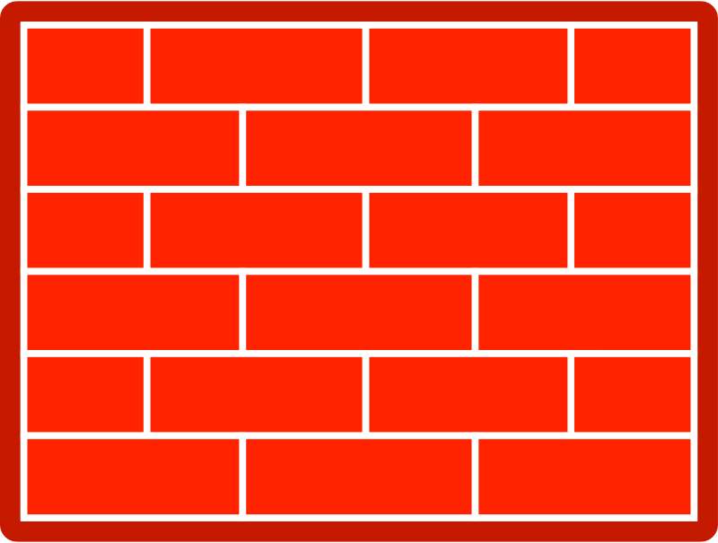
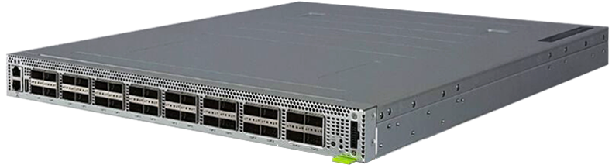
Princeton Campus Deployment
(https://p4campus.cs.princeton.edu)
Internet2
Internet
Network TAPs
Mirrored
traffic
Firewall
Princeton
Campus
Tofino-1
Tofino-2
Deployed: Microburst analysis, heavy hitter detection, trace anonymization
In progress: surveillance protection, RTT, DNS heavy hitters, OS fingerprinting

Slide 40
Conclusion
Rethinking networking
  Open interfaces to the data plane
  Separation of control and data
  Deployment of new solutions
Significant momentum
  In industry and in academic research
Next steps
  Enterprises
  Cellular (5G) networks

