Slide 1
Wireless Networks
Mike Freedman
COS 461: Computer Networks
http://www.cs.princeton.edu/courses/archive/spring20/cos461/

Slide 2
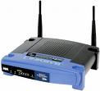
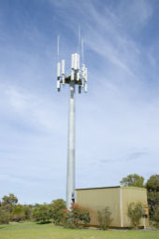
Widespread Deployment
Worldwide cellular subscribers
1993: 34 million
2005: more than 2 billion
2012: 6.8 billion
(2.1B with mobile broadband)
>> 1.2B landline subscribers
Wireless local area networks
Wireless adapters built into laptops, tablets, & phones
More ubiquitous than wired broadband? 700M in 2012

Slide 3
Wireless Links

Slide 4
Wireless Properties
Interference / bit errors
More sources of corruption compared to wired
Multipath propagation
Signal does not travel in a straight line
Broadcast medium
All traffic to everyone
Power trade-offs
Important for power constrained devices

Slide 5
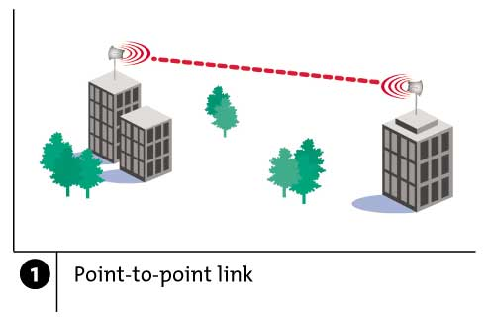
Wireless Links: High Bit Error Rate
Decreasing signal strength
Disperses as it travels greater distance
Attenuates as it passes through matter

Slide 6
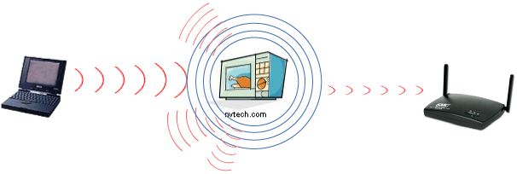
Wireless Links: High Bit Error Rate
Interference from other sources
Radio sources in same frequency band
E.g., 2.4 GHz wireless phone interferes with 802.11b wireless LAN
Electromagnetic noise (e.g., microwave oven)

Slide 7
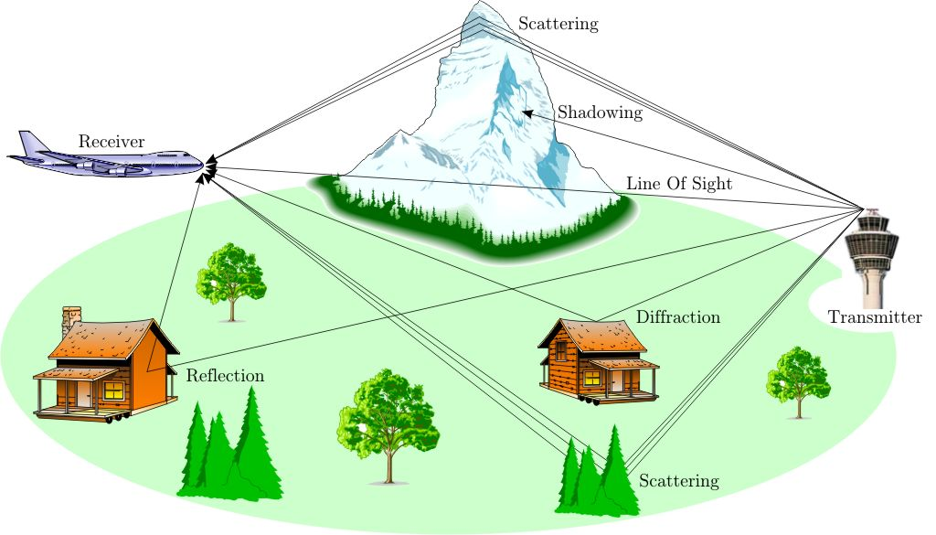
Wireless Links: High Bit Error Rate
Multi-path propagation
Electromagnetic waves reflect off objects
Taking many paths of different lengths
Causing blurring of signal at the receiver
receiver
transmitter

Slide 8
Dealing With Bit Errors
Wireless vs. wired links
Wired: most loss is due to congestion
Wireless: higher, time-varying bit-error rate
Dealing with high bit-error rates
Sender could increase transmission power
Requires more energy (bad for battery-powered hosts)
Creates more interference with other senders
Stronger error detection and recovery
More powerful error detection/correction codes
Link-layer retransmission of corrupted frames

Slide 9
Wireless Links: Broadcast Limitations
Wired broadcast links
E.g., Ethernet bridging, in wired LANs
All nodes receive transmissions from all other nodes
Wireless broadcast: hidden terminal problem
C
A and B hear each other
B and C hear each other
But, A and C do not
So, A and C are unaware of their interference at B
B
A

Slide 10
Wireless Links: Broadcast Limitations
Wired broadcast links
E.g., Ethernet bridging, in wired LANs
All nodes receive transmissions from all other nodes
Wireless broadcast: fading over distance
A
B
C
A and B hear each other
B and C hear each other
But, A and C do not
So, A and C are unaware of their interference at B
A’s signal
strength
C’s signal
strength
space

Slide 11
Example Wireless Link Technologies
Data networks
802.15.1 (Bluetooth): 2.1 Mbps – 10 m
802.11b (WiFi): 5-11 Mbps – 100 m
802.11a and g (WiFi): 54 Mbps – 100 m
802.11n (WiFi): 200 Mbps – 100 m
802.16 (WiMax): 70 Mbps – 10 km
Cellular networks, outdoors
2G: 56 Kbps
3G: 384 Kbps
3G enhanced (“4G”): 4 Mbps
LTE: 10-100 Mbps

Slide 12
Wireless Network: Wireless Link
Wireless link
Typically used to connect mobile(s) to base station
Also used as backbone link
Multiple access protocol coordinates link access
network
infrastructure

Slide 13
Wireless Network: Wireless Hosts
Wireless host
Laptop, smartphone
Run applications
May be stationary (non-mobile) or mobile
network
infrastructure

Slide 14
Wireless Network: Base Station
Base station
Typically connected to wired network
Relay responsible for sending packets between wired network and wireless host(s) in its “area”
E.g., cell towers, 802.11 access points
network
infrastructure

Slide 15
Wireless Network: Infrastructure
Network infrastructure
Larger network with which a wireless host wants to communicate
Typically a wired network
Provides traditional network services
May not always exist
network
infrastructure

Slide 16
Infrastructure Mode (APs)
Infrastructure mode
Base station connects mobiles into wired network
Network provides services (addressing, routing, DNS)
Handoff: mobile changes base station providing connection to wired network
network
infrastructure

Slide 17
Channels and Association
Multiple channels at different frequencies
Network administrator chooses frequency for AP
Interference if channel is same as neighboring AP

Slide 18
Channels and Association
Multiple channels at different frequencies
Network administrator chooses frequency for AP
Interference if channel is same as neighboring AP
Access points send periodic beacon frames
Containing AP’s name (SSID) and MAC address
Host scans channels, listening for beacon frames
Host selects an access point: association request/response protocol between host and AP

Slide 19
Mobility Within the Same Subnet
H1 remains in same IP subnet
IP address of the host can remain same
Ongoing data transfers can continue uninterrupted
H1 recognizes the need to change
H1 detects a weakening signal
Starts scanning for stronger one
Changes APs with same SSID
H1 disassociates from one
And associates with other
Switch learns new location
Self-learning mechanism
router
hub or
switch
BBS 1
AP 1
AP 2
H1
BBS 2

Slide 20
Questions
Loss is primary caused by bit errors
(Y) Ethernet (Wired)
(M) 802.11 (Wireless)
(C) Both
Neither
All hosts on subnet see all communication
(Y) Ethernet (Wired)
(M) 802.11 (Wireless)
(C) Both
Neither

Slide 21
Questions
Loss is primary caused by bit errors
(Y) Ethernet (Wired)
(M) 802.11 (Wireless)
(C) Both
Neither
All hosts on subnet see all communication
(Y) Ethernet (Wired)
(M) 802.11 (Wireless)
(C) Both
Neither
Notes:
Loss is primary caused by bit errors: B
All hosts on subset see all communication: A

Slide 22
WiFi: 802.11 Wireless LANs

Slide 23
802.11 LAN Architecture
Access Point (AP)
Base station that communicates with the wireless hosts
Basic Service Set (BSS)
Coverage of one AP
AP acts as the master
Identified by an “network name” known as an SSID
Internet
hub, switch
or router
AP
BSS 1
AP
BSS 2
SSID: Service Set Identifier

Slide 24
CSMA: Carrier Sense, Multiple Access
Multiple access: channel is shared medium
Station: wireless host or access point
Multiple stations may want to transmit at same time
Carrier sense: sense channel before sending
Station doesn’t send when channel is busy
To prevent collisions with ongoing transfers
But, detecting ongoing transfers isn’t always possible
A
B
C
C
A’s signal
strength
C’s signal
strength
B
A
space

Slide 25
CA: Collision Avoidance, Not Detection
Collision detection in wired Ethernet
Station listens while transmitting
Detects collision with other transmission
Aborts transmission and tries sending again
Problem #1: cannot detect all collisions
Hidden terminal problem
Fading

Slide 26
CA: Collision Avoidance, Not Detection
Collision detection in wired Ethernet
Station listens while transmitting
Detects collision with other transmission
Aborts transmission and tries sending again
Problem #1: cannot detect all collisions
Hidden terminal problem
Fading
Problem #2: listening while sending
Strength of received signal is much smaller
Expensive to build hardware that detects collisions
So, 802.11 does collision avoidance, not detection

Slide 27
Hidden Terminal Problem
A
B
C
A and C can’t see each other, both send to B
Occurs b/c 802.11 relies on physical carrier sensing, which is susceptible to hidden terminal problem

Slide 28
Virtual carrier sensing
First exchange control frames before transmitting data
Sender issues “Request to Send” (RTS), incl. length of data
Receiver responds with “Clear to Send” (CTS)
If sender sees CTS, transmits data (of specified length)
If other node sees CTS, will idle for specified period
If other node sees RTS but not CTS, free to send

Slide 29
Hidden Terminal Problem
A
B
C
A and C can’t see each other, both send to B
RTS/CTS can help
Both A and C would send RTS that B would see first
B only responds with one CTS (say, echoing A’s RTS)
C detects that CTS doesn’t match and won’t send

Slide 30
Exposed Terminal Problem
A
B
C
D
B sending to A, C wants to send to D
As C receives packets, carrier sense would prevent it from sending to D, even though wouldn’t interfere
RTS/CTS can help
C hears RTS from B, but not CTS from A
C knows it’s transmission will not interfere with A
C is safe to transmit to D

Slide 31
Impact on Higher-Layer Protocols
Wireless and mobility change path properties
Wireless: higher packet loss, not from congestion
Mobility: transient disruptions, and changes in RTT
Logically, impact should be minimal …
Best-effort service model remains unchanged
TCP and UDP can (and do) run over wireless, mobile
But, performance definitely is affected
TCP treats packet loss as a sign of congestion
TCP tries to estimate the RTT to drive retransmissions
TCP does not perform well under out-of-order packets
Internet not designed with these issues in mind

Slide 32
Questions
RTS/CTS more like:
(Y) Statistical multiplexing
(M) Time-division multiplexing
(C) Frequency-division multiplexing
Which of following is NOT true?
(Y) Collisions are minimized when RTS/CTS used.
(M) Sender can always detect a collision without feedback from receiver.
(C) TCP congestion control works poorly in wireless without link-layer retransmission.
(A) Wireless generally has higher loss rates than wired.

Slide 33
Questions
RTS/CTS more like:
(Y) Statistical multiplexing
(M) Time-division multiplexing
(C) Frequency-division multiplexing
Which of following is NOT true?
(Y) Collisions are minimized when RTS/CTS used.
(M) Sender can always detect a collision without feedback from receiver.
(C) TCP congestion control works poorly in wireless without link-layer retransmission.
(A) Wireless generally has higher loss rates than wired.

Slide 34
Bluetooth: 802.15.1 “personal-area-networks”

Slide 35
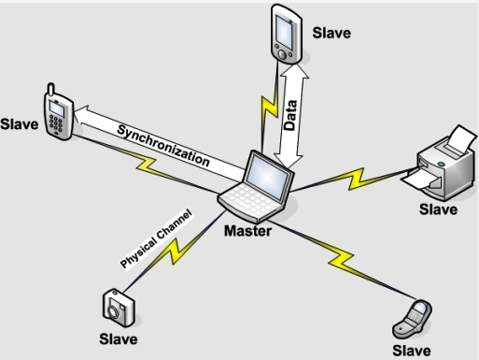
Bluetooth piconets
Up to 7 “slave devices and 225 “parked” devices
Operates on unlicensed wireless spectrum
How to prevent interference?

Slide 36
PHY: Spread Spectrum – Frequency Hopping
Nodes rapidly jump between frequencies
Sender and receiver coordinated in jumps
How coordinate? Pseudorandom number generator, with shared input known to sender/receiver
If randomly collide with other transmitted, only for short period before jump again
Bluetooth
79 frequencies, on each frequency for 625 microseconds
Each channel also uses TDMA, with each frame taking 1/3/5 consecutive slots.
Only master can start in odd slot, slave only in response
Notes:
Question: why bluetooth use this approach of TDMA, rather than CSMA?

Slide 37
Infrastructure vs. Ad Hoc
Infrastructure mode
Wireless hosts are associated with a base station
Traditional services provided by the connected network
E.g., address assignment, routing, and DNS resolution
Ad hoc networks
Wireless hosts have no infrastructure to connect to
Hosts themselves must provide network services
Similar in spirit to the difference between
Client-server communication
Peer-to-peer communication

Slide 38
Conclusions
Wireless
Already a major way people connect to the Internet
Gradually becoming more than just an access network
Mobility (not discussed)
Today’s users tolerate disruptions as they move
… and applications try to hide the effects
Tomorrow’s users expect seamless mobility
Challenges the design of network protocols
Wireless breaks the abstraction of a link, and the assumption that packet loss implies congestion
Mobility breaks association of address and location
Higher-layer protocols don’t perform as well

Slide 39
The Upside to Interference
Some systems leverage interference
If packets collide once, likely will again
Can use both collisions to construct original packets
Reduce effective error rate significantly
If two hosts send to each other through an AP, and collide, AP can broadcast collision to both
Both know what they sent, can “subtract” that from collision to get the other
Improves throughput of system!

