Slide 1
Content Distribution Networks (CDNs)
Mike Freedman
COS 461: Computer Networks
http://www.cs.princeton.edu/courses/archive/spr20/cos461/

Slide 2
Continuation of Lec 15

Slide 3
HTTP xfer = single object
Web pages = many objects

Slide 4
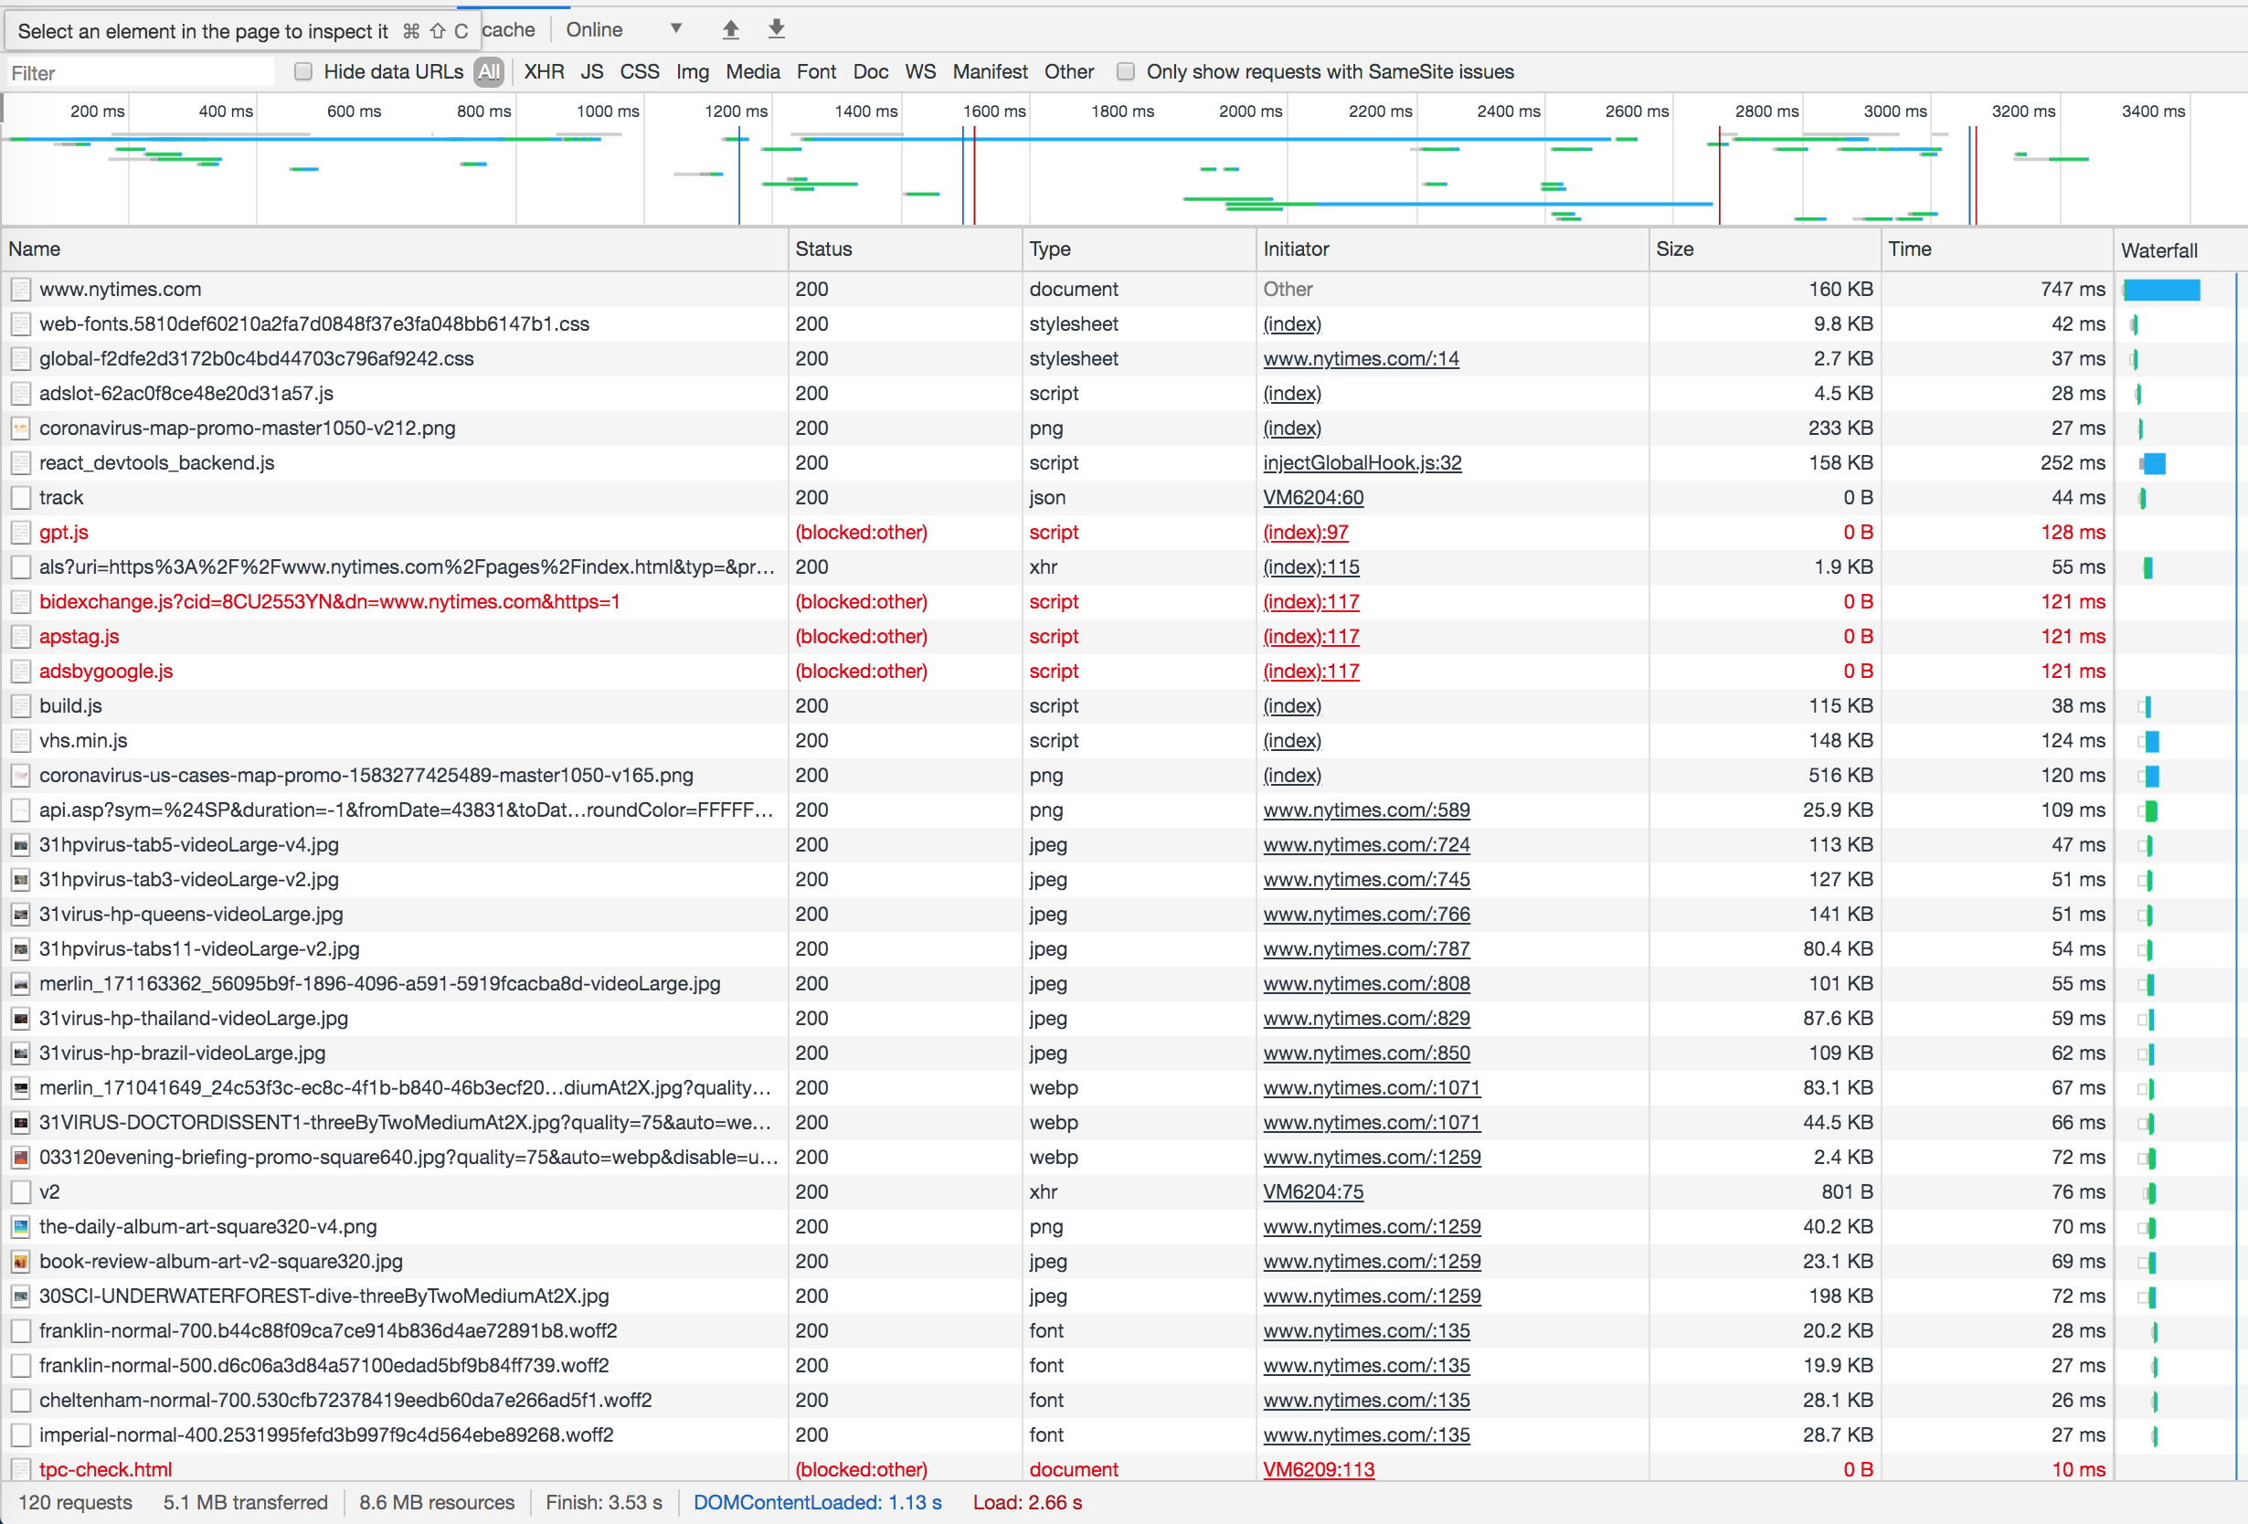
nytimes.com

Slide 5
How to handle many requests?
Maximize goodput by reusing connections
  Avoid connection (TCP) setup
  Avoid TCP slow-start
Client-server will maintain existing TCP connection for up to K idle seconds
GET / HTTP/1.1
Host: www.example.com
Connection: Keep-Alive
HTTP/1.1 200 OK
Date: Tue, 27 Mar 2001 03:50:51 GMT
Connection: Keep-Alive
5

Slide 6
Three approaches to multiple requests
Parallel
Connections
Persistent
Connections
Pipelined
Connections
Conn 1:
Request 1
Response 1
Conn 2:
Request 2
Response 2
Conn 1:
Request 1
Response 1
Request 2
Response 2
Request 3
Response 3
Conn 1:
Request 1
Request 2
Request 3
Response 1
Response 2
Response 3

Slide 7
What are challenges with pipelining?
Head-of-line blocking
  Small xfers can “block” behind large xfer
No reordering
  HTTP response does not “identify” which request it’s in response to; obvious in simple request/response
Can behave worse than parallel + persistent
  Can send expensive query 1 on conn 1, while sending many cheap queries on conn 2
7

Slide 8
Google’s SPDY -> HTTP/2
Server “push” for content
  One client request, multiple responses
  After all, server knows that after parsing HTML, client will immediately request embedded URLs
Better pipelining and xfer
  Multiplexing multiple xfers w/o HOL blocking
  Request prioritization
  Header compression
https://developers.google.com/web/fundamentals/performance/http2

Slide 9
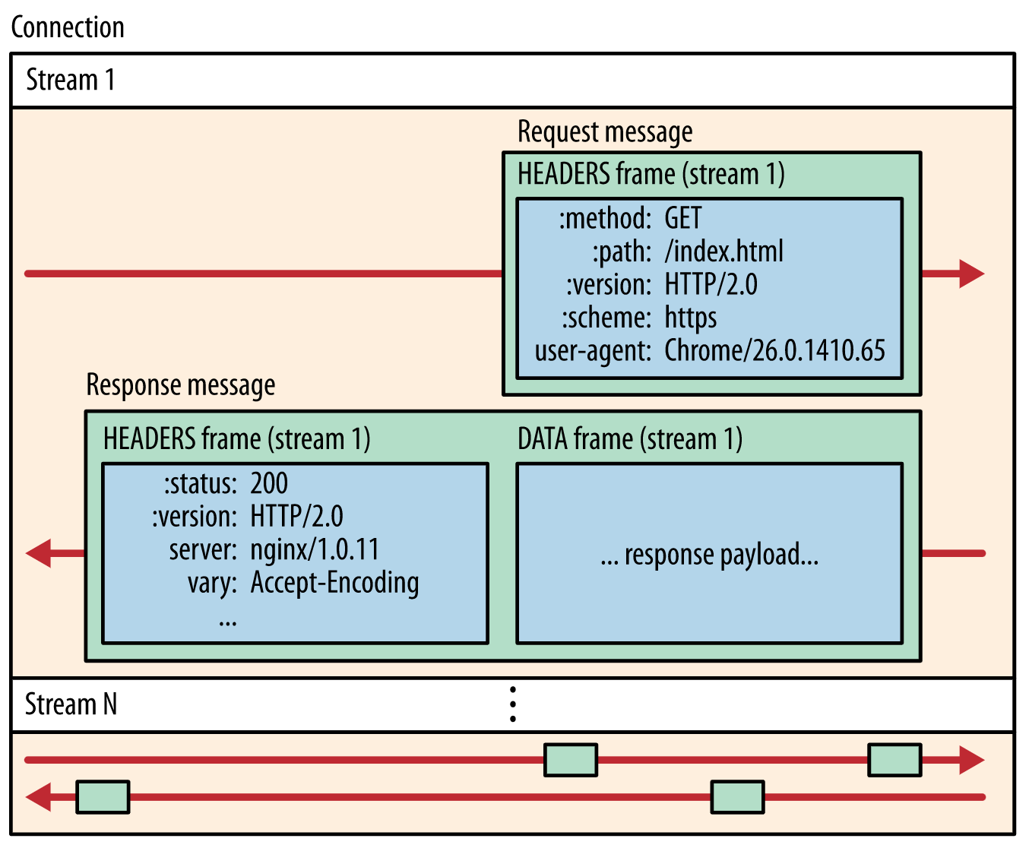

Slide 10
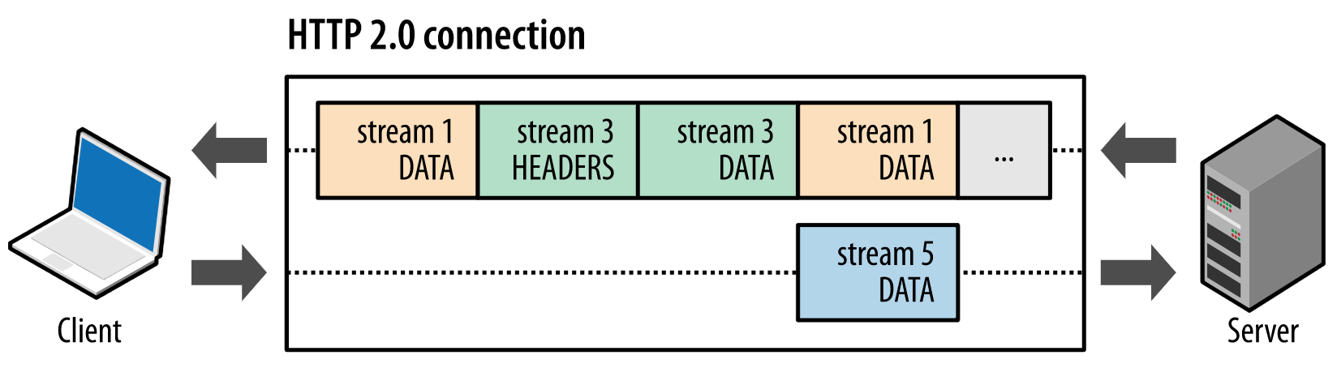

Slide 11
Why Web Caching?

Slide 12
Single Server, Poor Performance
Single server
  Single point of failure
  Easily overloaded
  Far from most clients
Popular content
  Popular site
  “Flash crowd” (aka “Slashdot effect”)
  Denial of Service attack

Slide 13
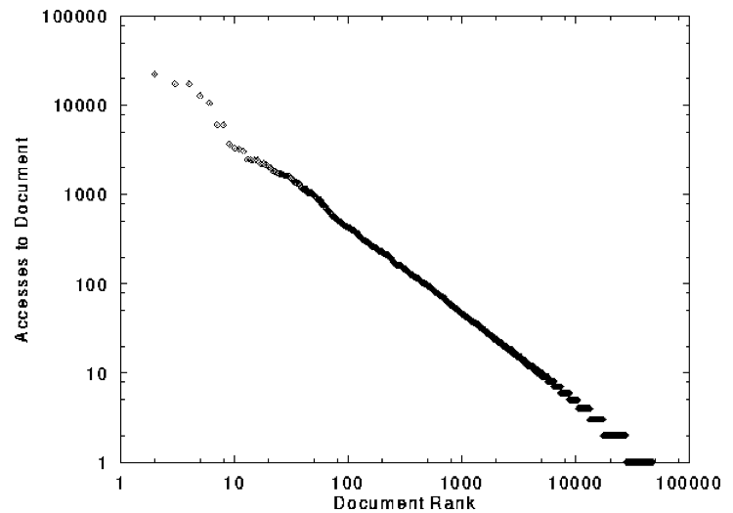
Skewed Popularity of Web Traffic
“Zipf” or “power-law” distribution
Characteristics of WWW Client-based Traces
Carlos R. Cunha, Azer Bestavros, Mark E. Crovella, BU-CS-95-01

Slide 14
Proxy Caches
origin
server
Proxy
server
HTTP request
HTTP request
client
HTTP response
HTTP response
HTTP request
HTTP response
client

Slide 15
Forward Proxy
Cache “close” to the client
  Under administrative control
  of client-side AS
Explicit proxy
  Requires configuring browser
Implicit proxy
  Service provider deploys an “on path” proxy
  … that intercepts and handles Web requests
Proxy
server
HTTP request
client
HTTP response
HTTP request
HTTP response
client

Slide 16
Reverse Proxy
Cache “close” to server
  Either by proxy run by server or in third-party content distribution network (CDN)
Directing clients to the proxy
  Map the site name to the
  IP address of the proxy
origin
server
Proxy
server
HTTP request
HTTP response
HTTP request
HTTP response
origin
server

Slide 17

Google Design
. .
.
Servers
Data Centers
Servers
Router
Router
Private Backbone
Reverse Proxy
Reverse Proxy
Internet
Requests
Client
Client
Client

Slide 18
Proxy Caches
(Y) Forward (M) Reverse (C) Both (A) Neither
Reactively replicates popular content
  Reduces origin server costs
  Reduces client ISP costs
  Intelligent load balancing between origin servers
  Offload form submissions (POSTs) and user auth
  Content reassembly or transcoding on behalf of origin
Smaller round-trip times to clients
Maintain persistent connections to avoid TCP setup delay (handshake, slow start)

Slide 19
Proxy Caches
(Y) Forward (M) Reverse (C) Both (A) Neither
Reactively replicates popular content
  Reduces origin server costs
  Reduces client ISP costs
  Intelligent load balancing between origin servers
  Offload form submissions (POSTs) and user auth
  Content reassembly or transcoding on behalf of origin
Smaller round-trip times to clients
Maintain persistent connections to avoid TCP setup delay (handshake, slow start)
C
C
Y
M
A
C
C
C

Slide 20
Modern HTTP Video-on-Demand
Download “content manifest” from origin server
List of video segments belonging to video
  Each segment 1-2 seconds in length
  Client can know time offset associated with each
  Standard naming for different video resolutions and formats: e.g., 320dpi, 720dpi, 1040dpi, …
Client downloads video segment (at certain resolution) using standard HTTP request.
  HTTP request can be satisfied by cache: it’s a static object
Client observes download time vs. segment duration, increases/decreases resolution if appropriate

Slide 21
Content Distribution Networks

Slide 22
Content Distribution Network
origin server
in North America
Proactive content replication
  Content provider (e.g., CNN) contracts with a CDN
CDN replicates the content
  On many servers spread throughout the Internet
Updating the replicas
  Reactive by TTL or updates pushed to replicas when the content changes
CDN distribution node
CDN server
in S. America
CDN server
in Asia
CDN server
in Europe

Slide 23
Server Selection Policy
Live server
  For availability
Lowest load
  To balance load across the servers
Closest
  Nearest geographically, or in round-trip time
Best performance
  Throughput, latency, …
Cheapest bandwidth, electricity, …
Requires continuous monitoring of liveness, load, and performance

Slide 24
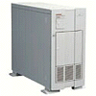

Server Selection Mechanism
Application
  HTTP redirection
Advantages
  Fine-grain control
  Selection based on client IP address
Disadvantages
  Extra round-trips for TCP connection to server
  Overhead on the server
GET
Redirect
GET
OK

Slide 25
Server Selection Mechanism
Advantages
  No extra round trips
  Route to nearby server
Disadvantages
  Does not consider network or server load
  Different packets may go to different servers
  Used only for simple request-response apps
Routing
  Anycast routing
1.2.3.0/24
1.2.3.0/24

Slide 26
Server Selection Mechanism
Advantages
  Avoid TCP set-up delay
  DNS caching reduces overhead
  Relatively fine control
Disadvantage
  Based on IP address of local DNS server
  “Hidden load” effect
  DNS TTL limits adaptation
Naming
  DNS-based server selection
1.2.3.4
DNS
query
1.2.3.5
local DNS server

Slide 27
How Akamai Works

Slide 28
Akamai Statistics
Distributed servers
  Servers: ~275,000
  Networks: 1,500
  Countries: 136
Many customers
  50% of Fortune Global 500
Network
  Up to 50 Tbps daily
  2019 Cricket World Cup: 25.3M concurrent viewers
  85% Internet is one network hop from Akamai servers
https://www.akamai.com/us/en/about/facts-figures.jsp

Slide 29
How Akamai Uses DNS
29
cnn.com (content provider)
HTTP
DNS root server
GET index.html
Akamai
cluster
cache.cnn.com/foo.jpg
Akamai global
DNS server
1
2
HTTP
Akamai regional
DNS server
Nearby
Akamai
cluster
End user

Slide 30
How Akamai Uses DNS
30
cnn.com (content provider)
HTTP
DNS TLD server
DNS lookup
cache.cnn.com
Akamai
cluster
Akamai global
DNS server
1
2
3
ALIAS:
g.akamai.net
4
Akamai regional
DNS server
Nearby
Akamai
cluster
End user

Slide 31
How Akamai Uses DNS
31
cnn.com (content provider)
HTTP
DNS TLD server
DNS lookup
g.akamai.net
Akamai
cluster
Akamai global
DNS server
5
1
2
3
4
6
Akamai regional
DNS server
ALIAS
a73.g.akamai.net
Nearby
Akamai
cluster
End user

Slide 32
How Akamai Uses DNS
32
cnn.com (content provider)
HTTP
DNS TLD server
Akamai
cluster
Akamai global
DNS server
5
1
2
3
4
6
Akamai regional
DNS server
7
DNS a73.g.akamai.net
8
Address
1.2.3.4
Nearby
Akamai
cluster
End user

Slide 33
How Akamai Uses DNS
33
cnn.com (content provider)
HTTP
DNS TLD server
Akamai
cluster
Akamai global
DNS server
5
1
2
3
4
6
Akamai regional
DNS server
7
8
9
Nearby
Akamai
cluster
End user
GET /foo.jpg
Host: cache.cnn.com

Slide 34

How Akamai Uses DNS
34
cnn.com (content provider)
HTTP
DNS TLD server
GET foo.jpg
11
12
Akamai
cluster
Akamai global
DNS server
5
1
2
3
4
6
Akamai regional
DNS server
7
8
9
Nearby
Akamai
cluster
End user
GET /foo.jpg
Host: cache.cnn.com

Slide 35
How Akamai Uses DNS
35
cnn.com (content provider)
HTTP
DNS TLD server
11
12
Akamai
cluster
Akamai global
DNS server
5
1
2
3
4
6
Akamai regional
DNS server
7
8
9
Nearby
Akamai
cluster
End user
10

Slide 36
How Akamai Works: Cache Hit
36
cnn.com (content provider)
HTTP
DNS TLD server
Akamai
cluster
Akamai global
DNS server
1
2
Akamai regional
DNS server
3
4
5
Nearby
Akamai
cluster
End user
6

Slide 37
Mapping System
Equivalence classes of IP addresses
  IP addresses experiencing similar performance
  Quantify how well they connect to each other
Collect and combine measurements
  Ping, traceroute, BGP routes, server logs
    E.g., over 100 TB of logs per days
  Network latency, loss, and connectivity

Slide 38
Routing Client Requests within Map
Map each IP class to a preferred server cluster
  Based on performance, cluster health, etc.
  Updated roughly every minute
    Short, 60-sec DNS TTLs in Akamai regional DNS accomplish this
Map client request to a server in the cluster
  Load balancer selects a specific server
  E.g., to maximize the cache hit rate

Slide 39
Selecting server inside cluster
“Consistent hashing”
  content_key = hash(URL) mod N
  node_key = hash(server ID) mod N
  Content belongs to server’s node_key is “closest” to URL’s content_key
Content 5
CK5
N105
CK20
Server 105
Circular
ID space
N32
N90
CK80

Slide 40
Adapting to Failures
Failing hard drive on a server
  Suspends after finishing “in progress” requests
Failed server
  Another server takes over for the IP address
  Low-level map updated quickly
Failed cluster or network path
  High-level map updated quickly
Failed path to customer’s origin server
  Route packets through an intermediate node

Slide 41
Akamai Transport Optimizations
Bad Internet routes
  Overlay routing through an intermediate server
Packet loss
  Sending redundant data over multiple paths
TCP connection set-up/teardown
  Pools of persistent connections
TCP congestion window and round-trip time
  Estimates based on network latency measurements

Slide 42
Akamai Application Optimizations
Slow download of embedded objects
  Prefetch when HTML page is requested
Large objects
  Content compression
Slow applications
  Moving applications to edge servers
  E.g., content aggregation and transformation
  E.g., static databases (e.g., product catalogs)

Slide 43
Conclusion
Content distribution is hard
  Many, diverse, changing objects
  Clients distributed all over the world
Moving content towards client is key
  Reduces latency, improves throughput, reliability
Contribution distribution solutions evolved
  Reactive caching, load balancing, to
  Proactive content distribution networks

