Slide 1
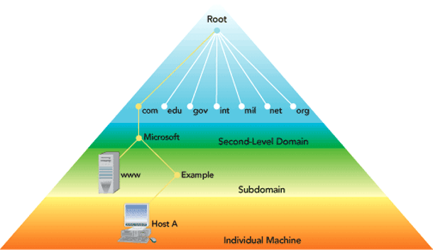
Discovery and DNS
http://mosaic.cnfolio.com/B101CW2011Article581
Mike Freedman
COS 461: Computer Networks
http://www.cs.princeton.edu/courses/archive/spr20/cos461/

Slide 2
Relationship Between Layers
name
logical link

Slide 3
Routing: Mapping Link to Path
name
logical link
physical
path
address

Slide 4
Discovery: Mapping Name to Address
name
logical link
address

Slide 5
Discovery

Slide 6
Directories
A key-value store
Key: name; value: address(es)
Answer queries: given name, return address(es)
Caching the response
Reuse the response, for a period of time
Better performance and lower overhead
Allow entries to change
Updating the address(es) associated with a name
Invalidating or expiring cached responses

Slide 7
Directory Design: Three Extremes
Flood the query (e.g., ARP)
The named node responds with its address
But, high overhead in large networks
Push data to all clients (/etc/hosts)
All nodes store a full copy of the directory
But, high overhead for many names and updates
Central directory server
All data and queries handled by one machine
But, poor performance, scalability, and reliability

Slide 8
Directory Design: Distributed Solutions
Hierarchical directory (e.g., DNS)
Follow the hierarchy in the name space
Distribute the directory, distribute the queries
Enable decentralized updates to the directory
Distributed Hash Table (e.g. P2P applications)
Directory as a hash table with flat names
Each directory node handles range of hash outputs
Use hash to direct query to the directory node

Slide 9
Domain Name System (DNS)
Computer science concepts underlying DNS
Indirection: names in place of addresses
Hierarchy: in names, addresses, and servers
Caching: of mappings from names to/from addresses

Slide 10
Strawman Solution #1: Local File
Original name to address mapping
Flat namespace
/etc/hosts
SRI kept main copy
Downloaded regularly
Count of hosts was increasing: moving from a machine per domain to machine per user
Many more downloads
Many more updates

Slide 11
Strawman Solution #2: Central Server
Central server
One place where all mappings are stored
All queries go to the central server
Many practical problems
Single point of failure
High traffic volume
Distant centralized database
Single point of update
Does not scale
Need a distributed, hierarchical collection of servers

Slide 12
Domain Name System (DNS)
Properties of DNS
Hierarchical name space divided into zones
Distributed over a collection of DNS servers
Hierarchy of DNS servers
Root servers
Top-level domain (TLD) servers
Authoritative DNS servers
Performing the translations
Local DNS servers and client resolvers
12

Slide 13
Distributed Hierarchical Database
unnamed root
com
edu
org
ac
uk
zw
arpa
generic domains
country domains
bar
ac
in-
addr
west
east
cam
12
foo
my
usr
34
my.east.bar.edu
usr.cam.ac.uk
56
12.34.56.0/24

Slide 14
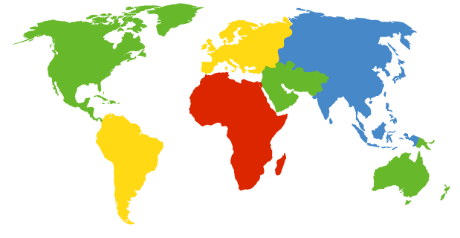
DNS Root Servers
13 root servers (see http://www.root-servers.org/)
Labeled A through M. Most are IP Anycasted.
A Verisign, Dulles, VA
C Cogent, Herndon, VA (also Los Angeles)
D U Maryland College Park, MD
G US DoD Vienna, VA
H ARL Aberdeen, MD
J Verisign, ( 11 locations)
K RIPE London (+ Amsterdam, Frankfurt)
I Autonomica, Stockholm (plus 3 other locations)
E NASA Mt View, CA
F Internet Software C. Palo Alto, CA (and 17 other locations)
m WIDE Tokyo
B USC-ISI Marina del Rey, CA
L ICANN Los Angeles, CA

Slide 15
TLD and Authoritative DNS Servers
Global Top-level domain (gTLD) servers
Generic domains (e.g., .com, .org, .edu)
Country domains (e.g., .uk, .fr, .ca, .jp)
Managed professionally (e.g., Verisign for .com .net)
Authoritative DNS servers
Provide public records for hosts at an organization
For the organization’s servers (e.g., Web and mail)
Can be maintained locally or by a service provider
15

Slide 16
Reliability
DNS servers are replicated
Name service available if at least one replica is up
Queries can be load balanced between replicas
$ dig NS nytimes.com +norecurse
;; QUESTION SECTION:
;nytimes.com. IN NS
;; AUTHORITY SECTION:
nytimes.com. 349 IN NS ns2.p24.dynect.net.
nytimes.com. 349 IN NS ns3.p24.dynect.net.
nytimes.com. 349 IN NS dns2.p06.nsone.net.
nytimes.com. 349 IN NS ns4.p24.dynect.net.
nytimes.com. 349 IN NS ns1.p24.dynect.net.
nytimes.com. 349 IN NS dns3.p06.nsone.net.
nytimes.com. 349 IN NS dns4.p06.nsone.net.
nytimes.com. 349 IN NS dns1.p06.nsone.net.

Slide 17
Reliability
DNS servers are replicated
Name service available if at least one replica is up
Queries can be load balanced between replicas
UDP used for queries
Need reliability: must implement this on top of UDP
Try alternate servers on timeout
Exponential backoff when retrying same server
Same identifier for all queries
Don’t care which server responds

Slide 18
DNS Queries and Caching

Slide 19
Using DNS
Local DNS server (“default name server”)
Usually near the end hosts who use it
Local hosts configured with local server (e.g., /etc/resolv.conf) or learn the server via DHCP
Client application
Extract server name (e.g., from the URL)
Do gethostbyname() or getaddrinfo() to get address
Server application
Extract client IP address from socket
Optional gethostbyaddr() to translate into name
19

Slide 20
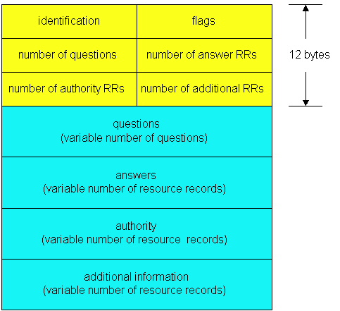
DNS Protocol
DNS protocol : query and reply msg,
both with same msg format
Message header
Identification: 16 bit # for query, reply to query uses same #
Flags:
Query or reply
Recursion desired
Recursion available
Reply is authoritative

Slide 21
DNS Resource Records
RR format: (name, value, type, ttl)
Type=A
Name: hostname
Value: IP address
Type=CNAME
Name: alias for some “canonical” (the real) name:
www.ibm.com is really
srveast.backup2.ibm.com
Value: canonical name
Type=NS
Name: domain
Value: hostname of name server for domain
Type=MX
Value: name of mailserver associated with name

Slide 22
Break for Demo

Slide 23
DNS Queries
root DNS server for .
Host a.cs.princeton.edu wants IP address for www.umass.edu
Note Recursive vs. Iterative Queries
3
TLD DNS server for .edu
4
5
local DNS server
dns.princeton.edu
6
2
7
9
local DNS server
dns.cs.princeton.edu
8
1
authoritative DNS server
for umass.edu
dns.umass.edu
10
requesting host
a.cs.princeton.edu
www.umass.edu
23

Slide 24
DNS Caching
root DNS server for .
DNS query latency
E.g., 1 sec latency before starting a download
Caching to reduce overhead and delay
Small # of top-level servers, that change rarely
Popular sites visited often
Where to cache?
Local DNS server
Browser
3
TLD DNS server for .edu
4
5
6
2
7
9
8
1
authoritative DNS server
for umass.edu
dns.umass.edu
10
requesting host
a.cs.princeton.edu
www.umass.edu
24

Slide 25
$ dig nytimes.com +norecurse @a.root-servers.net
;; QUESTION SECTION:
;nytimes.com. IN A
;; AUTHORITY SECTION:
com. 172800 IN NS a.gtld-servers.net.
com. 172800 IN NS b.gtld-servers.net.
com. 172800 IN NS c.gtld-servers.net.
com. 172800 IN NS d.gtld-servers.net.
com. 172800 IN NS e.gtld-servers.net.
com. 172800 IN NS f.gtld-servers.net.
com. 172800 IN NS g.gtld-servers.net.
com. 172800 IN NS h.gtld-servers.net.
com. 172800 IN NS i.gtld-servers.net.
com. 172800 IN NS j.gtld-servers.net.
com. 172800 IN NS k.gtld-servers.net.
com. 172800 IN NS l.gtld-servers.net.
com. 172800 IN NS m.gtld-servers.net.
;; ADDITIONAL SECTION:
a.gtld-servers.net. 172800 IN A 192.5.6.30
b.gtld-servers.net. 172800 IN A 192.33.14.30
c.gtld-servers.net. 172800 IN A 192.26.92.30
d.gtld-servers.net. 172800 IN A 192.31.80.30
e.gtld-servers.net. 172800 IN A 192.12.94.30
f.gtld-servers.net. 172800 IN A 192.35.51.30

Slide 26
$ dig nytimes.com +norecurse @b.gtld-servers.net
;; QUESTION SECTION:
;nytimes.com. IN A
;; AUTHORITY SECTION:
nytimes.com. 172800 IN NS ns3.p24.dynect.net.
nytimes.com. 172800 IN NS ns1.p24.dynect.net.
nytimes.com. 172800 IN NS ns2.p24.dynect.net.
nytimes.com. 172800 IN NS ns4.p24.dynect.net.
nytimes.com. 172800 IN NS dns1.p06.nsone.net.
nytimes.com. 172800 IN NS dns2.p06.nsone.net.
nytimes.com. 172800 IN NS dns3.p06.nsone.net.
nytimes.com. 172800 IN NS dns4.p06.nsone.net.
;; Query time: 11 msec
;; SERVER: 192.33.14.30#53(192.33.14.30)
;; WHEN: Sat Mar 28 10:56:03 2020
;; MSG SIZE rcvd: 201

Slide 27
$ dig nytimes.com +norecurse @ns3.p24.dynect.net
;; QUESTION SECTION:
;nytimes.com. IN A
;; ANSWER SECTION:
nytimes.com. 500 IN A 151.101.193.164
nytimes.com. 500 IN A 151.101.129.164
nytimes.com. 500 IN A 151.101.65.164
nytimes.com. 500 IN A 151.101.1.164
;; AUTHORITY SECTION:
nytimes.com. 300 IN NS ns2.p24.dynect.net.
nytimes.com. 300 IN NS ns4.p24.dynect.net.
nytimes.com. 300 IN NS ns3.p24.dynect.net.
nytimes.com. 300 IN NS ns1.p24.dynect.net.
nytimes.com. 300 IN NS dns3.p06.nsone.net.
nytimes.com. 300 IN NS dns2.p06.nsone.net.
nytimes.com. 300 IN NS dns4.p06.nsone.net.
nytimes.com. 300 IN NS dns1.p06.nsone.net.
;; Query time: 14 msec
;; SERVER: 208.78.71.24#53(208.78.71.24)
;; WHEN: Sat Mar 28 11:23:19 2020
;; MSG SIZE rcvd: 265

Slide 28
$ dig ANY nytimes.com +norecurse @ns3.p24.dynect.net
;; Truncated, retrying in TCP mode.
;; QUESTION SECTION:
;nytimes.com. IN ANY
;; ANSWER SECTION:
nytimes.com. 300 IN SOA dns1.p06.nsone.net. hostmaster.nytimes.com. 2019121930 300 150 1209600 300
nytimes.com. 300 IN NS dns3.p06.nsone.net.
nytimes.com. 300 IN NS dns1.p06.nsone.net.
nytimes.com. 300 IN NS dns4.p06.nsone.net.
nytimes.com. 300 IN NS ns3.p24.dynect.net.
nytimes.com. 300 IN NS ns4.p24.dynect.net.
nytimes.com. 300 IN NS ns2.p24.dynect.net.
nytimes.com. 300 IN NS ns1.p24.dynect.net.
nytimes.com. 300 IN NS dns2.p06.nsone.net.
nytimes.com. 500 IN A 151.101.129.164
nytimes.com. 500 IN A 151.101.193.164
nytimes.com. 500 IN A 151.101.1.164
nytimes.com. 500 IN A 151.101.65.164
nytimes.com. 300 IN MX 10 ASPMX2.GOOGLEMAIL.COM.
nytimes.com. 300 IN MX 10 ASPMX3.GOOGLEMAIL.COM.
nytimes.com. 300 IN MX 1 ASPMX.L.GOOGLE.com.
nytimes.com. 300 IN MX 5 ALT2.ASPMX.L.GOOGLE.com.
nytimes.com. 300 IN MX 5 ALT1.ASPMX.L.GOOGLE.com.

Slide 29
nytimes.com. 500 IN TXT "google-site-verification=aReMr8hkX3gxeHLKKk4tJ1s970U7QdEqUMIhMmLUfjQ"
nytimes.com. 500 IN TXT "dropbox-domain-verification=4ld3jahx0psi"
nytimes.com. 500 IN TXT "google-site-verification=ZTCMdpSKM7HwqTvGUf_00Ef008JhOnbzGgCSUGYfsro"
nytimes.com. 500 IN TXT "docusign=bd506110-db79-430e-b159-cc1d74fe1176"
nytimes.com. 500 IN TXT "google-site-verification=NIqXa_F8IaqdPJhTtexgR0NYbzVLD_-X-uRUvyf4GyQ"
nytimes.com. 500 IN TXT "MS=ms22827202"
nytimes.com. 500 IN TXT "adobe-idp-site-verification=5ce4d99c-af0a-4b76-9217-bd49d3336df0"
nytimes.com. 500 IN TXT "google-site-verification=4qJm5sAZa1_29BTwFjqW09t7_7D4Vee3LBFQqg8xYbs"
nytimes.com. 500 IN TXT "google-site-verification=ZsySMeZ_SRbJZFu-53ptepytP7h5pxHO0qAg8Z2bKug"
nytimes.com. 500 IN TXT "MS=A1BFCA84E21B7011CA98DF9DC251CDDF90E0174B"
nytimes.com. 500 IN TXT "google-site-verification=4TE2ggBoy6PktLjtZ03t32A2oEZ0VD0PY6MnTj8IL_g"
nytimes.com. 500 IN TXT "v=spf1 mx ptr ip4:170.149.160.0/19 ip4:170.149.240.0/19 ip4:209.11.220.51/32 include:alerts.wallst.com include:authsmtp.com include:sendgrid.net include:_spf.google.com include:inyt.com include:_spf.e.sparkpost.com include:mail.zendesk.com ~all"
nytimes.com. 500 IN TXT "google-site-verification=ic0Ur9LVhZ1hIjTj8LhMOhqx2Z52oS3hU_W2EqBY6UM"
nytimes.com. 500 IN TXT "google-site-verification=jZcmQFxPEP38yqYpmRvo0v_9hQFAdBZPUEBwTNUPUF8"
nytimes.com. 500 IN TXT "253961548-4297453"
nytimes.com. 500 IN TYPE257 \# 22 000569737375656C657473656E63727970742E6F7267
nytimes.com. 500 IN TYPE257 \# 19 00056973737565636F6D6F646F63612E636F6D
nytimes.com. 500 IN TYPE257 \# 19 0005697373756561777374727573742E636F6D
nytimes.com. 500 IN TYPE257 \# 22 00056973737565616D617A6F6E74727573742E636F6D
nytimes.com. 500 IN TYPE257 \# 15 00056973737565706B692E676F6F67
nytimes.com. 500 IN TYPE257 \# 19 0005697373756564696769636572742E636F6D
nytimes.com. 500 IN TYPE257 \# 17 00056973737565616D617A6F6E2E636F6D
nytimes.com. 500 IN TYPE257 \# 19 0005697373756573796D616E7465632E636F6D
nytimes.com. 500 IN TYPE257 \# 20 00056973737565616D617A6F6E6177732E636F6D

Slide 30
DNS Cache Consistency
Goal: Ensuring cached data is up to date
DNS design considerations
Cached data is “read only”
Explicit invalidation would be expensive
Server would need to keep track of all resolvers caching
Avoiding stale information
Responses include a “time to live” (TTL) field
Delete the cached entry after TTL expires
Perform negative caching (for dead links, misspellings)
So failures quick and don’t overload gTLD servers

Slide 31
Setting the Time To Live (TTL)
TTL trade-offs
Small TTL: fast response to change
Large TTL: higher cache hit rate
Following the hierarchy
Top of the hierarchy: days or weeks
Bottom of the hierarchy: seconds to hours
Tension in practice
CDNs set low TTLs for load balancing and failover
Browsers cache for 15-60 seconds

Slide 32
Questions
Tension:
DNS operators want high TTL for low load on DNS servers,
Domains want low TTL for faster failover b/w IP addrs
(Y) True (M) False
By returning IP addresses in “round robin” fashion, DNS operators can ensure equal load better servers
(Y) True (M) False
Most applications obey TTLs on DNS records
(Y) True (M) False

Slide 33
Questions
Tension:
DNS operators want high TTL for low load on DNS servers,
Domains want low TTL for faster failover b/w IP addrs
(Y) True (M) False
By returning IP addresses in “round robin” fashion, DNS operators can ensure equal load better servers
(Y) True (M) False
Most applications obey TTLs on DNS records
(Y) True (M) False

Slide 34
Inserting Resource Records into DNS
Example: just created startup “FooBar”
Register foobar.com at namecheap.com
Provide registrar with names and IP addresses of authoritative name server (primary and secondary)
Registrar inserts two RRs into the com TLD server:
(foobar.com, dns1.foobar.com, NS)
(dns1.foobar.com, 212.212.212.1, A)
Put in authoritative server dns1.foobar.com
Type A record for www.foobar.com
Type MX record for foobar.com

Slide 35
DNS attacks (1)
DNS cache poisoning
Client: Ask for www.evil.com
Attacker responds with additional section for (www.cnn.com, 1.2.3.4, A)
Client/resolver: Thanks! I won’t bother check what I asked for.

Slide 36
DNS attacks (2)
DNS hijacking
Attacker sends forged DNS reply to client for www.cnn.com, even when they don’t receive the request
How to prevent?
Client remembers the 16-bit DNS ID
Client only accepts reply if reply ID matches query ID
16 bits: 65K possible IDs
What rate for attacker to enumerate all in 1 sec? 64B/packet
64*65536*8 / 1024 / 1024 = 32 Mbps
Prevention: Also randomize the DNS source port
e.g., Windows DNS alloc’s 2500 DNS ports, leads to ~164M possible IDs
Would require 80 Gbps
Kaminsky attack: this source port…wasn’t random after all

