Slide 1
Routing Convergence
advertisements
peer
peer
traffic
Mike Freedman
COS 461: Computer Networks
http://www.cs.princeton.edu/courses/archive/spr20/cos461/

Slide 2


Routing Changes
Topology changes: new route to the same place
Host mobility: route to a different place

Slide 3
Topology Changes

Slide 4
Two Types of Topology Changes
Planned
  Maintenance: shut down a node or link
  Energy savings: shut down a node or link
  Traffic engineering: change routing configuration
Unplanned Failures
  Fiber cut,
  faulty equipment,
  power outage,
  software bugs, …

Slide 5
Detecting Topology Changes
Beaconing
  Periodic “hello” messages in both directions
  Detect a failure after a few missed “hellos”
Performance trade-offs
  Detection delay
  Overhead on link bandwidth and CPU
  Likelihood of false detection
“hello”

Slide 6
Routing Convergence:
Link-State Routing

Slide 7
Convergence
Control plane
  All nodes have consistent information
Data plane
  All nodes forward packets in a consistent way
2
3
1
1
4
2
1
5
4
3

Slide 8
Transient Disruptions
Detection delay
  A node does not detect a failed link immediately
  … and forwards data packets into a “blackhole”
  Depends on timeout for detecting lost hellos
2
3
1
1
4
2
1
5
4
3

Slide 9
Transient Disruptions
Inconsistent link-state database
  Some routers know about failure before others
  Inconsistent paths cause transient forwarding loops
2
2
3
1
3
1
1
1
4
4
2
1
2
1
5
4
3
4
3

Slide 10
Convergence Delay
Sources of convergence delay
  Detection latency
  Updating control-plane information
  Computing and install new forwarding tables
Performance during convergence period
  Lost packets due to blackholes and TTL expiry
  Looping packets consuming resources
  Out-of-order packets reaching the destination
Very bad for VoIP, online gaming, and video

Slide 11
Reducing Convergence Delay
Faster detection
  Smaller hello timers, better link-layer technologies
Faster control plane
  Flooding immediately
  Sending routing messages with high-priority
Faster computation
  Faster processors, and incremental computation
Faster forwarding-table update
  Data structures supporting incremental updates

Slide 12
Slow Convergence in
Distance-Vector Routing

Slide 13
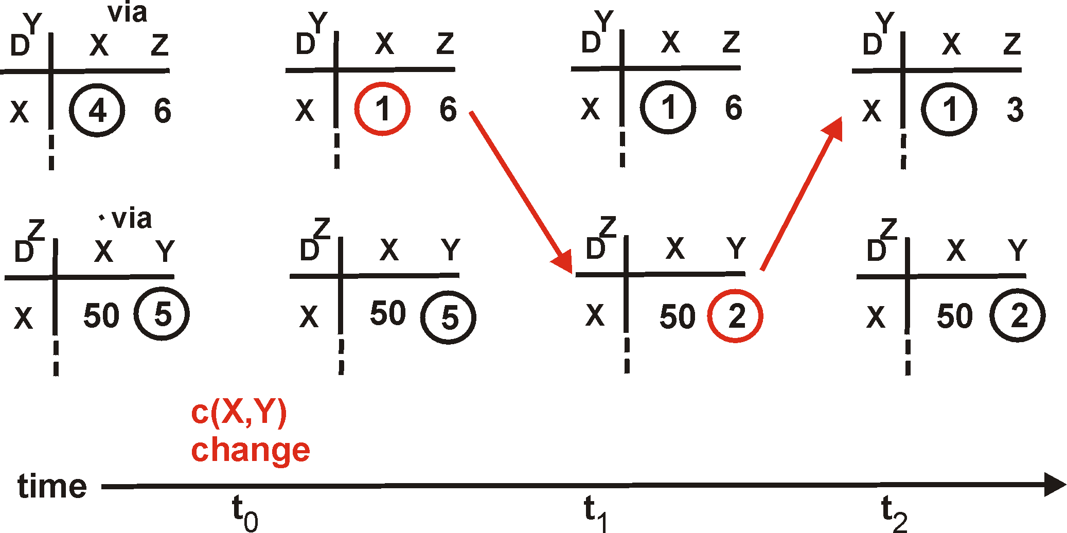
Distance Vector: Link Cost Changes
1
Y
Link cost decreases and recovery
  Node updates the distance table
  If cost change in least cost path, notify neighbors
4
1
X
Z
50
D^{Y} = Distances known to Y

Slide 14
Distance Vector: Link Cost Changes
1
Y
Link cost decreases and recovery
  Node updates the distance table
  If cost change in least cost path, notify neighbors
4
1
X
Z
50
D^{Y} = Distances known to Y

Slide 15
Distance Vector: Link Cost Changes
1
Y
Link cost decreases and recovery
  Node updates the distance table
  If cost change in least cost path, notify neighbors
4
1
X
Z
50
D^{Y} = Distances known to Y
“good
news
travels
fast”

Slide 16
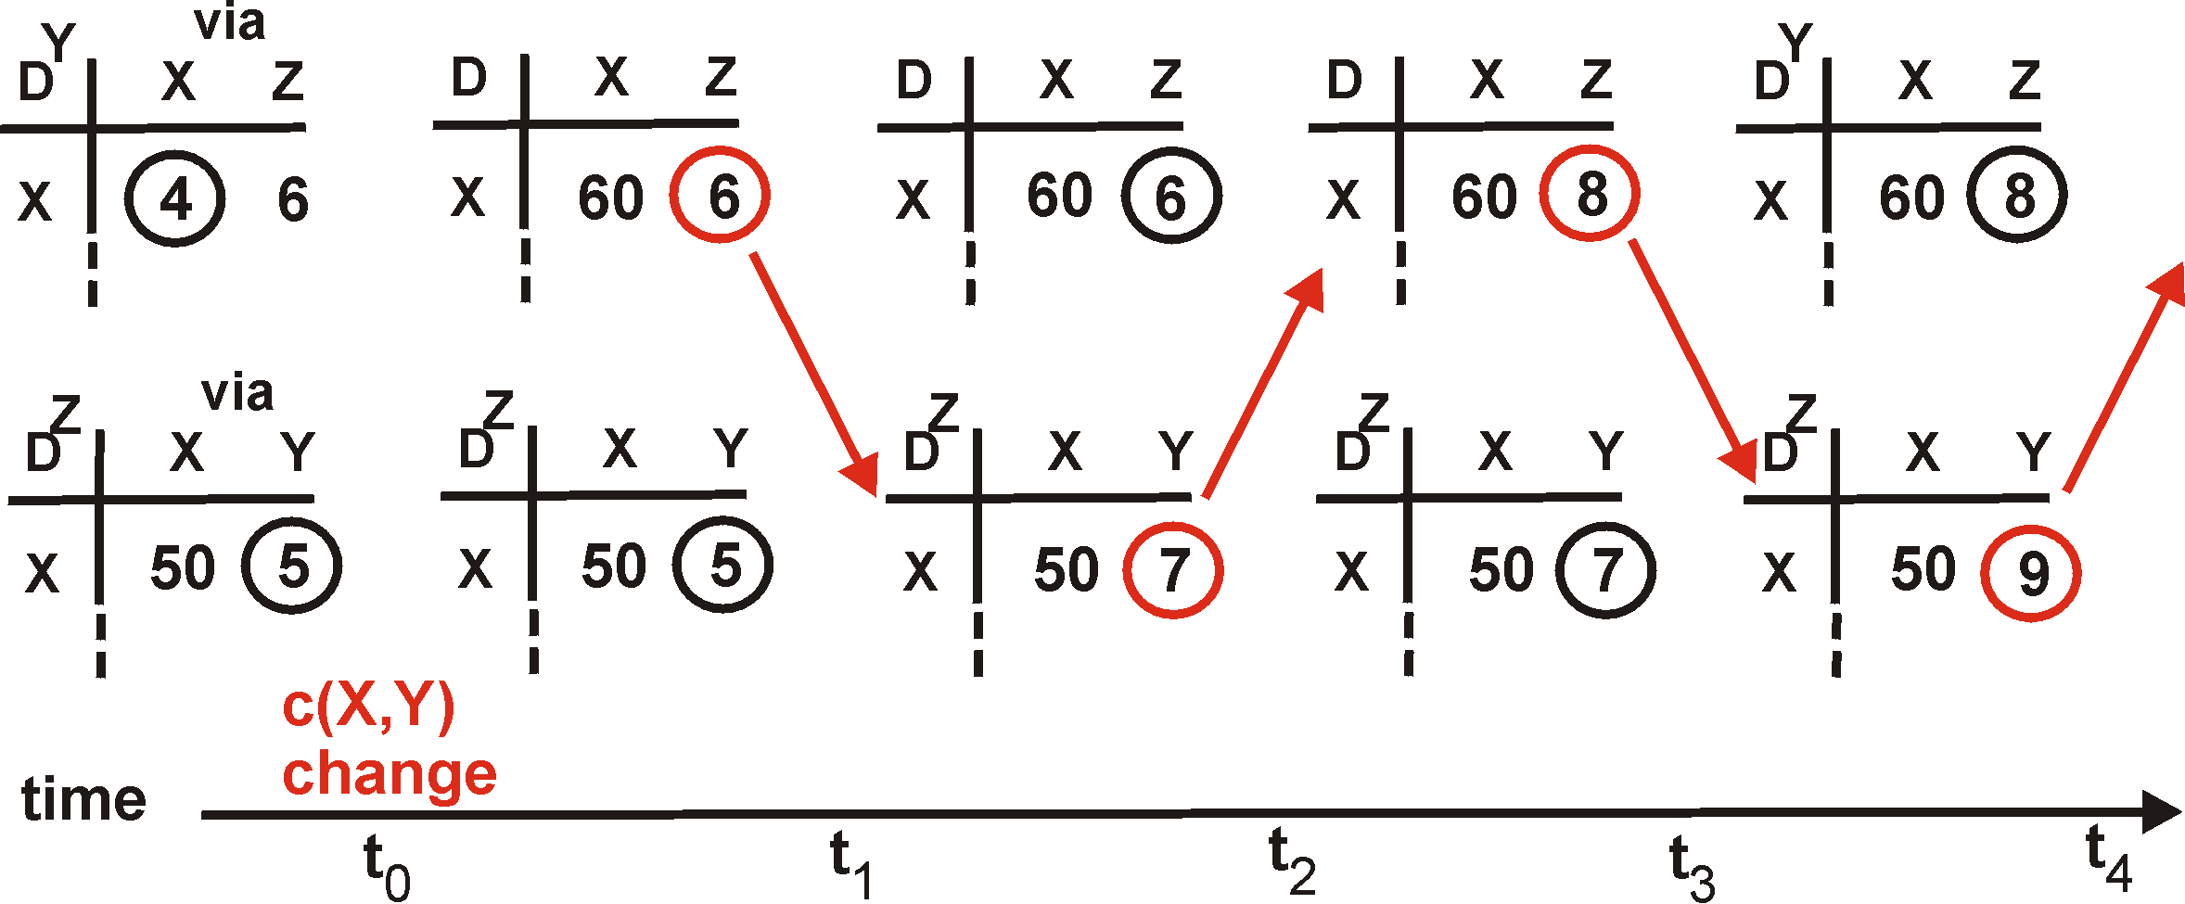
Distance Vector: Link Cost Changes
Link cost increases and failures
  Bad news travels slowly
  “Count to infinity” problem!
60
Y
4
1
X
Z
50

Slide 17
Distance Vector: Link Cost Changes
Link cost increases and failures
  Bad news travels slowly
  “Count to infinity” problem!
60
Y
4
1
X
Z
50
algorithm
continues
on!

Slide 18
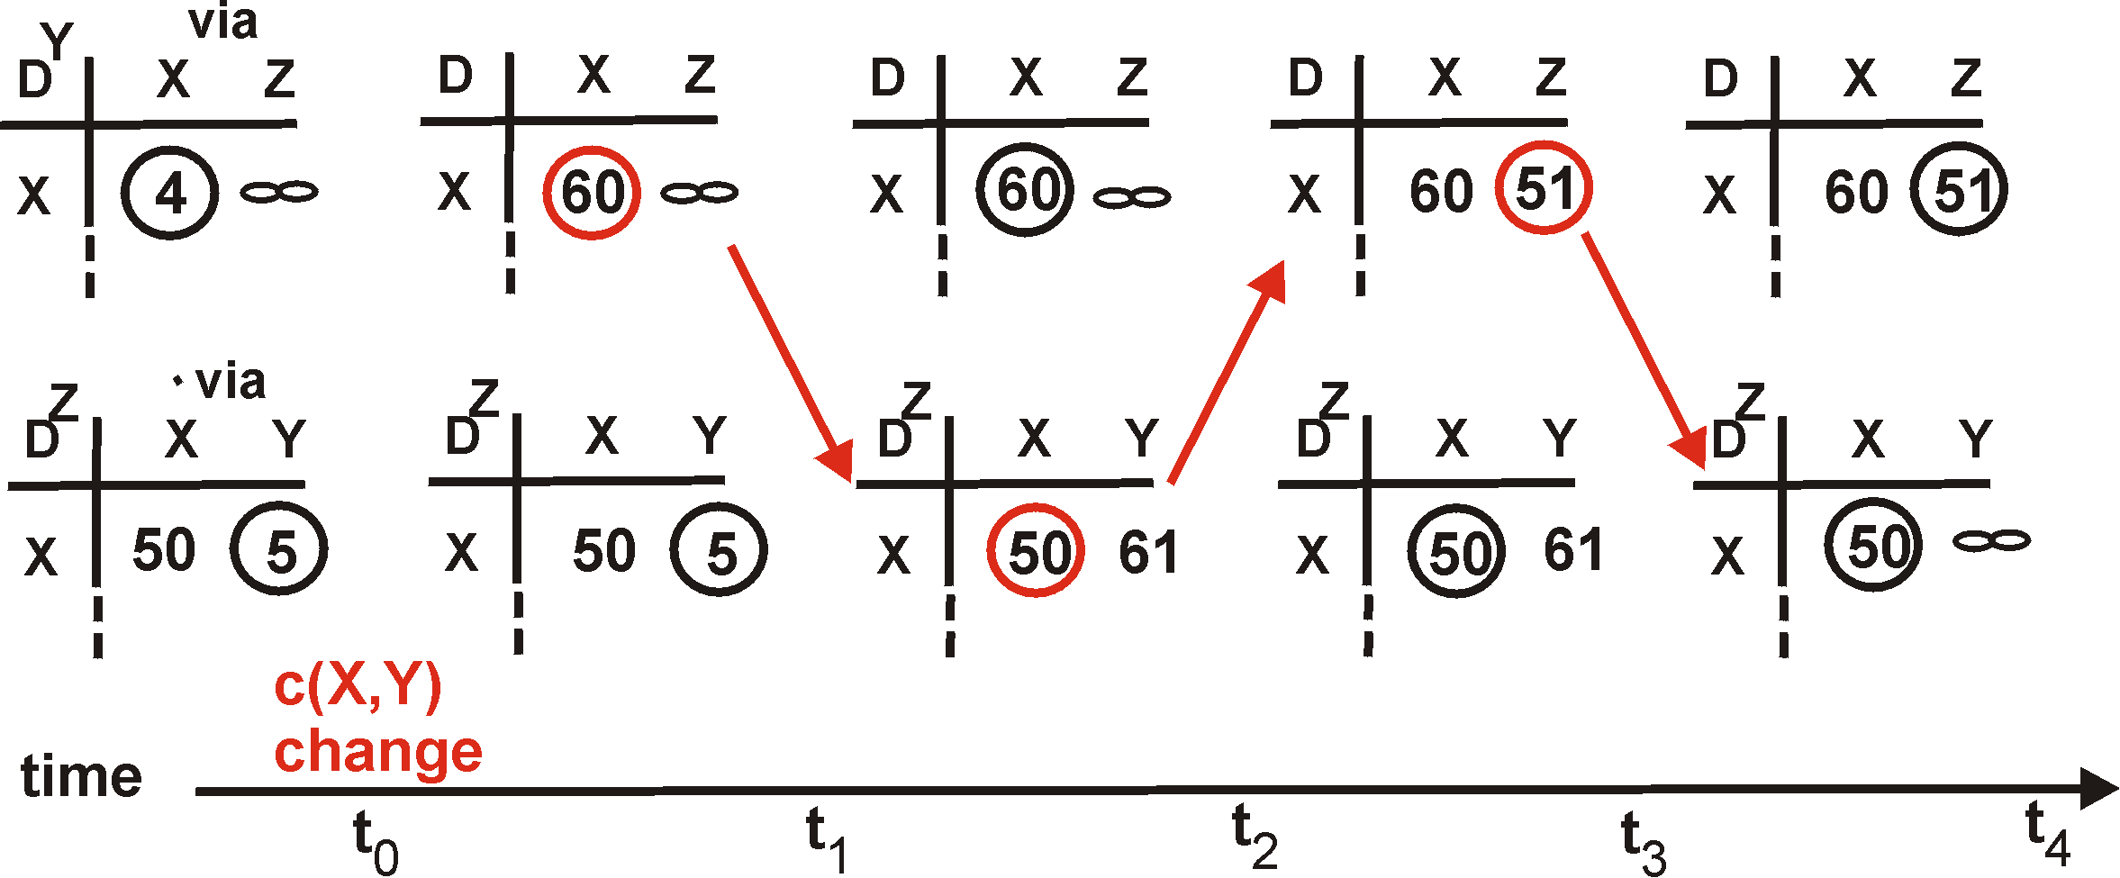
Distance Vector: Poison Reverse
If Z routes through Y to get to X :
  Z tells Y its (Z’s) distance to X is
  infinite (so Y won’t route to X via Z)
60
Y
4
1
X
Z
50
algorithm
terminates

Slide 19
Distance Vector: Poison Reverse
Can still have problems in larger networks
A and B use ACD and BCD, so A and B both poison to C.
But when CD withdrawn (cost goes to infinity), B switches to BACD, so BC no longer poisoned to C.
C then starts using CBACD. Loop.
A
C
D
B

Slide 20
Redefining Infinity
Avoid “counting to infinity”
  By making “infinity” smaller!
Routing Information Protocol (RIP)
  All links have cost 1
  Valid path distances of 1 through 15
  … with 16 representing infinity
Used mainly in small networks

Slide 21
Reducing Convergence Time With Path-Vector Routing
(e.g., Border Gateway Protocol)

Slide 22

Path-Vector Routing
Extension of distance-vector routing
  Support flexible routing policies
  Avoid count-to-infinity problem
Key idea: advertise the entire path
  Distance vector: send distance metric per dest d
  Path vector: send the entire path for each dest d
“d: path (2,1)”
“d: path (1)”
3
2
1
data traffic
data traffic
d

Slide 23
Faster Loop Detection
Node can easily detect a loop
  Look for its own node identifier in the path
  E.g., node 1 sees itself in the path “3, 2, 1”
Node can simply discard paths with loops
  E.g., node 1 simply discards the advertisement
“d: path (2,1)”
“d: path (1)”
3
2
1
“d: path (3,2,1)”

Slide 24
BGP Session Failure
BGP runs over TCP
  BGP only sends updates when changes occur
  TCP doesn’t detect lost connectivity on its own
Detecting a failure
  Keep-alive: 60 seconds
  Hold timer: 180 seconds
Reacting to a failure
  Discard all routes learned from neighbor
  Send new updates for any routes that change
AS1
AS2

Slide 25
Routing Change: Before and After
0
0
(1,0)
(2,0)
(2,0)
(1,2,0)
1
2
1
2
(3,1,0)
(3,2,0)
3
3
25

Slide 26
Routing Change: Path Exploration
AS 1
  Delete the route (1,0)
  Switch to next route (1,2,0)
  Send route (1,2,0) to AS 3
AS 3
  Sees (1,2,0) replace (1,0)
  Compares to route (2,0)
  Switches to using AS 2
0
(2,0)
(1,2,0)
1
2
(3,2,0)
3

Slide 27
Routing Change: Path Exploration
(2,0)
(2,1,0)
(2,3,0)
(2,1,3,0)
(1,0)
(1,2,0)
(1,3,0)
Initial: All AS use direct
Then destination 0 dies
  All ASes lose direct path
  All switch to longer paths
  Eventually withdrawn
How many intermediate routes following (2,0) withdrawal until no route known to 2?
  (2,0) → (2,1,0) → (2,3,0) → (2,1,3,0) → null
1
2
0
3
(3,0)
(3,1,0)
(3,2,0)

Slide 28
BGP Converges Slowly
Path vector avoids count-to-infinity
  But, ASes still must explore many alternate paths to find highest-ranked available path
Fortunately, in practice
  Most popular destinations have stable BGP routes
  Most instability lies in a few unpopular destinations
Still, lower BGP convergence delay is a goal
  Can be tens of seconds to tens of minutes
28

Slide 29
BGP Instability
29

Slide 30
Stable Paths Problem (SPP) Instance
Node
  BGP-speaking router
  Node 0 is destination
Edge
  BGP adjacency
Permitted paths
  Set of routes to 0
  at each node
  Ranking of the paths
2 1 0
2 0
2
5
5 2 1 0
2
4 2 0
4 3 0
4
0
1
3
3 0
1
1 3 0
1 0
most preferred
…
least preferred
30

Slide 31
Stable Paths Problem (SPP) Instance
Solution
  Path assignment per node
  Can be the “null” path
If node u has path uwP
  {u,w} is edge in graph
  w is assigned path wP
Each node is assigned
  Highest ranked path consistent with its neighbors
2 1 0
2 0
2
5
5 2 1 0
2
4 2 0
4 3 0
4
0
1
3
3 0
1
1 3 0
1 0
most preferred
…
least preferred
31

Slide 32
Stable Paths Problem (SPP) Instance
1 will use a direct path to 0
(Y) True (M) False
5 has a path to 0
(Y) True (M) False
2 1 0
2 0
2
5
5 2 1 0
2
4 2 0
4 3 0
4
0
1
3
3 0
1
1 3 0
1 0
most preferred
…
least preferred
32

Slide 33
Stable Paths Problem (SPP) Instance
1 will use a direct path to 0
(Y) True (M) False
5 has a path to 0
(Y) True (M) False
2 1 0
2 0
2
5
5 2 1 0
2
4 2 0
4 3 0
4
0
1
3
3 0
1
1 3 0
1 0
most preferred
…
least preferred
33

Slide 34
SPP May Have Multiple Solutions
1 2 0
1 0
1 2 0
1 0
1 2 0
1 0
1
1
1
0
0
0
2
2
2
2 1 0
2 0
2 1 0
2 0
2 1 0
2 0
First solution
Second solution
34

Slide 35
An SPP May Have No Solution
2 1 0
2 0
2
4
0
3 2 0
3 0
1 3 0
1 0
1
3
3
35

Slide 36
Avoiding BGP Instability
Detecting conflicting policies
  Computationally expensive
  Requires too much cooperation
Detecting oscillations
  Observing the repetitive BGP routing messages
Restricted routing policies and topologies
  Policies based on business relationships
36

Slide 37
Conclusion
The only constant is change
  Planned topology and configuration changes
  Unplanned failure and recovery
Routing-protocol convergence
  Transient period of disagreement
  Blackholes, loops, and out-of-order packets
Routing instability
  Permanent conflicts in routing policy
  Leading to bi-stability or oscillation
37

Slide 39
Link State: Shortest-Path Tree
Find shortest path t to v
Forwarding table entry at t
(Y) (t,x) (M) (t, s)
Distance from t to v
(Y) 6 (M) 7 (C) 8 (A) 9
Rounds to find shortest path
(Y) 5 (M) 6 (C) 7 (A) 8
v
1
y
4
1
4
x
1
u
z
3
1
5
t
w
1
2
s
Rounds: Add s (distance 2), w (distance 3), x (distance 4), z (distance 5), equi-distance to u or y (distance 6)
So could be 5 (via y) or 6 (via u then y)
39
Notes:
1: B (t,s), gets to X in 4
2: B: 7
3: A (non-negative weights)

Slide 40
Additive Increase/Decrease
Fairness Line
x₁ = x₂
_{AIAD}
User 2’s Allocation x₂
Efficiency Line
User 1’s Allocation x₁

Slide 41
Multiplicative Increase/Decrease
Fairness Line
x₁ = x₂
_{MIMD}
User 2’s Allocation x₂
Efficiency Line
User 1’s Allocation x₁

Slide 42
Additive Increase / Multiplicative Decrease
Fairness Line
x₁ = x₂
_{AIMD}
User 2’s Allocation x₂
Efficiency Line
User 1’s Allocation x₁

