Slide 1
Network Layer
Mike Freedman
COS 461: Computer Networks
http://www.cs.princeton.edu/courses/archive/spr20/cos461/

Slide 2
IP Protocol Stack: Key Abstractions
Application
Applications
Transport
Reliable streams
Messages
Network
Best-effort global packet delivery
Best-effort local packet delivery
Link

Slide 3
Best-Effort Global Packet Delivery

Slide 4
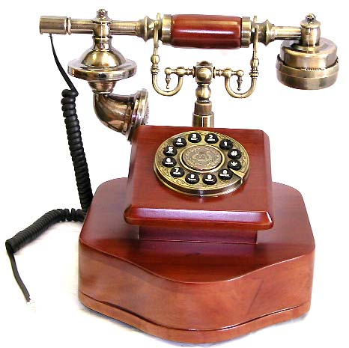
Circuit Switching (e.g., Phone Network)
Source establishes connection
  Reserve resources along hops in the path
Source sends data
  Transmit data over the established connection
Source tears down connection
  Free the resources for future connections

Slide 5
Circuit Switching: Static Allocation
Time-division
  Each circuit allocated
  certain time slots
Frequency-division
  Each circuit allocated certain frequencies
frequency
time
time

Slide 6
Packet Switching
Message divided into packets
  Header identifies the destination address
Packets travel separately through the network
  Forwarding based on the destination address
  Packets may be buffered temporarily
Destination reconstructs the message

Slide 7





Packet Switching:
Statistical (Time Division) Multiplexing
Packets
Intuition: Traffic by computer end-points is bursty!
  Versus: Telephone traffic not bursty (e.g., constant 56 kbps)
  One can use network while others idle
Packet queuing in network: tradeoff space for time
  Handle short periods when outgoing link demand > link speed
Notes:
STDM can be with cirtcuits (packets tagged with ID and preestablished state in switches) or with full packet switching (need full addressing in each packet)

Slide 8
Is Best Effort Good Enough?
Packet loss and delay
  Sender can resend
Packet corruption
  Receiver can detect, and sender can resend
Out-of-order delivery
  Receiver can put the data back in order
Packets follow different paths
  Doesn’t matter
Network failure
  Drop the packet
Network congestion
  Drop the packet

Slide 9
Packet (Y) vs. Circuit Switching (A)?
Predictable performance
Network never blocks senders
Reliable, in-order delivery
Low delay to send data
Simple forwarding
No overhead for packet headers
High utilization under most workloads
No per-connection network state
Circuit
Packet
Circuit
Packet
Circuit
Circuit
Packet
Packet

Slide 10
Network Addresses

Slide 11
IP Address (IPv4)
A unique 32-bit number
Identifies an interface (on a host, on a router, …)
Represented in dotted-quad notation
12
34
158
5
00001100
00100010
10011110
00000101

Slide 12
Grouping Related Hosts
The Internet is an “inter-network”
  Used to connect networks together, not hosts
  Need to address a network (i.e., group of hosts)
host
host
...
host
host
host
...
host
LAN 1
LAN 2
router
router
router
WAN
WAN
LAN = Local Area Network
WAN = Wide Area Network

Slide 13
Scalability Challenge
Suppose hosts had arbitrary addresses
  Then every router would need a lot of information
  …to know how to direct packets toward every host
1.2.3.4
5.6.7.8
2.4.6.8
1.2.3.5
5.6.7.9
2.4.6.9
host
host
...
host
host
host
...
host
LAN 1
LAN 2
router
router
router
WAN
WAN
1.2.3.4
1.2.3.5
forwarding table

Slide 14
Hierarchical Addressing: IP Prefixes
Network and host portions (left and right)
12.34.158.0/24 is a 24-bit prefix with 2⁸ addresses
12
34
158
5
00001100
00100010
10011110
00000101
Network (24 bits)
Host (8 bits)

Slide 15
Scalability Improved
Number related hosts from a common subnet
  1.2.3.0/24 on the left LAN
  5.6.7.0/24 on the right LAN
1.2.3.4
1.2.3.7
1.2.3.156
5.6.7.8
5.6.7.9
5.6.7.212
host
host
...
host
host
host
...
host
LAN 1
LAN 2
router
router
router
WAN
WAN
1.2.3.0/24
5.6.7.0/24
forwarding table

Slide 16
Easy to Add New Hosts
No need to update the routers
  E.g., adding a new host 5.6.7.213 on the right
  Doesn’t require adding a new forwarding-table entry
1.2.3.4
1.2.3.7
1.2.3.156
5.6.7.8
5.6.7.9
5.6.7.212
host
host
...
host
host
host
...
host
LAN 1
LAN 2
router
router
router
host
WAN
WAN
5.6.7.213
1.2.3.0/24
5.6.7.0/24
forwarding table

Slide 17
History of IP Address Allocation

Slide 18
Classful Addressing
In the olden days, only fixed allocation sizes
  Class A: 0*
    Very large /8 blocks (e.g., MIT has 18.0.0.0/8)
  Class B: 10*
    Large /16 blocks (e.g,. Princeton has 128.112.0.0/16)
  Class C: 110*
    Small /24 blocks (e.g., AT&T Labs has 192.20.225.0/24)
  Class D: 1110* for multicast groups
  Class E: 11110* reserved for future use
This is why folks use dotted-quad notation!

Slide 19
Classless Inter-Domain Routing (CIDR)
Use two 32-bit numbers to represent network:
  Network number = IP address + Mask
IP Address : 12.4.0.0 IP Mask: 255.254.0.0
Address
00001100
00000100
00000000
00000000
Mask
11111111
11111110
00000000
00000000
Network Prefix
for hosts
Written as 12.4.0.0/15

Slide 20
Hierarchical Address Allocation
Hierarchy is key to scalability
  Address allocated in contiguous chunks (prefixes)
  Today, the Internet has about 600-800,000 prefixes
12.0.0.0/16
12.1.0.0/16
:
:
:
12.3.0.0/24
12.2.0.0/16
12.3.1.0/24
12.3.0.0/16
:
:
:
:
:
12.0.0.0/8
12.3.254.0/24
12.253.0.0/19
12.253.32.0/19
:
:
12.254.0.0/16
12.253.160.0/19

Slide 21
Obtaining a Block of Addresses
Internet Corporation for Assigned Names and Numbers (ICANN)
  Allocates large blocks to Regional Internet Registries
Regional Internet Registries (RIRs)
  E.g., ARIN (American Registry for Internet Numbers)
  Allocates to ISPs and large institutions
Internet Service Providers (ISPs)
  Allocate address blocks to their customers
  Who may, in turn, allocate to their customers…
21

Slide 22
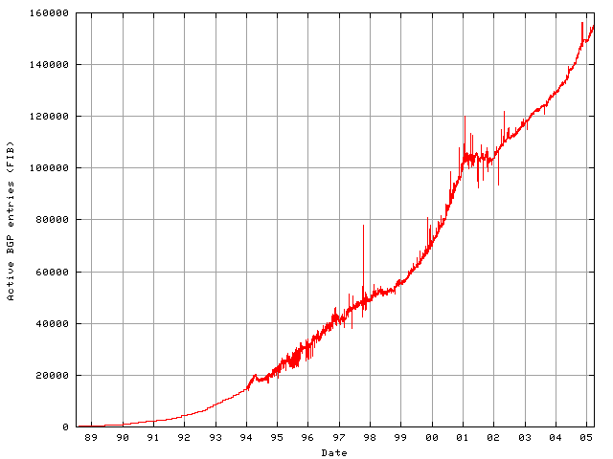
Long Term Growth (1989-2005)
Pre CIDR
CIDR’s
effect
DotCom
Boom
Post Boom

Slide 23
Long Term Growth (1989-2017)
Pre CIDR
CIDR’s
effect
DotCom

Slide 24
Packet Forwarding

Slide 25
Hop-by-Hop Packet Forwarding
Each router has a forwarding table
  Maps destination address to outgoing interface
Upon receiving a packet
  Inspect the destination address in the header
  Index into the table
  Determine the outgoing interface
  Forward the packet out that interface
Then, the next router in the path repeats

Slide 26
Separate Forwarding Entry Per Prefix
Prefix-based forwarding
  Map the destination address to matching prefix
  Forward to the outgoing interface
1.2.3.4
1.2.3.7
1.2.3.156
5.6.7.8
5.6.7.9
5.6.7.212
host
host
...
host
host
host
...
host
LAN 1
LAN
router
router
router
WAN
WAN
1.2.3.0/24
5.6.7.0/24
forwarding table

Slide 27
CIDR Makes Packet Forwarding Harder
Forwarding table may have many matches
  E.g., entries for 201.10.0.0/21 and 201.10.6.0/23
  The IP address 201.10.6.17 would match both!
201.10.0.0/21
201.10.6.0/23
Provider 1
Provider 2
201.10.0.0/22
201.10.4.0/24
201.10.5.0/24
201.10.6.0/23

Slide 28
Longest Prefix Match Forwarding
Destination-based forwarding
  Packet has a destination address
  Router identifies longest-matching prefix
  Cute algorithmic problem: very fast lookups
forwarding table
4.0.0.0/8
4.83.128.0/17
201.10.0.0/21
201.10.6.0/23
126.255.103.0/24
destination
201.10.6.17
outgoing link
Serial0/0.1

Slide 29
Creating a Forwarding Table
Entries can be statically configured
  E.g., “map 12.34.158.0/24 to Serial0/0.1”
But, this doesn’t adapt
  To failures
  To new equipment
  To the need to balance load
That is where the control plane comes in
  Routing protocols

Slide 30
Data, Control, & Management Planes
Processor
Switching
Fabric
 | Data | Control | Management
Time-scale | Packet (ns) | Event (10 ms to sec) | Human (min to hours)
Tasks | Forwarding, buffering, filtering, scheduling | Routing, signaling | Analysis, configuration
Location | Line-card hardware | Router software | Humans or scripts
30

Slide 31
Q’s: MAC vs. IP Addressing
Hierarchically allocated
    Y) MAC M) IP C) Both A) Neither
Organized topologically
  Y) MAC M) IP C) Both A) Neither
Forwarding via exact match on address
Y) MAC M) IP C) Both A) Neither
Automatically calculate forwarding by observing data
Y) Ethernet switches M) IP routers C) Both A) Neither
Per connection state in the network
Y) MAC M) IP C) Both A) Neither
Per host state in the network
Y) MAC M) IP C) Both A) Neither

Slide 32
Q’s: MAC vs. IP Addressing
Hierarchically allocated
    Y) MAC M) IP C) Both A) Neither
Organized topologically
  Y) MAC M) IP C) Both A) Neither
Forwarding via exact match on address
Y) MAC M) IP C) Both A) Neither
Automatically calculate forwarding by observing data
Y) Ethernet switches M) IP routers C) Both A) Neither
Per connection state in the network
Y) MAC M) IP C) Both A) Neither
Per host state in the network
Y) MAC M) IP C) Both A) Neither

Slide 33
IP Packet Format

Slide 34
IP Packet Structure
4-bit
Version
4-bit
Header
Length
8-bit
Type of Service
16-bit Total Length (Bytes)
16-bit Identification
3-bit
Flags
13-bit Fragment Offset
8-bit Time to
Live (TTL)
8-bit Protocol
16-bit Header Checksum
32-bit Source IP Address
32-bit Destination IP Address
Options (if any)
Payload

Slide 35
IP Header:
Transport Protocol
4-bit
Version
4-bit
Header
Length
8-bit
Type of Service
16-bit Total Length (Bytes)
16-bit Identification
3-bit
Flags
13-bit Fragment Offset
8-bit Time to
Live (TTL)
8-bit Protocol
16-bit Header Checksum
32-bit Source IP Address
32-bit Destination IP Address
Options (if any)
Protocol (8 bits)
  Identifies the higher-level protocol
    E.g., “6” for the Transmission Control Protocol (TCP)
    E.g., “17” for the User Datagram Protocol (UDP)
  Important for demultiplexing at receiving host
    Indicates what kind of header to expect next
Payload
protocol=6
protocol=17
IP header
IP header
TCP header
UDP header

Slide 36
IP Header:
Header Checksum
4-bit
Version
4-bit
Header
Length
8-bit
Type of Service
16-bit Total Length (Bytes)
16-bit Identification
3-bit
Flags
13-bit Fragment Offset
8-bit Time to
Live (TTL)
8-bit Protocol
16-bit Header Checksum
32-bit Source IP Address
32-bit Destination IP Address
Options (if any)
Checksum (16 bits)
  Sum of all 16-bit words in the header
  If header bits are corrupted, checksum won’t match
  Receiving discards corrupted packets
Payload
134
+ 212
= 346
Mismatch!
134
+ 216
= 350

Slide 37
IP Header:
Version, Length, ToS
4-bit
Version
4-bit
Header
Length
8-bit
Type of Service
16-bit Total Length (Bytes)
16-bit Identification
3-bit
Flags
13-bit Fragment Offset
8-bit Time to
Live (TTL)
8-bit Protocol
16-bit Header Checksum
32-bit Source IP Address
32-bit Destination IP Address
Options (if any)
Payload
Version number (4 bits)
  Necessary to know what other fields to expect
  Typically “4” (for IPv4), and sometimes “6” (for IPv6)
Header length (4 bits)
  Number of 32-bit words in the header
  Typically “5” (for a 20-byte IPv4 header)
  Can be more when “IP options” are used
Type-of-Service (8 bits)
  Allow different packets to be treated differently
  Low delay for audio, high bandwidth for bulk transfer

Slide 38
IP Header:
Length, Fragments, TTL
4-bit
Version
4-bit
Header
Length
8-bit
Type of Service
16-bit Total Length (Bytes)
16-bit Identification
3-bit
Flags
13-bit Fragment Offset
8-bit Time to
Live (TTL)
8-bit Protocol
16-bit Header Checksum
32-bit Source IP Address
32-bit Destination IP Address
Total length (16 bits)
  Number of bytes in the packet
  Max size is 63,535 bytes (2¹⁶ -1)
  … though most links impose smaller limits
Time-To-Live (8 bits)
  Used to identify packets stuck in forwarding loops
  … and eventually discard them from the network
Fragmentation information (32 bits)
  Supports dividing a large IP packet into fragments
  … in case a link cannot handle a large IP packet
Options (if any)
Payload

Slide 39
Conclusion
Best-effort global packet delivery
  Simple end-to-end abstraction
  Enables higher-level abstractions on top
  Doesn’t rely on much from the links below
IP addressing and forwarding
  Hierarchy for scalability and decentralized control
  Allocation of IP prefixes
  Longest prefix match forwarding
Next time: switches & routers

