Slide 1
Introduction Principles of System Design
COS 518: Advanced Computer Systems
Lecture 1
Mike Freedman

Slide 2
Goals of this course
Introduction to
Computer systems principles
Computer systems research
Historical and cutting-edge research
How “systems people” think
Learn how to
Read and evaluate papers
Give talks and evaluate talks
Perform basic system design and programming
Build and evaluate systems

Slide 3
What is a system?
System
Inside v. outside: defines interface with environment
A system achieves specific external behavior
A system has many components
This class is about the design of computer systems
Much of class will operate at the design level
Guarantees (semantics) exposed by components
Relationships of components
Internals of components that help structure
Notes:
Rather than giving you a direct definition, I’ll tell you three properties

Slide 4
Backrub (Google) 1997

Slide 5
Google 2012

Slide 6
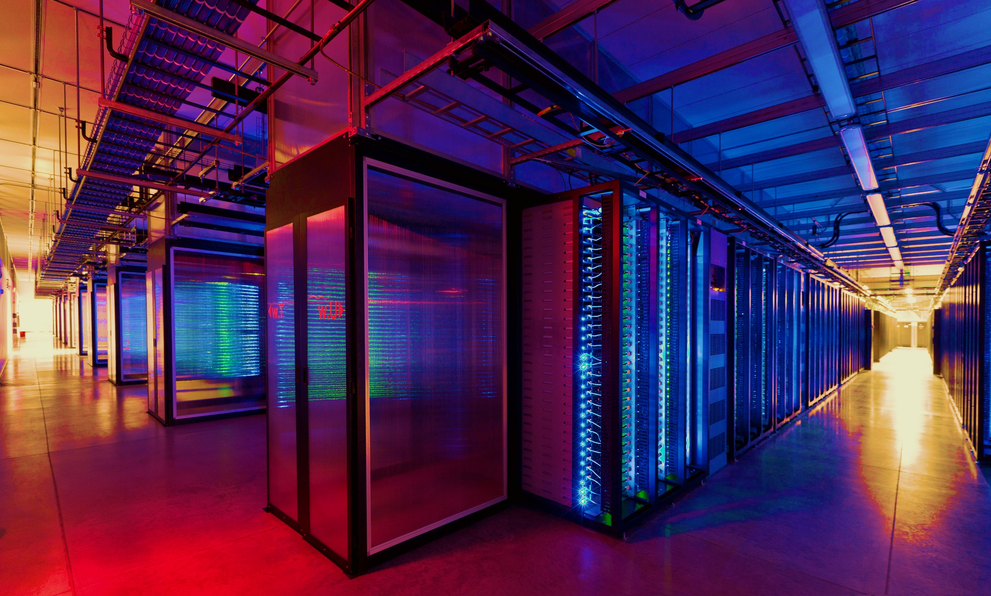
100,000s of physical servers
10s MW energy consumption
Facebook Prineville:
$250M physical infro, $1B IT infra

Slide 7
The central problem: Complexity
Complexity’s hard to define, but symptoms include:
Large number of components
Large number of connections
Irregular structure
No short description
Many people required to design or maintain

Slide 8
Course Organization

Slide 9
Learning the material
Instructors
Professor Mike Freedman
TA Zhenyu Song
Office hours immediately after lecture or by appt
Main Q&A forum: http://www.piazza.com/
Optional textbooks
Principles of Computer System Design. Saltzer & Kaashoek
Distributed Systems: Principles and Paradigms. Tanenbaum & Van Steen
Guide to Reliable Distributed Systems. Birman.

Slide 10
Format of Course
Introducing a subject
Lecture + occasional 1 background paper
Present lecture class before reading
Current research results
Signup to read 1 of ~2 papers per class
Before class: Carefully read selected paper
Beginning of class (before presentations): answer a few questions about readings (“quizlet”)
During class: 1 person presents, others add to discussion

Slide 11
Course Project: Schedule
Groups of 2 per project
Project schedule
Team selection (2/15)
Project proposal (3/1)
Finalized project (3/15)
Interim project presentation (4/3)
Final project presentation (before 5/13)
Final project report (5/14, Dean’s Date)

Slide 12
Course Project: Options
Choice #1: Reproducibility
Select paper from class (or paper on related topic)
Re-implement and carefully re-evaluate results
See detailed proposal instructions on webpage
Choice #2: Novelty (less common)
Must be in area closely related to 518 topics
We will take a narrow view on what’s permissible
Both approaches need working code, evaluation

Slide 13
Course Project: Process
Proposal selection process
See website for detailed instructions
Requires research and evaluation plan
Submit plan via Piazza, get feedback
For “novelty” track, important to talk with us early
Final report
Public blog-like post on design, eval, results
Source code published

Slide 14
Grading
15% paper presentation(s)
15% participation (in-class, Piazza)
20% in-class Q&A quizlets
50% project
10% proposal
40% final project

Slide 15
Organization of semester
Introduction / Background
Storage Systems
Big Data Systems
Applications

Slide 16
Storage Systems
Consistency
Consensus
Transactions
Database recovery and indexing
Column Stores
Modern storage technologies

Slide 17
Big Data Systems
Distributed queuing & Kafka
Batch processing & MapReduce
Stream processing
Approximate computing
Scheduling
Coding in systems

Slide 18
Applications
Distributed Hash Tables (DHTs)
Content Delivery Networks
Secure Systems
Blockchain and Decentralized Trust
Computing on Small Devices

Slide 19
Principles of System Design

Slide 20
Systems challenges common to many fields
Emergent properties (“surprises”)
Properties not evident in individual components become clear when combined into a system
Millennium bridge, London example

Slide 21
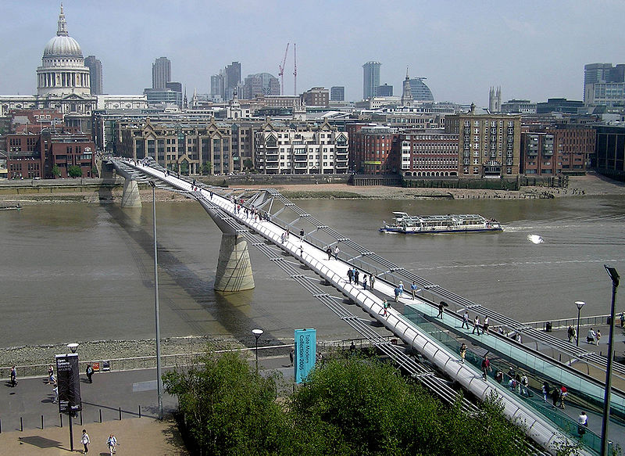
Notes:
Beautiful bridge, supposed to look like a “blade of light”
Opened in 2000 in London
Royal Institute of British Architects – very distinguished and prestigious architectural body had a competition for its design

Slide 22
Millennium bridge
Small lateral movements of the bridge causes synchronized stepping, which leads to swaying
Swaying leads to more forceful synchronized stepping, leading to more swaying
Positive feedback loop!
Nicknamed Wobbly Bridge after charity walk on Save the Children
Closed for two years soon after opening for modifications to be made (damping)

Slide 23
Systems challenges common to many fields
Emergent properties (“surprises”)
Propagation of effects
Small/local disruption → large/systemic effects
Automobile design example (S & K)
Notes:
(SEGUE: Auto design example on next slide)

Slide 24
Propagation of effects: Auto design
Want a better ride so increase tire size
Need larger trunk for larger spare tire space
Need to move the back seat forward to accommodate larger trunk
Need to make front seats thinner to accommodate reduced legroom in the back seats
Worse ride than before
Notes:
The point is that there is no small change!

Slide 25
Systems challenges common to many fields
Emergent properties (“surprises”)
Propagation of effects
Incommensurate scaling
Design for a smaller model may not scale

Slide 26
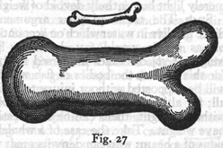
Galileo in 1638
“To illustrate briefly, I have sketched a bone whose natural length has been increased three times and whose thickness has been multiplied until, for a correspondingly large animal, it would perform the same function which the small bone performs for its small animal…
Thus a small dog could probably carry on his back two or three dogs of his own size; but I believe that a horse could not carry even one of his own size.”
—Dialog Concerning Two New Sciences, 2nd Day
Notes:
His overall point: things that work when small often don’t work when scaled up

Slide 27
Incommensurate scaling
Scaling a mouse into an elephant?
Volume grows in proportion to O(x³) where x is the linear measure
Bone strength grows in proportion to cross sectional area, O(x²)
[Haldane, “On being the right size”, 1928]
Real elephant requires different skeletal arrangement than the mouse

Slide 28
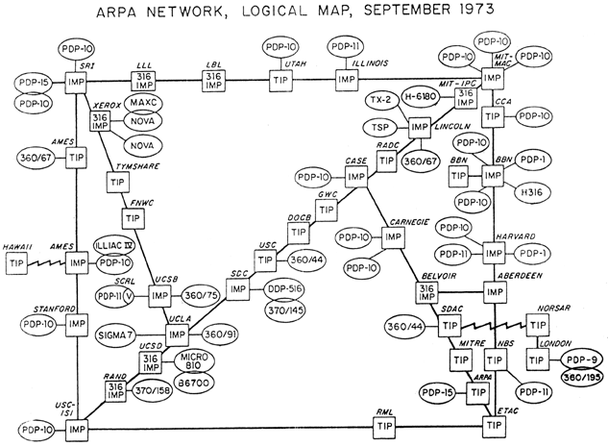
Incommensurate scaling: Scaling routing in the Internet
Just 39 hosts as the ARPA net back in 1973

Slide 29
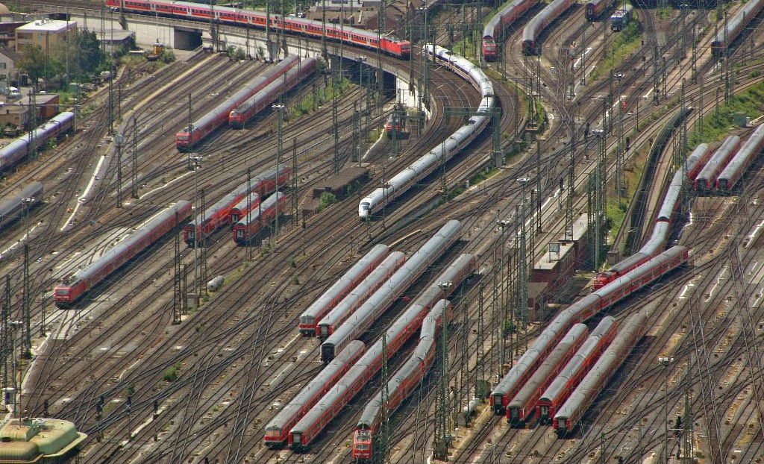
Incommensurate scaling: Scaling routing in the Internet
Total size of routing tables (for shortest paths): O(n²)
Today’s Internet: Techniques to cope with scale
Hierarchical routing on network numbers
32 bit address =16 bit network # and 16 bit host #
Limit # of hosts/network: Network address translation

Slide 30
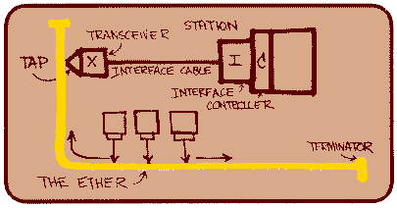
Incommensurate Scaling: Ethernet
All computers share single cable
Goal is reliable delivery
Listen-while-send to avoid collisions
Notes:
Ethernet is the most common LAN today.
For example those data jacks on the wall are Ethernet. My office phone.
Originally designed in early 1970s, has evolved since then.
You’ll study it later in the term, but here’s a preview of one of its subtle properties.
Mention 1km early, don’t mention speed of light until late.
The point: expect surprises!

Slide 31
Will listen-while-send detect collisions?
1 km at 60% speed of light is 5 μs
A can send 15 bits before first bit arrives at B
Thus A must keep sending for 2×5 μs
To detect collision if B sends when first bit arrives
Thus, min packet size is 2×5 μs×3 Mbit/s = 30 bits

Slide 32
From experimental Ethernet to standard
Experimental Ethernet design: 3 Mbit/s
Default header is 5 bytes = 40 bits
No problem with detecting collisions
First Ethernet standard: 10 Mbit/s
Must send for 2 × 20 μs = 400 bits
But header is just 112 bits
Need for a minimum packet size!
Solution: Pad packets to at least 50 bytes

Slide 33
Systems challenges common to many fields
Emergent properties (“surprises”)
Propagation of effects
Incommensurate scaling
Trade-offs
Many design constraints present as trade-offs
Improving one aspect of a system diminishes performance elsewhere

Slide 34
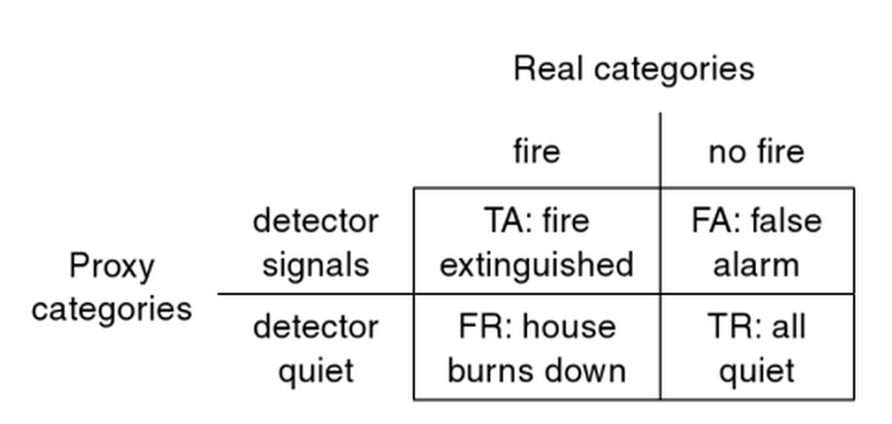
Binary classification trade-off
Have a proxy signal that imperfectly captures real signal of interest
Example: Household smoke detector
Notes:
Can trade-off the two different misclassification rates

Slide 35
Sources of complexity
Cascading and interacting requirements
Example: Telephone system
Features: Call Forwarding, reverse billing (900 numbers), Call Number Delivery Blocking, Automatic Call Back, Itemized Billing
A calls B, B forwards to 900 number, who pays?
A calls B, B is busy
Once B done, B calls A
A’s # appears on B’s bill
CNDB
ACB + IB
A
B
Notes:
first diagram: simple forwarding/forwarding interaction

Slide 36
Interacting Features
Each feature has a spec
An interaction is bad if feature X breaks feature Y
These bad interactions may be fixable…
But many interactions to consider: huge complexity
Perhaps more than n² interactions, e.g. triples
Cost of thinking about / fixing interaction gradually grows to dominate software costs
Complexity is super-linear

Slide 37
Sources of complexity
Cascading and interacting requirements
Maintaining high utilization of a scarce resource
Ex: Single-track railroad line through long canyon
Use pullout and signal to allow bidirectional op
But now need careful scheduling
Emergent property: Train length < pullout length
Notes:
first diagram: simple forwarding/forwarding interaction

Slide 38
Coping with complexity
Modularity
Divide system into modules, consider each separately
Well-defined interfaces give flexibility and isolation
Example: bug count in a large, N-line codebase
Bug count ∝ N
Debug time ∝ N × bug count ∝ N²
Now divide the N-line codebase into K modules
Debug time ∝ (N / K)² × K = N²/K
Notes:
How can we tackle complexity? First tool is modularity

Slide 39
Coping with complexity
Modularity
Abstraction
Ability of any module to treat others like “black box”
Just based on interface
Without regard to internal implementation
Symptoms
Fewer interactions between modules
Less propagation of effects between modules

Slide 40
Coping with complexity
Modularity
Abstraction
The Robustness Principle: Be tolerant of inputs and strict on outputs

Slide 41
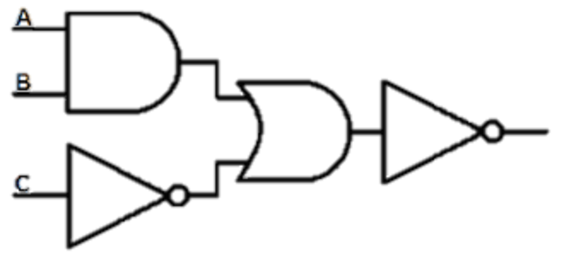
Robustness principle in action: The digital abstraction
Notes:
Example from digital circuits
Combine logic gates together to form a big combinatorial circuit like you see above
Challenge – noise degrades the signals from each logic gate

Slide 42
Coping with complexity
Modularity
Abstraction
Hierarchy
Start with small group of modules, assemble
Assemble those assemblies, etc.
Reduces connections, constraints, interactions

Slide 43
Coping with complexity
Modularity
Abstraction
Hierarchy
Layering
A form of modularity
Gradually build up a system, layer by layer
Example: Internet protocol stack

Slide 44
Layering on the Internet: The problem
Applications
HTTP
Skype
SSH
FTP
Transmission
media
Coaxial cable
Fiber optic
Wi-Fi
Re-implement every app for every new tx media?
Change apps on any change to tx media (+ vice versa)?
No! But how does the Internet design avoid this?

Slide 45
Layering on the Internet: Intermediate layers provide a solution
Applications
HTTP
Skype
SSH
FTP
Intermediate layers
Transmission
media
Coaxial cable
Fiber optic
Wi-Fi
Intermediate layers provide abstractions for app, media
New apps or media need only implement against intermediate layers’ interface
Notes:
Intermediate layers in this case is TCP and UDP running over IP, the Internet protocol

Slide 46
Computer systems: The same, but different
Often unconstrained by physical laws
Computer systems are mostly digital
Contrast: Analog systems have physical limitations (degrading copies of analog music media)
Back to the digital static discipline
Static discipline restores signal levels
Can scale microprocessors to billions of gates, encounter new, interesting emergent properties
Notes:
…like overheating!

Slide 47
Computer systems: The same, but different
Often unconstrained by physical laws
Unprecedented d(technology)/dt
Many examples:
Magnetic disk storage price per gigabyte
RAM storage price per gigabyte
Optical fiber transmission speed
Result: Incommensurate scaling, with system redesign consequences

Slide 48
Incommensurate scaling on the Internet
Normalized growth since 1981
Number of Internet hosts
Bits/second/$ (approximate)
Speed of light,
Shannon capacity,
Backhoe rental price
Notes:
Internet scaling is an example of this. Note the log scale on the y – axis!
Network getting bigger, protocols have to cope.
Incommensurate: unequal orders of magnitude
Amount of internet traffic.

Slide 49
Summary and lessons
Expect surprises in system design
There is no small change in a system
10-100× increase? ⇒ perhaps re-design
Complexity is super-linear in system size
Performance cost is super-linear in system size
Reliability cost is super-linear in system size
Technology’s high rate of change induces incommensurate scaling

Slide 50
For Wed, everybody reads 1) How to read a paper 2) Lampson’s Hints

