Slide 1
Content Distribution Networks
+ P2P File Sharing
COS 518: Advanced Computer Systems
Lecture 17
Mike Freedman

Slide 2
Single Server, Poor Performance
Single server
  Single point of failure
  Easily overloaded
  Far from most clients
Popular content
  Popular site
  “Flash crowd”
  Denial of Service attack

Slide 3
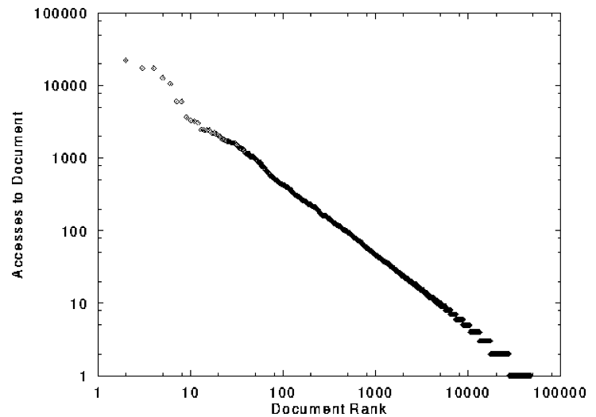
Skewed Popularity of Web Traffic
“Zipf” or “power-law” distribution
Characteristics of WWW Client-based Traces
Carlos R. Cunha, Azer Bestavros, Mark E. Crovella, BU-CS-95-01

Slide 4
Web Caching

Slide 5

Proxy Caches
5
origin
server
Proxy
server
HTTP request
HTTP request
client
HTTP response
HTTP response
HTTP request
HTTP response
client

Slide 6
Forward Proxy
Cache “close” to the client
  Under administrative control
  of client-side AS
Explicit proxy
  Requires configuring browser
Implicit proxy
  Service provider deploys an “on path” proxy
  … that intercepts and handles Web requests
Proxy
server
HTTP request
client
HTTP response
HTTP request
HTTP response
client

Slide 7
Reverse Proxy
origin
server
Cache “close” to server
  Either by proxy run by server or in third-party CDNs
Directing clients to the proxy
  Map the site name to the
  IP address of the proxy
Proxy
server
HTTP request
HTTP response
HTTP request
HTTP response
origin
server

Slide 8

Google Design
. .
.
Servers
Data Centers
Servers
Router
Router
Private Backbone
Reverse Proxy
Reverse Proxy
Internet
Requests
Client
Client
Client

Slide 9
Proxy Caches
(A) Forward (B) Reverse (C) Both (D) Neither
Reactively replicates popular content
  Reduces origin server costs
  Reduces client ISP costs
  Intelligent load balancing between origin servers
  Offload form submissions (POSTs) and user auth
  Content reassembly or transcoding on behalf of origin
Smaller round-trip times to clients
Maintain persistent connections to avoid TCP setup delay (handshake, slow start)

Slide 10
Proxy Caches
(A) Forward (B) Reverse (C) Both (D) Neither
Reactively replicates popular content (C)
  Reduces origin server costs (C)
  Reduces client ISP costs (A)
  Intelligent load balancing between origin servers (B)
  Offload form submissions (POSTs) and user auth (D)
  Content reassembly, transcoding on behalf of origin (C)
Smaller round-trip times to clients (C)
Maintain persistent connections to avoid TCP setup delay (handshake, slow start) (C)

Slide 11
Limitations of Web Caching
Much content is not cacheable
  Dynamic data: stock prices, scores, web cams
  CGI scripts: results depend on parameters
  Cookies: results may depend on passed data
  SSL: encrypted data is not cacheable
  Analytics: owner wants to measure hits
Stale data
  Or, overhead of refreshing the cached data

Slide 12
Modern HTTP Video-on-Demand
Download “content manifest” from origin server
List of video segments belonging to video
  Each segment 1-2 seconds in length
  Client can know time offset associated with each
  Standard naming for different video resolutions and formats: e.g., 320dpi, 720dpi, 1040dpi, …
Client downloads video segment (at certain resolution) using standard HTTP request.
  HTTP request can be satisfied by cache: it’s a static object
Client observes download time vs. segment duration, increases/decreases resolution if appropriate

Slide 13
What about large files?

Slide 14

Peer-to-Peer Networks: BitTorrent
BitTorrent history
  2002: B. Cohen debuted BitTorrent
Emphasis on efficient fetching, not searching
  Distribute same file to many peers
  Single publisher, many downloaders
Preventing free-loading
  Incentives for peers to contribute

Slide 15
BitTorrent: Simultaneous Downloads
Divide file into many chunks (e.g., 256 KB)
  Replicate different chunks on different peers
  Peers can trade chunks with other peers
  Peer can (hopefully) assemble the entire file
Allows simultaneous downloading
  Retrieving different chunks from different peers
  And uploading chunks to peers
  Important for very large files

Slide 16
BitTorrent: Tracker
Infrastructure node
  Keeps track of peers participating in the torrent
  Peers registers with the tracker when it arrives
Tracker selects peers for downloading
  Returns a random set of peer IP addresses
  So the new peer knows who to contact for data
Can have “trackerless” system
  Using distributed hash tables (DHTs)

Slide 17
BitTorrent: Overall Architecture
Web Server
Tracker
Web page
with link
to .torrent
.torrent
C
A
Peer
[Seed]
Peer
[Leech]
Downloader
“US”
B
Peer
[Leech]

Slide 18
BitTorrent: Overall Architecture
Web Server
Tracker
Web page
with link
to .torrent
Get-announce
C
A
Peer
[Seed]
Peer
[Leech]
Downloader
“US”
B
Peer
[Leech]

Slide 19
BitTorrent: Overall Architecture
Web Server
Tracker
Web page
with link
to .torrent
Response-peer list
C
A
Peer
[Seed]
Peer
[Leech]
Downloader
“US”
B
Peer
[Leech]

Slide 20
BitTorrent: Overall Architecture
Web Server
Tracker
Web page
with link
to .torrent
Shake-hand
C
A
Peer
[Seed]
Peer
[Leech]
Downloader
“US”
Shake-hand
B
Peer
[Leech]

Slide 21
BitTorrent: Overall Architecture
Web Server
Tracker
Web page
with link
to .torrent
pieces
C
A
pieces
Peer
[Seed]
Peer
[Leech]
Downloader
“US”
B
Peer
[Leech]

Slide 22
BitTorrent: Overall Architecture
Web Server
Tracker
Web page
with link
to .torrent
pieces
C
A
pieces
Peer
[Seed]
Peer
[Leech]
Downloader
“US”
pieces
B
Peer
[Leech]

Slide 23
BitTorrent: Overall Architecture
Web Server
Tracker
Web page
with link
to .torrent
Get-announce
Response-peer list
pieces
C
A
pieces
Peer
[Seed]
Peer
[Leech]
Downloader
“US”
pieces
B
Peer
[Leech]

Slide 24
BitTorrent: Chunk Request Order
Which chunks to request?
  Could download in order
  Like an HTTP client does
Problem: many peers have the early chunks
  Peers have little to share with each other
  Limiting the scalability of the system
Problem: eventually nobody has rare chunks
  E.g., the chunks need the end of the file
  Limiting the ability to complete a download
Solutions: random selection and rarest first

Slide 25
BitTorrent: Rarest Chunk First
Which chunks to request first?
  Chunk with fewest available copies (i.e., rarest chunk)
Benefits to the peer
  Avoid starvation when some peers depart
Benefits to the system
  Avoid starvation across all peers wanting a file
  Balance load by equalizing # of copies of chunks

Slide 26
Free-Riding in P2P Networks
Vast majority of users are free-riders
  Most share no files and answer no queries
  Others limit # of connections or upload speed
A few “peers” essentially act as servers
  A few individuals contributing to the public good
  Making them hubs that basically act as a server
BitTorrent prevent free riding
  Allow the fastest peers to download from you
  Occasionally let some free loaders download

Slide 27
Bit-Torrent: Preventing Free-Riding
Peer has limited upload bandwidth
  And must share it among multiple peers
  Tit-for-tat: favor neighbors uploading at highest rate
Rewarding the top four neighbors
  Measure download bit rates from each neighbor
  Reciprocate by sending to the top four peers
Optimistic unchoking
  Randomly try a new neighbor every 30 seconds
  So new neighbor has a chance to be a better partner

Slide 28
Conclusion
Content distribution is hard
  Many, diverse, changing objects
  Clients distributed all over the world
  Reducing latency is king
Contribution distribution solutions
  Reactive caching, proactive CDNs
BitTorrent
  Distributed download of large files
  Anti-free-riding techniques
Great example of how change can happen quickly in application-level protocols

