Slide 1
Topic 12: Register Allocation
COS 320
Compiling Techniques
Princeton University Spring 2016
Lennart Beringer

Slide 2
Structure of backend
Register allocation
assigns machine registers (finite supply!) to virtual registers
based on liveness analysis: interference graph
primary approach: graph coloring
spilling
needed in case of insufficient supply of machine registers
idea: hold values in memory (stack frame)
transfer to/from registers to perform arithmetic ops, conditional branches, …
architecture-specific requirements:
caller/callee-save
floating point vs integer, …

Slide 3
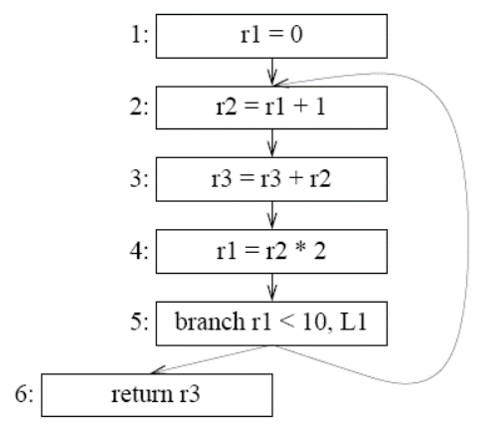
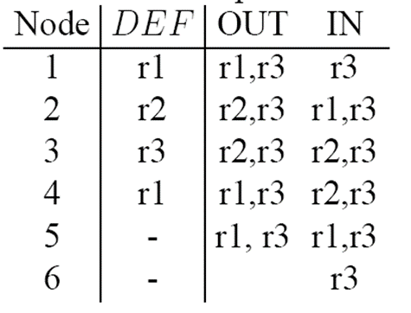
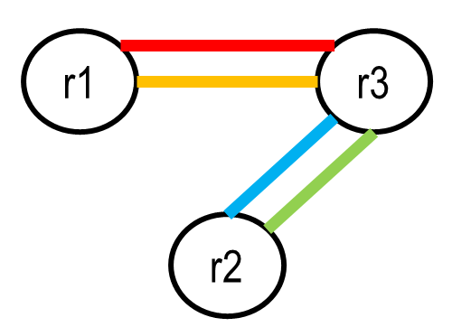
Recap: interference graph
Liveness conflicts: virtual registers x and y interfere if there is a node n in the CFG such that x and y are both LiveOut at n.
Representation: conflict/interference graph:
each virtual register represented by one node
Interference between x and y: undirected edge between nodes x and y

Slide 4
Interference graph: optimization for MOVEs
n₁:
t ← s (*move*)
Virtual registers s and t
are both live-out at n₁
hence interfere formally
will hence be assigned different registers
n₂:
x ← . . . s . . . (*use of s*)
s
t
n₃:
y ← . . . t . . . (*use of t*)
But: we’d like them to share a register, and to eliminate the move instruction!
Solution: treat move instructions differently during interference analysis
For
n:
a ← c (*move*)
and liveOut(n) = {b₁, …, b_{k}}, only add edges for those b_{i} that are different from c.
a
b_{i}

Slide 5
Graph coloring using Kempe’s heuristics (1879)
Observation:
suppose G has a node m with < K neighbors
if G – {m} can be K-1 colored, G can be K-colored:
m’s neighbors use at most K-1 colors in G - {m}
so can reinsert m into G and select a color
remove a node of degree < 6
color the remaining graph
K = 6
reinsert the node and select a color
➔ recursive (stack-based) algorithm

Slide 6
Optimistic coloring using Kempe
Build
construct interference graph

Slide 7
Optimistic coloring using Kempe
Build
construct interference graph
Simplify
repeatedly remove nodes of degree < K
push removed nodes on stack
each removal reduces degree of other nodes!

Slide 8
Optimistic coloring using Kempe
Build
construct interference graph
Simplify
repeatedly remove nodes of degree < K
push removed nodes on stack
each removal reduces degree of other nodes!
simplify fails if all nodes have degree >= K
select a node n for (potential) spilling
remove n from G, and push n into onto stack
Spill

Slide 9
Optimistic coloring using Kempe
Build
construct interference graph
Simplify
repeatedly remove nodes of degree < K
push removed nodes on stack
each removal reduces degree of other nodes!
simplify fails if all nodes have degree >= K
select a node n for (potential) spilling
remove n from G, and push n into onto stack
Spill
starting from empty graph, successively pop nodes, select color, and add node back into graph
when a potential spill node is popped:
all K neighbors have different color → actual spill; don’t assign color but continue selecting to identify other spills
the K neighbors use < K colors → use the free color - spill did not need to be realized (“optimistic coloring”)
Select

Slide 10
Optimistic coloring using Kempe
Build
construct interference graph
Simplify
repeatedly remove nodes of degree < K
push removed nodes on stack
each removal reduces degree of other nodes!
Start over
When all required spills have been identified
rewrite program: realize spills
recompute liveness – live ranges of spills typically short
simplify fails if all nodes have degree >= K
select a node n for (potential) spilling
remove n from G, and push n into onto stack
Spill
starting from empty graph, successively pop nodes, select color, and add node back into graph
when a potential spill node is popped:
all K neighbors have different color → actual spill; don’t assign color but continue selecting to identify other spills
the K neighbors use < K colors → use the free color - spill did not need to be realized (“optimistic coloring”)
Select

Slide 11
Basic coloring: example (K = 4)
// liveIn: k, j g := M [ j+12 ]
h := k – 1
f = g * h
e := M [ j + 8 ]
m := M [ j + 16 ]
b := M [ f ]
c := e + 8
d := c
k := m + 4
j := b
// liveOut d k j
f
move (relevant later)
interference
e
j
b
m
k
g
c
h
d

Slide 12
Basic coloring: example (K = 4)
// liveIn: k, j g := M [ j+12 ]
h := k – 1
f = g * h
e := M [ j + 8 ]
m := M [ j + 16 ]
b := M [ f ]
c := e + 8
d := c
k := m + 4
j := b
// liveOut d k j
f
move (relevant later)
interference
e
j
b
m
k
g
c
h
d
Nodes of degree < K: c, g, h, f
→
push g, h

Slide 13
Basic coloring: example (K = 4)
// liveIn: k, j g := M [ j+12 ]
h := k – 1
f = g * h
e := M [ j + 8 ]
m := M [ j + 16 ]
b := M [ f ]
c := e + 8
d := c
k := m + 4
j := b
// liveOut d k j
f
move (relevant later)
interference
e
j
b
m
k
g
c
h
d
Nodes of degree < K: c, f
→
push g, h
Next: push k, d, j, e, f, b, c

Slide 14
Basic coloring: example (K = 4)
// liveIn: k, j g := M [ j+12 ]
h := k – 1
f = g * h
e := M [ j + 8 ]
m := M [ j + 16 ]
b := M [ f ]
c := e + 8
d := c
k := m + 4
j := b
// liveOut d k j
f
move (relevant later)
interference
e
j
b
m
k
g
c
h
d
Nodes of degree < K: m
→
push g, h, k, d, j, e, f, b, c
Next: push m, pop m

Slide 15
Basic coloring: example (K = 4)
// liveIn: k, j g := M [ j+12 ]
h := k – 1
f = g * h
e := M [ j + 8 ]
m := M [ j + 16 ]
b := M [ f ]
c := e + 8
d := c
k := m + 4
j := b
// liveOut d k j
f
move (relevant later)
interference
e
j
b
m
k
g
c
h
d
Nodes of degree < K:
→
push g, h, k, d, j, e, f, b, c
Next: pop c, b, f

Slide 16
Basic coloring: example (K = 4)
// liveIn: k, j g := M [ j+12 ]
h := k – 1
f = g * h
e := M [ j + 8 ]
m := M [ j + 16 ]
b := M [ f ]
c := e + 8
d := c
k := m + 4
j := b
// liveOut d k j
f
move (relevant later)
interference
e
j
b
m
k
g
c
h
d
Nodes of degree < K:
→
push g, h, k, d, j, e
Next: pop e, j, d

Slide 17
Basic coloring: example (K = 4)
// liveIn: k, j g := M [ j+12 ]
h := k – 1
f = g * h
e := M [ j + 8 ]
m := M [ j + 16 ]
b := M [ f ]
c := e + 8
d := c
k := m + 4
j := b
// liveOut d k j
f
move (relevant later)
interference
e
j
b
m
k
g
c
h
d
Nodes of degree < K:
→
push g, h, k
Next: pop k, h, g

Slide 18
Basic coloring: example (K = 4)
// liveIn: k, j g := M [ j+12 ]
h := k – 1
f = g * h
e := M [ j + 8 ]
m := M [ j + 16 ]
b := M [ f ]
c := e + 8
d := c
k := m + 4
j := b
// liveOut d k j
f
move (relevant later)
interference
e
j
b
m
k
g
c
h
d
Nodes of degree < K:
→
Stack empty
Done – no spilling needed

Slide 19
Register coalescing
Nodes in the conflict graph can be coalesced, provided that they don’t interfere;
edges of coalesced node = union of edges associated with original nodes
a
c
a
bc
b
In particular: if source and dest of a move don’t interfere, coalescing allows one to eliminate the move instruction.

Slide 20
Register coalescing
Nodes in the conflict graph can be coalesced, provided that they don’t interfere;
edges of coalesced node = union of edges associated with original nodes
a
c
a
bc
b
In particular: if source and dest of a move don’t interfere, coalescing allows one to eliminate the move instruction.
But: coalescing before coloring may make graph not colorable!
a
c
a
c
a
Example:
is 2-colorable:
. But
is not.
b
d
b
d
b
cd

Slide 21
Safe coalescing heuristics: Briggs
Coalesce nodes that don’t interfere, provided that the resulting merged node has less than K neighbors of degree ≥ K.
a
c
a
Don’t merge c with d, since deg(a)=deg(b) = 2 in
Example:
.
b
d
b
cd

Slide 22
Safe coalescing heuristics: Briggs
Coalesce nodes that don’t interfere, provided that the resulting merged node has less than K neighbors of degree ≥ K.
a
c
a
Don’t merge c with d, since deg(a)=deg(b) = 2 in
Example:
.
b
d
b
cd
Why is this safe?

Slide 23
Safe coalescing heuristics: Briggs
Coalesce nodes that don’t interfere, provided that the resulting merged node has less than K neighbors of degree ≥ K.
a
c
a
Don’t merge c with d, since deg(a)=deg(b) = 2 in
Example:
.
b
d
b
cd
Why is this safe?
after simplification, all nodes of degree < K have been eliminated

Slide 24
Safe coalescing heuristics: Briggs
Coalesce nodes that don’t interfere, provided that the resulting merged node has less than K neighbors of degree ≥ K.
a
c
a
Don’t merge c with d, since deg(a)=deg(b) = 2 in
Example:
.
b
d
b
cd
Why is this safe?
after simplification, all nodes of degree < K have been eliminated
so only high-degree neighbors of merge remain

Slide 25
Safe coalescing heuristics: Briggs
Coalesce nodes that don’t interfere, provided that the resulting merged node has less than K neighbors of degree ≥ K.
a
c
a
Don’t merge c with d, since deg(a)=deg(b) = 2 in
Example:
.
b
d
b
cd
Why is this safe?
after simplification, all nodes of degree < K have been eliminated
so only high-degree neighbors of merge remain
if there are < K of such neighbors, the degree of the merge is < K, so we can simplify merge
Hence, merging does not render a colorable graph incolorable.

Slide 26
Safe coalescing heuristics: George
Coalesce noninterfering nodes x and y only if every neighbor t of x already interferes with y or is of degree < K.
a
c
Don’t merge c with d, since deg(a)= 2 and a does not yet interfere with d. Similarly, don’t merge d with c, since . . .
Example:
b
d

Slide 27
Safe coalescing heuristics: George
Coalesce noninterfering nodes x and y only if every neighbor t of x already interferes with y or is of degree < K.
a
c
Don’t merge c with d, since deg(a)= 2 and a does not yet interfere with d. Similarly, don’t merge d with c, since . . .
Example:
b
d
Why is this safe?

Slide 28
Safe coalescing heuristics: George
Coalesce noninterfering nodes x and y only if every neighbor t of x already interferes with y or is of degree < K.
a
c
Don’t merge c with d, since deg(a)= 2 and a does not yet interfere with d. Similarly, don’t merge d with c, since . . .
Example:
b
d
Why is this safe?
let S be the set of neighbors of x in G that have degree < K

Slide 29
Safe coalescing heuristics: George
Coalesce noninterfering nodes x and y only if every neighbor t of x already interferes with y or is of degree < K.
a
c
Don’t merge c with d, since deg(a)= 2 and a does not yet interfere with d. Similarly, don’t merge d with c, since . . .
Example:
b
d
Why is this safe?
let S be the set of neighbors of x in G that have degree < K
if coalescing is not performed, all nodes in S simplify, leaving a reduced graph G₁

Slide 30
Safe coalescing heuristics: George
Coalesce noninterfering nodes x and y only if every neighbor t of x already interferes with y or is of degree < K.
a
c
Don’t merge c with d, since deg(a)= 2 and a does not yet interfere with d. Similarly, don’t merge d with c, since . . .
Example:
b
d
Why is this safe?
let S be the set of neighbors of x in G that have degree < K
if coalescing is not performed, all nodes in S simplify, leaving a reduced graph G₁
if coalescing is performed, simplify also removes all nodes in S: each s є S is of degree < K or is already adjacent to both x and y in G, so still simplifies after merging of x and y

Slide 31
Safe coalescing heuristics: George
Coalesce noninterfering nodes x and y only if every neighbor t of x already interferes with y or is of degree < K.
a
c
Don’t merge c with d, since deg(a)= 2 and a does not yet interfere with d. Similarly, don’t merge d with c, since . . .
Example:
b
d
Why is this safe?
let S be the set of neighbors of x in G that have degree < K
if coalescing is not performed, all nodes in S simplify, leaving a reduced graph G₁
if coalescing is performed, simplify also removes all nodes in S: each s є S is of degree < K or is already adjacent to both x and y in G, so still simplifies after merging of x and y
the resulting G₂ is a subgraph of G₁ (“merge” in G₂ corresponds to y in G₁), so if G₁ can be colored, so can G₂
Again, merging does not render a colorable graph incolorable.

Slide 32
Safe coalescing heuristics: Briggs, George
Both heuristics are conservative:
we may miss some opportunities to coalesce (HW: example?)
specifically, we may fail to eliminate some move instructions
but that’s preferable to not coalescing at all, which results in more spills; spills significantly more expensive (time: load+store versus move; space)

Slide 33
Safe coalescing heuristics: Briggs, George
Both heuristics are conservative:
we may miss some opportunities to coalesce (HW: example?)
specifically, we may fail to eliminate some move instructions
but that’s preferable to not coalescing at all, which results in more spills; spills significantly more expensive (time: load+store versus move; space)
→ interleaving simplify with coalescing eliminates many moves, while still avoiding many spills. Thus, refine our allocation procedure:

Slide 34
Safe coalescing heuristics: Briggs, George
Both heuristics are conservative:
we may miss some opportunities to coalesce (HW: example?)
specifically, we may fail to eliminate some move instructions
but that’s preferable to not coalescing at all, which results in more spills; spills significantly more expensive (time: load+store versus move; space)
→ interleaving simplify with coalescing eliminates many moves, while still avoiding many spills. Thus, refine our allocation procedure:
Build
Simplify
Coalesce
construct interference graph
mark nodes that are the src or dest or a move
conservative: use Briggs or George
simplify reduced many degrees, so many opportunities
delete move instructions involved in coalescing
correct “move-related” classification of merged node if necessary
back to simplification!
successively remove nodes that
are of degree < K, and
are not move-related

Slide 35
Allocation with coalescing: freezing
Build
Simplify
Coalesce
Freeze
NEW PHASE:
select a low-degree node n that is marked move-related
mark it non-move-related
“give up hope to ever coalesce it”
also mark n’s move-partner non-move-related, unless it participates in some other move(s)
back to simplify: at least the now unmarked nodes can be simplified

Slide 36
Allocation with coalescing: completing the algorithm
Remaining phases as before:
push
simplify/coalesce exhausted
Build
Simplify
Coalesce
low-degree nodes exhausted
rewrite program, recompute interferences
Actual spill / start over
Freeze
push potential spill node
no freezable node of low degree
remember realization of spill
but keep selecting
Select
(Potential) spill
no actual spill
graph empty
pop node, select color

Slide 37
Coloring with coalescing: example (K = 4)
// liveIn: k, j g := M [ j+12 ]
h := k – 1
f = g * h
e := M [ j + 8 ]
m := M [ j + 16 ]
b := M [ f ]
c := e + 8
d := c
k := m + 4
j := b
// liveOut d k j
f
move
interference
e
j
b
m
k
g
c
h
d
Non-marked nodes of degree < K: g, h, f
→
push g, h, k

Slide 38
Coloring with coalescing: example (K = 4)
// liveIn: k, j g := M [ j+12 ]
h := k – 1
f = g * h
e := M [ j + 8 ]
m := M [ j + 16 ]
b := M [ f ]
c := e + 8
d := c
k := m + 4
j := b
// liveOut d k j
f
move
interference
e
j
b
m
k
g
c
h
d
could still simplify f instead!
Non-marked nodes of degree < K: f
Next: coalesce c & d
→
push g, h, k
George: all neighbors of c already interfere with d
Briggs: merged node has < K neighbors of degree ≥ K

Slide 39
Coloring with coalescing: example (K = 4)
// liveIn: k, j g := M [ j+12 ]
h := k – 1
f = g * h
e := M [ j + 8 ]
m := M [ j + 16 ]
b := M [ f ]
c := e + 8
d := c
k := m + 4
j := b
// liveOut d k j
f
move
interference
e
j
b
m
k
g
h
c&d
could still simplify f instead!
Non-marked nodes of degree < K: f
Next: coalesce j & b
→
push g, h, k
Briggs: merged node has < K neighbors of degree ≥ K

Slide 40
Coloring with coalescing: example (K = 4)
// liveIn: k, j g := M [ j+12 ]
h := k – 1
f = g * h
e := M [ j + 8 ]
m := M [ j + 16 ]
b := M [ f ]
c := e + 8
d := c
k := m + 4
j := b
// liveOut d k j
f
move
interference
e
j&b
m
k
g
h
c&d
Non-marked nodes of degree < K: f, e, c&d
Next: push c&d, j&b, f, m, e
→
push g, h, k
pop e

Slide 41
Coloring with coalescing: example (K = 4)
// liveIn: k, j g := M [ j+12 ]
h := k – 1
f = g * h
e := M [ j + 8 ]
m := M [ j + 16 ]
b := M [ f ]
c := e + 8
d := c
k := m + 4
j := b
// liveOut d k j
f
move
interference
e
j&b
m
k
g
h
c&d
Non-marked nodes of degree < K:
Next: pop m, f, j&b, c&d
→
push g, h, k, c&d, j&b, f, m

Slide 42
Coloring with coalescing: example (K = 4)
// liveIn: k, j g := M [ j+12 ]
h := k – 1
f = g * h
e := M [ j + 8 ]
m := M [ j + 16 ]
b := M [ f ]
c := e + 8
d := c
k := m + 4
j := b
// liveOut d k j
f
move
interference
e
j&b
m
k
g
h
c&d
Non-marked nodes of degree < K:
Next: pop k, h, g
→
push g, h, k

Slide 43
Coloring with coalescing: example (K = 4)
// liveIn: k, j g := M [ j+12 ]
h := k – 1
f = g * h
e := M [ j + 8 ]
m := M [ j + 16 ]
b := M [ f ]
c := e + 8
d := c
k := m + 4
j := b
// liveOut d k j
f
move
interference
e
j&b
m
k
g
h
c&d
Done

Slide 44
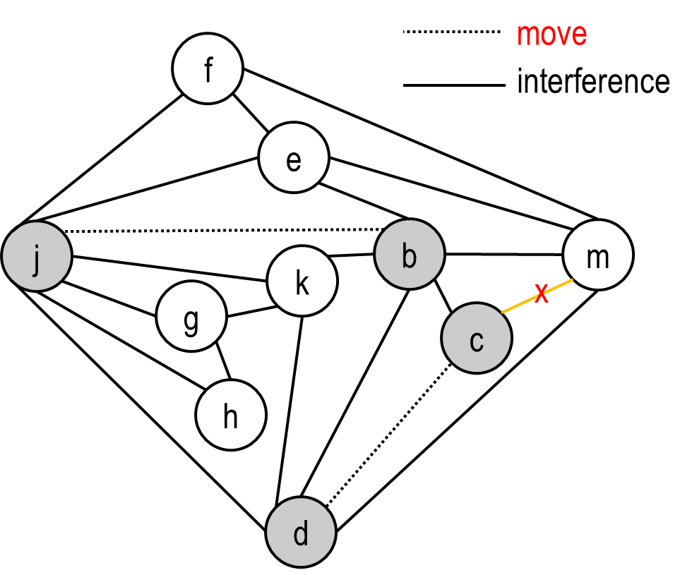
Spilling heuristics
// liveIn: k, j g := M [ j+12 ]
h := k – 1
f = g * h
e := M [ j + 8 ]
m := M [ j + 16 ]
M [ m_{loc} ] := m
b := M [ f ]
c := e + 8
d := c
m := M [ m_{loc} ]
k := m + 4
j := b
// liveOut d k j
splits single large liveness range of m into two short liveness ranges
eliminates interference c ←→ m
SPILL m
General heuristics: spill nodes that
have high degree, but few uses
particularly if the live-range is long but sparse

Slide 45
Spilling heuristics
// liveIn: k, j g := M [ j+12 ]
h := k – 1
f = g * h
e := M [ j + 8 ]
m := M [ j + 16 ]
M [ m_{loc} ] := m
b := M [ f ]
c := e + 8
d := c
m := M [ m_{loc} ]
k := m + 4
j := b
// liveOut d k j
splits single large liveness range of m into two short liveness ranges
eliminates interference c ←→ m
SPILL m

Slide 46
Spilling heuristics
Naïve spilling: when rewriting program, undo all register coalescing
Improvement: remember all coalescing done before the first potential spill was discovered – they will tend to be rediscovered -- but undo the later coalescings.

Slide 47
Spilling heuristics
Naïve spilling: when rewriting program, undo all register coalescing
Improvement: remember all coalescing done before the first potential spill was discovered – they will tend to be rediscovered -- but undo the later coalescings.
Coalescing spills:
many spill locations → large stack frames
don’t need to keep spill locations apart if their virtual registers don’t interfere!
further benefit: eliminate spill-to-spill-moves: a ←b when both a and b are spilled: t ← M [b_{loc}]; M[a_{loc}] ← t (typo in MCIL here – see errata list!)
Hence, can use coloring to minimize spill locations:
infinitely many colors: no bound on size of frame
liveness info yields interference between spilled nodes
first, coalesce all spill nodes related by moves
then, simplify and select (try to reuse colors)
resulting # colors is # spill locations
All done during “Start Over”, before spill code is generated and new register interference is computed

Slide 48
Precolored temporaries / nodes
some temporaries correspond directly to machine registers: stack / frame pointer, standard argument registers 1 & 2, …
these special temporaries implicitly interfere with each other
but: ordinary temporaries can share color with precolored node (see example below)

Slide 49
Precolored temporaries / nodes
some temporaries correspond directly to machine registers: stack / frame pointer, standard argument registers 1 & 2, …
these special temporaries implicitly interfere with each other
but: ordinary temporaries can share color with precolored node (see example below)
K-register machine:
introduce precolored K nodes, all interfering with each other
liveness range of special-purpose registers (frame pointer etc) interfere with all ordinary temporaries that are live
general-purpose registers have no additional interferences
precolored nodes can’t be simplified (they already have a color!), and can’t be spilled (they are registers!)
hence, consider them to be of infinite degree and start selection phase not from empty graph but graph of precolored nodes
to keep live ranges of precolored nodes short, front-end can “copy them away”, to freshly introduced temps

Slide 50
“Copying away” precolored temporaries
suppose register r7 is callee-save:
considering function entry as definition of r7, and function exit as use ensures it’s live throughout the body, so it will be preserved
but: we don’t want to block the callee-save-register color for the entire body
entry: def(r7) :
exit: use(r7)

Slide 51
“Copying away” precolored temporaries
suppose register r7 is callee-save:
considering function entry as definition of r7, and function exit as use ensures it’s live throughout the body, so it will be preserved
but: we don’t want to block the callee-save-register color for the entire body
so: introduce a new temporary t and insert moves
if register pressure is low, allocator will coalesce and eliminate moves
if register pressure is high, allocator will spill
entry: def(r7) :
exit: use(r7)
entry: def(r7)
t ← r7 :
r7 ← t
exit: use(r7)

Slide 52
“Copying away” precolored temporaries
suppose register r7 is callee-save:
considering function entry as definition of r7, and function exit as use ensures it’s live throughout the body, so it will be preserved
but: we don’t want to block the callee-save-register color for the entire body
so: introduce a new temporary t and insert moves
if register pressure is low, allocator will coalesce and eliminate moves
if register pressure is high, allocator will spill
entry: def(r7) :
exit: use(r7)
entry: def(r7)
t ← r7 :
r7 ← t
exit: use(r7)
Note: the thus introduced temps t (one for each callee-save register) interfere with each other, with “later” other callee-save regs, and with most variables defined + used in the body, and are hence of “high degree and low #uses”.
entry: def(r7, r8)
t ← r7
u ← r8
:
r8 ← u
r7 ← t
exit: use(r7, r8)
t
u
r8
r7

Slide 53
Liveness-across-call and caller/callee-save preference
Temporary x is not live across the call to f
allocating x to a callee-save register r will force body of f to store r away to some t (previous slide), and restore r before returning
but caller does not need x
Body of g():
:
x := 5
y := x + 1
z := f ()
return z + y

Slide 54
Liveness-across-call and caller/callee-save preference
Temporary x is not live across the call to f
allocating x to a callee-save register r will force body of f to store r away to some t (previous slide), and restore r before returning
but caller does not need x
prefer allocation of x to caller-save register s:
callee f is free to overwrite s
that’s ok: x is not used after function return
caller even does not even need to store s away prior to call – and knows this (liveness info)
Body of g():
:
x := 5
y := x + 1
z := f ()
return z + y

Slide 55
Liveness-across-call and caller/callee-save preference
Temporary x is not live across the call to f
allocating x to a callee-save register r will force body of f to store r away to some t (previous slide), and restore r before returning
but caller does not need x
prefer allocation of x to caller-save register s:
callee f is free to overwrite s
that’s ok: x is not used after function return
caller even does not even need to store s away prior to call – and knows this (liveness info)
Body of g():
:
x := 5
y := x + 1
z := f ()
return z + y
Temps not live across calls should be allocated to caller-save registers.

Slide 56
Liveness-across-call and caller/callee-save preference
Temporary y is live across the call to f
allocating y to a caller-save register s would mean that f is free to overwrite s
but caller does need y/s after function return
so y/s would additionally need to be spilled / copied away prior to call
we don’t want to spill all variables that are live across calls!
Body of g():
:
x := 5
y := x + 1
z := f ()
return z + y

Slide 57
Liveness-across-call and caller/callee-save preference
Temporary y is live across the call to f
allocating y to a caller-save register s would mean that f is free to overwrite s
but caller does need y/s after function return
so y/s would additionally need to be spilled / copied away prior to call
we don’t want to spill all variables that are live across calls!
prefer allocation of y to callee-save register r:
callee f copies r away to some t (coalesce if possible) and will restore r prior to return
no additional work needed on caller side
Body of g():
:
x := 5
y := x + 1
z := f ()
return z + y

Slide 58
Liveness-across-call and caller/callee-save preference
Temporary y is live across the call to f
allocating y to a caller-save register s would mean that f is free to overwrite s
but caller does need y/s after function return
so y/s would additionally need to be spilled / copied away prior to call
we don’t want to spill all variables that are live across calls!
prefer allocation of y to callee-save register r:
callee f copies r away to some t (coalesce if possible) and will restore r prior to return
no additional work needed on caller side
Body of g():
:
x := 5
y := x + 1
z := f ()
return z + y
Temps live across calls should be allocated to callee-save registers.

Slide 59
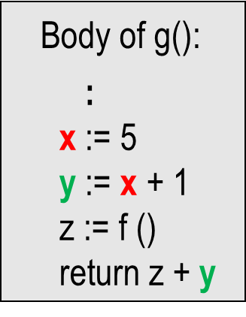
Liveness-across-call and caller/callee-save preference
Temps not live across calls should be allocated to caller-save registers.
Temps live across calls should be allocated to callee-save registers.
How can we nudge the allocator to do this?

Slide 60
Liveness-across-call and caller/callee-save preference
Temps not live across calls should be allocated to caller-save registers.
Temps live across calls should be allocated to callee-save registers.
How can we nudge the allocator to do this?
In CALL instruction, understand all N caller-save registers to be defined/live-out. They interfere with each other
s₁
s₂
s_{N}
s₄
s₃

Slide 61
Liveness-across-call and caller/callee-save preference
Temps not live across calls should be allocated to caller-save registers.
Temps live across calls should be allocated to callee-save registers.
How can we nudge the allocator to do this?
In CALL instruction, understand all N caller-save registers to be defined/live-out. They interfere with each other but not with x, so a good allocator will tend to assign x to the precolor of one of the s_{i}.
s₁
s₂
x
s_{N}
s₄
s₃

Slide 62
Liveness-across-call and caller/callee-save preference
Temps live across calls should be allocated to callee-save registers.
How can we nudge the allocator to do this?
In CALL instruction, understand all N caller-save registers to be defined/live-out. They interfere with each other and also with y.
s₁
s₂
x
s_{N}
y
s₄
s₃

Slide 63
Liveness-across-call and caller/callee-save preference
Temps live across calls should be allocated to callee-save registers.
How can we nudge the allocator to do this?
In CALL instruction, understand all N caller-save registers to be defined/live-out. They interfere with each other and also with y. But y also interferes with the t_{i} created by the front-end in the body of g.
s₁
s₂
t₁
x
s_{N}
y
:
s₄
s₃
t_{K}

Slide 64
Liveness-across-call and caller/callee-save preference
Temps live across calls should be allocated to callee-save registers.
How can we nudge the allocator to do this?
In CALL instruction, understand all N caller-save registers to be defined/live-out. They interfere with each other and also with y. But y also interferes with the t_{i} created by the front-end in the body of g. So a spill is likely. Since the t_{i} are “high degree, low use”, they are more likely to be selected for spill. So, the color of one callee-save registers is available for y.
s₁
s₂
t₁
x
s_{N}
y
:
s₄
s₃
t_{K}

Slide 65
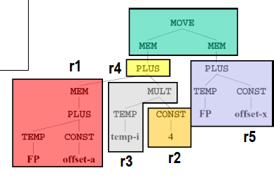
Register allocation for expression trees
Can avoid liveness calculation, interference graph construction, coloring.
Flashback to instruction selection: “tiling”, ie covering the tree with patterns corresponding to machine instructions.
In IR phase, had suggested use of separate (virtual) registers for each tile.
Clearly, can do better…

Slide 66
Register allocation for expression trees
Algorithm 1:
simple postorder traversal
can be combined with maximal munch (optimal but not optimum)
r1
r1
r1
r2
r1
r2
r1
r1
r2
r1
r2
r1
r2
r1
r2
r2
r2
r2
r2
r2

Slide 67
Register allocation for expression trees
Algorithm 2:
dynamic programming
label each tile with number of registers needed for its evaluation
when visiting node u with children u_{left} u_{right}, with needs n_{l} and n_{r}, respectively:
evaluating left child; hold result while evaluating right child: cost = max(u_{left}, 1 + u_{right})
evaluating right child; hold result while evaluating left child: cost = max(1 + u_{left}, u_{right})
choose cheaper evaluation order

