Slide 1
Topic 9: Control Flow
COS 320
Compiling Techniques
Princeton University
Spring 2016
Lennart Beringer

Slide 2
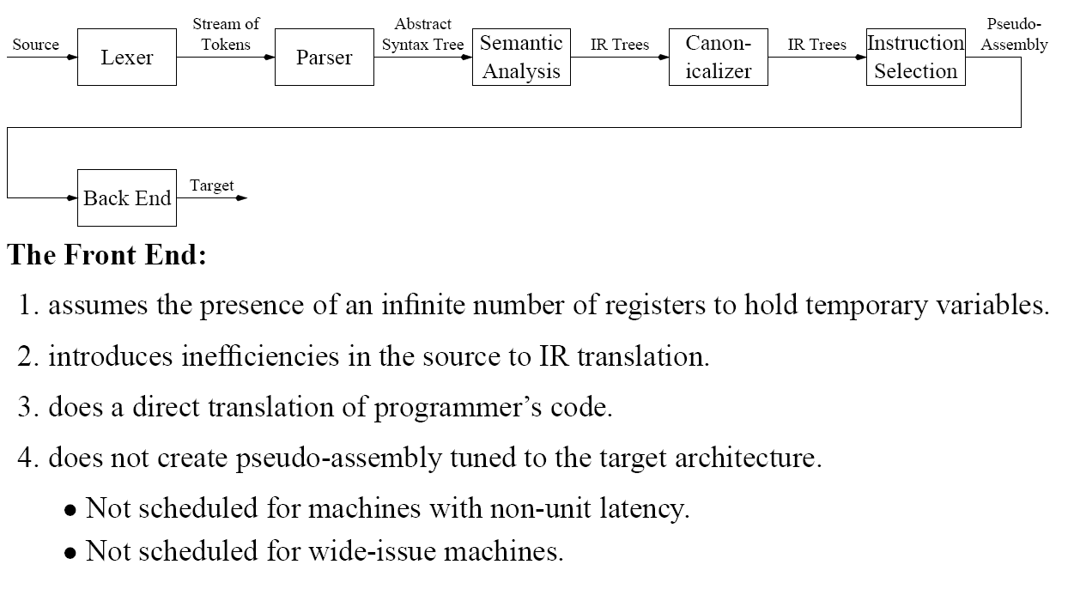
The Front End

Slide 3
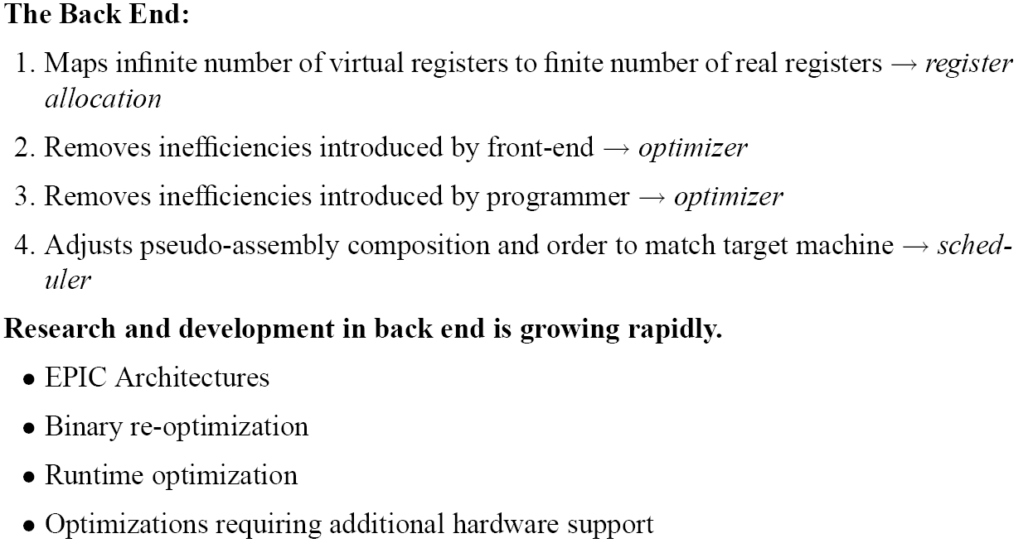
The Back End
(Intel-HP codename for “Itanium”; uses compiler to identify parallelism)

Slide 4
Optimization
← r1 holds loop index i
← load address of array a
← load constant 4
← calculate offset for index i
← calculate address of a[i]
← load content of x
← store x in a[i]
←increment loop counter i
← repeat, unless exit condition holds
How can we optimize this code for code size/speed/resource usage/…?

Slide 5
Optimization
← r1 holds loop index i
← load address of array a
← load constant 4
← calculate offset for index i
← calculate address of a[i]
← load content of x
← store x in a[i]
←increment loop counter i
← repeat, unless exit condition holds
Instructions not dependent of iteration count…
…can be moved outside the loop!

Slide 6
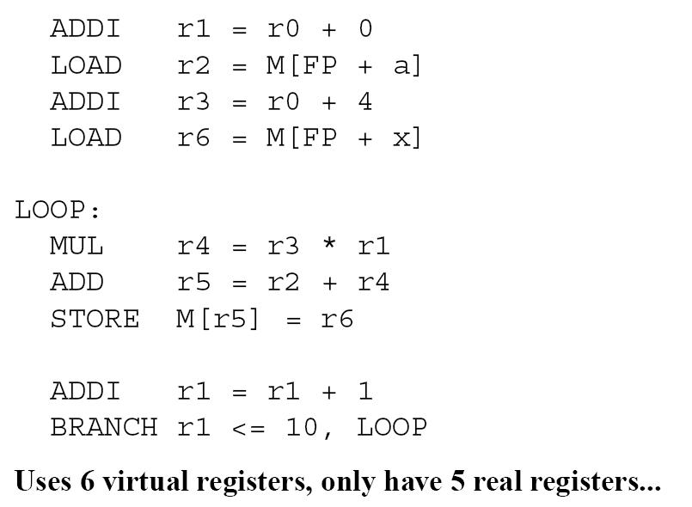
Register Allocation
Q: can any of the registers be shared/reused? – analyze liveness/def-use

Slide 7
Register Allocation
Q: can any of the registers be shared/reused? – analyze liveness/def-use
A: registers r4 and r5 don’t overlap – can map to same register, say r5!
Then, rename r6 to r4.

Slide 8
Scheduling
Q: can we exploit this?

Slide 9
Scheduling
A: can use the “empty slot” to execute some other instruction A, as long as A is independent (does not consume the value in r5)

Slide 10
Scheduling
Can use the “empty slot” to execute some other instruction A, as long as A is independent (does not consume the value in r5)

Slide 11
Backend analyses and tranformations
e.g. loop-invariant code removal

Slide 12
Control Flow Analysis

Slide 13
Control Flow Analysis Example
1
2
3
4
5
6
7
8

Slide 14
Control Flow Analysis Example
1
1
2
2
3
4
3
5
6
4
7
7
5
6
8
8

Slide 15
Basic Blocks
(extra labels and jumps mentioned in previous lecture now omitted for simplicity)

Slide 16
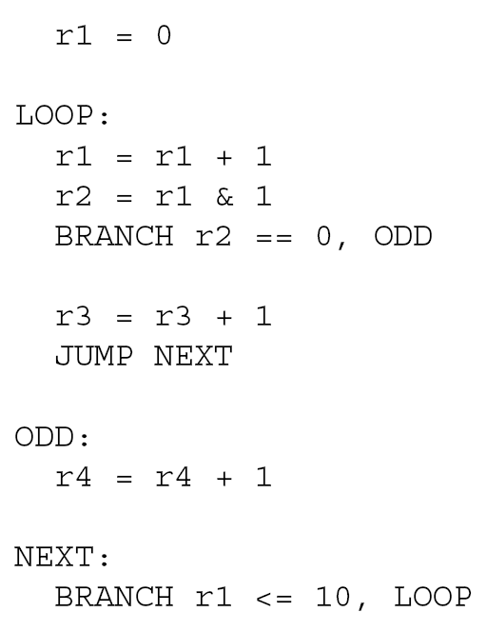

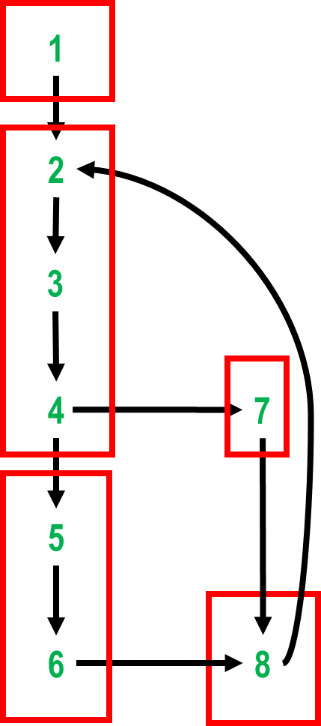
CFG of Basic Blocks
CFG:
Start
1
BB1
1
2
BB2
BB4
2
3
BB3
BB5
3
4
4
5
5
End

Slide 17
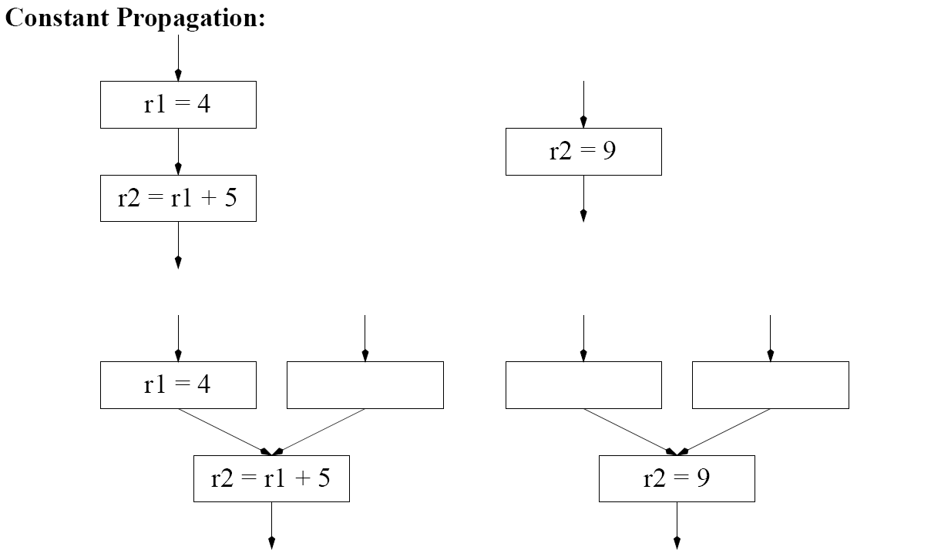
Domination Motivation
propagate r1=4
exploit 4+5=9
“constant folding”
assume r1 dead here

Slide 18
Domination Motivation
propagate r1=4
exploit 4+5=9
“constant folding”
assume r1 dead here
What about this:

Slide 19
Domination Motivation
propagate r1=4
exploit 4+5=9
What about this:
Illegal if r1=4 does not hold in the other incoming arc! -- Need to analyze which basic blocks are guaranteed to have been executed prior to join.

Slide 20
Dominator Analysis

Slide 21
Dominator Analysis

Slide 22
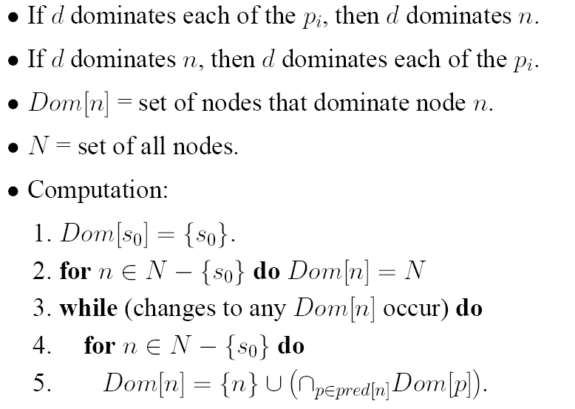
Dominator Analysis
starting point: n dominated by all nodes
nodes that dominate all predecessors of n

Slide 23
Dominator Analysis Example
s0=
Task: fill in column Dom[n]

Slide 24
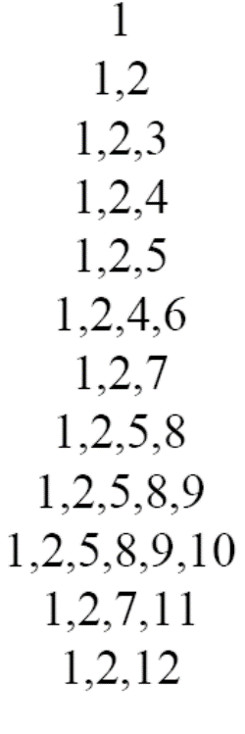
Dominator Analysis Example
s0=
More concise information: immediate dominators/dominator tree.

Slide 25
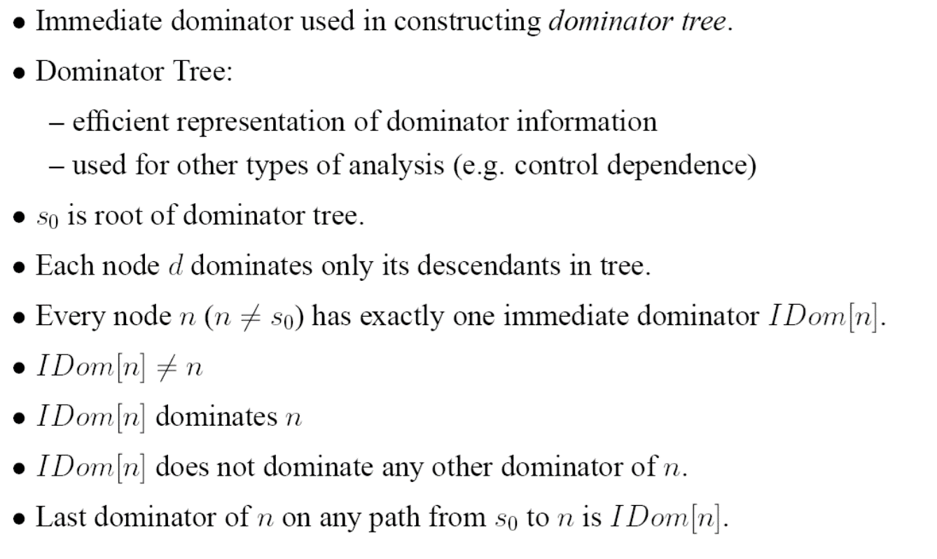
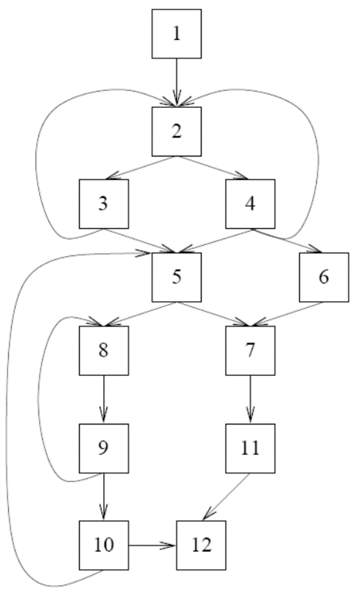

Dominator Analysis Example
Hence: last dominator of n on any path from s0 to n is IDom[n]
Task: fill in column IDom[n]

Slide 26
Dominator Analysis Example
Hence: last dominator of n on any path from s0 to n is IDom[n]
-
1
2
2
2
4
2
5
8
9
7
2

Slide 27
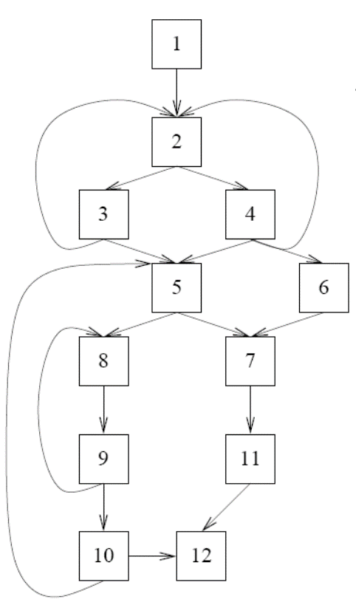
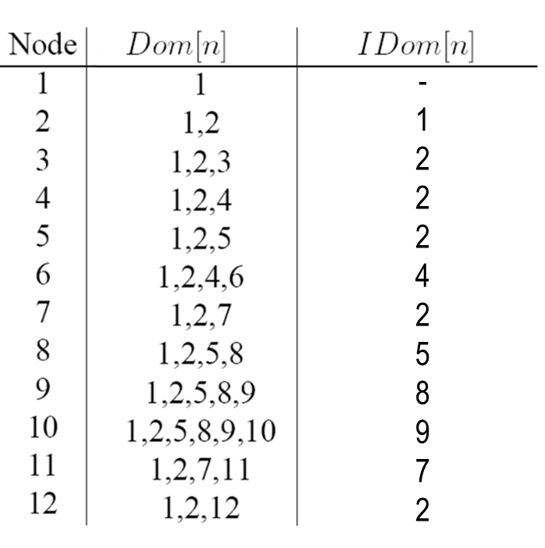
Use of Immediate Dominators: Dominator Tree
Immediate dominators can be arranged in tree
root: s0
children of node n: the nodes m such that n=IDom[m]
hence: each node dominates only its tree descendants
s0=1
2
3
4
5
7
12
6
8
11
9
10
(note: some tree arcs are CFG edges, some are not)

Slide 28
Post Dominator

Slide 29
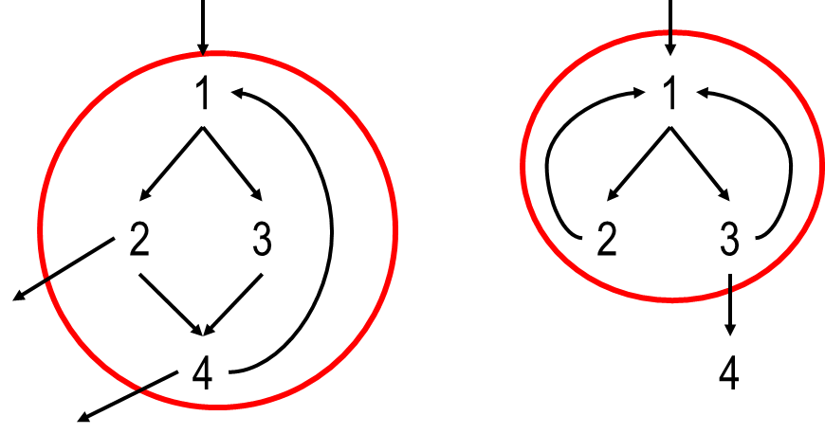
Loop Optimization

Slide 30
Examples of Loops
1
1
2
1
2
3
3
4
2
3
4
4
5
5
6

Slide 31
Examples of Loops
1
1
2
1
2
3
3
4
2
3
4
4
5
5
Header node: 1
6
Two loops, with identical header node: 1
Header node: 1
Header node: 2

Slide 32
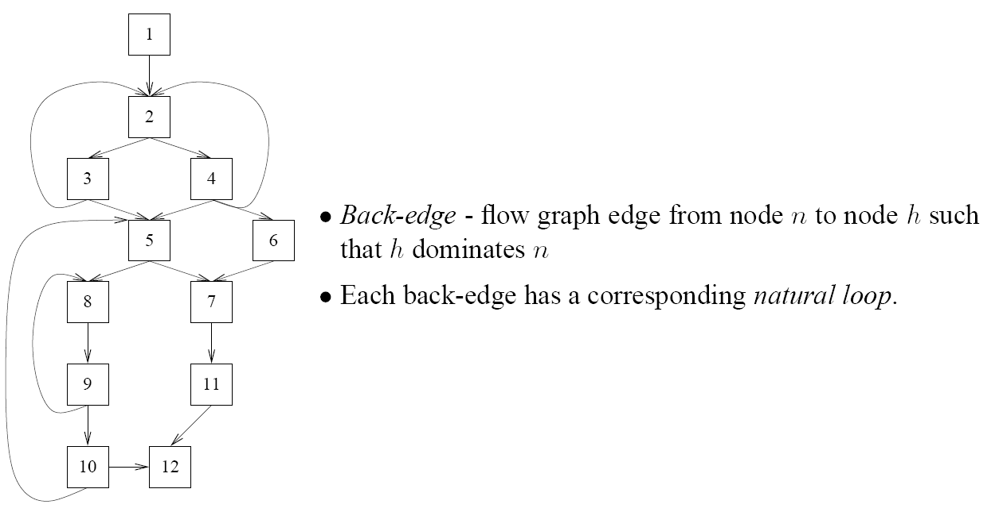
Back Edges
Back-edges: 3 → 2, 4 → 2, 9 → 8, 10 → 5

Slide 33
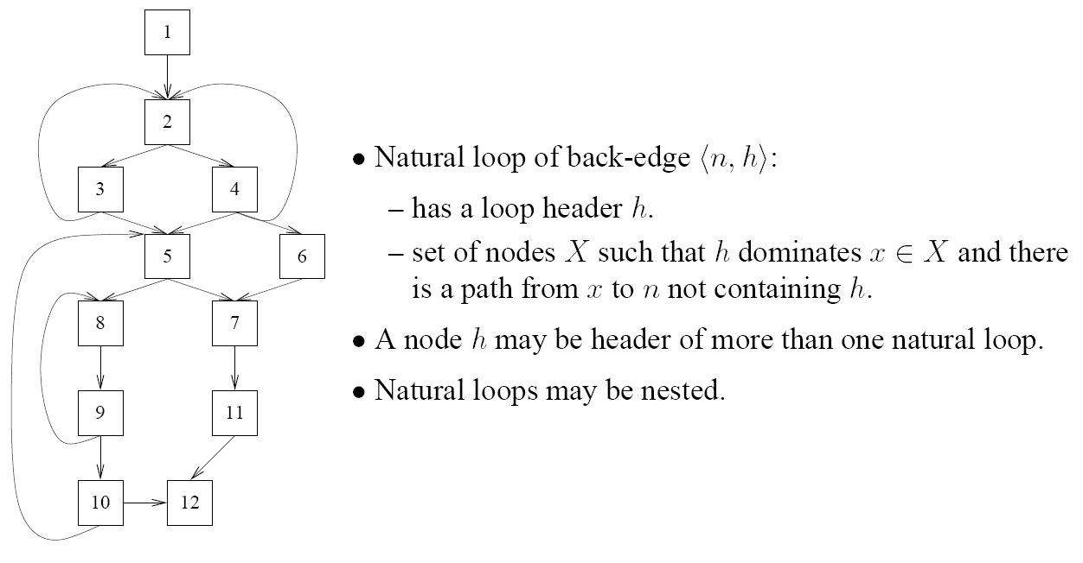
Natural Loops
Back-edge | Header of nat.loop | Nodes
3 → 2
4 → 2
9 → 8
10 → 5

Slide 34
Natural Loops
Back-edge | Header of nat.loop | Nodes
3 → 2 | 2 | 2, 3
4 → 2 | 2 | 2, 4
9 → 8 | 8 | 8, 9
10 → 5 | 5 | 5, 8, 9, 10
Q: Suppose we had an additional edge 5 → 3 – is this a backedge?

Slide 35
Natural Loops
Back-edge | Header of nat.loop | Nodes
3 → 2 | 2 | 2, 3
4 → 2 | 2 | 2, 4
9 → 8 | 8 | 8, 9
10 → 5 | 5 | 5, 8, 9, 10
Q: Suppose we had an additional edge 5 → 3 – is this a backedge?
A: No! 3 does not dominate 5!

Slide 36
Loop Optimization

Slide 37
Loop Optimization
{1,2,3} is not a loop:
1 is not a header: there are no paths/arcs back to 1
2 is not a header: it does not dominate 1 or 3
similarly for 3
This CFG does not contain a loop!
1
{2,3} is not a loop:
2 is not a header: it does not dominate 3
similarly for 3
2
3

Slide 38
Loop Optimization
“into the edge” leading to the header.

Slide 39
Loop Optimization
the loop increment/decrement i, and by a loop-independent value.
Q: is there an induction variable here?

Slide 40
Loop Optimization
the loop increment/decrement i, and by a loop-independent value.
exploit here?!
r1 is induction variable!
holds here
r1 | 1 | 2 | 3 | 4
r4 | 0 | 4 | 8 | 12

Slide 41
Loop Optimization
the loop increment/decrement I, by a loop-independent value.
r4 = -4
r4 = r4 + 4 // replace * by +
r1 | 1 | 2 | 3 | 4
r4 | 0 | 4 | 8 | 12
r4 <= 40
Eliminated r1 and r3, cut 2 instructions; made 1 instruction 1 cycle faster!

Slide 42
Non-Loop Cycles
Remember: this CFG does not contain a loop!
1
Reduction: collapse nodes, eliminate edges
2
3

Slide 43
Node Splitting
1
duplicate a node of the cycle, say 2
1
2’
2
3
2
3

Slide 44
Node Splitting
1
duplicate a node of the cycle, say 2
connect the copy to its successor and predecessor
1
2’
2
3
2
3

Slide 45
Node Splitting
1
duplicate a node of the cycle, say 2
connect the copy to its successor and predecessor
the successor of the copy is the loop header!
1
2’
2
3
2
3

Slide 46
Reduction
Collapse nodes, eliminate edges
1
A
4
5
6
A
2
3
7
9
B
C
B
C
8

