Slide 1
Topic 7:
Intermediate Representations
COS 320
Compiling Techniques
Princeton University
Spring 2016
Lennart Beringer

Slide 2
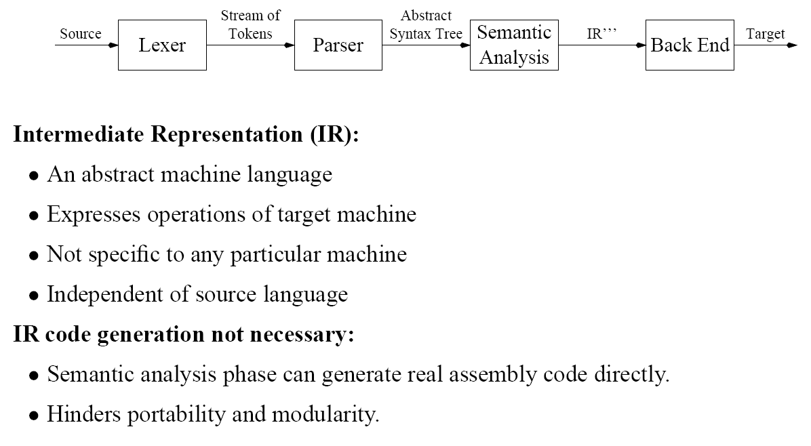
Intermediate Representations

Slide 3
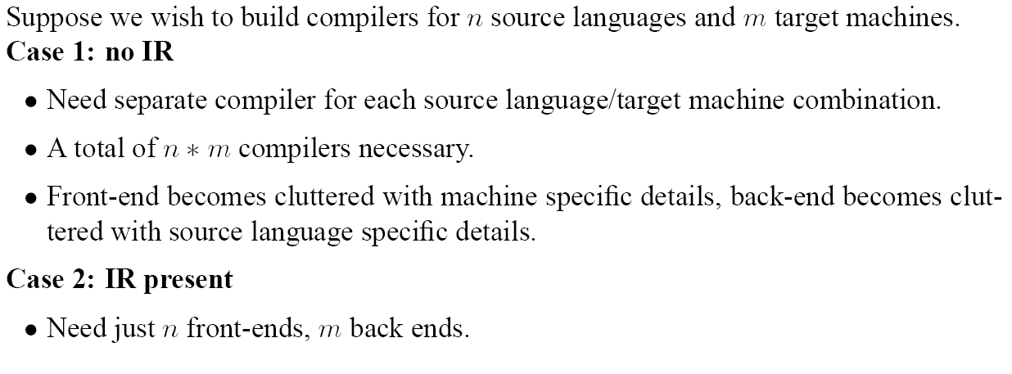
Intermediate Representations

Slide 4
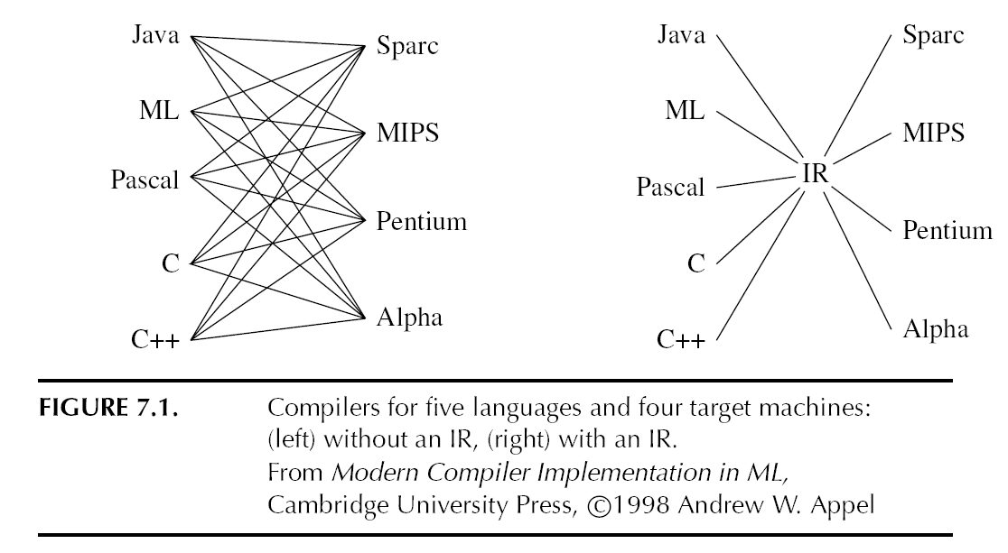
Intermediate Representations

Slide 5
Properties of a Good IR

Slide 6
IR Representations
and Tiger
(Explanations on next slides)

Slide 7
IR Expression Trees
(Explanations on next slides)

Slide 8
Expressions

Slide 9
Expressions

Slide 10
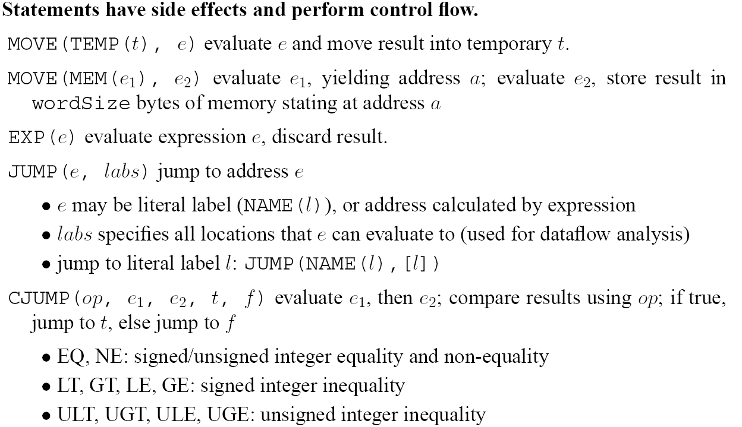
Statements

Slide 11
Statements
Next:
generation of IR code from Absyn
heavily interdependent with design of FRAME module in MCIL (abstract interface of activation records, architecture-independent)
But first …

Slide 12
Midterm exam info
When? Thursday, March 10th, 3pm – 4:20pm
Where? CS 104 (HERE)
Closed book / notes, no laptop/smartphone…. Honor code applies
Material in scope:
up to HW 3 (parser), and
anything covered in class until this Friday.
Preparation:
exercises at end of book chapters in MCIL
old exams: follow link on course home page

Slide 13
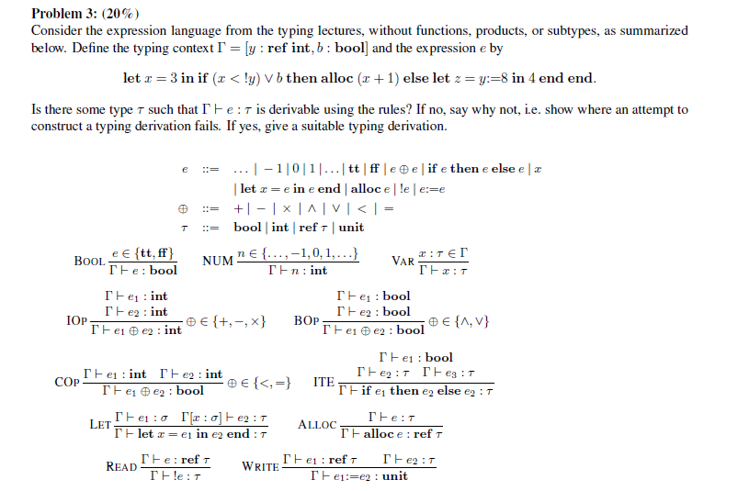
Midterm exam prep QUIZ (also because it’s Tuesday)
(Spring 2011)
e3

Slide 14
Translation of Abstract Syntax
Goal: function Translate: Absyn.exp => “IR”
Observation: different expression forms in Absyn.exp suggest use of different parts of IR
Solution 1: given e:Absyn.exp, always generate a Tree.exp term:
case A: immediate
case B: instead of a Tree.stm s, generate Tree.ESEQ(s, Tree.CONST 0)
case C: “Tree.ESEQ (s, Tree.TEMP r)”: cf expression on slide 16
Resulting code less clean than solution 2

Slide 15
Translation of Abstract Syntax
Solution 2:
define a wrapper datatype with “injections” (ie constructors) for the 3 cases

Slide 16
Translation of Abstract Syntax (Conditionals)
Translation of a simple conditional into a Tree.stm:
Translation of a more complex conditional into a Tree.stm:
Translation of a more conditional into a Tree.exp, to be assigned to a variable:
Then, can use
conversion function unEx: exp => Tree.exp. Convenient to have unNx and unCx, too:

Slide 17
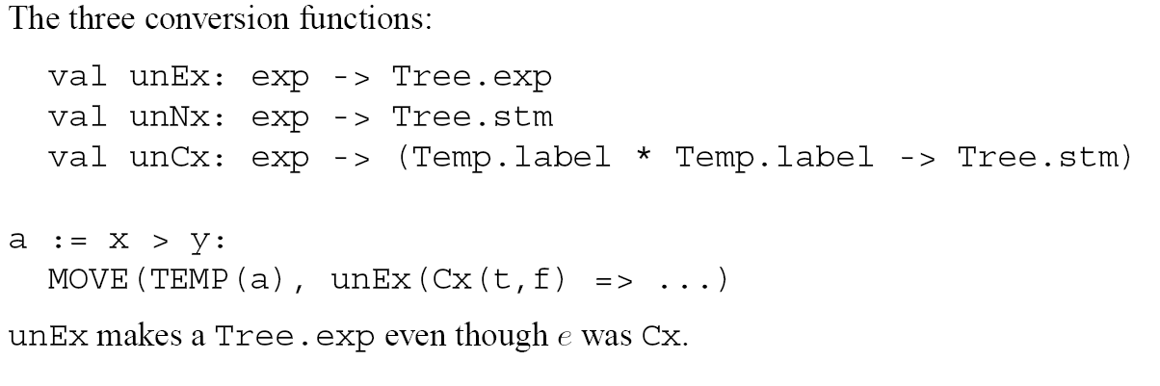
Translation of Abstract Syntax (Conditionals)
Implementation?

Slide 18
Translation of Abstract Syntax
unEx: exp => Tree.exp:
Pseudocode
Temp r := 1;
CJUMP (GT, Temp x, Temp y, t_label, f_label);
f_label: Temp r := 0;
t_label: flag := r (*program continuation*)
Example: flag := x>y:
genstmt = fun (t,f) =>
CJUMP (GT, Temp x, Temp y, t_label, f_label)
Implementation of unNx and unCx similar.

Slide 19
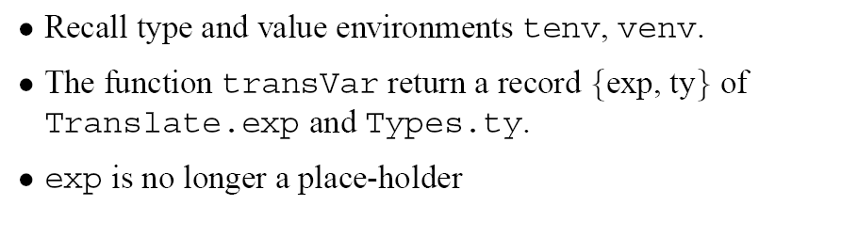
Translation of Abstract Syntax
Primary result of sematic analysis:
a type environment TENV: collects type declarations, ie maps type names to representations of type
a value environment VENV: collects variable declarations, ie maps variable names x to either
  a type (if x represents a non-function variable)
  a lists of argument types, and a return type (if x represents a function)
But also: generate IR code
Tiger: translation functions transExpr, transVar, transDec, and transTy based on the syntactic structure of Tiger’s Abysn.
In particular: TransExp returns record {Tree.exp, ty}.

Slide 20
IR code generation complex for Tiger
don’t want to be processor specific: abstract notion of frames, with abstract parameter slots (“access”): constructors inFrame or inReg,
further abstraction layer to separate implementation of translate function from use of these functions in semantic analysis (type check)

Slide 21
IR code generation complex for Tiger
don’t want to be processor specific: abstract notion of frames, with abstract parameter slots (“access”): constructors inFrame or inReg,
further abstraction layer to separate implementation of translate function from use of these functions in semantic analysis (type check)
Root problem: escaped variables
Address-taken variables
Call by reference variables
Nested functions
Stack-allocated data structures (records)
:

Slide 22

IR code generation complex for Tiger
don’t want to be processor specific: abstract notion of frames, with abstract parameter slots (“access”): constructors inFrame or inReg,
further abstraction layer to separate implementation of translate function from use of these functions in semantic analysis (type check)
Root problem: escaped variables
Address-taken variables
Call by reference variables
Nested functions
Stack-allocated data structures (records)
:
Absence of these features would make frame stack construction and hence IR emission MUCH easier

Slide 23
IR code generation complex for Tiger
don’t want to be processor specific: abstract notion of frames, with abstract parameter slots (“access”): constructors inFrame or inReg,
further abstraction layer to separate implementation of translate function from use of these functions in semantic analysis (type check)
Root problem: escaped variables
Address-taken variables
Call by reference variables
Nested functions
Stack-allocated data structures (records)
:
Absence of these features would make frame stack construction and hence IR emission MUCH easier
Compiler design
Language design
Example of modern language that avoids these features: Java

Slide 24
IR code generation: “local” variable access
Choice as to which variables are inFrame and which ones are inReg is architecture-specific, so implemented inside FRAME module.
FRAME also provides mechanism to construct abstract activation records, containing one inFrame/inReg access for each formal parameter.

Slide 25
IR code generation: variable access

Slide 26
Simple Variables
Thus, IR code generation for a function body can be done using uniform notion of “parameter slots” (“access”) in an abstract description of Frames:
interface of frame says for each parameter whether it’s inFrame or inReg
different implementations of Frame module can follow different policies
given any Frame implementation, Translate generates suitable code

Slide 27
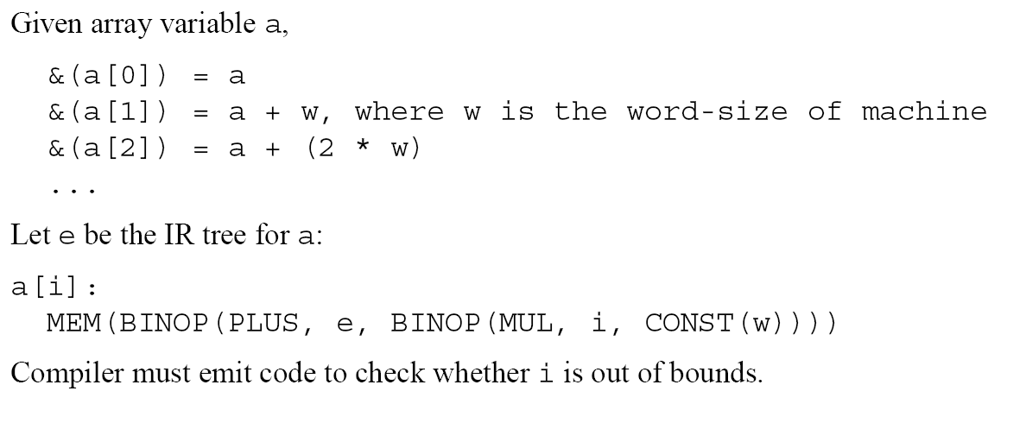
Array Access

Slide 28
Record Access
2

Slide 29
Records: allocation and deallocation
Records can outlive function invocations, so
allocation happens not on stack but on heap, by call to an other runtime function ALLOC to which a call is emitted by the compiler
  should include code for (type-correct) initialization of components
  details below

Slide 30
Records: allocation and deallocation
Records can outlive function invocations, so
allocation happens not on stack but on heap, by call to an other runtime function ALLOC to which a call is emitted by the compiler
  should include code for (type-correct) initialization of components
  details below
deallocation: no explicit instruction in the source language, so either
  no deallocation (poor memory usage: memory leak), or
  compiler has an analysis phase that (conservatively) estimates lifetime of records (requires alias analysis) and inserts calls to runtime function FREE at appropriate places, or
  dynamic garbage collection (future lecture)
Similar issues arise for allocation/deallocation of arrays.

Slide 31
Conditional Statements – if e1 then e2 else e3
Approach 1: use CJUMP
ok in principle, but doesn’t work well if e1 contains &, |

Slide 32
Conditional Statements – if e1 then e2 else e3
Approach 1: use CJUMP
ok in principle, but doesn’t work well if e1 contains &, |
Approach 2: exploit Cx constructor
yields good code if e1 contains &, |
treat e1 as Cx expression ➔ apply unCx
use fresh labels as “entry points” for e2 and e3
treat e2, e3 as Ex expressions ➔ apply unEx

Slide 33

Conditional Statements – if e1 then e2 else e3
Approach 1: use CJUMP
ok in principle, but doesn’t work well if e1 contains &, |
Approach 2: exploit Cx constructor
yields good code if e1 contains &, |
treat e1 as Cx expression ➔ apply unCx
use fresh labels as “entry points” for e2 and e3
treat e2, e3 as Ex expressions ➔ apply unEx
“if e1 then JUMP t else JUMP f”;
t: r := e2 (*code for e2, leaving result in r*)
JUMP join
f: r := e3 (*code for e3, leaving result in r*)
join: … (*program continuation, can use r*)

Slide 34
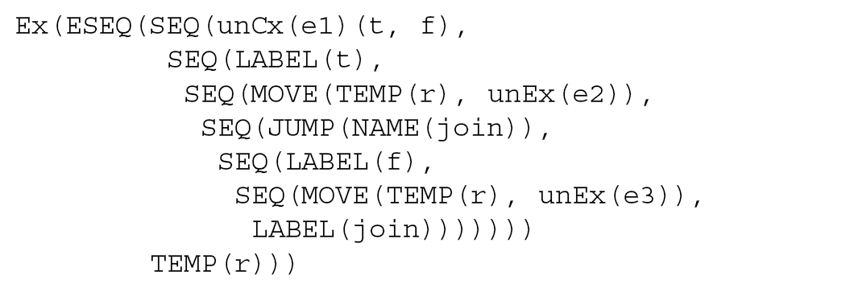
Conditional Statements – if e1 then e2 else e3
“if e1 then JUMP t else JUMP f”;
t: r := e2 (*code for e2, leaving result in r*)
JUMP join
f: r := e3 (*code for e3, leaving result in r*)
join: … (*program continuation, can use r*)
Optimizations possible, e.g. if e2/e3 are themselves Cx expressions – see MCIL

Slide 35
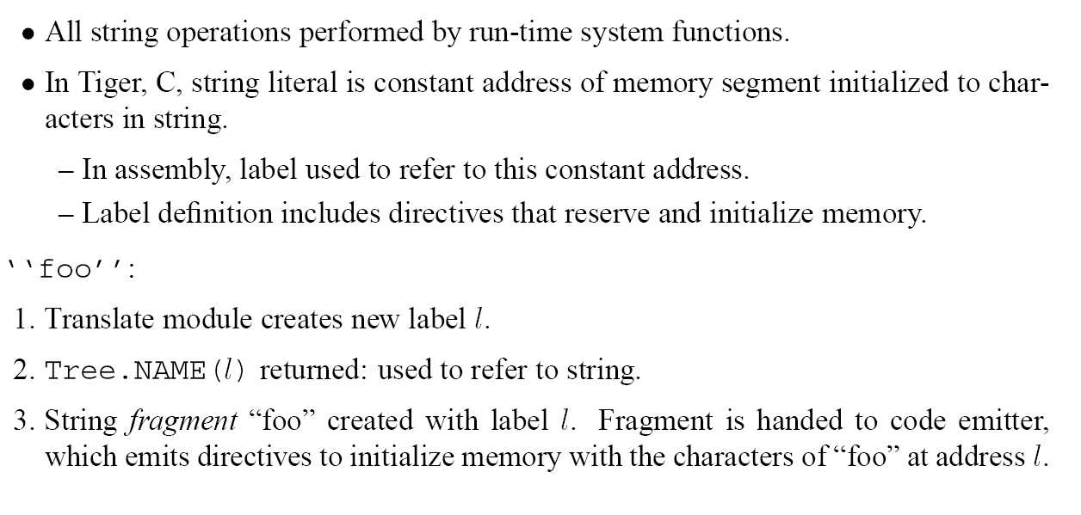
Strings
Can think of as additional function definitions, for which the compiler silently generates code, too

Slide 36
Strings
length

Slide 37
Strings

Slide 38
Array Creation

Slide 39
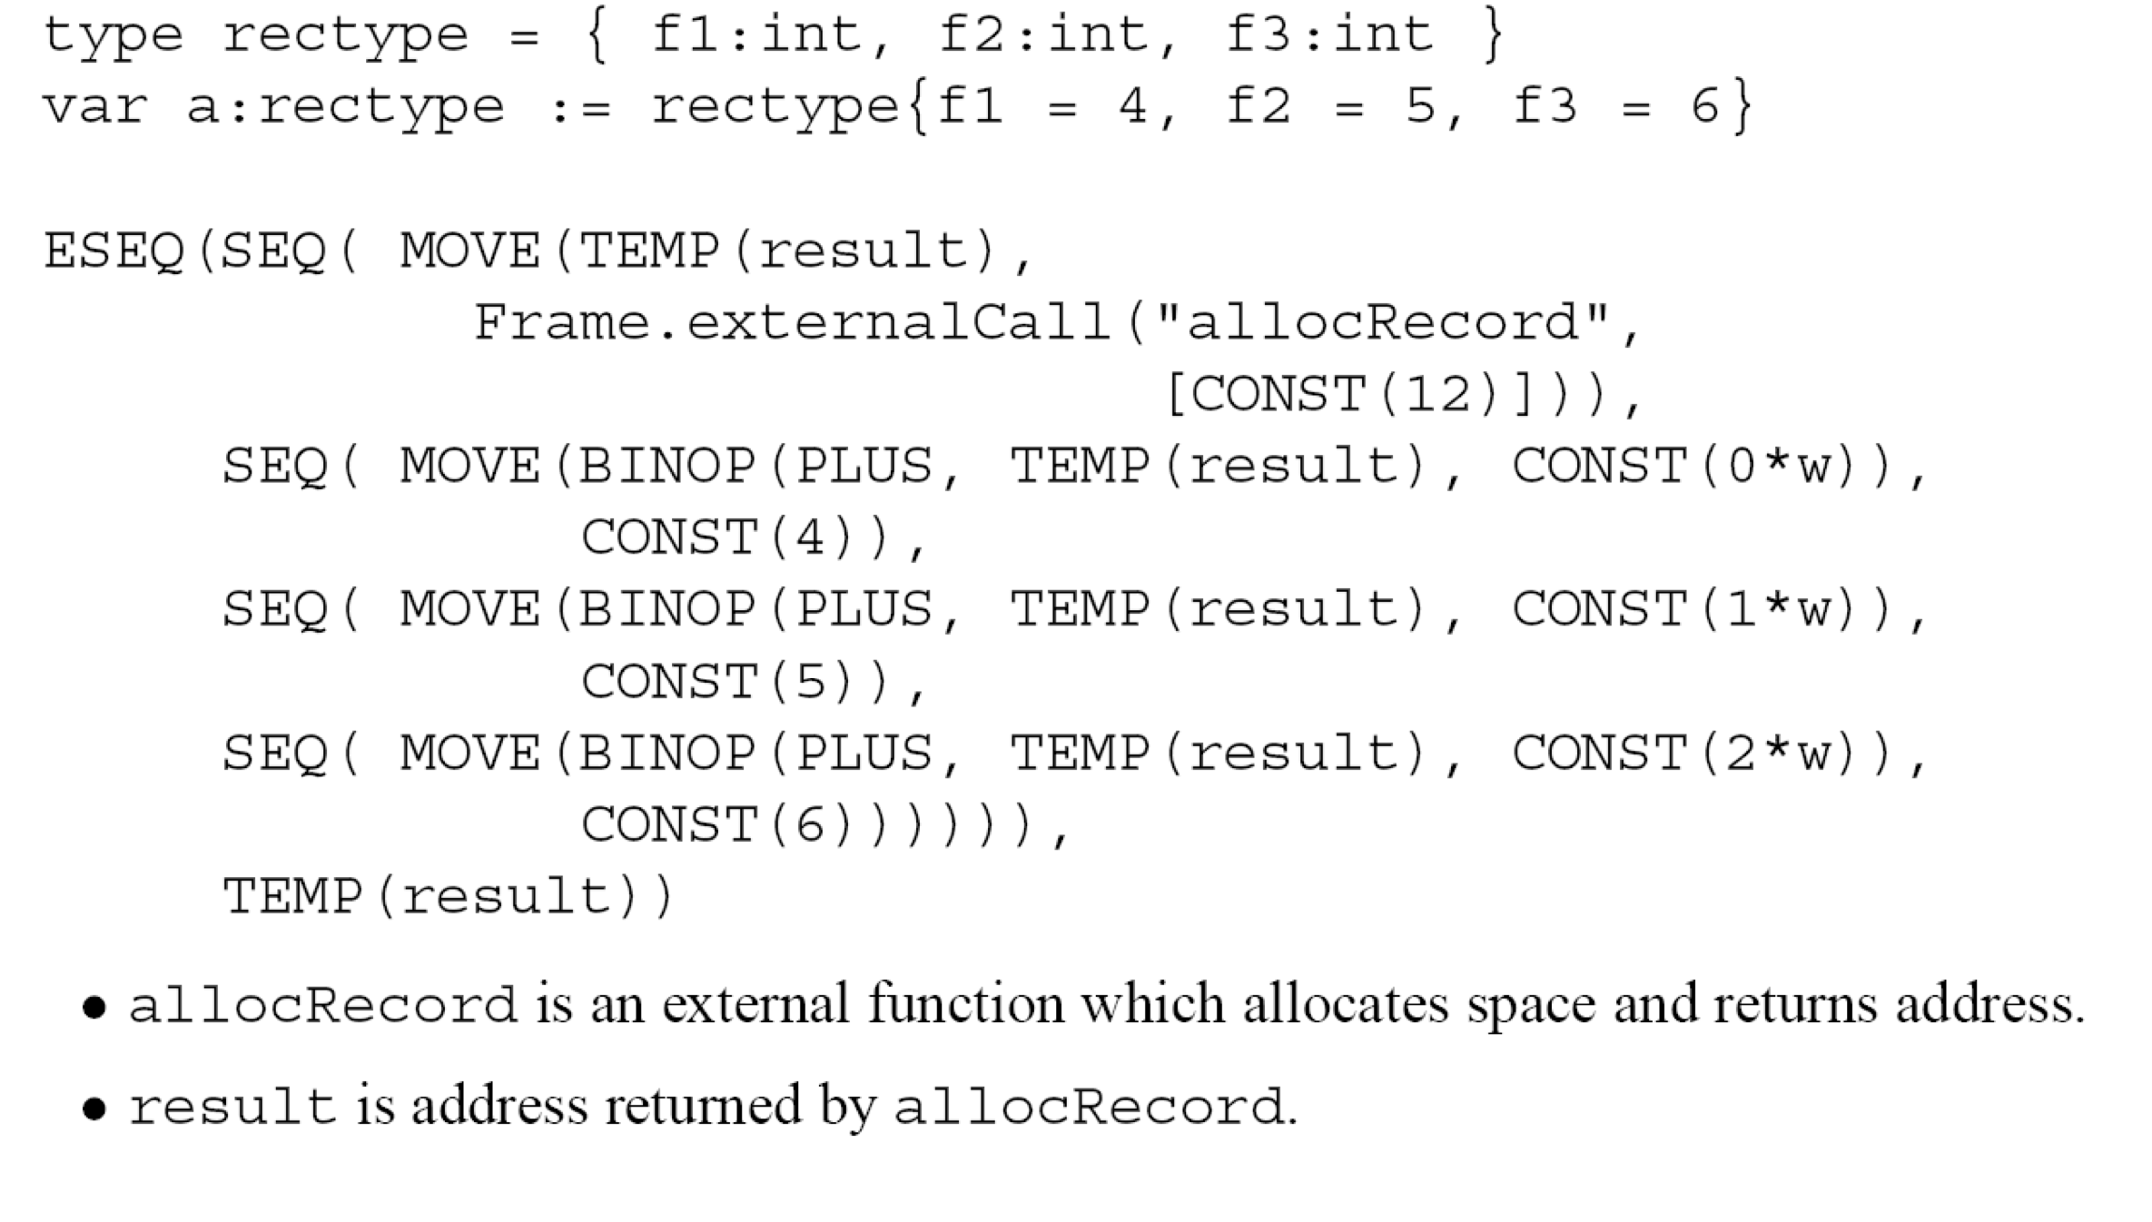
Record Creation
(3*w) ] ) ),

Slide 40
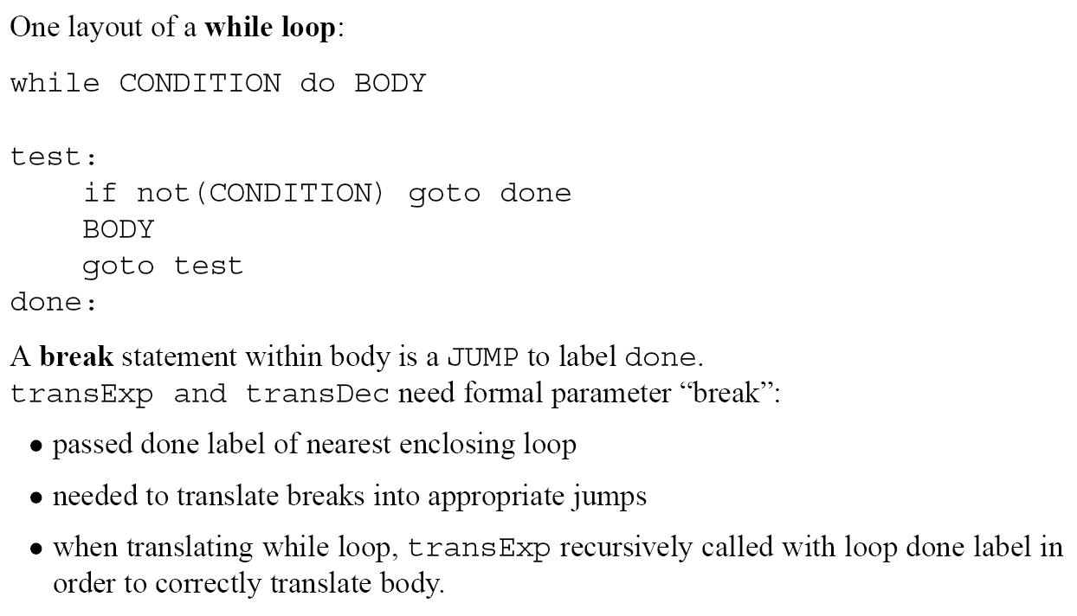
While Loops

Slide 41
For Loops

Slide 42
For Loops
(Approx.) solution hinted to in MCIL:
in if lo <= hi
then lab: body
if i < limit
then i++; JUMP lab
else JUMP done
else JUMP done
done:

Slide 43
Function Calls

Slide 44
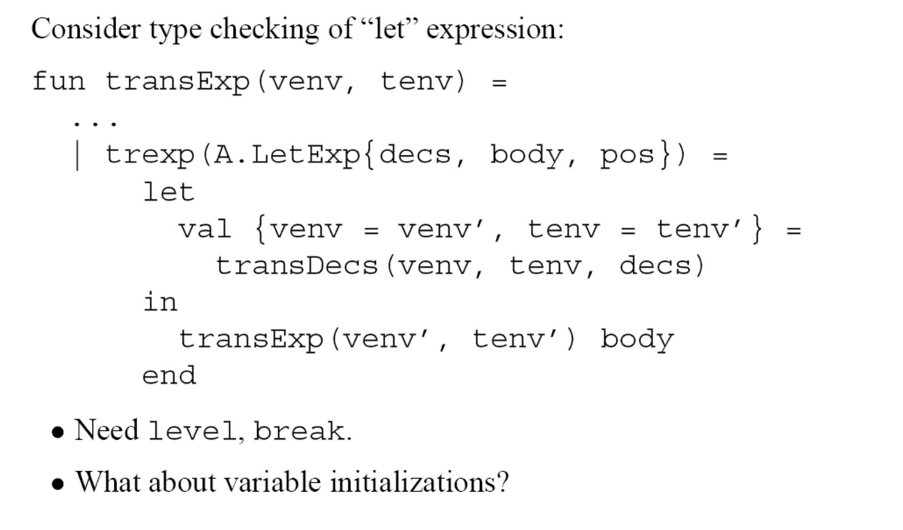
Declarations
basic idea:

Slide 45
Declarations
basic idea:
Complications:
need auxiliary info level, break inside translation of body
need to insert code for variable initialization.

Slide 46
Declarations
basic idea:
, inits = e} =
“ESEQ (e,
)”
Complications:
need auxiliary info level, break inside translation of body
need to insert code for variable initialization. Thus, transDecs is modified to additionally return an expression list e of assignment expressions that’s inserted HERE (and empty for function and type declarations)

Slide 47
Function Declarations

Slide 48
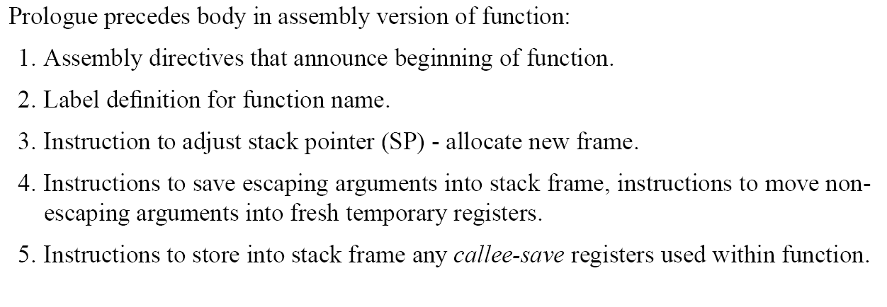
Function Prolog

Slide 49
Function Epilog

Slide 50
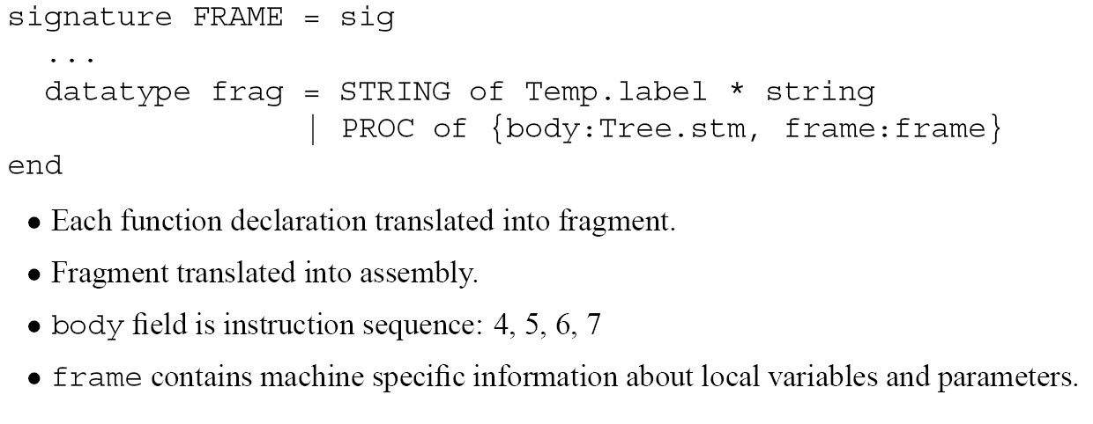
Fragments
inFrame, inReg etc

Slide 51
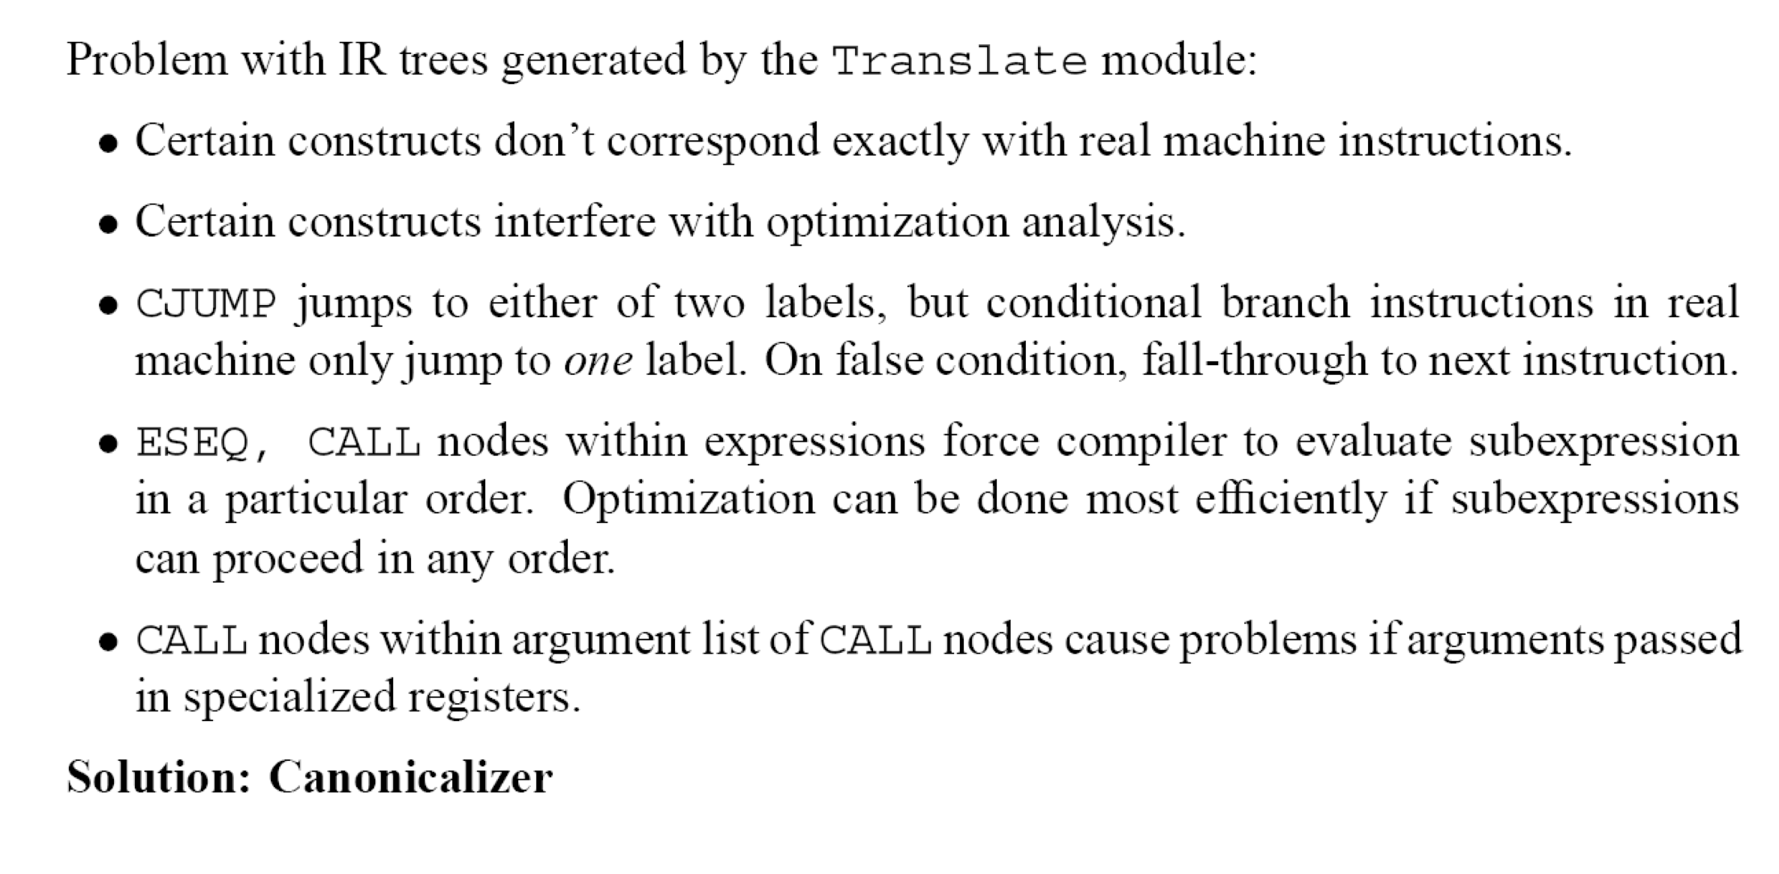
Problem with IR Trees

Slide 52
Canonicalizer: overview

Slide 53
Elimination of (E)SEQs
Goal:
Move ESEQ and SEQ nodes towards the top of a Tree.stm
by repeatedly applying local rewrite rules
SEQ
ESEQ
➔ … ➔
ESEQ
SEQ
(selected rewrite rules on next slides)

Slide 54
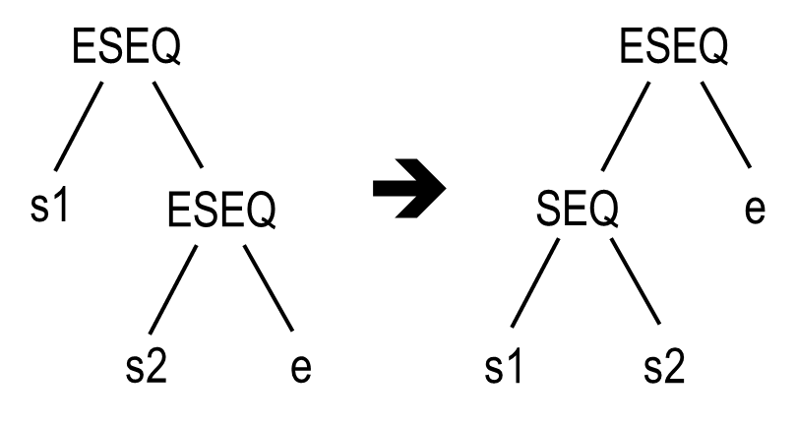
Rewrite rules
1

Slide 55
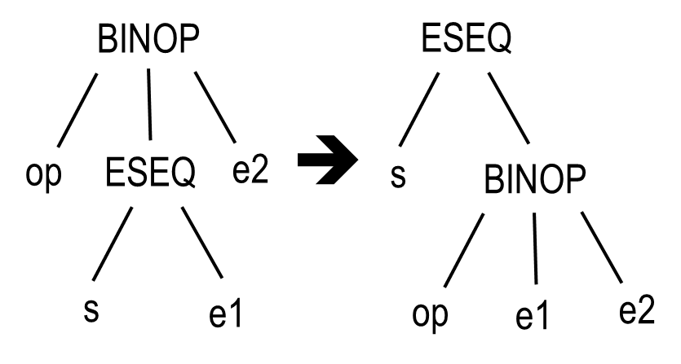
Rewrite rules
1
2
(also for MEM, JUMP, CJUMP in place of BINOP)

Slide 56
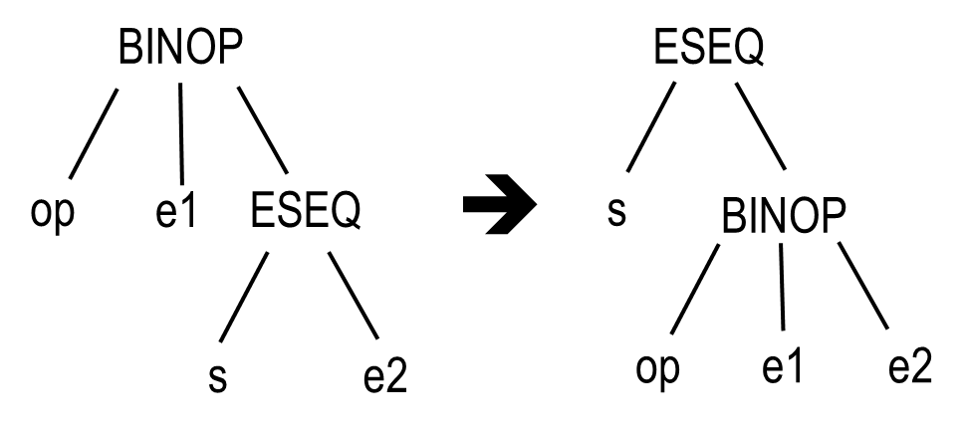
Rewrite rules
1
2
(also for MEM, JUMP, CJUMP in place of BINOP)
What about this:

Slide 57
Rewrite rules
1
2
(also for MEM, JUMP, CJUMP in place of BINOP)
What about this:
Incorrect if s contains assignment to a variable read by e1!

Slide 58
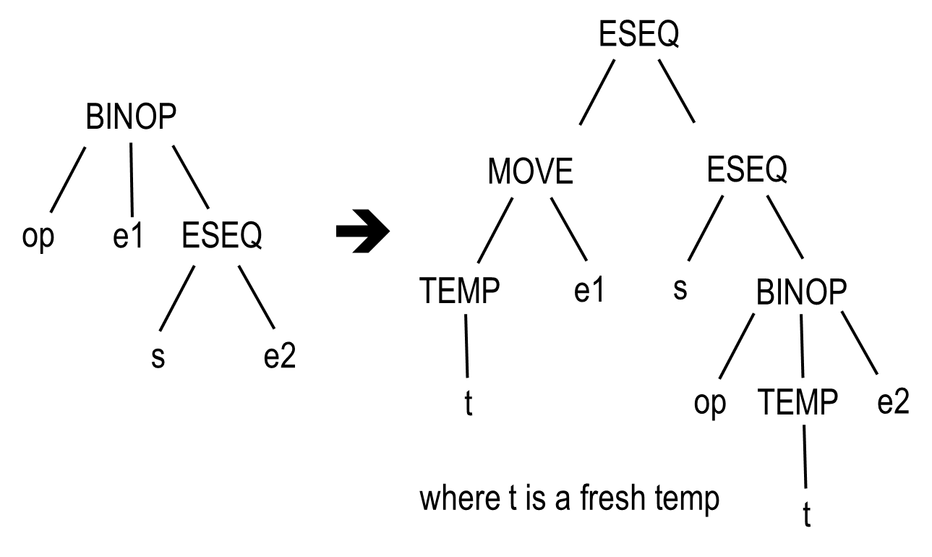
Rewrite rules
1
2
(also for MEM, JUMP, CJUMP in place of BINOP)
What about this:
General Solution:
3
Incorrect if s contains assignment to a variable read by e1!
(also for CJUMP in place of BINOP)

Slide 59
Rewrite Rules
Specific solution:
When do s and e commute?
variables and memory locations accessed by s are disjoint from those accessed by e
no disjointness but all accesses to such a shared resource are READ
4
In fact correct if s and e1 commute!
(Similarly for CJUMP)

Slide 60
Rewrite Rules
Specific solution:
When do s and e commute?
variables and memory locations accessed by s are disjoint from those accessed by e
no disjointness but all accesses to such a shared resource are READ
4
In fact correct if s and e1 commute!
(Similarly for CJUMP)
But: deciding whether MEM(x) and MEM(z) represent the same location
requires deciding whether x and z may be equal
Undecidable in general!

Slide 61
Rewrite Rules
Specific solution:
When do s and e commute?
variables and memory locations accessed by s are disjoint from those accessed by e
no disjointness but all accesses to such a shared resource are READ
4
In fact correct if s and e1 commute!
(Similarly for CJUMP)
Solution:
Compiler conservatively approximates disjointness / commutability, ie performs the rewrite cautiously
example: e1 == CONST(i)
But: deciding whether MEM(x) and MEM(z) represent the same location
requires deciding whether x and z may be equal
Undecidable in general!

Slide 62
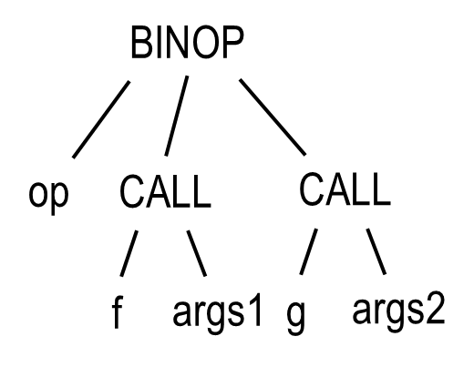
Rewrite Rules
Goal 2: ensure that parent of a CALL is EXP (…) or MOVE(TEMP t, …)
Motivation: calls leave their result in dedicated register rv. Now consider tree T.
What could go wrong?
T:

Slide 63
Rewrite Rules
Goal 2: ensure that parent of a CALL is EXP (…) or MOVE(TEMP t, …)
Motivation: calls leave their result in dedicated register rv. Now consider tree T.
What could go wrong? Call to g will overwrite result of f (held in rv) before BINOP is executed!
T:
Solution?

Slide 64
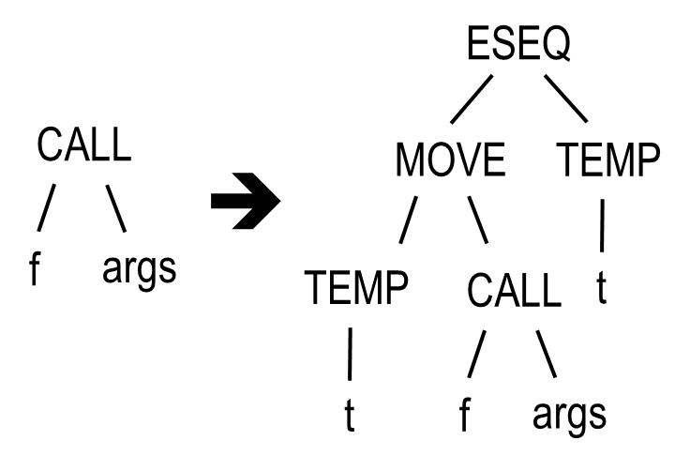
Rewrite Rules
Goal 2: ensure that parent of a CALL is EXP (…) or MOVE(TEMP t, …)
Motivation: calls leave their result in dedicated register rv. Now consider tree T.
What could go wrong? Call to g will overwrite result of f (held in rv) before BINOP is executed!
T:
Solution: save result of call to f before calling g, to avoid overwriting rv!
5
(where t is a fresh temp; don’t apply recursively under the pattern MOVE(TEMP(..), CALL(..)…))

Slide 65
Rewrite Rules
Goal 2: ensure that parent of a CALL is EXP (…) or MOVE(TEMP t, …)
Motivation: calls leave their result in dedicated register rv. Now consider tree T.
What could go wrong? Call to g will overwrite result of f (held in rv) before BINOP is executed!
T:
Solution: save result of call to f before calling g, to avoid overwriting rv!
5
Homework 1: apply rules 1-5 to rewrite T until no more rules can be applied. Is your solution optimal?
Homework 2: can you think of additional rules, for nested calls?
(where t is a fresh temp; don’t apply recursively under the pattern MOVE(TEMP(..), CALL(..)…))

Slide 66
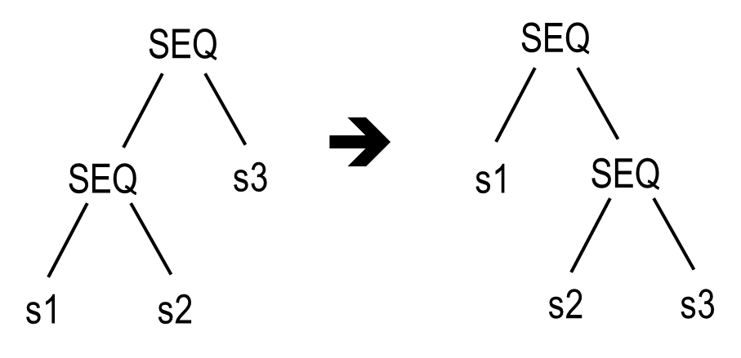
Elimination of SEQs
Associativity of SEQ:
6
Final step: once all SEQ’s are at top of tree, collect list of statements left-to-right

Slide 67
Elimination of SEQs
Associativity of SEQ:
SEQ
ESEQ
➔
ESEQ
s3
s1
SEQ
s1
e
s2
s3
Final steps: once all SEQ’s are at top of tree, extract list of statements left-to-right

Slide 68
Midterm exam
End of lecture material that’s relevant for the midterm.
Thus, MCIL material up to (and including) Section 8.1 “Canonical Trees” is fair game.

Slide 69
Normalization of branches
Remember conditional branch instruction of TREE:
“true” branch
“false” branch
CJUMP (relop, exp, exp, label, label)
Assembly languages: conditional branches typically have only one label
So need to analyze control flow of program: what’s the order in which an execution might “walk through program”, ie execute instructions?

Slide 70
Normalization of branches
Remember conditional branch instruction of TREE:
“true” branch
“false” branch
CJUMP (relop, exp, exp, label, label)
Assembly languages: conditional branches typically have only one label
So need to analyze control flow of program: what’s the order in which an execution might “walk through program”, ie execute instructions?
sequence of non-branching instructions: trivial, in sequential order
unconditional jumps: obvious – follow the goto
CJMUP: cannot predict outcome, so need to assume either branch may be taken
➔ For analysis of control flow, can consider sequences of non-branching instructions as single node (“basic block”)

Slide 71
Basic blocks
A basic block is a sequence of statements such that
the first statement is a LABEL instruction
the last statement is a JUMP or CJUMP
there are no other LABELSs, JUMPs, or CJUMPs

Slide 72
Basic blocks
A basic block is a sequence of statements such that
the first statement is a LABEL instruction
the last statement is a JUMP or CJUMP
there are no other LABELSs, JUMPs, or CJUMPs
Task: partition a sequence of statements (Ln: LABEL n; si = straight-line stmt)
L1
s1
s2
s3
CJUMP .. (L1, L3)
L2
s4
JUMP L1
L3
s5
s6
s7
JUMP L2
into a sequence of basic blocks
L1
s1
s2
s3
CJUMP .. (L1, L3)
L2
s4
JUMP L1
L3
s5
s6
s7
JUMP L2

Slide 73
Partitioning into basic blocks
Naïve algorithm:
traverse left-to-right
whenever a LABEL is found, start a new BB (and end current BB)
whenever a JUMP or CJUMP is found, end current BB (and start new BB)
insert fresh LABELs at beginnings of BBs that don’t start with a LABEL
insert JUMPs at ends of BBs that don’t end with a JUMP or CJUMP
s1
L1
s2
s3
CJUMP .. (L1, L3)
s4
L2
L3
s5
s6
JUMP L1
s7
JUMP L2

Slide 74
Partitioning into basic blocks
Naïve algorithm:
traverse left-to-right
whenever a LABEL is found, start a new BB (and end current BB)
whenever a JUMP or CJUMP is found, end current BB (and start new BB)
insert fresh LABELs at beginnings of BBs that don’t start with a LABEL
insert JUMPs at ends of BBs that don’t end with a JUMP or CJUMP
s1
L1
s2
s3
CJUMP .. (L1, L3)
s4
L2
L3
s5
s6
JUMP L1
s7
JUMP L2
s1
L1
s2
s3
CJUMP .. (L1, L3)
s4
L2
L3
s5
s6
JUMP L1
s7
JUMP L2

Slide 75
Partitioning into basic blocks
Better algorithm:
traverse left-to-right
whenever a LABEL is found, start a new BB (and end current BB)
whenever a JUMP or CJUMP is found, end current BB (and start new BB)
insert fresh LABELs at beginnings of BBs that don’t start with a LABEL
insert JUMPs at ends of BBs that don’t end with a JUMP or CJUMP
s1
L1
s2
s3
CJUMP .. (L1, L3)
s4
L2
L3
s5
s6
JUMP L1
s7
JUMP L2
JUMP L1
JUMP L2
JUMP L3
s1
L1
s2
s3
CJUMP .. (L1, L3)
s4
L2
L3
s5
s6
JUMP L1
s7
JUMP L2
L0
L4
L5

Slide 76
Partitioning into basic blocks
Better algorithm:
traverse left-to-right
whenever a LABEL is found, start a new BB (and end current BB)
whenever a JUMP or CJUMP is found, end current BB (and start new BB)
insert fresh LABELs at beginnings of BBs that don’t start with a LABEL
insert JUMPs at ends of BBs that don’t end with a JUMP or CJUMP
convenient to also add a special LABEL D for epilogue and add JUMP D
s1
L1
s2
s3
CJUMP .. (L1, L3)
s4
L2
L3
s5
s6
JUMP L1
s7
JUMP L2
JUMP L1
JUMP L2
JUMP L3
s1
L1
s2
s3
CJUMP .. (L1, L3)
s4
L2
L3
s5
s6
JUMP L1
s7
JUMP L2
L0
L4
L5

Slide 77
Ordering basic blocks
Given that basic blocks have entry labels and jumps at end
relative order of basic blocks irrelevant
so reorder to ensure (if possible) that a block ending in
  CJUMP is followed by the block labeled with the “FALSE” label
  JUMP is followed by its target label
More precisely: cover the collection of basic blocks by a set of traces:
sequences of stmts (maybe including jumps) that are potentially executed sequentially
aims:
  have each basic block covered by only one trace
  use low number of traces in order to reduce number of JUMPS

