Slide 1
Topic 6: Activation Records
COS 320
Compiling Techniques
Princeton University
Spring 2016
Lennart Beringer

Slide 2
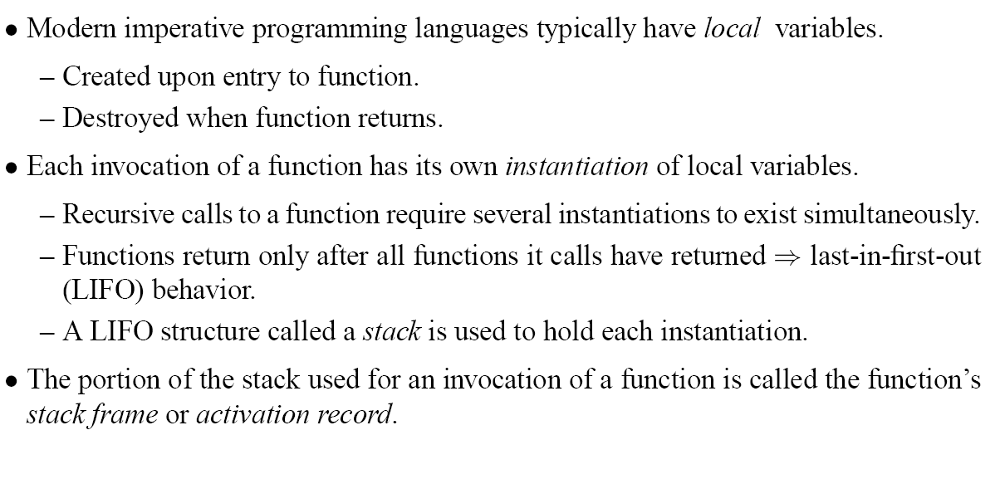
Activation Records

Slide 3
The Stack
holds local variables (and other data, see later)
implemented as large array that typically grows downwards towards lower addresses, and shrinks upwards
Push(r1):
r1
r1
u
u
stack_pointer --;
M[stack_pointer] = r1;
sp
u
sp
r1 = Pop():
r1
u
r1
v
r1 = M[stack_pointer];
stack_pointer++;
sp
v
v
sp
But:
occasionally, we also need to access the previous activation record (ie frame of caller). Hence, simple push/pop insufficient.
treat stack as array with index off of stack_pointer
push/pop entire activation records
Solution:

Slide 4
The Stack
holds local variables (and other data, see later)
implemented as large array that typically grows downwards towards lower addresses, and shrinks upwards
Push(r1):
r1
r1
u
u
stack_pointer --;
M[stack_pointer] = r1;
sp
u
sp
r1 = Pop():
r1
u
r1
v
r1 = M[stack_pointer];
stack_pointer++;
sp
v
v
sp
But:
occasionally, we also need to access the previous activation record (ie frame of caller). Hence, simple push/pop insufficient.
treat stack as array with index off of stack_pointer
push/pop entire activation records
Solution:

Slide 5
The Stack
holds local variables (and other data, see later)
implemented as large array that typically grows downwards towards lower addresses, and shrinks upwards
Push(r1):
r1
r1
u
u
stack_pointer --;
M[stack_pointer] = r1;
sp
u
sp
r1 = Pop():
r1
u
r1
v
r1 = M[stack_pointer];
stack_pointer++;
sp
v
v
sp
But:
occasionally, we also need to access the previous activation record (ie frame of caller). Hence, simple push/pop insufficient.
treat stack as array with index off of stack_pointer
push/pop entire activation records
Solution:

Slide 6
Example

Slide 7
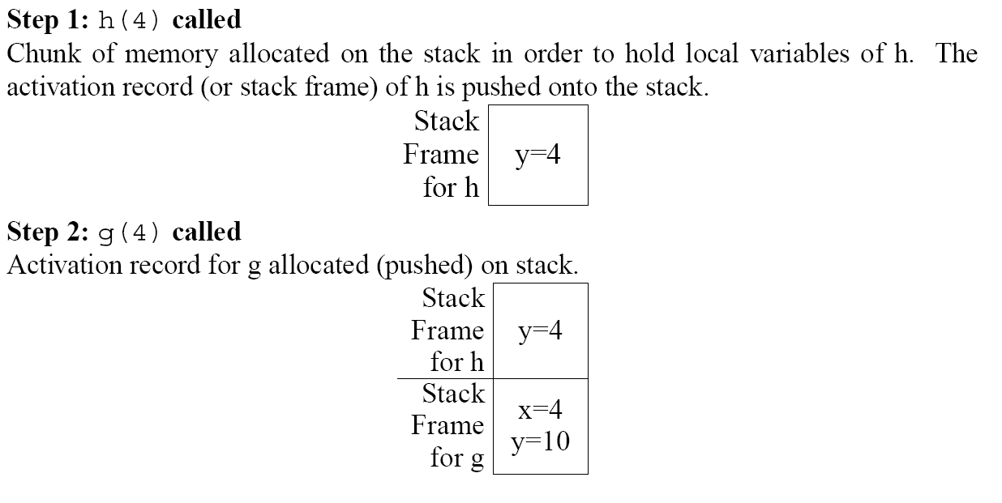
Example

Slide 8
Example

Slide 9
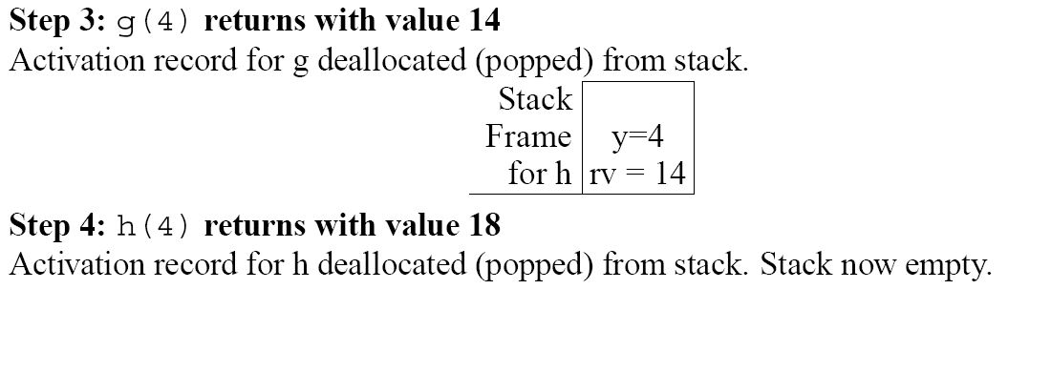
Example

Slide 10
Example

Slide 11
Recursive Example

Slide 12
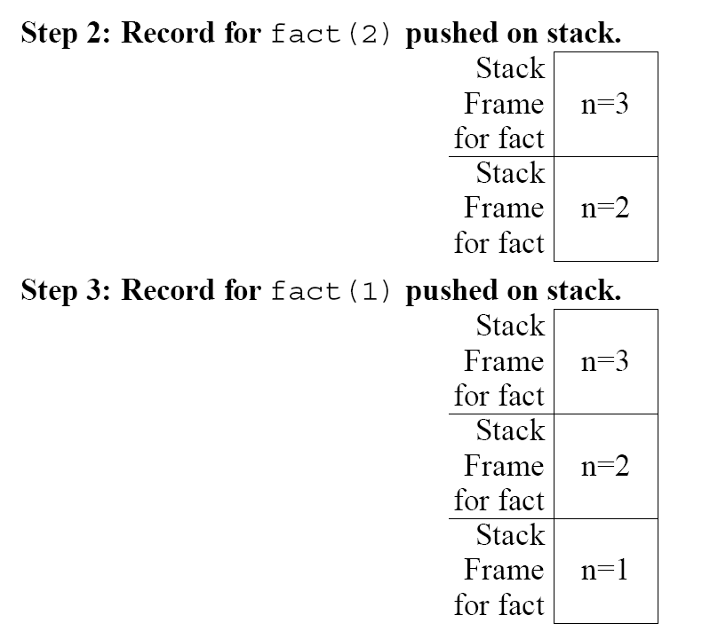
Recursive Example

Slide 13
Recursive Example

Slide 14
Recursive Example

Slide 15
Functional Languages

Slide 16
Functional Languages
Step2

Slide 17
Functional Languages
Step2
i.e. g(5)

Slide 18
Functional Languages
Combination of
nested functions and
functions that are returned as results (i.e. higher-order)
requires that
local variable remain in existence even after enclosing function has returned
activation records are allocated on heap (“closures”), not on the stack
For now, focus on languages that use stack.

Slide 19
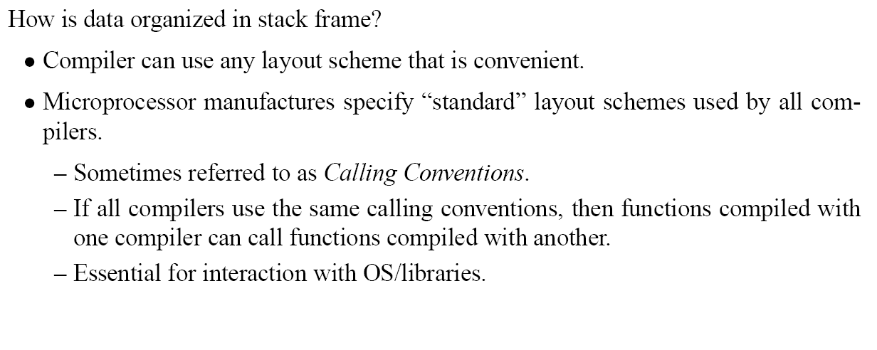
Stack Frame Organizations

Slide 20
Typical Stack Frame

Slide 21



Stack Frame Example

Slide 22
Stack Frame Example
push outgoing arguments; decrease SP
b3
b2
b1

Slide 23
Stack Frame Example
push frame pointer to f’s frame
make old SP the new FP for g
update SP by subtracting size(g)
b3
b2
b1

Slide 24
Stack Frame Example
restore f’s SP by setting it to g’s FP
restore f’s FP by following g’s dynamic link, now located at SP-1
b3
b2
b1
pop the arguments by incrementing SP
b3
b2/Garbage
b1/Garbage

Slide 25
Parameter Passing
in memory
a register argument has its address taken,
Solution: space is reserved by caller, but only written to by callee, and only if necessary

Slide 26
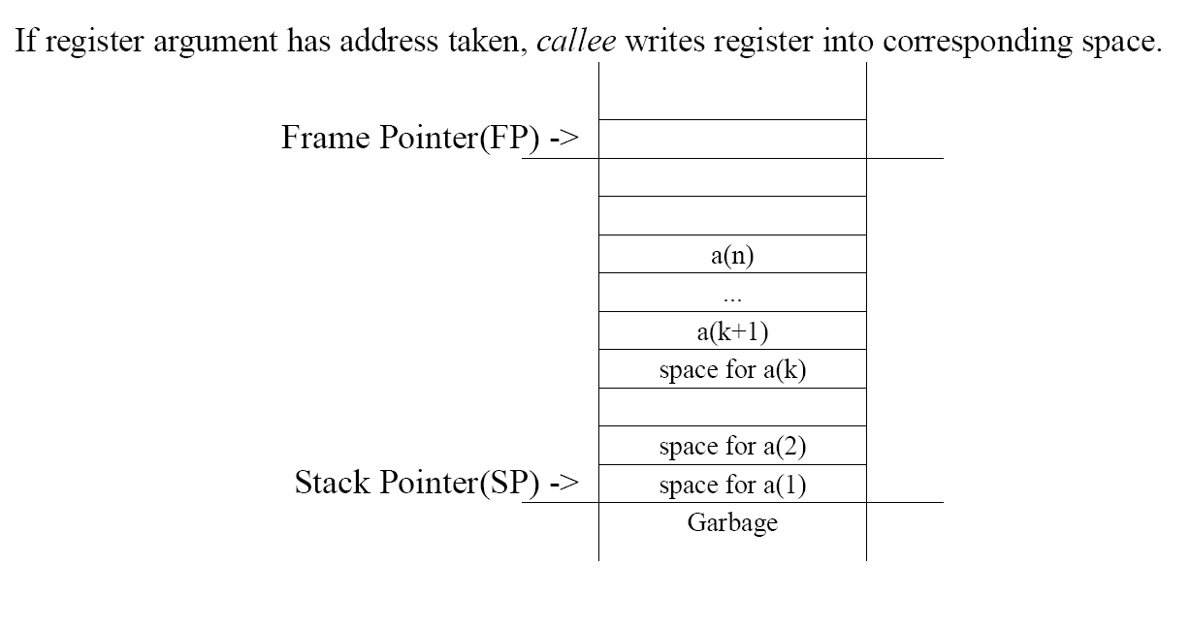
Parameter Passing

Slide 27
Registers

Slide 28
Registers

Slide 29
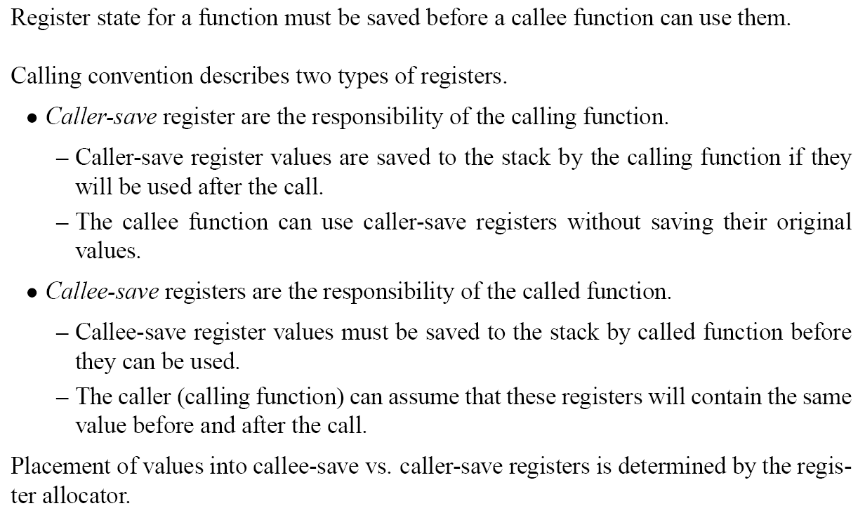
Registers

Slide 30
Return Address and Return Value

Slide 31
Frame Resident Variables
and must hence be held in memory if

Slide 32
Static Links

Slide 33
Static Links

Slide 34
Static Links: nonrecursive call
Dynamic links point to FP of caller
Static links point to FP of surrounding function’s most recent instance
Dynamic Link
a=5
&a = M[M[FP]]-2
&b = M[FP]-2

Slide 35
Static Links: recursive call
Dynamic links point to FP of caller
Static links point to FP of surrounding function’s most recent instance
Dynamic Link
a=5
&a = M[M[FP]]-2
&b = M[FP]-2

Slide 36
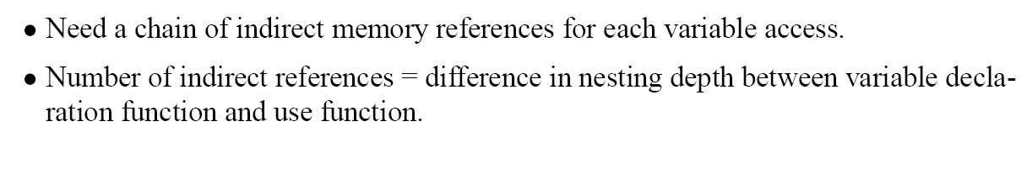
Static Links
dynamic link still needed to restore caller’s FP during function return
offsets on slides 22-24 need to be modified by +/- 1 to account for the extra slot used by the static link.

