Slide 1

Peer-to-Peer in the Datacenter: Amazon Dynamo
Aaron Blankstein
COS 461: Computer Networks
Lectures: MW 10-10:50am in Architecture N101
http://www.cs.princeton.edu/courses/archive/spr13/cos461/

Slide 2
Last Lecture…
F bits
d₄
u₄
upload rate u_{s}
Internet
d₁
d₃
u₁
u₂
u₃
d₂
upload rates u_{i}
download rates d_{i}
Notes:
This is a pretty powerful tool and it really changed the internet in a very serious way, power to the people if you will.

Slide 3
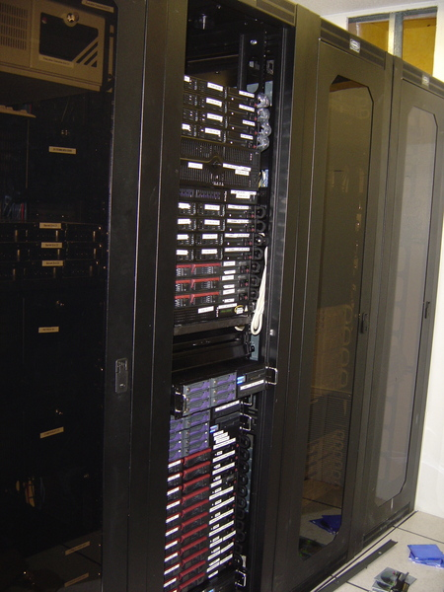
This Lecture…
Notes:
This lecture we’re going to look out how these same design choices apply to settings like this. Where before we were looking at what seemed like a very chaotic system (users stealing files on the internet) and now we are looking at what seems to be the very image of order.

Slide 4
Amazon’s “Big Data” Problem
Too many (paying) users!
  Lots of data
Performance matters
  Higher latency = lower “conversion rate”
Scalability: retaining performance when large

Slide 5
Tiered Service Structure
Stateless
Stateless
Stateless
All of the
State

Slide 6
Horizontal or Vertical Scalability?
Vertical Scaling
Horizontal Scaling

Slide 7
Horizontal Scaling Chaos
Horizontal scaling is chaotic*
Failure Rates:
  k = probability a machine fails in given period
  n = number of machines
  1-(1-k)^{n} = probability of any failure in given period
  For 50K machines, with online time of 99.99966%:
    16% of the time, data center experiences failures
    For 100K machines, 30% of the time!

Slide 8
Dynamo Requirements
High Availability
  Always respond quickly, even during failures
  Replication!
Incremental Scalability
  Adding “nodes” should be seamless
Comprehensible Conflict Resolution
  High availability in above sense implies conflicts

Slide 9
Dynamo Design
Key-Value Store ➔ DHT over data nodes
  get(k) and put(k, v)
Questions:
  Replication of Data
  Handling Requests in Replicated System
  Temporary and Permanent Failures
  Membership Changes

Slide 10
Data Partitioning and Data Replication
Familiar?
Nodes are virtual!
  Heterogeneity
Replication:
  Coordinator Node
  N-1 successors also
  Nodes keep preference list

Slide 11
Handling Requests
Requests handled by coordinator
  Consults replicas
Forward request to N replicas from pref. list
  R or W responses form a quorum
For load balancing/failures, any of the top N in the pref. list can handle request

Slide 12
Detecting Failures
Purely Local Decision
  Node A may decide independently that B has failed
  In response, requests go further in the pref. list
A request hits an unsuspecting node
  “temporary failure” handling occur

Slide 13
Handling Temporary Failures
E is in replica set
  Needs to receive the replica
  Hinted Handoff: replica contains “original” node
When C comes back
  E forwards the replica back to C
X
Add E to the replica set!

Slide 14
Managing Membership
Peers randomly tell another their known membership history – “gossiping”
Also called epidemic algorithm
  Knowledge spreads like a disease through system
  Great for ad hoc systems, self-configuration, etc.
  Does this make sense in Amazon’s environment?

Slide 15
Gossip could partition the ring
Possible Logical Partitions
  A and B choose to join ring at about the same time: unaware of one another, may take long time to converge to one another
Solution:
  Use seed nodes to reconcile membership views: well-known peers which are contacted more frequently

Slide 16
Why is Dynamo Different?
So far, looks a lot like normal p2p
Amazon wants to use this for application data!
Lots of potential synchronization problems
Dynamo uses versioning to provide eventual consistency.

Slide 17
Consistency Problems
Shopping Cart Example:
  Object is a history of “adds” and “removes”
  All adds are important (trying to make money)
Client:
Put(k, [+1 Banana])
Z = get(k)
Put(k, Z + [+1 Banana])
Z = get(k)
Put(k, Z + [-1 Banana])
Expected Data at Server:
[+1 Banana]
[+1 Banana, +1 Banana]
[+1 Banana, +1 Banana,
-1 Banana]

Slide 18
What if a failure occurs?
Client:
Put(k, [+1 Banana])
Z = get(k)
Put(k, Z + [+1 Banana])
Z = get(k)
Put(k, Z + [-1 Banana])
Data on Dynamo:
[+1 Banana] at A
A Crashes
B not in first Put’s quorum
[+1 Banana] at B
[+1 Banana, -1 Banana] at B
Node A Comes Online
At this point, Node A and B disagree about the
current state of the object – how is that resolved?
Can we even tell that there is a conflict?

Slide 19
“Time” is largely a human construct
What about time-stamping objects?
  We could authoritatively say whether an object is newer or older…
  all events are not necessarily witnessed
If our system’s notion of time corresponds to “real-time”…
  A new object always blasts away older versions, even though those versions may have important updates (as in bananas example).
Requires a new notion of time (causal in nature)
Anyhow, real-time is impossible in any case

Slide 20
Causality
Objects are causally related if the value of one object depends on (or witnessed) the previous
Conflicts can be detected when replicas contain causally independent objects for a given key.
Can we have a notion of time which captures causality?

Slide 21
Versioning
Key Idea: every PUT includes a version, indicating the most recently witnessed version of the object being updated
Problem: replicas may have diverged
  No single authoritative version number (or “clock” number)
  Notion of time must use a partial ordering of events

Slide 22
Vector Clocks
Every replica has its own logical clock
  Incremented before it sends a message
Every message attached with vector version
  Includes originator’s clock
  Highest seen logical clocks for each replica
If M₁ is causally dependent on M₀:
  Replica sending M₁ will have seen M₀
  Replica will have seen clocks ≥ all clocks in M₀

Slide 23
Vector Clocks in Dynamo
Vector clock per object
Gets() return vector clock of object
Puts() contain most recent vector clock
  Coordinator treated as “originator”
Serious conflicts are resolved by the application / client

Slide 24
Vector Clocks in Banana Example
Client:
Put(k, [+1 Banana])
Z = get(k)
Put(k, Z + [+1 Banana])
Z = get(k)
Put(k, Z + [-1 Banana])
Data on Dynamo:
[+1] v=[(A,1)] at A
A Crashes
B not in first Put’s quorum
[+1] v=[(B,1)] at B
[+1,-1] v=[(B,2)] at B
Node A Comes Online
[(A,1)] and [(B,2)] are a conflict!

Slide 25
Eventual Consistency
Versioning, by itself, does not guarantee consistency
  If you don’t require a majority quorum, you need to periodically check that peers aren’t in conflict
  How often do you check that events are not in conflict?
In Dynamo
  Nodes consult with one another using a tree hashing (Merkel tree) scheme
  Allows them to quickly identify whether they hold different versions of particular objects and enter conflict resolution mode

Slide 26
NoSQL
Notice that Eventual Consistency, Partial Ordering do not give you ACID!
Rise of NoSQL (outside of academia)
  Memcache
  Cassandra
  Redis
  Big Table
  Neo4J
  MongoDB

