Slide 1
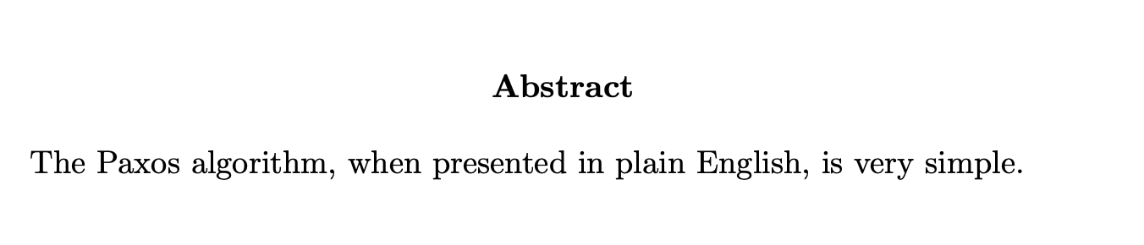
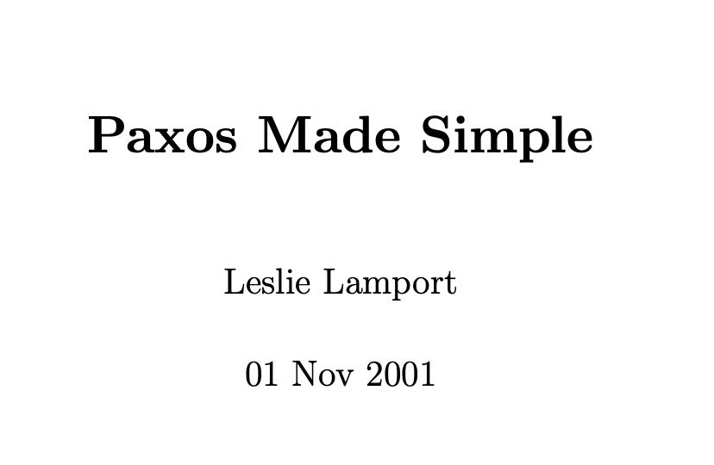
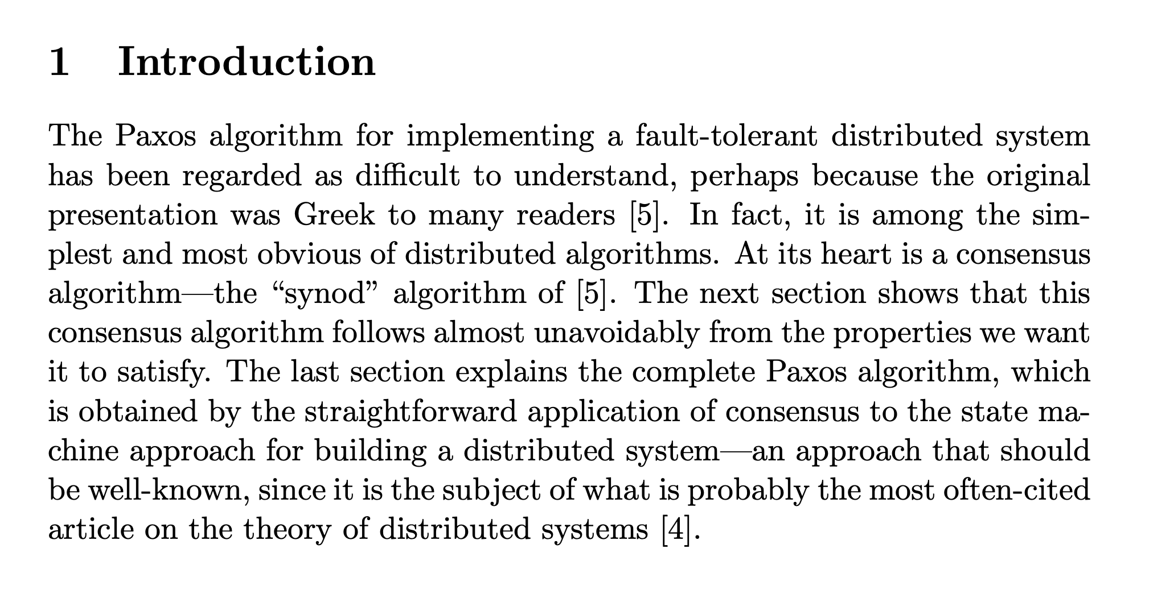
Paxos
October 2026
Notes:
Abstract and Intro of the Paxos Made Simple Paper
Mention that

Slide 2
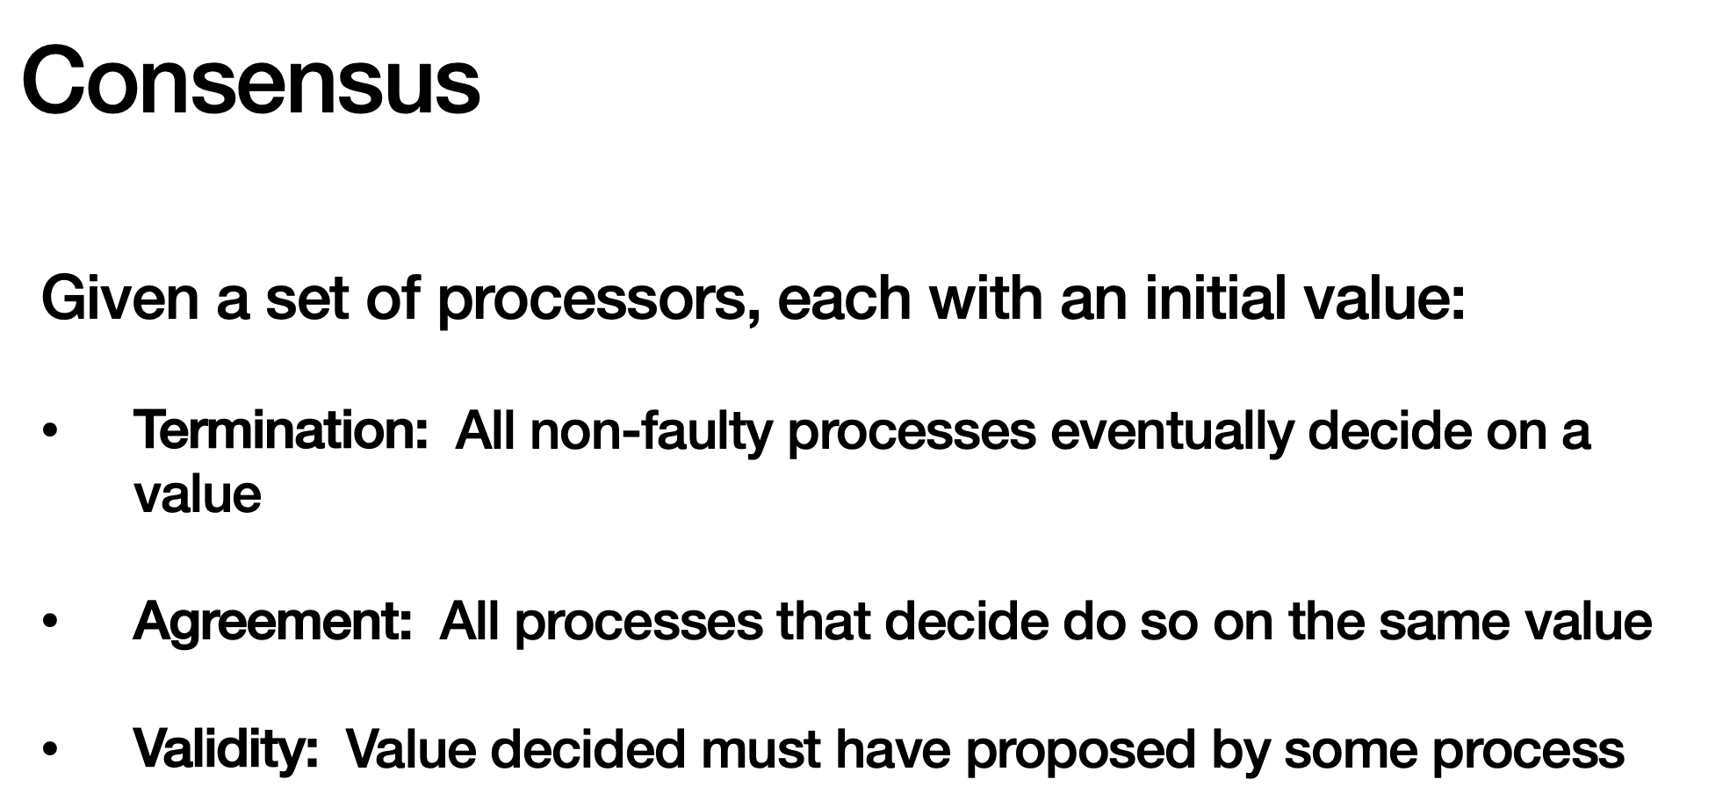
Paxos is all about consensus
Notes:
Review of the problem Pacos is solving as seen in class

Slide 3
Wrong Solutions to Consensus
1 leader that accepts proposals

Slide 4
Wrong Solutions to Consensus
1 leader that accepts proposals
  Can’t progress when the leader dies!
Notes:
If we just let non-primaries make changes and propose changes to the leader then we haven’t gained any resiliency if the leader fails!

Slide 5
Wrong Solutions to Consensus
1 leader that accepts proposals
  Can’t progress when the leader dies!
Everyone can accept proposals, wait for a majority

Slide 6
Wrong Solutions to Consensus
1 leader that accepts proposals
  Can’t progress when the leader dies!
Everyone can accept proposals, wait for a majority
  Fails to progress when there’s lots of proposals!
Notes:
If everyone can make arbitrary proposals then we might wait forever for a majority to accept a single value as the proposal.

Slide 7
Invariants
All proposals are have a unique identifier
  Strictly increasing integer + proposer ID like 1a for machine a
A proposal (i, v) has a value equal to the proposal with the largest identifier < i
  Avoids the second problem of conflicting values
Notes:
These simple invariants largely define the algorithm for us, everything else is pretty straightforward after that.

Slide 8
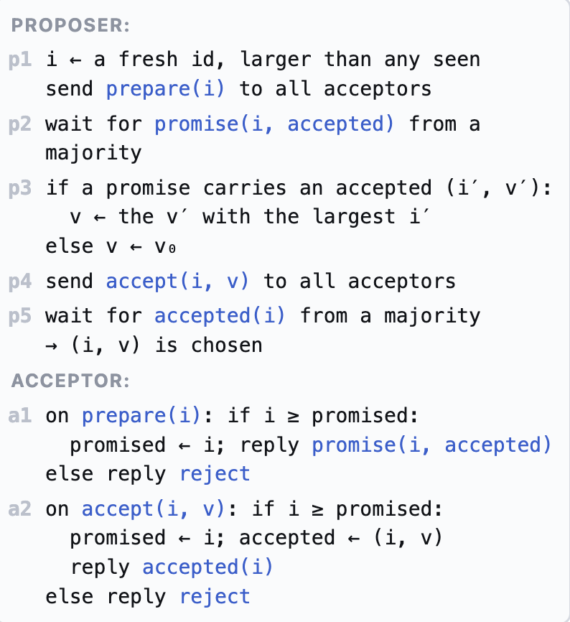
Pseudocode
Notes:
Emphasize the first bullet point, often students think their code is doing X while in fact it is doing Y. They can catch these kinds of bugs much much earlier if they print regularly.
Consensus
Paxos Example [2 proposer]
Not all acceptors are responding
Intuition: Safety

Slide 9
Review of Paxos [High-Level]
Phase 2: Proposal
Phase 3: Acceptors Broadcast Accepted Values to learners
Phase 1: Prepare/Election
ACK
ACK
Prepare (Please choose me!)
Value v, accept?
Any node can be a learner. The Phase 2 ACK to the proposer can double as the acceptors’ broadcast to learners if we assume that the proposer also acts as a learner.
Proposer
Acceptor
Notes:
Mention that a process could be proposer, acceptor and learner at the same time
Note that the proposer itself could the the learner so ACK back to the proposer could essentially just be the learning messages

Slide 10

Review of Paxos [Detailed]
Phase 1: Prepare/Election
ACK
<prepare, n>
n: prepare id
Reject
n < n_highest
This acceptor has seen a prepare message with a higher prepare_id
Proposer
Acceptor

Slide 11

Review of Paxos [Detailed]
Phase 1: Prepare/Election
<Promise, n , ∅>
<prepare, n>
n: prepare id
<Promise, n , ∅>
Both acceptors accept and update their n_highest = n
Assumption: None of them had accepted other proposals before
Proposer
Acceptor

Slide 12
Review of Paxos [Detailed]
So here the proposer has to retry with the v_a, instead of its own proposed value [Do not race, just complete the duty of the previous proposer]
Phase 1: Prepare/Election
<Promise, n , ∅>
<prepare, n>
n: prepare id
<Promise, n , (n_a, v_a)>
Both acceptors accept and update their n_highest = n
Assumption: One of them accepted an older proposal before [the proposal made by n_a prepare round]
Proposer
Acceptor

Slide 13
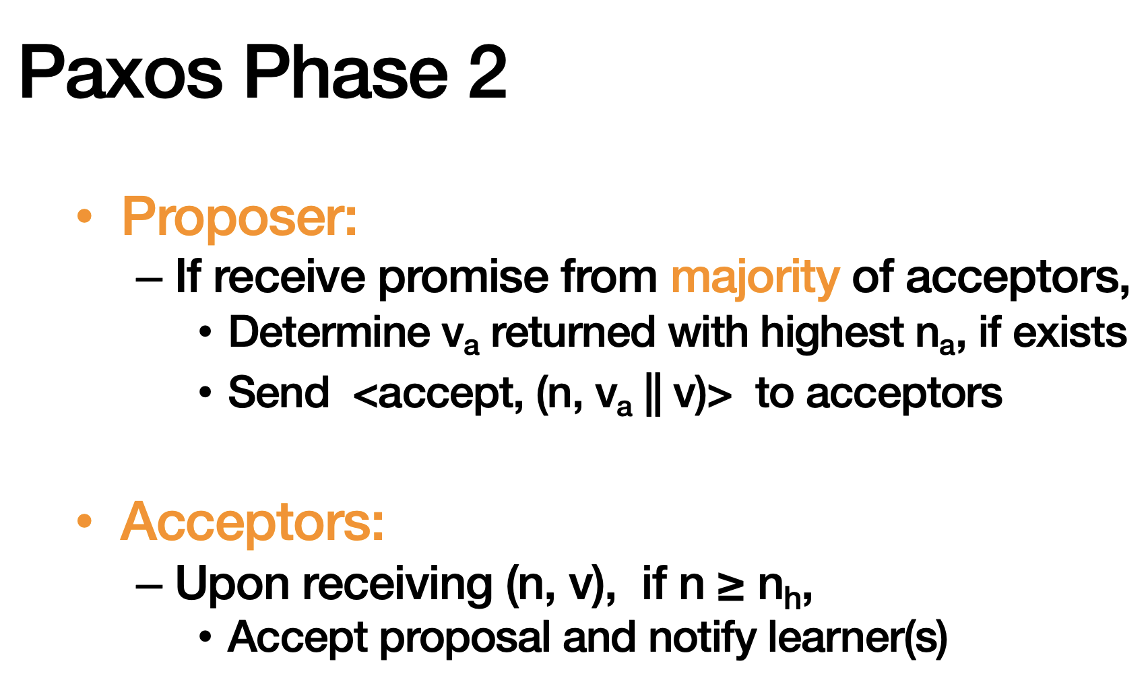
Review of Paxos [Detailed]

Slide 14
Let’s practice
In this example, we have 5 processes. All of them are learners.
All of them might become proposers and acceptors at different times.
P1
P2
P3
P4
P5
Notes:
This is example stresses how paxos might not be live [never terminates]

Slide 15
Let’s practice: Failed Prepare
Each prepare/proposal needs at least (5+1)/2 = 3 ACK [including itself]
Green Arrows are ACK and Red ones are REJECT.
P1: Prepare(1)
P2: Prepare(2)
P1
P2 Got the Majority
P2
P3
P4
P5
Pink Arrows are slow communications, still on-route
Notes:
P1 sends a prepare message to everyone: Network delay: messages to N3, N4, N5 are slow.
This figure is all about the phase 1 prepare/elect.

Slide 16
Let’s practice: Failed Prepare
Each prepare/proposal needs at least (5+1)/2 = 3 ACK [including itself]
Green Arrows are ACK and Red ones are REJECT.
P1: Prepare(1)
P2: Prepare(2)
P1 Failed to get the majority
P1
P2 Got the Majority
P2
P3
P4
P5
Pink Arrows are slow communications, still on-route
Notes:
Here finally the first prepare from P1 arrives
Mention the same pattern of failed prepare can happen in the proposal phase also “Failed Proposal”

Slide 17

Let’s practice: Racing
P1: Prepare(1)
P1
P2
P3
P4
P5
Successful Prepare Phase; Now P1 can propose!

Slide 18
Let’s practice: Racing
P1: Propose(val=10)
P1
P2
P3
P4
P3: Prepare<2>
P5
But before the proposal arrive at {P3, P4, P5}, P3 starts prepare with higher id
And {P4, P5} accepts the new prepare! So P3 wins the prepare too.

Slide 19
Let’s practice: Racing
Some of the late arrows that will arrive in future and get rejected are not shown for readability.
The old proposal value of P1 is now declined, because there was a higher new prepare.
P1: Propose(val=10)
P1
P2
P3
P4
P3: Prepare<2>
P5
P2 also accepts the prepare from P3, but sends the previously accepted value 10 to P3
Notes:
Assume the links between P3 and P1 is slow and unstable

Slide 20
Let’s practice: Racing
Some of the late arrows that will arrive in future and get rejected are now shown for readability.
P1: Propose(val=10)
P1
P2
P3: Propose(val=10)
P3
P4
P3: Prepare<2>
P5
P3 starts proposal with the same value=10!
Notes:
Important to notice that how P3 was forced to propose the same value

Slide 21
Let’s practice: Racing
Some of the late arrows that will arrive in future and get rejected are now shown for readability.
P1: Propose(val=10)
P1
P2
P3: Propose(val=10)
P3
P4
P3: Prepare<2>
P5
If at least 2 other processes ACK, we’re all good! 10 is decided and P3’s proposal is complete
P3 starts proposal with the same value=10!
Notes:
Important to notice that how P3 was forced to propose the same value

Slide 22
Let’s practice: Racing
But what if (similar to P1’s proposal), some process send <prepare> with a higher id before at least 2 processes ACK to P3’s proposal?
P1: Propose(val=10)
P1
P2
P3: Propose(val=10)
P3
P4
P3: Prepare<2>
P5
P4: Prepare<3>
P3 starts proposal with the same value=10!

Slide 23
This can repeat indefinitely: before any proposal round completes, another process
starts a new one,
wins the majority in the prepare phase, and
causes previous proposals to be rejected.
The new leader then tries to finish the proposal (with the old value), but is interrupted again — and the cycle continues.

Slide 24
Takeaway
What we saw was safe!
Whenever an accept happens it respects previously accepted values.
But liveness failed
Because two proposers continually preempt each other
Accept phases never gather a majority of accepts.
Higher proposal numbers keep invalidating earlier attempts, so no progress is made until one proposer stops or the network schedules deliver differently.
In practice people inject artificial delays between processes so they don’t race concurrently and there is some delay!

