Slide 1
Distributed Snapshots
September 2026

Slide 2
A Note on Channels and Goroutines
Using channels is easy, debugging them is hard…
Bullet-proof way: Keep track of how many things go in and go out
Always ask yourself: is this channel buffered?
In general, don’t use locks or atomic operations with channels (awkward)
Try not to nest goroutines (would be hard to reason about them)
Notes:
Bullet-proof way: easier said than done, but it’s something to look out for when debugging. E.g. last iteration of for loop is often a tricky case.
It is important to know if your channel is buffered or not because it might introduce implicit blocking across goroutines in your code.
Atomic operations are provided in go by sync/atomic package. They have smaller overhead than channels or locks. Example:
var counter int32 = 0
atomic.AddInt32(&counter, 1)

Slide 3
Review of Snapshot Fundamentals

Slide 4
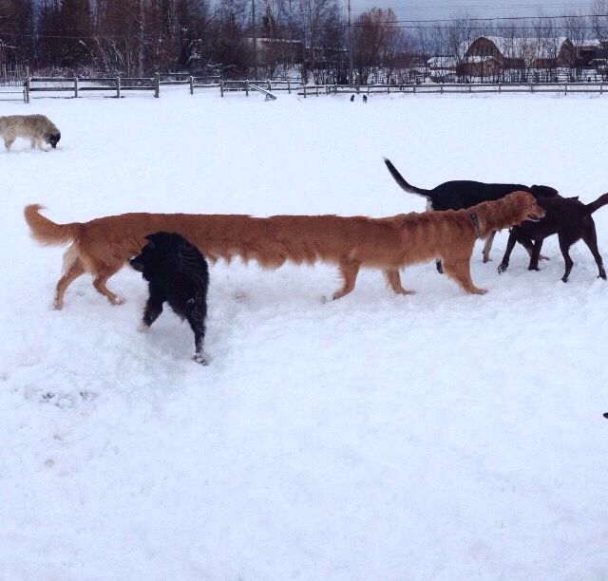
Taking a panorama with a moving object in the scene.
N1
N2
N3
N4
Notes:
Suppose we would like to take a panorama of a scene. However, there is a moving object (in this case, a dog) in the scene.

Slide 5
Notes:
If we do nothing, we end up with this monstrosity of a panoramic photo. Ideally we’d like to record the dog in its entirety only once, in some part of this panorama. That is going to the the goal of distributed snapshot algorithms.

Slide 6
Distributed snapshots are hard
Must ensure state is not duplicated across the cluster (we only want one dog)
Must ensure state is not lost across the cluster (we still want the dog there)
We must carefully consider how and when exactly to record state.
Notes:
Why ensuring state is not duplicated or lost: the state could reflect exclusive ability to do something, e.g., remember who is the leader in raft. The leader coordinates the nodes and makes sure they are consistent with the leader.

Slide 7
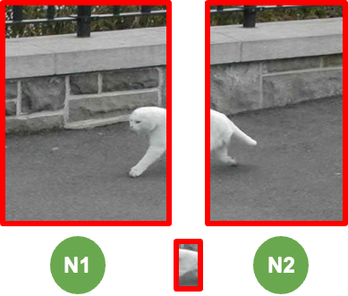
Event order:
1.Snap N1
2.N2 sends body
3.Snap N2
4.N1 receives body
Should record message!

Slide 8
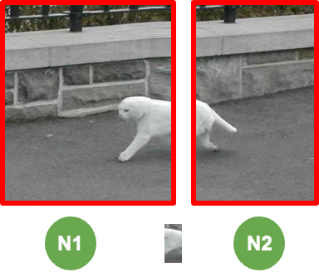
Event order:
1.N2 sends body
2.Snap N2
3.N1 receives body
4.Snap N1
N1 already received the body in step 3
Should NOT record message

Slide 9
Intuition: guarantee zero loss + zero duplication
If you haven’t snapshotted your local state yet:
Do NOT record future messages you receive
If you have snapshotted your local state:
Do record future messages you receive
Which one guarantees zero loss?
Which one guarantees zero duplication?
Notes:
"Do NOT record future messages you receive if you haven’t snapshotted your local state yet" → Guarantees zero duplication
If you record a message as “in the channel” before you start the snapshot, then you will later record it again in the destination node when it starts the snapshot.
"Do record future messages you receive if you have snapshotted your local state" → Guarantees zero loss
When a message is sent, it is either sent before or after the marker. If it is sent before, it will be recorded in the destination, and otherwise “in the channel”.

Slide 10
What is a Global Snapshot?
m1
m2
A global snapshot captures the global state of a distributed system:
A
B
  Local state of each process within the distributed system
  Local state of each communication channel
m3
m5
m4
These local states are instantaneous
  e.g messages in transit from one node to another only exist in transit for a few milliseconds or less
C
Notes:
A distributed system can contain hundreds/thousands of servers, each communicating with one another via messages.
They can have very complicated interactions with each other.
So what does global snapshot mean here?
It captures the global state which includes 2 aspects: the states on the nodes, and the states of channels containing in-transit messages.
These states are instantaneous, meaning that they could change at any time.
A distributed snapshot is a process where each node or process records its own local state, but a global snapshot is the collection of all local snapshots and recorded channel states.

Slide 11
Global Snapshots are Useful
Checkpointing
  Recover more quickly after failures
Garbage Collection
  Remove objects that are not referenced any more by other objects/processes at any other servers
Deadlock Detection
  Examine the global application state and identify any deadlocks, useful in transactional database systems
And many others …
Notes:
So why would we like to have global snapshots?
It turns out that they are very useful for recovery and reasoning about certain system properties.

Slide 12
System Model
N processes in the system
  Each process keeps track of some state
There are two unidirectional communication channels between each pair of processes P and Q
  FIFO-ordered (First-In-First-Out)
  Message arrives intact and is unduplicated
  Each channel also has some state
No failures
Notes:
Before moving on to the distributed snapshot algorithm, it is important to first define our system model.
Then, explain each bullet point on this slide.
Here, we mention about “messages” and “states”. But what are they? What could be a message type? What could be stored in a state?
Messages: RPC request/responses, heartbeats, acknowledgements
State: local variables, database state, pending messages

Slide 13
Messages and States
What are the messages?
  Application messages that differ across systems (e.g “sending $10 from A to B”, “read value at memory address X and write back with a new value”)
  Special messages (e.g marker message) that should not interfere with application messages
What are the states?
  Process state: application-defined state, or the classic notion of state which includes heap, registers, program counters and etc
  Channel state: the set of messages inside
Tips for Assignment 2
  See *.top, *.events, *.snap files under ./test_data to understand what states and messages mean in this assignment
  Read test_common.go to understand the syntax of the above files, and their relationships with the simulator

Slide 14
Distributed Snapshot
“Distributed Snapshots: Determining Global States of Distributed Systems” 1985, by K. Mani Chandy and Leslie Lamport
Key Idea: Servers send marker messages to each other
Marker messages
Mark the beginning of the snapshot process on the server
Act as a barrier (stopper) for recording messages
Notes:
Distributed snapshot is an algorithm that can capture the global snapshot of a distributed system, without disturbing its normal execution.
It is proposed by K. Main Chandy and Leslie Lamport in this 1985 paper.
Its key idea is the use of a special type of messages, marker messages, which serves two purposes.
Then explain point 1 and 2.
Now let us get to the details of this algorithm.

Slide 15
Chandy-Lamport Algorithm
Any process can initiate the snapshot
Record local state
Create marker messages and send them to all outbound channels
Start recording messages from all incoming channels
Notes:
This marker message means that the process has recorded everything happened so far.
Whatever happens after this point is not included in the current snapshot.

Slide 16
Chandy-Lamport Algorithm Continued
When receiving a marker message from channel C
If this is the first marker message that this process has even seen:
Record the local state
Record the state of C as “empty sequence”
Send out the marker message on all outbound channels
Start recording messages from all of its other incoming channels
If it has already seen a marker message (e.g. from some other channel)
Record the state of C as the sequence of messages received since the process’s local state has been recorded
Stop recording messages on C (i.e done with recording the channel’s state)
Notes:
Subtle additional requirement: record messages on all OTHER channels, not the one we received the marker message from. Why?
Ans: we know the other end has already recorded its local state
How: because it sent a marker message!
Whatever messages it sends afterward happened AFTER the snapshot; not included in this snapshot
Otherwise might double-count state
Example of this later
Similarly, why can we stop recording messages on C when it is not the first marker message we see?
Ans: The other end also has recorded its state. We have recorded the state of the channel. No need to keep tracking more.
So we are waiting from a marker message from every channel to actually finish recording messages.

Slide 17
Chandy-Lamport Algorithm Continued
When is the algorithm terminated?
All processes have received marker messages (i.e have recorded their local states)
All processes have received marker messages from all of their incoming channels (i.e have recorded the local states of all channels)
Both need to satisfy
What happens after the termination?
Optional and out of the scope of Chandy-Lamport algorithm
Usually, there will be a central server that collects local snapshots from all servers to build a global snapshot (e.g the simulator in Assignment 2) and maybe run some computations (e.g deadlock detection) on it
Notes:
Algorithm terminates when we’re sure that the marker messages have covered all the links in the system.
What happens after the termination?
It usually depends on what system admins want to do with these snapshots.
And it is out of scope of the original chandy-lamport algorithm
Next, we will go over some examples

Slide 18
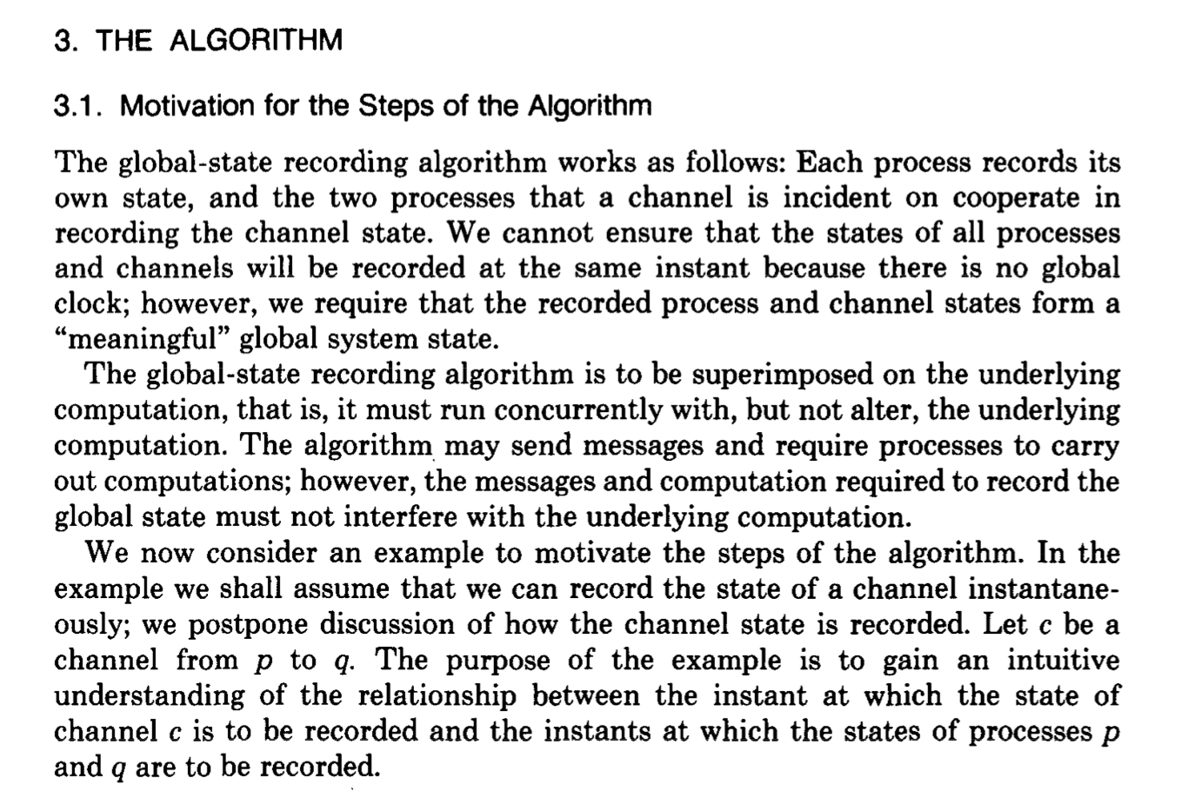
See Section 3 of the original paper for more details

Slide 19
Exercises

Slide 20
Token Passing Example 1
1 Token
0 Tokens
A
B
Notes:
Start with a simple case considering only two processes and a pair of channels

Slide 21
Token Passing Example 1
Event order:
A sends 1 token
0 Tokens
0 Tokens
1 Token
A
B

Slide 22
Token Passing Example 1
Event order:
A sends 1 token
A starts snapshot, sends marker
0 Tokens
0 Tokens
M
1 Token
A
B
Notes:
Green indicates node has been snapshotted

Slide 23
Token Passing Example 1
Event order:
A sends 1 token
A starts snapshot, sends marker
B receives 1 token
0 Tokens
1 Token
M
A
B

Slide 24
Token Passing Example 1
Event order:
A sends 1 token
A starts snapshot, sends marker
B receives 1 token
B receives marker, starts snapshot
0 Tokens
1 Token
A
B
M

Slide 25
Token Passing Example 1
Event order:
A sends 1 token
A starts snapshot, sends marker
B receives 1 token
B receives marker, starts snapshot
A receives marker, ends snapshot
0 Tokens
1 Token
A
B
We did not record the token message because B received it before B started the snapshot process
Notes:
If we had recorded the token message then we would have more than 1 token in the snapshot!

Slide 26
Token Passing Example 2
0 Tokens
1 Token
A
B

Slide 27
Token Passing Example 2
Event order:
B sends 1 token
0 Tokens
0 Tokens
A
B
1 Token

Slide 28
Token Passing Example 2
Event order:
B sends 1 token
A starts snapshot, sends marker
0 Tokens
0 Tokens
M
A
B
1 Token

Slide 29
Token Passing Example 2
Event order:
B sends 1 token
A starts snapshot, sends marker
A receives 1 token, records message
0 Tokens
0 Tokens
M
A
B
1 Token

Slide 30
Token Passing Example 2
Event order:
B sends 1 token
A starts snapshot, sends marker
A receives 1 token, records message
B receives marker, starts snapshot
0 Tokens
0 Tokens
A
B
M
1 Token

Slide 31
Token Passing Example 2
Event order:
B sends 1 token
A starts snapshot, sends marker
A receives 1 token, records message
B receives marker, starts snapshot
A receives marker, ends snapshot
0 Tokens
0 Tokens
A
B
1 Token
We recorded the token message because A received it after it has already started the snapshot process
Notes:
Why do we record the message this time? What’s the difference between this example and the previous?
If we did not record the message we would have ended up with 0 tokens in the system!

Slide 32
Token Passing Example 3
Which messages are definitely recorded*?
Which messages are definitely not recorded?
Which messages might be recorded?
* recorded as in-flight messages, i.e., as part of channel state rather than process state
m1
M
m2
A
B
m3
m6
M
m7
m4
m5
C
Notes:
Now let’s take a look at a slightly more complicated case, assuming 3 process
Node A starts snapshot…
Here, “recorded” means that will be recorded as an in-flight message (that exists in some channel) in the global snapshot.

Slide 33
Token Passing Example 3
Which messages are definitely recorded*?
Which messages are definitely not recorded?
Which messages might be recorded?
*recorded as in-flight messages
m1
M
m2
A
B
m7
m3
m6
M
m7
m1, m3
m4
m5
C
m2, m4, m5, m6
Notes:
m7 is definitely recorded: it arrives at A after A sends the marker message and before C will have sent a marker message back to A.
m1, m3 are sent by A after it has sent the marker message, so those tokens will be snapshotted by A before they are sent as messages.
m2, m4 may be received by B, C before B, C receive the marker message, so they will be part of local state when it is time to snapshot. However, if B receives m2 AFTER C forwards the marker message from A, then m2 will be recorded as a message. Likewise with C receiving m4 after B forwards the marker message from A.
Is it possible for B to receive M before m2? Ans: No. FIFO.
m5, m6 will be recorded as in-flight messages if they arrive at B, C after the marker message arrives. If they arrive before the marker message, they will be recorded as local state at B, C.
Note that at each node from whoever you get the token for the first time; the link state is empty; so if C gets the token from A earlier than getting the token from B; channel(A,C) will be empty but if somehow the first token that C gets is from B instead of A then Channels (B,C) is going to be empty.

Slide 34
Takeaways
Tokens arriving on the incoming channels of a process that has already started the snapshot are recorded as the state of that channel.
Tokens sent on an outbound channel after a process has sent a marker on that channel are not included in the state of the channel.
The channels through which each process receives the marker for the first time are recorded to be empty.
m1
M
m2
A
B
m3
m6
M
m7
m4
m5
C

Slide 35
Puzzles from the Lecture

Slide 36
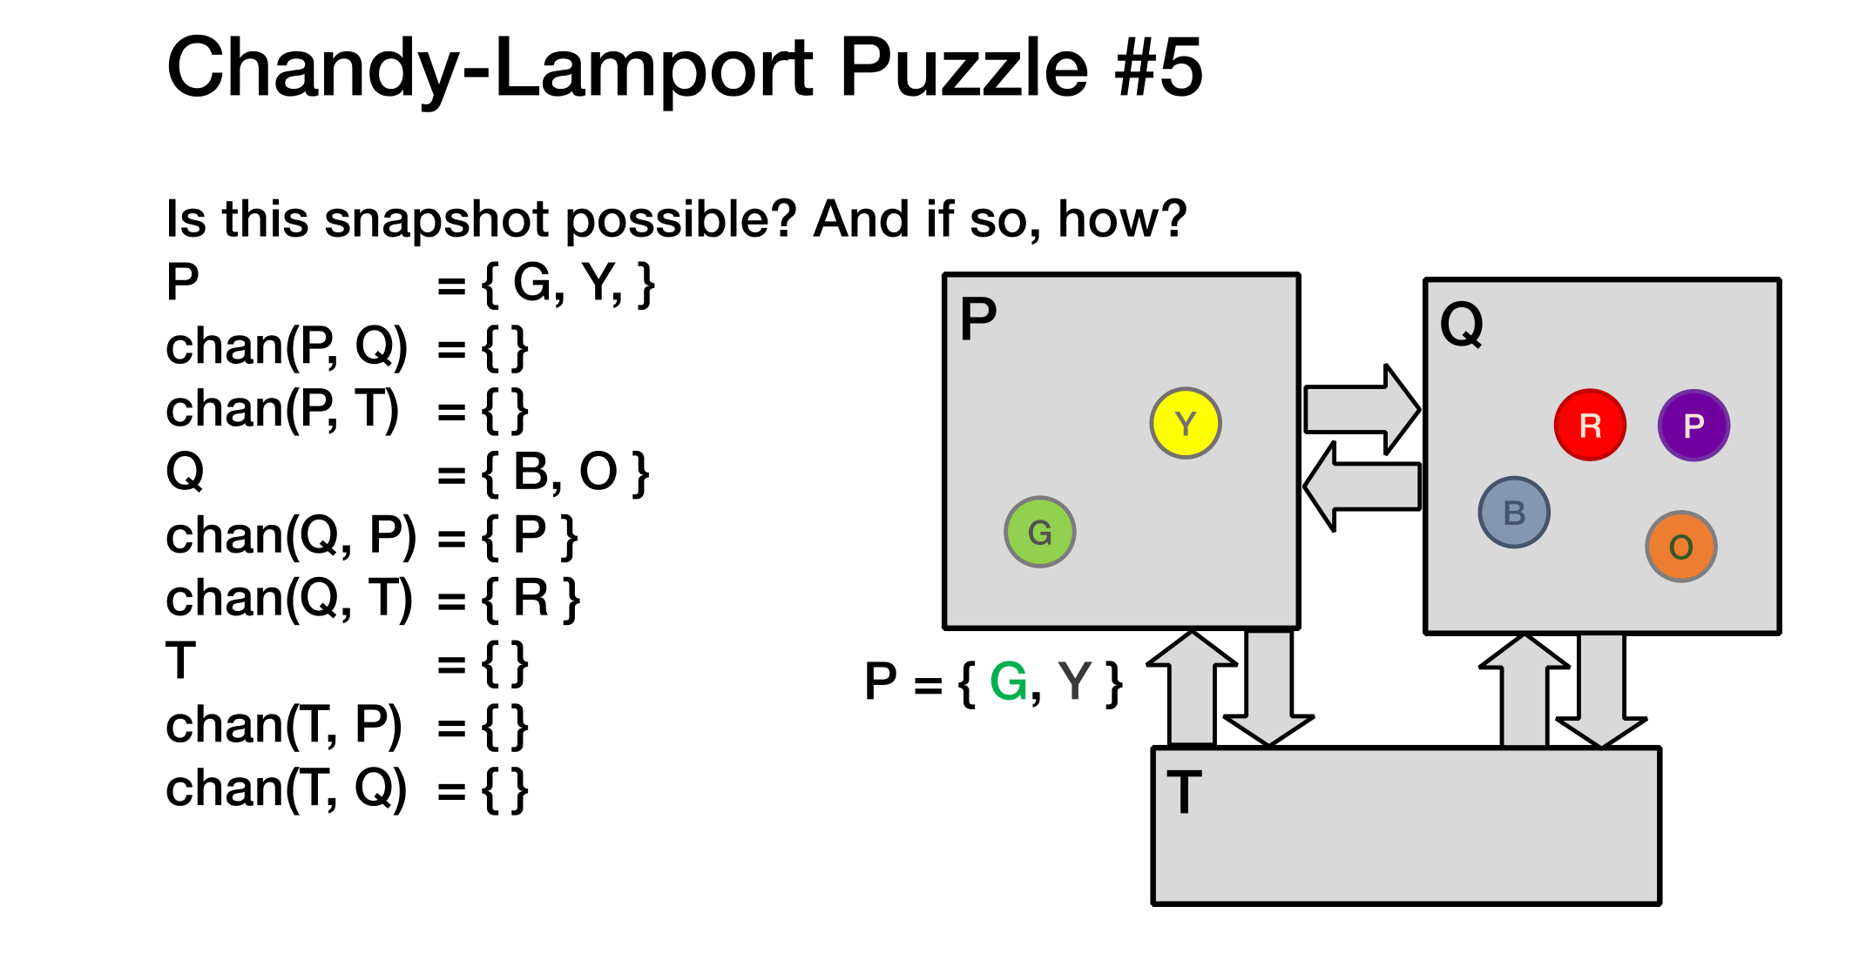
Notes:
For R to be in chan (Q,T) -> marker should be received after R in the channel
For P to be in (Q,P); P should start the snapshot and before getting the marker back receives P on its inbound

Slide 37
P was captured in (Q,P)
1. Process P started the snapshot before Token P was received
2. It received the marker back after receiving Token P
R was captured in (Q,T)
1. Process T started the snapshot before Token R was received
2. It received the marker back after receiving Token R
Notes:
For R to be in chan (Q,T) -> marker should be received after R in the channel
For P to be in (Q,P); P should start the snapshot and before getting the marker back receives P on its inbound
Go though the reasoning of how to think back from the fact that a token was captured in a channel.

Slide 38
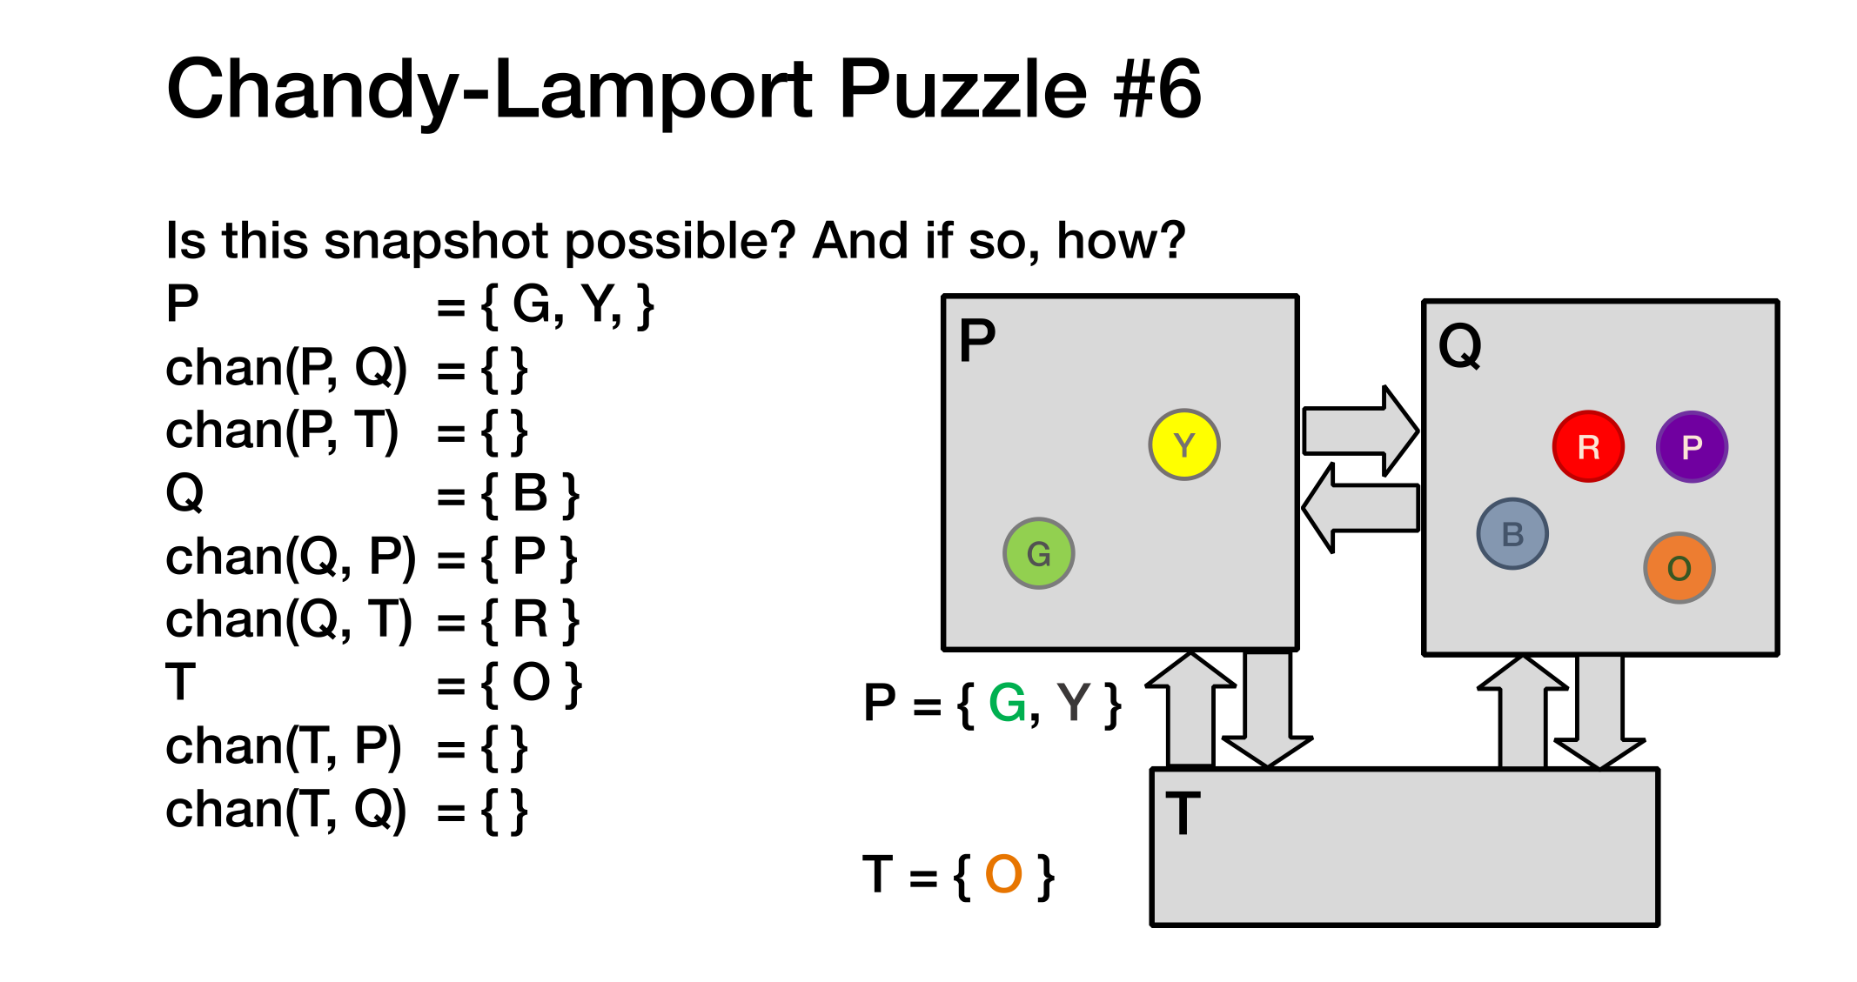
Notes:
In a system with N processes, the Chandy-Lamport snapshot algorithm will always show that at least (N-1) channels are empty. (The channels through which each process receives the marker for the first time are recorded to be empty. All such channels define a spanning tree, thus, there are N-1 empty channels

Slide 39
Assignment 2 Overview
You will implement the Chandy-Lamport snapshot algorithm
Application is a token passing system
  Number of tokens must be preserved in your snapshots
Implementation uses discrete time simulator to order events
  Simulator manages servers and injects events into the system
  Server implements the snapshot algorithm
Allow multiple active snapshot processes
  E.g, The second snapshot can start before the first snapshot completes in the system
Notes:
What is a “discrete time simulator”?: Simulates passage of time in discrete steps, i.e., system is assumed to change only at each discrete time tick

Slide 40
Assignment 2 Interfaces
func (sim *Simulator) Tick()
func (sim *Simulator) StartSnapshot(serverId string)
func (sim *Simulator) NotifySnapshotComplete(serverId string, snapshotId int)
func (sim *Simulator) CollectSnapshot(snapshotId int) *SnapshotState
What kind of state does the simulator need to keep track of?
  Time
  Topology
  Channels to signal the completion of snapshots
  ...

Slide 41
Assignment 2 Interfaces
func (server *Server) SendToNeighbors(message interface{})
func (server *Server) SendTokens(numTokens int, dest string)
func (server *Server) HandlePacket(src string, message interface{})
func (server *Server) StartSnapshot(snapshotId int)
What kind of state does the server need to keep track of?
  Local state
  Neighbors
  Which channels received markers
  Recorded messages
  ...

Slide 42
Assignment 2
Start Early ☺
Due October 3 (Friday) at 11:59pm!

