Slide 1
Distributed Snapshots
COS 418/518: Distributed Systems
Lecture 6
Jialin Ding, Mike Freedman

Slide 2
Distributed Snapshots
What is the state of a distributed system?
San Francisco
acct1 balance = $1000
acct2 balance = $2000
New York
acct1 balance = $1000
acct2 balance = $2000

Slide 3
System model
N processes in the system with no process failures
  Each process has some state it keeps track of
There are two first-in, first-out, unidirectional channels between every process pair P and Q
  Call them channel(P, Q) and channel(Q, P)
  The channel has state, too: the set of messages inside
  All messages sent on channels arrive intact, unduplicated, in order

Slide 4
Aside: FIFO communication channel
  “All messages sent on channels arrive intact, unduplicated, in order”
Q: Arrive?
Q: Intact?
Q: Unduplicated?
Q: In order?
TCP provides all of these when processes don’t fail
Notes:
Q: How can we get such a FIFO channel?
A: At-least-once retransmission + at-most-once deduplication + ordering of messages (seq no + delivery in seq no order)
A: TCP provides all of the above for us as long as processes do not fail (which we assumed here)
At-least-once retransmission
Network layer checksums
At-most-once deduplication
Sender includes sequence numbers,
receiver only delivers in sequence order

Slide 5
Global snapshot is global state
Each distributed application has a number of processes running on a number of physical servers
These processes communicate with each other via channels
A global snapshot captures
  The local states of each process (e.g., program variables), and
  The state of each communication channel

Slide 6
Why do we need snapshots?
Checkpointing: Restart if the application fails
Collecting garbage: Remove objects that aren’t referenced
Detecting deadlocks: The snapshot can examine the current application state
  Process A grabs Lock 1, B grabs 2, A waits for 2, B waits for 1... …
Notes:
Garbage detection (zero-reference detection) and deadlock are “stable properties,” i.e., once they are true, they remain true

Slide 7
System model: Graphical example
Let’s represent process state as a set of colored tokens
Suppose there are two processes, P and Q:
Process P:
Process Q:
P
Q
channel(P, Q)
Y
R
P
B
G
channel(Q, P)
O
Correct global snapshot = Exactly one of each token

Slide 8
When is inconsistency possible?
Suppose we take snapshots only from a process perspective
Suppose snapshots happen independently at each process
Let’s look at the implications...

Slide 9
Problem: Disappearing tokens
P, Q put tokens into channels, then snapshot
This snapshot misses Y, B, and O tokens
P
Q
Y
Y
R
P
B
G
B
O
O
P = { G }
Q = { R, P }

Slide 10
Problem: Duplicated tokens
P snapshots, then sends Y
Q receives Y, then snapshots
This snapshot duplicates the Y token
P
Q
Y
Y
Y
R
P
B
G
O
P = { G, Y }
Q = { Y, R, P, B, O }

Slide 11
Idea: “Marker” messages
What went wrong?
  We should have captured the state of the channels as well
    Avoids missing tokens
  We should have coordinated snapshots at different processes
    Avoids duplicate tokens
Let’s send a marker message ▲
  Used to capture channel state and coordinate different processes
  Distinct from other messages
  Channels deliver marker and other messages FIFO
Notes:
Why not just tell the system to “freeze” in order to take a snapshot?
Bad for performance because the system is not making any progress

Slide 12
Chandy-Lamport Algorithm: Overview
We’ll designate one node (say P) to start the snapshot
  Without any steps in between, P:
    Records its local state (“snapshots”)
    Sends a marker on each outbound channel
Nodes remember whether they have snapshotted
On receiving a marker, a non-snapshotted node performs steps (1) and (2) above

Slide 13
Chandy-Lamport: Sending process
P snapshots and sends marker, then sends Y
Send Rule: Send marker on all outgoing channels
  Immediately after snapshot
  Before sending any further messages
P
Q
Y
▲
Y
R
P
B
G
O
snap: P = { G, Y }

Slide 14
Chandy-Lamport: Receiving process (1/2)
At the same time, Q sends orange token O
Then, Q receives marker ▲
Receive Rule (if not yet snapshotted)
  On receiving marker on channel c record c’s state as empty
channel(P,Q) = { }
P
Q
Y
▲
▲
R
P
B
G
O
O
P = { G, Y }
Q = { R, P, B }

Slide 15
Chandy-Lamport: Receiving process (2/2)
Q sends marker to P
P receives orange token O, then marker ▲
Receive Rule (if already snapshotted):
  On receiving marker on c record c’s state: all msgs from c since snapshot
channel(P,Q) = { }
P
Q
Y
O
▲
R
P
▲
B
G
O
P = { G, Y }
channel(Q,P) = { O }
Q = { R, P, B }

Slide 16
Chandy-Lamport Algorithm: Details
We’ll designate one node (say P) to start the snapshot
  Without any steps in between, P:
    Records its local state (“snapshots”)
    Sends a marker on each outbound channel
    Starts recording messages on each inbound channel
Nodes remember whether they have snapshotted
On receiving a marker on channel c
  If (¬snapshotted) then performs steps 1—3
  4. Stop recording messages on channel c

Slide 17
Chandy-Lamport Algorithm: Details
Chandy-Lamport snapshot is a “consistent cut”
  The snapshot’s state did not necessarily happen at any point in real time, but it could plausibly have happened
  Guarantees that no effect is in the past while its cause is in the future
    Cause = sending a message, effect = receiving the message
    Prevents duplication (cannot receive a message at node B if it wasn’t sent yet at node A)

Slide 18
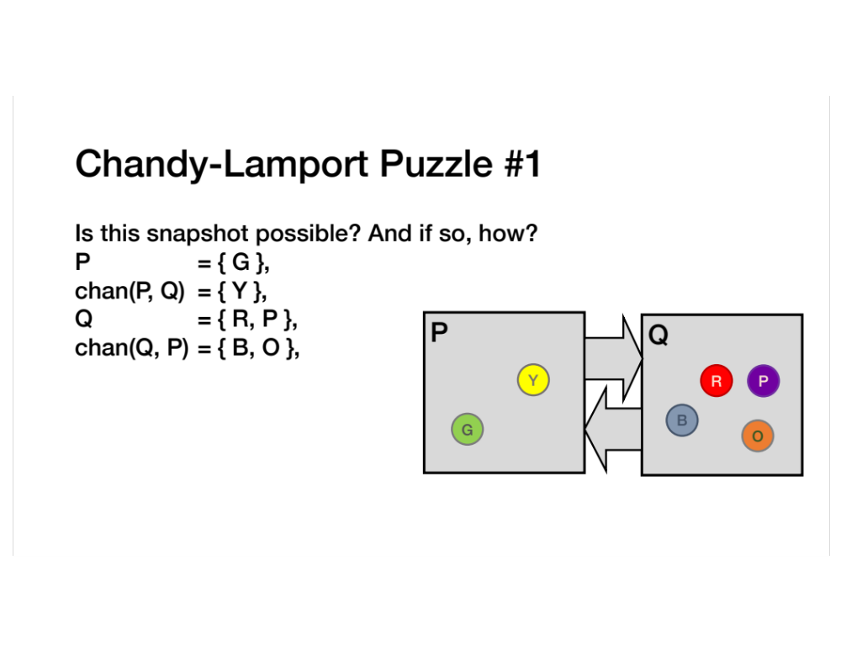
What if multiple nodes can initiate simultaneously for the same snapshot?
Usually, each initiator will assign a unique ID to its snapshot

Slide 19
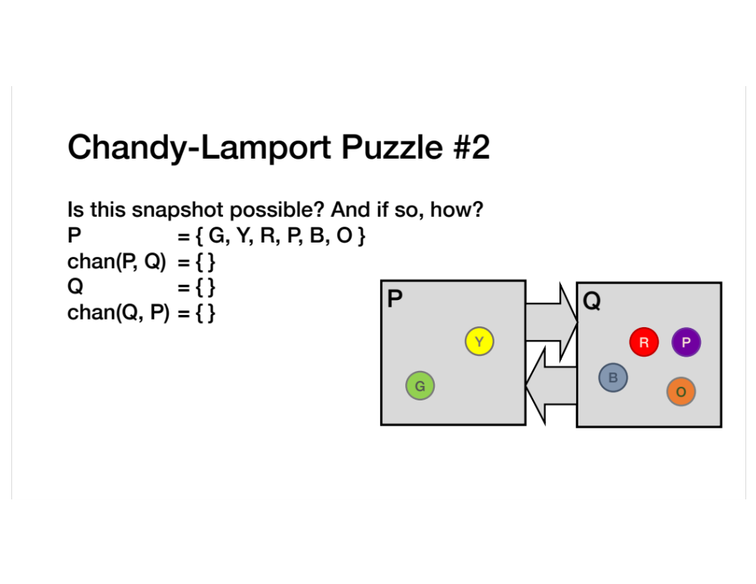

Slide 20
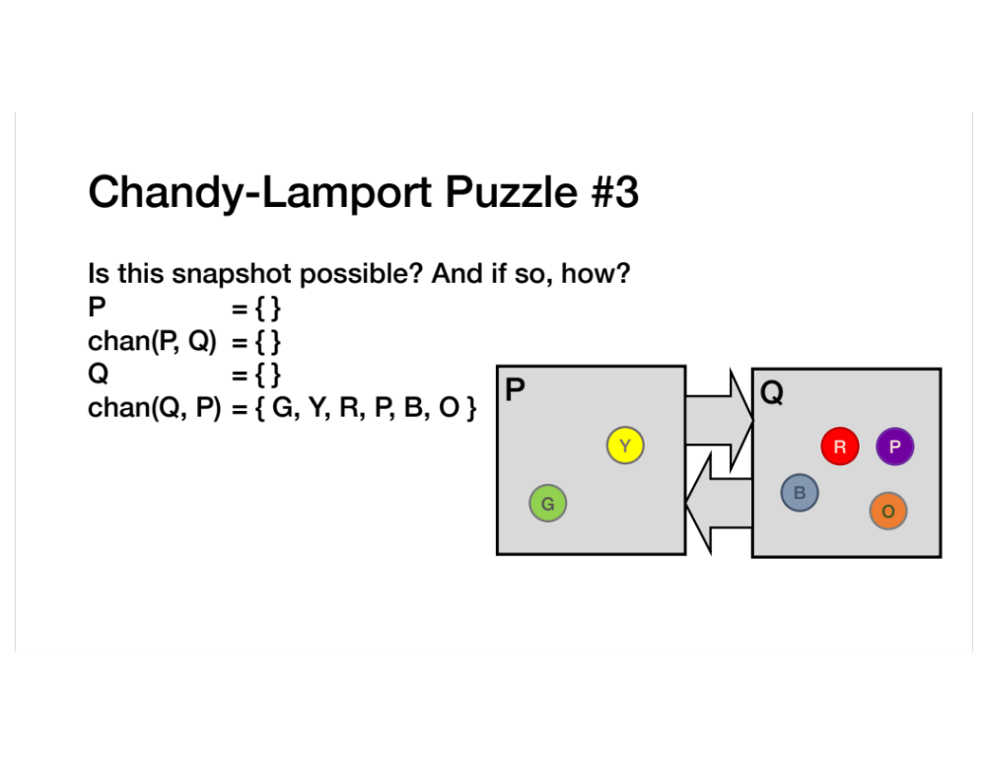

Slide 21
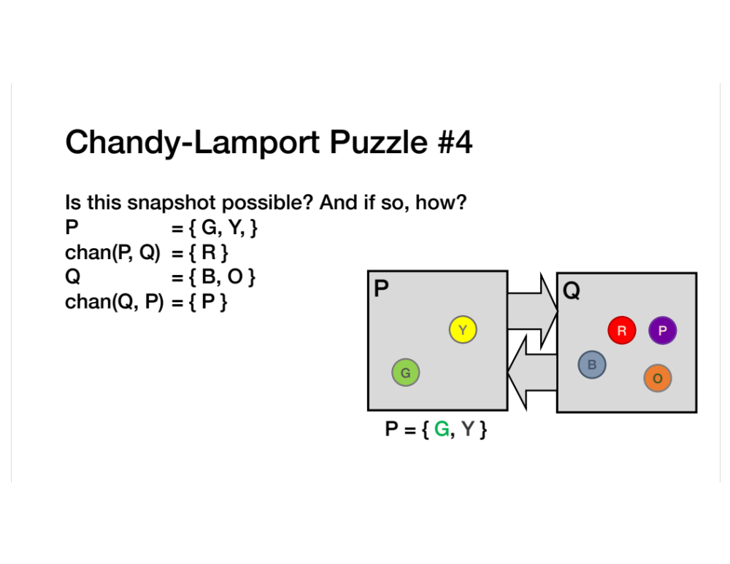
Is it possible (and how) if we add:
  A process T and just a chan(T,P)?
  T, chan(T,P) and chan (T,Q)?

Slide 22
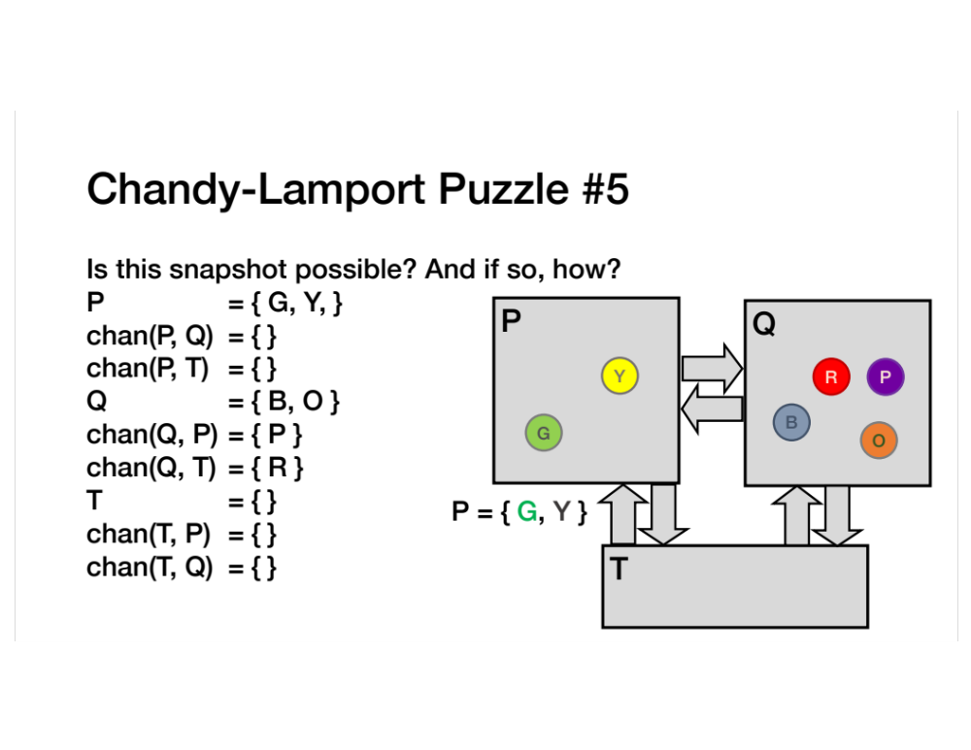

Slide 23


Slide 24
Terminating a Snapshot
Distributed algorithm: No one process decides when it terminates
Eventually, all processes have received a marker (and recorded their own state)
All processes have received a marker on all the N–1 incoming channels (and recorded their states)
Later, a central server can gather the local states to build a global snapshot

Slide 25
Take-away points
Distributed Global Snapshots
  FIFO Channels: we can do that!
  Chandy-Lamport algorithm: use marker messages to coordinate
Reasoning about concurrency
  You’re doing it!
  Use trickier and trickier puzzle methodology to understand how
  (and if) systems really work

