Slide 1
Replication State Machines via Primary-Backup Replication
COS 418/518: Distributed Systems
Lecture 10
Jialin Ding, Mike Freedman

Slide 2
From eventual to strong consistency
Eventual consistency
  Multi-master: Any node can accept operation
  Asynchronously, nodes synchronize state
Eventual consistency inappropriate for many applications
  Imagine bank ledger as eventually consistent
Stronger consistency makes applications easier to write
  (More on downsides later)
Notes:
Bayou and Chord are eventually consistent

Slide 3


Primary-Backup Replication
Mechanism: Replicate and separate servers
Goal #1: Provide a highly reliable service (despite failures)
Goal #2: Servers should behave just like a single, more reliable server
Client C
Primary P
Backup B

Slide 4
Primary-Backup Replication
Client C
Nominate one replica primary, other backup
  Clients send all ops to current primary
  Primary orders clients’ operations
Only one primary at a time
Primary P
Backup B
Need to keep clients, primary, and backup in sync: who is primary and who is backup
Notes:
VM-FT has a solution for shared disk. A general solution requires consensus, which is the focus of the next several lectures.

Slide 5
State machine replication
Idea: A replica is essentially a state machine
  Set of (key, value) pairs is state
  Operations transition between states
Need an op to be executed on all replicas, or none at all
  i.e., we need distributed all-or-nothing atomicity
  If op is deterministic, replicas will end in same state
Key assumption: Operations are deterministic

Slide 6
Primary-Backup Replication
Client C
Primary gets operations
Primary orders ops into log
Replicates log of ops to backup
Backup exec’s ops or writes to log
put(x,1)
Primary P
put(x,1)
Backup B

Slide 7
Primary-Backup Replication
Asynchronous Replication
Client C
put(x,1)
ack
Primary gets operations
Primary exec’s ops
Primary orders ops into log
Replicates log of ops to backup
Backup exec’s ops or writes to log
Primary P
put(x,1)
Backup B
Notes:
Q: Class what can go wrong w/ async replication?

Slide 8
Primary-Backup Replication
Synchronous Replication
Client C
put(x,1)
ack
Primary gets operations
Primary orders ops into log
Replicates log of ops to backup
Backup exec’s op or writes to log
Primary gets ack, execs ops
Primary P
put(x,1)
ack
Backup B

Slide 9

Why does this work? Synchronous Replication
Clients
shl
Logging
Module
State
Machine
Logging
Module
State
Machine
Servers
Log
Log
add
jmp
mov
shl
add
jmp
mov
shl
Backup
Primary
Replicated log => replicated state machine
  All servers execute same commands in same order

Slide 10
Why does this work? Synchronous Replication
Clients
shl
Logging
Module
State
Machine
Logging
Module
State
Machine
Logging
Module
State
Machine
Servers
Log
Log
Log
add
jmp
mov
shl
add
jmp
mov
shl
add
jmp
mov
shl
Backup
Backup
Primary
Replicated log => replicated state machine
  All servers execute same commands in same order

Slide 11
Need determinism? Make it so!
Operations are deterministic
  No events with ordering based on local clock
    Convert timer, network, user into logged events
  Nothing using random inputs
Execution order of ops is identical
  Most RSMs are single threaded

Slide 12
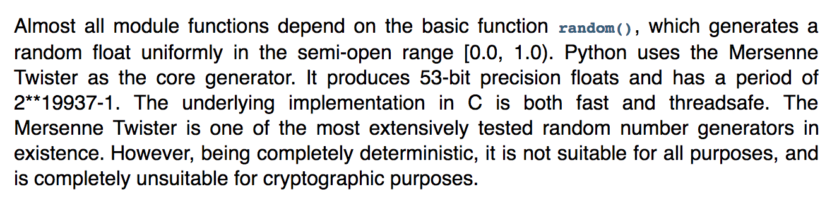
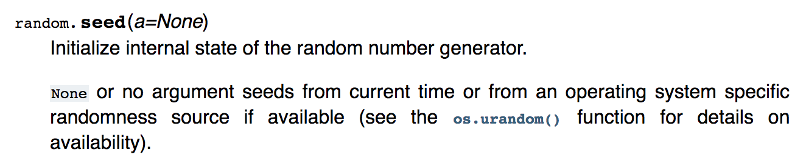
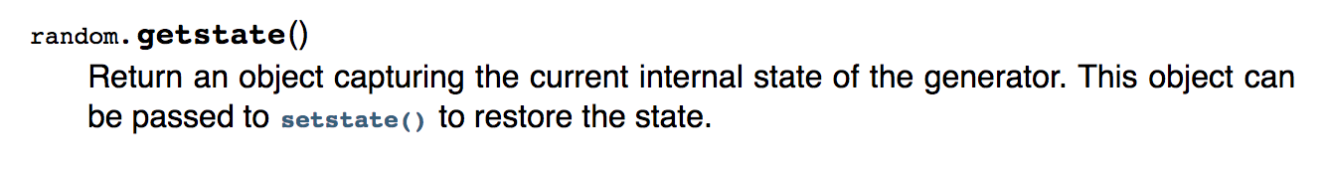
Example: Make random() deterministic

Slide 13
Example: Make random() deterministic
Primary:
  Initiates PRNG with OS-supplied randomness, gets initial seed
  Sends initial seed to to backup
Backup
  Initiates PRNG with seed from primary

Slide 14
Case study
The design of a practical system for
fault-tolerant virtual machines
D. Scales, M. Nelson, G. Venkitachalam, VMWare
SIGOPS Operating Systems Review 44(4), Dec. 2010 (pdf)

Slide 15
VMware vSphere Fault Tolerance (VM-FT)
Goals:
Replication of the whole virtual machine
Completely transparent to apps and clients
High availability for any existing software
Notes:
Ambitious system from VMware – want to give an entire Virtual Machine the benefits of primary-backup replication.
>>> Actually run a virtual machine on top of primary-backup replication!

Slide 16
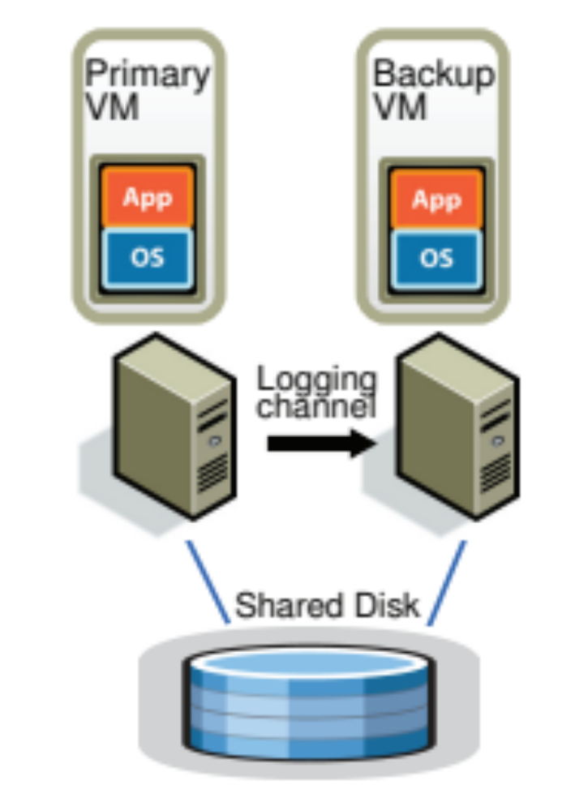
vSphere Overview
Two virtual machines (primary, backup) on different bare metal
Logging channel runs over network
Shared disk via fiber channel
Notes:
The backup executes identically to the primary, except with a small time lag.
>>> Wrinkle: Disk not replicated, instead shared

Slide 17
Virtual Machine I/O
VM inputs
  Incoming network packets
  Disk reads
  Keyboard and mouse events
  Clock timer interrupt events
VM outputs
  Outgoing network packets
  Disk writes
Notes:
To replicate the VM they need to look at the VM as a black box.
VM inputs: everything that flows into the VM.
VM outputs: everything that flows out of the VM.
>>> Disk writes are considered an output because they go to the shared disk attached to both VMs.

Slide 18
Overview
Primary sends inputs to backup
Backup outputs dropped
Primary-backup heartbeats
  If primary fails, backup takes over
Notes:
The backup executes identically to the primary, except with a small time lag.
>>> Wrinkle: Disk not replicated, instead shared

Slide 19
VM-FT: Challenges
Making the backup an exact replica of primary
Making the system behave like a single server
Avoiding two primaries (Split Brain)
Notes:
(Outline slide) So we have a general idea of how this works from the basic primary-backup design, but here are the subtle points that the VM-FT paper addresses.
(Exact replica:) How to cope with non-determinism

Slide 20
Log-based VM replication
Step 1: Hypervisor at primary logs causes of non-determinism
  Log results of input events
    Including current program counter value for each
  Log results of non-deterministic instructions
    e.g. log result of timestamp counter read
Notes:
Want to model VM as a deterministic state machine, so to do that we have to convert non-deterministic operations to deterministic operations so that state machine replication holds.
Inputs: packet with arbitrary data may arrive; arbitrary keystroke may arrive. So once the primary has logged both causes of non-determinism, the backup can use this information.

Slide 21
Log-based VM replication
Step 2: Primary hypervisor sends log entries to backup
Backup hypervisor replays the log entries
  Stops backup VM at next input event or non-deterministic instruction
    Delivers same input as primary
    Delivers same non-deterministic instruction result as primary
Notes:
Needs to know when the next input event occurs, so backup lags behind primary by one (actually many) input event

Slide 22
VM-FT Challenges
Making the backup an exact replica of primary
Making the system behave like a single server
  Fault Tolerance Protocol
Avoiding two primaries (Split Brain)
Notes:
So now we are reasoning about the output events that the system generates, in particular when the primary fails. And their solution to this problem is called the fault tolerant (FT) protocol.

Slide 23
Primary to backup failover
When backup takes over, non-determinism makes it execute differently than primary would have
  This is okay!
Output requirement
  When backup takes over, execution is consistent with outputs the primary has already sent
Notes:
>>> Want to avoid contradictions between the primary and backup when it fails over.

Slide 24
The problem of inconsistency
Input
Event?
Output
Primary
Backup
Primary fails
Notes:
Suppose primary fails just after an output event. Of “in flight” events, backup doesn’t know whether they came before/after output event.
(e.g., event could be a timer interrupt)
Red event may have influenced value of output, backup doesn’t know where in its execution stream to place it: before or after the output.
Primary also doesn’t know what the value of the output event was, so can’t fix it that way.
Subtle: Arbitrarily many events may have happened at primary unbeknownst to backup, can’t speculate!

Slide 25
VM-FT protocol
Primary logs each output operation
Delays sending output until Backup acknowledges it
    But does not need to delay execution
Input
Primary fails
Output
Primary
ack
Backup
Notes:
There are no other events in the backup’s log so it can reach the same state as the primary was when it made the output.
Might output twice but that is okay – duplicate network packet or duplicate write to disk.
>>> Primary doesn’t need to delay execution, just outputs.

Slide 26
VM-FT protocol
Primary logs each output operation
Delays sending output until Backup acknowledges it
    But does not need to delay execution
Input
Primary fails
Output
Primary
ack
Backup
Restart execution at last output event
Notes:
There are no other events in the backup’s log so it can reach the same state as the primary was when it made the output.
Might output twice but that is okay – duplicate network packet or duplicate write to disk.
>>> Primary doesn’t need to delay execution, just outputs.

Slide 27
VM-FT Backup Promotion Process #1
Backup switches from backup mode to primary mode at the last output event in the log
Should it resend the last output event (packet)?
  Not sending same as the network dropping it
    Okay to not send
  Resending same as sending a duplicate packet, which TCP does
    Okay to send
  Paper doesn’t specify

Slide 28
VM-FT: Challenges
Making the backup an exact replica of primary
Making the system behave like a single server
Avoiding two primaries (Split Brain)
  Logging channel may break
Notes:
Finally, avoiding split brain gets difficult when the logging channel breaks.

Slide 29
Detecting and responding to failures
Primary and backup each run UDP heartbeats, monitor logging traffic from their peer
Before “going live” execute atomic test-and-set on variable in shared storage
If the replica finds variable already set, it fails itself
Notes:
This method of avoiding split brain is possible because the VMs have a shared disk. In general, avoiding split brain requires a consensus protocol.

Slide 30
Backup Promotion Additional Work
Advertise same MAC address as primary was using
Startup a new backup
If the primary detects the backup failed
  It starts a new backup
Notes:
[Reissue any pending operations to the disk (additional work is done to ensure they are idempotent)]

Slide 31
Primary-Backup Replication
State-machine replication: same input, deterministic processing => identical replicas
VM-FT: we can do this with whole machines!
  Determinism tricky, but doable
  Primary delays output until acked by backup
  Use atomic test-and-set on shared disk to avoid split brain

