Slide 1
Web Caching
COS 316: Principles of Computer System Design
Lecture 10
Wyatt Lloyd
Content for final exam, not this Thursday’s midterm

Slide 2

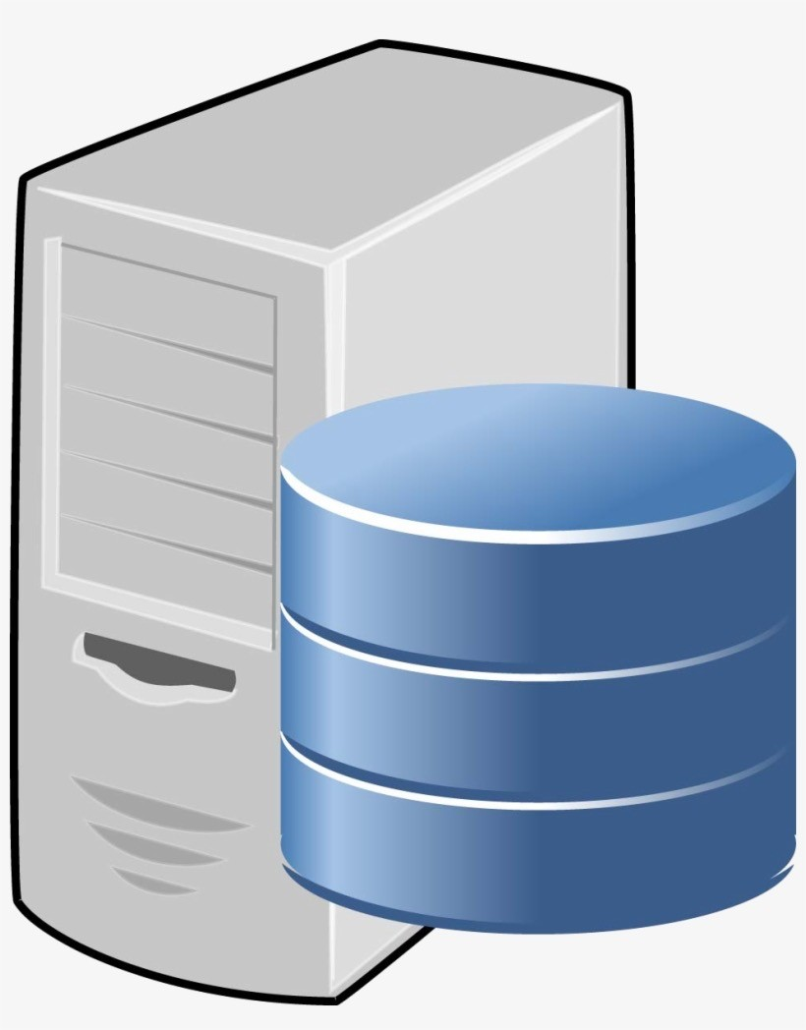
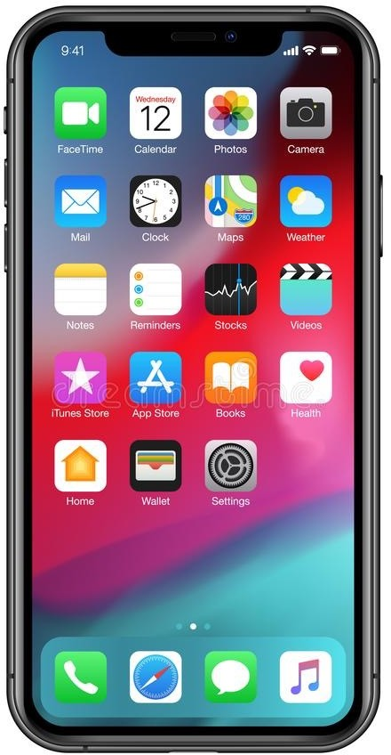
Downloading a Web Page
User visits https://www.youtube.com
The Internet
www.youtube.com

Slide 3

Downloading a Web Page (https://www.youtube.com)
www.youtube.com?
142.251.41.14
Web messages (HTTP)
Secure session (TLS)
End-to-end connection (TCP)
www.youtube.com 142.251.41.14

Slide 4


Multiple Problems
User latency
  Round-trips to query multiple DNS servers
  Multiple round-trips with the Web server
  Delivery of a (possibly large) Web item
Server overhead
  Handling many requests from many clients
  Financial costs to deploy enough servers
Network bandwidth
  Traffic on many links in multiple networks
  Financial costs for the affected networks

Slide 5

A Solution: Caching
Keep all data in bigger, cheaper, slower storage
Keep copies of active data in smaller, more expensive, faster storage

Slide 6
What do we cache?
Data stored verbatim in slower storage
Previous computations – recomputations are a kind of `slow storage’
Examples
  CPU memory hierarchy
  File system page buffer
  Domain Name System (DNS)
  Content Distribution Networks (CDN)
  Web browser caches
  Database caches

Slide 7
Caching to the Rescue: Domain Name System
What to cache?
  Mapping of popular names to IP addresses
    E.g., www.youtube.com → 142.251.41.14
  Mapping of parts of names to DNS server IPs
    E.g., .com top-level domain → 192.26.92.30

Slide 8

Domain Name System (DNS) 101
What is the IP address for www.youtube.com?
root DNS server
2
3
.com DNS server
4
local DNS server
5
7
6
1
8
authoritative DNS server
requesting host

Slide 9
Caching to the Rescue: Domain Name System
What to cache?
  Mapping of popular names to IP addresses
    E.g., www.youtube.com → 142.251.41.14
  Mapping of parts of names to DNS server IPs
    E.g., .com top-level domain → 192.26.92.30
root DNS server
2
3
.com DNS server
4
local DNS server
Where to cache?
  Local DNS server (e.g., for the campus)
  Client machine (e.g., user’s browser)
5
7
6
1
8
How to avoid stale information?
  Cached entries have a limited “time to live”
authoritative DNS server
requesting host

Slide 10
Caching to the Rescue: Communication Channel
End-to-end communication
  TLS: confidentiality, integrity, and authenticity
  TCP: ordered, reliable delivery of byte stream
Establishing the channel is expensive
  Communication delays, creating data structures, and computing keys
Exploit temporal locality by reusing the channels
Transport Layer Security (TLS) Transmission Control Protocol (TCP)

Slide 11
Temporal Locality
Temporal locality: nearness in time
Data accessed now was probably accessed recently
Useful data tends to continue to be useful

Slide 12
Caching to the Rescue: Web Items
Cache Web items closer to the client
  Reduce latency
  Reduce server overhead
  Reduce use of network bandwidth
cache hit!
Web Cache

Slide 13
Web Caching Should Work Well!
10,000
1000
Number of
Zipf Distribution Item of rank k has frequency ~ 1/kª
100
10
1
Requests
…
1
10 100 1000 10,000
Popularity Rank

Slide 14
CDN Cache Hit
G?
A B C
D E F
G H I
J K L
G
On cache hit, retrieve the object from the cache!

Slide 15
CDN Cache Miss
X?
X
X?
A B C
D E F
G H I
J K L
X
X
If I want to store X, what do I get rid of to make space?

Slide 16
Cache Algorithms 101
First In First Out (FIFO)
Least recently used (LRU)
Least frequently used (LFU)
Belady (Offline optimal)
(Note: all fully associative today)

Slide 17
First-In-First-Out (FIFO)
Evict objects added to cache longest ago
Very simple!
3 item cache example:
  Request stream: a, b, a, c, a, d, a, e, a, f, g
Can we do better?
Notes:
Discuss cache state, hit or miss: DRAW ON BOARD
Is FIFO making any bad choices?

Slide 18
Least Recently Used (LRU)
Evict object used longest ago
  “Objects used more recently are more likely to be accessed again”
  Exploits temporal locality
Implementation: Update access time for every hit
3 item cache example:
  Request stream: a, b, a, c, a, d, a, e, a, f, g
  Request stream: h, h, h, i, j, k, h
Notes:
Discuss cache state, hit or miss, DRAW ON BOARD

Slide 19
Least Frequently Used (LFU)
Evict object with fewest hits
  “Objects used more often are more likely to be accessed again”
  If tie, use LRU
Implementation: Update access count for every hit
3 item cache example:
  Request stream: a, b, a, c, a, d, a, e, a, f, g
  Request stream: h, h, h, i, j, k, h
  Request stream: l, l, m, n, o, m
Notes:
Discuss cache state, hit or miss, DRAW ON BOARD

Slide 20
Belady (Offline Optimal Caching)
What is the best a caching algorithm could do?
Offline: uses knowledge of the future
  (Can’t use in practice)
Evict the object with the furthest next access time
  Worst object to keep in the cache
3 item cache example:
  Request stream: h, h, h, i, j, k, h
  Request stream: l, l, m, n, o, m
Notes:
DRAW ON BOARD

Slide 21
Effectiveness of Algorithms for CDN Caching?
[Figures from From “An Analysis of Facebook Photo Caching” at Symposium on Operating System Principles, 2013.]

Slide 22
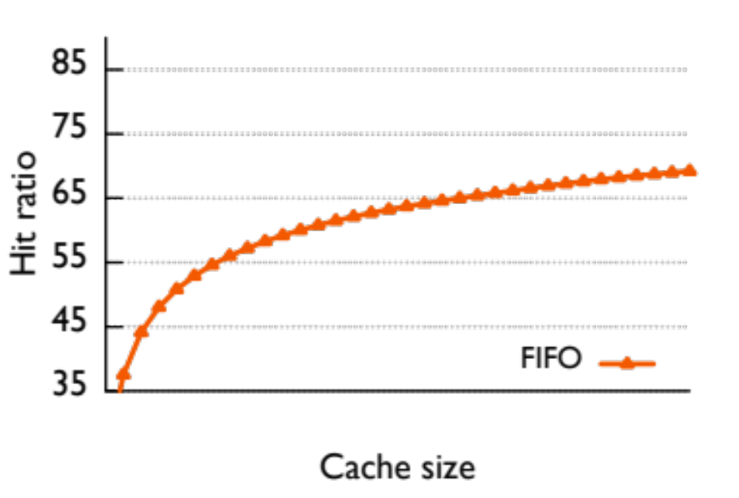
Edge Cache with Different Sizes
59%
Facebook’s San Jose CDN edge cache circa 2013

Slide 23
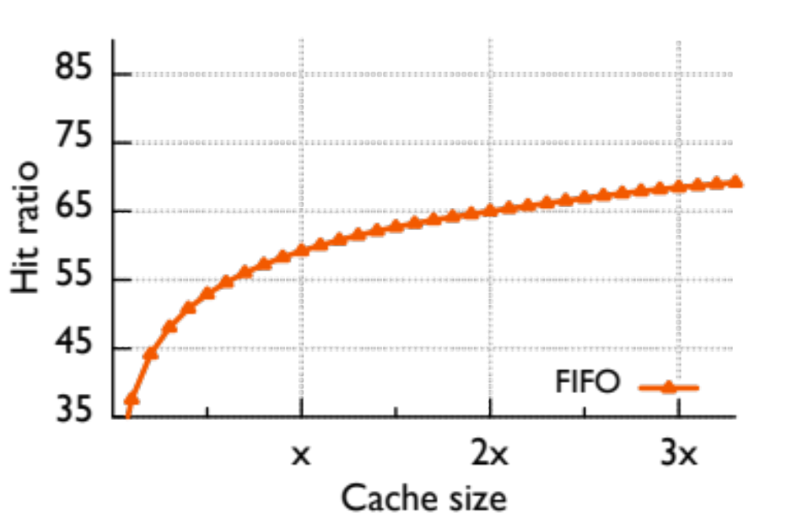
Edge Cache with Different Sizes
68%
65%
59%
“x” estimates deployment size (59% hit ratio)

Slide 24
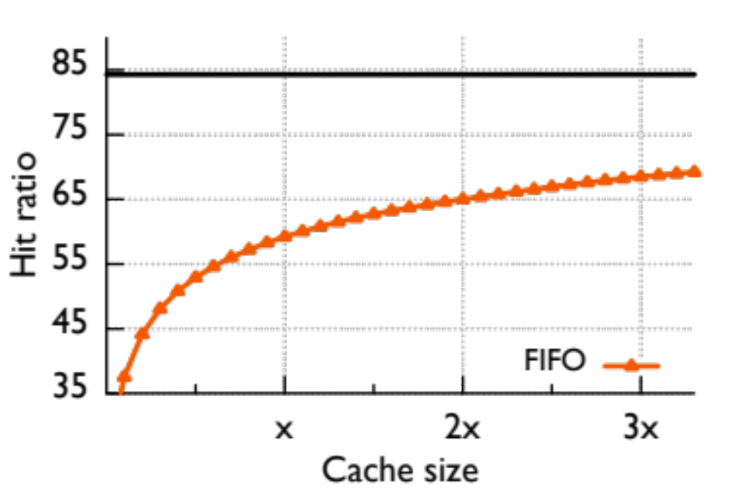
Edge Cache with Different Sizes
Infinite Cache
68%
65%
59%
“Infinite” size ratio needs 45x of capacity

Slide 25
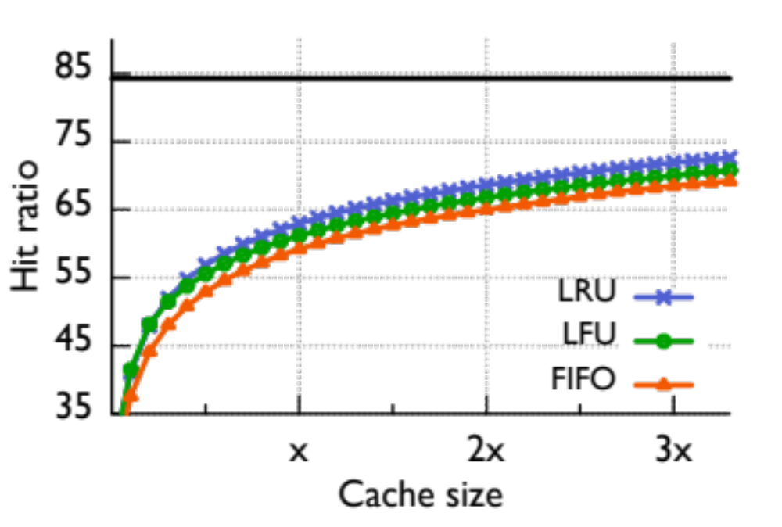
Edge Cache with Different Algos
Infinite Cache
LRU > LFU > FIFO

Slide 26
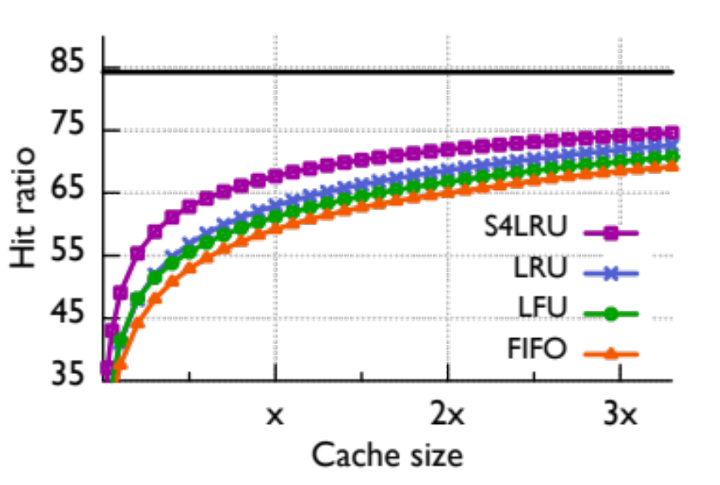
Edge Cache with Different Algos
Infinite Cache
68%
59%
1/3x
S4LRU is a more complex algorithm, uses recency and frequency

Slide 27
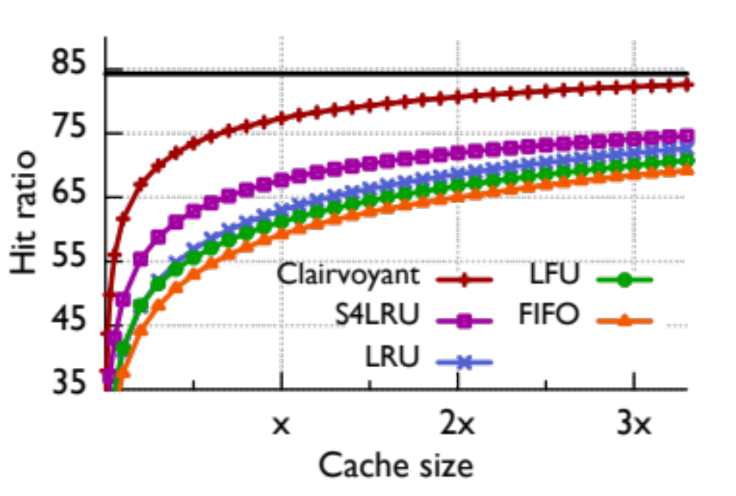
Edge Cache with Different Algos
Infinite Cache
Clairvoyant (Bélády) shows we can do much better!

Slide 28
Cache Consistency

Slide 29
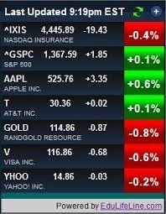


Some Web Content is Not Cacheable
Dynamic content
  E.g., stock prices, scores
Content generated by scripts
  Results depend on the specific parameters
  E.g., https://www.google.com/search?q=php+script+url
Personalized content
  E.g., based on cookie sent by the browser
Encrypted content
  Cannot decrypt without the appropriate key

Slide 30
Cache Consistency Challenges
Shared Cache
Personal
Cache
Web cache needs to know
Whether to cache an item
How long to cache an item
Whether to check an item’s freshness
Whether it is okay to return a stale item
Whether the item has sensitive data

Slide 31
Cache Consistency Challenges
Shared Cache
Personal
Cache
Web cache needs to know
Whether to cache an item
How long to cache an item
Whether to check an item’s freshness
Whether it is okay to return a stale item
Whether the item has sensitive data
Server knows the content
Whether the item is dynamic
How often the item changes
Whether the item has changed
Whether stale information is useful
Whether item contains sensitive data
Scalability challenge: the server cannot remember every client that has cached an item

Slide 32
HTTP Response Header for Cache Control
Whether to cache
  no store: no cache should store it
Who should cache
  private: only a private cache (e.g., browser)
  public: any cache, including shared ones
How long to cache
  max-age=N: for N seconds
  must-revalidate: check with the server (don’t return stale item)
Cache-Control: public, max-age=86400, must-revalidate

Slide 33
Cache Validation: Client Checks Freshness
GET /index.html
“if <this version> is stale”
Personal
Cache
304 Not Modified

Slide 34
Cache Validation: Client Checks Freshness
GET /index.html
“if <this version> is stale”
Personal
Cache
304 Not Modified
How do they identify the “version”?
Timestamp
  When the item was modified by the server
  E.g., Last-Modified: Tue, 03 Mar 2026 07:28:00 GMT
Version number
  Entity tag provided by the server
  E.g., ETag: "33a64df551425fcc55e4d42a148795d9f25f89d4"

Slide 35
Cache Placement

Slide 36
Client Machine (e.g., Browser)
Advantages
Very low latency
Preserves access bandwidth
Available when disconnected
Disadvantages
Low hit rate due to “cold” misses
Many cache consistency checks
Incomplete logs at the server
Personal Cache

Slide 37


Client Network (Forward Proxy Cache)
Advantages
Low latency
Preserves enterprise bandwidth
Hits for locally popular content
Disadvantages
Cost to deploy the cache
Many consistency checks
Incomplete logs at the server
Shared Cache

Slide 38
Server Network (Reverse Proxy Cache)
Advantages
High hit rate across global users
Greater cooperation with server
Complete request logs for server
Preserves server bandwidth
Disadvantages
Costs to deploy the cache
Does not reduce latency much
Consumes wide-area bandwidth
Shared
Cache

Slide 39
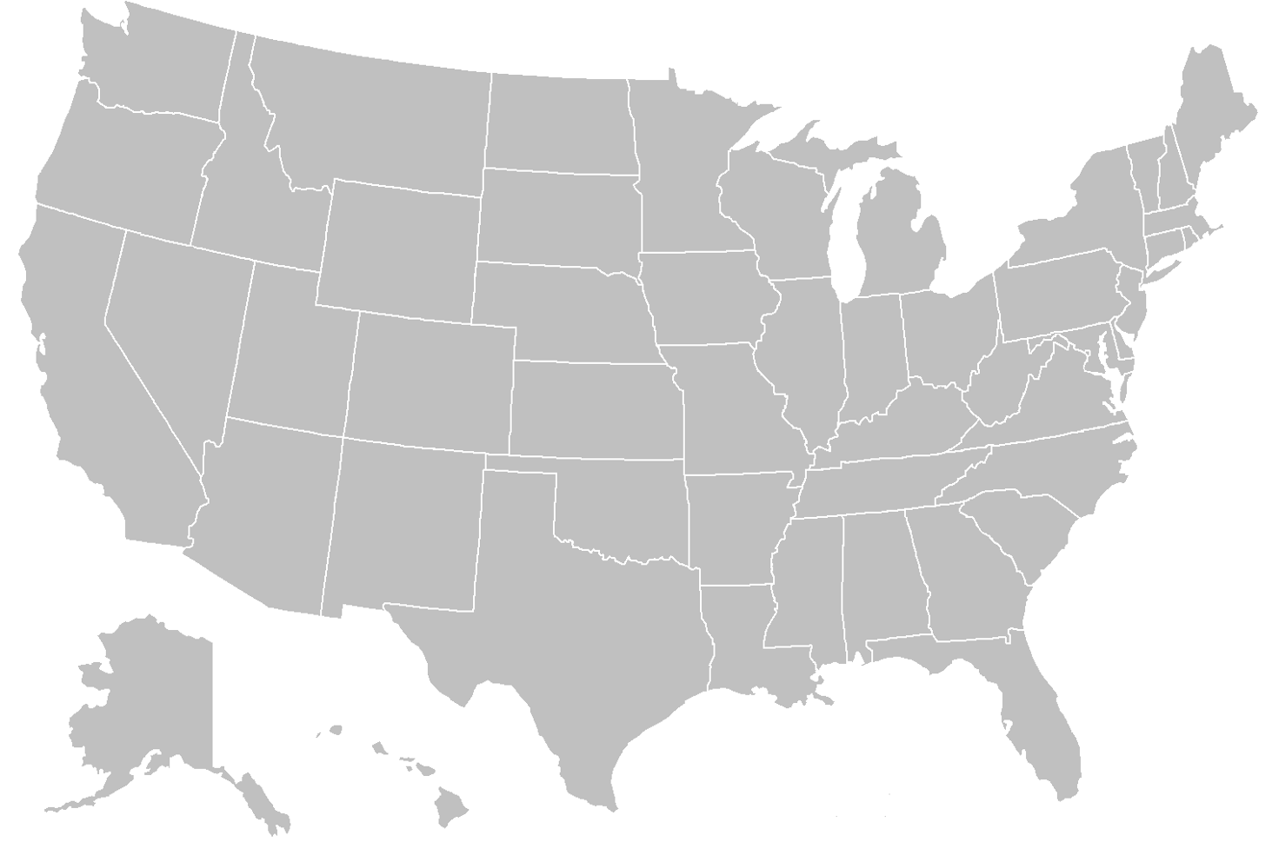







Content Distribution Network (CDN)
Outsourced caching infrastructure
  Caching for clients and servers
  Dedicated equipment and software
  Trained staff, best practices, etc.
Coordination with the server
  Generating non-cacheable content
  Providing detailed measurement data
Smart cache placement
  Many caches: handle large request load
Close to many clients: reduce latency
More than 4200 locations in 135 countries

Slide 40
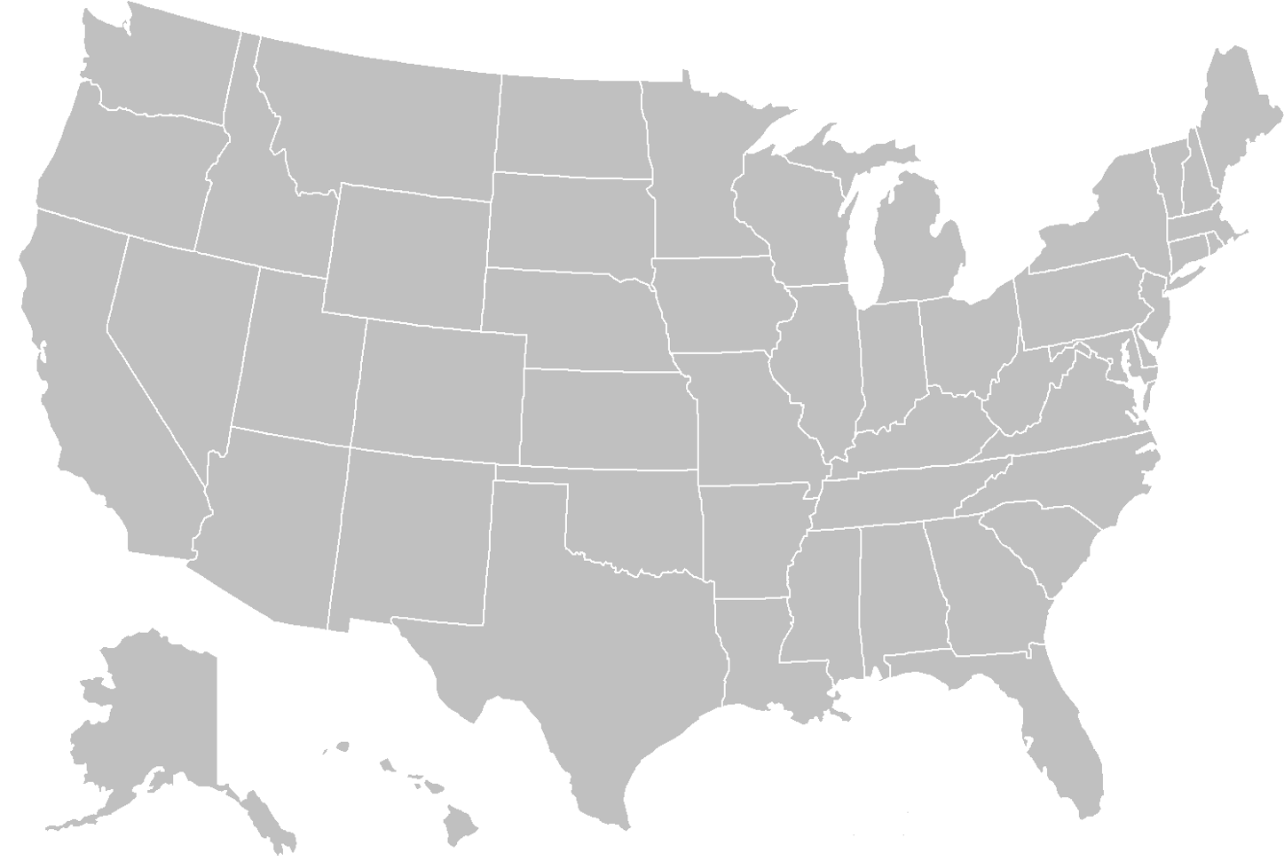






CDN Challenges
a.com | b.com | c.com
Where to place edge sites?
  Close to many clients, with reasonable cost
Where to replicate a server’s content?
  Many edge sites → duplicated data
  Few edge sites → larger client latency
How to direct a client to an edge site?
  Proximity: for low latency
  Light load: to reduce congestion
How to manage each cache?
  Maximize hit rate?
  Minimize miss penalty?
  Fairness across origin servers?
cache
c
c
_{c} c

Slide 41
A Hierarchy of CDN Caches
[Figures from Qi Huang’s 2013 SOSP Talk]

Slide 42

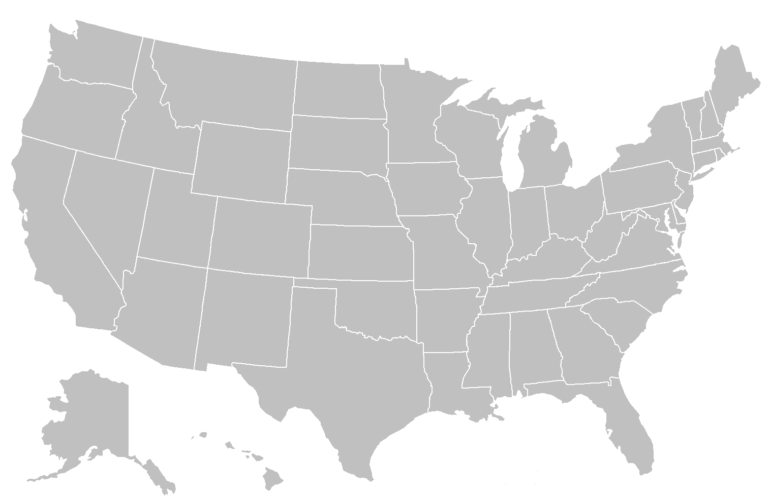
Geo-distributed Edge Cache (FIFO)
Client
PoP
Browser
Cache
Edge
Cache
(Millions)
(Tens)

Slide 43
Geo-distributed Edge Cache (FIFO)
Client
PoP
Browser
Cache
Edge
Cache
(Millions)
(Tens)
Purpose
Reduce cross-country latency
Reduce Data Center bandwidth

Slide 44
Geo-distributed Edge Cache (FIFO)
Client
PoP
Browser
Cache
Edge
Cache
(Millions)
(Tens)

Slide 45
Geo-distributed Edge Cache (FIFO)
Client
PoP
Browser
Cache
Edge
Cache
(Millions)
(Tens)

Slide 46
Single Global Origin Cache (FIFO)
Client
PoP
Data Center
Browser
Cache
Edge
Cache
Origin
Cache
(Millions)
(Tens)
(Four)

Slide 47
Single Global Origin Cache (FIFO)
Client
PoP
Data Center
Browser
Cache
Edge
Cache
Origin
Cache
(Millions)
(Tens)
(Four)
Purpose
Minimize I/O-bound operations

Slide 48
Single Global Origin Cache (FIFO)
Client
PoP
Data Center
Browser
Cache
Edge
Cache
Origin
Cache
(Millions)
(Tens)
(Four)
Hash(url)

Slide 49
Single Global Origin Cache (FIFO)
Client
PoP
Data Center
Browser
Cache
Edge
Cache
Origin
Cache
(Millions)
(Tens)
(Four)

Slide 50
Backend
Client
PoP
Data Center
Browser
Cache
Edge
Cache
Origin
Cache
Backend
(Millions)
(Tens)
(Four)

Slide 51
CDN Effectiveness
Client
PoP
Data Center
Browser
Cache
Edge
Cache
Origin
Cache
Backend
R
77.2M
26.6M
65.5%
11.2M
58.0%
7.6M
31.8%
Traffic Share
65.5%
20.0%
4.6%
9.9%

Slide 52
Conclusions
Downloading a Web page
  Name resolution, transport connection, secure session, web messages
Benefits of caching
  Reduces user latency, server load, and network bandwidth
Cache replacement
  Maximize hit rate by trying to predict the future
Cache consistency
  Efficient ways to avoid returning unnecessarily stale responses
Content distribution networks
  Caching close to clients, while working on behalf of the servers

Slide 55


Anatomy of a Web Page Fetch
Web page = HTML file + embedded images/objects
HTML page does not embed objects in it
  Q: Why not?
Client
Server
TCP SYN
TCP SYN+ACK
Web page
HTTP GET /index.html
(HTML page)
TCP FIN
TCP FIN+ACK
TCP SYN
TCP SYN+ACK
HTTP GET image1.jpg
Objects
(JPEG image)
TCP FIN
TCP FIN+ACK
…

Slide 56
Serve It All From Datacenters?
Asia
Europe
High latency for many clients ☹
Use a ton of bandwidth to send the same objects over and over ☹

Slide 57
Serve Objects From CDN
Asia
Europe
Lower latency because content is closer ☺
Less global bandwidth ☺

Slide 58
CDN Locations
Where can we stick machines?
Inside our datacenters
At colocation facilities
(other people’s DCs)
At Internet Exchange Points
Inside others’ networks
Not that many machines
(limited space and/or high cost)

Slide 59
CDN Locations vs Datacenters
There are many more CDN locations
  e.g., Akamai has 1000+
CDNs are closer to people
  Because there are more of them
  Placed for locality
CDN locations are much wimpier
  Maybe 1 rack (~40 machines)
  …
  Maybe 8 racks (~320 machines)
Which ones do clients connect to?
What do we store on them?

Slide 60
CDN Locations Store What?
Store everything?
  Exabytes of data for some services
  1 rack (40 machines):
    144 GB memory? * 40 -> 5.8TB memory … not even close…
    10x4 TB HDD? * 40 -> 1.6 PB … not even close…
Need to store a subset of objects!
  Q: But which objects to store?

