Slide 1
System Implementation Strategies
Paxos
October 2025

Slide 2
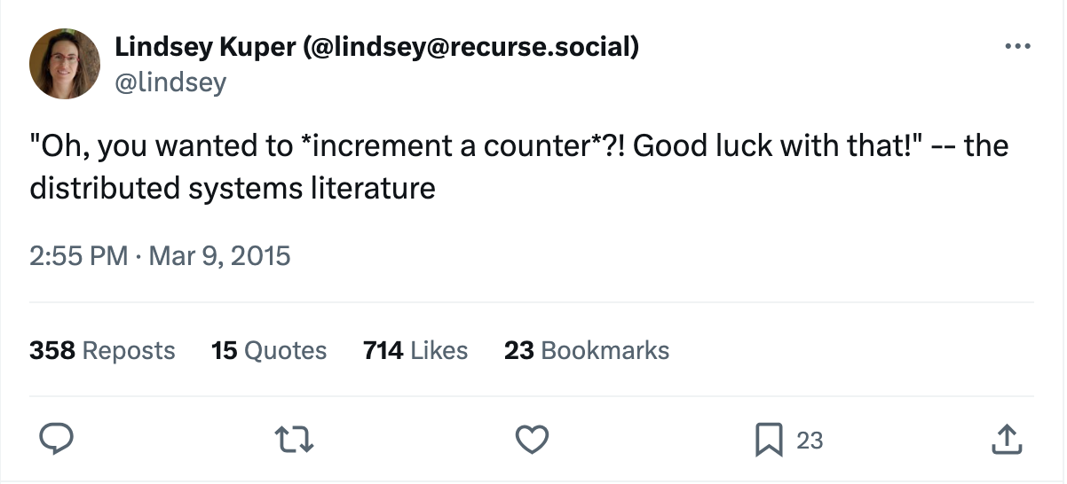
Notes:
Doing what seems like simple things is hard.
https://martinfowler.com/bliki/TwoHardThings.html
In distributed system, even a simple operation is hard and prune to errors. For example, incrementing a counter that is accessible for multiple servers.
So it is very important to have good implementation strategies and planning.

Slide 3
Overview
Successful System Implementation Strategies
Understand the Concepts and Code Structure
Iterative Design Process
Modular Programming
Tips on Debugging
Paxos

Slide 4
Understanding Concepts and Code Structure

Slide 5
Understand the Concept and Code Structure
What is the conceptual system you want to build?
Understand the concept and verify your knowledge with some examples
Rewrite the algorithm to some pseudocode, which can serve as the guide during actual programming
How is the system physically built?
Read the skeleton code
Map the algorithms/concepts to the given code structure
Draw flow charts to understand the code flow
How to use the system?
Read the testing script to see how an external user will talk to our system and invoke its APIs to accomplish desired tasks
Concept
Build
Usage
Notes:
It is always important to spend enough time understanding the concepts and starter code before writing your own code.
Make sure you know the answers for these 3 big questions about the assignment.
Elaborate on each point.
Graphical representations can be very helpful in understanding the code structure. Let us take Assignment 2 as an example and see how flow charts can quickly assist us to understand its starter code.

Slide 6
Understand Concept and Code Structure
Concept
Build
Usage
Fully comprehend the algorithm
Spend time to map your understanding of the concept to the starter code
For both the system interface and individual modules, understand what data is transferred between and how
Charts and pseudocode can help A LOT!
Notes:
Here is a quick summary.
Understanding these interfaces gives us insights on what data should be transferred and how <- this is good for debugging
Emphasize that charts and pseudocode help break down the complexity of a project and make it easier to understand

Slide 7
How is the System Physically Built?
Concept
Build
Usage
Understand the simulator’s implementation (see simulator.go)
The role of the simulator
Methods it uses to interact with the server module
StartSnapshot(server_id)
Server 3
NotifySnapshotComplete
(server_id, snap_id)
...
Server 1
CollectSnapshot
(snap_id)
Server 2
Simulator
Notes:
Graphical representations can be very helpful in understanding the code structure. Let us take Assignment 2 as an example and see how flow charts can quickly assist us to understand its starter code.
There are 2 main modules: the simulator and the server.
We will take a look at simulator.go to understand the role of simulator and how it interacts with the rest of the system, more specifically - the servers.
First, let’s ignore the details of the server and treat them as a separate entity, like a blackbox.
The simulator can only communicate with servers using these pre-defined methods.
After reading the scripts and comments, we have a high-level view of their interactions.
The simulator signals the global snapshot by picking a particular server via StartSnapshot with the server’s ID.
Each server, when completing its local snapshot, will notify the simulator via NotifySnapshotComplete.
After all servers have notified the simulator of their completion, the simulator can proceed and create a final global snapshot via CollectSnapshot.

Slide 8
How is the System Physically Built?
Concept
Build
Usage
Understand the server’s implementation (see server.go)
Methods it uses to communicate with each other
Methods it uses to take a local snapshot
HandlePacket
(msg)
SendTokens()
HandlePacket
(msg)
StartSnapshot
(snap_id)
Server 3
Tick()
StartSnapshot
(snap_id)
...
SendTokens()
Server 1
HandlePacket
(msg)
Simulator
SendTokens()
StartSnapshot
(snap_id)
Server 2
Notes:
Next, let’s look at the server’s module to understand how they interact with each other and how they take a local snapshot.
Since the simulator picks a server to start the global snapshot (assuming it is server 3 there), the server will call HandlePacket() to process the received message and take a local snapshot via StartSnapshot() if it is the first marker message seen.
Servers talk to each other via SendTokens(). This message passing is assisted by each Tick() of the simulator.
Other servers will also process messages and start a local snapshot if necessary.

Slide 9
How to Use the System?
Concept
Build
Usage
Understand how the external environment talks to our system
(see test_common.go and snapshot_test.go)
InjectEvents()
Topology File
Event File
Server 3
...
Server 1
Global Snapshot
Simulator
Server 2
Notes:
By now, we have a good understanding of the internals of our system.
But how will external users use our system (or how the testing is carried out :) )?
After reading the test files, we know that to use our system, the user need to provide 2 kinds of files: one outlines the network topology, and the other includes ordered events that should happen in the system.
The simulator reads the above two files and calls InjectEvents() to carry out the desired operations on the servers on behalf of the user.
Finally, it generates the final global snapshot.
By drawing out the details of these modules and their interactions, we can have a very good high-level understanding of the framework. It makes it much easier and efficient to find out the missing pieces and filling them with the correct logic/data.

Slide 10

Iterative Design Process

Slide 11
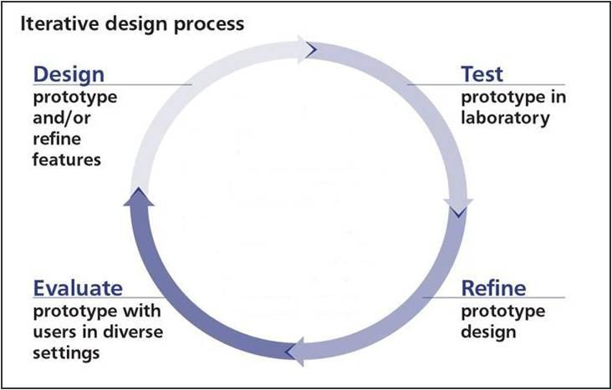
Iterative Design Process
Common design methodology in product design, including software design
You will understand a little more about your design when you start implementing it.
Start with the base case (aka simplest case)
Example: one global snapshot at a time for Assignment 2, distributed MapReduce without any failure for Assignment 1.3
Test regularly: should pass test case for 2 nodes, then 3 nodes and …
Add one more complexity at a time
Image Source from the Internet

Slide 12
Iterative Design Process: Distributed Snapshot
Key Idea: Start Simple, then Build Up
Phase 1: single snapshot at a time
Phase 2: concurrent global snapshots
When passing all non-concurrent tests
Testing
Testing
Simple design with one snapshot at a time
Final design with concurrent snapshots
Done!☺
Implementation
Implementation
Notes:
Let us take Assignment 2 as a case study for iterative design process.
The key idea is to always start with the simple case, then build up the system while refining your design.
We can divide its development into two phases. The first phase considers the simple case where only one global snapshot exists at a time in our system. The second phase builds on top of it and can have multiple active global snapshots going on at the same time.
Then, go over the animation.

Slide 13

Modular Programming

Slide 14

Modular Programming
Iterative design means code change every time when refining the design ☹
Modular programming
Decompose the system into several independent modules/pieces
Use a set of simple yet flexible APIs for intra-module communication
Advantages of modular programming
Makes it easier to reason about and debug each component of your system
Requires minimal change in the code
Notes:
With iterative design, at each iteration, we will refine the design and possibly change a lot of code in our prototype. So how can we control the amount of code change in a more systematic way? One solution for this is modular programming.
It is a programming style that decomposes a complex system into smaller independent components where they communicate with each other through a set of simple but also flexible APIs.
Now if we change our system, we only need to change the modules that are related while keeping most parts of the system unmodified because most of the modules are independent from each other.
Then, talk about the advantages.
Next, we will revisit Assignment 2 and see how modular programming with a good choice of APIs can decrease the amount of work during code change.

Slide 15
Modular Programming
Server Module
State
Phase 1: single snapshot at a time
Divide our server module into 3 pieces:
Server State
Helper Functions API
Execution logic
A layer of helper functions
Execution Logic
func HandlePacket(...) {
case TokenMessage:
// Do something
case MarkerMessage:
...
}
Goal: write a flexible layer of helper functions
Notes:
We start with the simple case where only one global snapshot exists at a time in our system.
We will break the server module into 3 pieces: the server state, the execution logic for taking the snapshot, and a layer of helper functions.
We enforce that functions like HandlePacket() cannot directly access or modify the state, but only though the exposed APIs from the helper functions.
Now, let’s see how a good choice of helper functions with modular programming can decrease the amount of coding work when we refine our design.

Slide 16
Modular Programming: Single Snapshot
Execution Logic
func HandlePacket(...) {
...
}
State
Helper Functions API
// ID of the current snapshot
snapId: int (init to -1)
// State of the current snapshot
snapState: SnapshotState
// Track if each incoming channel has seen a marker message (default to false)
receivedMarker:
map(source channel, bool)
func updateSnapshot(src, msg) {
snapMsg = SnapshotMessage(src, msg)
snapState.messages.append(snapMsg)
}
func setReceivedMarker(src) {
receivedMarker[src] = true
}
func firstMarkerMsg(snap_id) {
return snapId != snap_id
}
Func receiveAllMarkers() {
return receivedMarker.size == inboundLinks.size
}
func HandlePacket(src, msg) {
...
case TokenMessage:
updateSnapshot(src, msg)
// Also, update server’s local state
case MarkerMessage:
snap_id = getSnapId(msg)
if firstMarkerMsg(snap_id) {
StartSnapshot(snap_id)
} else {
setReceivedMarker(src)
if receiveAllMarkers() {
// Notify simulator of the completion
}
}
Notes:
In phase 1, since we have only one snapshot at a time
We store 3 variables for the server state:
snapId is an integer storing the id of the current snapshot
snapState is a SnapshotState structure bind to the current snapshot
receivedMarkers is a map whose key is the source channel name, and value is a boolean variable indicating whether this source channel has already seen a marker message or not. It defaults to false.
Then, explain the execution logic of HandlePacket() and its use of 4 example helper functions.

Slide 17
Modular Programming
Server Module
State
Some change
Phase 2: concurrent snapshots
Update the state variables and helper functions’ implementation
Keep the API and execution logic unmodified (almost)
Helper Functions API
Some change
Little change☺
Execution Logic
func HandlePacket(...) {
case TokenMessage:
// Do something
case MarkerMessage:
...
}
Notes:
Now, we move on to the more complex case where the system can have concurrent snapshots.
We will need to update the state variable, and thus the internals of helper functions.
However, the hope is the helper functions API and the execution logic stays mostly intact.
And since, at this stage, we have passed all non-concurrent tests, we have high confidence that execution logic is correct.

Slide 18
Modular Programming: Concurrent Snapshots
Execution Logic
func HandlePacket(...) {
...
}
State
Helper Functions API
func updateSnapshot(snap_id, src, msg) {
snapMsg = SnapshotMessage(src, msg)
snapStates[snap_id].messages.append(snapMsg)
}
func setReceivedMark(snap_id, src) {
receivedMarker[snap_id][src] = true
}
func firstMarkerMsg(snap_id) {
return (snap_id in snapStates.keys())
}
Func receiveAllMarkers(snap_id) {
return receivedMarker[snap_id].size == inboundLinks.size }
// States of concurrent snapshots
// map snapshot ID to its state
snapStates: map(int, SnapshotState)
// For each snapshot, track if each incoming channel has seen a marker message (default to false)
receivedMarker:
map(int, map(source channel, bool))
func HandlePacket(src, msg) {
...
case TokenMessage:
for snap_id in snapStates.keys() {
updateSnapshot(snap_id, src, msg)
}
// Also, update server’s local state
case MarkerMessage:
snap_id = getSnapId(msg)
if firstMarkerMsg(snap_id) {
StartSnapshot(snap_id)
} else {
setReceivedMarker(snap_id, src)
if receiveAllMarkers(snap_id) {
// Notify simulator of the completion
}
}
2. Update helper functions while keeping most of its API intact
1. Update state variables
3. Minimal change on execution logic
Notes:
Places highlighted in red are changed.
Walk through Step 1,2,3
For the server state, we update the variables.
For the helper function, we change its inner implementation, and have some slight change in its input parameters (basically include the snap_id)
For the execution logic, we simply just update the inputs for the helper functions.
Emphasize that with a good choice of helper functions API + modularity programming, code upgrade becomes much easier

Slide 19

Tips for Debugging

Slide 20
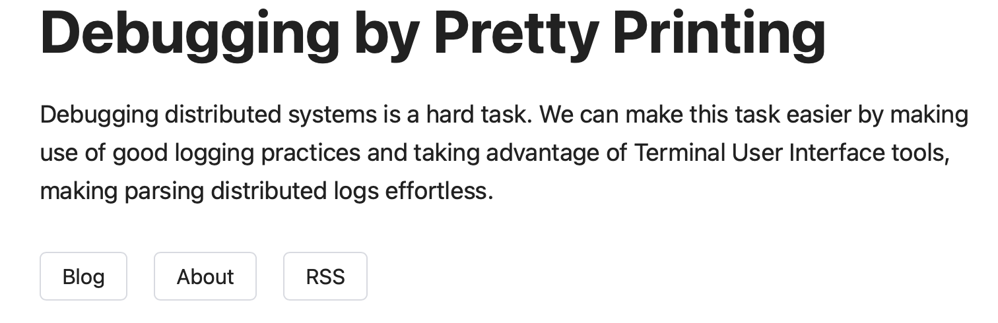
Tips on Debugging
Start Early! (This is imperative for Assignment #4)
Commit your code to Git often and early, and every time when you pass a new test (enable comparative debugging later if necessary)
Have proper naming for variables and add comments in your code
Easier for both you and others to read and debug your code
Take advantage of Go Playground if you are not familiar with any Go specifics
Print statements are your friend!
Read this ASAP
Notes:
Emphasize git commit regularly and everytime after passing new tests

Slide 21
Prints Are Your Friend ☺
Always verify the behavior of your program! Sometimes, it may not align with your expectation because of some hidden bugs.
Track execution using printing statements to understand the code flow
Especially helpful in the early development of your design when the code complexity is not too high
Help catch errors in the early stage
Example
In Assignment 2, we can print out the server state before and after HandlePacket() and StartSnapshot() that you implement after each tick of the simulator
Notes:
Emphasize the first bullet point, often students think their code is doing X while in fact it is doing Y. They can catch these kinds of bugs much much earlier if they print regularly.
Consensus
Paxos Example [2 proposer]
Not all acceptors are responding
Intuition: Safety

Slide 22
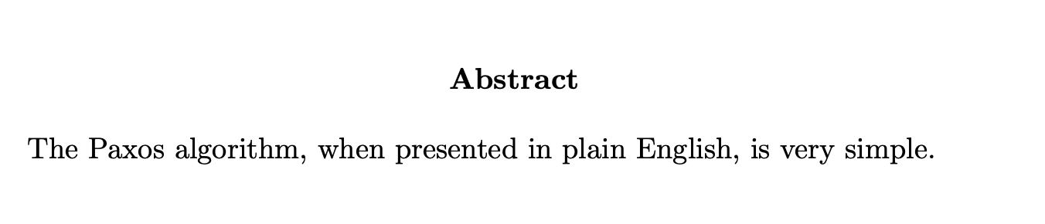
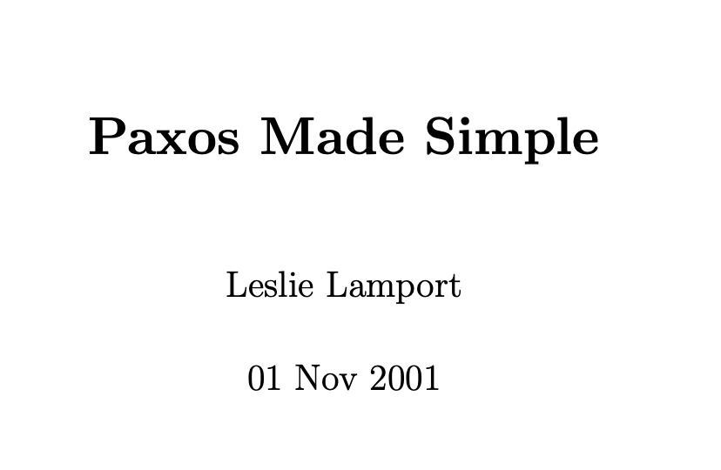
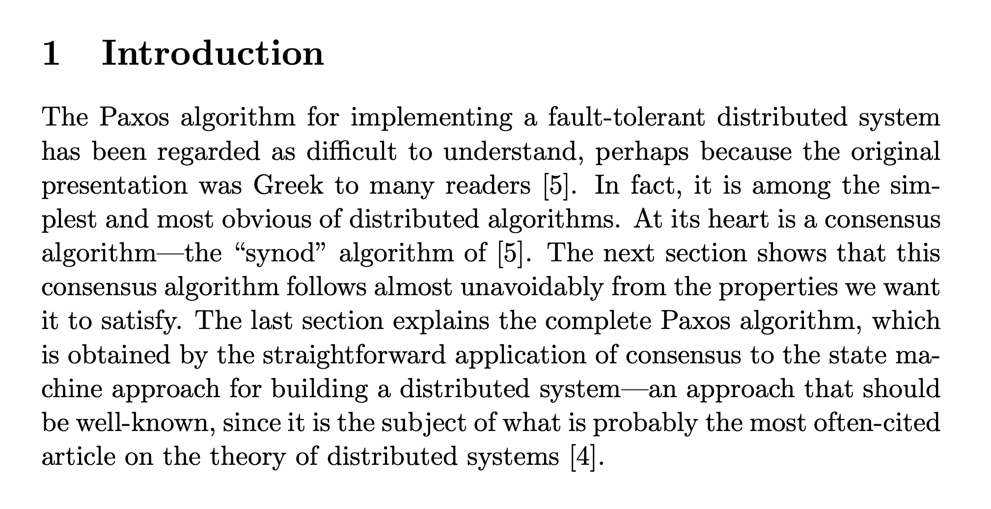
Paxos
Notes:
Abstract and Intro of the Paxos Made Simple Paper
Mention that

Slide 23
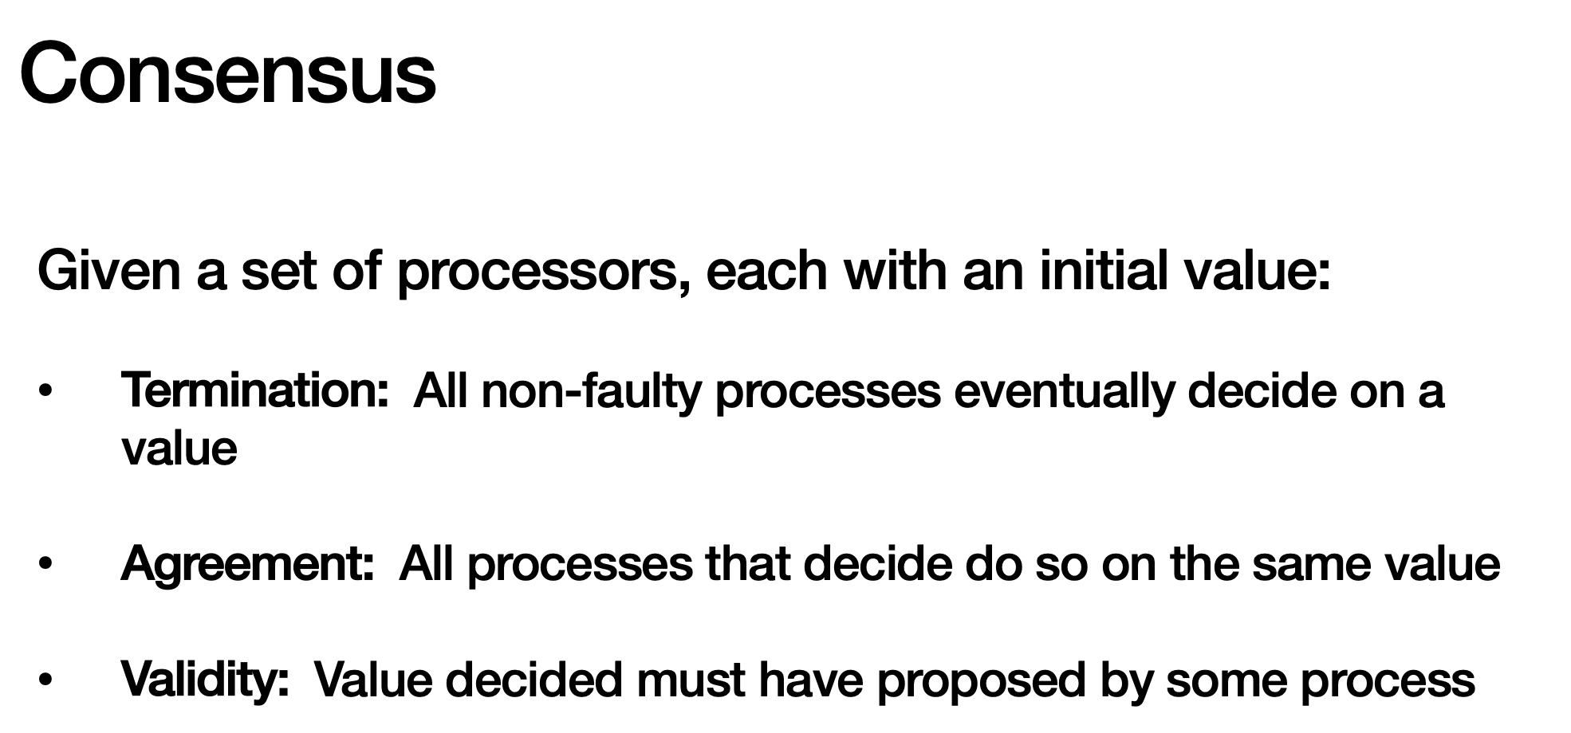
Paxos is all about consensus
Notes:
Review of the problem Pacos is solving as seen in class

Slide 24
Review of Paxos [High-Level]
Phase 2: Proposal
Phase 3: Acceptors Broadcast Accepted Values to learners
Phase 1: Prepare/Election
ACK
ACK
Prepare (Please choose me!)
Value v, accept?
Any node can be a learner. The Phase 2 ACK to the proposer can double as the acceptors’ broadcast to learners if we assume that the proposer also acts as a learner.
Proposer
Acceptor
Notes:
Mention that a process could be proposer, acceptor and learner at the same time
Note that the proposer itself could the the learner so ACK back to the proposer could essentially just be the learning messages

Slide 25

Review of Paxos [Detailed]
Phase 1: Prepare/Election
ACK
<prepare, n>
n: prepare id
Reject
n < n_highest
This acceptor has seen a prepare message with a higher prepare_id
Proposer
Acceptor

Slide 26

Review of Paxos [Detailed]
Phase 1: Prepare/Election
<Promise, n , ∅>
<prepare, n>
n: prepare id
<Promise, n , ∅>
Both acceptors accept and update their n_highest = n
Assumption: None of them had accepted other proposals before
Proposer
Acceptor

Slide 27
Review of Paxos [Detailed]
So here the proposer has to retry with the v_a, instead of its own proposed value [Do not race, just complete the duty of the previous proposer]
Phase 1: Prepare/Election
<Promise, n , ∅>
<prepare, n>
n: prepare id
<Promise, n , (n_a, v_a)>
Both acceptors accept and update their n_highest = n
Assumption: One of them accepted an older proposal before [the proposal made by n_a prepare round]
Proposer
Acceptor

Slide 28
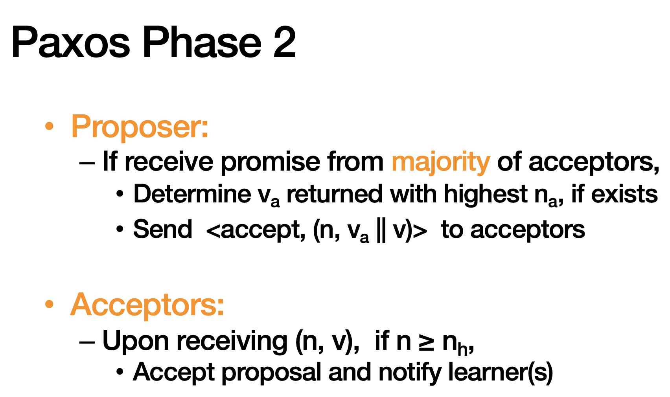
Review of Paxos [Detailed]

Slide 29
Let’s practice
In this example, we have 5 processes. All of them are learners.
All of them might become proposers and acceptors at different times.
P1
P2
P3
P4
P5
Notes:
This is example stresses how paxos might not be live [never terminates]

Slide 30
Let’s practice: Failed Prepare
Each prepare/proposal needs at least (5+1)/2 = 3 ACK [including itself]
Green Arrows are ACK and Red ones are REJECT.
P1: Prepare(1)
P2: Prepare(2)
P1
P2 Got the Majority
P2
P3
P4
P5
Pink Arrows are slow communications, still on-route
Notes:
P1 sends a prepare message to everyone: Network delay: messages to N3, N4, N5 are slow.
This figure is all about the phase 1 prepare/elect.

Slide 31
Let’s practice: Failed Prepare
Each prepare/proposal needs at least (5+1)/2 = 3 ACK [including itself]
Green Arrows are ACK and Red ones are REJECT.
P1: Prepare(1)
P2: Prepare(2)
P1 Failed to get the majority
P1
P2 Got the Majority
P2
P3
P4
P5
Pink Arrows are slow communications, still on-route
Notes:
Here finally the first prepare from P1 arrives
Mention the same pattern of failed prepare can happen in the proposal phase also “Failed Proposal”

Slide 32

Let’s practice: Racing
P1: Prepare(1)
P1
P2
P3
P4
P5
Successful Prepare Phase; Now P1 can propose!

Slide 33
Let’s practice: Racing
P1: Propose(val=10)
P1
P2
P3
P4
P3: Prepare<2>
P5
But before the proposal arrive at {P3, P4, P5}, P3 starts prepare with higher id
And {P4, P5} accepts the new prepare! So P3 wins the prepare too.

Slide 34
Let’s practice: Racing
Some of the late arrows that will arrive in future and get rejected are not shown for readability.
The old proposal value of P1 is now declined, because there was a higher new prepare.
P1: Propose(val=10)
P1
P2
P3
P4
P3: Prepare<2>
P5
P2 also accepts the prepare from P3, but sends the previously accepted value 10 to P3
Notes:
Assume the links between P3 and P1 is slow and unstable

Slide 35
Let’s practice: Racing
Some of the late arrows that will arrive in future and get rejected are now shown for readability.
P1: Propose(val=10)
P1
P2
P3: Propose(val=10)
P3
P4
P3: Prepare<2>
P5
P3 starts proposal with the same value=10!
Notes:
Important to notice that how P3 was forced to propose the same value

Slide 36
Let’s practice: Racing
Some of the late arrows that will arrive in future and get rejected are now shown for readability.
P1: Propose(val=10)
P1
P2
P3: Propose(val=10)
P3
P4
P3: Prepare<2>
P5
If at least 2 other processes ACK, we’re all good! 10 is decided and P3’s proposal is complete
P3 starts proposal with the same value=10!
Notes:
Important to notice that how P3 was forced to propose the same value

Slide 37
Let’s practice: Racing
But what if (similar to P1’s proposal), some process send <prepare> with a higher id before at least 2 processes ACK to P3’s proposal?
P1: Propose(val=10)
P1
P2
P3: Propose(val=10)
P3
P4
P3: Prepare<2>
P5
P4: Prepare<3>
P3 starts proposal with the same value=10!

Slide 38
This can repeat indefinitely: before any proposal round completes, another process
starts a new one,
wins the majority in the prepare phase, and
causes previous proposals to be rejected.
The new leader then tries to finish the proposal (with the old value), but is interrupted again — and the cycle continues.

Slide 39
Takeaway
What we saw was safe!
Whenever an accept happens it respects previously accepted values.
But liveness failed
Because two proposers continually preempt each other
Accept phases never gather a majority of accepts.
Higher proposal numbers keep invalidating earlier attempts, so no progress is made until one proposer stops or the network schedules deliver differently.
In practice people inject artificial delays between processes so they don’t race concurrently and there is some delay!

