Slide 1
Bayou / Chord
2025 Spring
[Adapted from Andrew Or and Ion Stoica’s original slides]

Slide 2
Context on Bayou: Disconnected Nodes [Stoica]
Early days: Nodes always on when not crashed
Network bandwidth always plentiful
Never needed to work on a disconnected node
Now: Nodes detach then reconnect elsewhere
Even when attached, bandwidth is variable
Reconnection elsewhere means often talking to different replica
Work done on detached nodes
Notes:
The motivation of Bayou is: the problem of disconnected devices, they are not crashed like the early days, and there can be local work done on the disconnected device , by the time the device reconnects, it may have new states.

Slide 3
Bayou
”Replicated, [eventually] consistent storage system designed for portable machines with less-than-ideal network connectivity.”
System developed at PARC in the mid-90’s
First coherent attempt to fully address the problem of disconnected operation
Notes:
PARC = Palo Alto Research Center They also developed: GUI, Computer mouse, Ethernet, Laser Printing, Object-Oriented Programming (OOP), Distributed Computing

Slide 4
Bayou – Goals
Maximize availability, support offline collaboration
Minimize network communication
Agree on all values (eventually consistent)

Slide 5
Bayou Update Protocol: Review from Class
Client sends updates to a server
Each update is uniquely identified by: ⟨Commit Sequence Number (CSN), Local Timestamp, Node ID⟩
Updates can be committed or tentative
CSNs increase monotonically (Tentative updates have commit-stamp = ∞)
Only the Primary server can commit updates
Assigns CSNs in monotonically increasing order
CSN ≠ Timestamp
Notes:
Go over Bayou protocol, this slide is update, next slide is anti-entropy (how to resolve inconsistency between local states among devices)
CSNs ensure a global total order of committed updates.
The primary server allocates CSNs so every committed update has a unique, increasing number.
A CSN is not the same as a timestamp — timestamps reflect local time at a node, while CSNs reflect the commit order established by the primary.

Slide 6
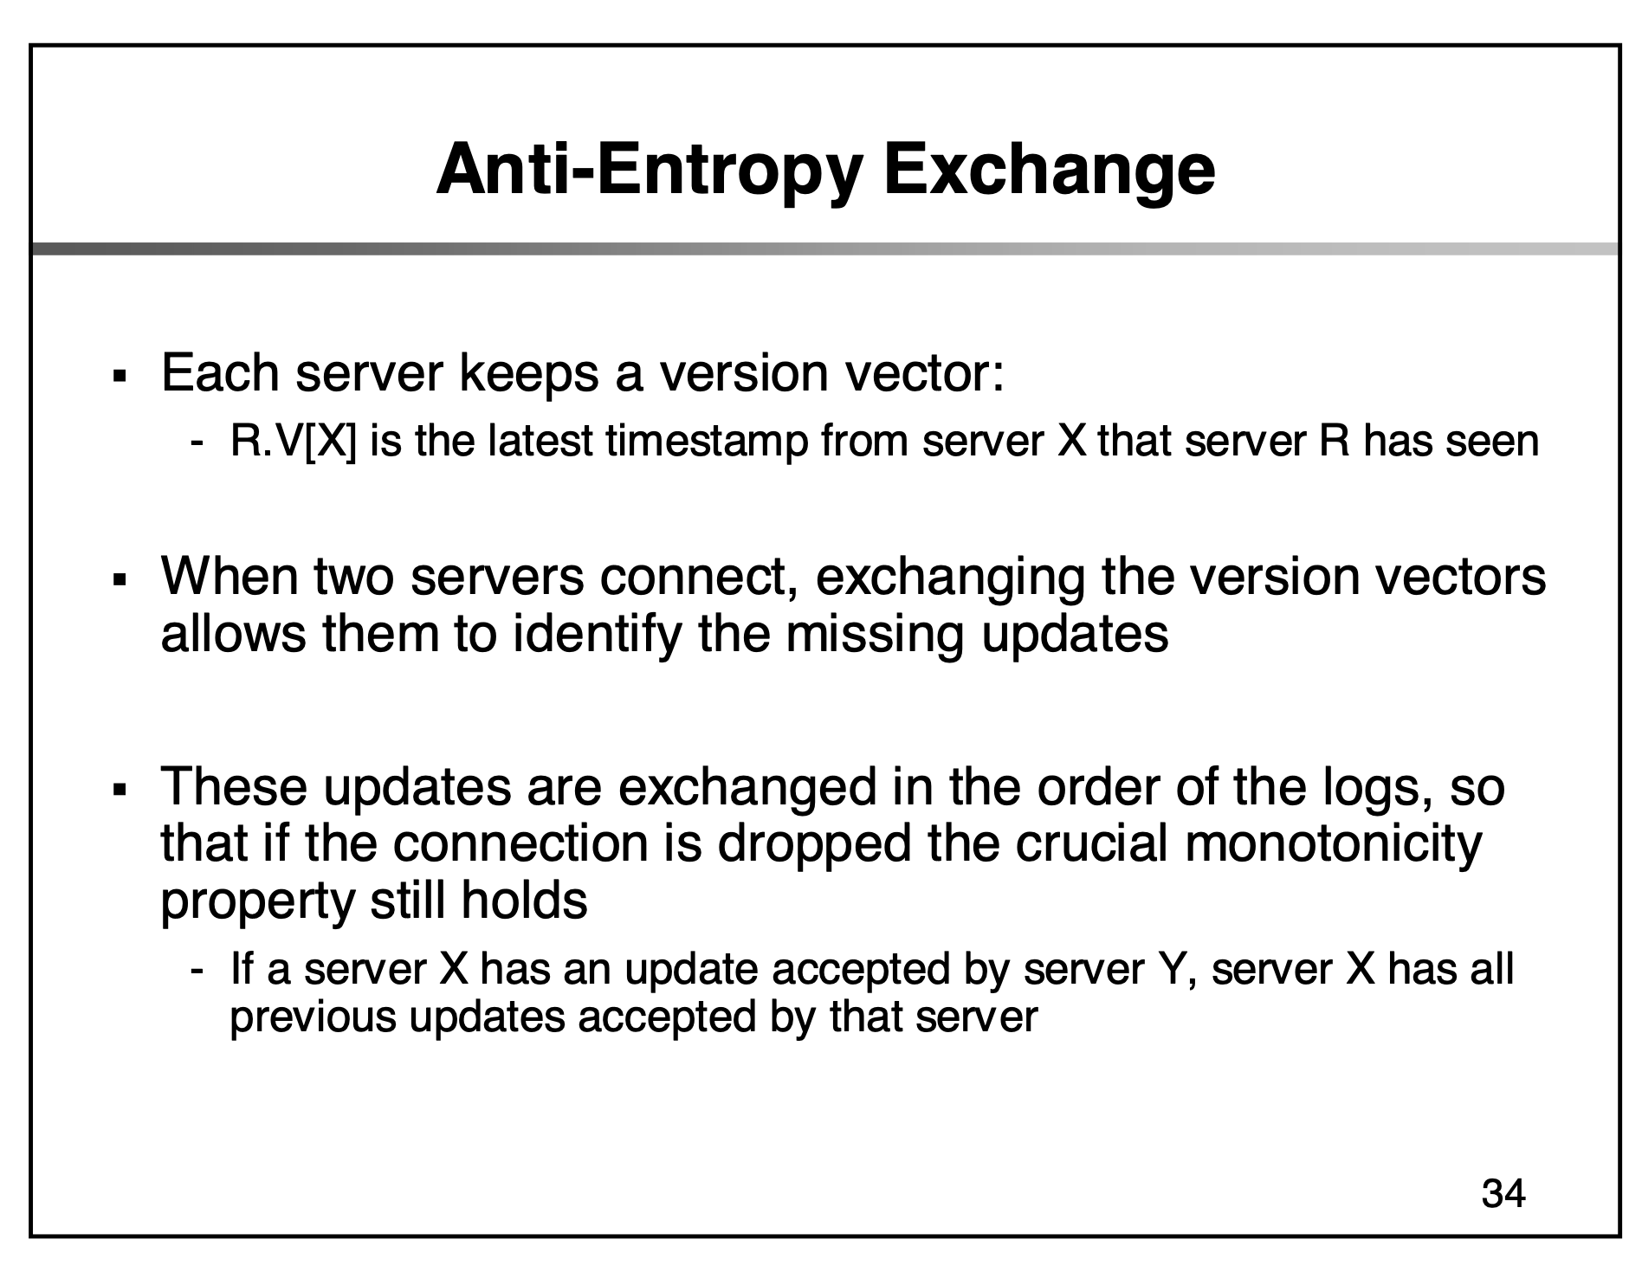
Source: Berkeley CS 268 Lecture 20 Slide Deck
Notes:
Ongoing entropy would mean stability is never reached (this is one of entropy’s definitions) Y accepted means in Y’s log
anti-entropy (how to resolve inconsistency between local states among devices)
Anti-entrop is the pairwise gossip protocol where servers exchange updates to ensure all replicas eventually contain the same set of committed and tentative updates.
In distributed systems, “entropy” refers to divergence or disorder between replicas. The anti-entropy protocol reduces that disorder by gossiping and exchanging updates until replicas converge.

Slide 7
Bayou Writes
Primary
Versions
P: 1
A: 0
B: 0
Client 1
W(X, 4)
A
Versions
B
Versions
P: 0
A: 0
B: 0
P: 0
A: 0
B: 0
Notes:
Assume client 1 contacts the primary, write X → primary gives it a local timestamp of 1

Slide 8
Bayou Writes
Primary
Versions
∞:1:P W(X,4)
P: 1
A: 0
B: 0
Client 1
W(X, 4)
A
Versions
B
Versions
P: 0
A: 0
B: 0
P: 0
A: 0
B: 0
(value1 : value2 : value3) = (CSN : Local Timestamp : Node)
Notes:
EXPLAIN THE COLON SYNTAX (Commit timestamp:write timestamp:write server) Commit timestamp is infinity if tentative write.

Slide 9
Bayou Writes
Primary
Versions
∞:1:P W(X,4)
P: 1
A: 0
B: 0
Client 1
W(Y, 8)
Client 2
A
B
Versions
Versions
W(X, 3)
P: 0
A: 0
B: 0
P: 0
A: 0
B: 0
(value1 : value2 : value3) = (CSN : Local Timestamp : Node)
Notes:
Two events happen concurrently:
Client 1 contacts primary, write Y → We will assume primary gives this operation a local timestamp of 7 (which will reflect in the next slide)
Client 2 contacts node A, write X → Node A gives it a local timestamp of 7 as well

Slide 10
Bayou Writes
Primary
Versions
∞:1:P W(X,4)
∞:7:P W(Y,8)
P: 7
A: 0
B: 0
Client 1
W(Z, 8)
Client 2
A
B
W(Y, 4)
Versions
Versions
∞:7:A W(X,3)
P: 0
A: 7
B: 0
P: 0
A: 0
B: 0
(value1 : value2 : value3) = (CSN : Local Timestamp : Node)
Notes:
Two events happen concurrently:
Client 2 contacts node A, write Y → A gives it a local timestamp of 12
Client 1 contacts Node B, write Z → B gives it a local timestamp of 5

Slide 11
Bayou Writes
Primary
Versions
∞:1:P W(X,4)
∞:7:P W(Y,8)
P: 7
A: 0
B: 0
A
Versions
B
Versions
∞:7:A W(X,3)
∞:12:A W(Y,4)
P: 0
A: 12
B: 0
∞:5:B W(Z,8)
P: 0
A: 0
B: 5
(value1 : value2 : value3) = (CSN : Local Timestamp : Node)
Notes:
At this point, the 3 nodes in the system ( primary, node A and node B ) haven’t contacted each other yet and their local logs are inconsistent / diverge.
We will resolve inconsistency of log via a anti-entropy session, namely sync-up to resolve inconsistencies

Slide 12
Bayou Anti-Entropy (Sync)
P
Versions
∞:1:P W(X,4)
∞:7:P W(Y,8)
P: 7
A: 0
B: 0
Anti-entropy Session
A & B
A
Versions
B
Versions
P: 0
A: 0
B: 5
∞:5:B W(Z,8)
∞:7:A W(X,3)
∞:12:A W(Y,4)
P: 0
A: 12
B: 0
∞:5:B W(Z,8)
P: 0
A: 0
B: 5
P: 0
A: 12
B: 0
∞:7:A W(X,3)
∞:12:A W(Y,4)
(value1 : value2 : value3) = (CSN : Local Timestamp : Node)
Notes:
Assume A and B now contact each other
They exchange their local logs and also update them locally

Slide 13
P
Versions
Bayou Anti-Entropy (Sync)
∞:1:P W(X,4)
∞:7:P W(Y,8)
P: 7
A: 0
B: 0
A
Versions
B
Versions
∞:5:B W(Z,8)
∞:7:A W(X,3)
∞:12:A W(Y,4)
P: 0
A: 12
B: 5
∞:5:B W(Z,8)
∞:7:A W(X,3)
∞:12:A W(Y,4)
P: 0
A: 12
B: 5
(value1 : value2 : value3) = (CSN : Local Timestamp : Node)
Notes:
Now A and B have the same log for data (X, Y, Z) A merges logs in the correct order, and then replays reordered operations to update all variables correctly.

Slide 14
Bayou Commit
P
Versions
1:1:P W(X,4)
2:7:P W(Y,8)
P: 7
A: 0
B: 0
Primary commits its entries
A
Versions
B
Versions
∞:5:B W(Z,8)
∞:7:A W(X,3)
∞:12:A W(Y,4)
P: 0
A: 12
B: 5
∞:5:B W(Z,8)
∞:7:A W(X,3)
∞:12:A W(Y,4)
P: 0
A: 12
B: 5
(value1 : value2 : value3) = (CSN : Local Timestamp : Node)
Notes:
At some point, the primary commits and assigns the commit timestamp for operations in its log

Slide 15
Bayou Write
P
Versions
1:1:P W(X,4)
2:7:P W(Y,8)
P: 7
A: 0
B: 0
Client 1
Write after anti-entropy session
Write timestamp = max(clock, max(TS)+1)
D(Y)
A
Versions
B
Versions
∞:5:B W(Z,8)
∞:7:A W(X,3)
∞:12:A W(Y,4)
P: 0
A: 12
B: 5
∞:5:B W(Z,8)
∞:7:A W(X,3)
∞:12:A W(Y,4)
∞:13:B D(Y)
P: 0
A: 12
B: 13
(value1 : value2 : value3) = (CSN : Local Timestamp : Node)
Notes:
D(Y) == delete(Y)
Client 1 contacts node B, and deletes Y → we assign a local timestamp 13 to this operation

Slide 16
P
Versions
Bayou Anti-Entropy (Sync)
1:1:P W(X,4)
2:7:P W(Y,8)
P: 7
A: 0
B: 0
P: 0
A: 12
B: 13
Anti-entropy Session
P & B
∞:5:B W(Z,8)
∞:7:A W(X,3)
∞:12:A W(Y,4)
∞:13:B D(Y)
A
Versions
B
Versions
1:1:P W(X,4)
2:7:P W(Y,8)
∞:5:B W(Z,8)
∞:7:A W(X,3)
∞:12:A W(Y,4)
P: 0
A: 12
B: 5
∞:5:B W(Z,8)
∞:7:A W(X,3)
∞:12:A W(Y,4)
∞:13:B D(Y)
P: 0
A: 12
B: 13
P: 7
A: 0
B: 0
(value1 : value2 : value3) = (CSN : Local Timestamp : Node)
Notes:
Later, primary and node B contact each other and exchange their logs

Slide 17
Bayou Anti-Entropy
P
Versions
1:1:P W(X,4)
2:7:P W(Y,8)
∞:5:B W(Z,8)
∞:7:A W(X,3)
∞:12:A W(Y,4)
∞:13:B D(Y)
P: 7
A: 12
B: 13
Primary respects causality!
A
Versions
B
Versions
∞:5:B W(Z,8)
∞:7:A W(X,3)
∞:12:A W(Y,4)
P: 0
A: 12
B: 5
1:1:P W(X,4)
2:7:P W(Y,8)
∞:5:B W(Z,8)
∞:7:A W(X,3)
∞:12:A W(Y,4)
∞:13:B D(Y)
P: 7
A: 12
B: 13
(value1 : value2 : value3) = (CSN : Local Timestamp : Node)
Notes:
Since the Primary begins its log at 1 and each commit timestamp is incremented by 1 B knows that it’s tentative write will be committed after those writes with commit timestamps 1 and 2.

Slide 18
Bayou Commit
P
Versions
1:1:P W(X,4)
2:7:P W(Y,8)
3:5:B W(Z,8)
4:7:A W(X,3)
5:12:A W(Y,4)
6:13:B D(Y)
P: 7
A: 12
B: 13
Primary commits its entries
A
Versions
B
Versions
∞:5:B W(Z,8)
∞:7:A W(X,3)
∞:12:A W(Y,4)
P: 0
A: 12
B: 5
1:1:P W(X,4)
2:7:P W(Y,8)
∞:5:B W(Z,8)
∞:7:A W(X,3)
∞:12:A W(Y,4)
∞:13:B D(Y)
P: 7
A: 12
B: 13
(value1 : value2 : value3) = (CSN : Local Timestamp : Node)
Notes:
Primary later commits the operations sent from B

Slide 19
Bayou
P
Versions
1:1:P W(X,4)
2:7:P W(Y,8)
3:5:B W(Z,8)
4:7:A W(X,3)
5:12:A W(Y,4)
6:13:B D(Y)
P: 7
A: 12
B: 13
After a number of commits and anti-entropy sessions (without further writes), all nodes converge on the same state.
A
Versions
B
Versions
1:1:P W(X,4)
2:7:P W(Y,8)
3:5:B W(Z,8)
4:7:A W(X,3)
5:12:A W(Y,4)
6:13:B D(Y)
P: 7
A: 12
B: 13
1:1:P W(X,4)
2:7:P W(Y,8)
3:5:B W(Z,8)
4:7:A W(X,3)
5:12:A W(Y,4)
6:13:B D(Y)
P: 7
A: 12
B: 13
(value1 : value2 : value3) = (CSN : Local Timestamp : Node)
Notes:
Eventually, every node in the system will have the same log (that is, the same view of event orders happening within the system)

Slide 20
Bayou (review from class)
Eventual consistency: if updates stop, all replicas eventually have the same view.
Update functions for automatic app-driven conflict resolution.
Ordered update log is the real truth, not the DB.
Use Lamport clocks: eventual consistency that respects causality.
Notes:
Update functions mean application-specific merge or conflict resolution functions

Slide 21
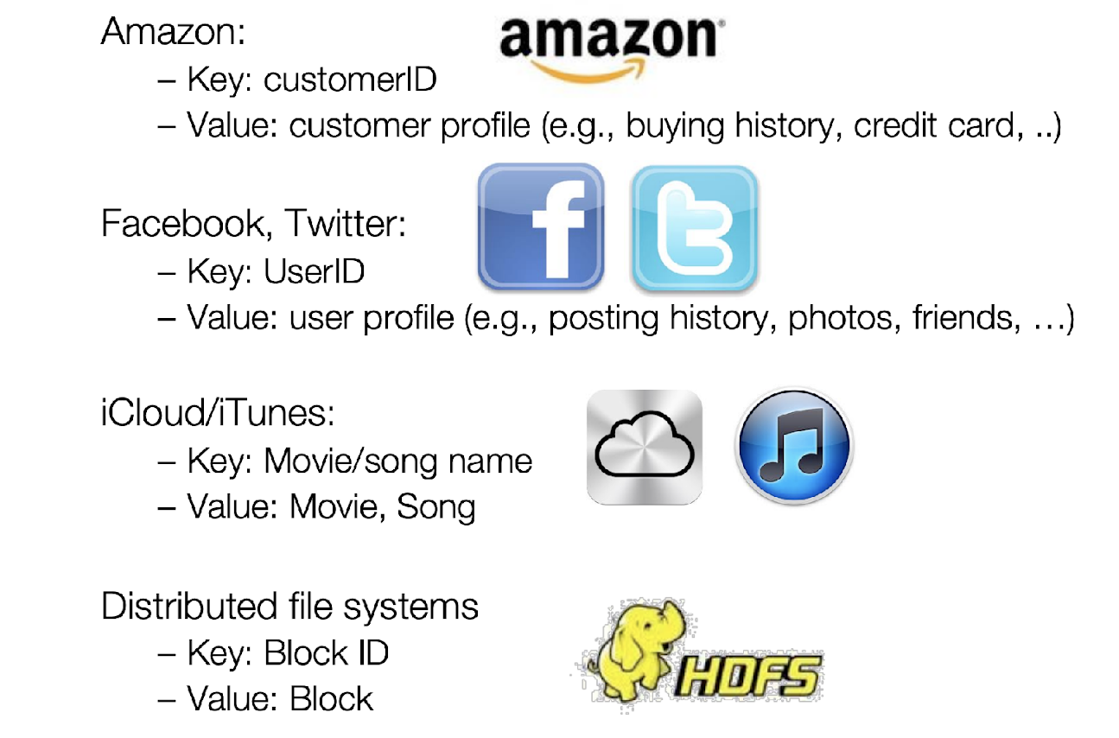
Context for Chord: Key Value Stores
Credit: Ion Stoica’s slide deck
Notes:
Talk about the context.
We need to partition the keys across nodes.
Redis / Memcached / DynamoDB

Slide 22
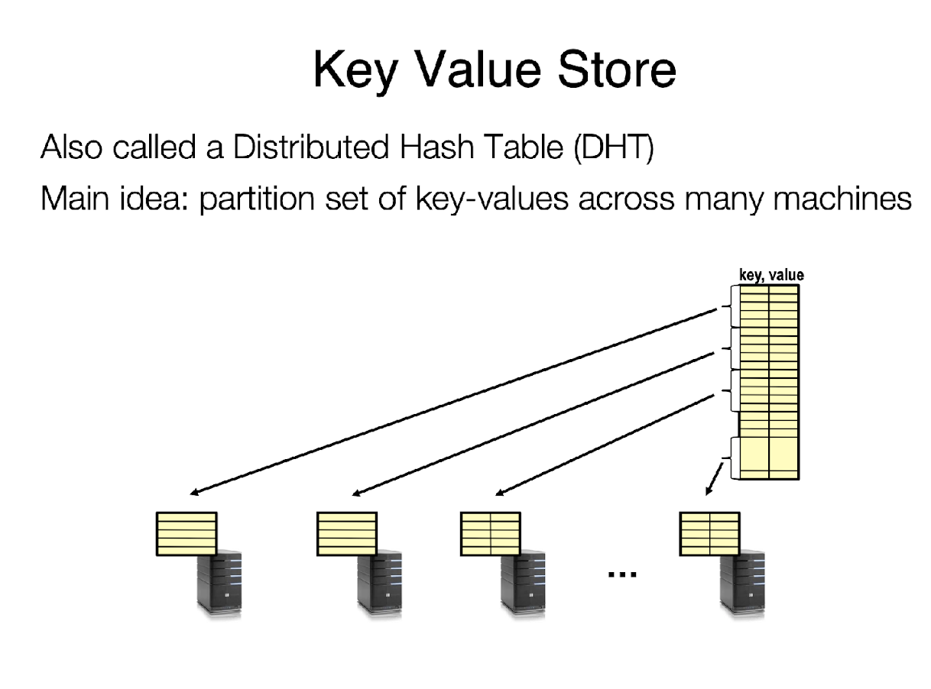
Context for Chord: Key Value Stores
Credit: Ion Stoica’s slide deck

Slide 23
Chord
Chord is a “distributed lookup protocol” for a peer-to-peer distributed hash table [Stoica ‘01]
Main techniques:
Consistent hashing for partitioning key space
Finger Tables for lookup
Notes:
We will focus on consistent hashing in this class.
It has two parts:
How to do partitioning?
How to do lookups?

Slide 24
Identifiers in Chord
Key identifier = SHA1(key) mod 2^{m}
Node identifier = SHA1(IP address) mod 2^{m}
Both are uniformly distributed in the same identifier space
The identifier length, m, must be large enough to make the probability of two nodes or keys hashing to the same identifier negligible (e.g. m = 160)
How do we map key IDs to node IDs?
Notes:
Hashing naturally solves the partitioning problem. [note that this is not consistent hashing yet; this is just hashing]

Slide 25
Consistent Hashing: Assigning Keys to Nodes
A node owns the preceding key range, including its own identifier.
Key k is stored at its successor node, the first node whose identifier is equal to or greater than the identifier of key k.
(120, 10]
120
10
(90, 105]
105
32
90
k = 40
60
k = 90
Notes:
What is consistent hashing?
From the original paper: Consistent hashing assigns keys to nodes as follows. Identifiers are ordered in an identifier circle modulo . Key is assigned to the first node whose identifier is equal to or follows (the identifier of) in the identifier space. This node is called the successor node of key k, denoted by successor(k).
Ask the class.
What is the key space node 10 is responsible for? Ans: (120, 10]
What about node 105? Ans: (90, 105]
What is the successor of key 40? Ans: node 60
What about key 90? Ans: node 90

Slide 26
Basic Lookups
N = 6
m = 7
Each node only remembers its successor node in the circle.
Lookups in clockwise direction.
Assume N nodes and K keys.
m: the number of bits in the node/key identifier.
120
10
105
k = 80
32
entry point
What is the lookup time?
90
O(N) hops
60
Notes:
Each node keeps a small amount of routing information.
Every node only needs to remember its successor node in the circle.
However, this scheme is inefficient as it may require traversing all N nodes to find the appropriate mapping.
Why? Walk through the example of k = 80 with assume the entry node is 105 (in chord, key lookup can contact any node)
The lookup time is O(N)
To accelerate this process, every node in Chord maintains additional information (not for correctness, just for lookup performance). This additional information is the finger table.

Slide 27
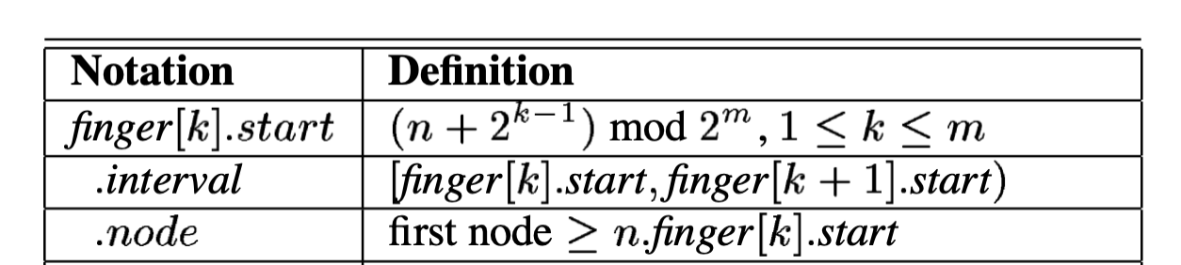
Finger Table Notations
Each node maintains additional routing information (e.g., finger tables) to accelerate lookups.
A finger table contains m entries
120
10
105
32
start interval node
k = 1
91 [91, 92) 105
n: Identifier of the node
m: Number of bits in identifiers
k = 2
k = 3
k = 4
k = 5
k = 6
k = 7
92 [92, 94) 105
90
94 [94, 98) 105
98 [98, 106) 105
106 [106, 122) 120
122 [122, 26) 10
26 [26, 90) 32
60
Notes:
To accelerate this process, Chord maintains additional information (that is, finger table) to accelerate lookups.
The notations are taken from the original Chord paper.
Explain these 3 important variables.
Show the class the finger table for node 90 and the calculation.
Be careful with the interval, it is circular, don’t forget to mod

Slide 28
Finger Table of Node 10
start interval node
11 [11, 12) 32
120
12 [12, 14) 32
14 [14, 18) 32
18 [18, 26) 32
26 [26, 42) 32
42 [42, 74) 60
74 [74, 10) 90
10
105
32
start interval node
91 [91, 92) 105
92 [92, 94) 105
94 [94, 98) 105
98 [98, 106) 105
106 [106, 122) 120
122 [122, 26) 10
26 [26, 90) 32
90
60
Notes:
Ask the class, what is the finger table of node 10? Walk through it

Slide 29
Route k = 15
start interval node
11 [11, 12) 32
120
12 [12, 14) 32
14 [14, 18) 32
18 [18, 26) 32
26 [26, 42) 32
42 [42, 74) 60
74 [74, 10) 90
10
105
32
start interval node
91 [91, 92) 105
92 [92, 94) 105
94 [94, 98) 105
98 [98, 106) 105
106 [106, 122) 120
122 [122, 26) 10
26 [26, 90) 32
90
60
k = 15
Notes:
Assume key = 15 comes in and contacts node 90. How do we route it to its correct successor node?
Find the node ID that is not greater than the key ID

Slide 30
Route k = 15
start interval node
11 [11, 12) 32
120
12 [12, 14) 32
14 [14, 18) 32
18 [18, 26) 32
26 [26, 42) 32
42 [42, 74) 60
74 [74, 10) 90
10
105
32
start interval node
91 [91, 92) 105
92 [92, 94) 105
94 [94, 98) 105
98 [98, 106) 105
106 [106, 122) 120
122 [122, 26) 10
26 [26, 90) 32
90
60
k = 15

Slide 31
Route k = 15
start interval node
11 [11, 12) 32
120
12 [12, 14) 32
14 [14, 18) 32
18 [18, 26) 32
26 [26, 42) 32
42 [42, 74) 60
74 [74, 10) 90
10
105
32
start interval node
91 [91, 92) 105
node 32 is your successor
92 [92, 94) 105
94 [94, 98) 105
98 [98, 106) 105
106 [106, 122) 120
122 [122, 26) 10
26 [26, 90) 32
90
60
k = 15
Notes:
At node 10, all nodes in the table are greater than 15. So 32 is the successor node.

Slide 32
Route k = 15
start interval node
11 [11, 12) 32
120
12 [12, 14) 32
14 [14, 18) 32
18 [18, 26) 32
26 [26, 42) 32
42 [42, 74) 60
74 [74, 10) 90
10
105
Lookup Goal:
Get closer and closer to the node whose successor stores the key, but not passing the node
32
start interval node
91 [91, 92) 105
node 32 is your successor
92 [92, 94) 105
94 [94, 98) 105
98 [98, 106) 105
106 [106, 122) 120
122 [122, 26) 10
26 [26, 90) 32
90
60
k = 15
Notes:
At node 10, all nodes in the table are greater than 15. So 32 is the successor node.

Slide 33
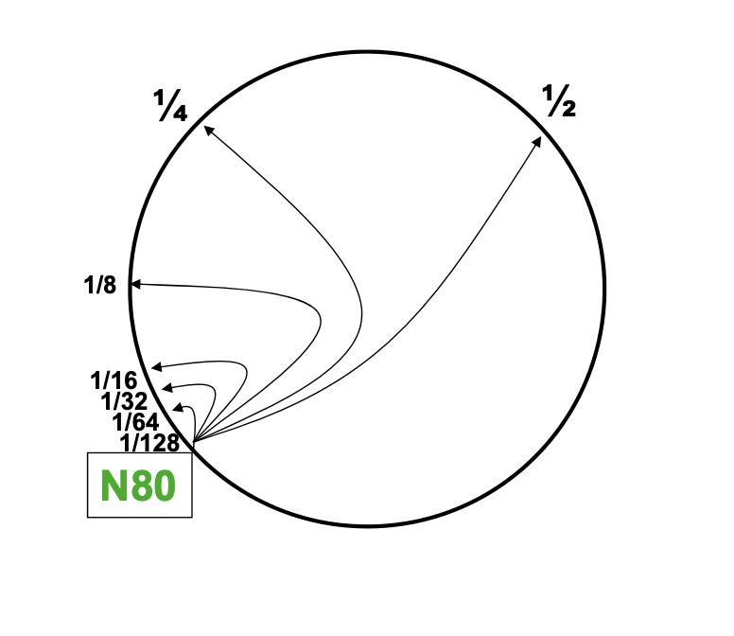
Summary: Finger Table
Each node maintains additional routing information (e.g., finger tables) to accelerate lookups.
This information is not essential for correctness, as long as the successor information is correct.
A finger table contains m entries.
We trade off space for better lookup performance.
What is the lookup time?
O(logN) hops
Credit: UC Berkeley CS 262a Fall 2023 slide deck.
Notes:
Summarize.
Emphasize we are making a tradeoff, by keep more states per node, we improve lookup performance.
And note that the finger table is not essential for correctness of routing. As long as each node remembers who its successor node is correctly, we can always route a key to the right node in Chord. We are relying on the fact that nodes are distributed uniformly between keys
Intuition of the complexity: each entry covers a range of distances around the ring, doubling each time. -> This gives each node "shortcuts" that cover exponentially growing portions of the ring.
Entry 1 points ~1 step away.
Entry 2 points ~2 steps away.
Entry 3 points ~4 steps away.
…
Entry m points ~2^(m-1) steps away.

