Slide 1
RPCs in Go
September 2025
Notes:
Notes

Slide 2
Outline
RPC Overview
  Example: Writing an RPC server in Go
MapReduce: fault tolerance and optimizations
Notes:
For this precept, we will talk about RPC in more details.
Give an overview of Go
Walk through a example to show how to build such a RPC server in Go

Slide 3
RPC Overview

Slide 4
Remote Procedure Call (RPC)
Execute a procedure on a remote process (e.g on another server) as if it was local
Request-Response interface
  Request: arguments to remote procedure
  Response: return values of remote procedure
Examples: client-server, master-worker, peer-peer communication
Notes:
RPCs are the fundamental bedrock of distributed systems. It’s how most of these systems, including hadoop mapreduce for example, are built. Its pervasiveness is due to its simple interface.

Slide 5
Example: Master-Worker
Master {
func LaunchTasks() {
for worker in workers {
// want to call Worker.RunTask(...)
}
}
}
Worker {
func RunTask(index) result {
// ...
}
}

Slide 6
Example: Master-Worker
index = worker.Index
address = worker.Address
request = MakeRequest(index)
response = sendRPC("RunTask", address, request)
result = response.Result
handleResult(result)
Worker {
func RunTask(index) result {
// ...
}
}
Master {
func LaunchTasks() {
for worker in workers {
}
}
}
What is the problem?
How is performance?
Notes:
This works, but what’s the problem? How’s the performance?
(Ans: we have to launch tasks on the workers one by one, no parallelism, all operations are handled by the master goroutine in order)
Note above is the pseudo code, we assume that worker and response structs have fields like Index, Address, and Result

Slide 7
Asynchronous RPC
Key Idea: Await RPC response in a separate thread
Multiple ways to implement this:
Pass a callback to RPC that will be invoked later

Slide 8
Asynchronous RPC
Key Idea: Await RPC response in a separate thread
Multiple ways to implement this:
Pass a callback to RPC that will be invoked later
func handleResponse {
…
// e.g process result and notify the master
}
sendRPC("RunTask", address, request, handleResponse)
Notes:
We can implement a function “sendRPC” that takes in a callback function
Such that when RPC call for RunTask completes and returns, the callback function handleResponse will be triggered to process the RPC result

Slide 9
Asynchronous RPC
Key Idea: Await RPC response in a separate thread
Multiple ways to implement this:
Pass a callback to RPC that will be invoked later
Use channels to communicate RPC reply back to main thread

Slide 10
Asynchronous RPC
Key Idea: Await RPC response in a separate thread
Use channels to communicate RPC reply back to main thread
for _, worker := range workers {
go func() {
channel <- sendRPC("RunTask", address, request)
}()
}
select {
case res := <-channel:
handleResponse(res)
default:
// do other stuff
}
Notes:
Dispatch a goroutine that issues the RPC and sends response to channel
The main goroutine can then receive the response from channel

Slide 11
What’s an example application where we would want asynchronous RPCs?
Notes:
There are many… actually MOST RPCs are asynchronous
Whenever you want to send multiple messages at once, e.g.
Building a scheduler loop
Client contacting multiple servers at once and returning the first result
Background tasks, e.g.
Cleaning up metadata that has gone stale, e.g. removing cached objects that are no longer referenced
Backing up results
Compressing data that is not frequently accessed

Slide 12
Writing an RPC server in GO

Slide 13
RPC Implementations in Go
There are 3 types of RPC implementations in Go’s built-in library
  net/rpc
  net/rpc/jsonrpc
  gRPC
Notes:
We will use net/rpc extensively for the assignments.
However, net/rpc is only supported in Go.
To support RPC in cross-language platforms, Go library uses net/rpc/jsonrpc. It is based on TCP protocol but currently does not support HTTP methods. This limits its application in real life.
gRPC is a high-performance, widely used open-source RPC framework by Google. It can support popular languages like Python, Go, and Java.

Slide 14
RPCs in GO (net/rpc server)
Write stub receiver methods in the form:
func (t *T) MethodName(args T1, reply *T2) error
Create a server
  Create a TCP server (or some other types of server to receive data)
  Create a listener that will handle RPCs
  Register the listener and accept inbound RPC
See https://golang.org/pkg/net/rpc/ for more details
Notes:
Note: “receiver” here means the type to which this method applies, not a communication receiver
TODO: might have question about the input parameters in the stub function (args, and reply)
Why is reply a pointer, but not args?
first argument represents the arguments provided by the caller; the second argument represents the result parameters to be returned to the caller.
Reply is a pointer because it is used to store output. Note that the return value is error.
Answer: Read-Only Usage
If args is not modified within the function, passing by value is fine.
It makes the function safer since it guarantees args won't be altered.

Slide 15
Go example: Word count server
func (*WordCountServer) Compute(
request WordCountRequest,
reply *WordCountReply) error {
counts := make(map[string]int)
input := request.Input
tokens := strings.Fields(input)
for _, t := range tokens {
counts[t] += 1
}
reply.Counts = counts
return nil
}
type WordCountServer struct {
addr string
}
type WordCountRequest struct {
Input string
}
type WordCountReply struct {
Counts map[string]int
}
Step 1: write the stub function

Slide 16
Go example: Word count server
type WordCountServer struct {
addr string
}
type WordCountRequest struct {
Input string
}
type WordCountReply struct {
Counts map[string]int
}
func (*WordCountServer) Compute(
request WordCountRequest,
reply *WordCountReply) error {
counts := make(map[string]int)
input := request.Input
tokens := strings.Fields(input)
for _, t := range tokens {
counts[t] += 1
}
reply.Counts = counts
return nil
}
Step 1: write the stub function
Notes:
(NB: *WordCountServer is the “receiver” for this method.)

Slide 17
Go example: Word count server
func (server *WordCountServer) Listen() {
rpc.Register(server)
listener, err := net.Listen("tcp", server.addr)
checkError(err)
go func() {
rpc.Accept(listener)
}()
}
Step 2.1: create a server

Slide 18
Go example: Word count server
func (server *WordCountServer) Listen() {
rpc.Register(server)
listener, err := net.Listen("tcp", server.addr)
checkError(err)
go func() {
rpc.Accept(listener)
}()
}
Step 2.2: create a listener that handles RPCs

Slide 19
Go example: Word count server
func (server *WordCountServer) Listen() {
rpc.Register(server)
listener, err := net.Listen("tcp", server.addr)
checkError(err)
go func() {
rpc.Accept(listener)
}()
}
Step 2.3: register the listener and accept inbound RPCs
Notes:
Note that Accept blocks, so this server only handles one request at a time (inefficient!)

Slide 20
RPCs in GO (net/rpc client)
Create a client
Issue a RPC call
Unpack return value

Slide 21
Go example: Word count client
func makeRequest(input string, serverAddr string) (map[string]int, error) {
client, err := rpc.Dial("tcp", serverAddr)
checkError(err)
args := WordCountRequest{input}
reply := WordCountReply{make(map[string]int)}
err = client.Call("WordCountServer.Compute", args, &reply)
if err != nil {
return nil, err
}
return reply.Counts, nil
}
Step 1: create a client
Notes:
rpc.Dial establishes new connection and returns a new client (which is responsible for handling requests)

Slide 22
Go example: Word count client
func makeRequest(input string, serverAddr string) (map[string]int, error) {
client, err := rpc.Dial("tcp", serverAddr)
checkError(err)
args := WordCountRequest{input}
reply := WordCountReply{make(map[string]int)}
err = client.Call("WordCountServer.Compute", args, &reply)
if err != nil {
return nil, err
}
return reply.Counts, nil
}
Step 2.1: create the RPC arguments

Slide 23
Go example: Word count client
func makeRequest(input string, serverAddr string) (map[string]int, error) {
client, err := rpc.Dial("tcp", serverAddr)
checkError(err)
args := WordCountRequest{input}
reply := WordCountReply{make(map[string]int)}
err = client.Call("WordCountServer.Compute", args, &reply)
if err != nil {
return nil, err
}
return reply.Counts, nil
}
Step 2.2: Make a RPC call

Slide 24
Go example: Word count client-server
func main() {
serverAddr := "localhost:8888"
server := WordCountServer{serverAddr}
server.Listen()
input1 := "hello I am good hello bye bye bye bye good night hello"
wordcount, err := makeRequest(input1, serverAddr)
checkError(err)
fmt.Printf("Result: %v\n", wordcount)
}
Step 3: Unpack return values
Result: map[hello:3 I:1 am:1 good:2 bye:4 night:1]

Slide 25
Is this synchronous or asynchronous?
func makeRequest(input string, serverAddr string) (map[string]int, error) {
client, err := rpc.Dial("tcp", serverAddr)
checkError(err)
args := WordCountRequest{input}
reply := WordCountReply{make(map[string]int)}
err = client.Call("WordCountServer.Compute", args, &reply)
if err != nil {
return nil, err
}
return reply.Counts, nil
}
How to make it asynchronous?
Notes:
Let’s go back to our RPC client. Is this synchronous or async? Ans: synchronous
How would we make this asynchronous? What would the signature look like? (What would we return?)

Slide 26
Making client asynchronous - Option 1
func makeRequest(input string, serverAddr string) chan Result {
client, err := rpc.Dial("tcp", serverAddr)
checkError(err)
args := WordCountRequest{input}
reply := WordCountReply{make(map[string]int)}
return ch
}
ch := make(chan Result)
go func() {
err := client.Call("WordCountServer.Compute", args, &reply)
if err != nil {
ch <- Result{nil, err} // something went wrong
} else {
ch <- Result{reply.Counts, nil} // success
}
}()
Result Channel
Notes:
Option: still use Call API, but make a result channel ourselves to recieve results asynchronously

Slide 27
Making client asynchronous - Option 2
func makeRequest(input string, serverAddr string) *Call {
client, err := rpc.Dial("tcp", serverAddr)
checkError(err)
args := WordCountRequest{input}
reply := WordCountReply{make(map[string]int)}
return client.Go("WordCountServer.Compute", args, &reply, nil)
}
call := makeRequest(...)
<-call.Done
checkError(call.Error)
handleReply(call.Reply)
Notes:
(NB: “The Call method waits for the remote call to complete while the Go method launches the call asynchronously and signals completion using the Call structure's Done channel.” from https://golang.org/pkg/net/rpc/)
Option 2: directly use Go method provided in the built-in RPC library (emphasize here we are calling client.Go and not client.Call)

Slide 28
Go’s net/rpc is at-most-once
Opens a TCP connection and writes the request
  TCP may retransmit but server’s TCP receiver will filter out duplicates internally, with sequence numbers
  No retry in Go RPC code (i.e will not create a second TCP connection)
However, Go RPC returns an error if it doesn’t get a reply
  Perhaps after a TCP timeout
  Perhaps server didn’t see the request
  Perhaps server processed request but server or network failed before reply came back

Slide 29
RPC in Your Assignments
Go’s RPC isn’t enough for Assignments 1 and 2
  It only applies to a single RPC call
  If worker doesn’t respond, master re-sends to another (e.g handling worker failures in part D of assignment 1-3)
    Go RPC can’t detect this kind of duplicate
  Breaks at-most-once semantics
    No problem in Assignments 1 and 2 (handles at application level)
In Assignment 3, you will explicitly detect duplicates using techniques we’ve talked about in lectures

Slide 30
Exercise: Cristian’s algorithm
Implement a CristianServer that other machines sync their local time to
Notes:
Probably not enough time for this

Slide 31


Cristian’s algorithm: Outline
Client sends a request packet, timestamped with its local clock T₁
Server timestamps its receipt of the request T₂ with its local clock
Server sends a response packet with its local clock T₃ and T₂
Client locally timestamps its receipt of the server’s response T₄
Client
Server
T₁
request:
T₁
T₂
T₃
T₄
T₂ ,T₃
response:
Time ↓

Slide 32
Cristian’s algorithm: Offset sample calculation
Goal: Client sets clock ← T₃ + 𝛿_{resp}
Client
Server
Client samples round trip time 𝛿 = 𝛿_{req} + 𝛿_{resp} = (T₄ − T₁) − (T₃ − T₂)
But client knows 𝛿, not 𝛿_{resp}
T₁
request:
T₁
𝛿_{req}
T₂
𝛿_{resp}
T₃
Assume: 𝛿_{req} ≈ 𝛿_{resp}
T₂ ,T₃
T₄
response:
Client sets clock ← T₃ + ½𝛿
Time ↓

Slide 33
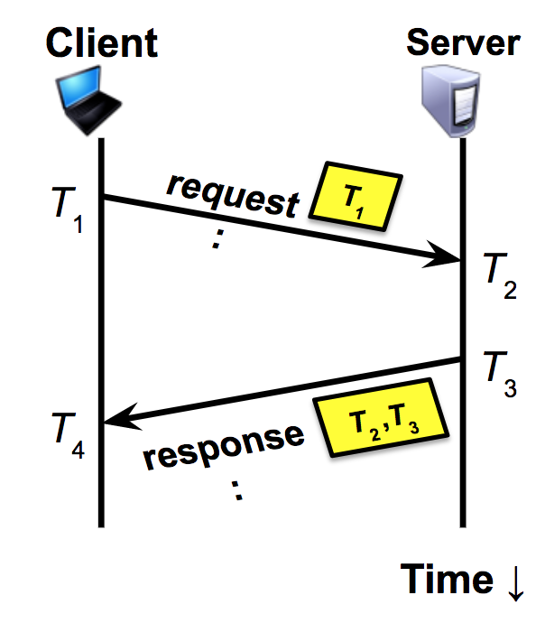
Exercise: Cristian’s algorithm
Implement a CristianServer that other machines sync their local time to
func SyncTime(serverAddr string) (time.Time, error)
Set local time = T₃ + RTT/2, where RTT = (T₄ - T₁) - (T₃ - T₂)
Note: You can just build a simplified version where T₂ = T₃
Hint: use time.Time’s Sub and Add methods, time.Now()

Slide 34
MapReduce: Fault Tolerance and Optimizations
Notes:
If time permits, go through this mapreduce section in more detail

Slide 35
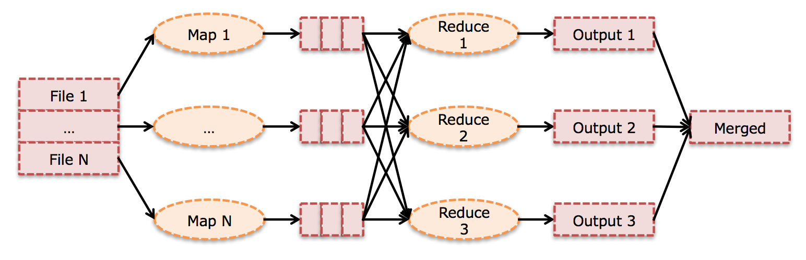
MapReduce: Fault Tolerance
Notes:
Last time we talked about how mapreduce is hard despite having such a simple interface. This precept we’re gonna run through a couple of very realistic failure scenarios.
Ovals represent processes/tasks, squares represent storage

Slide 36

MapReduce: Fault Tolerance
Synchronization barrier
Notes:
Map task fails, what needs to be recomputed? Just the partition
However, this is still bad because reduce stage needs to wait until all map tasks have been successfully computed. Why? Can we run half the reduce tasks first and have the other half wait for the one missing map task?
(Ans: NO, because we don’t know if the failed map task will have data for us)
Thus, there’s what we call a synchronization barrier between the map and the reduce stages, because reduce cannot begin until after map has finished.
(Note: you can start FETCHING the map outputs in a reduce task, but you will still need to wait for all the map outputs to be present before doing any aggregation)

Slide 37
MapReduce: Fault Tolerance
Synchronization barrier
Notes:
Map task fails, what needs to be recomputed? Just the partition
However, this is still bad because reduce stage needs to wait until all map tasks have been successfully computed. Why? Can we run half the reduce tasks first and have the other half wait for the one missing map task?
(Ans: NO, because we don’t know if the failed map task will have data for us)
Thus, there’s what we call a synchronization barrier between the map and the reduce stages, because reduce cannot begin until after map has finished.
(Note: you can start FETCHING the map outputs in a reduce task, but you will still need to wait for all the map outputs to be present before doing any aggregation)

Slide 38
MapReduce: Fault Tolerance
Notes:
Map task fails, what needs to be recomputed? Just the partition
However, this is still bad because reduce stage needs to wait until all map tasks have been successfully computed. Why? Can we run half the reduce tasks first and have the other half wait for the one missing map task?
(Ans: NO, because we don’t know if the failed map task will have data for us)
Thus, there’s what we call a synchronization barrier between the map and the reduce stages, because reduce cannot begin until after map has finished.
(Note: you can start FETCHING the map outputs in a reduce task, but you will still need to wait for all the map outputs to be present before doing any aggregation)

Slide 39
Launch same task on a different machine
Assumes tasks are deterministic and idempotent
Map 1*
Notes:
One optimization we could do here is speculative execution, which means launch the same task but on a different, presumably faster, node. Meanwhile the old (slow) task still runs in parallel. In effect we’re expending more resources to have the two tasks race.
How do we reconcile the fact that there are now two copies of the same task running?
Easy: Whichever finishes sooner will be used, while the results of the slower one will be discarded. This is conceptually simple but the scheduler needs to handle this.
So now we’ve seen that we need to handle failures and stragglers. This is what complicates the scheduler in mapreduce significantly. In your homework you’re gonna build a very simplified scheduler that doesn’t handle stragglers.

Slide 40

What if server 1 is just REALLY slow?
Server 1 is a straggler
Notes:
Here’s another optimization.
We saw earlier that there is a synchronization barrier between the map and reduce stages. Now if a server is really slow then we call it a straggler because all the other servers NEED to wait for that server to finish before proceeding to the next stage.
What are some ways to fix this? Any ideas?

Slide 41
Use the same idea!
Speculative execution
Map 1*
Notes:
One optimization we could do here is speculative execution, which means launch the same task but on a different, presumably faster, node. Meanwhile the old (slow) task still runs in parallel. In effect we’re expending more resources to have the two tasks race.
How do we reconcile the fact that there are now two copies of the same task running?
Easy: Whichever finishes sooner will be used, while the results of the slower one will be discarded. This is conceptually simple but the scheduler needs to handle this.
So now we’ve seen that we need to handle failures and stragglers. This is what complicates the scheduler in mapreduce significantly. In your homework you’re gonna build a very simplified scheduler that doesn’t handle stragglers.

Slide 42
What should we re-execute?
Notes:
Reduce task fails, what needs to be recomputed?
Ans: just the reduce task, assuming all map outputs are intact on the local disks on all nodes. We just fetch the map outputs again.

Slide 43
All mappers might provide inputs to Reduce 2
Notes:
What if all map tasks fail?
We have do the map computation again.

Slide 44
Can we be smarter?
Notes:
Reduce task fails, what needs to be recomputed?
Can we be smarter?

Slide 45
What should we re-execute?
Write intermediate output to stable storage
Notes:
Reduce task fails, what needs to be recomputed?
Ans: just the reduce task, assuming all map outputs are intact on the local disks on all nodes. We just fetch the map outputs again.’
Write intermediate output to stable storage to ensure all map outputs are intact

Slide 46
What could go wrong?
Notes:
Server #2 goes down during the reduce phase. We lose all of its map outputs. What needs to be recomputed?
Map 2, obviously
Do we have to recompute all the reduce tasks?
In general, only the ones that still need to fetch Map 2 outputs
(If a reduce task already finished, we don’t need to re-run it because map 2 outputs aren’t gonna change)

Slide 47
Mapreduce: What could go wrong?
Key idea: Determine tasks to recompute using data lineage, instead of recomputing all tasks
Notes:
Data lineage is a flow of dependencies. This means we keep track of which partition each task depends on. When a task fails, we just need to trace back the arrows to find the partitions that we need to recompute.
This is one of the reasons why the mapreduce model is so successful

Slide 48
Lineage is useful for optimizations too
Notes:
Let’s say now nothing fails. With this model there are some optimizations we can do because of lineage. The first is reusing map outputs. We saw that keeping around map outputs (as local files on disks) help us recover from reduce failures quickly, without having to recompute the map tasks. It turns out this also enables an optimization.

Slide 49
Reusing map outputs
Job 1:
Job 2:
Notes:
Suppose you want to run two different kinds of aggregation (reduces) and they both use the same map outputs, then instead of re-running the map tasks you can simply keep the map outputs from the previous job

