Slide 1
Concurrency in Go
September 2025

Slide 2
Go Resources
https://tour.golang.org/list
https://play.golang.org
https://gobyexample.com

Slide 3
Today’s Precept…
Two synchronization mechanisms
  Locks
  Channels
Mapreduce

Slide 4
Two synchronization mechanisms
Locks - limit access to a critical section
Channels - pass information across processes using a queue
Notes:
Emphasize that go uses channels a lot more
Go Philosophy: "Don’t communicate by sharing memory; share memory by communicating
Instead of multiple goroutines poking into the same memory (which requires locks to prevent race conditions), you send messages through channels.
Locks are easy to misuse: forgetting to unlock, double-locking, or deadlocking. Go does provide sync.Mutex, RWMutex, Cond, and atomic operations.
These are used for performance-critical sections or when channels don’t fit well (e.g., protecting small shared state).

Slide 5

Example: Bank account
Thread 1
Bank Account
Thread 2
100
Read b = 100
b = b + 10
Write b = 110
110
Read b = 110
b = b + 10
120
Write b = 120
Notes:
B&A both want to add $10 to a shared bank account

Slide 6

Example: Bank account
Thread 1
Bank Account
Thread 2
100
Read b = 100
b = b + 10
Read b = 100
Write b = 110
110
b = b + 10
110
Write b = 110
Notes:
What went wrong?

Slide 7
What went wrong?
Changes to balance are not atomic
func Deposit(amount) {
read balance
balance = balance + amount
write balance
}

Slide 8
What went wrong?
Suppose the function is called in two threads, with the Thread 1 chosen to run first.
Thread 1
Thread 2
func Deposit(amount) {
read balance
balance = balance + amount
write balance
}
func Deposit(amount) {
read balance
balance = balance + amount
write balance
}

Slide 9
What went wrong?
Suppose the function is called in two threads, with the Thread 1 chosen to run first.
Thread 1
Thread 2
func Deposit(amount) {
read balance
balance = balance + amount
write balance
}
func Deposit(amount) {
read balance
balance = balance + amount
write balance
}

Slide 10
What went wrong?
Then, an interrupt happens, and the OS scheduler selects Thread 2 to run.
Thread 1
Thread 2
func Deposit(amount) {
read balance
balance = balance + amount
write balance
}
func Deposit(amount) {
read balance
balance = balance + amount
write balance
}

Slide 11
What went wrong?
Thread 1 did not write new balance to shared storage, so Thread 2 reads the old value.
Thread 1
Thread 2
func Deposit(amount) {
read balance
balance = balance + amount
write balance
}
func Deposit(amount) {
read balance
balance = balance + amount
write balance
}

Slide 12
What went wrong?
This is called a race condition.
Thread 1
Thread 2
func Deposit(amount) {
read balance
balance = balance + amount
write balance
}
func Deposit(amount) {
read balance
balance = balance + amount
write balance
}

Slide 13
Solution - Locks
Changes to balance are now atomic.
func Deposit(amount) {
lock balanceLock
read balance
balance = balance + amount
write balance
unlock balanceLock
}
Critical section
Notes:
Multiple threads could execute this function at the same time.
Without protection, two deposits might both read the old balance before either writes the new one.
Result: lost updates — some deposits effectively disappear.
To fix this, the entire function must be treated as a critical section.
The critical section should be protected with a lock before the read, and released only after the write.

Slide 14
Good Video Explanations
Race Conditions:
https://www.youtube.com/watch?v=FY9livorrJI
Deadlocks:
https://www.youtube.com/watch?v=LjWug2tvSBU

Slide 15
Locks in Go
func (a *Account) CheckBalance() int {
a.mu.Lock()
defer a.mu.Unlock()
return a.balance
}
package account
import "sync"
type Account struct {
balance int
mu sync.Mutex
}
func (a *Account) Withdraw(v int) {
a.mu.Lock()
defer a.mu.Unlock()
a.balance -= v
}
func NewAccount(init int) Account {
return Account{balance: init}
}
func (a *Account) Deposit(v int) {
a.mu.Lock()
defer a.mu.Unlock()
a.balance += v
}
Notes:
Need “sync” library
Why a special data type? Why not just use ints? → testing and setting the variable must be atomic! Lock, Unlock are atomic operations.

Slide 16
Locks in Go
func (a *Account) CheckBalance() int {
a.mu.Lock()
defer a.mu.Unlock()
return a.balance
}
package account
import "sync"
type Account struct {
balance int
mu sync.Mutex
}
func (a *Account) Withdraw(v int) {
a.mu.Lock()
defer a.mu.Unlock()
a.balance -= v
}
func NewAccount(init int) Account {
return Account{balance: init}
}
func (a *Account) Deposit(v int) {
a.mu.Lock()
defer a.mu.Unlock()
a.balance += v
}
Notes:
Need “sync” library
Lock has type “mutex” --- “mutually exclusive” access.
Why a special data type? Why not just use ints? → testing and setting the variable must be atomic! Lock, Unlock are atomic operations.
A defer statement defers the execution of a function until the surrounding function returns.

Slide 17
Read Write Locks in Go
func (a *Account) CheckBalance() int {
a.rwLock.RLock()
defer a.rwLock.RUnlock()
return a.balance
}
package account
import "sync"
type Account struct {
balance int
rwLock sync.RWMutex
}
func (a *Account) Withdraw(v int) {
a.rwLock.Lock()
defer a.rwLock.Unlock()
a.balance -= v
}
func NewAccount(init int) Account {
return Account{balance: init}
}
func (a *Account) Deposit(v int) {
a.rwLock.Lock()
defer a.rwLock.Unlock()
a.balance += v
}
Notes:
From godocs: “A RWMutex is a reader/writer mutual exclusion lock. The lock can be held by an arbitrary number of readers or a single writer. The zero value for a RWMutex is an unlocked mutex.”

Slide 18
Read Write Locks in Go
func (a *Account) CheckBalance() int {
a.rwLock.RLock()
defer a.rwLock.RUnlock()
return a.balance
}
package account
import "sync"
type Account struct {
balance int
rwLock sync.RWMutex
}
func (a *Account) Withdraw(v int) {
a.rwLock.Lock()
defer a.rwLock.Unlock()
a.balance -= v
}
func NewAccount(init int) Account {
return Account{balance: init}
}
func (a *Account) Deposit(v int) {
a.rwLock.Lock()
defer a.rwLock.Unlock()
a.balance += v
}
Notes:
From godocs: “A RWMutex is a reader/writer mutual exclusion lock. The lock can be held by an arbitrary number of readers or a single writer. The zero value for a RWMutex is an unlocked mutex.”
RLock is a shared read lock. When a lock is taken with it, other threads* can also take their own lock with RLock. This means multiple threads* can read at the same time. It's semi-exclusive.
If the mutex is read locked, a call to Lock is blocked**. If one or more readers hold a lock, you cannot write.
If the mutex is write locked (with Lock), RLock will block**.

Slide 19

Two Solutions to the Same Problem
Locks:
Multiple threads can reference same memory location
Use lock to ensure only one thread is updating it at any given time
Channels:
Data item initially stored in channel
Threads must request item from channel, make updates, and return item to channel
T1
T2
T3
T1
T2
T3
100
C
0x1000: 100
100
110
Notes:
Locks
Multiple threads (goroutines) share the same memory location.
A mutex lock ensures that only one thread can update it at a time.
This is the shared memory with locks model.
Channels
Instead of sharing memory directly, the data is placed in a channel.
Threads must request the item from the channel, update it, then return it to the channel.
This enforces because only one thread can hold the item at a time.

Slide 20
Bank Account Code (using channels)
package account
type Account struct {
// Fill in Here
}
func NewAccount(init int) Account {
// Fill in Here
}
func (a *Account) CheckBalance() int {
// What goes Here?
}
func (a *Account) Withdraw(v int) {
// ???
}
func (a *Account) Deposit(v int) {
// ???
}

Slide 21
Bank Account Code (using channels)
package account
type Account struct {
balance chan int
}
func NewAccount(init int) Account {
a := Account{
balance: make(chan int, 1)
}
a.balance <- init
return a
}
func (a *Account) CheckBalance() int {
// What goes Here?
}
func (a *Account) Withdraw(v int) {
// ???
}
func (a *Account) Deposit(v int) {
// ???
}

Slide 22
Bank Account Code (using channels)
package account
type Account struct {
balance chan int
}
func NewAccount(init int) Account {
a := Account{
balance: make(chan int, 1)
}
a.balance <- init
return a
}
func (a *Account) CheckBalance() int {
bal := <-a.balance
a.balance <- bal
return bal
}
func (a *Account) Withdraw(v int) {
// ???
}
func (a *Account) Deposit(v int) {
//???
}

Slide 23
Bank Account Code (using channels)
package account
type Account struct {
balance chan int
}
func NewAccount(init int) Account {
a := Account{
balance: make(chan int, 1)
}
a.balance <- init
return a
}
func (a *Account) CheckBalance() int {
bal := <-a.balance
a.balance <- bal
return bal
}
func (a *Account) Withdraw(v int) {
bal := <-a.balance
a.balance <- (bal - v)
}
func (a *Account) Deposit(v int) {
//???
}

Slide 24
Bank Account Code (using channels)
package account
type Account struct {
balance chan int
}
func NewAccount(init int) Account {
a := Account{
balance: make(chan int, 1)
}
a.balance <- init
return a
}
func (a *Account) CheckBalance() int {
bal := <-a.balance
a.balance <- bal
return bal
}
func (a *Account) Withdraw(v int) {
bal := <-a.balance
a.balance <- (bal - v)
}
func (a *Account) Deposit(v int) {
bal := <-a.balance
a.balance <- (bal + v)
}
Notes:
Why does this work?
The three functions on the right will block on the first read if the channel is empty. Only the person who reads from the channel can write (so same as a lock).

Slide 25
Go channels
result := make(chan int, numWorkers)
// Launch workers
for i := 0; i < numWorkers; i++ {
go func() {
doWork()
}()
}
Channels also allow us to safely communicate between goroutines
result <- i
// Wait until all worker threads have finished
for i := 0; i < numWorkers; i++ {
handleResult(<-result)
}
fmt.Println("Done!")
Notes:
A common pattern in Go is to create a bunch of worker goroutines, and then by the time they finish you want to somehow gather the results back to the main goroutine. This already looks like a mini distributed system where the master is the main goroutine. This is one reason why channels make distributed programming natural.

Slide 26
Go channels
result := make(chan int, numServers)
// Send query to all servers
for i := 0; i < numServers; i++ {
go func() {
resp := // ... send RPC to server
}()
}
Easy to express asynchronous RPC
Awkward to express this using locks
result <- resp
// Return as soon as the first server responds
handleResponse(<-result)
Notes:
This is almost identical to the previous example, except this time we’re the client and we’re trying to contact all the servers to get an answer to our query. Note that here we’re only concerned with the first answer, so we can just consume from the channel once.
Channels are a natural way to build distributed systems (using async RPCs)
Locks and semaphores are more suited for controlling concurrent access to local state

Slide 27
Select statement
select allows a goroutine to wait on multiple channels at once
for {
select {
case money := <-dad:
buySnacks(money)
case money := <-mom:
buySnacks(money)
}
}
Notes:
the select statement allows you to wait on multiple channel operations, such as sending or receiving values. Similar to a switch statement, select enables you to proceed with whichever channel case is ready, making it ideal for handling asynchronous tasks efficiently.
If multiple cases are ready, one is chosen at random.

Slide 28
Select statement
select allows a goroutine to wait on multiple channels at once
for {
select {
case money := <-dad:
buySnacks(money)
case money := <-mom:
buySnacks(money)
case default:
starve()
time.Sleep(5 * time.Second)
}
}
Notes:
The default case executes if no other case is ready, avoiding a block.
Why the sleep?
Otherwise the thread is busy polling, so here we force it to sleep every x interval

Slide 29
Handle timeouts using select
// Asynchronously request an answer
// from server, timing out after X
// seconds
result := make(chan int)
timeout := make(chan bool)
// Ask server
go func() {
response := // ... send RPC
result <- response
}()
// Start timer
go func() {
time.Sleep(5 * time.Second)
timeout <- true
}()
// Wait on both channels
select {
case res := <-result:
handleResult(res)
case <-timeout: fmt.Println("Timeout!")
}

Slide 30
Exercise: Implementing a mutex using channels
type Lock struct {
// ???
}
func NewLock() Lock {
// ???
}
func (l *Lock) Lock() {
// ???
}
func (l *Lock) Unlock() {
// ???
}

Slide 31
Exercise: Implementing a mutex using channels
type Lock struct {
ch chan bool
}
func NewLock() Lock {
// ???
}
func (l *Lock) Lock() {
// ???
}
func (l *Lock) Unlock() {
// ???
}

Slide 32
Exercise: Implementing a mutex using channels
type Lock struct {
ch chan bool
}
func NewLock() Lock {
lock := Lock{make(chan bool, 1)}
lock.ch <- true
return lock
}
func (l *Lock) Lock() {
// ???
}
func (l *Lock) Unlock() {
// ???
}

Slide 33
Exercise: Implementing a mutex using channels
type Lock struct {
ch chan bool
}
func NewLock() Lock {
lock := Lock{make(chan bool, 1)}
lock.ch <- true
return lock
}
func (l *Lock) Lock() {
<-lock.ch
}
func (l *Lock) Unlock() {
// ???
}

Slide 34
Exercise: Implementing a mutex using channels
type Lock struct {
ch chan bool
}
func NewLock() Lock {
lock := Lock{make(chan bool, 1)}
lock.ch <- true
return lock
}
func (l *Lock) Lock() {
<-lock.ch
}
func (l *Lock) Unlock() {
lock.ch <- true
}

Slide 35
Mutexes vs. Semaphores
1
Mutexes allow 1 process to enter critical section at a time. Allows at most n concurrent accesses
Semaphores allow up to N processes to enter critical section simultaneously
Study Rooms
7
2
6
3
5
4
Notes:
Library Study rooms act as a semaphore.
Each room is only suited for a single student.
Each student comes up to the front desk and asks if a room is available.
If a room is available the student will just go and acquire the open room.
If all rooms are full, then the librarian will make the student wait until one becomes free.

Slide 36
Outline
Two synchronization mechanisms
Locks
Channels
MapReduce

Slide 37
Application: Word count
How much wood would a woodchuck chuck if a wooadchuck could chuck wood?
how: 1, much: 1, wood: 2, would: 1, a: 2, woodchuck: 2, chuck: 2, if: 1, could: 1

Slide 38
Application: Word count
Locally: tokenize and put words in a hash map
How do you parallelize this?
Partition the document into n partitions.
Build n hash maps, one for each partition
Merge the n hash maps (by key)

Slide 39

How do you do this in a distributed environment?

Slide 40
When in the Course of human events, it becomes necessary for one people to dissolve the political bands which have connected them with another, and to assume, among the Powers of the earth, the separate and equal station to which the Laws of Nature and of Nature's God entitle them, a decent respect to the opinions of mankind requires that they should declare the causes which impel them to the separation.
Input document

Slide 41
When in the Course of human events, it becomes necessary for one people to
dissolve the political bands which have connected them with another, and to assume,
among the Powers of the earth, the separate and equal station to which the Laws of
Nature and of Nature's God entitle them, a decent respect to the opinions of mankind
requires that they should declare the causes which impel them to the separation.
Partition

Slide 42
When in the Course of human events, it becomes necessary for one people to
dissolve the political bands which have connected them with another, and to assume,
among the Powers of the earth, the separate and equal station to which the Laws of
Nature and of Nature's God entitle them, a decent respect to the opinions of mankind
requires that they should declare the causes which impel them to the separation.
Shard 1
Shard 1
Shard 2
Shard 2
Shard 3
Shard 3
Shard 4
Shard 4
Shard 5
Shard 5
Partition

Slide 43
requires that they should declare the causes which impel them to the separation.
When in the Course of human events, it becomes necessary for one people to
Nature and of Nature's God entitle them, a decent respect to the opinions of mankind
dissolve the political bands which have connected them with another, and to assume,
among the Powers of the earth, the separate and equal station to which the Laws of

Slide 44
requires: 1, that: 1, they: 1, should: 1, declare: 1, the: 1, causes: 1, which: 1 ...
when: 1, in: 1,
the: 1, course: 1,
of: 1, human: 1,
events: 1, it: 1
nature: 2, and: 1, of: 2, god: 1, entitle: 1, them: 1, decent: 1, respect: 1, mankind: 1, opinion: 1 ...
dissolve: 1, the: 2, political: 1, bands: 1, which: 1, have: 1, connected: 1, them: 1 ...
among: 1, the: 2, powers: 1, of: 2, earth: 1, separate: 1, equal: 1, and: 1 ...
Compute word counts locally

Slide 45
requires: 1, that: 1, they: 1, should: 1, declare: 1, the: 1, causes: 1, which: 1 ...
when: 1, in: 1,
the: 1, course: 1,
of: 1, human: 1,
events: 1, it: 1
Now what…
How to merge results?
nature: 2, and: 1, of: 2, god: 1, entitle: 1, them: 1, decent: 1, respect: 1, mankind: 1, opinion: 1 ...
dissolve: 1, the: 2, political: 1, bands: 1, which: 1, have: 1, connected: 1, them: 1 ...
among: 1, the: 2, powers: 1, of: 2, earth: 1, separate: 1, equal: 1, and: 1 ...
Compute word counts locally

Slide 46
Merging results computed locally
Several options
— requires additional computation for correct results
Don’t merge
Send everything to one node
— what if data is too big? Too slow…
Partition key space among nodes in cluster (e.g. [a-e], [f-j], [k-p] ...)
Assign a key space to each node
Split local results by the key spaces
Fetch and merge results that correspond to the node’s key space

Slide 47
requires: 1, that: 1, they: 1, should: 1, declare: 1, the: 1, causes: 1, which: 1 ...
when: 1, in: 1,
the: 1, course: 1,
of: 1, human: 1,
events: 1, it: 1
nature: 2, and: 1, of: 2, god: 1, entitle: 1, them: 1, decent: 1, respect: 1, mankind: 1, opinion: 1 ...
dissolve: 1, the: 2, political: 1, bands: 1, which: 1, have: 1, connected: 1, them: 1 ...
among: 1, the: 2, powers: 1, of: 2, earth: 1, separate: 1, equal: 1, and: 1 ...

Slide 48
[a-e]
[f-j]
[k-p]
[q-s]
[t-z]
causes: 1, declare: 1,
requires: 1, should: 1,
that: 1, they: 1, the: 1,
which: 1
when: 1, the: 1,
in: 1, it: 1, human: 1,
course: 1, events: 1,
of: 1
nature: 2, of: 2,
mankind: 1, opinion: 1,
entitle: 1, and: 1,
decent: 1, god: 1,
them: 1, respect: 1,
bands: 1, dissolve: 1,
connected: 1, have: 1,
political: 1, the: 1,
them: 1, which: 1
among: 1, and: 1,
equal: 1, earth: 1,
separate: 1, the: 2,
powers: 1, of: 2
Split local results by key space

Slide 49
[q-s]
[t-z]
[f-j]
[a-e]
[k-p]
All-to-all shuffle

Slide 50
[a-e]
[f-j]
[k-p]
[q-s]
[t-z]
requires: 1, should: 1, respect: 1, separate: 1
when: 1, the: 1, that: 1, they: 1, the: 1, which: 1, them: 1, the: 2, the: 1, them: 1, which: 1
god: 1, have: 1, in: 1, it: 1, human: 1,
bands: 1, dissolve: 1,
connected: 1, course: 1,
events: 1, among: 1, and: 1,
equal: 1, earth: 1, entitle: 1,
and: 1, decent: 1, causes: 1,
declare: 1
powers: 1, of: 2,
nature: 2, of: 2,
mankind: 1, of: 1,
opinion: 1, political: 1
Note the duplicates...

Slide 51
requires: 1, should: 1, respect: 1, separate: 1
when: 1, the: 4, that: 1, they: 1, which: 2, them: 2
god: 1, have: 1, in: 1, it: 1, human: 1,
bands: 1, dissolve: 1,
connected: 1, course: 1,
events: 1, among: 1, and: 2,
equal: 1, earth: 1,
entitle: 1, decent: 1,
causes: 1, declare: 1
powers: 1, of: 5,
nature: 2, mankind: 1,
opinion: 1, political: 1
Merge results received from other nodes

Slide 52
Mapreduce
Partition dataset into many chunks
Map stage: Each node processes one or more chunks locally
Reduce stage: Each node fetches and merges partial results from all other nodes

Slide 53
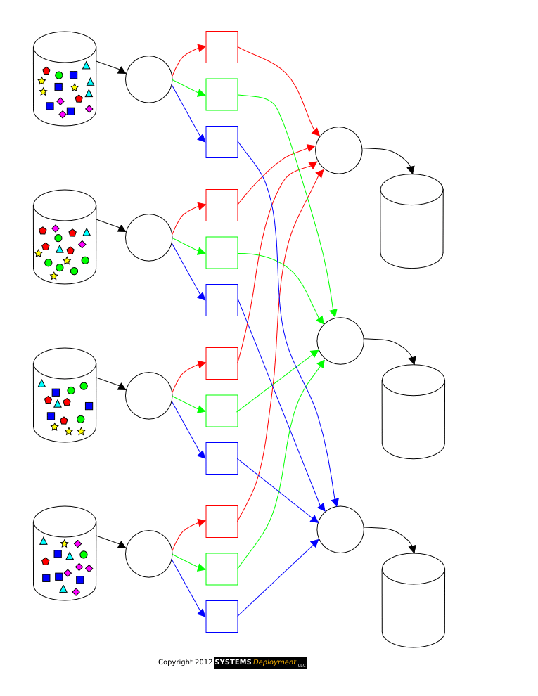
Visualizing MapReduce
Note the 3 stages:
Map
Reduce
Shuffle
** Source: http://www.systems-deployment.com/animation.html
Notes:
skip this slide if short in time

Slide 54
Mapreduce Interface
map(key, value) -> list(<k’, v’>)
Apply function to (key, value) pair
Outputs list of intermediate pairs

Slide 55
Mapreduce: Word count
map(key, value):
// key = document name
// value = document contents
  for each word w in value:
  emit (w, 1)

Slide 56
Mapreduce Interface
map(key, value) -> list(<k’, v’>)
Apply function to (key, value) pair
Outputs list of intermediate pairs
reduce(key, list<value>) -> <k’, v’>
Applies aggregation function to values
Outputs result
Notes:
Map
Takes a key-value pair as input.
Applies a user-defined function to that pair.
Produces a list of intermediate key-value pairs <k’, v’>.
Reduce Function
Takes a key and a list of values associated with that key.
Applies an aggregation function to combine the values.
Produces a final output pair <k’, v’>.

Slide 57
Mapreduce: Word count
map(key, value):
// key = document name
// value = document contents
  for each word w in value:
  emit (w, 1)
reduce(key, values):
// key = the word
// values = number of occurrences of that word
count = sum(values)
emit (key, count)

Slide 58
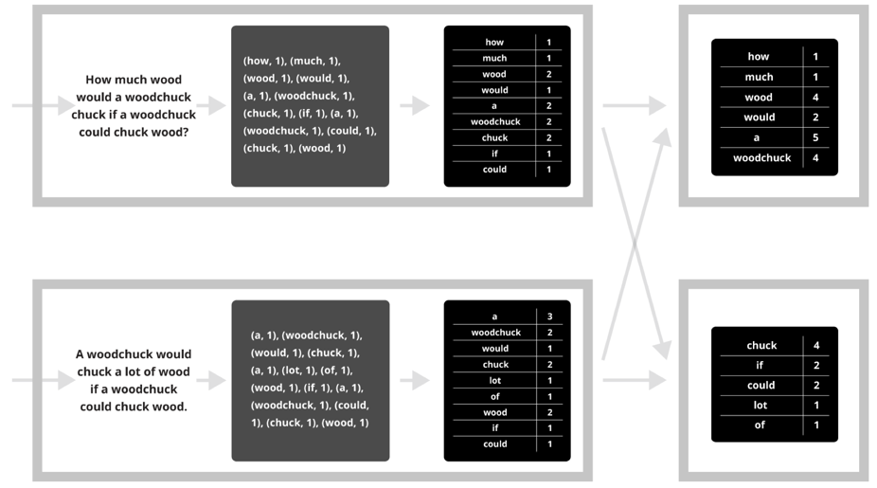
Mapreduce: Word count
map
combine
shuffle
reduce

Slide 59
Why is implementing MapReduce hard?
Failure is common
  Even if each machine is available p = 99.999% of the time, a datacenter with
  n = 100,000 machines still encounters failures (1-p^{n}) = 63% of the time
Data skew causes unbalanced performance across cluster
Problems occur at scale.
Hard to debug!
Notes:
Data skew: distribution of letters at start of words in English is not uniform, so even partition of letters across reduce nodes will be unbalanced

Slide 60




MapReduce
2004
2007
2011
2012
2015
Dryad
Notes:
Dryad (Microsoft, 2007) → Generalized MapReduce by modeling computation as a DAG of tasks (not just map→reduce), giving more flexibility for complex workflows.
adoop MapReduce (Apache, 2006) → Open-source reimplementation of Google’s MapReduce + GFS; became the backbone of the “big data” ecosystem in industry and academia.
Spark (UC Berkeley, 2010s) → Extended MapReduce with in-memory data processing (RDDs), making iterative and interactive workloads (like ML, graph algorithms) much faster.
Cloud Dataflow (Google, 2014) → A cloud-native successor to MapReduce; unified batch + stream processing under one programming model, with automatic scaling and optimizations.

