Slide 1
AI Systems:
Building GenAI workflows
COS 418/518: Distributed Systems
Lecture 21
Mike Freedman, Jialin Ding

Slide 2
Today’s lecture
Large language models (ChatGPT, Claude, Llama, etc.) are here
Today’s topic: How can we use them when building systems?
What we are NOT covering:
  How LLMs work: model architecture, training, serving
  See COS 485, COS 568

Slide 3
Outline
Foundational models
Fine-tuning vs. contextual learning
Retrieval-Augmented Generation (RAG)
Vector Search on embeddings
Model Context Protocol (MCP)
Deploying models behind APIs

Slide 4
What is Generative AI?
AI models that generate new content (text, images, code, etc.) from learned probability distributions. Try to produce new samples (e.g., what’s the next word/token) given input and model.
Difference from traditional discriminative models (e.g., classifiers, which try to classify inputs to existing samples.
Examples:
  Text generation: GPT family (next-token prediction via transformers).
  Image synthesis: GANs, diffusion models (denoising data step-by-step).
  Code generation: GitHub Copilot (autoregressive models trained on code repositories).
Underlying techniques:
  Neural networks, especially transformers
  Trained on massive datasets

Slide 5
What are Foundational Models?
Versatile and basis for many GenAI systems
Large, general-purpose models trained on broad data (today, often ”transformer based”)
Examples: GPT (OpenAI), LLaMA (Meta), Claude (Anthropic), Gemini (Google)
Characteristics:
  Billions of parameters (GPT-3: 175B parameters, GPT-4: ~1.8T parameters).
  Training today requires large-scale distributed computing, GPU clusters, and large-scale optimization techniques.

Slide 6
Improving foundational models for use case
Fine-tuning
Additional training on specialized data to produce a new version of the model
Produces a new version of the model
  Take foundation model's weights as initial.
  Train (typ. supervised learning) on task-specific labeled datasets with smaller learning rates.
  Result: Model's weights adjusted to capture new data, altering internal representations.
Pros: High accuracy, task-specific knowledge
Cons: Expensive, slower, risk of forgetting
Contextual learning
Provide additional information directly in the input prompt (prompt engineering).
Doesn't change model weights; uses original model at inference.
Examples of context:
  Recent thread of discussion between user and model
  “Few-shot” learning with several labelled examples.
Pros: much more flexible at run-time
Cons: limited context

Slide 7

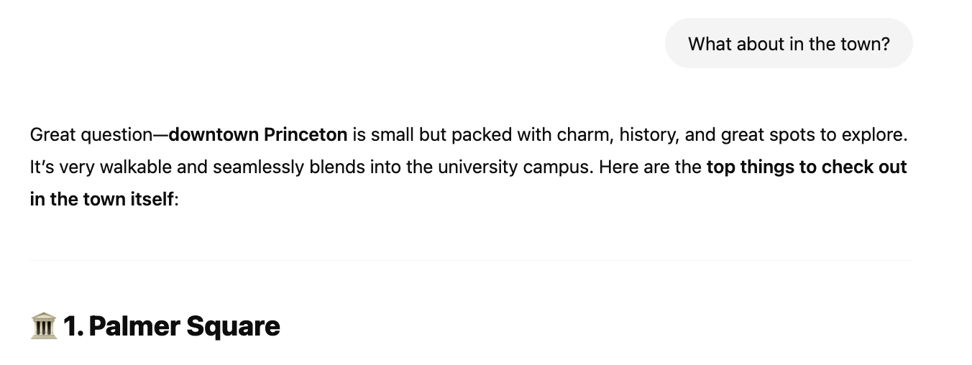
Examples of contextual learning

Slide 8
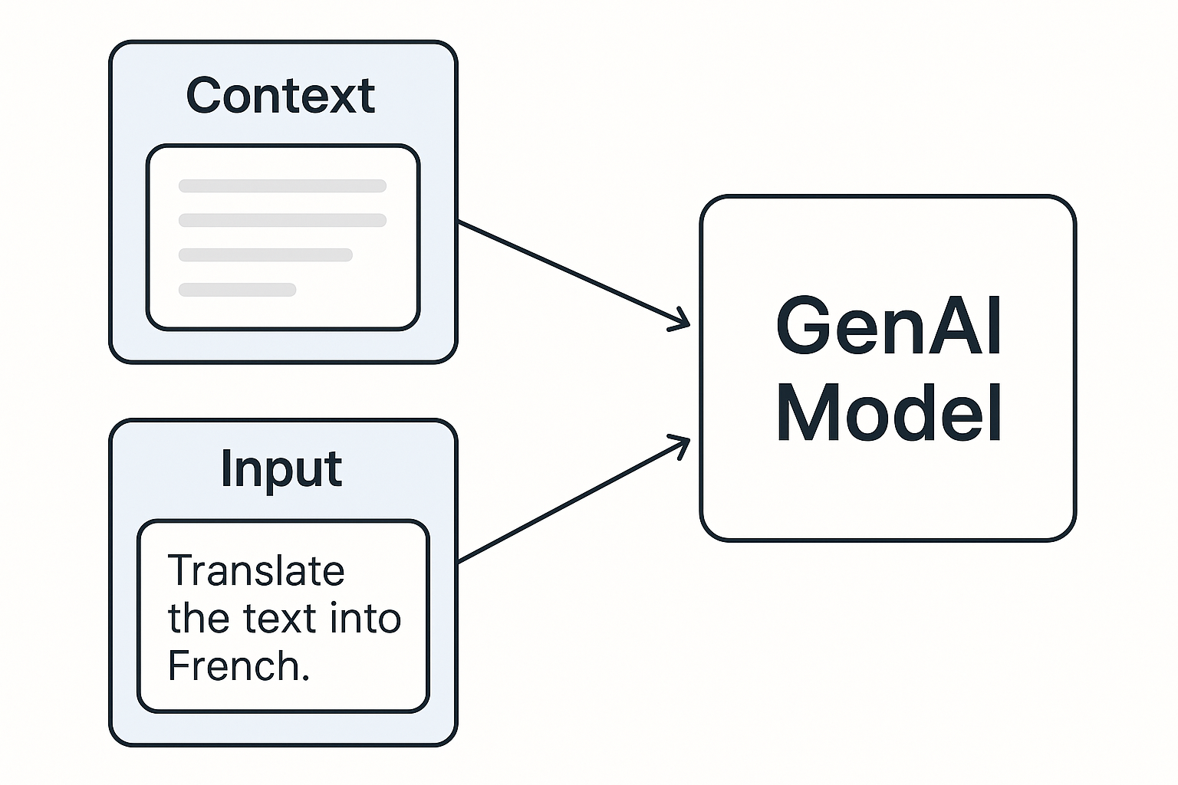
Few-shot prompting
LLM is given a few examples of input-output pairs to help guide behavior for a specific task.
Useful when you want the model to generalize from a small number of demonstrations rather than rely only on task descriptions.

Slide 9
Few-shot: Text Classification
Classify the following movie reviews as Positive or Negative.
Review: "I loved the story and the acting was superb!"
Sentiment: Positive
Review: "The plot was predictable and the characters were flat."
Sentiment: Negative
Review: "It was a fun and engaging experience with brilliant visuals."
Sentiment:

Slide 10
Few-shot: Named Entity Recognition (NER)
Extract the names of people, locations, and organizations.
Text: "Barack Obama was born in Hawaii and was president of the United States."
Entities: Person: Barack Obama; Location: Hawaii; Organization: United States
Text: "Sundar Pichai is the CEO of Google, which is based in Mountain View."
Entities:

Slide 11
Few-shot prompting
Write a blog post in the style of Mike Freedman, describing X.
Examples: <Two recent blog posts>

Slide 12
What if your context is really large?
Examples:
  Software repository with 1M lines of source code
  100s of pages of technical documentation
  Internal corporate knowledge base / intranet
Enter Retrieval-Augmented Generation (RAG)…

Slide 13
Retrieval-Augmented Generation (RAG)
4. Prompt:
Input, Context
Model
5. Generated
Answer
1. Input
2. Search
Query:
Input
3. Top-K
Results:
Context
Data
Set
RAG = Embedding + Vector Search + LLM
Pipeline:
Technical Pipeline:
User query converted to embedding vector.
Embedding used for semantic vector search to retrieve relevant documents (context retrieval step).
Retrieved documents included in prompt, feeding into generative model (LLM).
Generative model outputs response conditioned explicitly on retrieved context.
Advantages:
Reduces hallucination by grounding responses in actual retrieved data.
Combines the strengths of embeddings (semantic accuracy) and generative models (expressiveness).
Example Tech Stack:
Embedding model (Sentence-BERT, OpenAI embeddings).
Vector DB (FAISS, Pinecone).
LLM (GPT-4 or similar models).

Slide 14
How to “search” in RAG?
Traditional “keyword search” bad for semantic meaning
  “User” and “person” don’t match in keyword search, but mean similar things in English
Semantic search
  Concept: Search by meaning, not exact match
  But how to find nearest items in “semantic space”?
RAG = Embedding + Vector Search + LLM
Pipeline:
Technical Pipeline:
User query converted to embedding vector.
Embedding used for semantic vector search to retrieve relevant documents (context retrieval step).
Retrieved documents included in prompt, feeding into generative model (LLM).
Generative model outputs response conditioned explicitly on retrieved context.
Advantages:
Reduces hallucination by grounding responses in actual retrieved data.
Combines the strengths of embeddings (semantic accuracy) and generative models (expressiveness).
Example Tech Stack:
Embedding model (Sentence-BERT, OpenAI embeddings).
Vector DB (FAISS, Pinecone).
LLM (GPT-4 or similar models).

Slide 15
Vector Search on Embeddings
Method to find similar items (text, images, audio) by comparing mathematical representation of items – called embeddings or vectors – in high-dimension space
Problem: Given a set of vectors D and an input vector I, find some k vectors in D that are nearest to I according to a distance metric
  Common distance metrics: cosine similarity, Euclidean distance in high-dimensional space
  Anywhere from 100s of vector embeddings to billions of embeddings
This is basically a search or indexing problem to find the top-k vectors:
  IVFFlat (InVerted File Flat)
  HNSW (Hierarchical Navigable Small World Graph)
  DiskANN (Disk-based Approximate Nearest Neighbor)
Vector DBs: Pinecone, Qdrant, Weaviate, Postgres pgvector, Tiger pgvectorscale

Slide 16
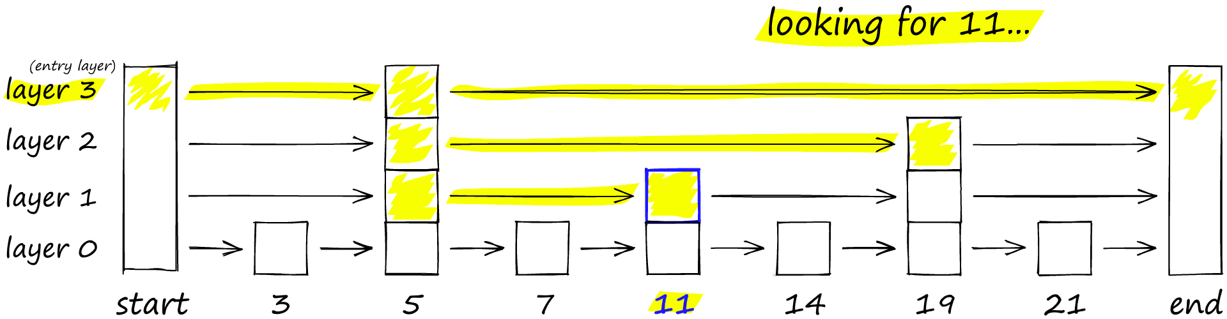
Ex: Hierarchical Navigable Small World Graph
Conceptual idea: Skip List

Slide 17
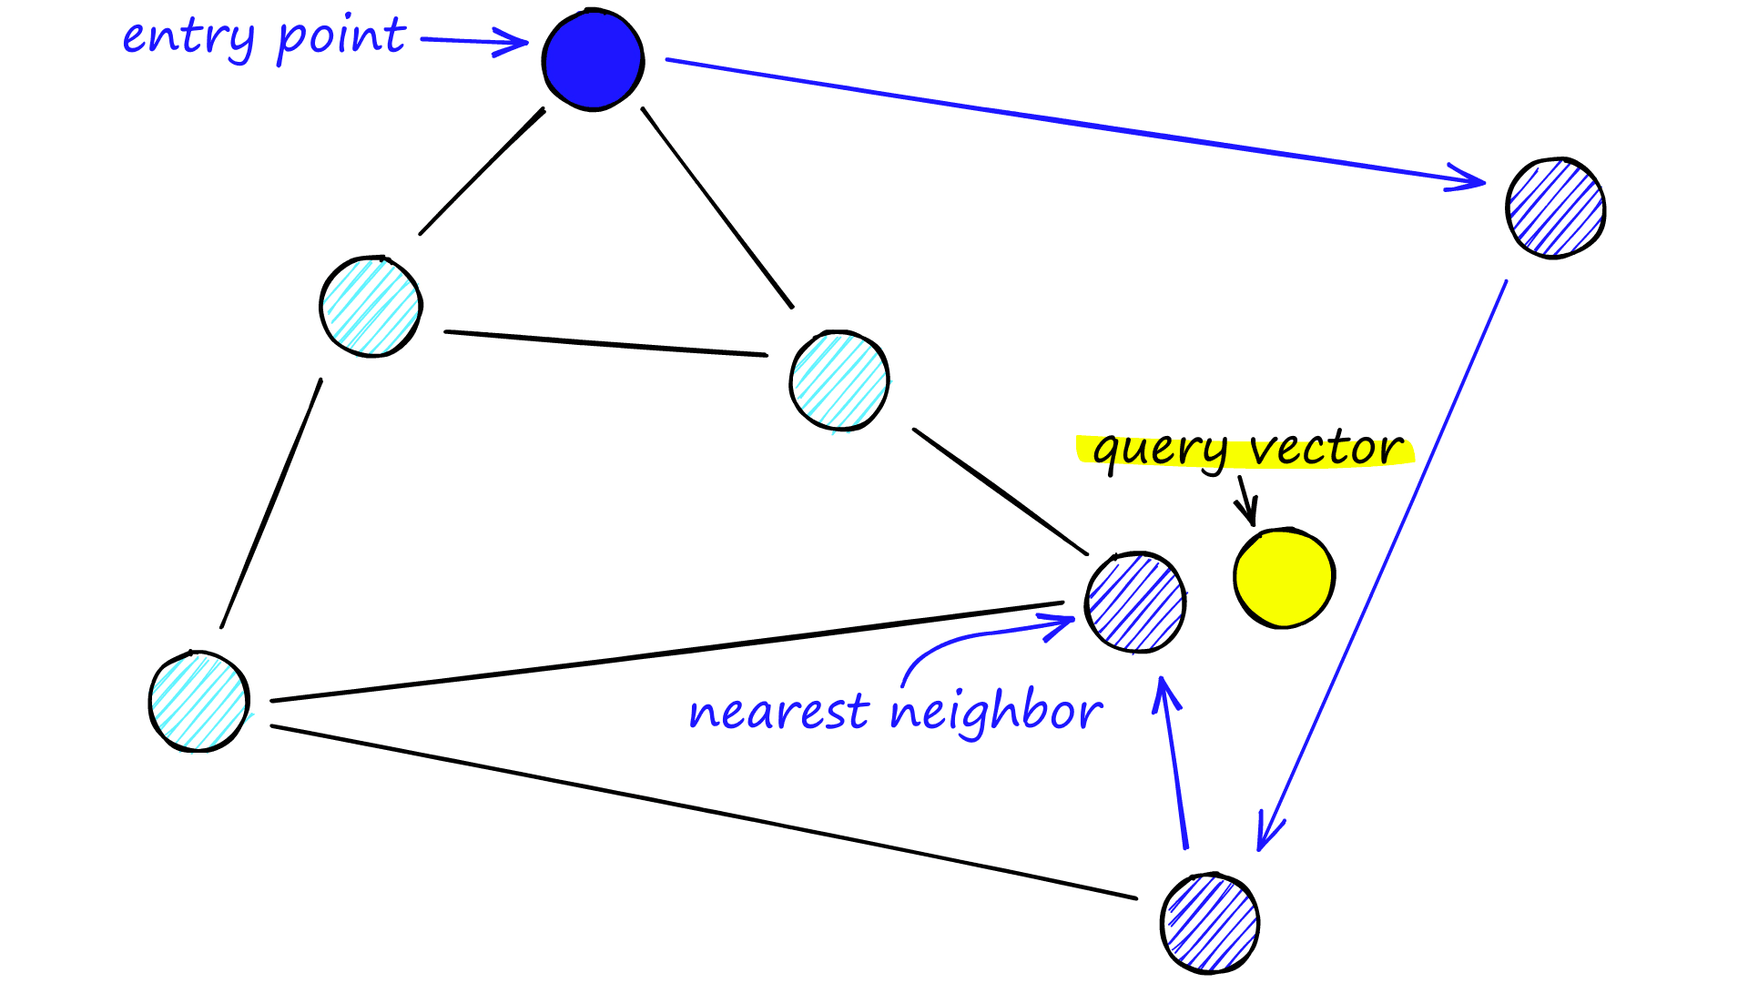
Ex: Hierarchical Navigable Small World Graph
Conceptual idea: Navigable Small World

Slide 18
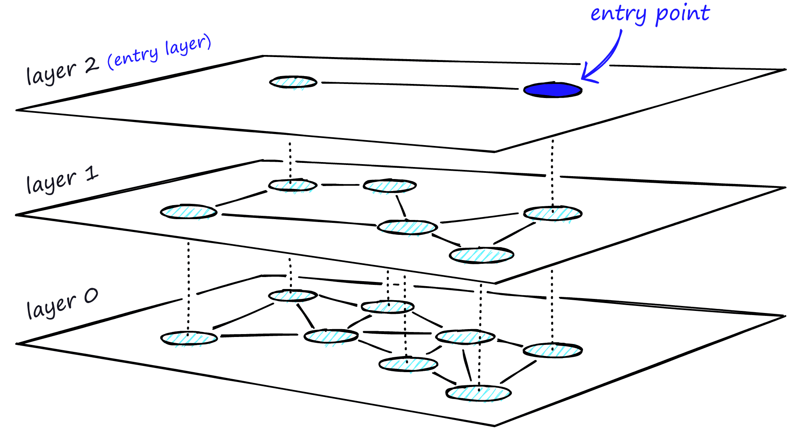
Ex: Hierarchical Navigable Small World Graph
Hierarchical Navigable Small World

Slide 19
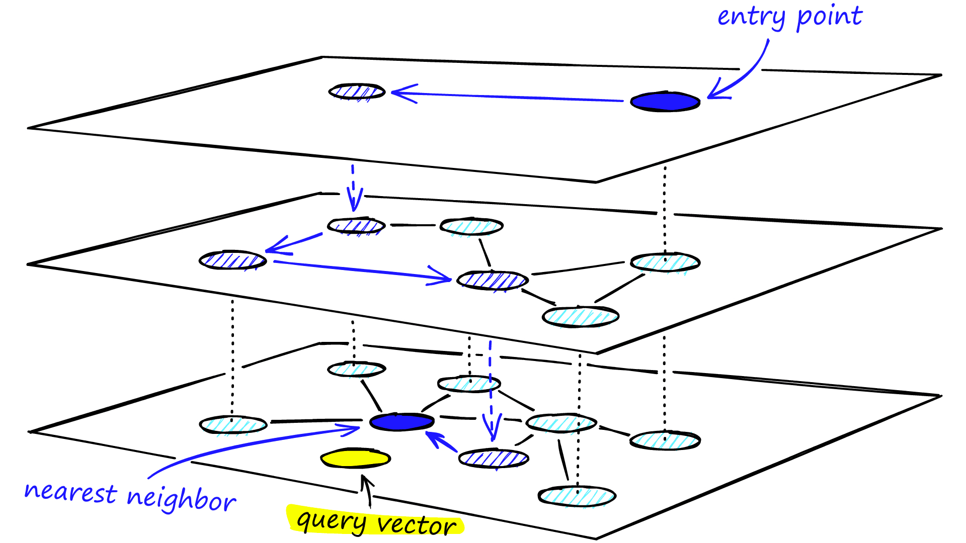
Ex: Hierarchical Navigable Small World Graph
Hierarchical Navigable Small World

Slide 20
Vector Search on Embeddings
Vector index creation:
Take input set of documents.
For each input document:
    Divide document into text chunks
    For each chunk, use embedding model to compute vector embedding
    Insert vector embedding into database
    Create mapping from vector embedding to text chunk
Build a vector index on embeddings
Vector Search:
Given input query
Use embedding model to compute vector embedding of input query
Perform vector search to find top-k embeddings closest to input embedding
Lookup text chunk associated with each top-k embedding
Return top-k text chunks
Notes:
]

Slide 21
Retrieval-Augmented Generation (RAG)
4. Prompt:
Input, Context
Model
5. Generated
Answer
1. Input
2a. Search
Query:
Input
3b. Top-K
Results:
Context
Model
2b. Search
Query:
Embedding
3a. Top-K
Embeddings
Vector
DB
RAG = Embedding + Vector Search + LLM
Pipeline:
Technical Pipeline:
User query converted to embedding vector.
Embedding used for semantic vector search to retrieve relevant documents (context retrieval step).
Retrieved documents included in prompt, feeding into generative model (LLM).
Generative model outputs response conditioned explicitly on retrieved context.
Advantages:
Reduces hallucination by grounding responses in actual retrieved data.
Combines the strengths of embeddings (semantic accuracy) and generative models (expressiveness).
Example Tech Stack:
Embedding model (Sentence-BERT, OpenAI embeddings).
Vector DB (FAISS, Pinecone).
LLM (GPT-4 or similar models).

Slide 22
New: Hybrid Search
4. Prompt:
Input, Context
Model
5. Generated
Answer
1. Input
2. Semantic
and
keyword
search
3. Top-K
Results:
Context
Reranking
Vector
Search
Keyword
Search

Slide 23
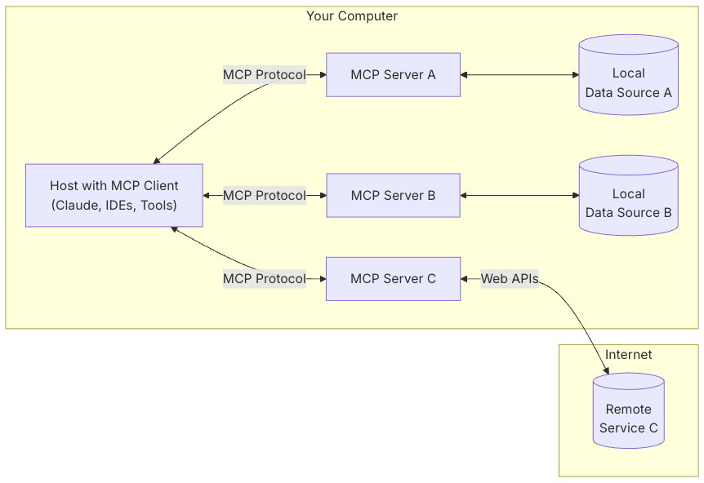
Model-Context Protocol (MCP)
Generalize notion of “getting context” for our model?
  In Nov 2024, Anthropic released MCP, a protocol for structuring how applications and tools can provide context to LLMs.
  Think of MCPs as the “APIs” for LLMs
What do MCP servers expose?
  Resources: File-like data that can be read by clients (like API responses or file contents)
  Tools: Functions that can be called by the LLM (with user approval)
  Prompts: Pre-written templates that help users accomplish specific tasks

Slide 24
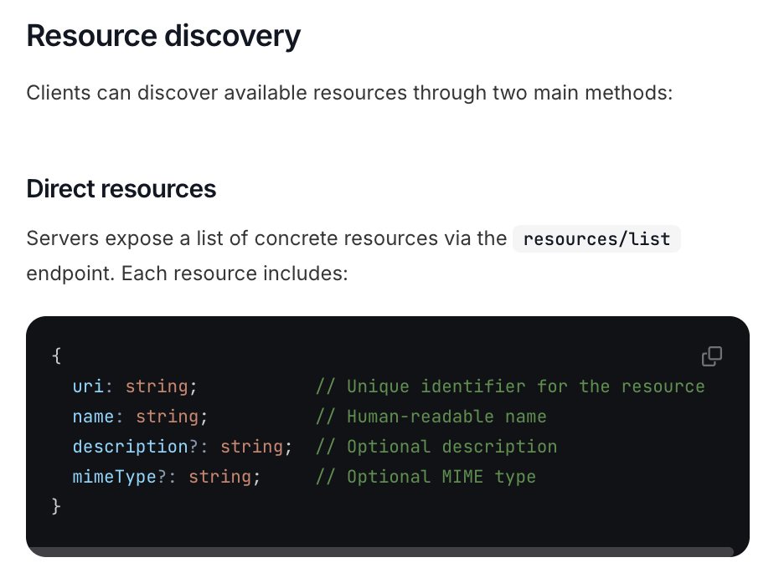
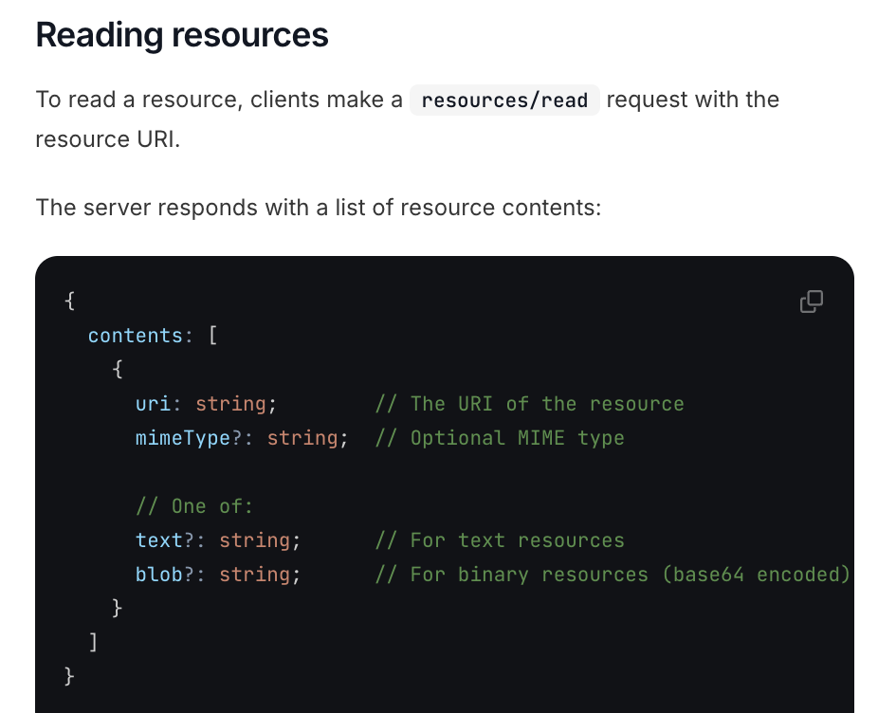
Model-Context Protocol (MCP)

Slide 25
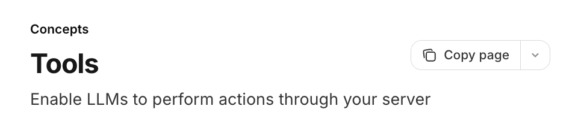
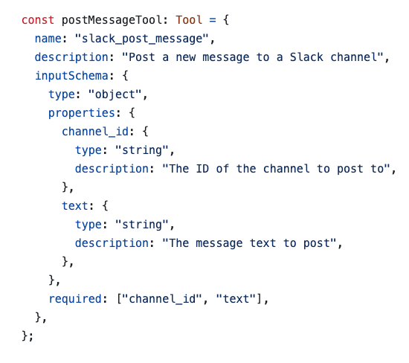
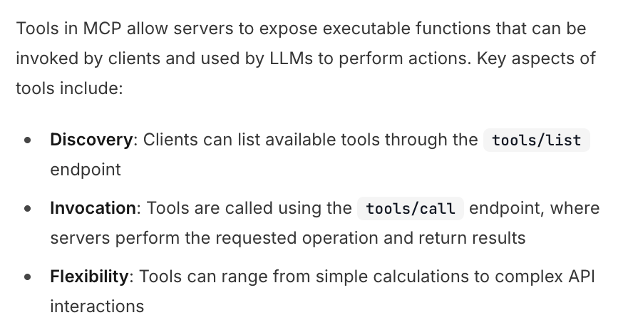
Model-Context Protocol (MCP)

Slide 26
Using MCP Server
2. User Input,
Context: Tools,
Memory, etc.
1. User Input
Agent
Model
0. List Tools
(Discovery)
3. Result
e.g., call tool
MCP
MCP
MCP

Slide 27
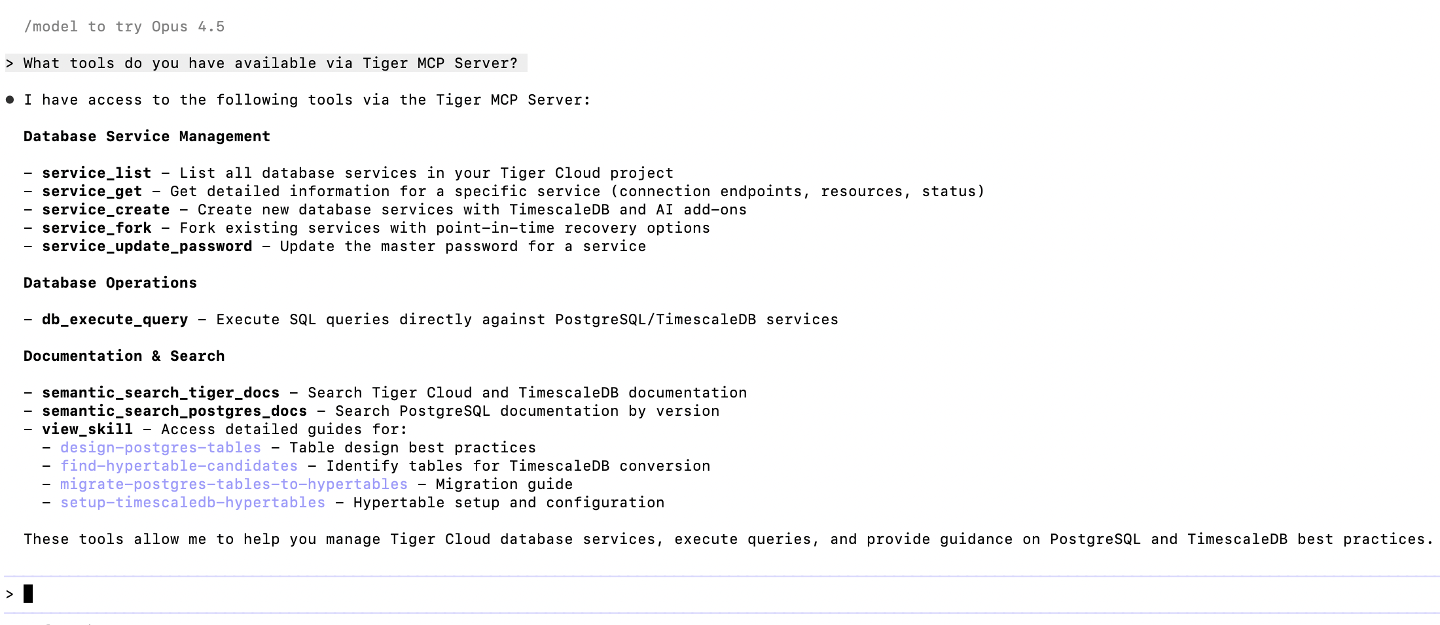
Example MCP: Tiger Database Server

Slide 28
Using MCP Server
> I want you to perform the following actions:
Create a Postgres schema for storing Bitcoin bockchain information, using best practices from Postgres skills for storing time-series data.
Create a new free database service.
Install the schema in the database service.
Tell me the list of all actions you preferred, including MCP tool calls.
Agent
Model
MCP

Slide 29
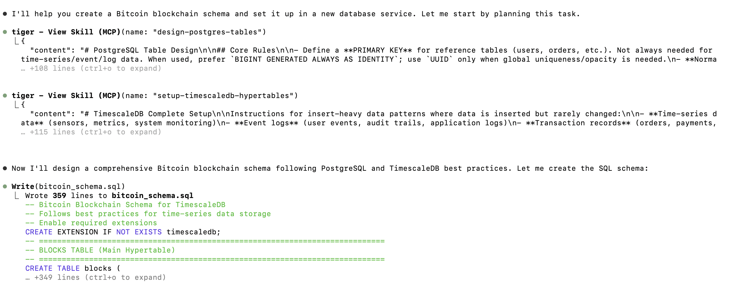
Using MCP Server
Agent
Model
MCP

Slide 30
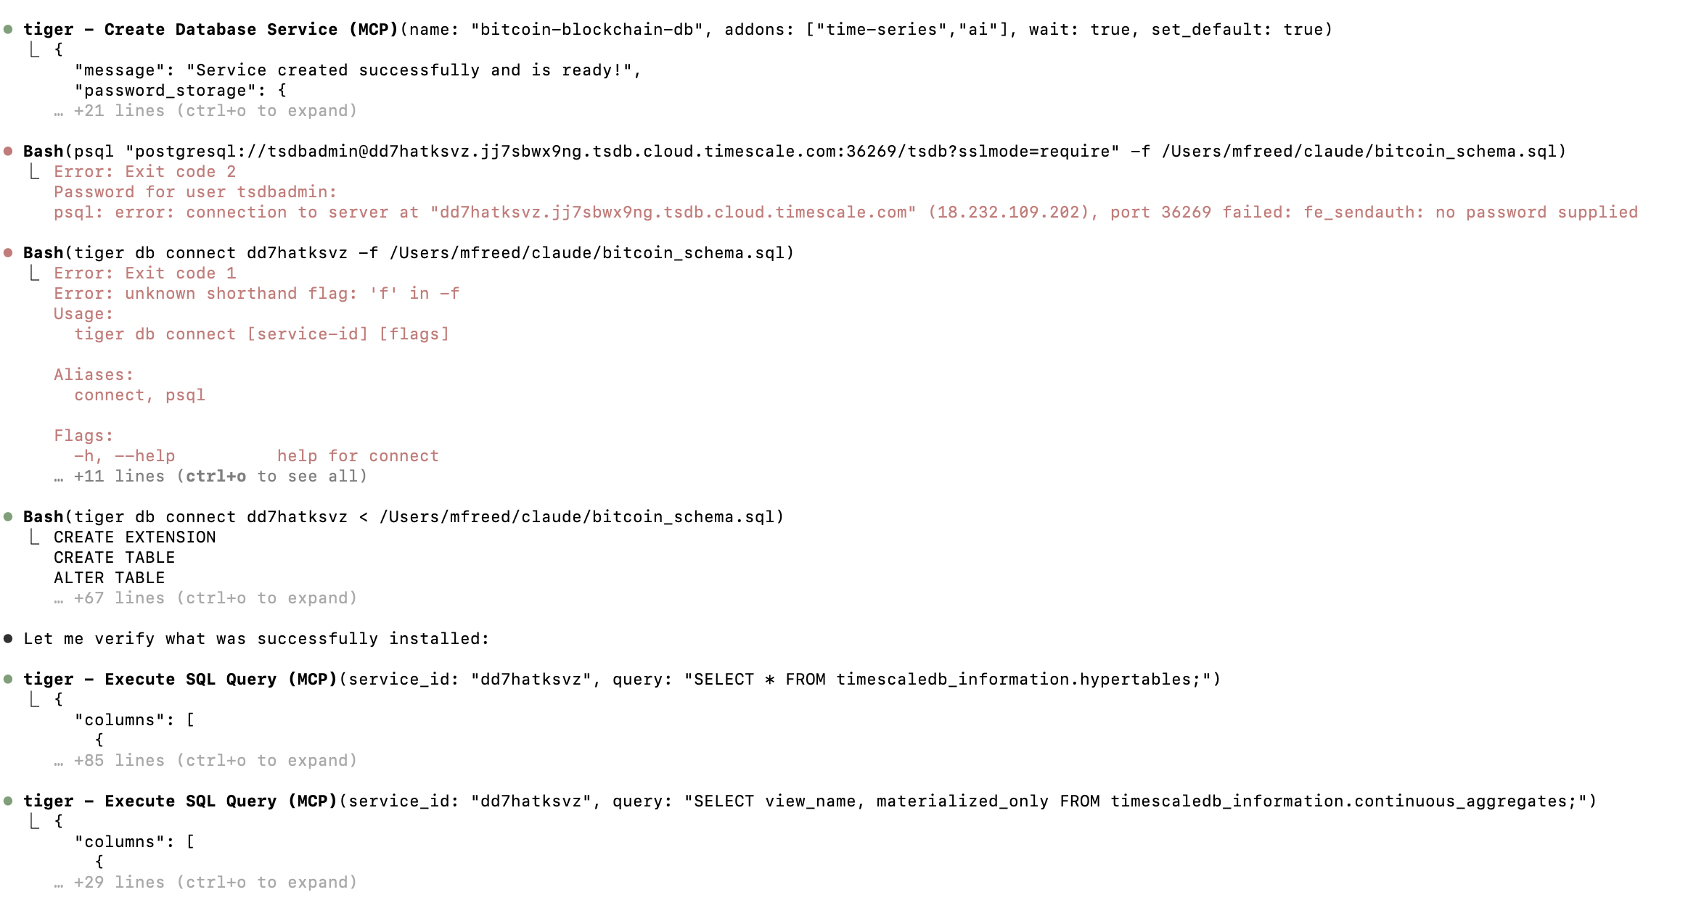
Using MCP Server
Agent
Model
MCP

Slide 31
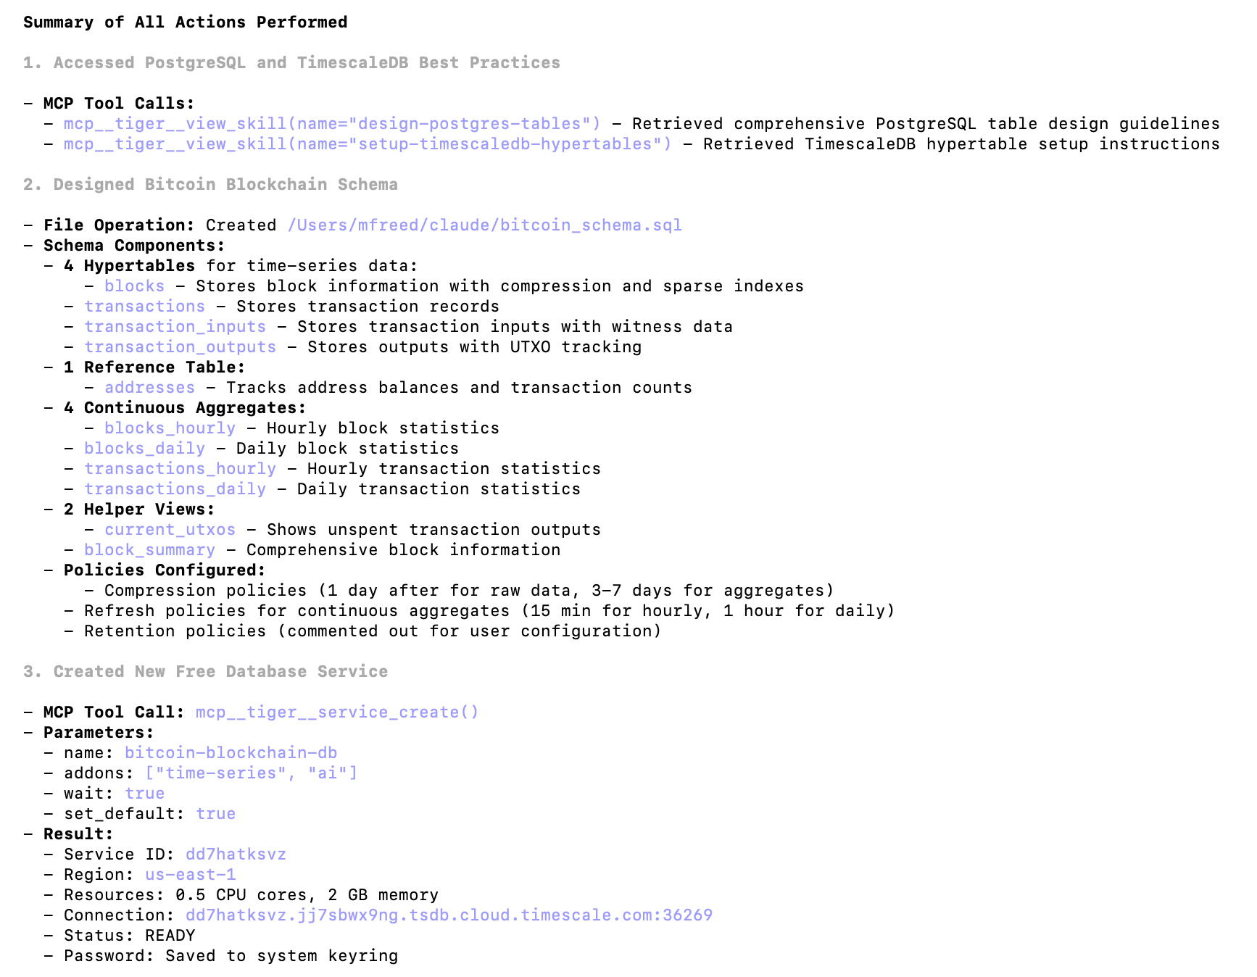
Using MCP Server
Agent
Model
MCP

Slide 32
Conclusions
We’re in the “Cambrian Era” of GenAI models and systems
Every 3 months is something new; industry and tools are rapidly changing and evolving.
One fundamental difference:
  For past 50 years, our computer systems are heavily deterministic. We rely on that determinism.
  GenAI systems (and the inputs to them) are inherently non-deterministic. Natural language is not precise. Still figuring out how to build “robust” systems in face of such non-determinism / imprecision.

Slide 33

