Slide 1
Course Overview
COS 418/518: Distributed Systems
Lecture 2
Jialin Ding, Mike Freedman

Slide 2
Learning Objectives
Reasoning about concurrency
Reasoning about failure
Reasoning about performance
Building systems that correctly handle concurrency and failure
Notes:
[Also mention art of abstraction design]

Slide 3
Lectures
M/W 9:35am-10:25am
  Slides posted just before class
Schedule posted on course website

Slide 4
Precepts
Th or Fr
  Slides will be posted after all precepts
Helps with assignments and/or reinforces lecture material
Actively work through problems together

Slide 5
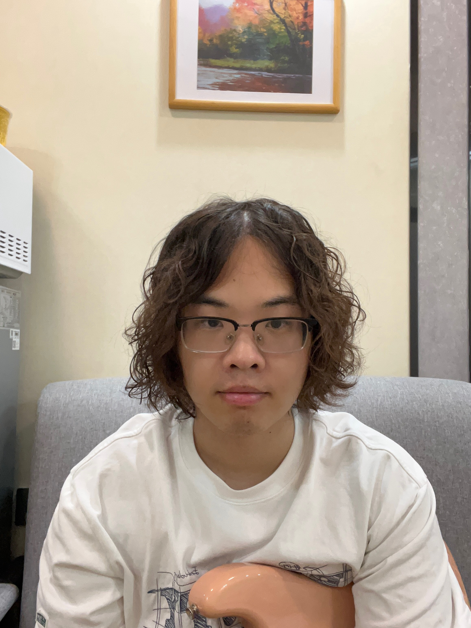
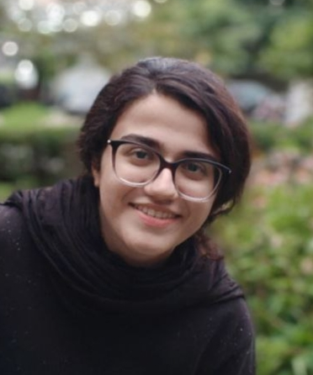
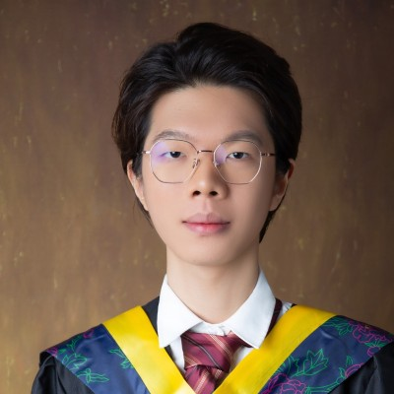
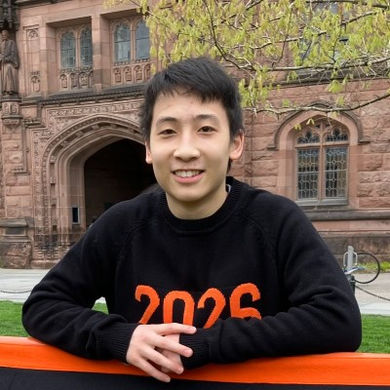
Course Staff Intro
Jialin Ding
Mike Freedman
Grad TAs:
  Haoran Wan (P1)
  Mohanna Shahrad (P2)
  Zijian Qin (P3)
Lab TA:
  Alexander Ding

Slide 6
Grading
Two exams (50%)
  Midterm 25%
  Final 25%
Assignments (50%)
  Five assignments 10% each
Notes:
[Simple and direct to calculate your grade]

Slide 7
Grade Cutoffs
We do not anticipate a curve up
We will not curve down
A [93, 100]
A- [90, 93)
B+ [87, 90)
B [83, 87)
…
Notes:
A+ is not a particular cutoff, typically top 1-2 students in class

Slide 8
Exams
In person exams
  3 hours: should not have time pressure
  Closed book
Midterm
  Registrar will schedule during week of October 6-10
  Likely Thursday, October 9, 7:30pm-10:30pm
Final
  Wednesday, December 17, 8:30am–11:30am (in the morning)

Slide 9
Exams
Test learning objectives mostly using designs covered in lectures
And tests knowledge of specific design patterns and designs
Recipe for success:
  Attend lecture and actively think through problems
  Ask questions during lecture and afterwards in my office hours
  Attend precept and actively work through problems
  Complete programming assignments
  Study lecture materials for specific design patterns and designs
  Run the system designs in your mind / on paper and see what happens
Notes:
[Attend lectures, actively think through problems, ask questions after class in my office hours,

Slide 10
Midterm Review
Monday, October 20, in class + time before and/or after
Go over midterm together
One and only opportunity to argue for points
Notes:
Ask for a raise of hands for who has a class before or after this one

Slide 11
Programming Assignments
Reinforce / demonstrate all learning objectives!
1: “MapReduce” in Go
2: Distributed Snapshots
3: Raft Leader Election
4: Raft Log Consensus
5: Key-Value Storage Service

Slide 12
Programming Assignments
All are individual assignments
We will give you all the tests
  Non-determinism for later tests though
    Each failed test run => lose 50% of points for a test
Grading script emails your grade
  We use exactly this grade

Slide 13
Programming Assignments- Late Policy
Late policy
  G = Grade you would have earned if turned in on time
  1 day late => 90%*G
  …
  > 5 days late => 50%*G
3 “free” late days
  We assign them at the end of the semester to maximize your score
  Used in 1 day granularity
  Cannot use for last assignment (Deans date)

Slide 14
Policies: Write Your Own Code
Programming is an individual creative process. At first, discussions with friends is fine. When writing code, however, the program must be your own work.
Do not copy another person’s programs, comments, or any part of submitted assignment. This includes character-by-character transliteration but also derivative works. Cannot use another’s code, etc. even while “citing” them.
Writing code for use by another or using another’s code is academic fraud in context of coursework.
Do not publish your code e.g., on Github, during/after course!

Slide 15
Generative AI policy
Heuristic: GenAI should aid your understanding, not replace it
Allowed:
  Explaining concepts in natural language
  Syntax reminders
  Understanding error messages
Not allowed:
  Copy/pasting entire functions into an LLM prompt
  Coding assistants (e.g., Cursor, Copilot) that read the entire codebase
Submit GenAI statement with each assignment
  Whether or not you used GenAI, and if so, how (2-3 sentences)
  Up to 5% bonus for longer insightful statements

Slide 16
Warnings
This is a 400-level course,
with expectations to match.

Slide 17
Warning #1:
Assignments are a LOT of work
Assignment 1 is purposely easy to teach Go. Don’t be fooled.
Starting 3-4 days before deadline for later assignment => Disaster.
Distributed systems are hard
  Need to understand problem and protocol, carefully design
  Can take 5x more time to debug than “initially program”
Assignment #4 builds on your Assignment #3 solution, i.e., you can’t do #4 until your own #3 is working! (That’s the real world!)

Slide 18
Programming Assignment Statistics
Self Reported Hours Spent on Assignments: Median [Min-Max]
1-1: 2 [1-6]
1-2: 3 [1-8]
1-3: 4 [1-10]
2: 6 [2-15]
3: 12 [5-29]
4: 30 [10-100+]
5: 14 [3-25]

Slide 19
Warning #2:
Software engineering, not just programming
COS 126, 217, 226 told you how to design & structure your programs. This class doesn’t.
Real software engineering projects don’t either.
You need to learn to do it.
If your system isn’t designed well, can be significantly harder to get right.
Your friend: test-driven development
  We’ll supply tests, you’re welcome to add more

Slide 20
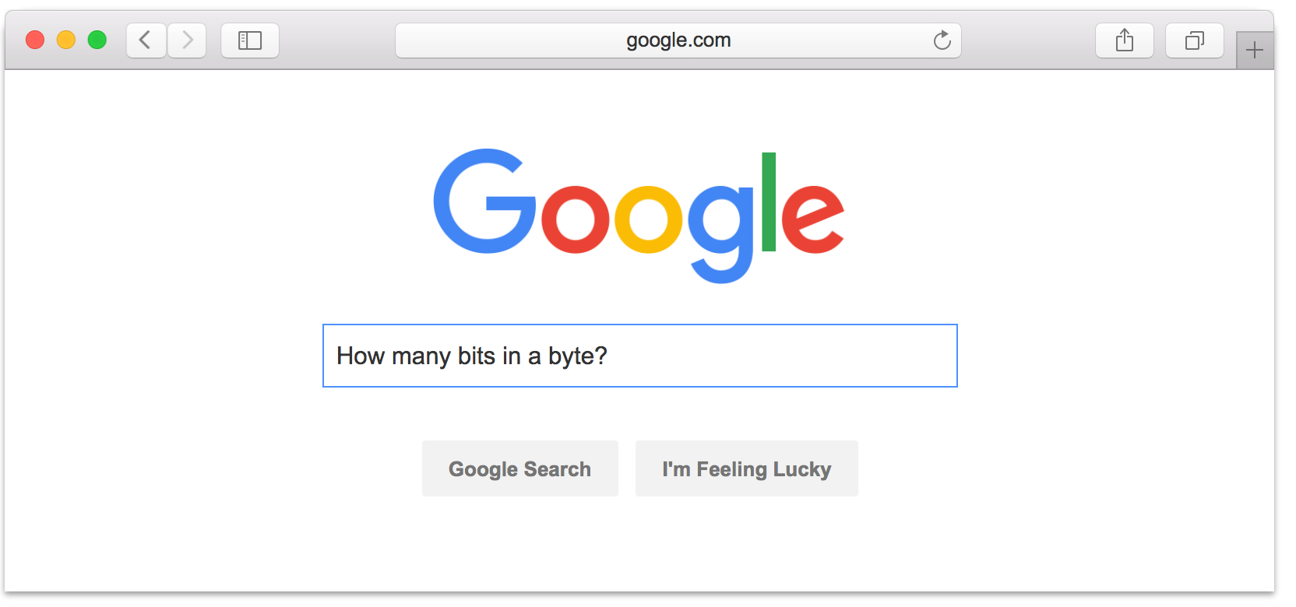
Warning #3:
Don’t expect 24x7 answers
Try to figure out yourself
EdStem not designed for debugging
  Utilize right venue: go to office hours
  Send detailed Q’s / bug reports, not “no idea what’s wrong”
Staff are not always online
  Will aim to respond within one business day
  Questions Friday night @ 11pm should not expect fast responses
Implications
  Students should answer each other
  Start your assignments early!

Slide 21
Programming Assignments
Recipe for disaster
  Start day assignment is due
  Write code first, think later
  Test doesn’t pass => randomly flip some bits
  Assume you know what program is doing

Slide 22
Programming Assignments
Recipe for success
  Start early (weeks early)
  Think through a complete design
  Progressively build out your design (using tests to help)
  Checkpoint progress in git (and to Github) frequently
  Debug, debug, debug
    Verify program state is what you expect (print it out!)
    Write your own smaller test cases
    Reconsider your complete design
  Attend office hours

Slide 23
Programming Assignment Office Hours
10 hours of office hours per week
  2 hours per day, Monday-Friday
Schedule posted on pinned EdStem post
  Any changes will be posted on EdStem
Expectations
  No: “You have a bug on line 17.”
  Yes: Helping you think like they would think about a problem

Slide 24

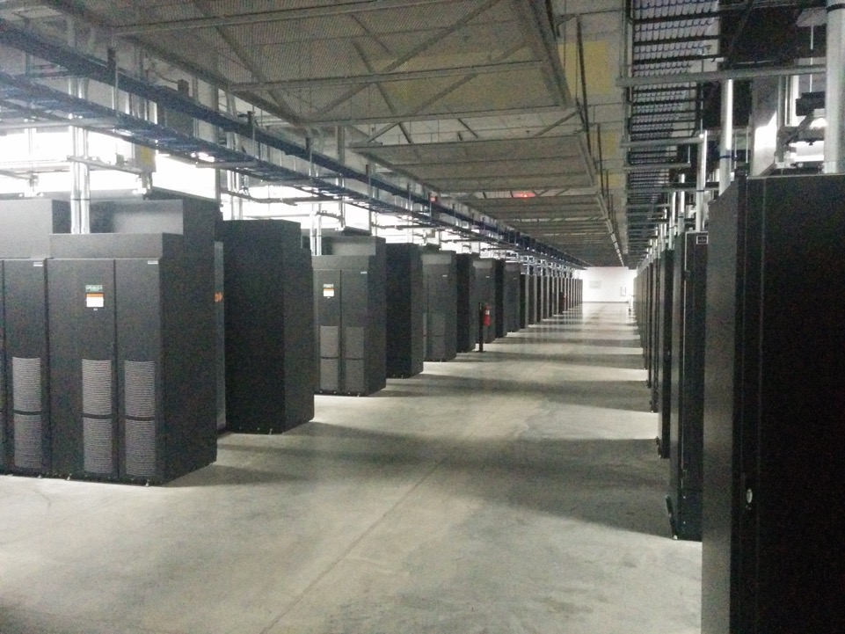
Course Overview Conclusion
Attend lecture, attend precept, think actively!
Start programming assignments early, use the right strategy!
Super cool distributed systems stuff starts Wednesday!

