Slide 1
Distributed Systems Intro
COS 418/518: Distributed Systems
Lecture 1
Fall 2025
Mike Freedman, Jialin Ding

Slide 2
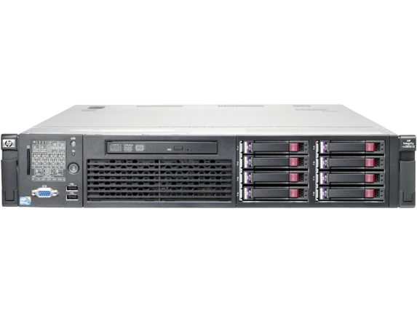
Distributed Systems, What?
Multiple computers
Connected by a network
Doing something together

Slide 3
Distributed Systems, Why?
Or, why not 1 computer to rule them all?
  Failure
  Limited computation/storage/…
  Physical location
Notes:
[Student chat me their answers here]

Slide 4
Distributed Systems, Where?
Web Search (e.g., Google, Bing)
Shopping (e.g., Amazon, Walmart)
File Sync (e.g., Dropbox, iCloud)
Social Networks (e.g., Facebook, Twitter)
Music (e.g., Spotify, Apple Music)
Ride Sharing (e.g., Uber, Lyft)
Video (e.g., Youtube, Netflix)
Online gaming (e.g., Minecraft, Roblox)
AI Models (OpenAI, Anthropic)
Notes:
[Online service-centric, can also add examples of high performance computing for scientific discoveries, …]

Slide 5
Backrub (Google) 1997

Slide 6
Google 2012

Slide 7
“The Cloud” is not amorphous

Slide 8
Microsoft

Slide 9
Google

Slide 10
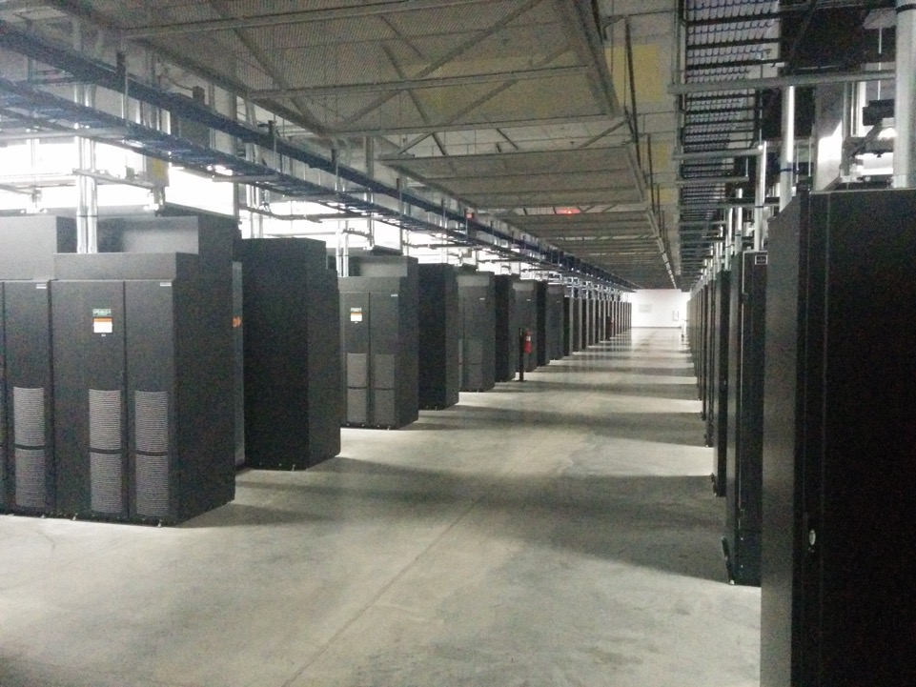
Facebook

Slide 11
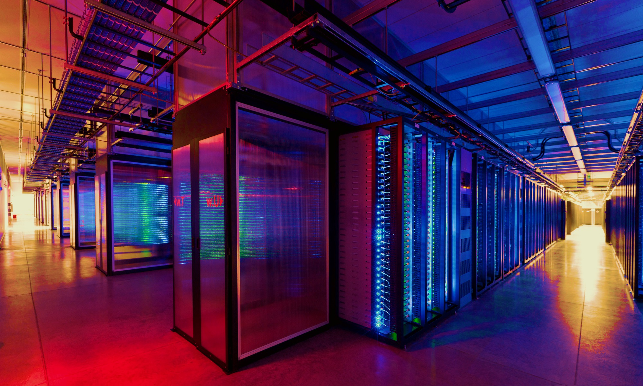
100,000s of physical servers
10s MW energy consumption
Facebook Prineville:
$250M physical infro, $1B IT infra

Slide 12
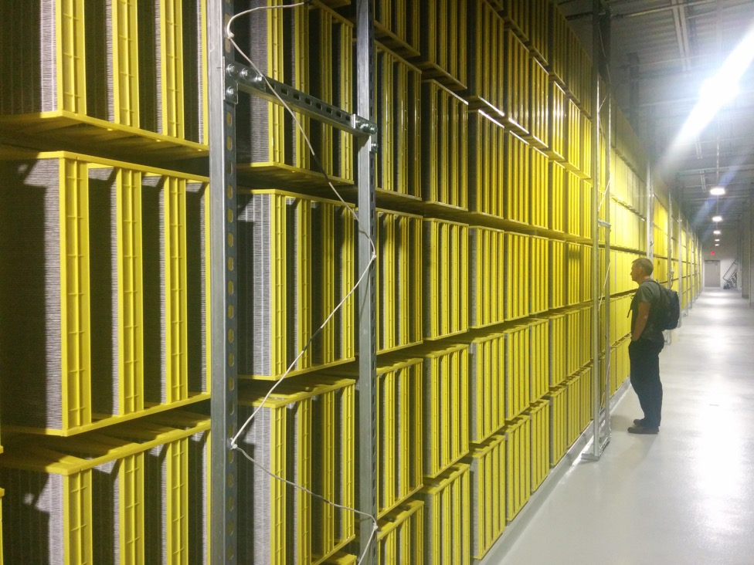
Facebook

Slide 13
Everything changes at scale
“Pods provide 7.68Tbps to backplane”

Slide 14
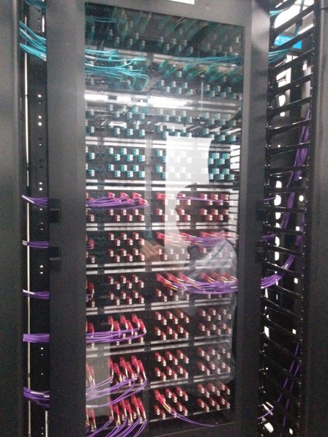
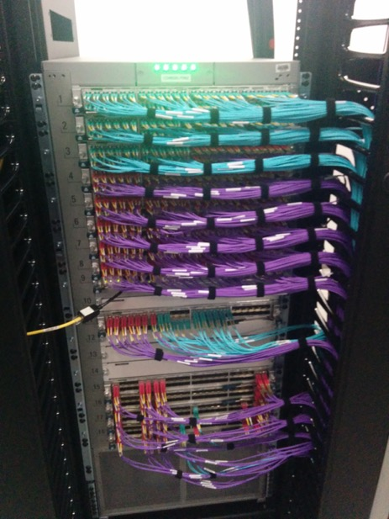
Facebook

Slide 15
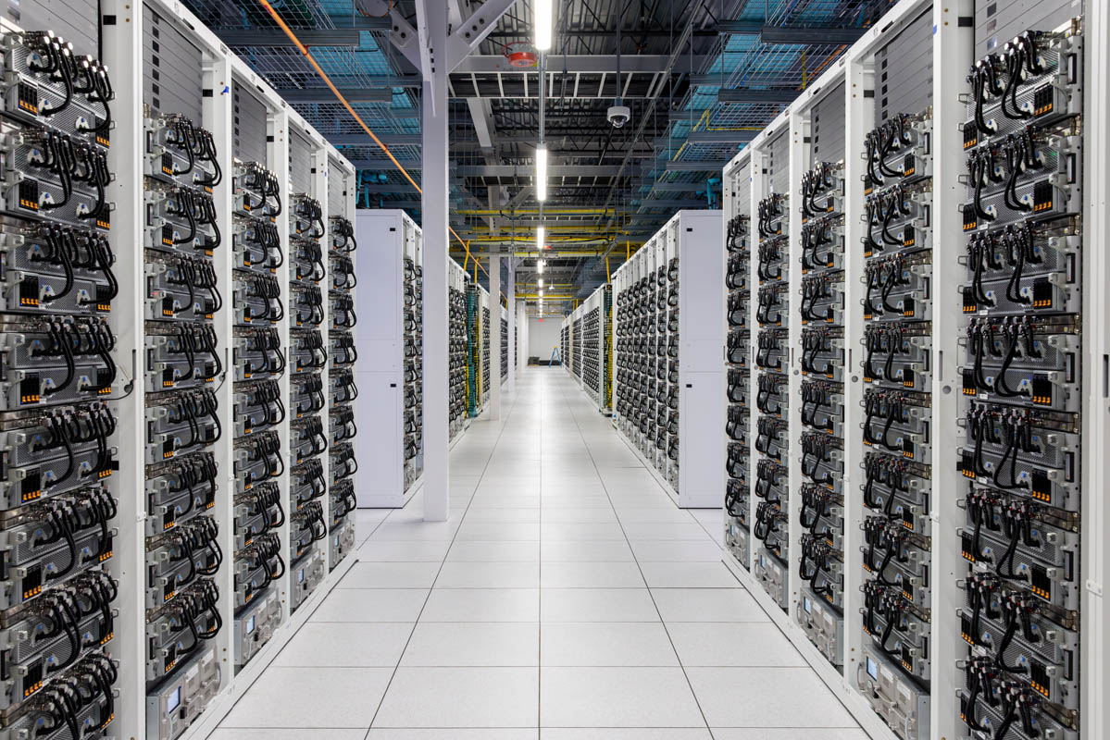
xAI Colossus:
100K NVIDIA H100 GPUs

Slide 16
Distributed Systems Goal
Service with higher-level abstractions/interface
    e.g., file system, database, key-value store, programming model, …
Hide complexity
  Scalable (scale-out)
  Reliable (fault-tolerant)
  Well-defined semantics (consistent)
Do “heavy lifting” so app developer doesn’t need to

Slide 17
Scalable Systems in this Class
Scale computation across many machines
  MapReduce
Scale storage across many machines
  Dynamo, COPS, Spanner

Slide 18
Fault Tolerant Systems in this Class
Retry on another machine
  MapReduce, Distributed Snapshots
Maintain replicas on multiple machines
  Primary-backup replication
  Paxos
  RAFT
  Bayou
  Dynamo, COPS, Spanner

Slide 19
Range of Abstractions and Guarantees
Eventual Consistency
  Dynamo
Causal Consistency
  Bayou, COPS
Linearizability
  Paxos, RAFT, Primary-backup replication
Strict Serializability
  2PL, Spanner

Slide 20
Advanced Topics
Blockchain as a distributed system
AI inference in distributed systems

Slide 21
Learning Objectives
Reasoning about concurrency
Reasoning about failure
Reasoning about performance
Building systems that correctly handle concurrency and failure
Knowing specific system designs and design components
Notes:
[Also mention art of abstraction design]

Slide 22
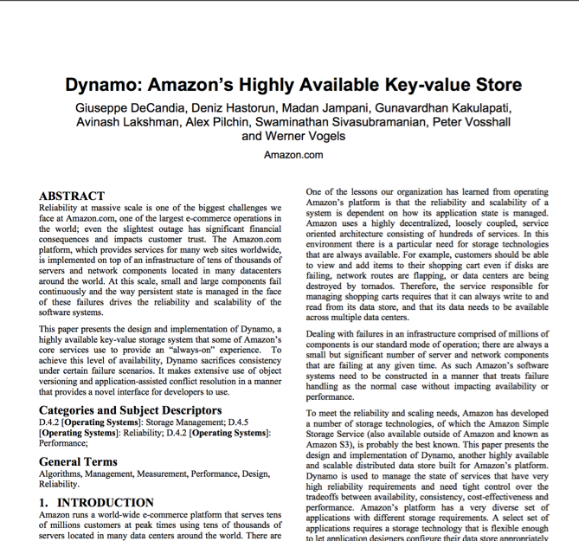
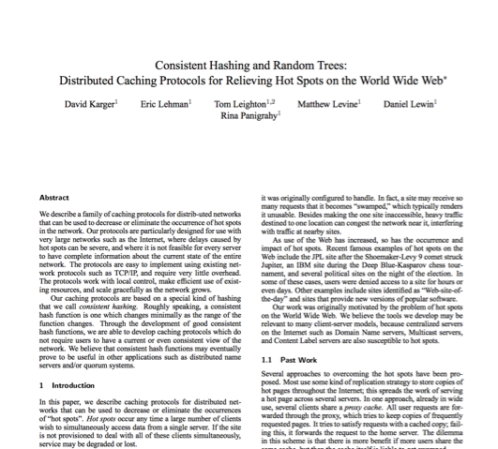
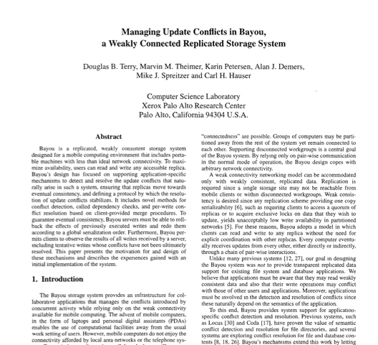
Research results matter: NoSQL
Notes:
NoSQL:
Consistent hash tables
+ consistency tradeoffs (e.g., eventual)
Amazon Dynamo popularized (published SOSP 2007), CTO was faculty at Cornell on distributed systems

Slide 23
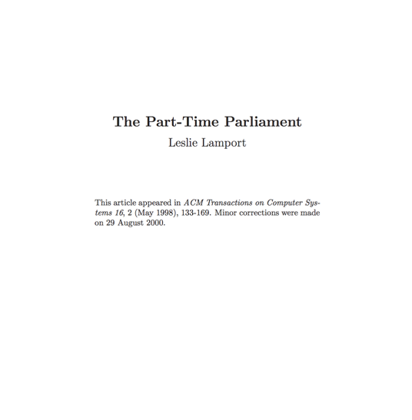
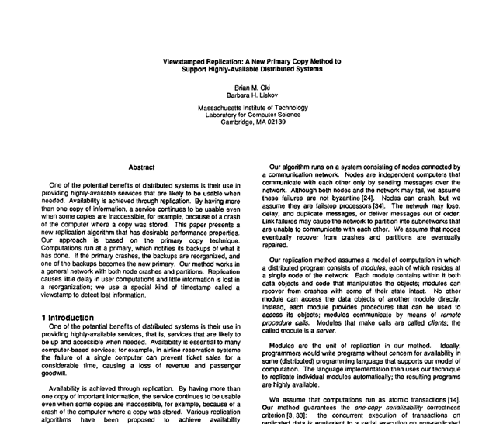
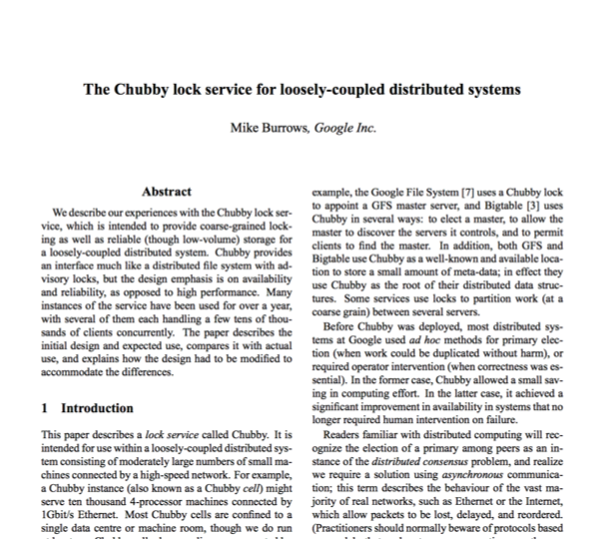
Research results matter: Paxos
Notes:
Paxos
Long history starting in early 1990s on “reaching consensus in distributed systems”
Google Chubby
Coordinate datacenters at scale
When a file server fails, who takes over?
Authors for industrial research labs and academia (DEC SRC, Cambridge/UW, etc.)
Led to open-source Apache Zookeeper

Slide 24
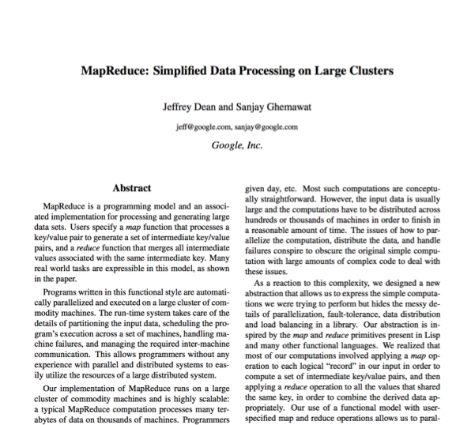
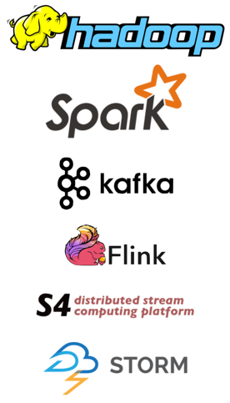
Research results matter: MapReduce
Notes:
Google MapReduce
How to process large volumes of data over 1000s of servers, even in face of failures
Authors for industrial research labs and academia (DEC WRL, MIT/UW, etc.)
Led to open-source Apache Hadoop
Created Big Data industry…

Slide 25
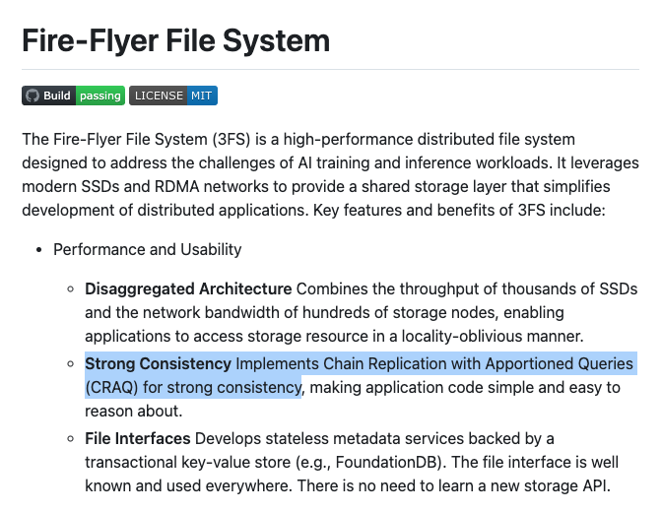
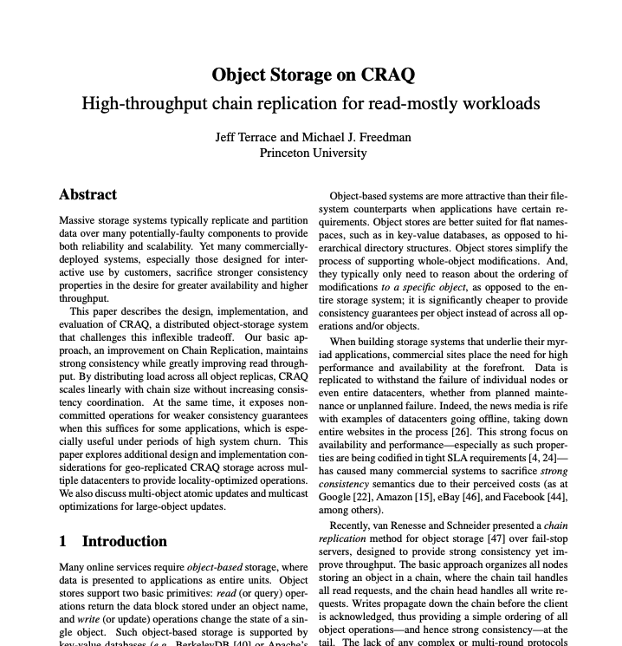
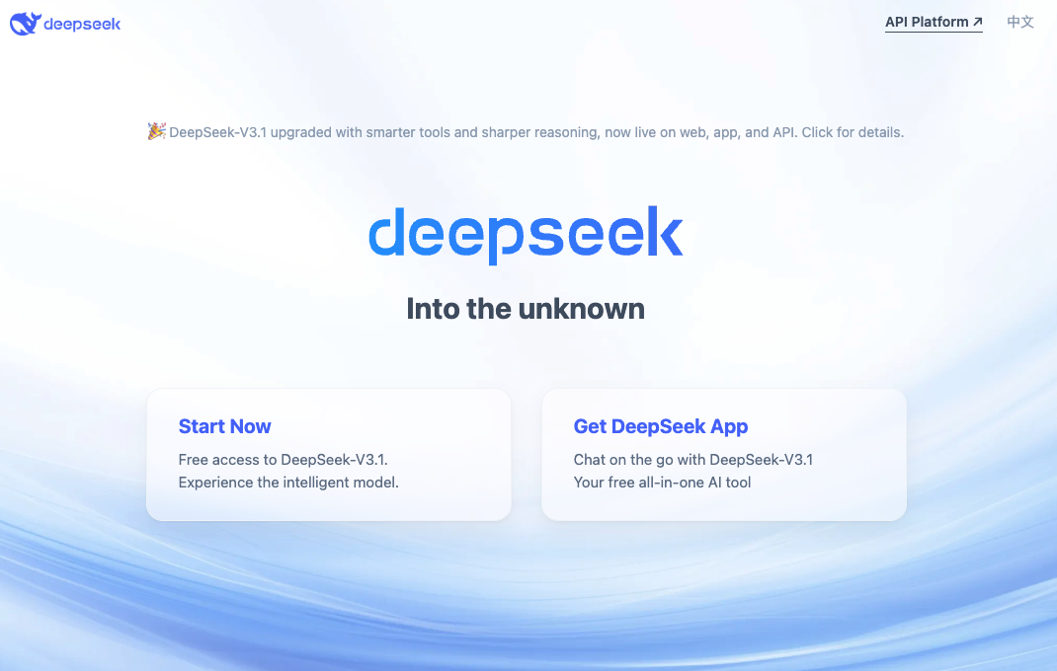
Research results matter: Chain Replication

Slide 26
Conclusion
Distributed Systems
  Multiple machines doing something together
  Pretty much everywhere and everything computing now
“Systems”
  Hide complexity and do the heavy lifting (i.e., interesting!)
  Scalability, fault tolerance, guarantees

