Slide 1
COS 316 Precept:
Concurrency

Slide 2
Today’s Plan
Background on concurrency
Key Golang mechanisms for developing concurrent programs (used in assignment 5)

Slide 3
Background: Overview of Concurrency
Sequential programs:
Single thread of control
Subprograms / tasks - don’t overlap in time - executed one after another
Concurrent programs
Multiple threads of control
Subprograms / tasks - may (conceptually) overlap in time - (appear to be) executed at the same time
Computer with a single processor can have multiple processes at once
OS schedules different processes - giving illusion that multiple processes are running simultaneously
Note - parallel architectures can have N processes running simultaneously on N processors
Notes:
Let’s give an overview of concurrency in the systems context
We can start off by talking about a normal, sequential program
For these, there is a single thread of execution
The CPU processes these programs one at a time and there is no concurrency
For concurrent programs, things are different
There are multiple threads of control

Slide 4
Background: Operating System (Review)
Allows many processes to execute concurrently
Ensures each process’ physical address space does not overlap
Ensures all processes get fair share of processor time and resources
Processes can run concurrently and (context) switch
User's perspective: appears that processes run in parallel although they don't
Notes:
Operating systems are responsible for scheduling processes and isolating them from each other

Slide 5
Background: Context Switch
Control flow changes from one process to another
  E.g., switching from processA to processB
Overhead:
  Before each switch OS has to save the state (context) of currently running process and restore it when next time its execution gets resumed

Slide 6
Background: Threads vs Processes
Processes
  Process context switching time is long
  (change of virtual address space & other resources)
Threads
  thread is a “lightweight” process
  thread shares some of the context with other threads in a process, e.g.
    Virtual memory
    File descriptors
Private context for each thread:
  Stack
  Data registers
  Code (PC)
Switching between threads is faster because there is less context
– less data that has to be read/written from/to memory

Slide 7
Background: Why Concurrency?
Performance gain
  Google search queries
Application throughput
  Throughput = amount of work that a computer can do in a given time period
  When one task is waiting (blocking) for I/O another task can continue its execution
Model real-world structures
  Multiple sensors
  Multiple events
  Multiple activities

Slide 8
Tradeoffs - Concurrent Programming
Complex
Error-prone
Hard to debug

Slide 9

Example
Jesse
Bank Account
Alex
Read b = 100
b = b + 10
Write b = 110
100
110
Read b = 110
b = b + 10
Write b = 120
120
time

Slide 10
Example
Jesse
Bank Account
Alex
Read b = 100
100
Read b = 100
b = b + 10
Write b = 110
110
b = b + 10
Write b = 110
110
time

Slide 11
Go and Concurrency
Goroutines
The sync package - https://golang.org/pkg/sync
  sync.Mutex
  sync.Cond

Slide 12
Goroutines
A lightweight thread managed by the Go runtime
Many goroutines execute within a single OS thread
  One goroutine is created automatically to execute the main()
  Other goroutines are created using the go keyword
  Order of execution depends on the Go scheduler
    Go takes a process with main thread and schedules / switches goroutines within that thread
Compare
Sequential Program
https://play.golang.org/p/PLeCGtRp2QB
Concurrent program
https://play.golang.org/p/sDitCEr_3vX
Notes:
Go employs what we call green threads and they call goroutines, which means that instead of using the operating system’s threading infrastructure, it uses its own form of threads
Go has its own scheduler for deciding which goroutine should be running at any given moment
Separate go routines are created and executed using the go keyword

Slide 13
Goroutines - Exiting
goroutine exits when code associated with its function returns
When the main goroutine is complete, all other goroutines exit, even if they are not finished
  goroutines are forced to exit when main goroutine exits
  goroutine may not complete its execution because main completes early
Execution order of goroutines is non-deterministic
Notes:
Goroutines have a separate thread of control from the main thread
They terminate whenever their code is done being run
However, even if they haven’t finished running, the termination of the main thread causes all goroutines to terminate
In addition, their execution order is non-deterministic.
This means that there there’s no way to predict when a goroutine will finish relative to the main goroutine or any other goroutine

Slide 14
A simple example to show non-determinism
https://play.golang.org/p/sDitCEr_3vX
Switch the order of the calls from
go say("world") say("hello")
say("hello") go say("world")
  What happens?
  How to fix?
Notes:
We can use Go’s synchronization tools which we will talk about in the next few slides to address this non-determinism.
Out-of-scope solution with WaitGroup: https://go.dev/play/p/bPVORhgVDWY

Slide 15
Synchronization
Synchronization is when multiple threads agree on a timing of an event
Global events whose execution is viewed by all threads, simultaneously
One goroutine does not know the timing of other goroutines
Synchronization can introduce some global events that every thread sees at the same time

Slide 16
Synchronization and Go
type Cond
  Func (*Cond) Signal()
  func (*Cond) Broadcast()
  func (*Cond) Wait()
type Mutex
  func (m *Mutex) Lock()
  func (m *Mutex) Unlock()
Channels
  See COS 418

Slide 17
Mutex (Mutual Exclusion)
Sharing variables between goroutines (concurrently) can cause problems
Two goroutines writing to the same shared variable can interfere with each other
Function/goroutine is said to be concurrency-safe if can be executed concurrently with other goroutines without interfering improperly with them
  e.g., it will not alter variables in other goroutines in some unexpected/unintended/unsafe way

Slide 18
Sync.Mutex
A mutex ensures mutual exclusion
Uses a binary semaphore
  If flag is up → shared variable is in use by somebody
Only one goroutine can write into variable at a time
Once goroutine is done with using shared variable it has to put the flag down
  if flag is down → shared variable is available
If another goroutine see that flag is down it knows it can use the shared variable but first it has to put the flag up
Notes:
A semaphore ~= a signal

Slide 19
Back to our example
Jesse
Bank Account
Alex
func Deposit(amount) {
lock balanceLock
read balance
balance = balance + amount
write balance
unlock balanceLock
}
Read b = 100
100
}
Read b =
CRITICAL
SECTION
b = b + 10
Write b = 110
110
= 110
b = b + 10
Write b = 120
120
time

Slide 20
Sync.Mutex
Lock()
  Puts the flag up (if none of other goroutines has already put the flag up)
  If second goroutine also calls Lock()it will be blocked, it has to wait until first goroutine releases the lock
  Note - any number of goroutines (not just two) competing to Lock()
Unlock()
  Puts the flag down
  When Unlock() is called, a blocked Lock() can proceed
In general: put Lock() at the beginning of the critical section and call Unlock() at the end of it; ensures that only one goroutine will be in critical section region
Create a Mutex
var mut sync.Mutex
  To lock a critical section
mut.Lock()
  To unlock a critical section
mut.Unlock()

Slide 21
Mutex Exercise
Consider:
var i int = 0
var wg sync.WaitGroup
func inc() {
i = i + 1
wg.Done()
}
func main() {
wg.Add(2)
go inc()
go inc()
wg.Wait()
fmt.Println(i)
}
Run the program
https://play.golang.org/p/hNevYkKDp30
Is it concurrency-safe?
Use Lock() and Unlock() to make these programs concurrency-safe
Notes:
Solution: https://go.dev/play/p/HnJIXA67slb

Slide 22
Mutex Exercise - Bank Account
Jesse
Bank Account
Alex
Read b = 100
100
Make this code concurrency-safe
https://go.dev/play/p/VboCb85otn0
Read b =
b = b + 10
Write b = 110
110
= 110
b = b + 10
Write b = 120
120
time
Notes:
Solution: https://go.dev/play/p/Q12qkDAajCK

Slide 23
Interesting Example
Consider:
var mu sync.Mutex
func funcA() {
mu.Lock()
funcB()
mu.Unlock()
}
func funcB() {
mu.Lock()
fmt.Println("Hello, World")
mu.Unlock()
}
func main() {
funcA()
}
Run the program
https://play.golang.org/p/c2Qgo-W_4mP
What happens?
Notes:
This is a deadlock; we have func A holding the lock that func B is waiting for, but func A calls func B so A can’t terminate before B, hence nothing terminates and both funcs wait endlessly

Slide 24
Condition Variables - sync.Cond
sync.Cond type - provides an efficient way to send notifications among goroutines
sync.Cond value holds a sync.Locker field with name L - field value is of type *sync.Mutex or *sync.RWMutex
  E.g.:
    cond := sync.NewCond(&sync.Mutex{})
    cond.L.Lock()
    cond.L.UnLock()
sync.Cond value holds a FIFO queue of waiting goroutines
commonly used to allow threads to wait on a condition to be true: consumers wait until a producer signals that something happened
L
Mutex or
RWMutex

Slide 25
Condition Variables - L.Lock(), L.Unlock(),
Wait(), Broadcast(), Signal()
cond := sync.NewCond(&sync.Mutex{})
cond.L.Lock()
cond.Wait()
cond.Broadcast()
cond.Signal()
Call L.Lock() before Wait()
Insert calling goroutine in queue and block (wait)
Calls L.Unlock()
Unblock all the goroutines in (and remove them from) the waiting goroutine queue
Blocked routines go back to running state
Invokes cond.L.Lock() (in the resumed cond.Wait() call) to try to acquire and hold the lock cond.L again
cond.Wait() call exits after the cond.L.Lock() call returns
Unblock the head goroutine in (and remove them from) the waiting goroutine queue

Slide 26
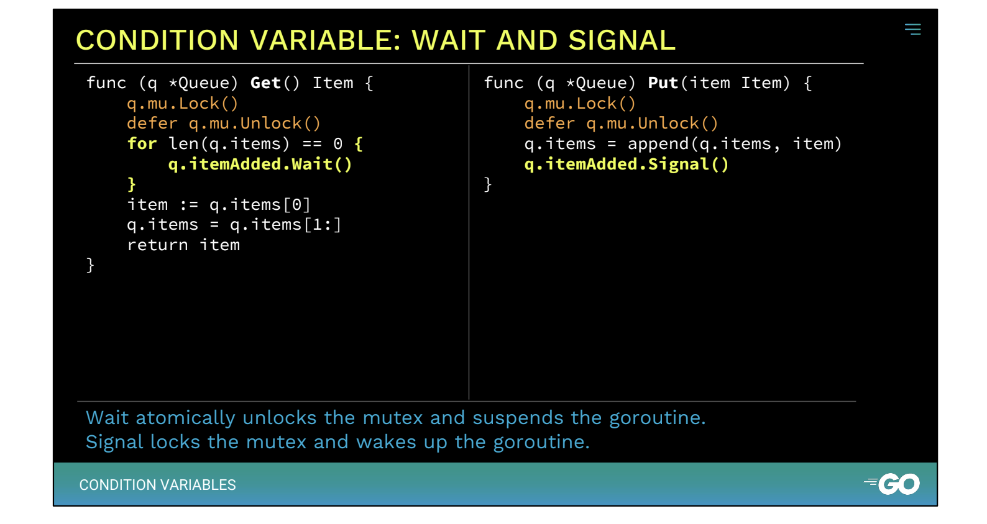
A Basic Example:
Notes:
The two basic operations on condition variables are Wait, and Signal.
Wait atomically unlocks the mutex and suspends the calling goroutine.
Signal wakes up a waiting goroutine, which relocks the mutex before proceeding.
In our queue, we can use Wait to block on the availability of enqueued items, and Signal to indicate when another item has been added.
Slide from here: https://drive.google.com/file/d/1nPdvhB0PutEJzdCq5ms6UI58dp50fcAN/view (also linked here on go’s sync documentation https://pkg.go.dev/sync#Cond)

Slide 27
sync.Cond - Always Check the Condition!
Why is this loop here?
cond.Wait() does not guarantee the condition holds when it returns
The condition could have been made false again while the goroutine was waiting to run
Always check the condition, and keep waiting if it does not hold
checkCondition := func() bool {
// Check the condition
}
for !checkCondition() {
cond.Wait()
}
cond.L.Unlock()

