Slide 1
COS 316 Precept #7:
Caching + Eviction
Notes:
In today’s precept, we’ll go over some cache-related concepts that were touched on in lecture and that students need a bit of help with
We’ve talked a bit about CDNs and “the edge”, so we’ll give a quick definition of those, before jumping back to more caching stuff

Slide 2
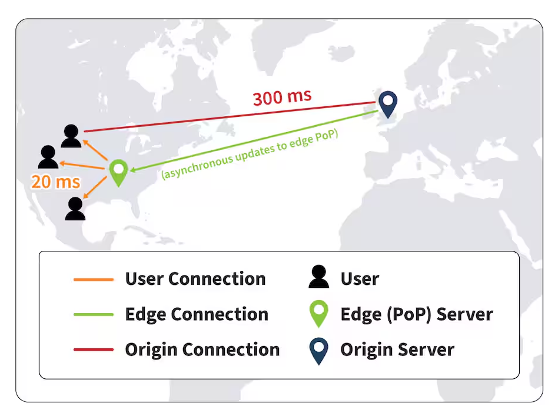
What is the Edge?
Move compute and storage closer to end-users
An evolution of traditional datacenter-centered architecture
Notes:
Let’s talk about the edge
There is nothing special about an edge network
There’s no special way to communicate with them and they don’t operate on some brand new layer in the network that we haven’t discussed yet
Edge networks are just a different way of organizing servers
Rather than a provider having a single datacenter that contains a bunch of servers that handle all requests, that provider can geo-distribute those servers so that they’re closer to end-users
When we talk about the edge, we’re just talking about servers that don’t reside in a main datacenter and that have been placed closer to end-users

Slide 3
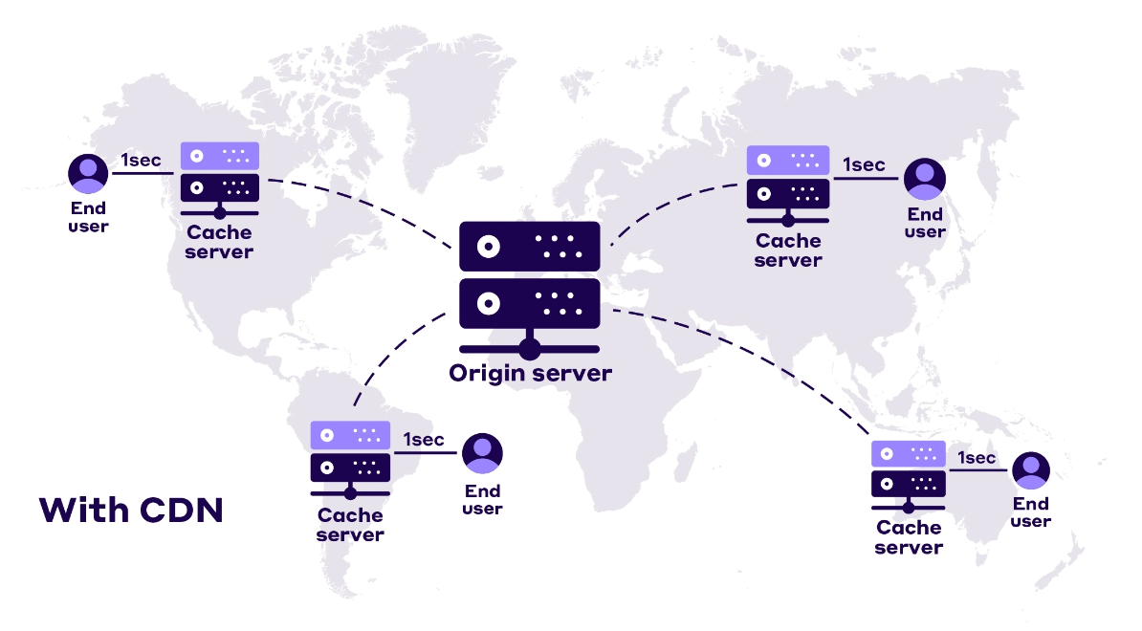
What is a CDN?
Content delivery network (CDN):
A group of servers over a region/the world to speed up content delivery.
CDN servers cache web content such as image and videos.
It sends to the users who request the webpage.
https://nitropack.io/blog/post/cdn-beginners-guide
Notes:
CDNs are groups of servers that are meant to serve content to end-users
They’re entirely architectured around the need to serve content to geo-distributed end-users
This means that there will be cache servers scattered around the world so they can serve content to users that are close to those cache servers

Slide 4
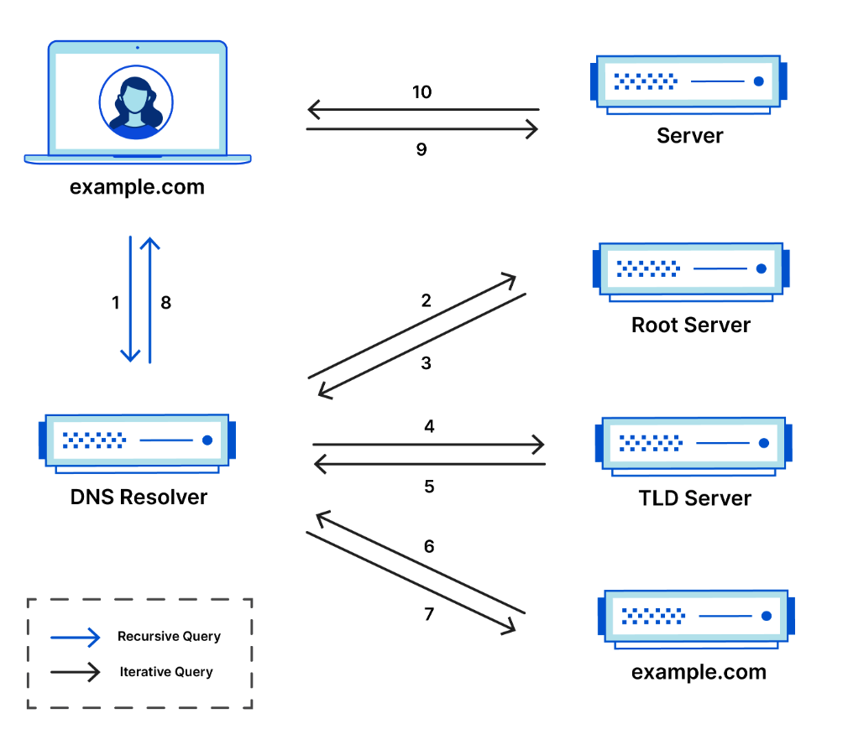
DNS
Domain Name System (DNS):
Send the DNS query to the DNS resolver
Resolver queries the root server
The root server responds with address of TLD server (“Here is where you should go for URLs that end in .com”)
Resolver queries TLD server that handles “.com” URLs
TLD server responds with address of authoritative name server (“Here is the server that should hold the IP address for example.com”)
Resolver queries authoritative name server
Authoritative name server responds with the IP address of example.com
Resolver returns response to the client
https://www.cloudflare.com/learning/dns/what-is-a-dns-server/
Notes:
Remember that DNS is the system that translates URLs to IP addresses
DNS is a hierarchical system where fully resolving a query may take many round trips
Let’s walk through an example of a DNS query and its ensuing response
First, let’s talk about the DNS resolver
In the slides, Wyatt labels this the local DNS server
This is the machine that a client issues a query to and that ultimately returns a response
It does all of the work
Now, let’s move onto the actual process of issuing a DNS request and getting a response
Look at all of these messages that must be exchanged for a single DNS query to be satisfied
Each of those messages take time and it would be useful to cache their responses!

Slide 5
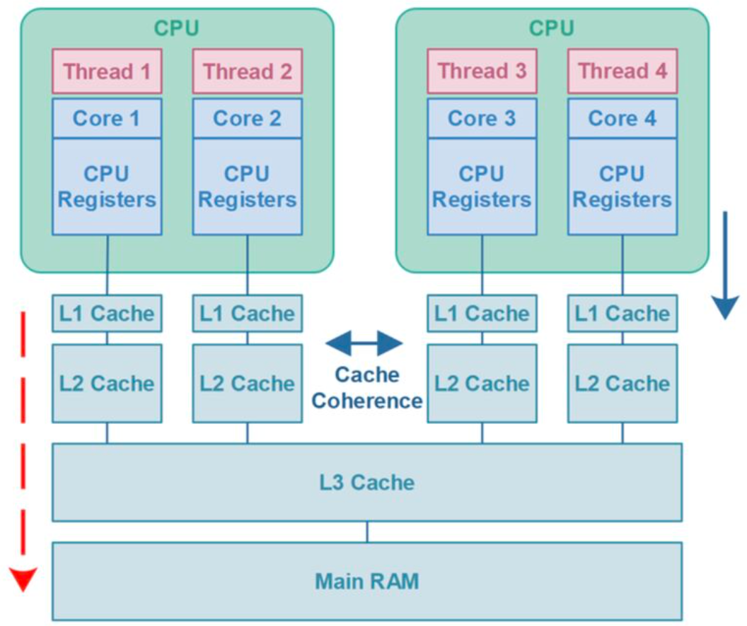
Example: CPU caching
Hierarchical structure
L1 Cache: Smallest and fastest
L2 Cache: Larger but slower than L1
L3 Cache: Larger but slower than L2
L1 cache 100x faster than DRAM
https://www.linkedin.com/posts/gopal-chakraborty-b6a7b91b_cpu-systemdesign-performance-activity-7191333397699436544-uxFs/
Notes:
Here is an example of a cache that you all use every day, but whose inner-workings you may not be familiar with
This is the memory hierarchy for a CPU with a 3-level cache
You can see that there are 3 levels in the cache, L1, L2, and L3, and Main RAM at the bottom
Each of the caches should hold a subset of the data in the next cache
So L1 contains part of the data in L2, and so on
The cache closest to the CPU, the L1 cache is both the smallest cache, due to space constraints, and the fastest cache, because it’s so close
The next cache, L2 is larger because its further away from the CPU and has more space to be placed, and slower, because its further away from the CPU
This shows that even on your local machine where data doesn’t have to go across a network, caching is useful

Slide 6
Example: Communication Channel
TLS session caching
Reduce connection time
Cache key information for TLS connections
Length of time for the information being kept would be set
TCP connection caching (TCP fast-open)
Speed up the opening of successive TCP connections between two endpoints
Generate a TFO cookie when establishing connection for the first time.
When re-connecting, the client can append the cookie to the SYN packet to authenticate itself. The server will directly send data without waiting for finishing the 3-way handshake.

Slide 7
Belady’s Algorithm
Provably optimal
Will maximize hit rate and minimize miss rate for any given cache
Requires knowledge of the future
Impossible in practice!
Notes:
We’ve talked about a few cache eviction policies
Remember that these come into play when a cache is full, something needs to be inserted into the cache, and the cache needs to decide what to evict
We’ve discussed the FIFO algorithm, which will evict the oldest object in the cache
We’ve discussed the LRU algorithm, which will evict the item that was last used the furthest in the past
We’ve discussed the LFU algorithm, which will evict the item that has been used the least frequently
We’d need to keep an access count for this policy
Each of these may win out over the others, depending on the data access pattern of the clients that are using the cache
But is there some optimal algorithm? Some algorithm that is the best that you can ever do with a cache? Yes!
That is Belady’s algorithm
If a cache were to employ Belady’s algorithm for eviction, it would be get the highest hit rate and lowest miss rate that’s possible for that cache
So why isn’t it employed? Because it requires knowledge of the future!
For Belady’s algorithm, the item that the cache decides to evict is the item whose next access is the farthest in the future

