Slide 1
COS 316 Precept #6:
Caching + Eviction (Replacement)
Please visit ed discussion to download the
precept 6 exercise code (here)

Slide 2
What is caching?
Client
Cache
Storage/Server
Notes:
This week, you’ve learned a bit about web caching in lecture
Let’s talk about what a cache is and why’d you use one
As a general computing term, a cache is a place where some objects from a larger dataset are stored for more convenient access
You may have encountered a few caches in your computer science education
There are caches in the CPU memory hierarchy that store a subset of main memory’s contents
The TLB, which you learned about earlier, is a cache that stores virtual to physical address translations
And the list goes on
So why would we want to store objects in two places?
Really there are two reasons:
Accessing a cache is often faster than accessing the main datastore, because caches tend to be closer to the entity that’s requesting the object
They also result in less traffic to the storage device or server that holds the entire dataset, which lowers the bandwidth and computing requirements of the storage server
Caches generally take advantage of something called locality
In this context, it refers to the tendency of data accesses to be correlated in some way
Temporal locality is a type of locality that describes the tendency of things to be reused
For example, if I access a particular object, I’m likely to use it again in the near future
I’ve described this in a very vague and general sense so far. Let’s dive a bit deeper with an example from lecture

Slide 3
Overview of Web Caching
Basic idea:
Bring objects “closer” to clients
Three primary features:
Reduce network bandwidth
Reduce client-perceived delays
Reduce load on server
Cache Replacement Strategy
When a cache becomes full, which object should be evicted/replaced?
Reverse
Proxy
Cache
Proxy
Cache
Clients
(e.g. , browser)
Local Cache
Cache
Cache
Cache
Cache
Notes:
Web caching is a specific instance of caching where objects are requested over the web and stored at one or more caches between the client and the server
The cache may sit somewhere in the network between the client and the server
Or the cache may be on the client itself, meaning the client has decided to store objects from previous requests
This is done for several reasons:
First, it reduces network bandwidth usage
The network is a shared resource and if less data has to go over many of its connections, it can reduce congestion
Second, it reduces delays
Remember that caches are closer to clients than the servers are. This means that when a client needs to request an object, it will receive it faster from a cache
Third, it reduces load on the server
Simply put: If requests are handled by a cache, that means they don’t need to be handled by a server.
But caches require management
Caches are necessarily limited in size for various reasons, principal among them being that storage is expensive
What happens when we want to insert an object into a cache that’s already full?
We have to evict something!
It turns out that what we choose to evict from a cache is important and there’s an entire field of research based around this question

Slide 4
Cache Eviction Algorithms
Client requests a new object
If object in cache
return the object
Else:
Get object from server/provider and return the object to client
Attempt to insert the object into the cache:
If Cache full:
Identify an object in cache to evict
Evict the object in the cache
Replace with new object (insert new object)
Admit the new object to the cache

Slide 5
Cache Eviction Algorithms
Least recently used (LRU): Evict the object from the cache whose last request is the oldest
First-in, First-out (FIFO): Evict the object from the cache that has been in the cache the longest
Many others...
Notes:
Here are a few important cache eviction algorithms that are commonly used and taught
The first is least recently used, or LRU for short.
LRU caches keep track of the last time an object was accessed.
When an object needs to be evicted from the cache, it chooses the object whose most recent access is the furthest in the past
LRU is a very intuitive algorithm; Just think about your closet.
If you need to free up space in your closet, are you going to donate the shirt that you wore yesterday or the one that you can’t even remember wearing?
This kind of cache exploits temporal locality: Objects that were used recently are more likely to be used again
Another algorithm that gets some use is FIFO. With this algorithm, you just evict the object that has been in the cache for the longest time
There are many caching algorithms out there, each meant to maximize hit rate, which is the fraction of object requests that the cache can handle
A high hit rate means that a cache is able to handle a large fraction of the requests
A low hit rate means that most of the requests end up being handled by the server

Slide 6
LRU
id: 8
size: 10
request: __:__
admit: __:__
Current
time:
16:00
Cache capacity = 50
Cache size = 45
id: 6
size: 2
request: 13:00
admit: 11:00
id: 3
size: 10
request: 13:45
admit: 13:45
id: 1
size: 3
request: 15:01
admit: 12:01
id: 4
size: 5
request: 11:53
admit: 11:33
id: 11
size: 8
request: 11:30
admit: 11:30
id: 7
size: 17
request: 13:30
admit: 13:30
Notes:
Here we have an example of the LRU eviction algorithm in action
This is a cache with capacity 50 units
Each of the smaller rectangles is an object
Notice the metadata associated with each object
They each have an ID (just so we know what object we’re referring to), size, most recent request time, and admission time
In this example, the cache currently contains 45 units of objects when an object of size 10 comes in
This would push the cache over its capacity, so something has to evicted
Since this is an example of LRU, we have to look at the object that’s currently in the cache with the oldest request time
That is the object with id 11
So we evict it!
We then have enough space to place object 8

Slide 7
LRU
id: 8
size: 10
request: __:__
admit: __:__
Current
time:
16:00
id: 8
size: 10
request: __:__
admit: __:__
Current
time:
16:00
Cache capacity = 50
Cache size = 45
Cache capacity = 50
Cache size = 45
Cache capacity = 50
Cache size = 47
id: 6
size: 2
request: 13:00
admit: 11:00
id: 3
size: 10
request: 13:45
admit: 13:45
id: 6
size: 2
request: 13:00
admit: 11:00
id: 3
size: 10
request: 13:45
admit: 13:45
id: 6
size: 2
request: 13:00
admit: 11:00
id: 3
size: 10
request: 13:45
admit: 13:45
id: 1
size: 3
request: 15:01
admit: 12:01
id: 4
size: 5
request: 11:53
admit: 11:33
id: 1
size: 3
request: 15:01
admit: 12:01
id: 4
size: 5
request: 11:53
admit: 11:33
id: 1
size: 3
request: 15:01
admit: 12:01
id: 4
size: 5
request: 11:53
admit: 11:33
id: 11
size: 8
request: 11:30
admit: 11:30
id: 7
size: 17
request: 13:30
admit: 13:30
id: 11
size: 8
request: 11:30
admit: 11:30
id: 7
size: 17
request: 13:30
admit: 13:30
id: 8
size: 10
request: 16:00
admit: 16:00
id: 7
size: 17
request: 13:30
admit: 13:30
t
Notes:
Here we have an example of the LRU eviction algorithm in action
This is a cache with capacity 50 units
Each of the smaller rectangles is an object
Notice the metadata associated with each object
They each have an ID (just so we know what object we’re referring to), size, most recent request time, and admission time
In this example, the cache currently contains 45 units of objects when an object of size 10 comes in
This would push the cache over its capacity, so something has to evicted
Since this is an example of LRU, we have to look at the object that’s currently in the cache with the oldest request time
That is the object with id 11
So we evict it!
We then have enough space to place object 8

Slide 8
FIFO
id: 8
size: 10
request: __:__
admit: __:__
Current
time:
16:00
Cache capacity = 50
Cache size = 45
id: 1
size: 3
request: 15:01
admit: 12:01
id: 3
size: 10
request: 13:45
admit: 13:45
id: 6
size: 8
request: 13:00
admit: 11:00
id: 4
size: 5
request: 10:30
admit: 01:33
id: 4
size: 5
request: 11:53
admit: 11:33
id: 11
size: 8
request: 09:11
admit: 11:30
id: 11
size: 8
request: 11:30
admit: 11:30
id: 7
size: 11
request: 13:30
admit: 13:30
Notes:
Next we have an example of the FIFO eviction algorithm
Again, we have objects that keep track of all of the same metadata
Again, an object comes in whose insertion would push the cache over its capacity
We look for the object with the oldest admit time and evict it!

Slide 9
FIFO
id: 8
size: 10
request: __:__
admit: __:__
Current
time:
16:00
id: 8
size: 10
request: __:__
admit: __:__
Current
time:
16:00
Cache capacity = 50
Cache size = 45
Cache capacity = 50
Cache size = 45
Cache capacity = 50
Cache size = 47
id: 1
size: 3
request: 15:01
admit: 12:01
id: 3
size: 10
request: 13:45
admit: 13:45
id: 1
size: 3
request: 15:01
admit: 12:01
id: 3
size: 10
request: 13:45
admit: 13:45
id: 1
size: 3
request: 15:01
admit: 12:01
id: 3
size: 10
request: 13:45
admit: 13:45
id: 6
size: 8
request: 13:00
admit: 11:00
id: 4
size: 5
request: 10:30
admit: 01:33
id: 4
size: 5
request: 11:53
admit: 11:33
id: 6
size: 8
request: 13:00
admit: 11:00
id: 4
size: 5
request: 11:53
admit: 11:33
id: 8
size: 10
request: 16:00
admit: 16:00
id: 4
size: 5
request: 11:53
admit: 11:33
id: 11
size: 8
request: 09:11
admit: 11:30
id: 11
size: 8
request: 11:30
admit: 11:30
id: 7
size: 11
request: 13:30
admit: 13:30
id: 11
size: 8
request: 11:30
admit: 11:30
id: 7
size: 11
request: 13:30
admit: 13:30
id: 11
size: 8
request: 11:30
admit: 11:30
id: 7
size: 11
request: 13:30
admit: 13:30
Notes:
Next we have an example of the FIFO eviction algorithm
Again, we have objects that keep track of all of the same metadata
Again, an object comes in whose insertion would push the cache over its capacity
We look for the object with the oldest admit time and evict it!

Slide 10
Experiments
> Download exercise code from ed
> cd precept6/webcachesim-master
> make
Notes:
There’s a web cache simulator on ed that we can use to experiment with different algorithms and cache sizes

Slide 11
Trace File Form
Example
time id size
1 1 120
2 2 64
3 1 120
4 3 14
4 1 120
See test.tr
Request traces must be given in a space-separated format with three columns
time - long long int
id - long long int, used to uniquely identify objects
size should be a long long int, object's size in bytes

Slide 12
Using the Simulator*
> ./webcachesim test.tr LRU 1000
LRU:1000 bytes, 10492 reqs, 8495 hits, 81 hits/reqs(%)
> ./webcachesim test.tr FIFO 1000
FIFO:1000 bytes, 10492 reqs, 8206 hits, 78 hits/reqs(%)
* Derived from https://github.com/dasebe/webcachesim
Notes:
Now we can see how these eviction algorithms perform by running the above commands

Slide 13
Experiments
LRU and FIFO
Vary cache sizes
80
160
320
640
1280
2560
5120
Create a Google Sheet
Three columns
SIZE LRU FIFO
Copy results accordingly
Select three columns to create line chart

Slide 14
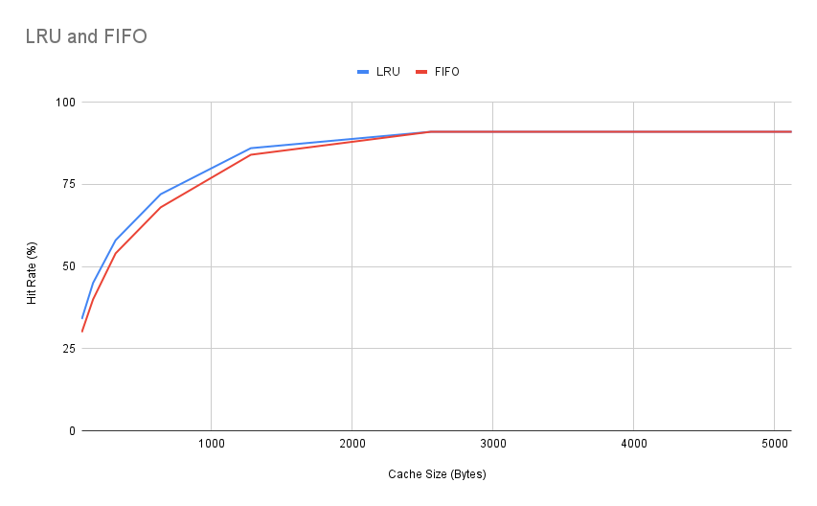
Experiments

