Slide 1
COS 316 Precept #5
Testing & Benchmarking

Slide 2
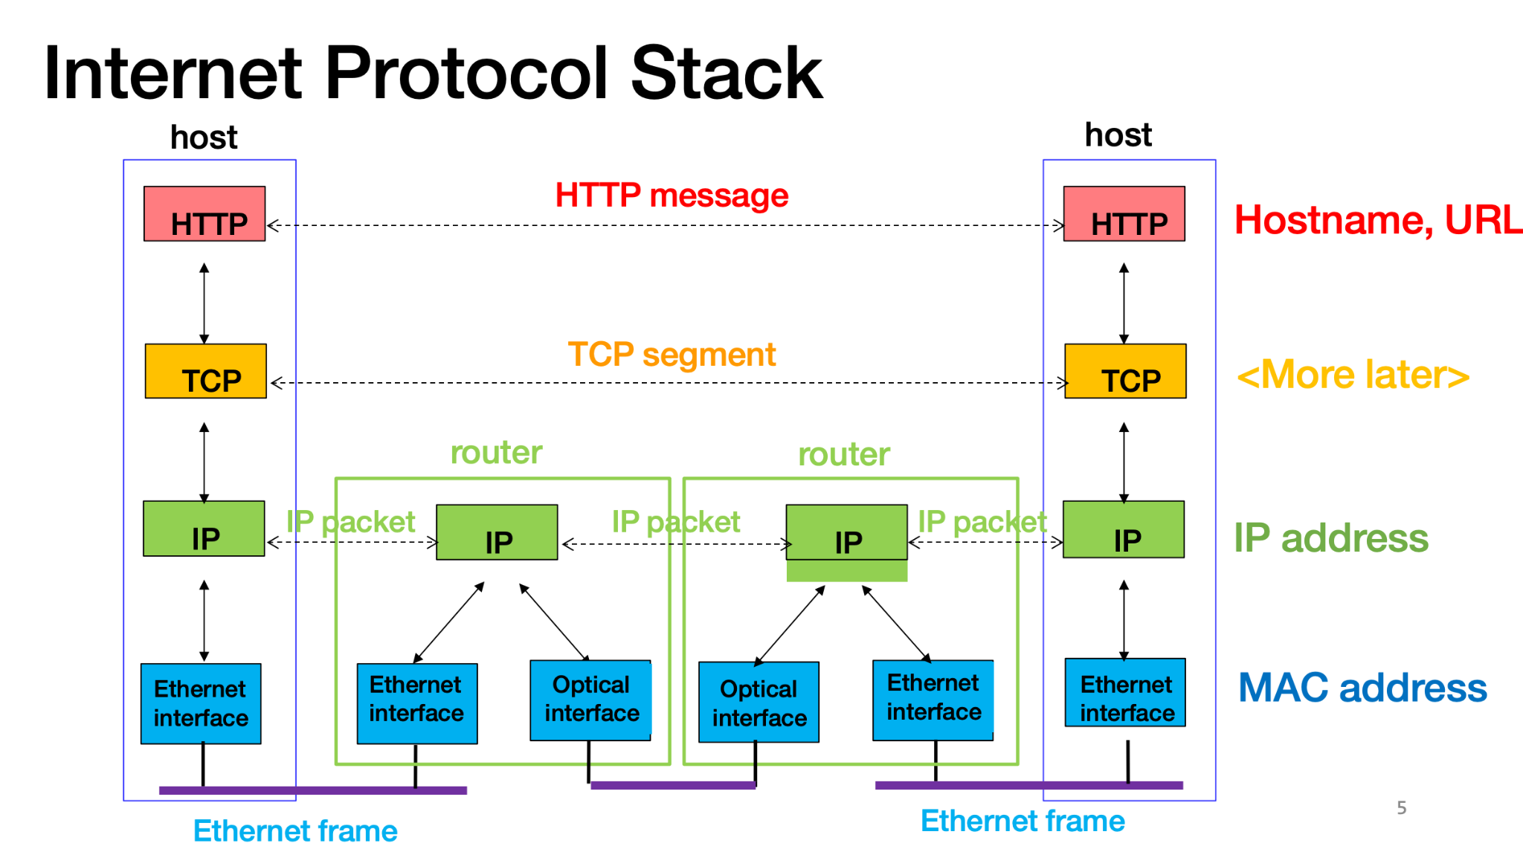
TCP is about streams
Notes:
TCP is a stream-oriented transport layer protocol
This means that it is meant to send long streams of data, even if that data has to be split across multiple packets
On this slide, we’ve included a figure of the network layers that were discussed in lecture
What we want you to take away from this figure is the following:
This figure represents two hosts that are communicating over a network connection
When data is sent from one host to another, you can think of the data as going down the layers on the sender, then upon receipt, going back up the through the layers on the receiving side
Each host has code that implements each layer of the network stack
They each have code that handles the IP protocol, TCP or UDP, HTTP, etc.
As data makes its way down through the network layers, the code on the sender appends layer-specific information to the packet and continues to pass it down
This layer-specific information is called a header and there’s a different header for each layer
On the receiver side, the code at each layer will consume the layer specific information that is on the received packet and act on it

Slide 3
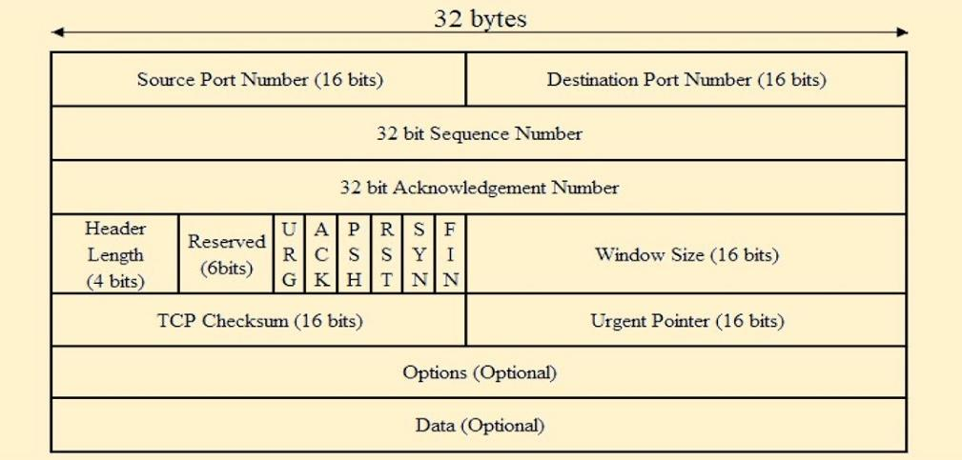
The TCP header
Notes:
Let’s take a look at the TCP header
We see the source and destination port numbers
Remember that those are used by the hosts to multiplex their IP connections
Below that, we have the 32-bit sequence number. Remember that TCP is for transmitting long byte-streams. The sequence number on each packet tells the receiver that the first byte of the data contained in the packet starts at offset “sequence number” of the whole data stream.
For example, if the first data packet’s seqno is m, and assume that each subsequent data packet contains 10 bytes of (non-TCP-header) data,
then the 4th, 5th, 10th packet sent by the client would have seq numbers m+40, m+50, and m+100 respectively.
The acknowledgment number is the next sequence number that the sender of this packet expects from the receiver (detailed in next example)
Most of the rest of this we can gloss over, but let’s point out a few things.
In the fourth row, there are several vertical rectangles; these are flags
For the next slide, we care about the SYN and ACK flags, and we’ll elaborate on them there
For now, let’s move on to how TCP connections are initiated

Slide 4
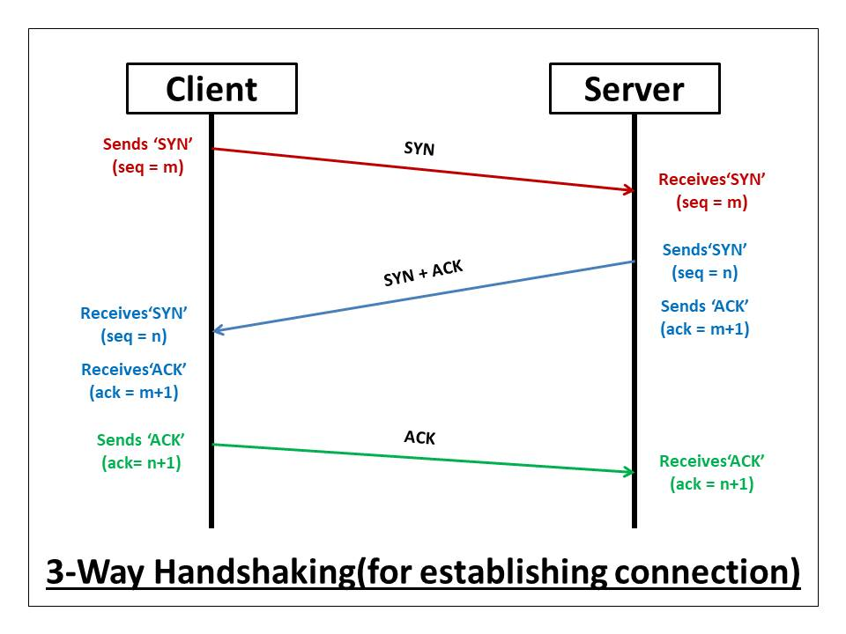
3-way handshake
Notes:
In order to initiate a new TCP connection, something called a 3-way handshake takes place
Usually, a new TCP connection is initiated by a client that is attempting to connect to a server, so for the rest of this discussion, we’ll assume that is the case
For clarity, TCP can be used between any two hosts, regardless of the client and server language that we use. It just happens that this is both a useful teaching tool and the most common way that TCP connections are established
Also, it’s called a 3-way handshake but in reality it’s just 3 messages. Not sure why “way” is used instead of “message”, but let’s just go with it
The first part of the handshake is a message from the client to the server
It is a SYN (synchronize) packet; this means that the SYN flag in the TCP header is set so that the receiver knows that this is an attempt at a new connection
Notice in the diagram that it says “seq = m”
That is the sequence number for the packet
Remember that the sequence number is essentially a byte offset and it tells the receiver of the packet that the start of the data in this packet is byte m of the stream
When the server receives the SYN packet, it will respond with a SYN-ACK packet
This is a packet with both the SYN and ACK flags set
Looking at the figure, you’ll notice that on the server side, it says seq = n (the sequence number used by the server) and ack = m + 1 (the server acknowledges the client’s sequence number m, and expects the next one to be m+1)
Each host in a TCP connection has its own sequence number that it keeps track of
The ack number is always the sequence number that the receiver expects to receive next
We’ll walk through an example later so that things are more clear
Finally, the client responds with a final ACK packet and the connection is established
These two hosts can continue to communicate indefinitely until one of them shuts the connection down!

Slide 5
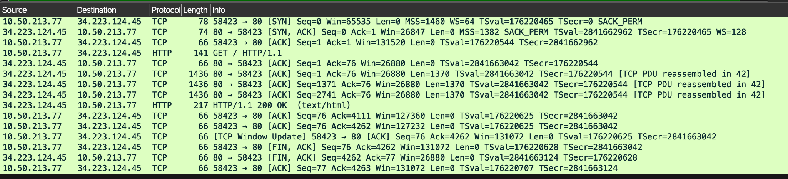
Example
Notes:
Here’s a screenshot of some network traffic results from wireshark; you can see an example of what the establishment of a TCP connection and data exchange looks like
We use a terminal to request a webpage from neverssl.com
Each of these rows represents a packet that my machine has either sent or received
The first three packets are the 3-way handshake
The next packet is my terminal sending an HTTP Get request
The next few packets are the web page being sent back in chunks, followed by the HTTP Response with a status message
And finally, the teardown of the TCP connection is started by the host

Slide 6
Overview
What is testing?
  evaluation of software against user requirements & systems specs
  identify defects in software - show the presence of bugs, but not their absence
What is benchmarking?
  evaluation of system performance - time (CPU vs wall clock), memory, etc.
Notes:
What is Testing?
Evaluation of software to ensure it meets user requirements and system specifications.
Identify defects in the software, ensuring that bugs are detected. It can show the presence of bugs, but it's important to note that it cannot guarantee the absence of bugs.
What is Benchmarking?
Benchmarking is the process of evaluating system performance by measuring various parameters.
Common metrics include processing time such as CPU time, wall-clock time (real world time) and resource usage like memory.
Difference of CPU time and wall-clock time?
CPU time only measures the time CPU is used to process
Wall-clock time is the whole time user should wait. It can include some other time such as I/O
Question? Is it possible that CPU time is longer than wall clock
YES! Multi-threaded Systems!

Slide 7
Testing - Basic Approach in Go
Source files and associated test files are placed in the same package/folder
The name of the test file for any given source file is _test.go
  E.g., router.go and router_test.go
Import “testing”
Test functions need to have the “Test” prefix, and the next character in the function name should be capitalized

Slide 8
Testing - Exercises
> cd precept4/mysort
# run test framework
> go test -v
# fix the bug and demonstrate tests pass
Notes:
The bug is in the mysort_test.go. The MergeSort function has a return value but it’s verifying the old list instead of the returned list.
slice = MergeSort(slice)

Slide 9
Benchmarking - Basic Approach in Go
Benchmarks also reside in the _test.go files
Import “testing”
Benchmark functions need to have the “Benchmark” prefix, and the next character in the function name should be capitalized
Notes:
Benchmarks are written within _test.go files, the same files where you define test functions.
Also need to import “testing”
Recall that the test functions have “Test” prefix. Benchmark functions have “Benchmark” prefix.

Slide 10
Benchmark - Exercises
How to eliminate certain code in benchmarks?
  b.ResetTimer(), b.StartTimer(), b.StopTimer()
How to benchmark specific functions:
  go test --bench=Fib20
How to show memory allocations?
  go test --bench=. --benchmem
or
  b.ReportAllocs()
Notes:
To exclude certain parts of code (like setup tasks that shouldn't be measured in the benchmark), use:
b.ResetTimer(): ResetTimer zeroes the elapsed benchmark time and memory allocation counters and deletes user-reported metrics. It does not affect whether the timer is running.
b.StartTimer(): StartTimer starts timing a test. This function is called automatically before a benchmark starts, but it can also be used to resume timing after a call to B.StopTimer
b.StopTimer(): StopTimer stops timing a test. This can be used to pause the timer while performing complex initialization that you don't want to measure.
benchmark specific functions by running by specify a function as an argument.
You can also show memory allocations by specify “benchmem”
go test --bench=. --benchmem This command means to run all benchmarks and includes memory allocation statistics.

Slide 11
Benchmark - Exercises
> cd precepts/precept4/fib
# run benchmark framework
> go test --bench=.
# will run for 10 seconds
> go test --bench=. --benchtime=10s
# will run experiment 10 times
> go test --bench=. --count=10
Notes:
–benchtime=10s means that for each benchmark, go will run the benchmark for a minimum of 10 seconds.
If running the benchmark takes less than 10 seconds, golang will run with multiple iterations to reach 10s. If longer than 10s, golang will not terminate it but wait it to finish with only one iteration.

Slide 12
Testing and Benchmark - Exercises
> cd precepts/precept4/stack
# develop and run tests
# develop and run benchmarks
Questions:
Does your testing framework pass all tests?
Do your benchmark(s) demonstrate improved performance?
Notes:
The bug is in the function Pop(); the s.n = s.n - 1 line is commented out but is needed.

