Slide 1
COS 316 Precept #4:
Networking and HTTP

Slide 2
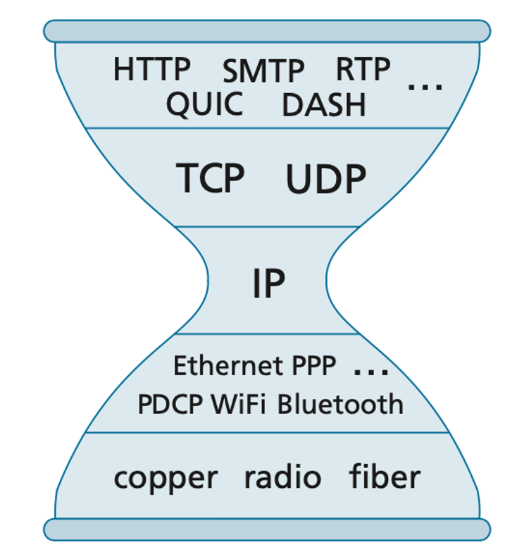
Layers of the network
Notes:
The OSI model of the network separates it into 7-ish layers, 5 of which we’ll discuss today: layers 1, 2, 3, 4, and 7
Each of the layers builds on the layer underneath to provide additional functionality
Each of the layers (save for IP, which we’ll talk about in a second), has multiple protocols that can fit into that layer

Slide 3
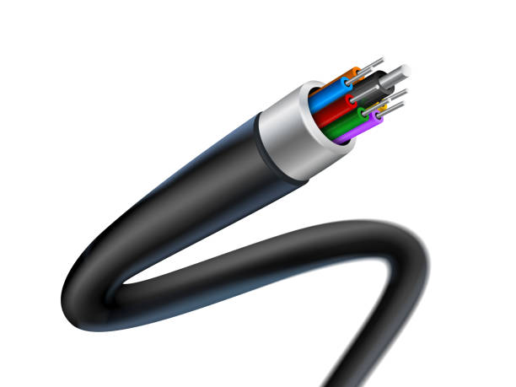
Layer 1: The Physical Layer
Notes:
Layer 1 is the physical layer
Layer 1 protocols describe how bits of information are sent over some communication medium
There’s a protocol that describes how to use light to send data over fiber optic cables
There’s another protocol that describes how to use differential signaling to send data over twisted pairs of copper wires
And there’s another protocol that describes how to use different voltage levels to send data over coaxial cables
We generally don’t worry very much about this layer in networking. We abstract it away.
But what’s useful to understand about this layer is that all of the protocols within it provide a way to send bits across a communication medium, which we can refer to as bits on a proverbial wire

Slide 4
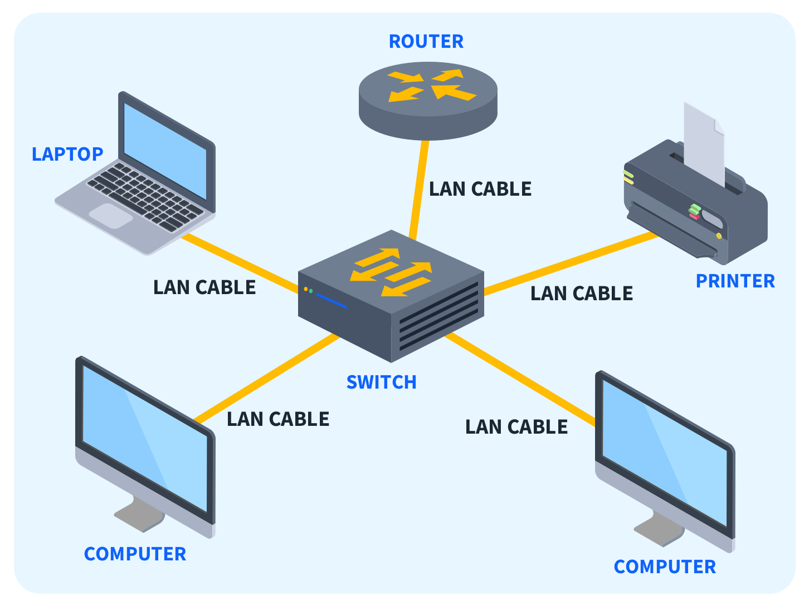
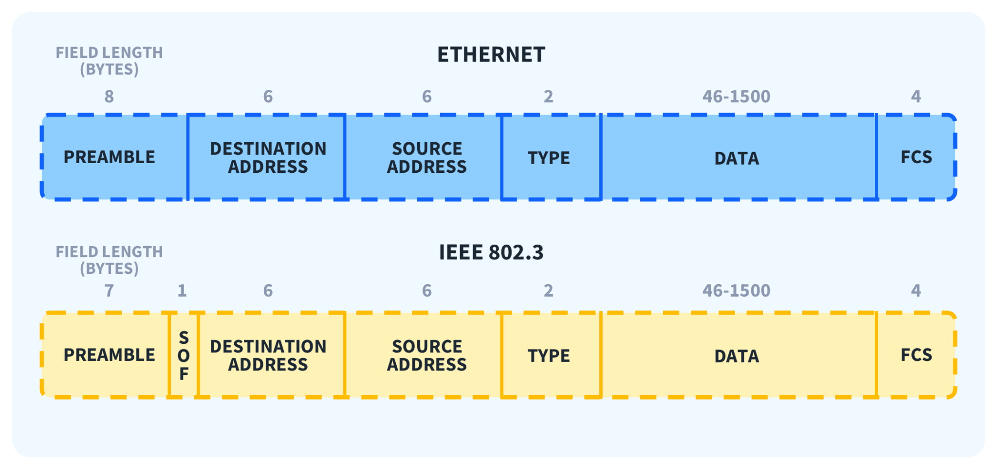
Layer 2: The Link Layer
Notes:
Now that we can get bits on a wire, we need to do something with them
We introduce layer 2, the link layer
Layer 2 protocols describe how bits can be arranged into data frames and how to send those data frames between machines on the same local network
We’ve included an image of the data frame format for ethernet on the slide shown
This layer introduces an addressing mechanism so that machines can communicate with each other
Every machine that operates on a network has a layer 2 address, which is generally referred to as a MAC (media access control) address
These addresses are used to communicate between machines on the LOCAL network
For an image of what the local network looks like, take a look at the slide
The local network consists of everything connected to the switch at the center of the image
So if any of those computers wanted to send data to another one of the computers in the image, they would have to use that computer’s MAC address
There are two things to know about MAC addresses:
They are static. The MAC address of each computer is hardwired into the hardware when the computer is manufactured
They’re locally routable: they only work within the local network.
If a computer wants to communicate with a machine outside of its local network, then it needs to use a globally routable address, which we’ll discuss in the next section

Slide 5
Layer 3: The Network Layer
Notes:
A shortcoming of layer 2 is that it only allows communication between machines that are on the same local network. This means that I can send and receive things to a machine that’s connected to the same wifi network as my machine, but if I want to communicate with Google or some other service over the internet, I’m out of luck!
For this purpose, we introduce layer 3, the network layer
If you look at the network stack, you can see that there’s something unique about layer 3: There’s only one protocol in use!
IP is the universally implemented protocol for machines that want to speak to other machines across the internet
The addressing mechanism introduced at this layer is called an IP address, and it has two important attributes that differentiate it from MAC addresses
It is globally routable and it can be assigned dynamically
Let’s refer back to MAC addresses for a second
Remember, they’re burned into a machine when the machine is manufactured
Because of this, by their very nature, they cannot include any information about what their current location is
But IP addresses are assigned dynamically so they can absolutely include this information
When all of you connected your phones or computers to Princeton’s WiFi network, your MAC addresses remained the same as they had always been
But you were assigned an IP address by the WiFi network that makes it easier for other machines to find you from afar
You can think of a MAC address as your given name and you can think of an IP address as your mailing address
It’s easy to deliver a message to your friends because you’re near them and you know them. “Tell Chris that I said this” would work in a small area
But that wouldn’t work if the sender lived across the country (even with assuming ‘Chris’ is globally unique)
But they could certainly send a letter to my address and the postal service will ensure that it gets to me, because it will be delivered to my address

Slide 6
Layer 4: The Transport Layer
Notes:
We now have a way for machines to communicate with each other outside of their local networks
So a machine in California can send data to a machine in New York, and the internet will perform the steps to deliver that data
Except, it won’t always do that
There are two important things that are missing from the network layer:
The first is ordered, reliable delivery. The internet will ATTEMPT to deliver sent data to its intended recipient and in the correct order, but there’s no built-in mechanism to ensure that happens
If some device in the network goes down temporarily and drops the packet, neither the sender or intended recipient will know about it, and the network will do nothing to resend the dropped packet
In addition, if packets are reordered for some reason (weirder things have happened), how will the recipient know?
The second thing that’s missing from the network layer is the ability to multiplex IP addresses
When you connected to Princeton’s Wifi network, your machine was given an IP address
This is what your machine will use to communicate with the outside world
But there are many applications running on the machine and you want your machine to be able to differentiate the traffic that’s meant for Spotify vs Chrome
So your machine needs the ability to multiplex its internet connection
There are two primary transport protocols in use today
We touched on them in a previous precept:
TCP and UDP
TCP addresses both points from earlier. It provides ordered, reliable delivery on top of the network layer, in addition to allowing applications on a machine to multiplex a single network connection
UDP only addresses the latter point. It doesn’t provide any kind of ordering or delivery guarantees, but it allows for multiplexing,

Slide 7
Layer 7: The Application Layer
Notes:
The application layer consists of protocols that need use these multiplexed connections
A few examples are SMTP, which is used for exchanging emails, DASH, which is used for streaming video, and HTTP, which is used for the exchange of web pages

Slide 8
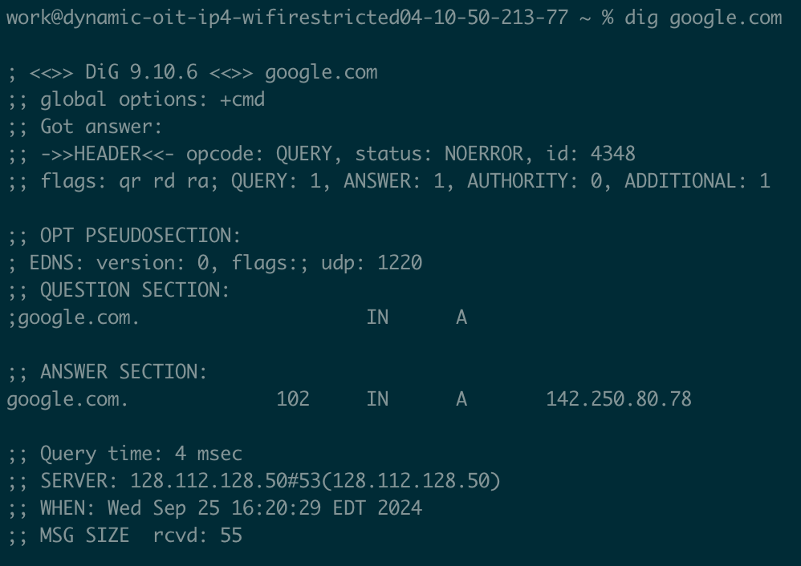
DNS
Notes:
A quick note on DNS
We know that every machine can reach every other internet-connected machine using their IP addresses
But IP addresses aren’t human readable and it would be difficult to remember the IP address for the servers that hold all of the websites that we want to use
DNS is an optimization that’s meant to make it easier for humans to specify another machine’s address
DNS provides a service that maps hostnames to IP addresses
When you type a website into your browser, the DNS service is used under the hood to translate that name to an IP address
We’ve included a screenshot of dig, a tool that lets us see this translation
Try this with Google.com or something like neverssl.com
Don’t try this with Princeton.edu. There’s some certificate magic that stops it from working

Slide 9
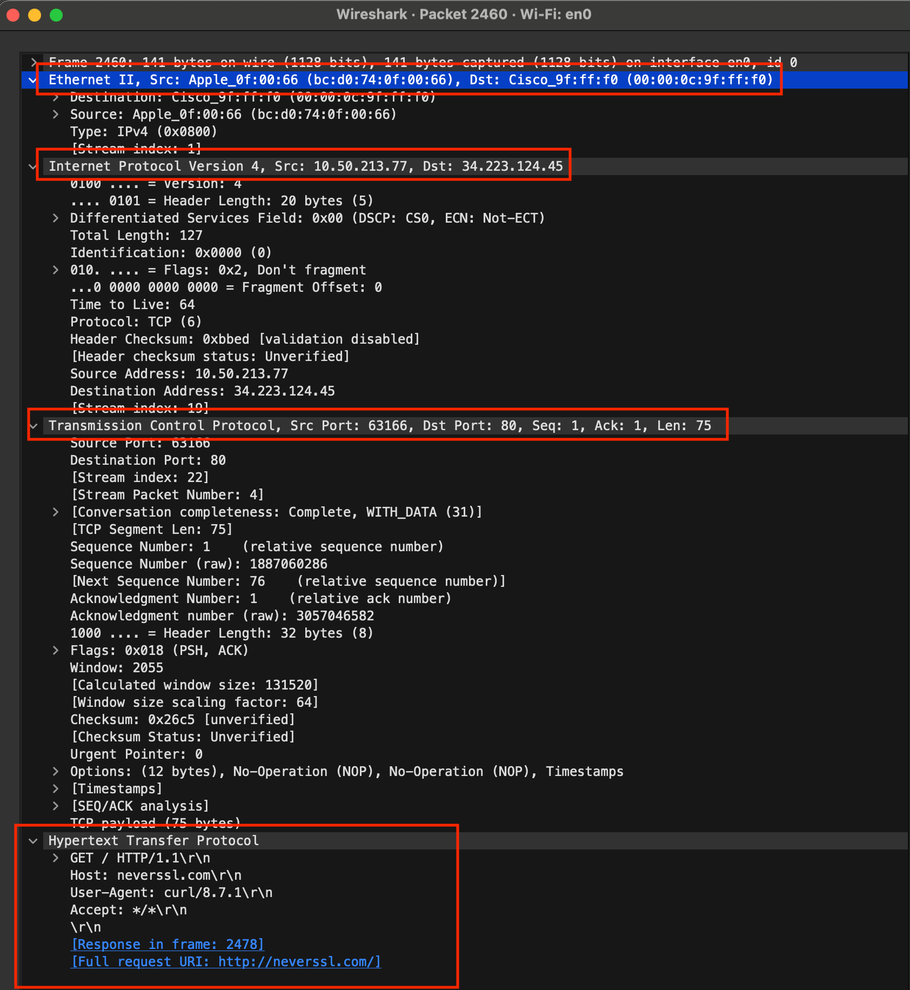
The layers in practice
Notes:
Let’s see how this works in practice:
This is a capture of a single packet
I issued the command “curl -v neverssl.com” in order to request a web page from my terminal.
While doing this, I recorded the network traffic from my machine
You can see the header for each layer of the network stack
At the top is the layer 2 header with associated MAC addresses
Below that is the layer 3 header
Below that is the layer 4 header
And below that is the layer 7 header

Slide 10
Questions?

Slide 11
Overview of HTTP
HyperText Transfer Protocol
Used to distribute hypertext over the Internet (i.e., HTML web pages)
Relies on a bidirectional stream protocol underneath → TCP!
Unit of operation: request+response pairs
Establish a connection from client to server
Client: send HTTP request to server
Server: send HTTP response to client
Stateless protocol
No mandatory state maintained beyond a request+response operation
Server & client can cooperate to maintain application state, e.g., through cookies
Standardized through a series of RFCs → overview of applicable standards
Client
1. Request
2. Response
Server
Notes:
Let’s talk about HTTP!
HTTP is an application layer protocol for distributing hypertext, in other words, HTML web pages
It is short for HyperText Transfer Protocol and it is built on top of TCP, the transport layer protocol
HTTP operates in a call and response fashion
Once a client has established a connection, it can issue an HTTP request, and the server will issue an ensuing response
It is a stateless protocol, meaning that there’s no state required to be kept by the client or server in order for the protocol to work
However, there is an optional way for state to persist: Cookies!

Slide 12
URLs
Uniform Resource Locator
uniquely identifies a given resource on the web
Syntax:
scheme://authority/path?param=val#anchor
Examples:
http://www.ietf.org/rfc/rfc959.txt
http://xyz.org:8081/route/subroute
http://www.ietf.org/rfc/rfc959.txt
mailto:ak18@cs.princeton.edu
ftp://tug.ctan.org/pub
rtsp://192.168.0.164/axis-media/media.amp
Scheme:
Specifies protocol a client must use to interact with the resource.
E.g., http or ftp
Anchor:
Encode additional information for the client (not sent to server).
E.g., #section-assignments
Path:
Indicates location of a resource within the scope of the service.
E.g., /precepts or /courses/archive/fall19/cos316
Authority:
Indicates location of a given resources in terms of a service, e.g., offered by a server accepting TCP connections. Hostname and port (sometimes omitted).
E.g., princeton.edu:80 or google.com
Parameters:
Encode additional information sent to the server. Behavior depends on the server.
E.g., ?mobile=true&lang=es
Notes:
URLs refer to uniform resource locator
“Uniform” means that it can interact with different resource such as file/webpage/email address
Scheme:
Specify the protocol used when client is interacting with the server
HTTP: Use HTTP protocol to communicate. Usually webpage
FTP: File transfer protocol. Transfer files between clients and server
Authority:
Location of the resource in terms of a service
Can be either an ip address or hostname. Port number is optional
If doesn’t provide port number, a default value will be used. Eg. HTTP -> 80. HTTPS -> 443
Path:
The path specifies the location of the resource on the server.
Parameters
It’s server dependent. Typical after a “?” mark and they are key=value pairs
lang=es means language is English. mobile=True means client is a mobile device.
Anchor
This is to encode additional information. This will not send to the server
E.g., #section-assignment mean that after your browser received the page (web page), it points you to a specific part in this web page (Maybe that part is called section-assignment)

Slide 13
HTTP Example
1. Client requests URL: http://www.xyz.org:80/path/file
3. Server routes request to the appropriate handler/file
Client
2. Client sends request message:
GET URL HTTP 1.1
Host: www.xyz.org:80
………....
Server
handlers / files
4. Server sends response message:
HTTP 1.1 200 OK
………....
TCP
5. Client processes response
Notes:
Client requests URL
Specify the URL (resource) the user wants from the server
Send request
Send HTTP request to the server and wait for the server’s response
In this example, the request is a “GET”, requesting the resource from the server
Server routes request
The server basically looks for the right resource that the client requests
Server sends response
After server finds the corresponding resource, it gives response.
200 OK means that it finds the request is successful. The requested resource is also sent back in this response.
Client processes response
One request-response pair is finished.

Slide 14
HTTP Request and Response Messages
Message Header
Blank line
Message Body (optional)
Notes:
This is a high-level overview of the structure of an HTTP request or response

Slide 15
HTTP Request Message
Request Message Header:
Request Line
Request Headers
Request Line
[request-method-name] [request-URI] [HTTP-version]
request-method-name: HTTP verb
GET, HEAD, POST, etc.
request-URI:
Name of resource (route) requested
HTTP-version:
HTTP/1.0, HTTP/1.1 or HTTP/2.0
Request Header
Consists of name:value pairs
Multiple values, separated by commas
request-header-name: request-header-value1, request-header-value2, ...
Examples
Host: www.xyz.com
Connection: Keep-Alive
Accept: image/gif, image/jpeg, */*
Accept-Language: us-en, fr, cn
Blank line
Request Message Body (optional)
Notes:
Request Line:
[request method name]:
GET: request resource from the server
HEAD; request the metadata of the resource from the server
POST: send data to the server
Request header example
Host: www.xyz.com
Specify the hostname that the client will send the request to
Connection: Keep-Alive
After this request-response pair, keep the connection open so that the TCP connection can be continuously used for the subsequent requests
Accept: image/gif, image/jpeg, */*
Tell the server what type of media that the client can received. */* is a wildcard for any type
Accept-Language: us-en, fr, cn
Preferred language. (US English, Franch, Chinese in this example)

Slide 16
HTTP Request Methods (verbs)
Common methods
GET
retrieve a resource from the server
HEAD
return only the headers of GET response
POST
create a resource on the server (client sends resource in the request body)
Case Sensitive

Slide 17
HTTP Request Message
Browser
https://registrar.princeton.edu/course-offerings/course-details?term=1202&courseid=015166
HTTP Request Message
GET /course-offerings/course-details?term=1202&courseid=015166 HTTP/1.1
Host: registrar.princeton.edu
User-Agent: Mozilla/5.0 (Macintosh; Intel Mac OS X 10.14; rv:69.0) Gecko/20100101 Firefox/69.0
Accept: text/html,application/xhtml+xml,application/xml;q=0.9,*/*;q=0.8
Accept-encoding: gzip, deflate, br
Notes:
When you are typing the URL and “enter” in the browser, the HTTP request message is constructed.
User-Agent:
Provides some info for the client such as browser, OS etc
Accept:
Type of content the client can receive
Accept-encoding:
Type of compression client can accept.
Compression can make the data transmission faster.

Slide 18
HTTP Response Message
Status Line
[HTTP-version] [status-code] [reason-phrase]
HTTP-version: HTTP version used in this session e.g., HTTP/1.0,HTTP/1.1,HTTP2.0
status-code: 3-digit response code
reason-phrase: short explanation for status code
Common status-code and reason-phrases are
"200 OK"
"404 Not Found"
Examples
HTTP/1.1 200 OK
HTTP/1.0 404 Not Found
Response Headers
Multiple values, separated by commas
response-header-name: response-header-value1, response-header-value2, …
Examples
Content-Type: text/html
Content-Length: 35
Keep-Alive: timeout=15, max=10
Response Message Body
Data requested, e.g., HTML+CSS+JavaScript
Response Message Header:
Status Line
Response Headers
Blank line
Request Message Body (optional)
Notes:
Response header:
Content-Type
Response content type.
HTML in this example
Content-Length
Size of the response body (bytes)
Keep-Alive
Timeout=15: connection will keep opening for 15 seconds for the (request-response) pair to be finished
max=10: Maximum number of requests can be sent using this connection before it is closed.
Response message Body: Exact data requested by the client.

Slide 19
HTTP Response Message
HTTP Response Message
HTTP/1.1 200 OK
Server: nginx
Date: Fri, 09 Aug 2019 17:52:38 GMT
Content-Type: text/html; charset=UTF-8
Content-Length: 38475
…
<!DOCTYPE html>
<html lang="en" dir="lt
…
</html>
Browser
Notes:
The client browser just received the HTTP response, parse it and render a webpage to the user.
The response body in this example is a html5 document.

Slide 20
HTTP/2
Features
is binary, instead of textual
is fully multiplexed, instead of ordered and blocking
can therefore use one connection for parallelism
uses header compression to reduce overhead
allows servers to “push” responses proactively into client caches
IETF Standard
https://httpwg.org/specs/rfc7540.html
More on HTTP later in semester
Notes:
HTTP/1.1 is created in 1997
HTTP/2 is created in 2015
HTTP/2 is much faster and more efficient. Significant performance improvement.

